Slide 1
CPCI
v1.5.0
Implementation Coordination Meeting
May 19, 2023

Slide 2
Participated Members
Vadlamani B. Kumar (organizer)
Li Xu (Python Application Author)
Steven Earle (NCO Ops Chief)

Slide 3
Outline
Quad chart
R&R
Scope of Changes
CONOPS / Flowchart
Compute resources
Job timing changes
WCOSS & HPSS disk resources
Input and Output Changes
Bugzilla Update
External software dependencies
Downstream model dependency status

Slide 4
CPC International Desks (CPCI)
Project Status as of December 16, 2022
G
Scheduling
G
Project Information and Highlights
Milestone (NCEP) | Date | Status
CPCI v1.5.0 Code Delivery | June 02, 2023
Lead: Dr. Wassila Thiaw
Scope: CPC International Desks
Expected Benefits: The CPC Internaatonal Desks products are updated real time for the benefit of the users including the U.S. government and meteorological services around the world.
Issues/Risks
G
G
Resources
Issues:
Risks:If the scripts do not meet NCO requirements, then this will have an impact on the product updates on the CPC International Desks website.
Mitigation:
Staff: Wassila Thiaw, Vadlamani Kumar, Li Xu
Funding source: CPC
Compute resources: WCOSS2
Storage resources: WCOSS2
Management Attention Required
R
Y
Potential Management Attention Needed
G
On Track
v1.1 02/1122

Slide 5
Project Team
Roles and Responsibilities
Federal Oversight
Wanqiu Wand, Branch Chief, CPC
Project Lead
Wassila Thiaw, International Desks, CPC
Testing and Coordination
Vadlamani Kumar
Li Xu
Code handoff & NCO POCs
Vadlamani Kumar
Li Xu
NCO Staff
Steven Earle
Anne Myckow

Slide 6
Upgrade includes:
Adding Python based GEFS EPS grams for a selected number of station locations at corresponding nearest model grid point
Adding Python based GFS SKEW-T Plots for a selected number of station locations at corresponding nearest model grid point
Adding the domain of Central Africa to the current 21 domains making the total to 22 domains for Gempak based GFS, GEFS and GDAS model output plots. Fixed bug related jcpci_gfs.ecf job in task distribution by separating into 7 tasks
Scope of Changes: Summary

Slide 7
CPCI FLOW CHART
GFS, GEFS and GDAS Spatial Maps ($MODEL,$RUN,$NET remain the same for each Gempak specific run)
GEFS EPS grams - BOXW Plots ($MODEL same but $RUN, $NET are python specific run)
GFS SKEW-T/LogP Plots ($MODEL same but $RUN, $NET are python specific run)
Next two slides show the flow charts for Versions CPCI v1.4.2 and CPCI v1.5.0 respectively

Slide 8
CPCI v1.4.2
…/jobs/JSUB
…/jobs/JCPCI
…/scripts/ExecCPCI
…/ush
GFS (225 tasks)
GEFS (111 tasks)
GDAS (55 tasks)
$TAROUT
3 JOBS
3 JOBS
$TAROUT
$TAROUT

Slide 9
CPCI v1.5.0
…/jobs/JSUB
…/jobs/JCPCI
…/scripts/ExecCPCI
…/ush
GFS (225 tasks)
GEFS (111 tasks)
GDAS (55 tasks)
GFS Skewt (29 tasks)
GEFS EPS grams (50 tasks)
…/ush_python/
$TAROUT
$TAROUT
$TAROUT
5 JOBS
5 JOBS
GEFS EPSgrams
$TAROUT
GFS SkewT plots
$TAROUT

Slide 10
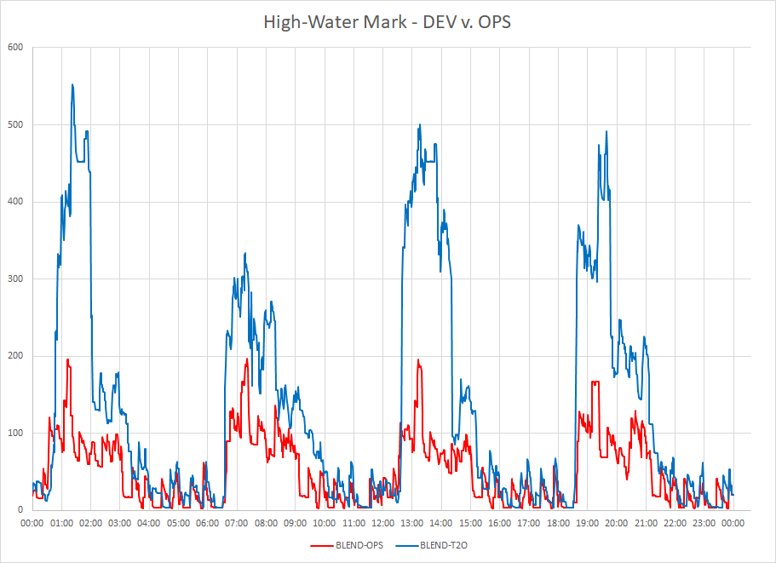
CPU Resource Changes
Provide an overlaid HWM chart, comparing ops vs the upgrade
Raw data for chart creation can be found at: /lfs/h1/ops/prod/com/hwm/v1.0/hwm.yyyymmdd

Slide 11
CPU & Timing Changes
CPCI | CPCI v1.4.2 time (min) nodes |  | CPCI v1.5.0 time (min) nodes
cpci_gdas | 22 min approx | 1 | 25 min approx | 1
cpci_gefs | 32 min aoorox | 2 | 35 min approx | 2
cpci_gfs | 2 hr 30 min approx | 3 | 2 hours approx | 3
cpci_gefs_boxw_py | -na- | -na- | 20 min approx | 1
cpci_gfs_skewt_py | -na- | -na- | 15 min approx | 1
Include details of every job, timing and node changes; highlight significant changes

Slide 12
WCOSS & HPSS Disk Resource Changes
CPCI_GFS
 | Operational (v1.4.2) | Upgrade (v1.5.0)
COM | 2.81 TB | 3 TB
DATA | 116 TB approx | 118 TB approx
Package | 12.9 GB | 37.1 GB
HPSS | None | None

Slide 13
CPCI v1.5.0 Input Changes
No changes to directory changes or File names

Slide 14
CPCI v1.5.0 Output Changes (com data to public)
Directory Structure
No changes to directory changes or file names
*** Use regex/variables when it’s appropriate to save space/time!

Slide 15
Output Changes (com data to public)
File Contents - Example
New Python based GEFS BOX-WISHKER PLOTS (EPS GRAMS):
For precipitation, 2m temp, wind speed and cloud cover
New Python based GFS SKEWT PLOTS:
SkewT plots at selected locations in Africa
Added 22nd geographical domain for Central Africa

Slide 16
Output Changes
WMO Headed Products
For both data on the SBN/NOAAPORT as well as TGFTP
Not Applicable in this CPCI project

Slide 17
Bugzilla Status
Bug ID | Fixed? Yes / No | Description | STATUS If not fixed already, what is the status? If it is fixed, what was the solution?
721 | Yes | CPCI cpci_gfs Establishing restart of a failed run | Established restart capability. Created a separate restart directory and instructions.
733 | Yes | CPCI cpci_gfs Adding error handling | Added adequate error handling

Slide 18
List external software dependencies
Job | Module list
jcpci_gfs | intel/${intel_ver}, gempak/${gempak_ver}, cray-pals/${cray_pals_ver}, python virtual, imagemagick, prod_util/2.0.8
jcpci_gefs | intel/${intel_ver}, gempak/${gempak_ver}, cray-pals/${cray_pals_ver}, python virtual, imagemagick, prod_util/2.0.8
jcpci_gdas | intel/${intel_ver}, gempak/${gempak_ver}, cray-pals/${cray_pals_ver}, python virtual, imagemagick, prod_util/2.0.8
jcpci_gefs_boxw_py | intel/${intel_ver}, gempak/${gempak_ver}, cray-pals/${cray_pals_ver}, python virtual, imagemagick, prod_util/2.0.8
jcpci_gfs_skewt_py | intel/${intel_ver}, gempak/${gempak_ver}, cray-pals/${cray_pals_ver}, python virtual, imagemagick, prod_util/2.0.8

Slide 19
Python dependencies
python – 3.10.4
numpy - latest
scipy - latest
mpi4py - 3.1.0 or later
ESMPy - 8.0.0
*** This list will be used to create a virtual environment for the package

Slide 20
Downstream dependencies
None

