Slide 1
CCA and Neural Network Multinominal Regression Toolkits Setup: Prerequisite Packages and Run Instructions
NOAA CPC / International Desks

Slide 2
System Requirements
HARDWARE: Windows (64 bit, Windows 11)
MEMORY: 4GB or more (if possible)
Free DISK SPACE: 50GB or more
Internet Connection
SOFTWARE (to be installed): micromamba

Slide 3
1. Windows Subsystem for Linux (WSL)
Enable WSL in Windows by opening a PowerShell prompt as an administrator. For Windows 11, the WSL will install Ubuntu. This requires for you to enter a user name and password. You can copy texts from 1SoftwareInstallationCommands.txt and enter it in the Windows Command line for each step
wsl –install
It may be necessary to upgrade the wsl to version 2 for previous version and install Ubuntu (This is not required for Windows 11)
wsl --set-default-version 2
wsl --install -d Ubuntu

Slide 4
2. Update Ubuntu & Install Apps
After the WSL was installed, your laptop must be restarted before system update
sudo apt-get update
sudo apt-get install imagemagick
sudo apt-get install firefox --fix-missing
sudo apt install x11-apps -y
sudo apt install gedit -y

Slide 5
3. Micromamba Installation
After Ubuntu update, start a new Ubuntu terminal using the dropdown (short arrow).
Copy from the text file and enter as is:
"${SHELL}" <(curl -L micro.mamba.pm/install.sh)
Follow the on-screen instructions to complete the setup: Use the default configuration. There are 4 places where you either enter the keyboard or type Y for Yes:
→ ENER → Y → Y → ENTER
Once completed, open a new Ubuntu terminal

Slide 6
4. Create a micromamba environment
Copy the below command (part 4) from 1SoftwareInstallation.txt and enter as is (It may not work if you copy from this PowerPoint):
micromamba create -n cpc_rcca_env -c conda-forge \
python=3.10 geopandas shapely jupyter cartopy xarray netcdf4 numpy pandas scipy scikit-learn matplotlib seaborn \
ncl \
r-rnetcdf r-mass r-nnet r-ncdf4 r-lattice
To activate a micromamba environment we just created type:
micromamba activate cpc_rcca_env

Slide 7
5. The Prediction Toolkits (for general understanding)
The prediction toolkits (to be downloaded) contain all data and codes we need for seasonal prediction. The toolkits are tarred and zipped into one file. When unzipped and untarred, the file contains six sub-directories, three text files, and one PowerPoint deck (this copy). Here is a brief description of the subdirectories
cca_toolkit -- Directory that contain three subdirectories and when the CCA toolkit is run
multinom -- Directory where the multinominal regression is run
templateCodes -- Directory containing the raw multinominal codes.
colors -- Directory containing predefined colors for plotting
shpfiles -- Directory of shape files for the lower WMO RA IV countries
precip -- Directory containing MSWEP (Multi Source Weighted Ensemble Precipitation) for 1991-2025 in NetCDF format for the lower WMO RA IV countries (Central America, Caribbean, and Mexico)
The other three text files contain commands to copy from and paste at Ubuntu terminal.

Slide 8
6. Download and Reorganize directories for the upcoming forecast from June 2026 initializations
We want to place colors, shapefiles, precip under $HOME/seasonal so that we can test some of the codes without any change. From the seasonal directory (copy the below commands from this text file: 2PrepareToolkitsCommands.txt):
  cd $HOME
  mkdir seasonal
  cd $HOME/seasonal
  wget https://ftp.cpc.ncep.noaa.gov/International/usrcc/training/2026/toolkits.tar.gz
  tar -zxvf toolkits.tar.gz
  mv toolkits/colors .
  mv toolkits/shpfiles .
  mv toolkits/precip .
  mkdir Jun2026
  cd Jun2026
  ln -sf ../precip .
  cp -r ../toolkits/cca_toolkit .
  cp -r ../toolkits/multinom .
  cp -r ../toolkits/templateCodes .

Slide 9

7. Install the CCA Toolkit
List the files in the directory
ls
ersstv5_sst: Contains CCA scripts and associated libraries to run the CCA model using ERSSTv5 observed sea surface temperature (SST) as a predictor.
nmme_sst: Contains CCA scripts and associated libraries to run the CCA model using NMME-predicted SST as a predictor.
nmme_precip: Contains CCA scripts and associated libraries to run the CCA model using NMME-predicted precipitation as a predictor.

Slide 10
8. Run the CCA_toolkit Scripts
Change your directory to one of the sub-directories. You can copy commands from the first section of 3RunCCA-NNETCommands.txt) and paste at the Ubuntu’s terminal:
cd ersstv5_sst
Activate the micromamba environment:
micromamba activate cpc_rcca_env
Launch Jupyter Notebook
jupyter notebook

Slide 11
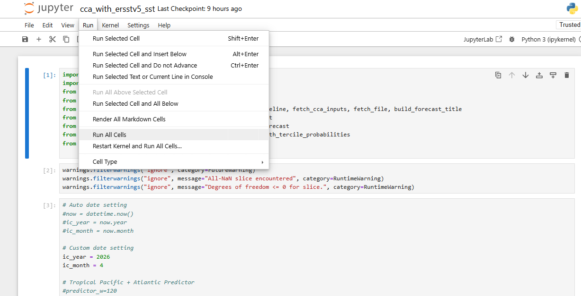
9. Run CCA_toolkits Scripts (contd.)
Make configuration changes as needed and run the script:

Slide 12
10. Visualize the first CCA results
Once the run is complete (assuming the steps in Slide 8, Part 6 were followed) open File Explorer and navigate to the ersstv5_sst folder in WINDOWS. Click at Ubuntu (right side of the Pane) and click
→ home → $USER → seasonal → Jun2026 → cca_toolkit → ersstv_sst → index.html
In the $USER represents your user name you just created with wsl -- install
Double-click the index.html file to open an offline page displaying the CCA run output.
Repeat the same steps for the other two subdirectories to view their results as well.

Slide 13
11. Test the Neural Network’s multinominal Regression
Change directory to the multinominal regression for June 2026 forecast. :You can copy commands from the second parts of 3RunCCA-NNETCommands.txt) and paste at the Ubuntu’s terminal:
  cd ${HOME}/seasonal/Jun2026/multinom
Run the default code for testing (a low resolution forecast for Costa Rica
time bash LaunchAll.sh
Navigate to the multinom directory in Windows environment and double click on templateIndex.html
Default predictors/statistical models you can visualize are only for Lead 1 (L1) and for four predictors: a) MGI, b) rNino34, c) PCR1, and d) ALLP_INT

