Slide 1
October 2017 Experimental Sea Ice Outlook Climate Prediction Center, NCEP/NWS/NOAA
Acknowledgments: This work was supported by NOAA CPO Climate Variability and Predictability Program. Both hindcasts and forecasts were produced on NOAA GAEA computer.

Slide 2
Procedure
Use Climate Forecast System Version 2 (CFSv2) model initialized with Pan-Arctic Ice Ocean Modeling and Assimilation System (PIOMAS) initial sea ice thickness conditions (20 initializations: October 21-25, 2017).
Correct biases using 2005-2015 mean error with respect to NSIDC observations
Present unbiased results
The following maps are included
SIE Monthly time series (mean and spread)
SIC Monthly forecast panels (Ensemble mean)
SIC Monthly standard deviation panels
Monthly ice cover probability
Mean first ice freeze day/ standard deviation (Alaska region)

Slide 3
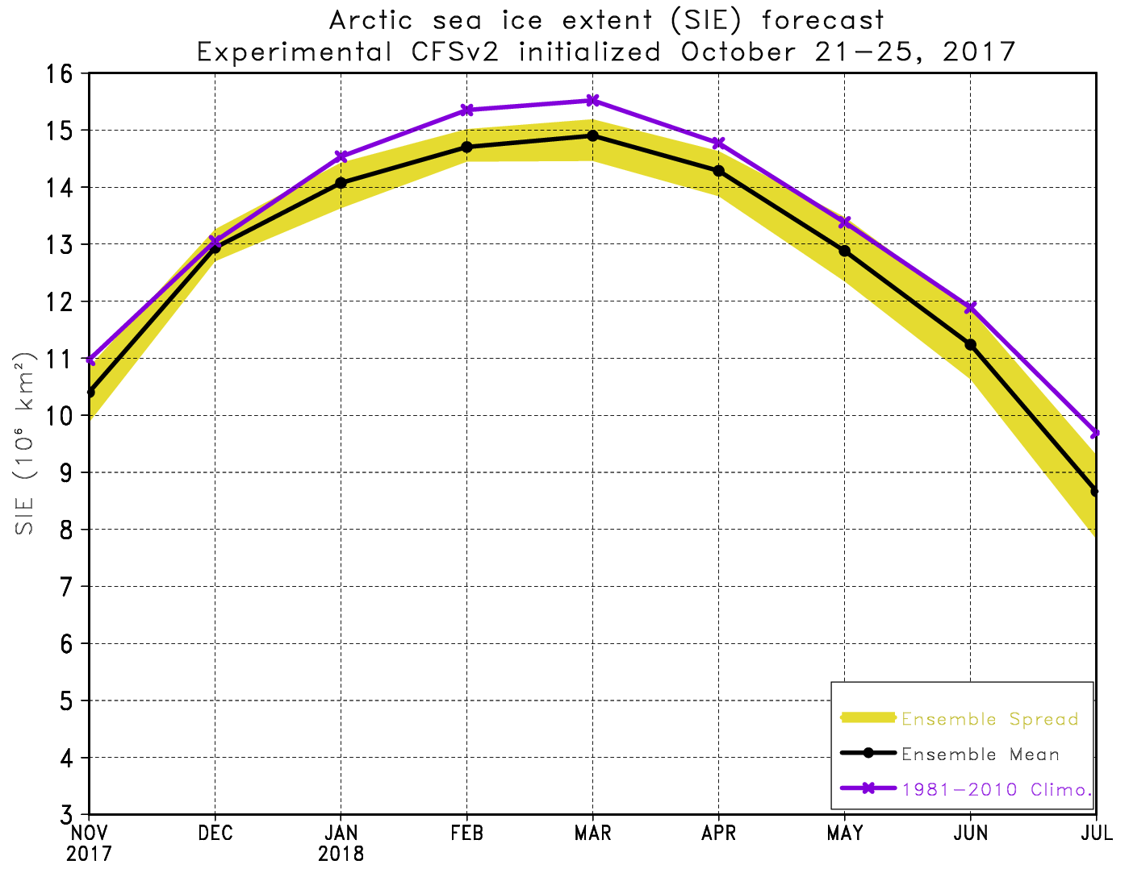
SIE Plot

Slide 4
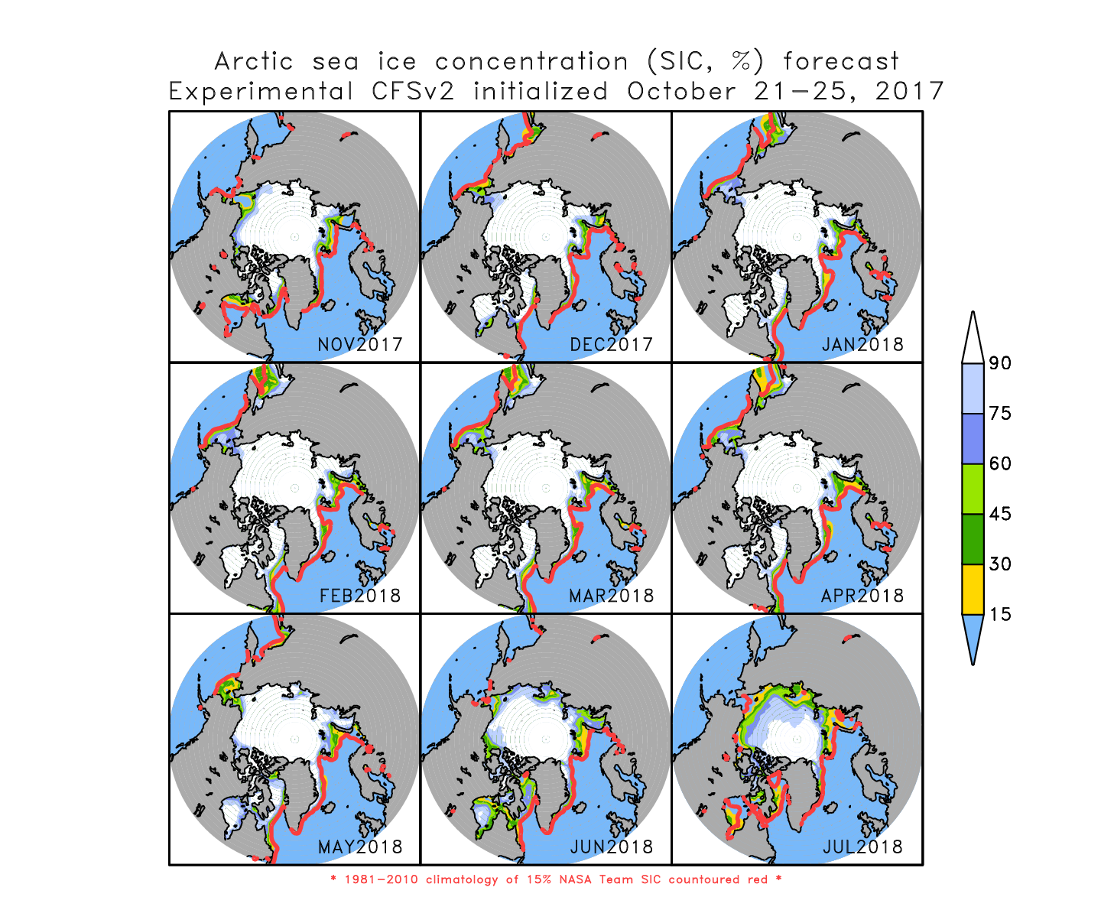

Slide 5
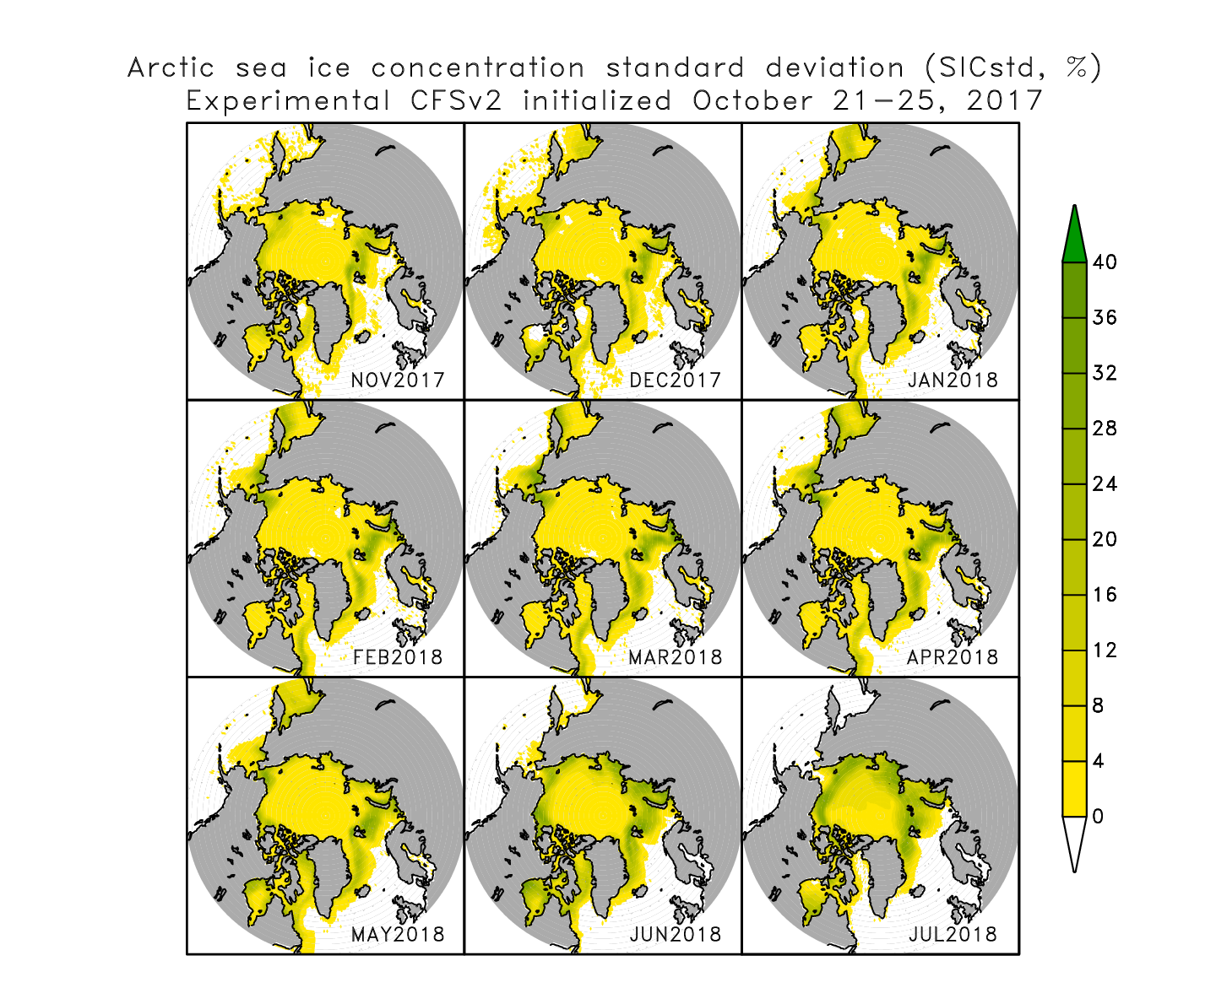
Sea ice concentration standard deviation

Slide 6
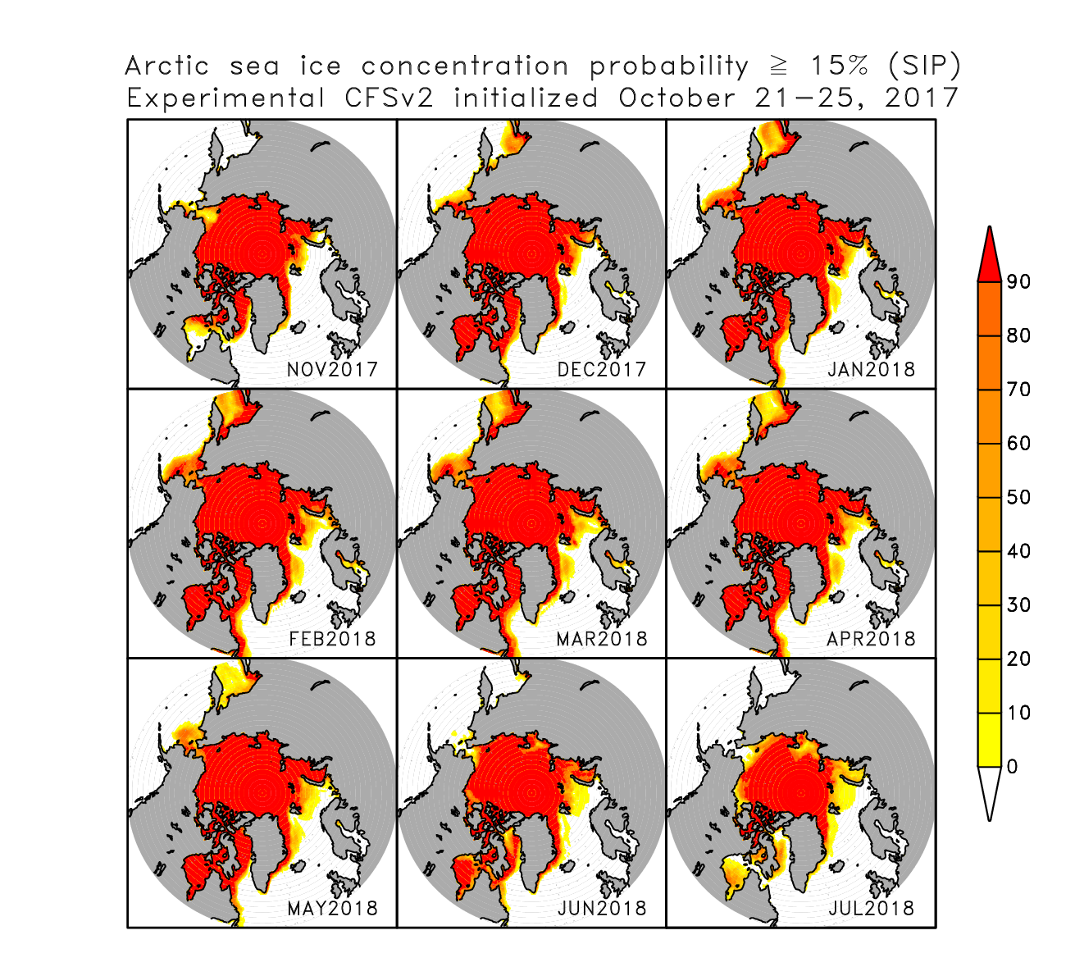

Slide 7
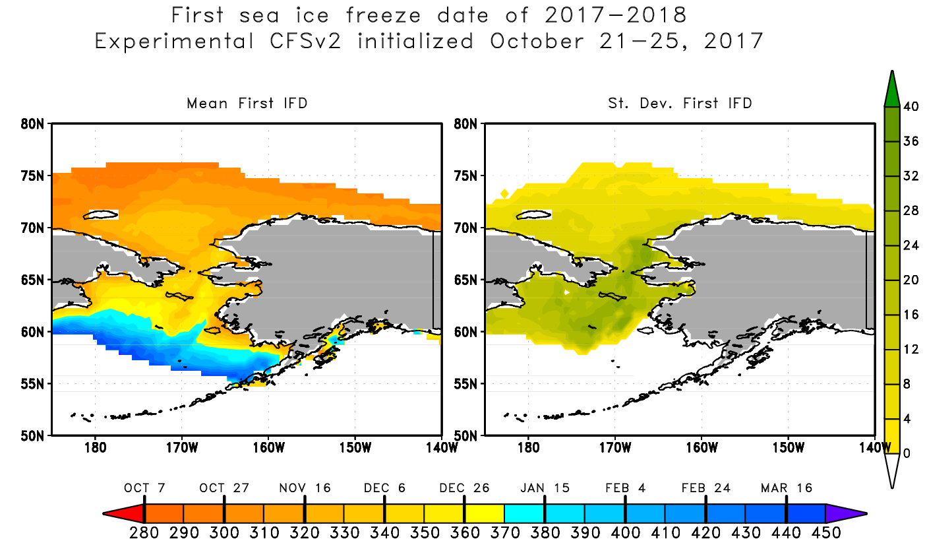
Time step is every 12 hours so 2 observations per day which are averaged to create a single daily observation. If one of the observations increases above 15%, the value on the map reflects the day of year occurred. If ice is permanent or if there is never ice, the value is set to undefined. Values greater than 365 denote days in 2018.

Slide 8
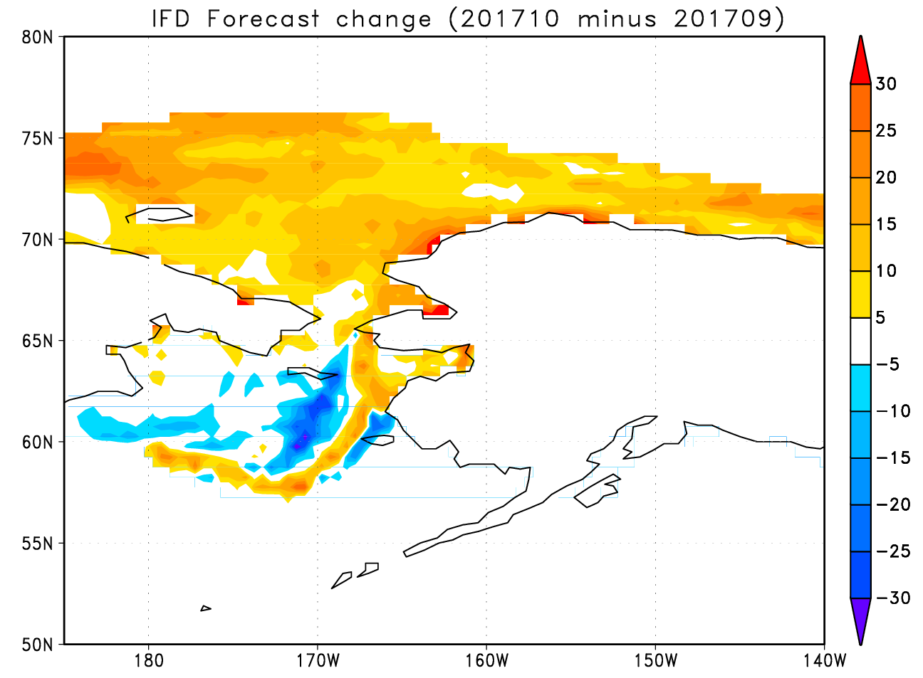
Change in mean IFD forecast with respect to the IFD forecast issued using September initial conditions.

Slide 9
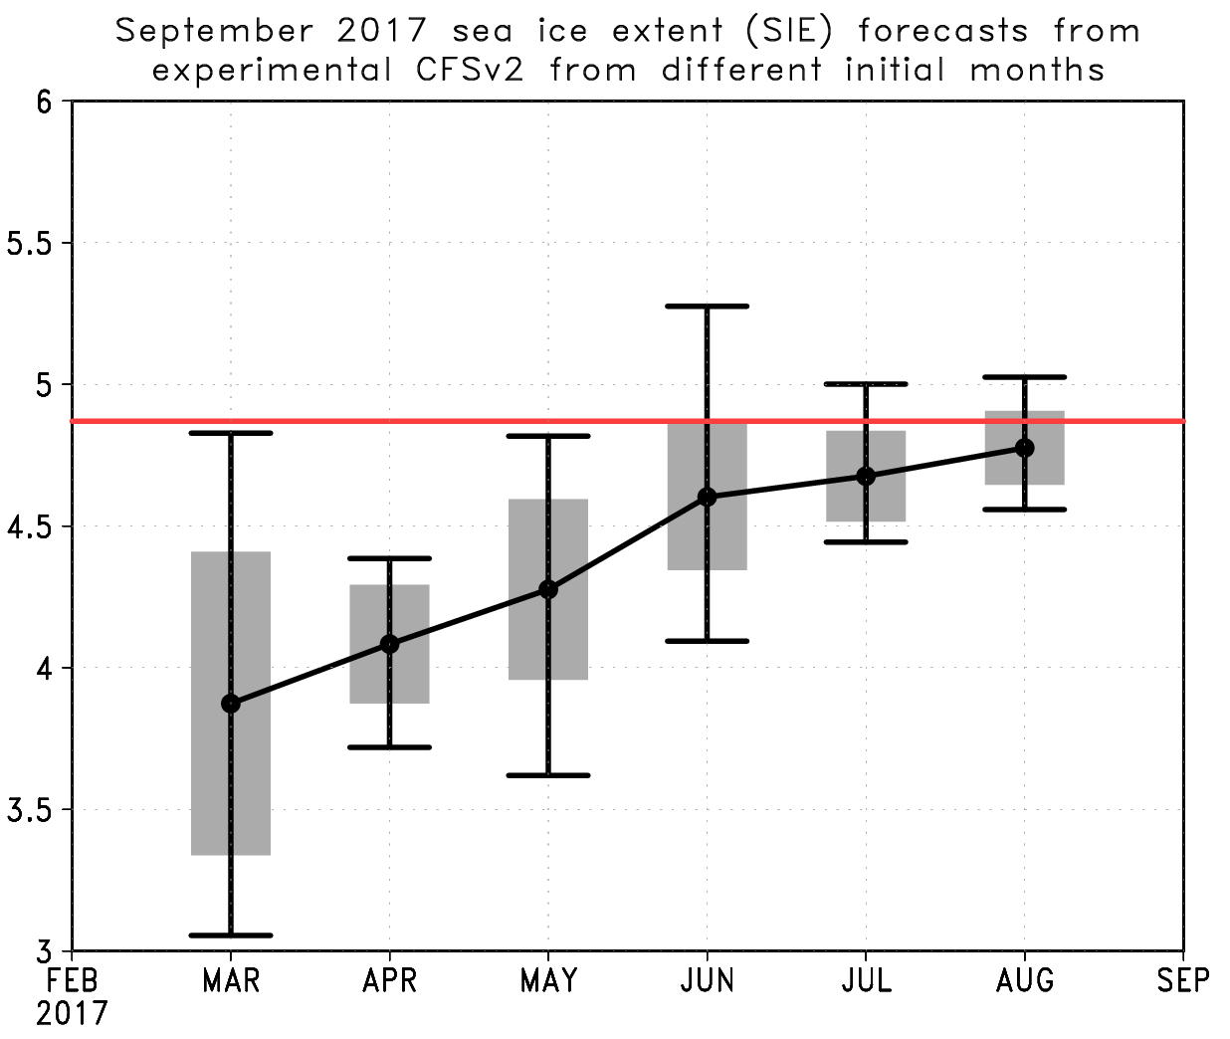
September 2017 SIE Verification
Month | March | April | May | June | July | August | Verif.
Ens. Mean | 3.87 | 4.08 | 4.28 | 4.60 | 4.68 | 4.78 | 4.87
Std. Dev. | 0.46 | 0.21 | 0.32 | 0.26 | 0.16 | 0.13 | -
Gray shading denotes +/- 1 st. dev of the 20 ensemble members.
Error bars denote the ensemble min/max
The red line is the observed value (4.87)

Slide 10
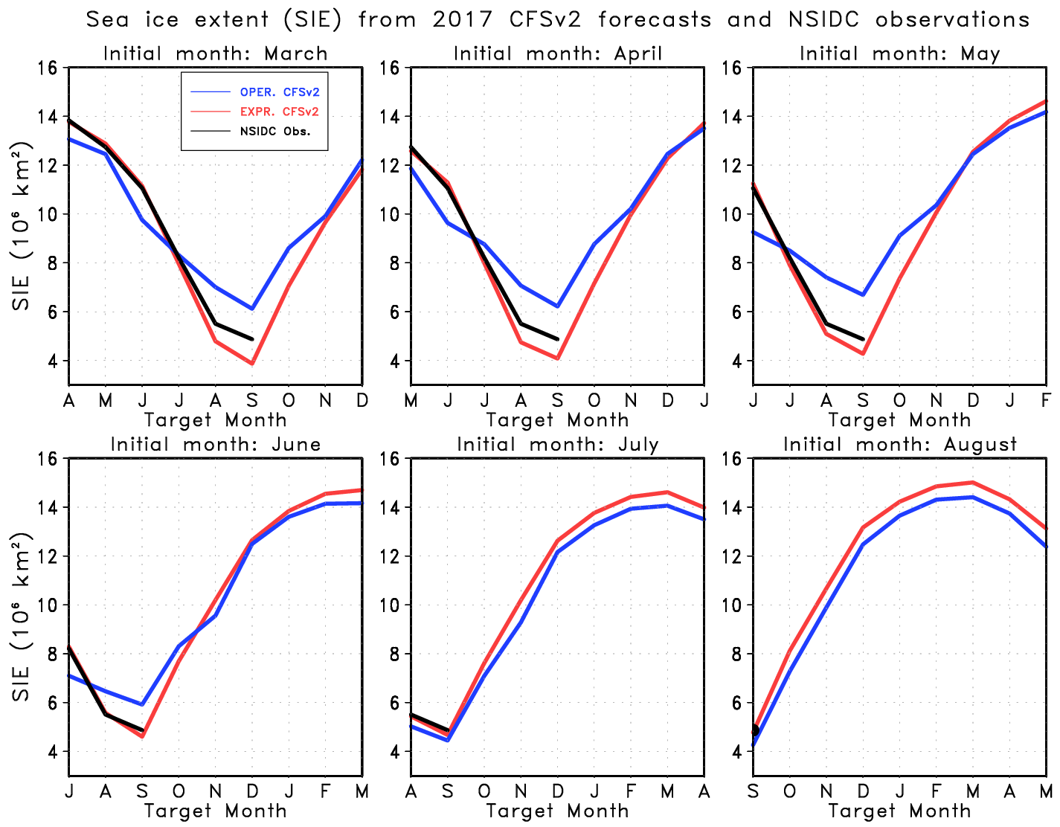
Experimental CFSv2 forecasts (red) had more skill than the operational (blue), even at longer lead times (For RMSE, only the March forecast is considered for lead time=6). Experimental performed much better at shorter leads.

