Slide 1
Week-2 Severe Weather Forecast Product Cross-Branch Kickoff
Development → Operations Transition
Hui Wang
April 17, 2026

Slide 2
Why This Matters
Current Gap
Existing Week-2 Hazard Outlook does not explicitly address severe convective weather
Limited guidance on tornado, hail, and damaging wind potential at this lead time
Current Operational Week-2 Hazard Outlook
Extreme heat / temperature extremes
High winds
Heavy precipitation / snow
Flooding, rapid onset drought
Added Value of This Product
Extends hazard outlook to include severe weather (tornado, hail, damaging winds)
Provides earlier situational awareness of convective risk
Supports planning and preparedness in the extended range

Slide 3
Week-2 Severe Weather Outlook
Purpose
Complement the existing Week-2 Hazard Outlook
Provide guidance on severe convective weather potential
What It Provides
Daily updated Week-2 outlook
Identification of regions with elevated severe weather risk at week-2 time range
Focus on: Tornadoes, hail, and damaging winds
Based On
GEFS ensemble forecast
Large-scale atmospheric environment
Output
Spatial outlook (probability-based maps)

Slide 4
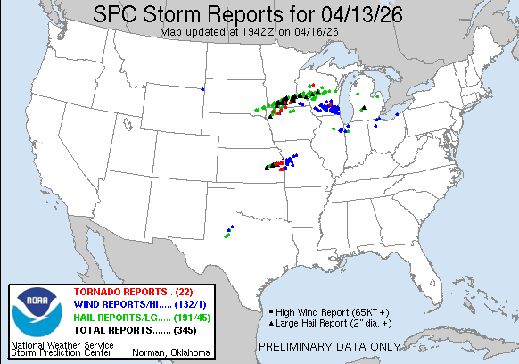
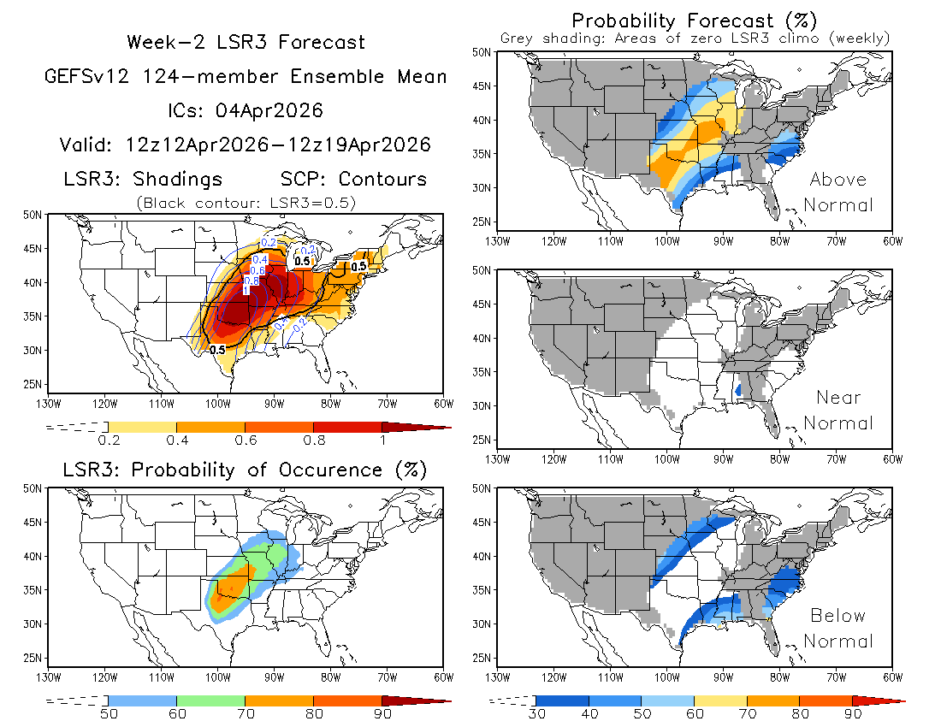
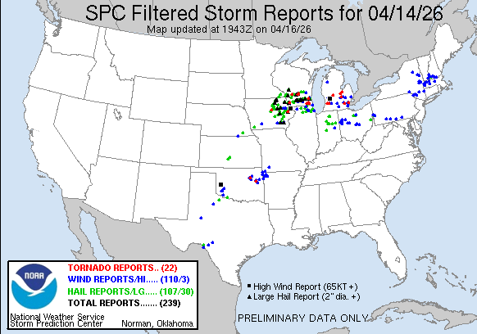
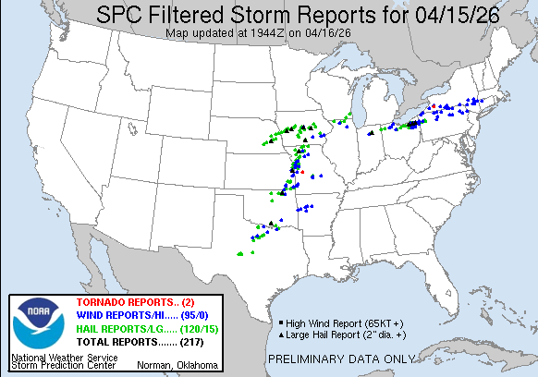
Example Output (Week-2 Outlook)
Highlighted: Regions of elevated severe weather risk at week-2 lead time
Observed Storm Reports
(Verification)

Slide 5
Current State
Running on CF3 DEV VM
Fully automated
Daily updates
Forecast webpage: https://ftp.cpc.ncep.noaa.gov/hwang/week2sw/

Slide 6
What Ops Requires
To be operational, the product needs
Compliance with CF3 QA/OPS protocols
Adherence to CPC coding standards
Automated workflow (e.g., makefile)
Complete documentation
Version control (GitHub)

