Slide 1
Update (7/29/2025)
Conducted a preliminary comparison of the AC skills between CCA and SVD-CLSST seasonal precipitation forecasts.
CCA: Canonical Correlation Analysis Tool
1982 – present, North America
Monthly aggregated into seasonal
Lead times: 1 – 13 months
Standardized anomalies (divided by 1991-2020 std. dev.)
Probability forecast (above, near, and below normal)
Skill metrics: AC, RPSS
Forecast verification: Hit/Miss analysis

Slide 2
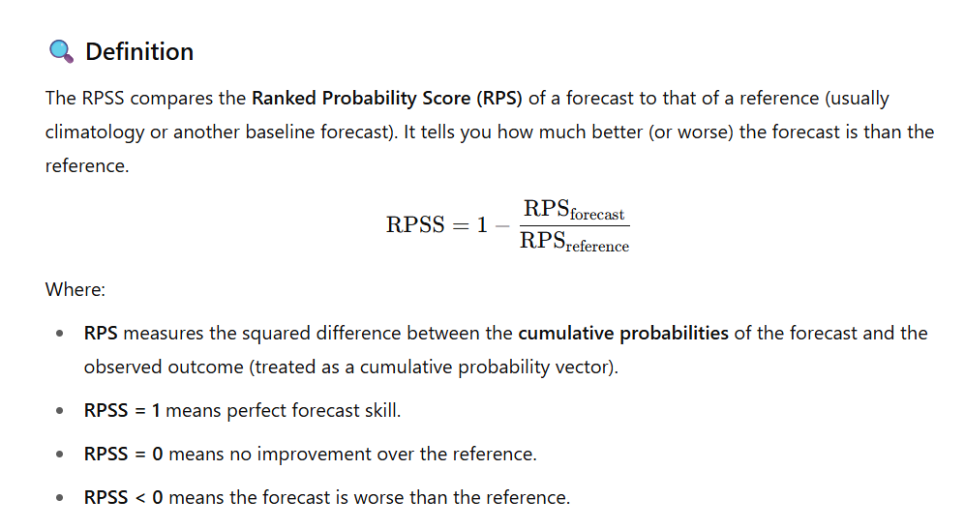
: RPSS (Ranked Probability Skill Score)

Slide 3
SVD-CLSST Tool
AC skill
Seasonal forecasts: 1 to 6-month leads
CCA Tool
AC skill
RPSS
Forecast verification

Slide 4
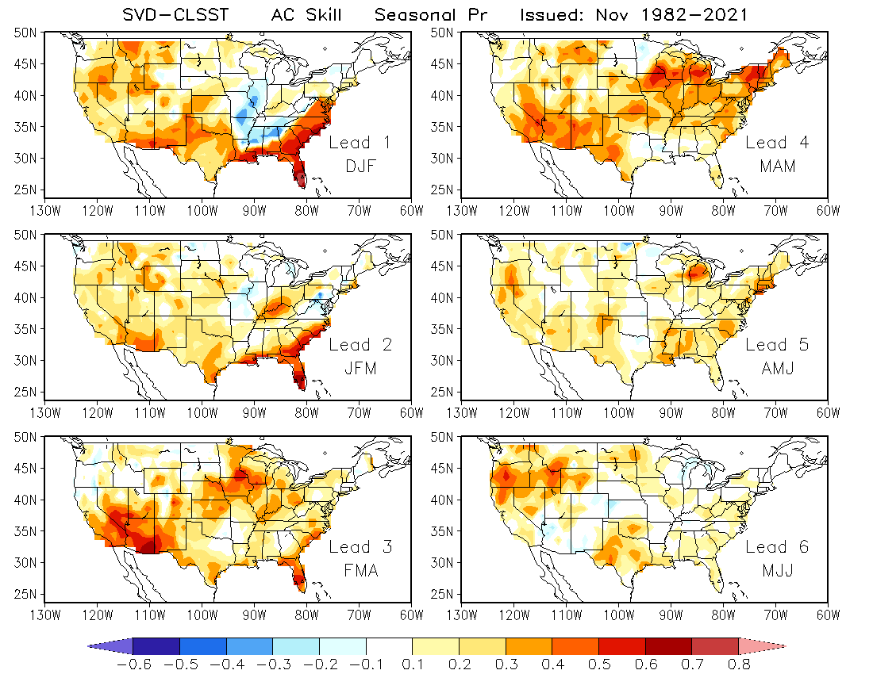
SVD
AC Skill
IC: Nov

Slide 5
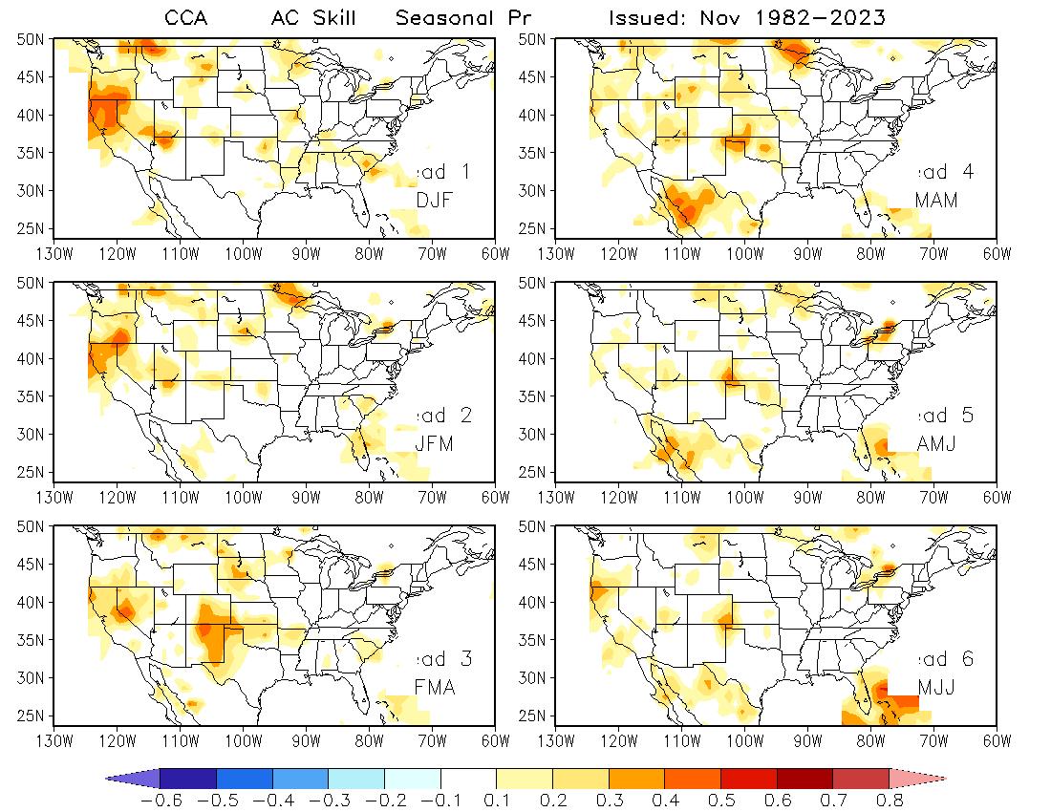
CCA
AC Skill
IC: Nov

Slide 6
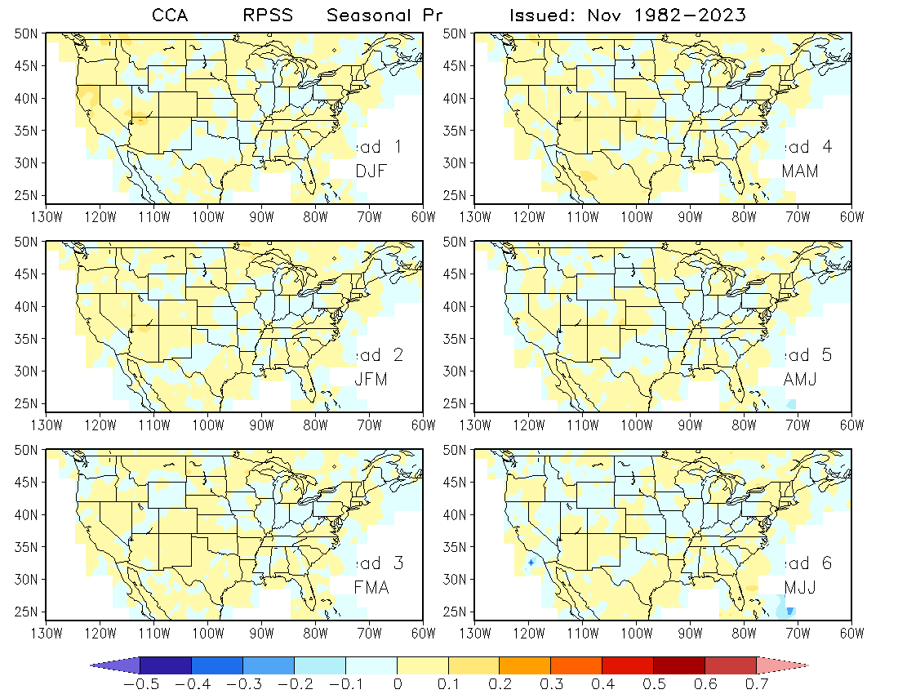
CCA
RPSS
IC: Nov

Slide 7
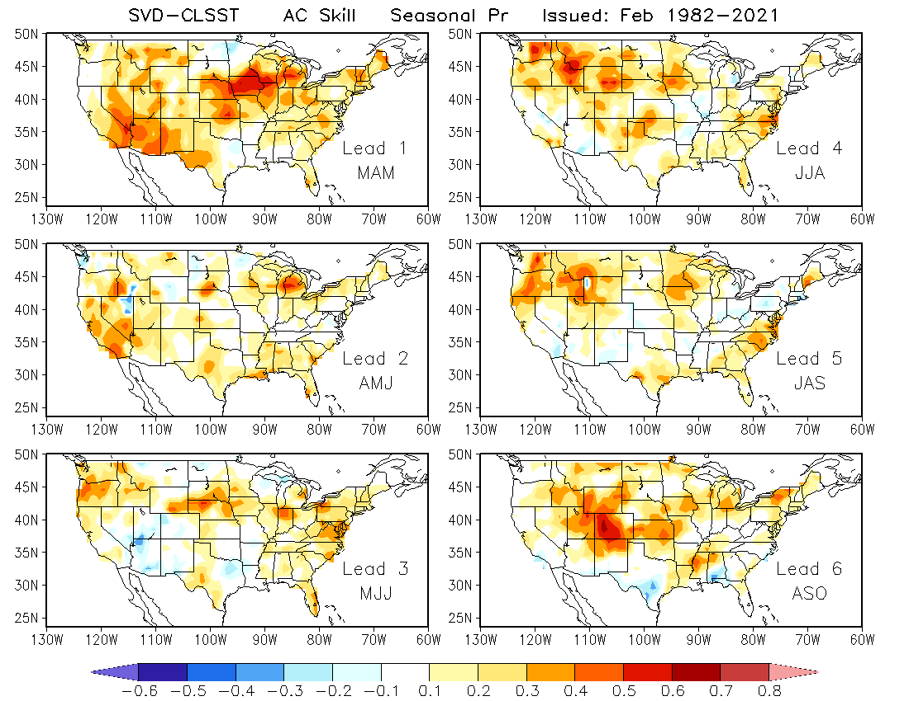
SVD
AC Skill
IC: Feb

Slide 8
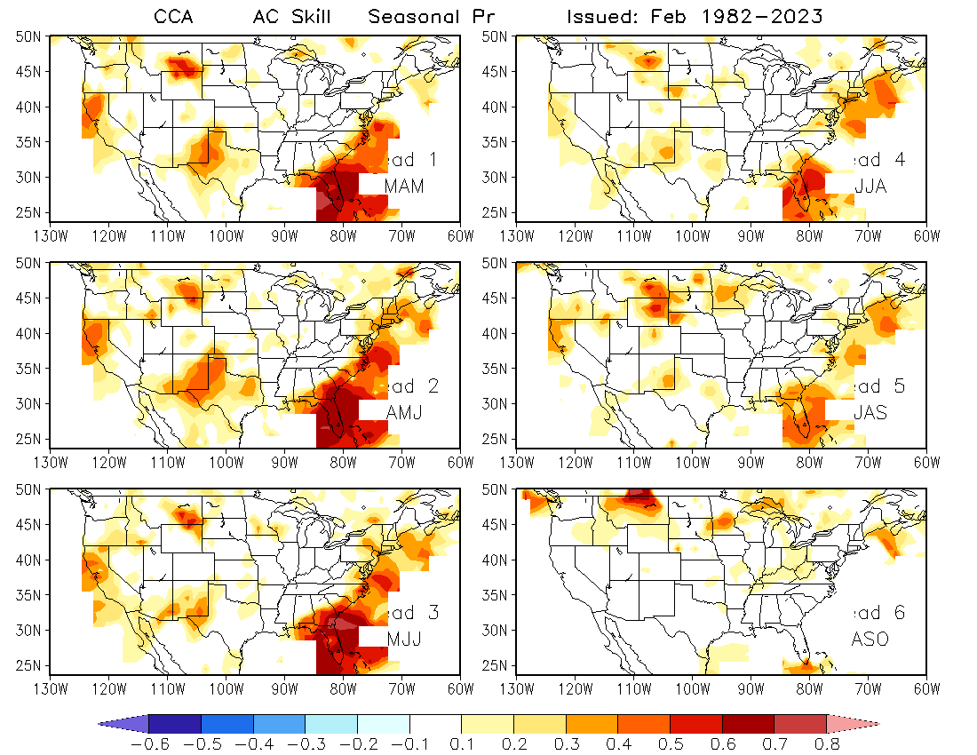
CCA
AC Skill
IC: Feb

Slide 9
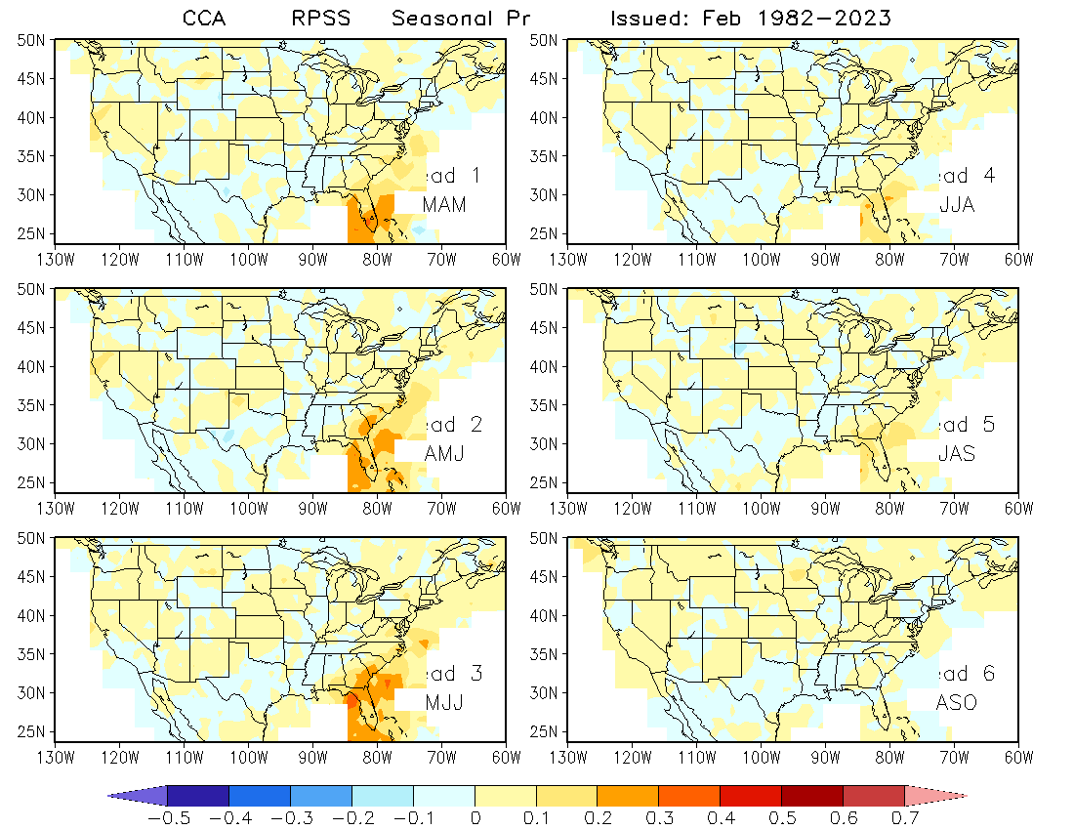
CCA
RPSS
IC: Feb

Slide 10
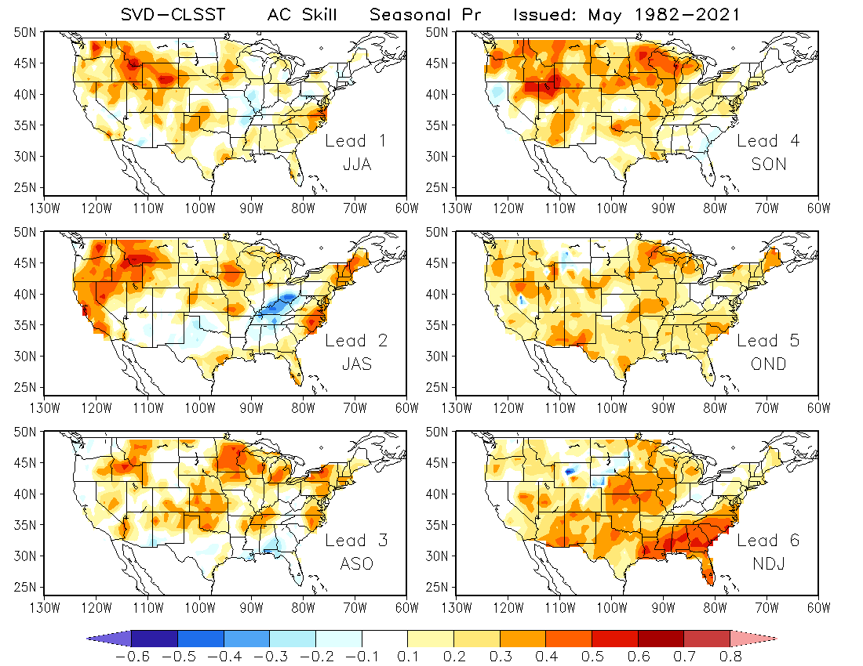
SVD
AC Skill
IC: May

Slide 11
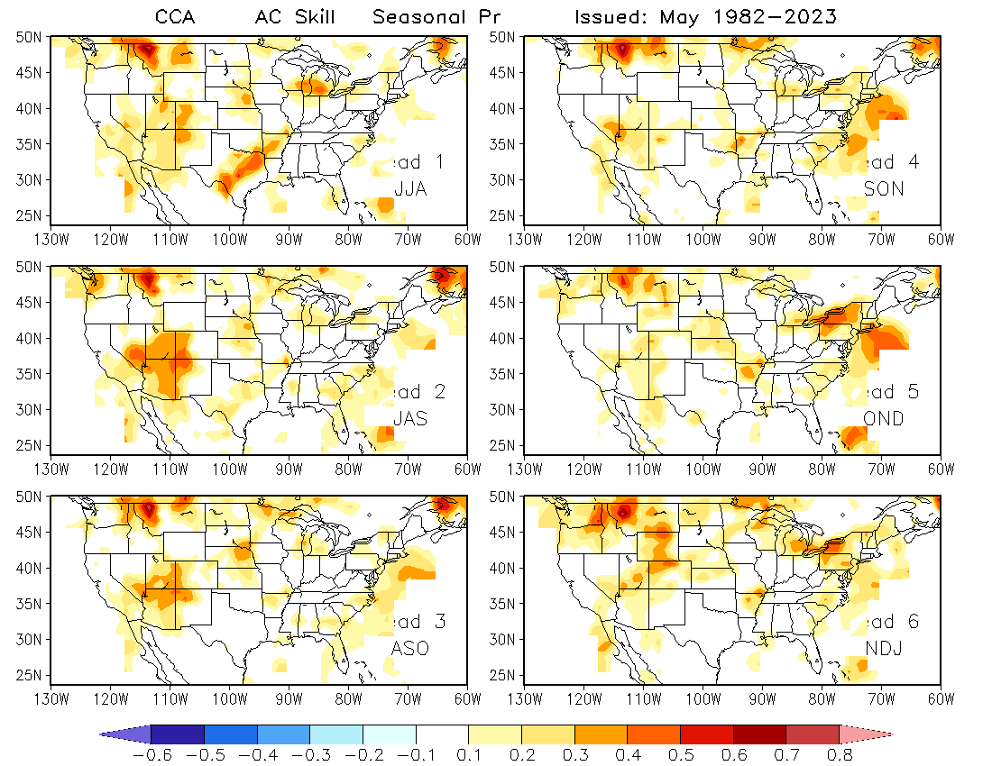
CCA
AC Skill
IC: May

Slide 12
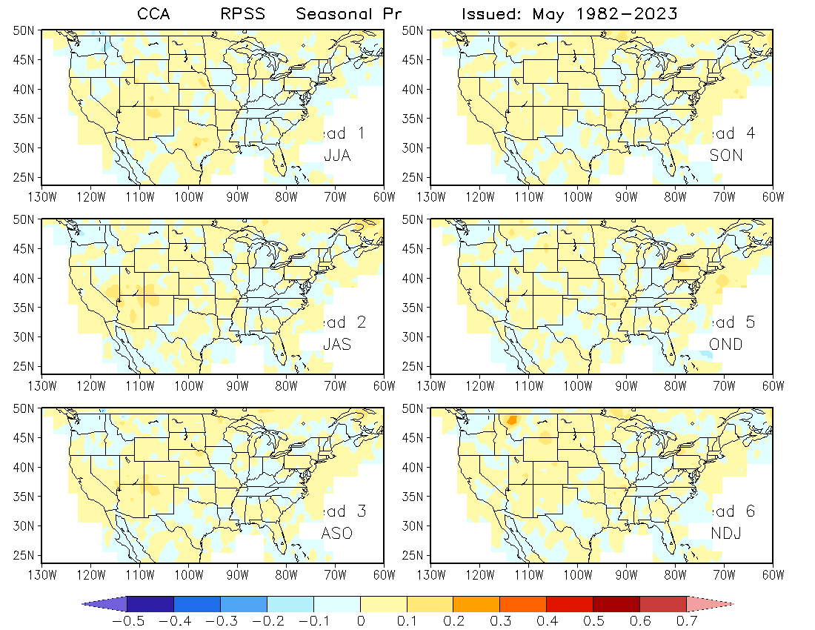
CCA
RPSS
IC: May

Slide 13
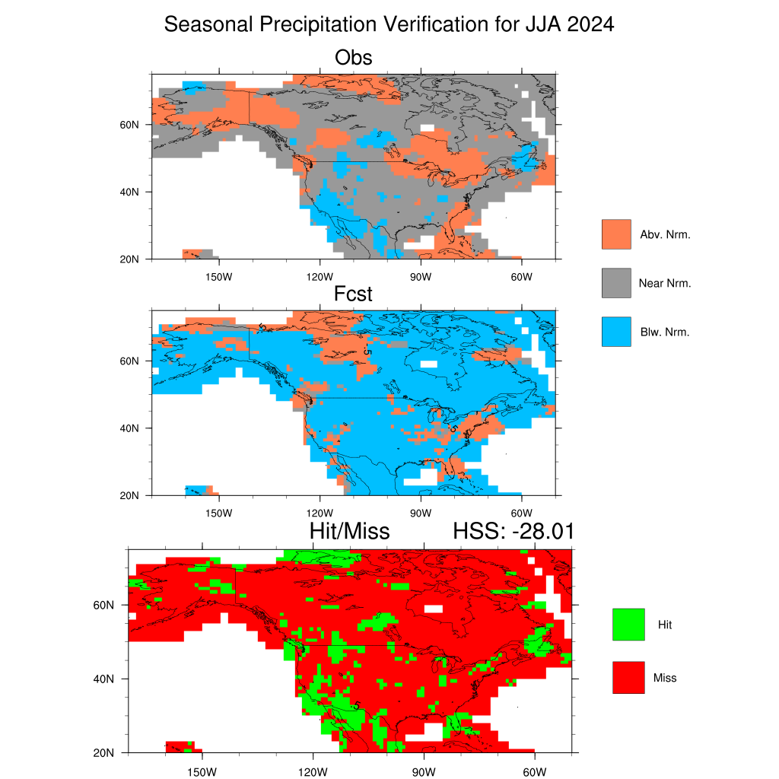
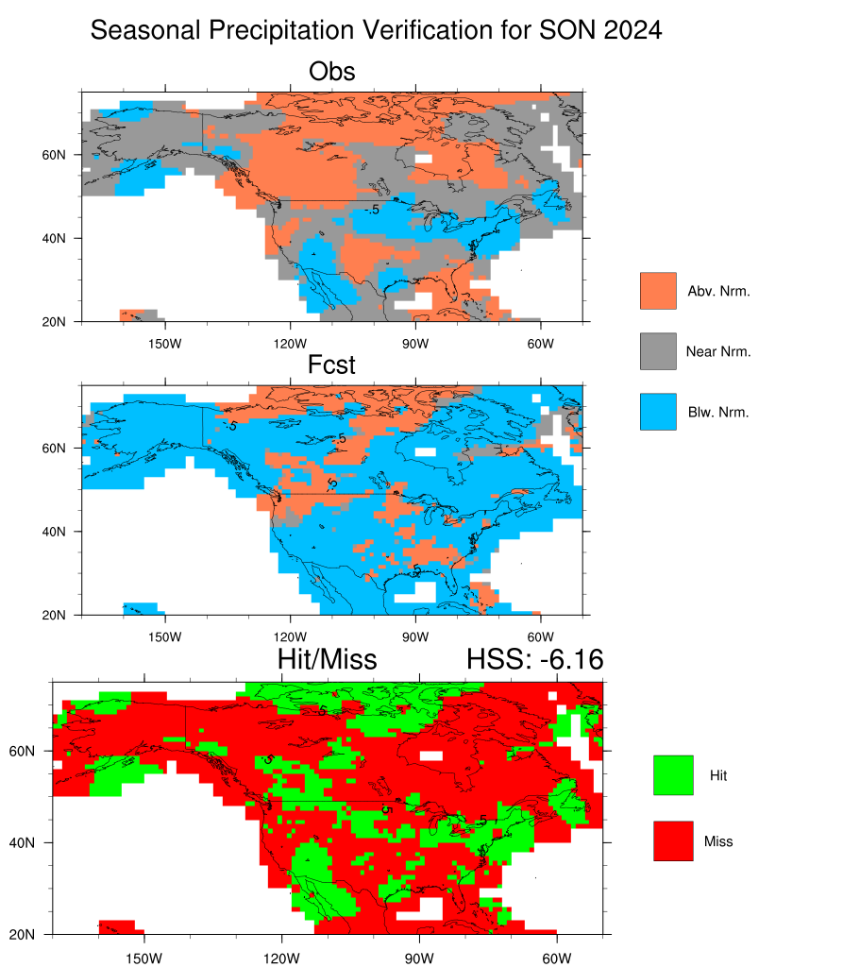
Verification
CCA

Slide 14
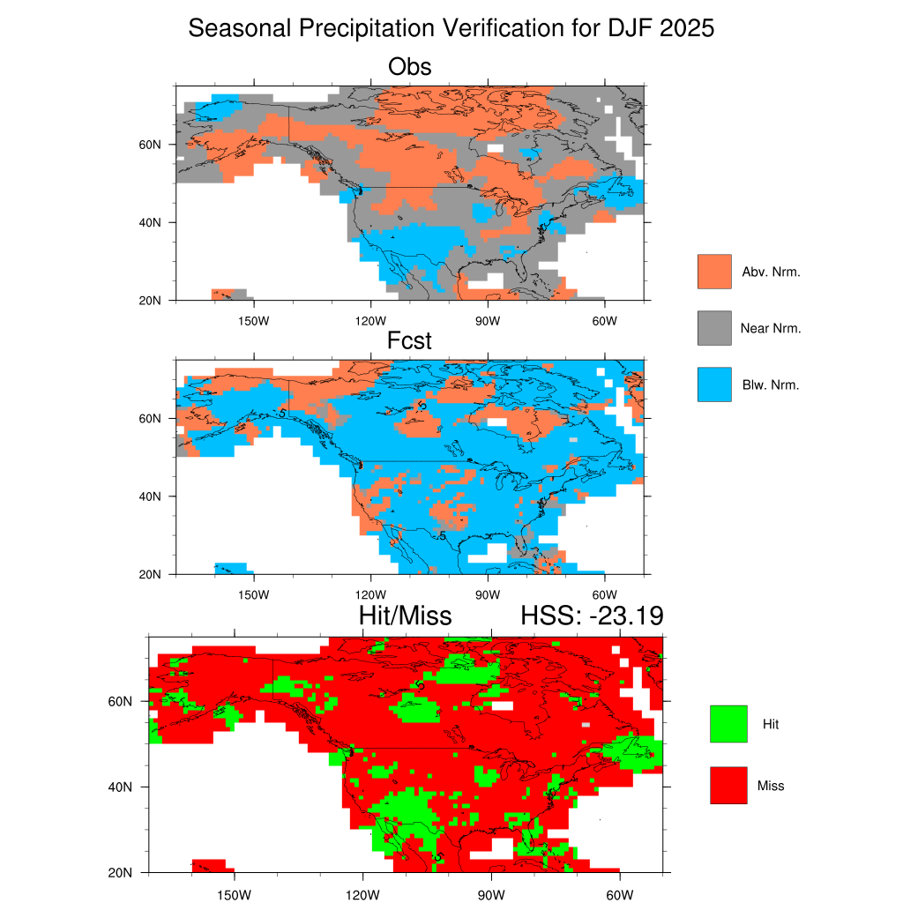
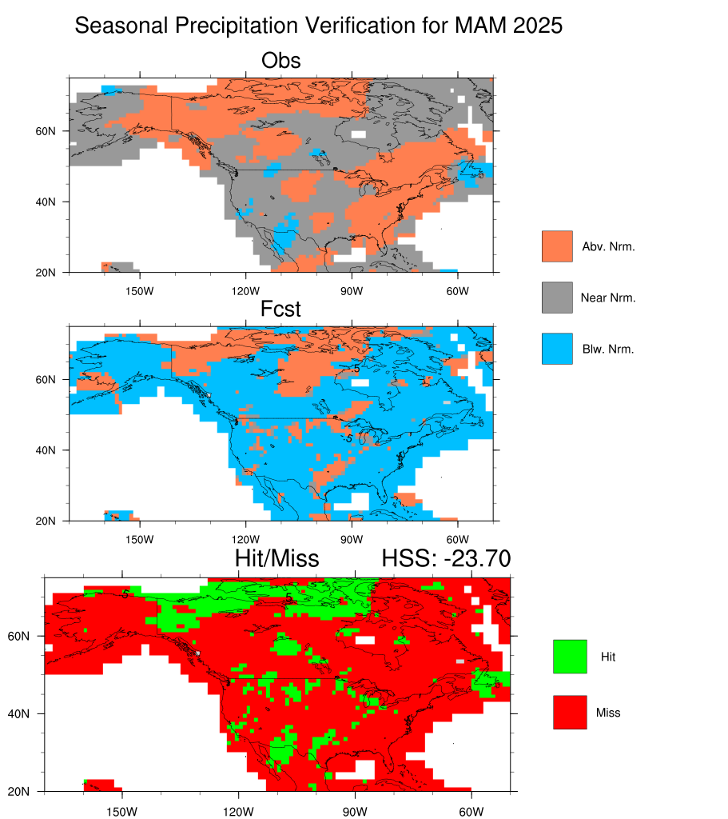
Verification
CCA

Slide 15
To-do:
Perform the same assessment as CCA for the SVD-CLSST forecasts
Calculate RPSS
Conduct forecast verification (hit/miss analysis)

