Slide 1
Update
13Dec2018
Forecast SW (LSR3) with the linear regression model
  Using 5º×5º box-averaged anomaly
  Using GEFS predicted SCP as a predictor
  Forecasts for MAM
  Forecast skill assessed based on cross-validation
    Anomaly correlation
  Comparison between the skills with 5º×5º box-averaged anomaly vs. 2.5º×2.5º grid and 1º×1º
Seasonal cycle from 1999-2010 CFSv2-45day
Monthly mean
Forecast Week 1-2-3-4
12Z-12Z
4 members

Slide 2
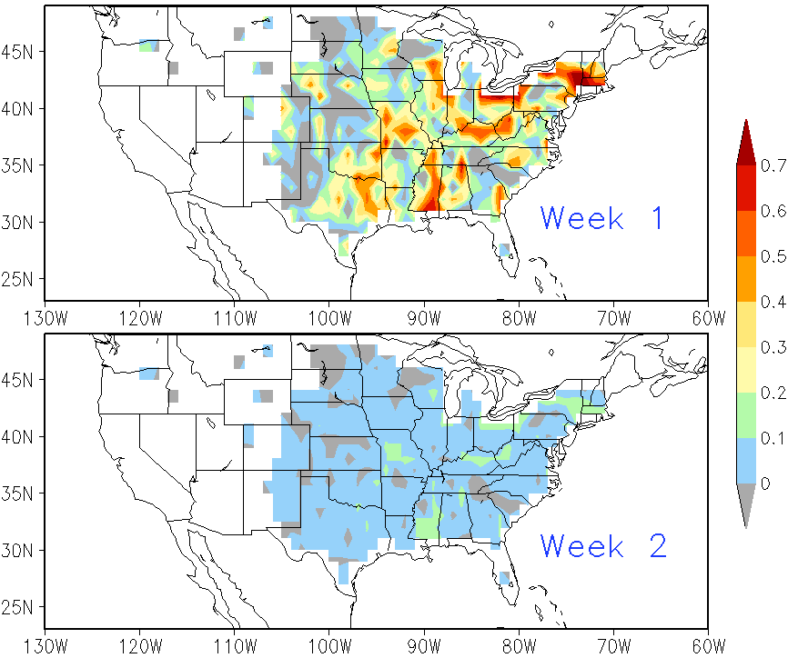
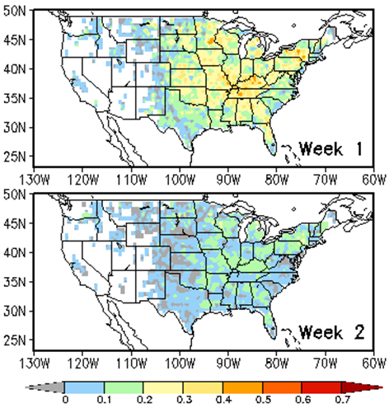
Forecast Skill LSR3 MAM 1999-2010
1°x1°
CFSv2
GEFS

Slide 3
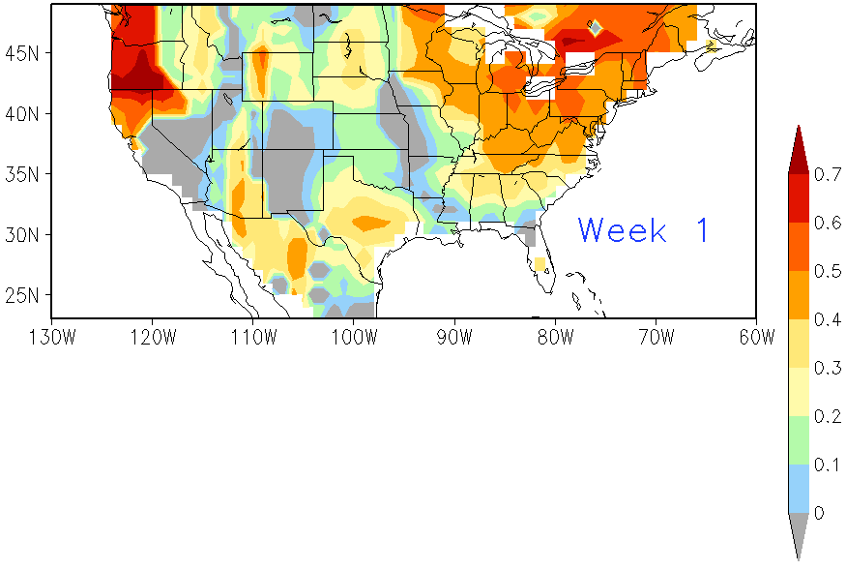
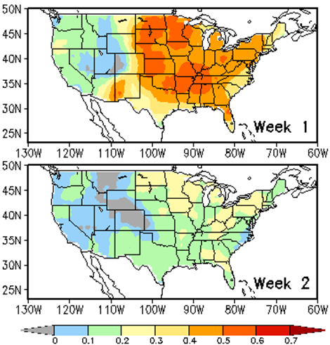
Forecast Skill LSR3 MAM 1999-2010
5°x5°
CFSv2
GEFS

Slide 4
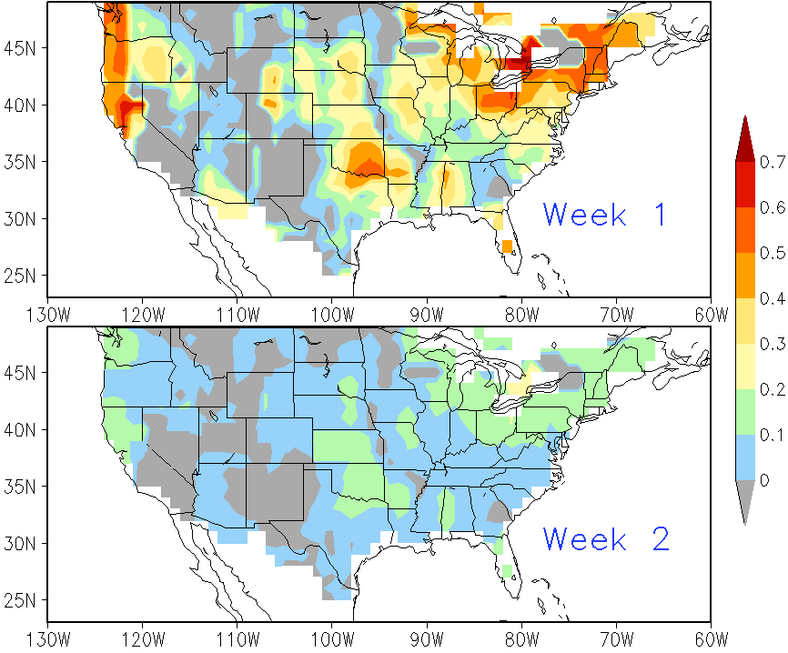
Forecast Skill LSR3 MAM 1999-2010
2.5°x2.5°
CFSv2

Slide 5
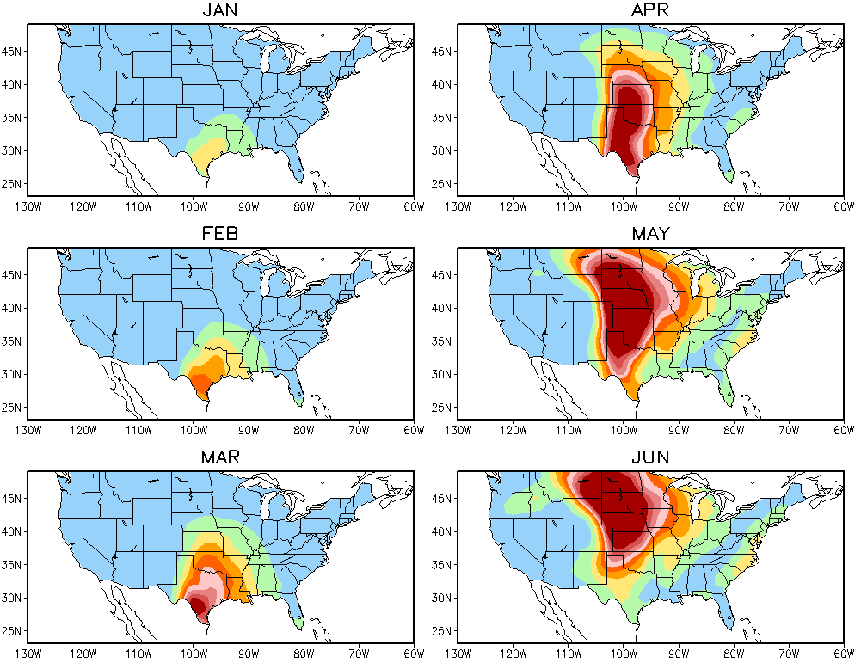
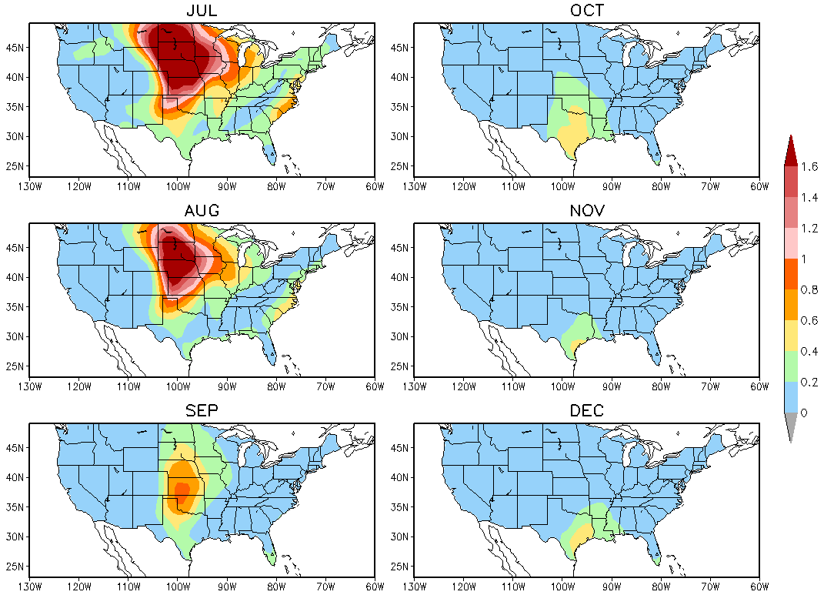
Week 1
CFSv2 SCP Monthly Climatology 1999-2010

Slide 6
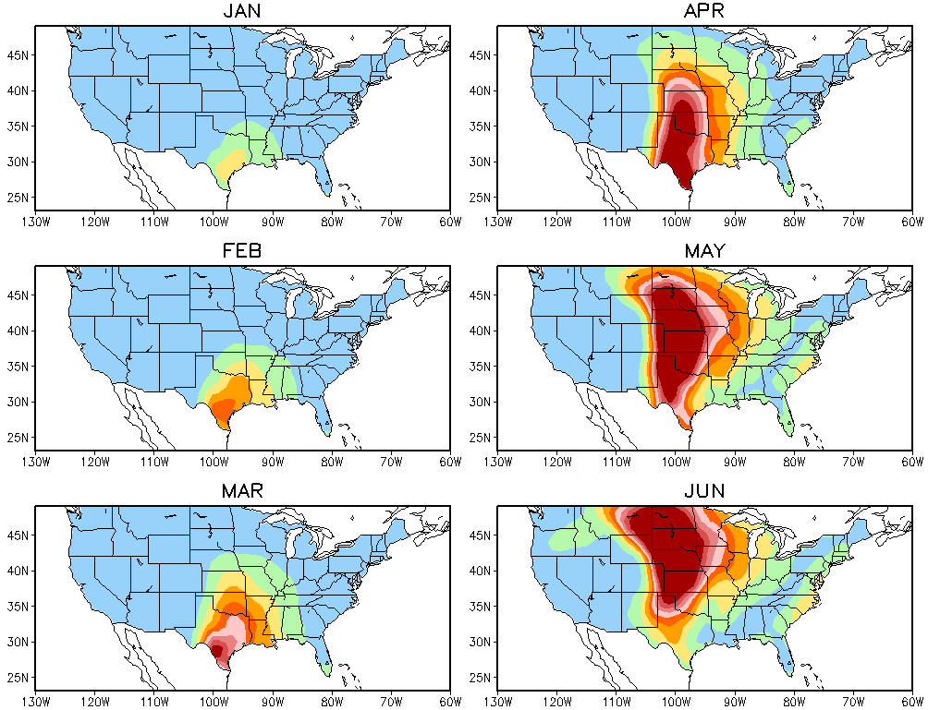
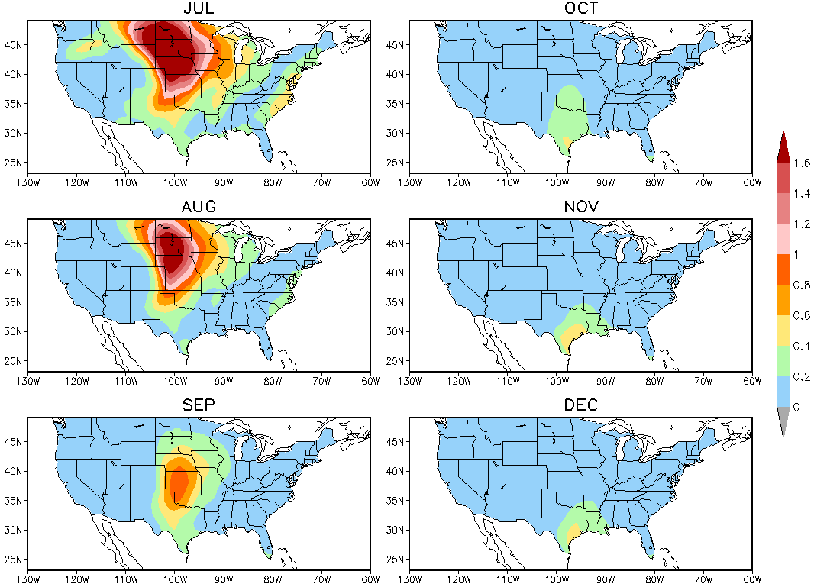
Week 2
CFSv2 SCP Monthly Climatology 1999-2010

Slide 7
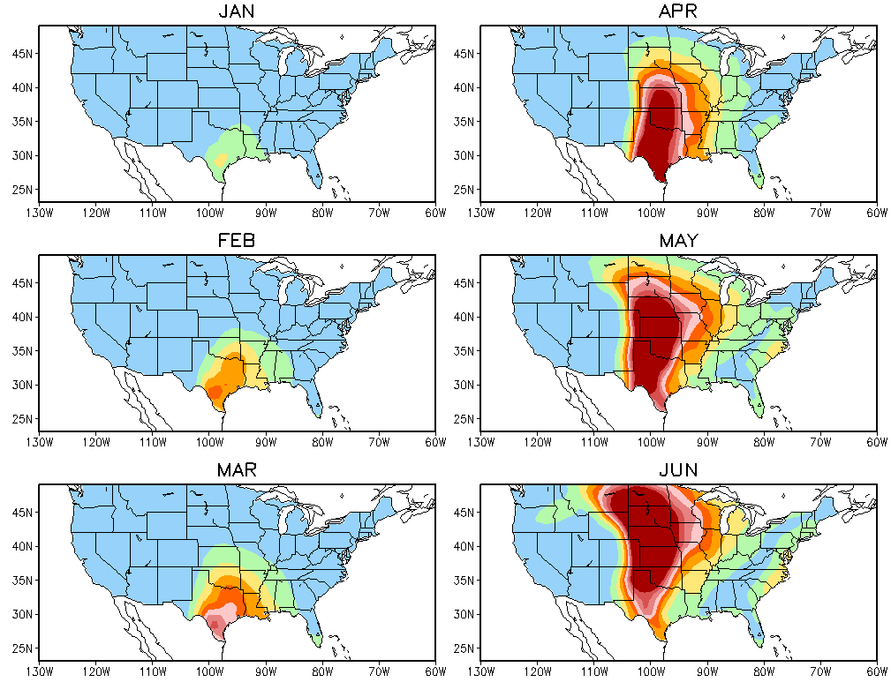
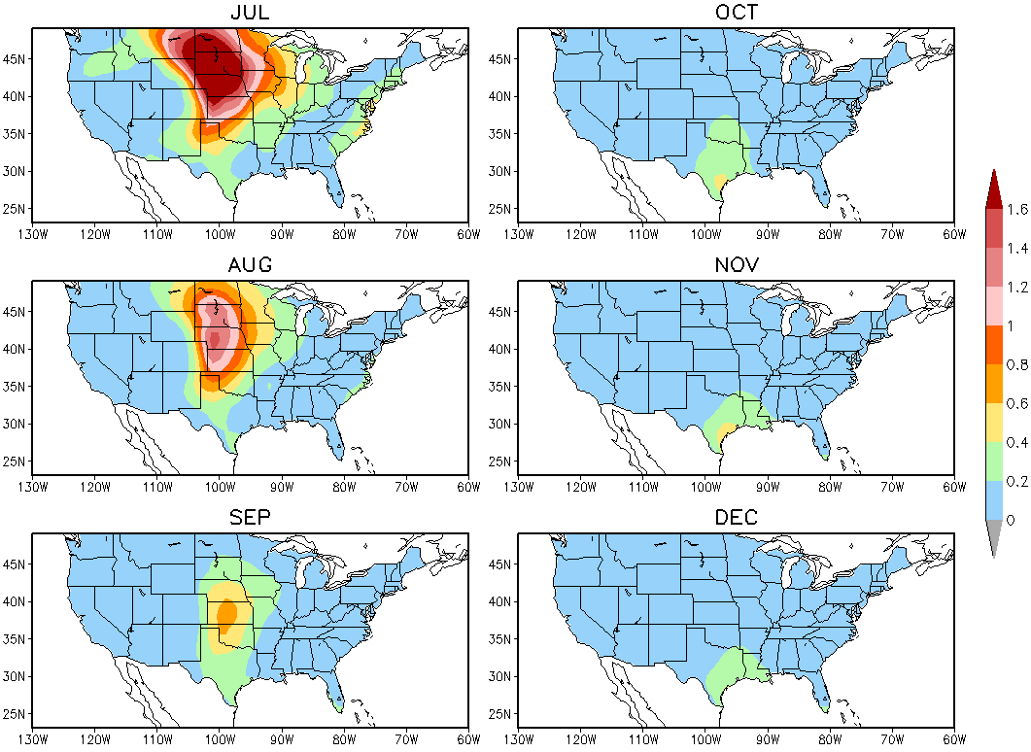
Week 3
CFSv2 SCP Monthly Climatology 1999-2010

Slide 8
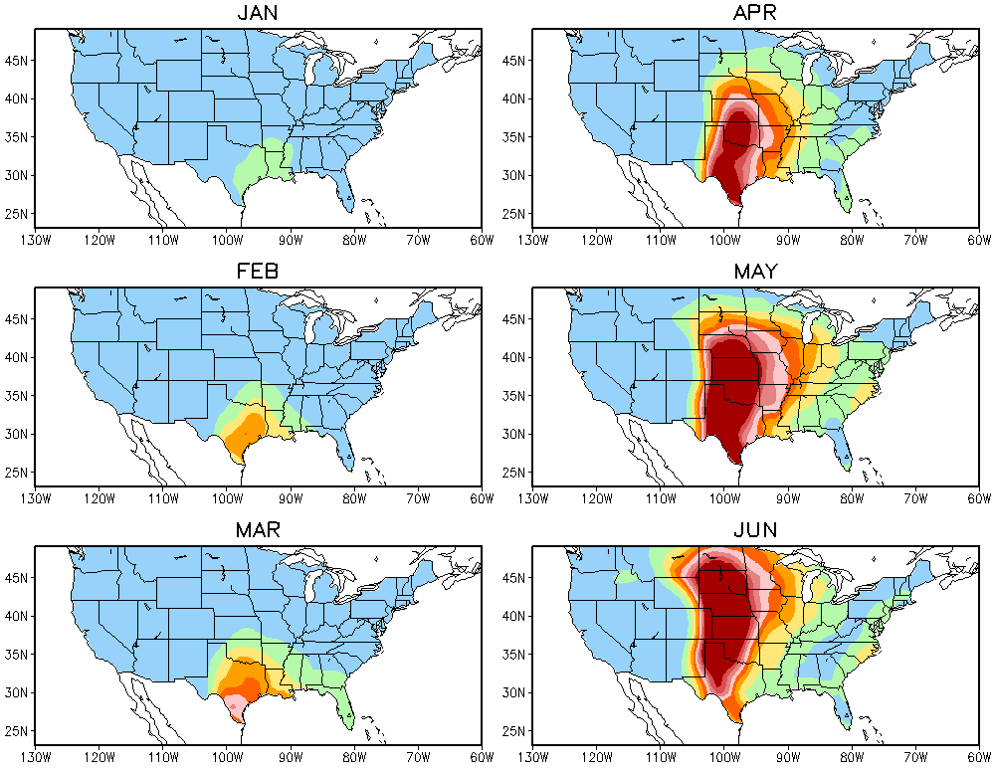
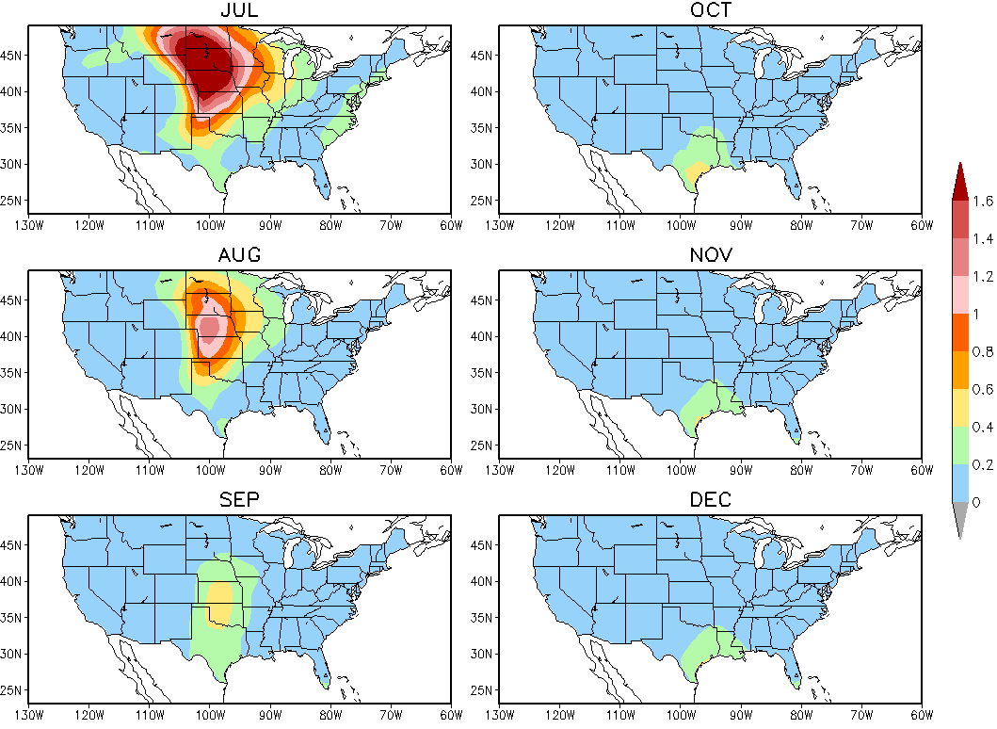
Week 3
CFSv2 SCP Monthly Climatology 1999-2010

