Slide 1
Update for June 19 2018
CFSv2 hindcast
1999 – 2011, 12 years (2011 not complete so removed)
Each year 365 days, 90 forecasts, 6 hourly
4 members
SCP from January to June from 1999 to 2010
the seasonal cycle for Week 1 2 3 and 4 from 1999 to 2004
To do
Calculate the seasonal variability from 1999 to 2010
Calculate the forecast skill between model (SCP CFSv2) and observation (SCP CFSR)
1999 2000 2001 2002 2003 2004 2005 2006 2007 2008 2009 2010

Slide 2
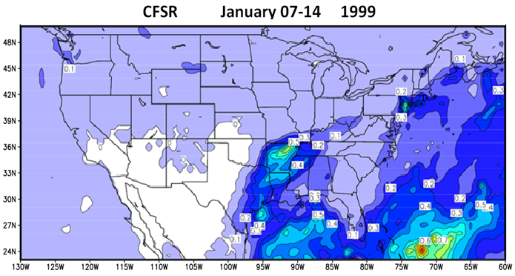
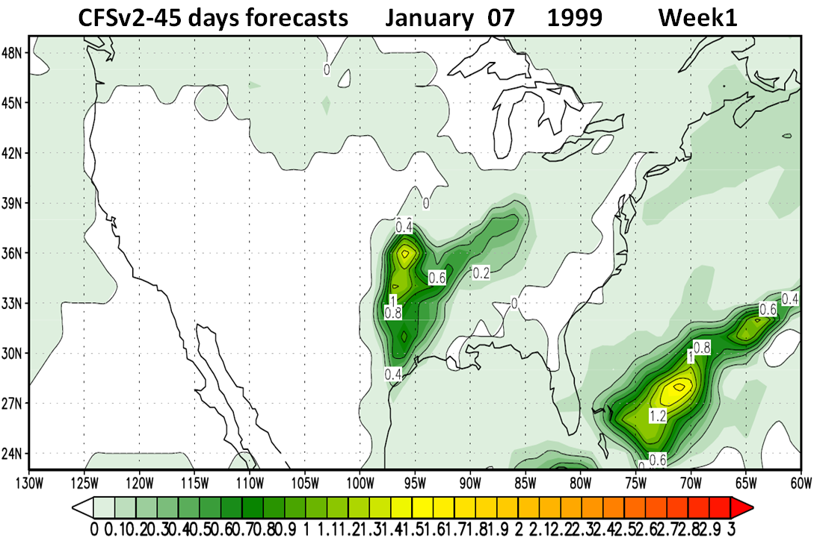
Observation
Model

