Slide 1
Update
04May2018
Seasonality MAM
Relationship between SCP CFSv2 and SCP CFSR
Anomaly SCP CFSv2
Working on
Anomaly Correlation Week 1-2-3-4 SCP CFSv2 vs. SCP CFSR

Slide 2
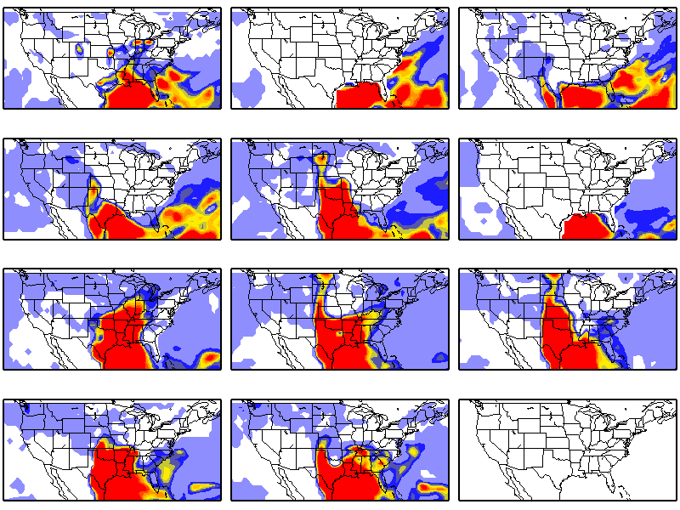
Anomaly SCP CFSv2 Forecast data Mars 03 2002
Day1
Day2
Day3
Day4
Day5
Day6
Day7
Day8
Day9
Day10
Day11
Day12

Slide 3
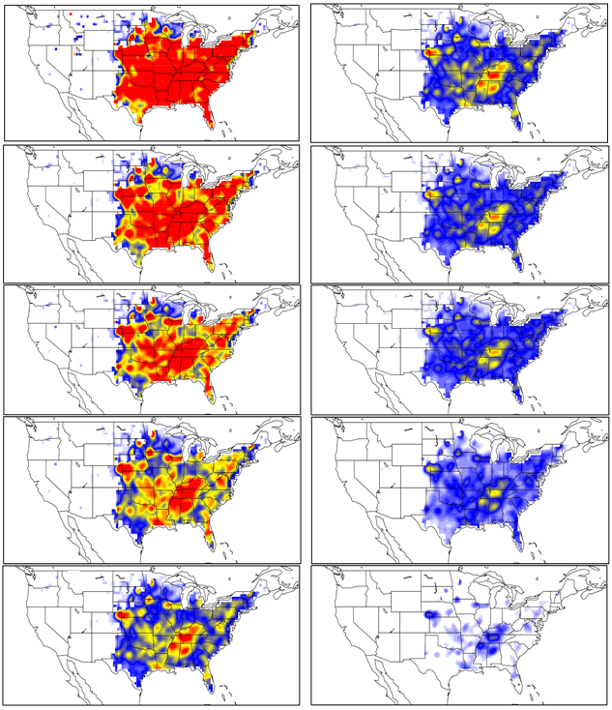
TC: SCP CFSv2 vs. SCP CFSR Daily data 2002-2010
Mask <0.1
Day1
Day6
Day2
Day7
Day3
Day8
Day4
Day9
Day5
Day10

