Slide 1
Update
04May2018
Seasonality MAM
Relationship between SCP CFSv2 and SCP CFSR
Total correlation (TC)
Access Wcoss /NECPDEV/CPC-om/? Submitted a ticket ……..Resolved 05/03/18
Working on
TC Week 1-2-3-4 SCP CFSv2 vs. SCP CFSR
Checking available data on /NECPDEV/CPC-om/?

Slide 2
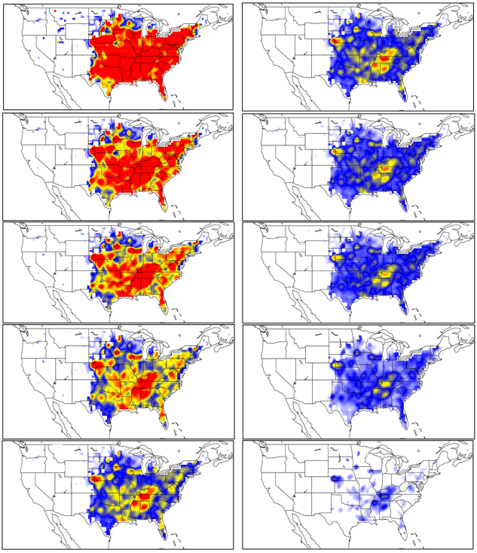
TC: SCP CFSv2 vs. SCP CFSR Daily data 2002-2010
Mask <0.1
Day1
Day6
Day2
Day7
Day3
Day8
Day4
Day9
Day5
Day10

