Slide 1
Update
12Jan2019
Monthly climatology from 2002 to 2010
Forecast from 0 to 44

Slide 2
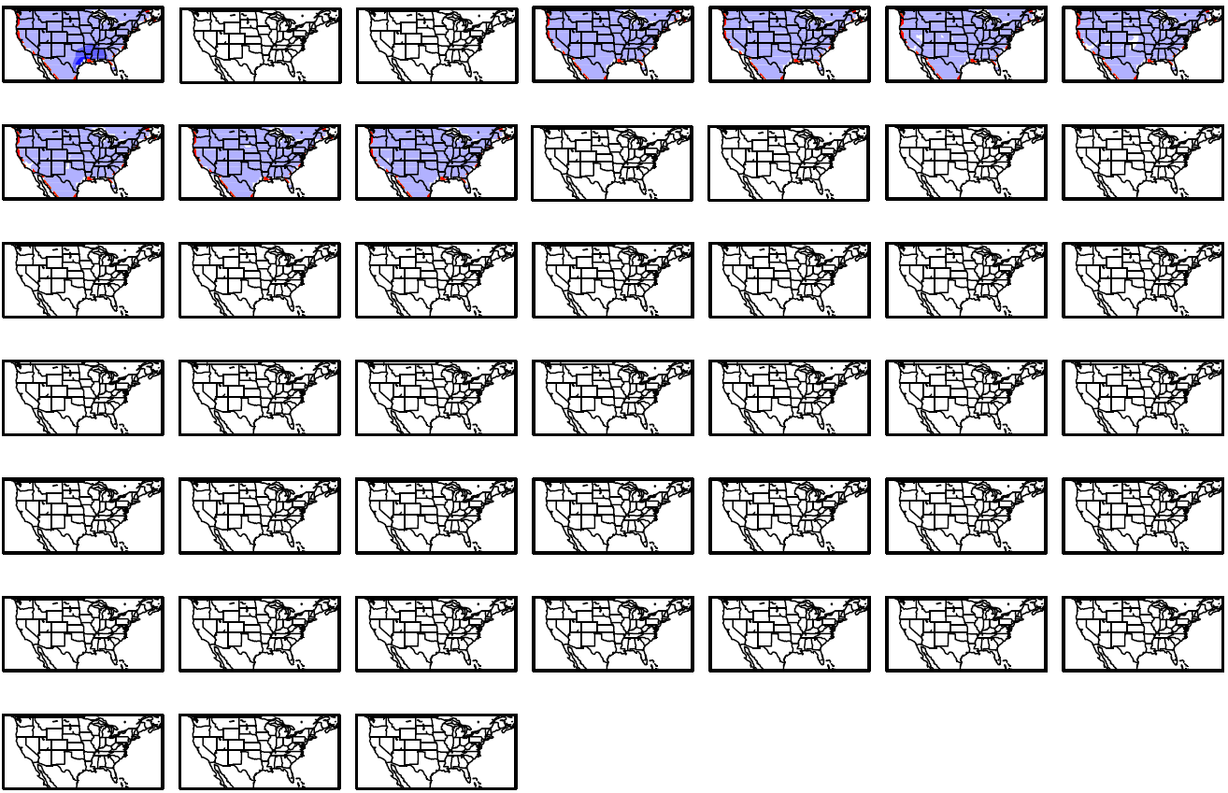
January
Day 1-07
Day 08-14
Day 15-21
Day 22-28
Day 29-35
Day 36-42
Day 43-45

Slide 3
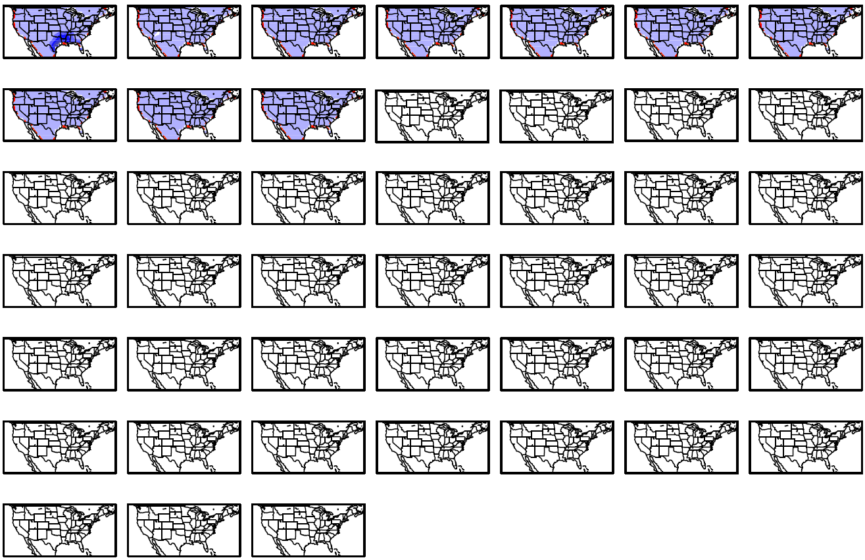
February
Day 1-07
Day 08-14
Day 15-21
Day 22-28
Day 29-35
Day 36-42
Day 43-45

Slide 4
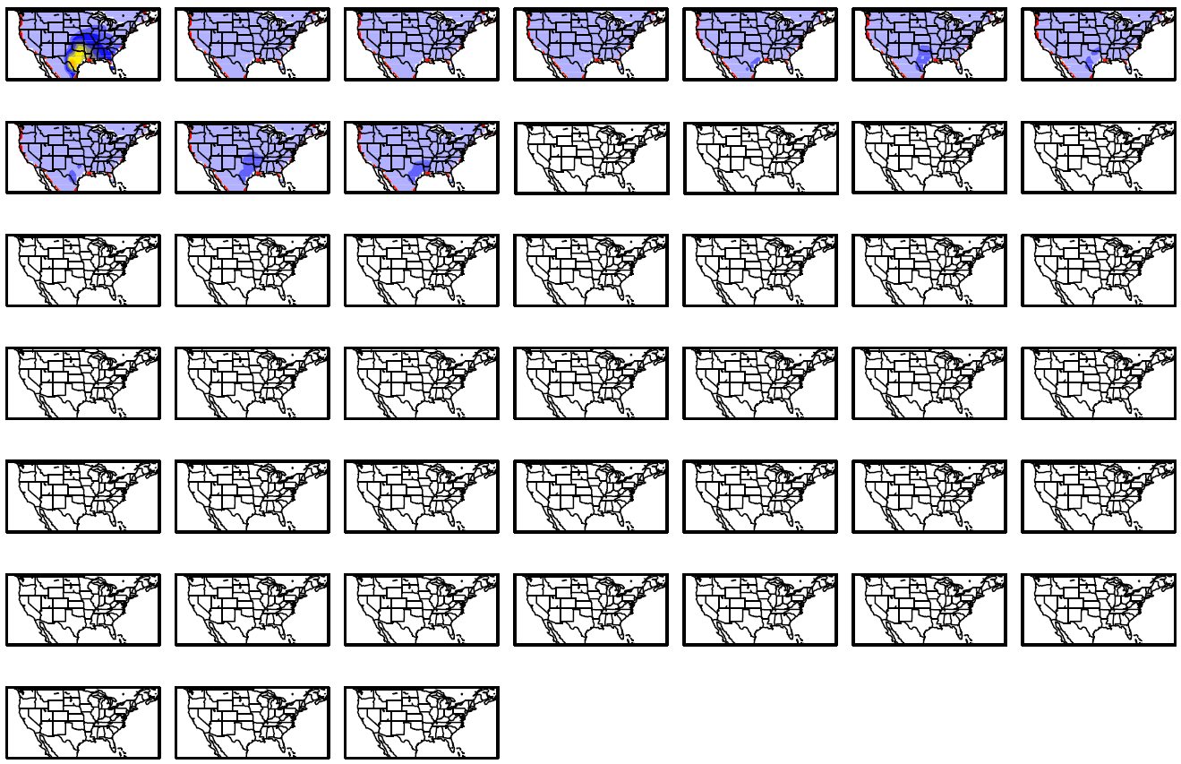
Mars
Day 1-07
Day 08-14
Day 15-21
Day 22-28
Day 29-35
Day 36-42
Day 43-45

Slide 5
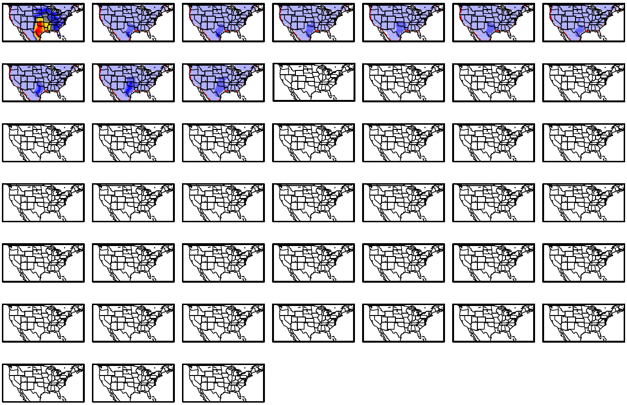
April
Day 1-07
Day 08-14
Day 15-21
Day 22-28
Day 29-35
Day 36-42
Day 43-45

Slide 6
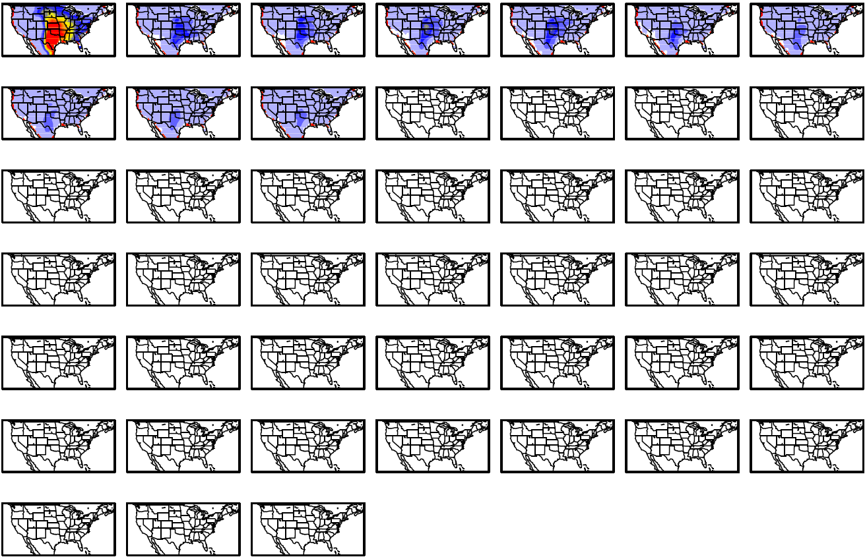
May
Day 1-07
Day 08-14
Day 15-21
Day 22-28
Day 29-35
Day 36-42
Day 43-45

Slide 7
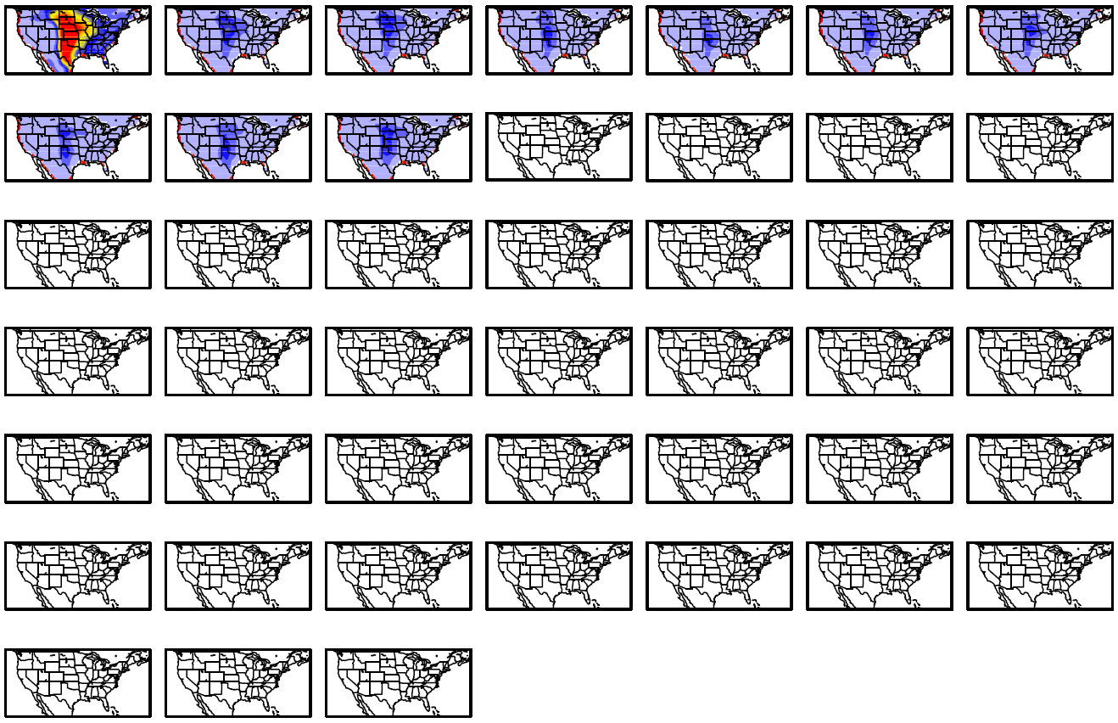
June
Day 1-07
Day 08-14
Day 15-21
Day 22-28
Day 29-35
Day 36-42
Day 43-45

Slide 8
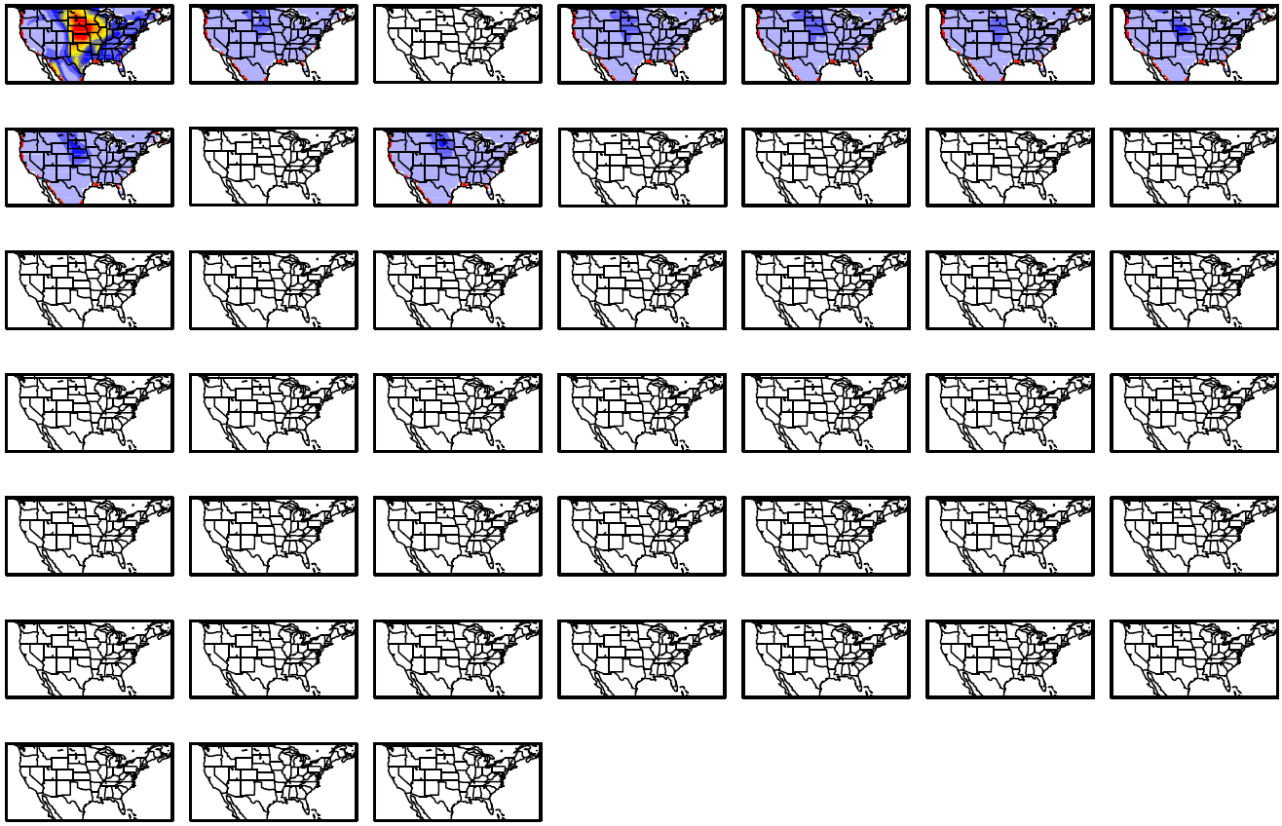
July
Day 1-07
Day 08-14
Day 15-21
Day 22-28
Day 29-35
Day 36-42
Day 43-45

Slide 9
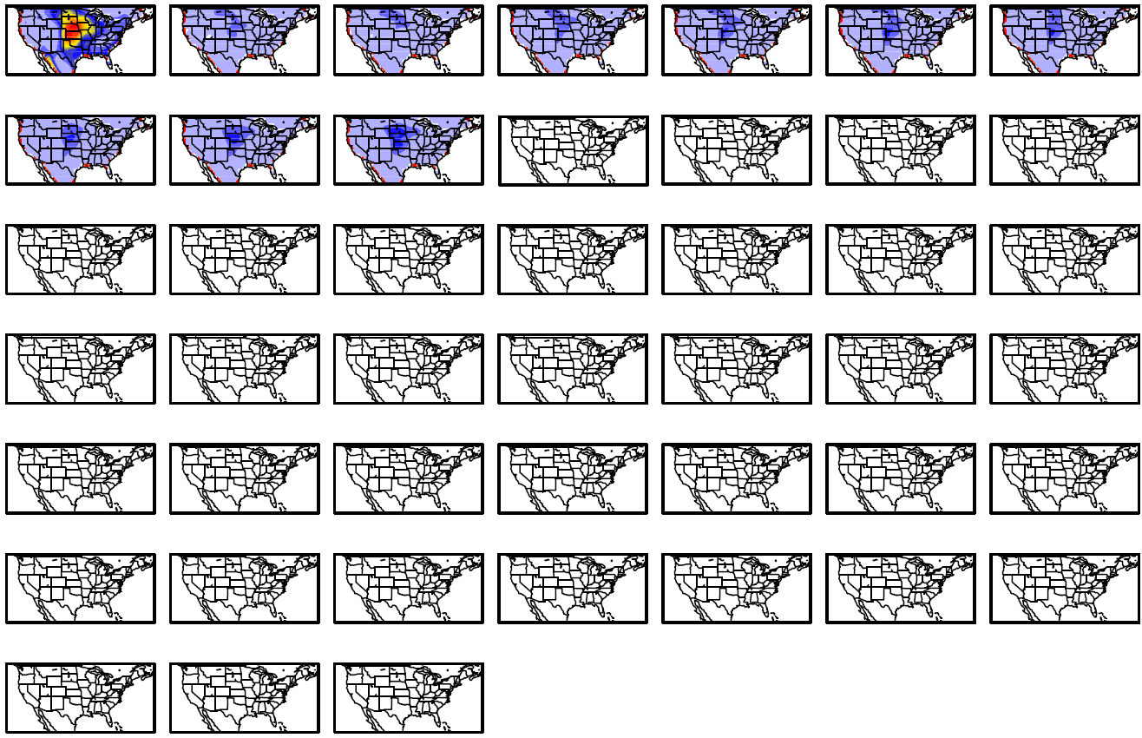
August
Day 1-07
Day 08-14
Day 15-21
Day 22-28
Day 29-35
Day 36-42
Day 43-45

Slide 10
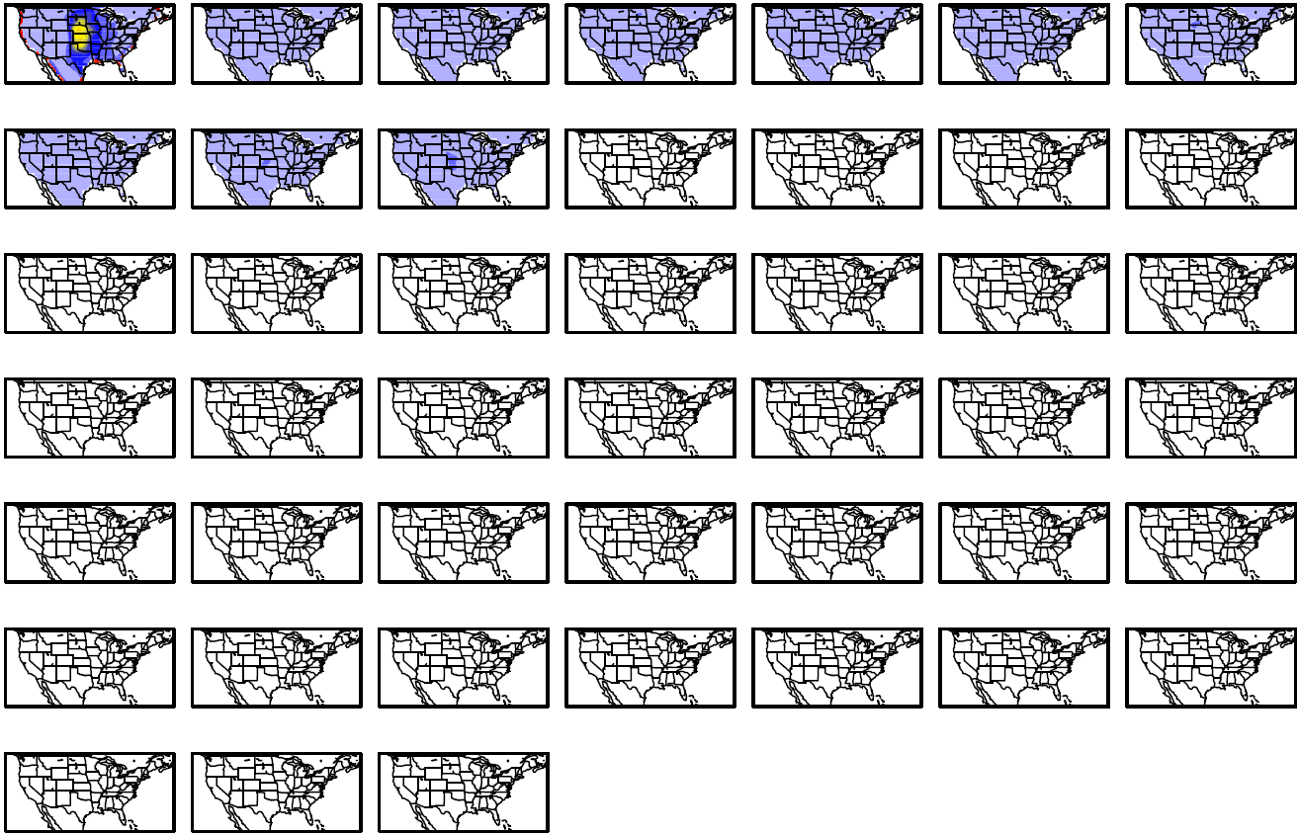
September
Day 1-07
Day 08-14
Day 15-21
Day 22-28
Day 29-35
Day 36-42
Day 43-45

Slide 11
October
Day 1-07
Day 08-14
Day 15-21
Day 22-28
Day 29-35
Day 36-42
Day 43-45

Slide 12
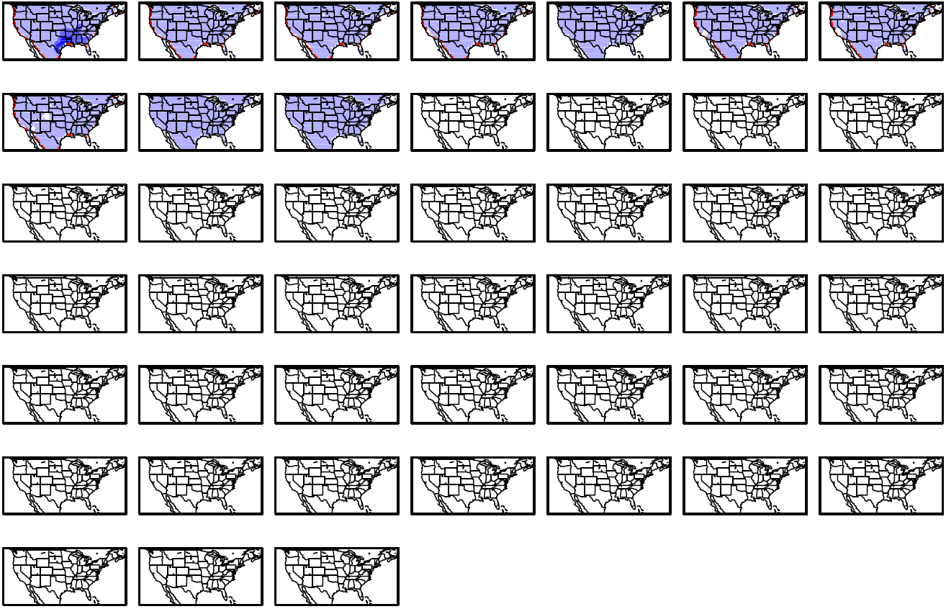
November
Day 1-07
Day 08-14
Day 15-21
Day 22-28
Day 29-35
Day 36-42
Day 43-45

Slide 13
December
Day 1-07
Day 08-14
Day 15-21
Day 22-28
Day 29-35
Day 36-42
Day 43-45

