Slide 1
Update
05Jan2018
Used daily data, Active season Mars 2002, image boxes size ‘set gxout grfill’
Working on
Relationship between SCP CFSv2 and LSR3
LSR: Local Storm
Anomaly correlation (AC)
Seasonality
Conditional AC (SCP >= 1)

Slide 2
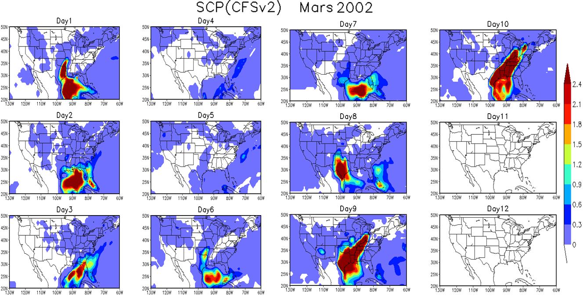

Slide 3
