Slide 1
Weekly Meeting
17NOV2017
Investigated the U and V component of BWD data of CFSR GEFS and CFSv2
U&V
CFSR: 0-30hPa above ground layer and 500hPa
GEFS: 0–30hPa above ground layer and 10m above ground layer
CFSv2: 0–30hPa-above-ground layer and 500 hPa
To do
Compare 1996-2012 GEFS to 1999-2011 CFSv2
Do the same method GEFS for CFSv2

Slide 2
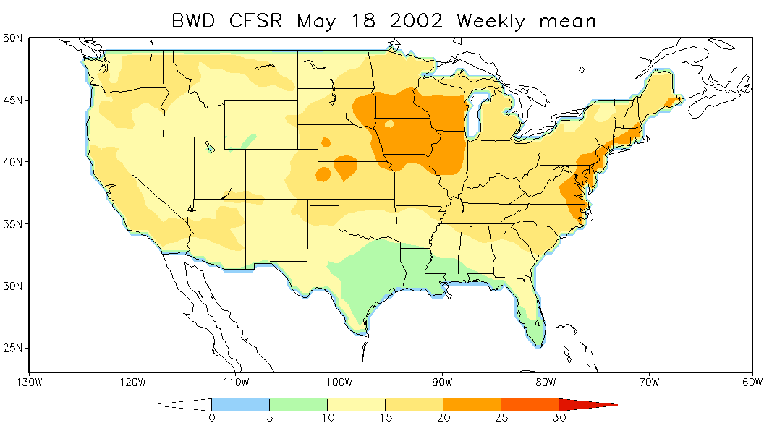
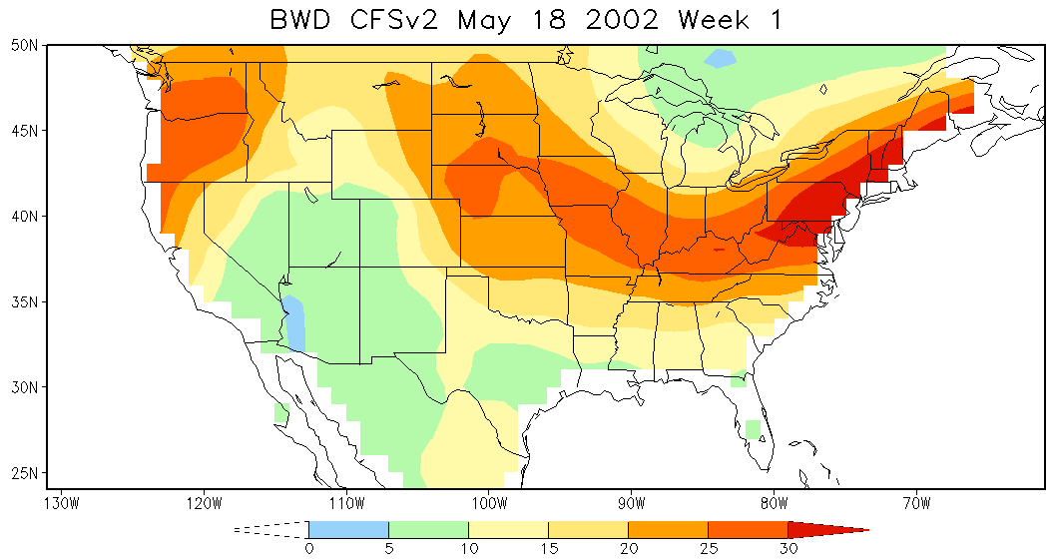
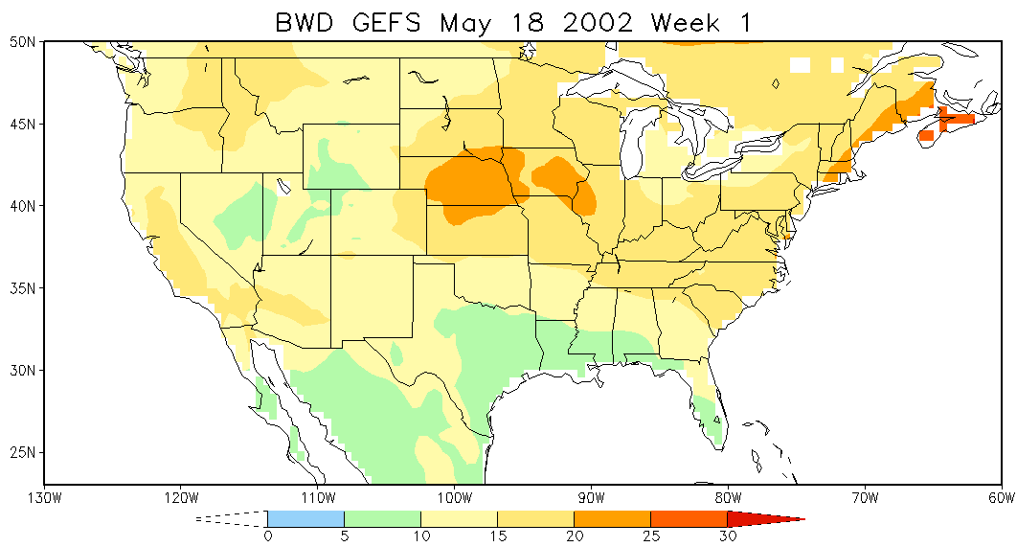
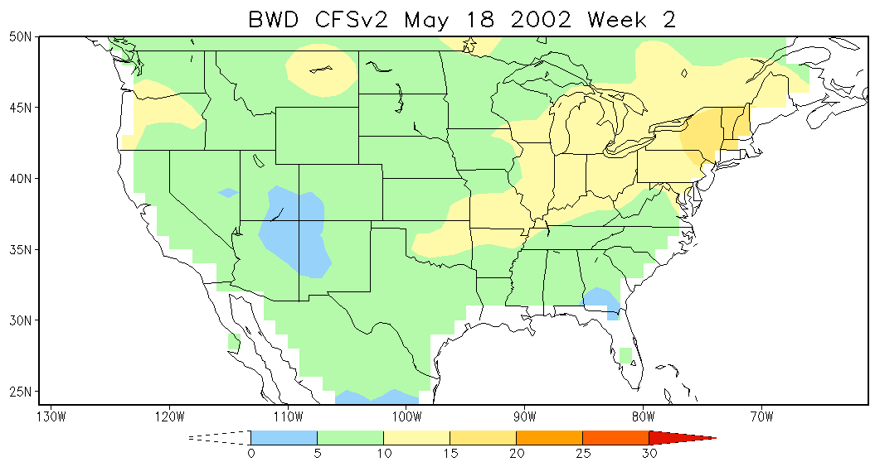
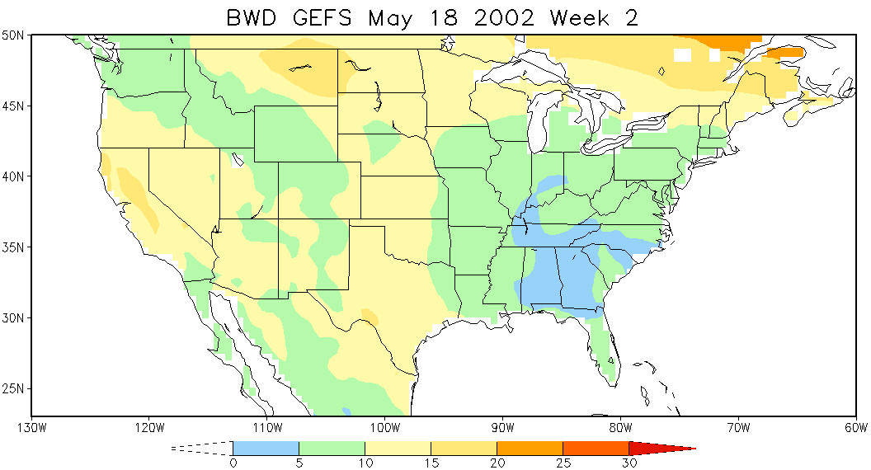
Wind

Slide 3
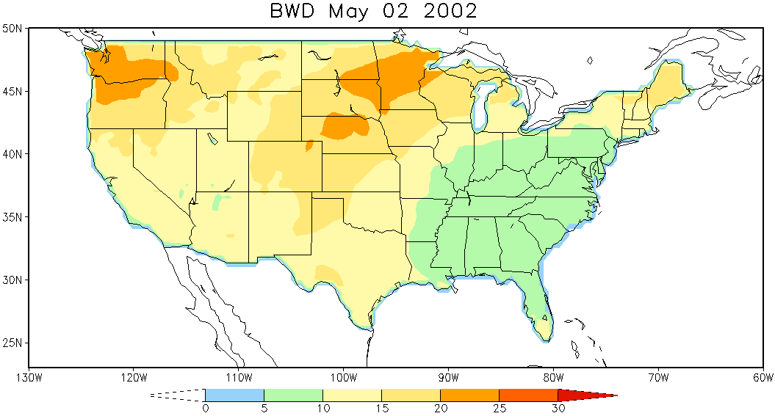
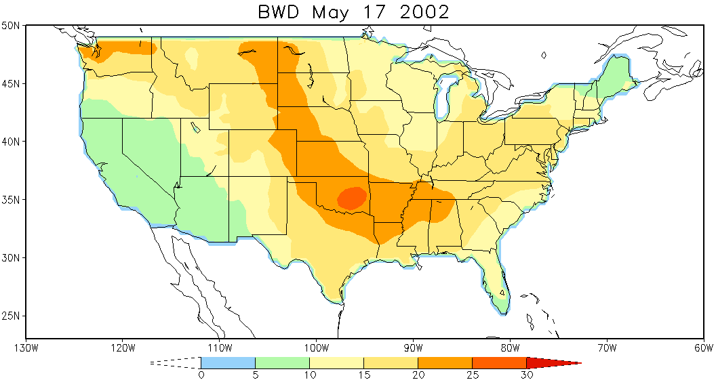
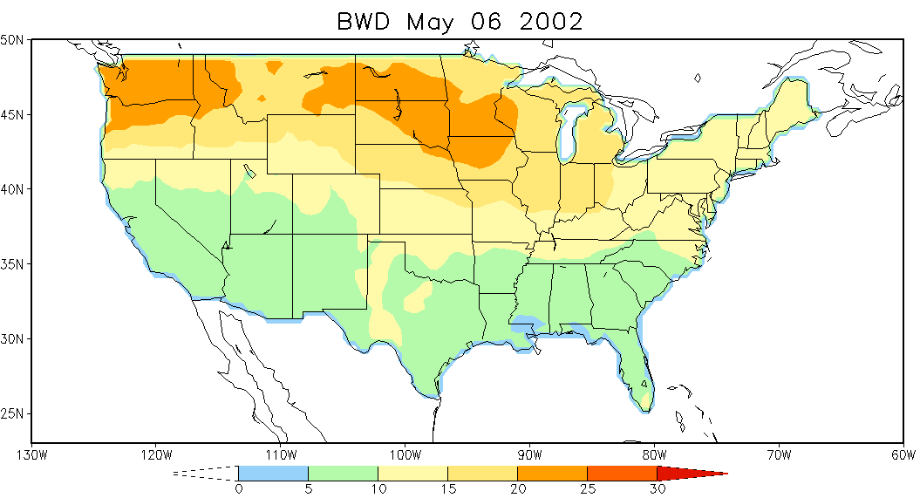
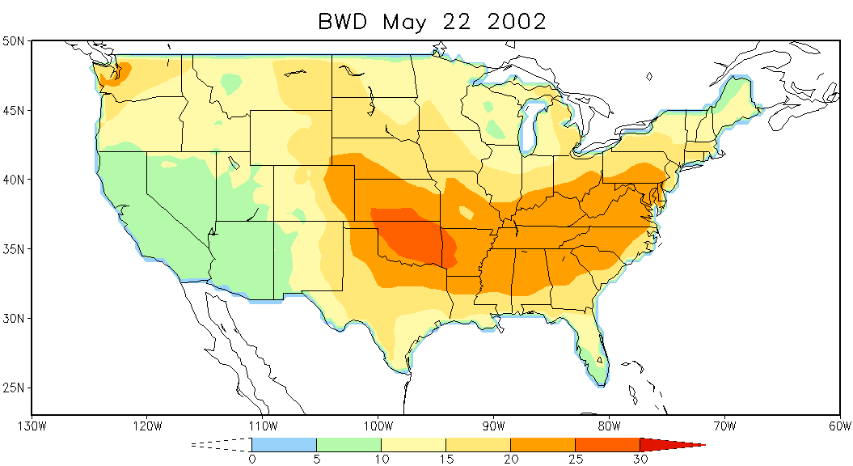
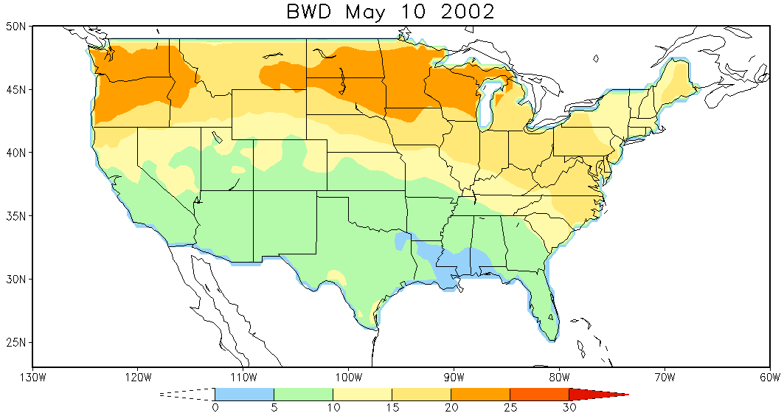
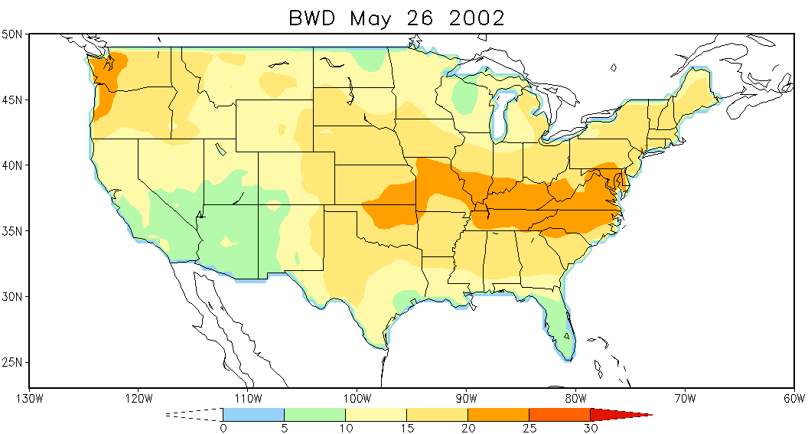
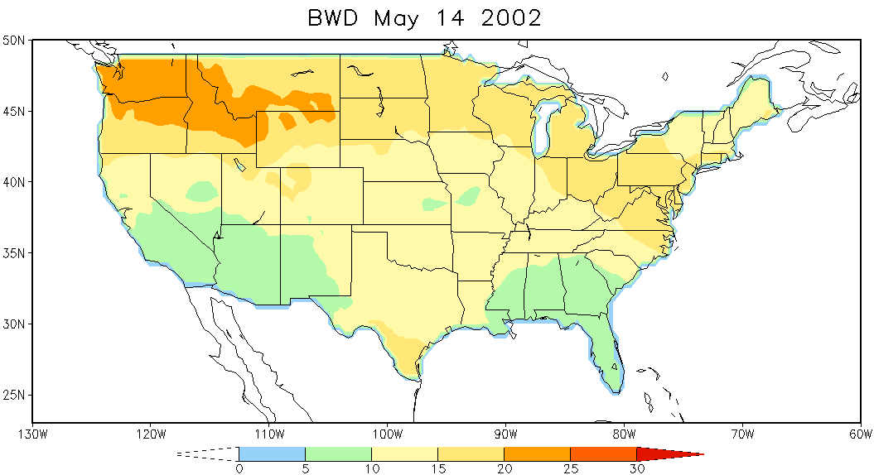
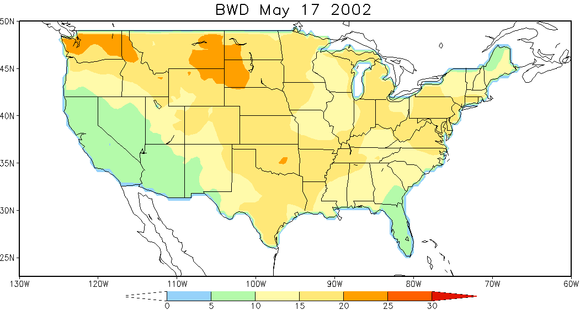
BWD CFSR
BWD CFv2

