Slide 1
Update
09June2017
Only over the US
-Calculated SCP (GEFS) weekly1-2 mean for from 1996-2012
Week2 (8-14 days)
Week1 (1-7 days)
Jan041996 Jan08 1996 Jan121996 Jan161996 Jan201996 Jan241996 Jan281996 Feb011996
-Calculated SCP(CFSR) weekly mean from GEFS day1 from 1996-2012
-Calculated SCP(GEFS) monthly climatology (1996-2012)/ 14 forecasts
To do
-Calculating monthly correlation map from 1996-2012 of
Total SCP(GEFS) & LSR(Hail+Wind+Tornado)
SCP>1 (GEFS)& LSR
Make scatter plot of SCP(CFSR and GEFS) and LSR
Correlation between SCP(GEFS)&SCP(CFSR) weekly1 mean from 1996-2012

Slide 2
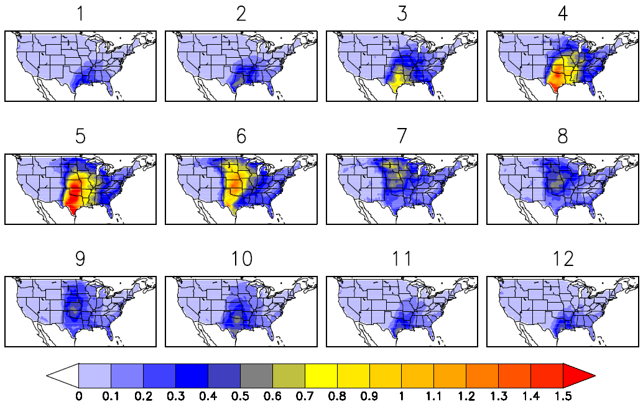
SCP(CFSR) Monthly Climatology 1996-2012

Slide 3
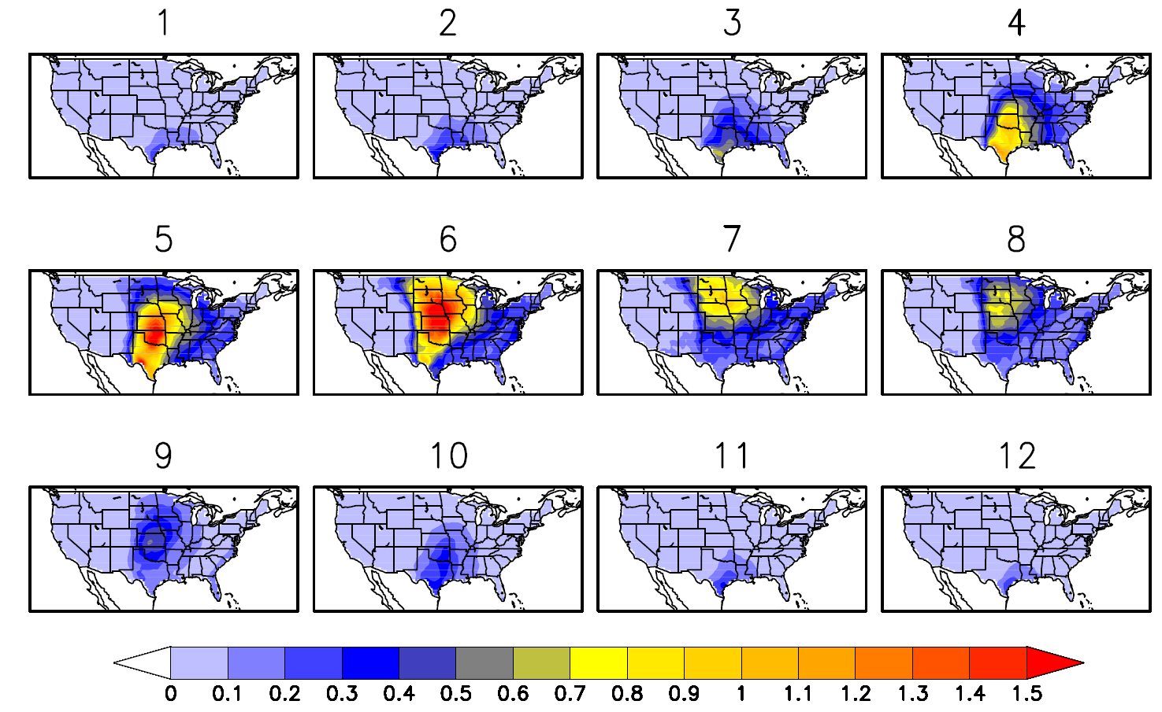
SCP (GEFS) Monthly Climatology 1996-2012, 14 forecast

