Slide 1
Joplin Missouri tornado, May 22, 2011
Oklahoma/Kansas tornado outbreak, May 3, 1999
Central Alabama tornado outbreak, April 27, 2011

Slide 3
Related GEFS 16-day hindcasts: May 9, 13, 17, 21 for 5/22/2011
Longer lead
Shorter lead
May 2011
Su Mo Tu We Th Fr Sa
1 2 3 4 5 6 7
8 9 10 11 12 13 14
15 16 17 18 19 20 21
22 23 24 25 26 27 28
29 30 31
May 2011
Su Mo Tu We Th Fr Sa
1 2 3 4 5 6 7
8 9 10 11 12 13 14
15 16 17 18 19 20 21
22 23 24 25 26 27 28
29 30 31
Week 2
Week 2
May 2011
Su Mo Tu We Th Fr Sa
1 2 3 4 5 6 7
8 9 10 11 12 13 14
15 16 17 18 19 20 21
22 23 24 25 26 27 28
29 30 31
May 2011
Su Mo Tu We Th Fr Sa
1 2 3 4 5 6 7
8 9 10 11 12 13 14
15 16 17 18 19 20 21
22 23 24 25 26 27 28
29 30 31
Week 1
Week 1

Slide 4
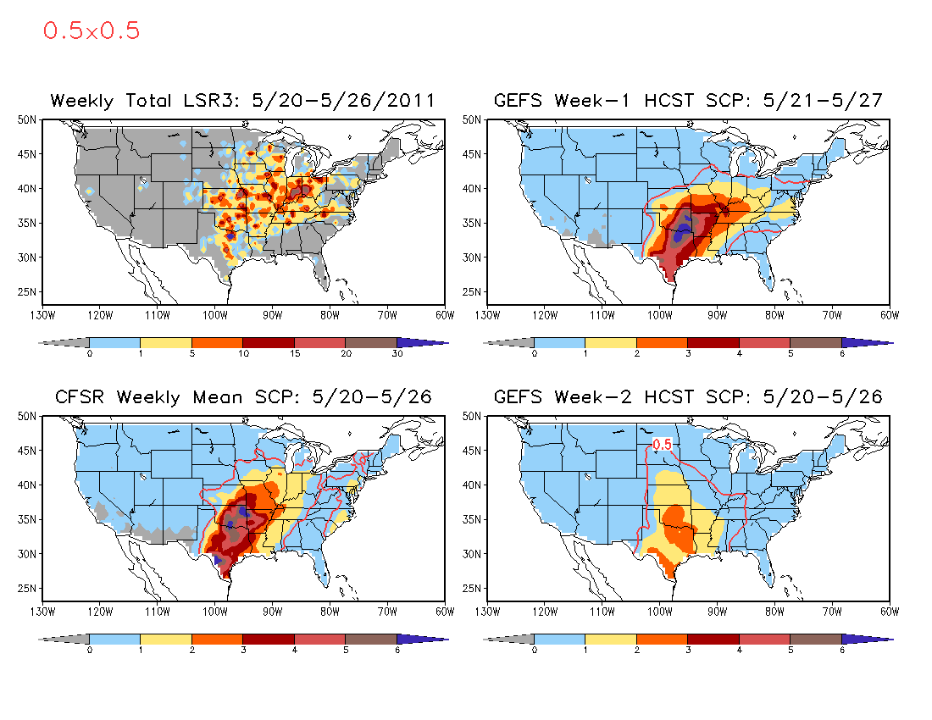

Slide 5
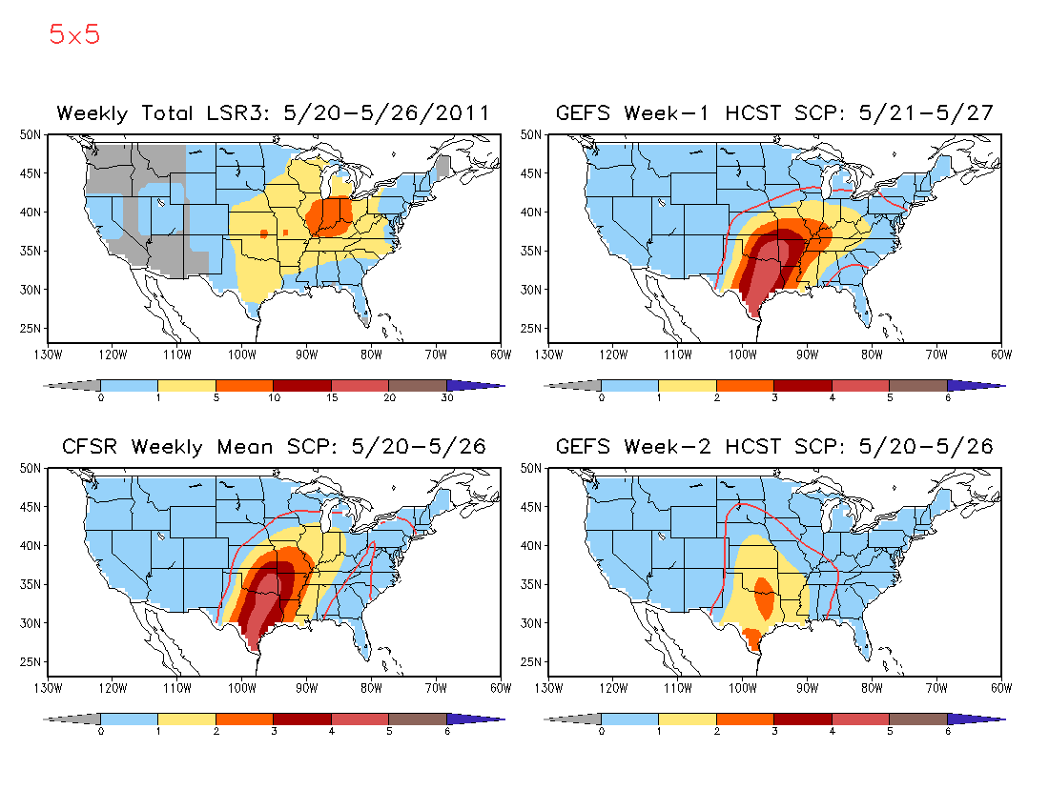

Slide 6
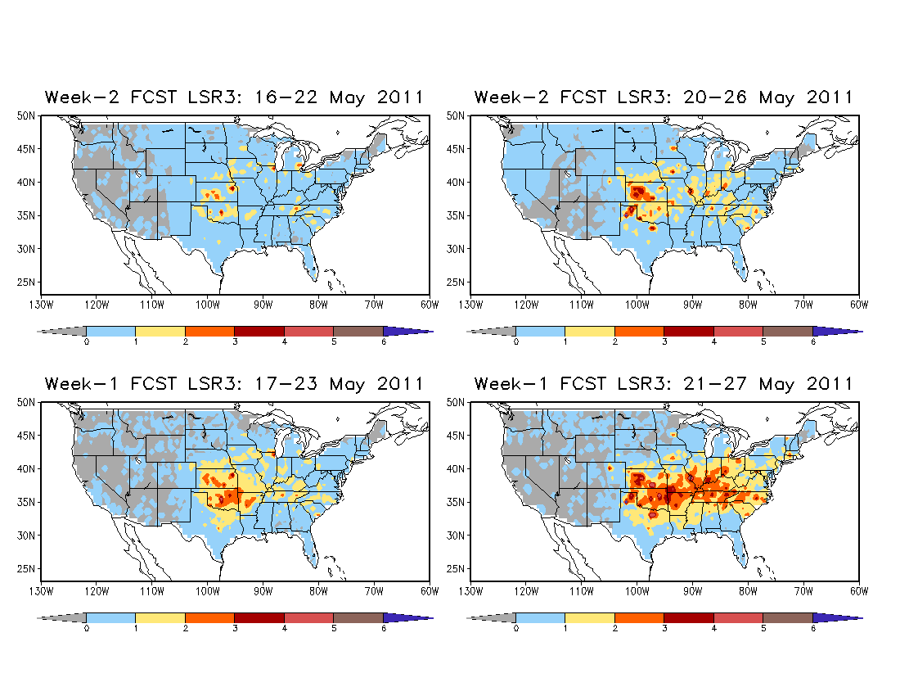
5º×5º
Hybrid Model Week 1 and 2 LSR3 Forecast

Slide 7
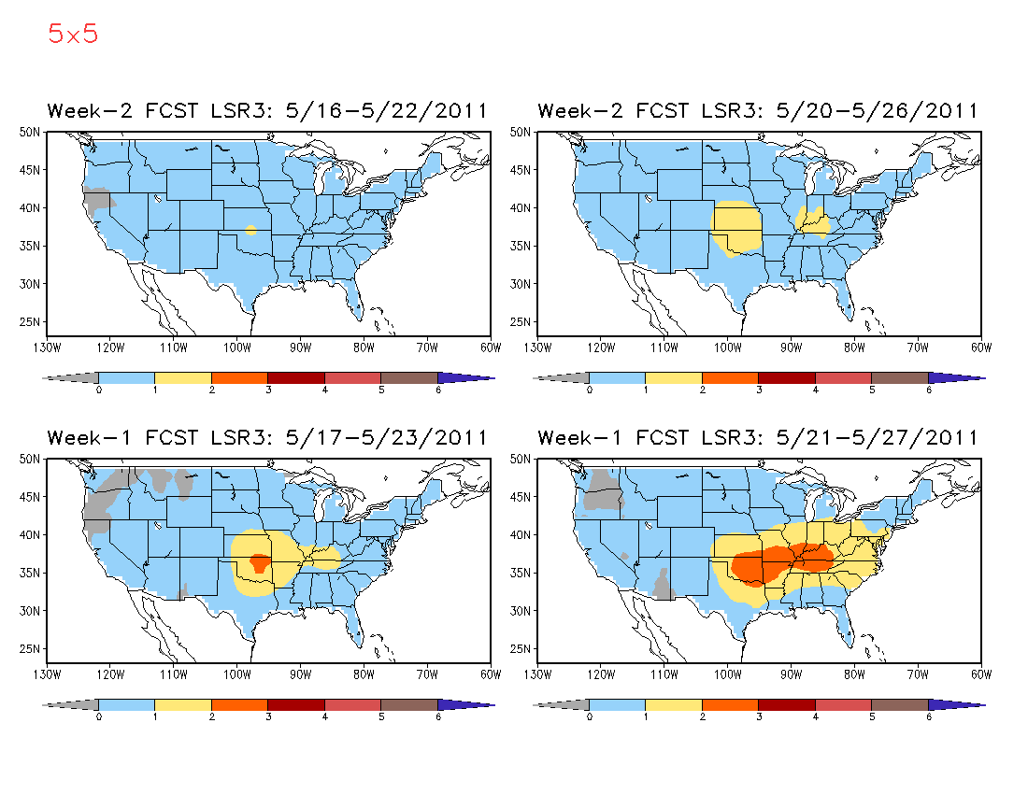
Hybrid Model Week 1 and 2 LSR3 Forecast

Slide 8
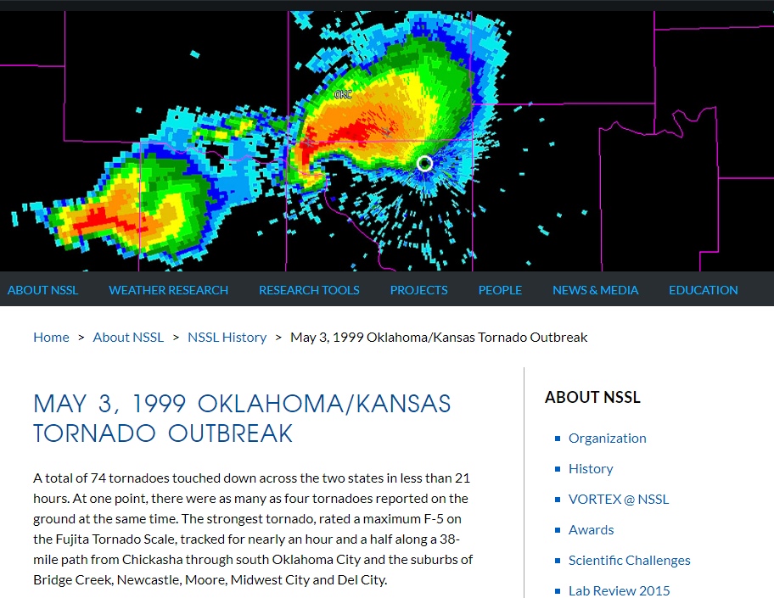

Slide 9
GEFS 16-day hindcasts: April 23, 27, May 1
April/May 1999
Su Mo Tu We Th Fr Sa
11 12 13 14 15 16 17
18 19 20 21 22 23 24
25 26 27 28 29 30 1
2 3 4 5 6 7 8
9 10 11 12
April/May 1999
Su Mo Tu We Th Fr Sa
11 12 13 14 15 16 17
18 19 20 21 22 23 24
25 26 27 28 29 30 1
2 3 4 5 6 7 8
9 10 11 12
Week 2
Week 2
April/May 1999
Su Mo Tu We Th Fr Sa
11 12 13 14 15 16 17
18 19 20 21 22 23 24
25 26 27 28 29 30 1
2 3 4 5 6 7 8
9 10 11 12
April/May 1999
Su Mo Tu We Th Fr Sa
11 12 13 14 15 16 17
18 19 20 21 22 23 24
25 26 27 28 29 30 1
2 3 4 5 6 7 8
9 10 11 12
Week 1
Week 1

Slide 10
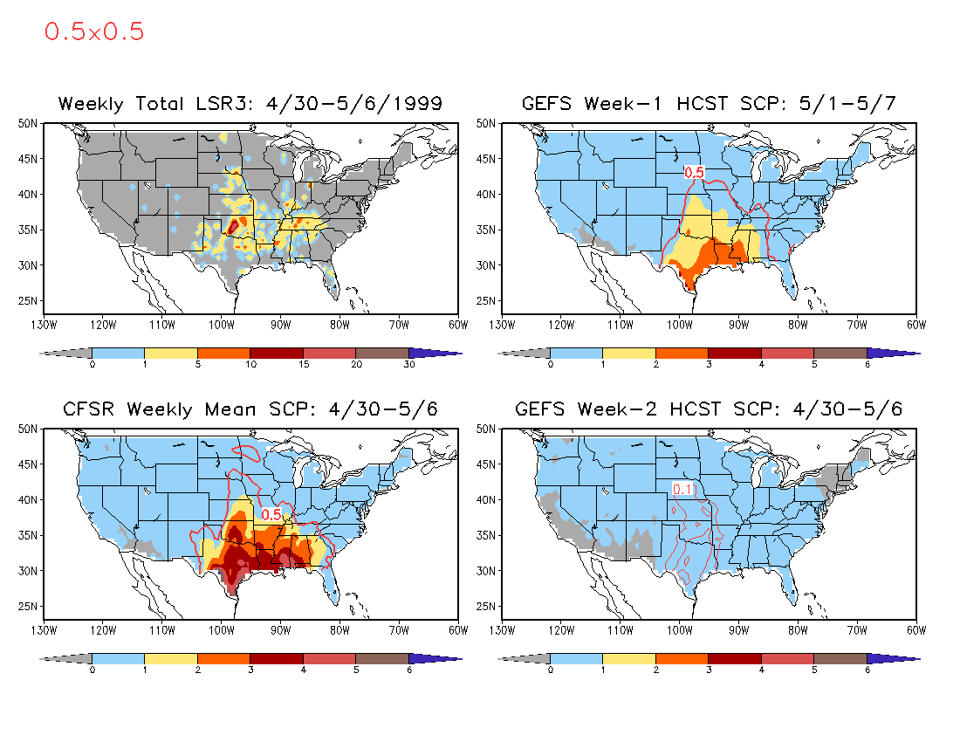

Slide 11
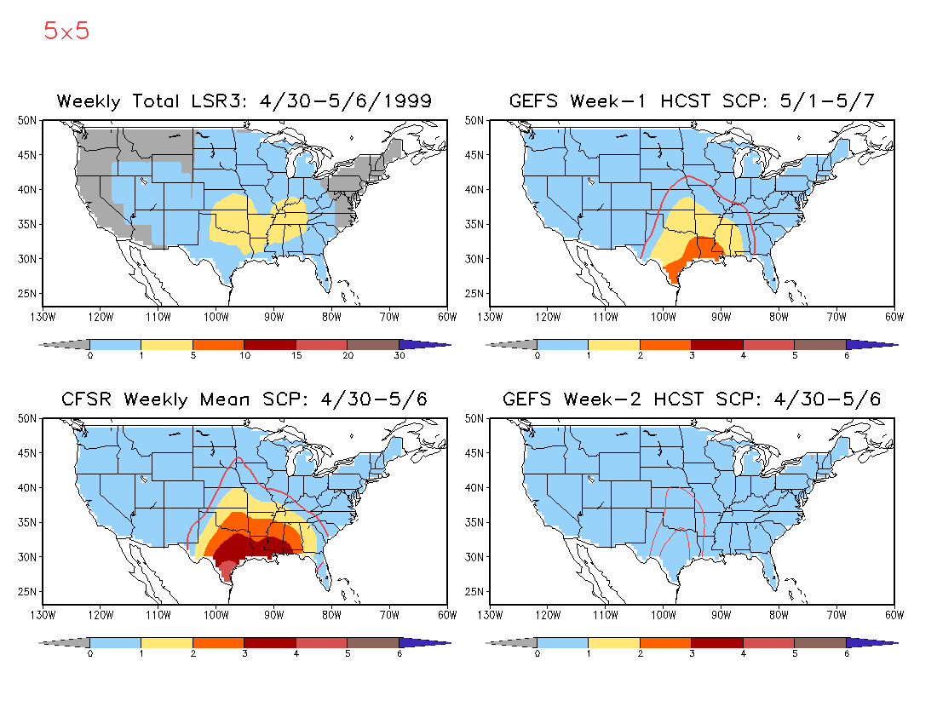

Slide 12
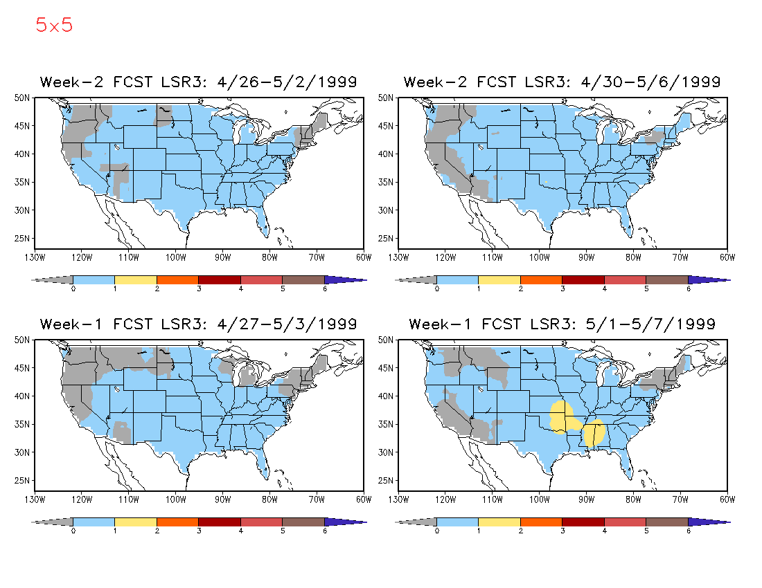
Hybrid Model Week 1 and 2 LSR3 Forecast

Slide 13
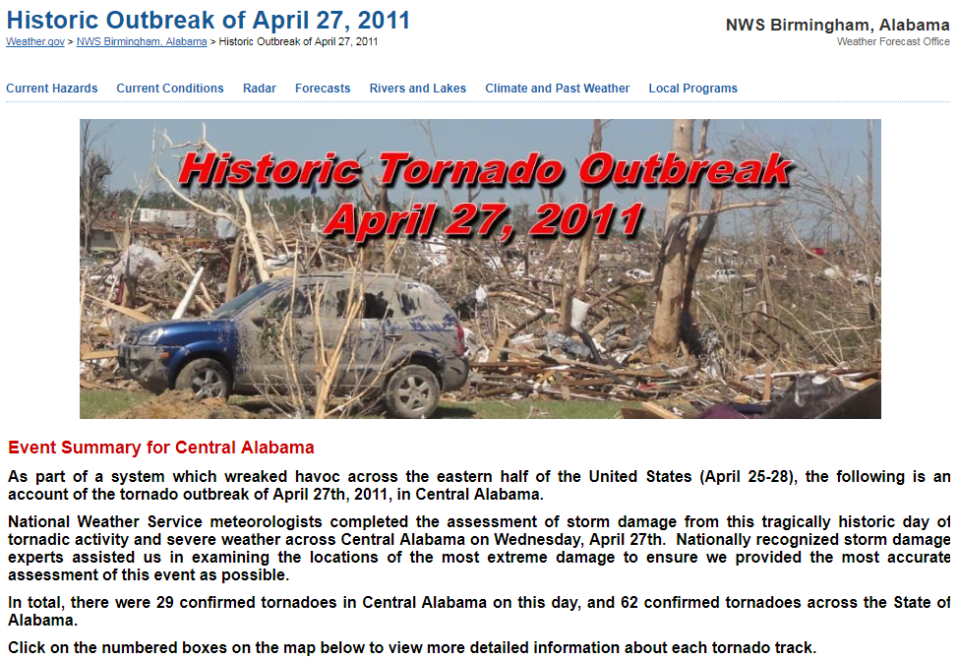

Slide 14
GEFS 16-day hindcasts: April 15, 19, 23, 27
April/May 2011
Su Mo Tu We Th Fr Sa
3 4 5 6 7 8 9
10 11 12 13 14 15 16
17 18 19 20 21 22 23
24 25 26 27 28 29 30
1 2 3 4 5
April/May 2011
Su Mo Tu We Th Fr Sa
3 4 5 6 7 8 9
10 11 12 13 14 15 16
17 18 19 20 21 22 23
24 25 26 27 28 29 30
1 2 3 4 5
Week 2
Week 2
April/May 2011
Su Mo Tu We Th Fr Sa
3 4 5 6 7 8 9
10 11 12 13 14 15 16
17 18 19 20 21 22 23
24 25 26 27 28 29 30
1 2 3 4 5
April/May 2011
Su Mo Tu We Th Fr Sa
3 4 5 6 7 8 9
10 11 12 13 14 15 16
17 18 19 20 21 22 23
24 25 26 27 28 29 30
1 2 3 4 5
Week 1
Week 1

Slide 15
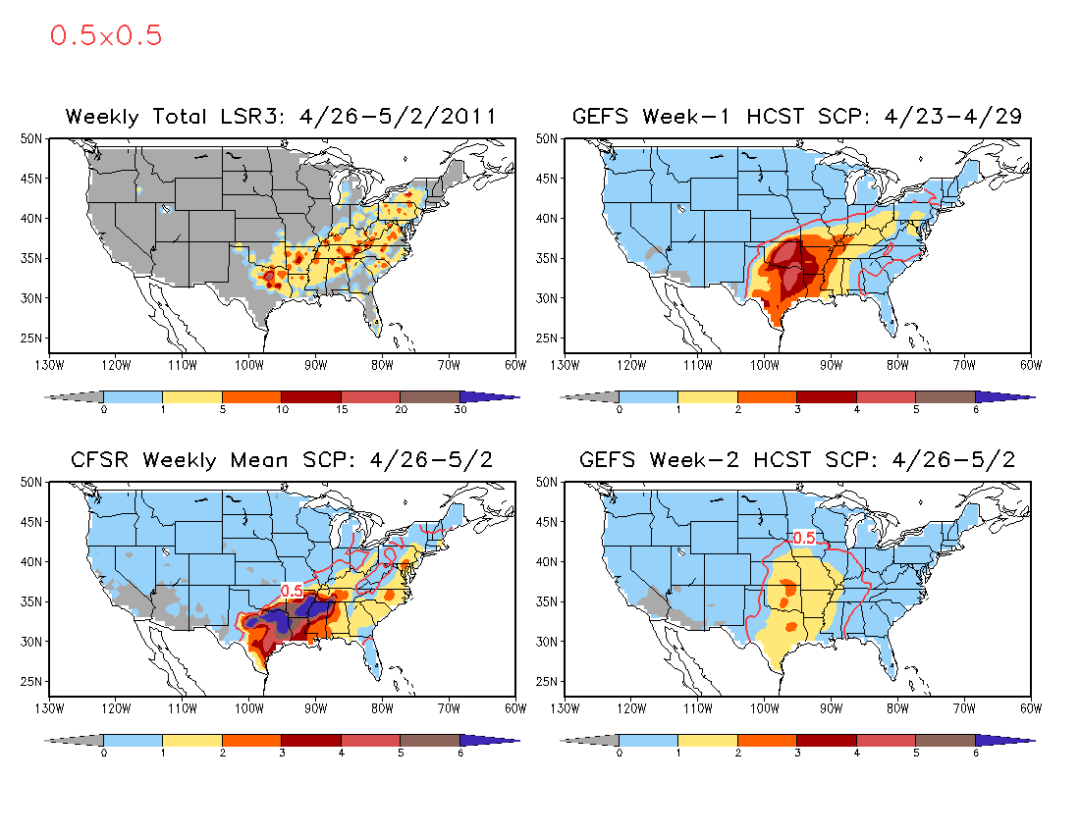

Slide 16
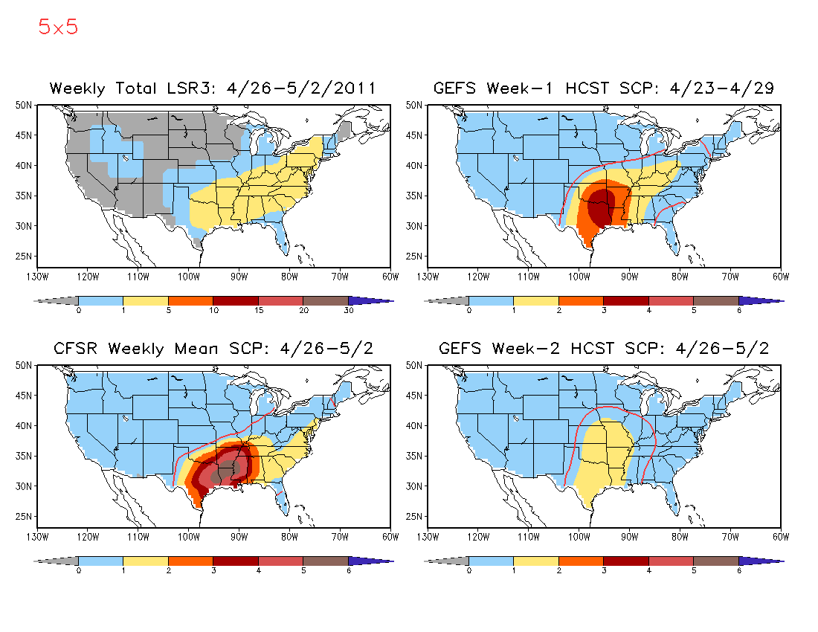

Slide 17
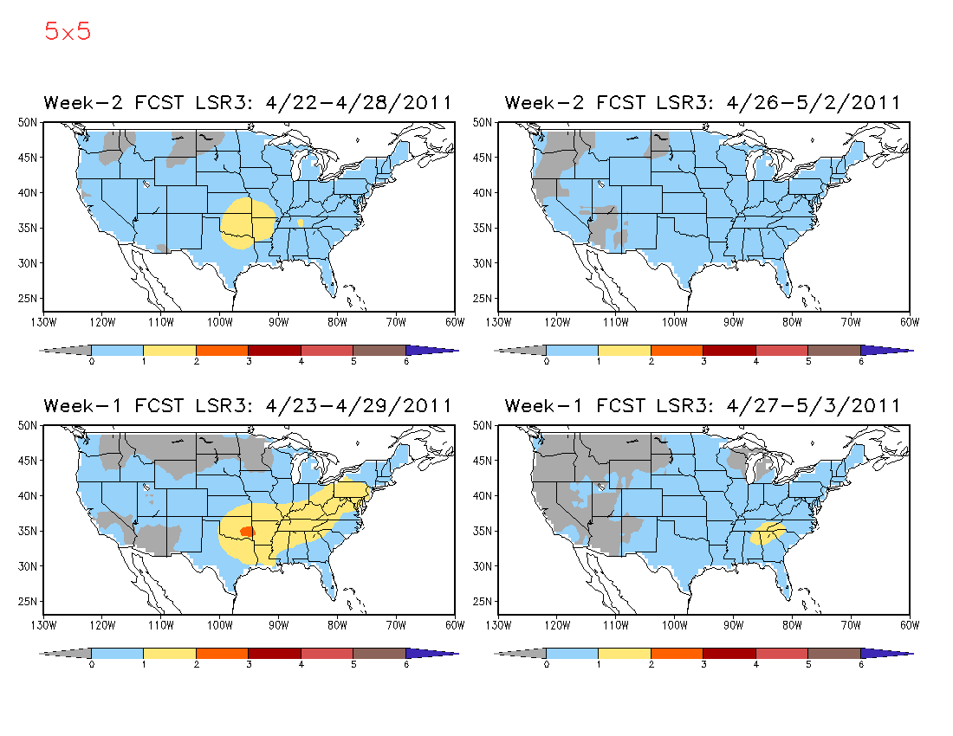
Hybrid Model Week 1 and 2 LSR3 Forecast

