Slide 1
Weekly Meeting
07Jul2017
Relationship between GEFS predicted SCP and LSR
LSR: Local Storm Report (hail, tornado, damaging wind)
Anomaly correlation (AC) for 7-day mean
3-month shift windows
Conditional AC (SCP >= 1)
These are the basis for the development of linear regression forecast model.

Slide 2
Anomaly correlation for 3-month shift windows
GEFS 7-day mean forecast SCP vs. LSR3
Lead time: day 1 to day 8

Slide 3
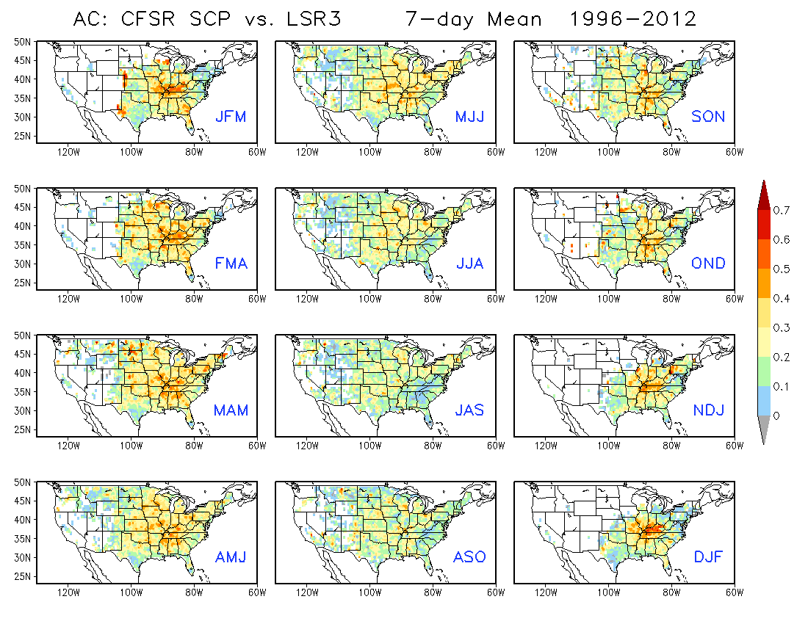

Slide 5
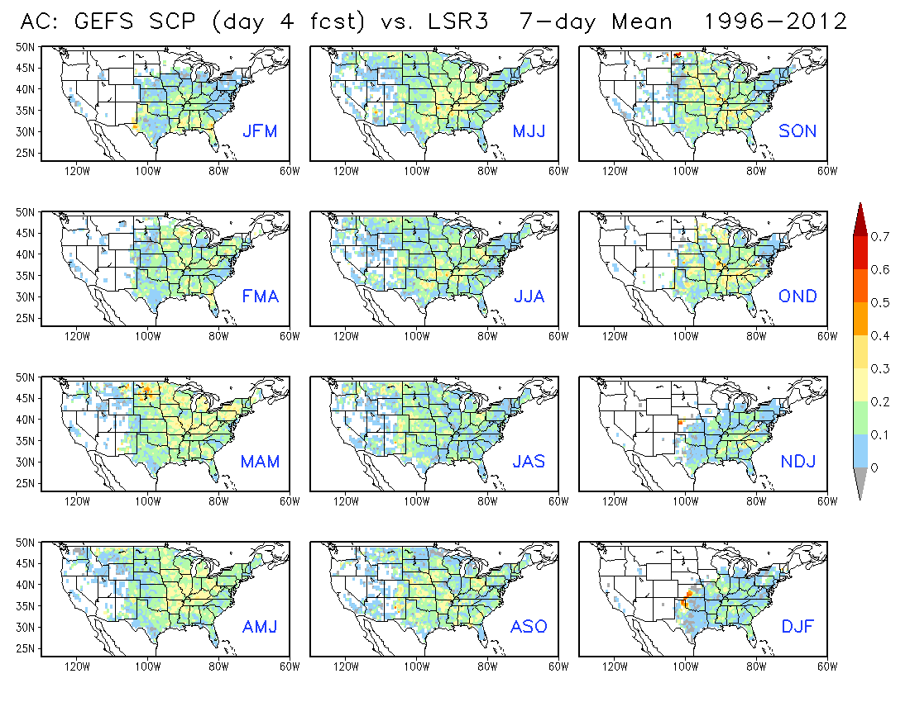

Slide 7
Anomaly correlation for 3-month shift windows
conditioned to SCP >= 1
GEFS 7-day mean forecast SCP vs. LSR3
Lead time: day 1 to day 8

Slide 8
