Slide 1
Potential predictability of weekly TC activity assessed by using predictors derived from observations
Forecast skills for weekly TC activity using MJO as an additional predictor

Slide 2
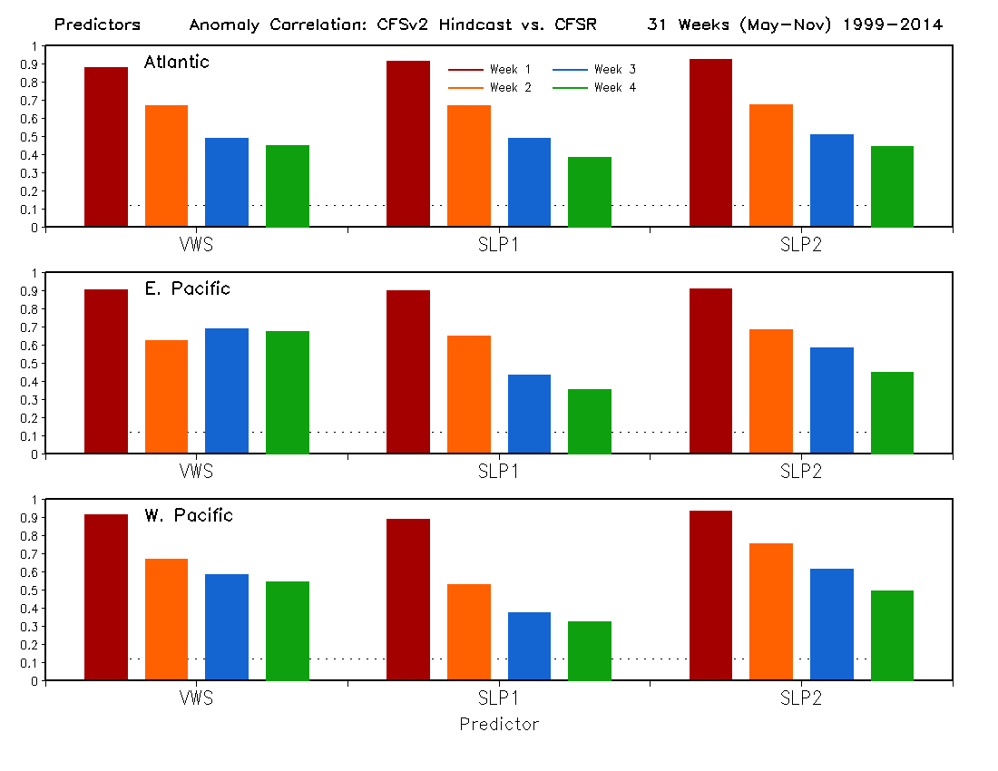
99% significance level
Forecast skill of CFSv2 for predictors VWS and SLP

Slide 3
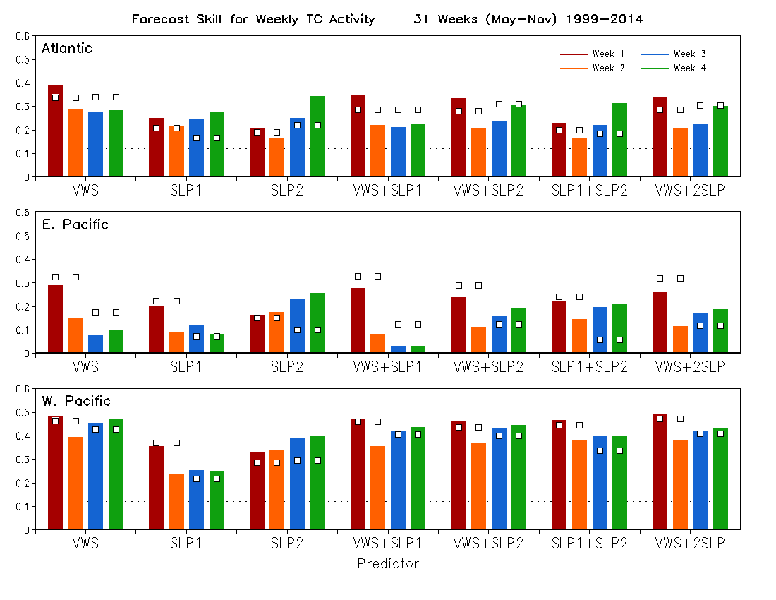
Skill using predictors derived from OBS (Potential predictability)
99% significance level
Compare forecast skills with potential predictability

Slide 4
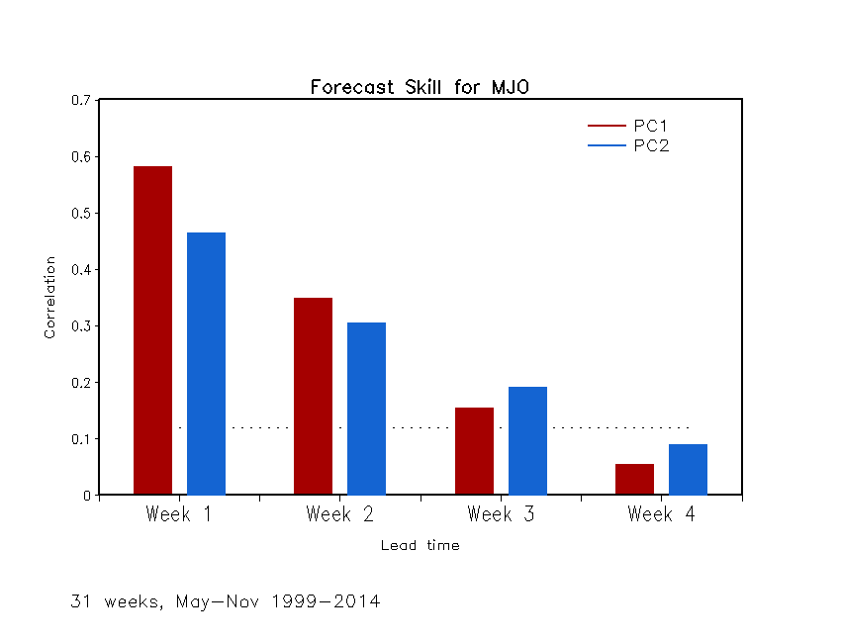
MJO: Weekly Indices
(PC1, PC2)
99% significance level

Slide 5
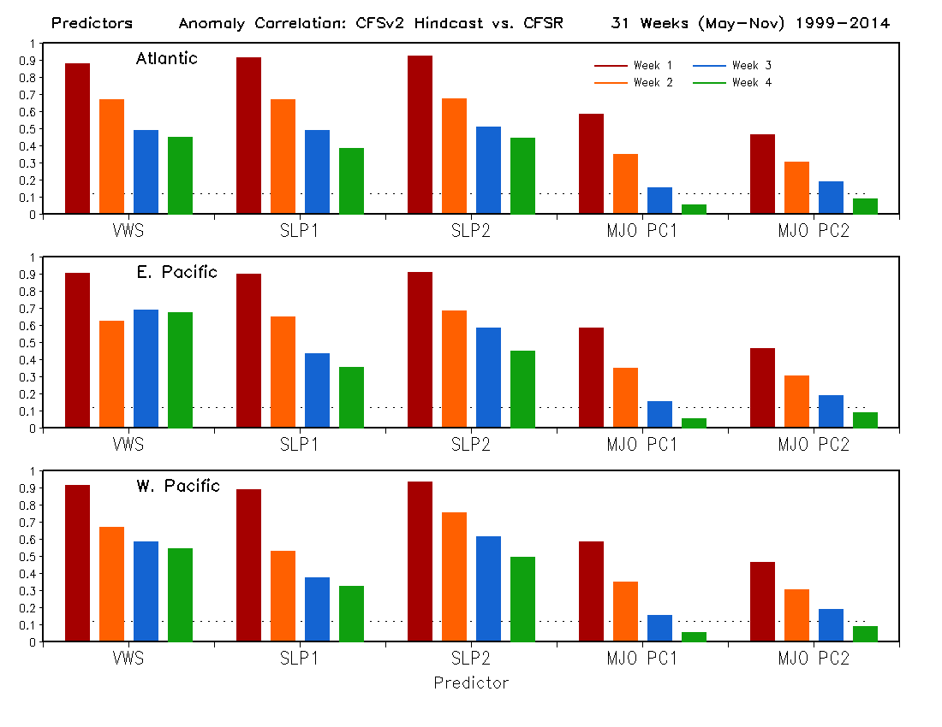
99% significance level
The forecast skills of CFSv2 for VWS and SLP are better than for MJO.

Slide 6
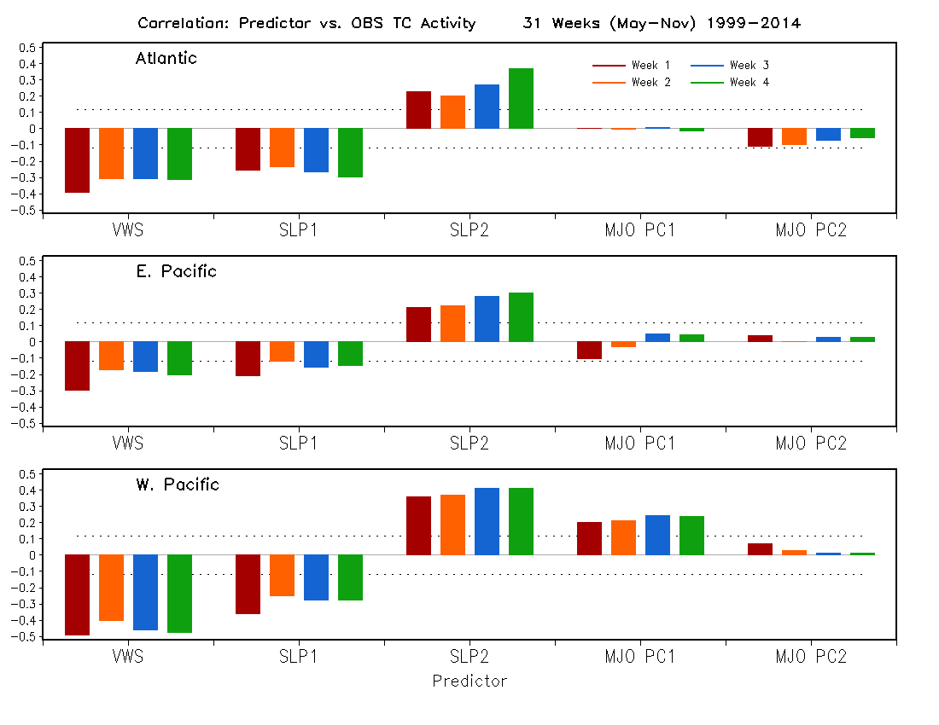
99% significance level
A high correlation implies a good predictor.

Slide 7
99% significance level
Using predictors derived from OBS
Correlation between OBS TC activity and predictor derived from OBS

Slide 8
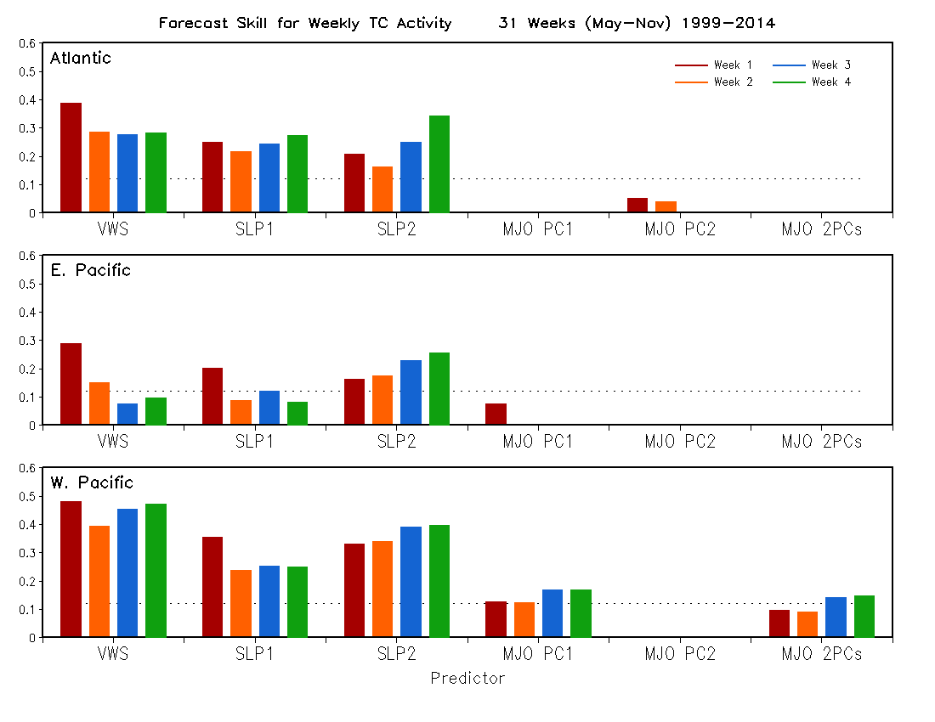
99% significance level
The forecast skill of weekly TC activity using MJO as a predictor is lower than using vertical or SLP as a predictor, consistent with the lower forecast skill for weekly MJO indices and weaker correlation between the MJO indices and weekly TC activity.
Compare the skills using MJO indices with other individual predictors

Slide 9
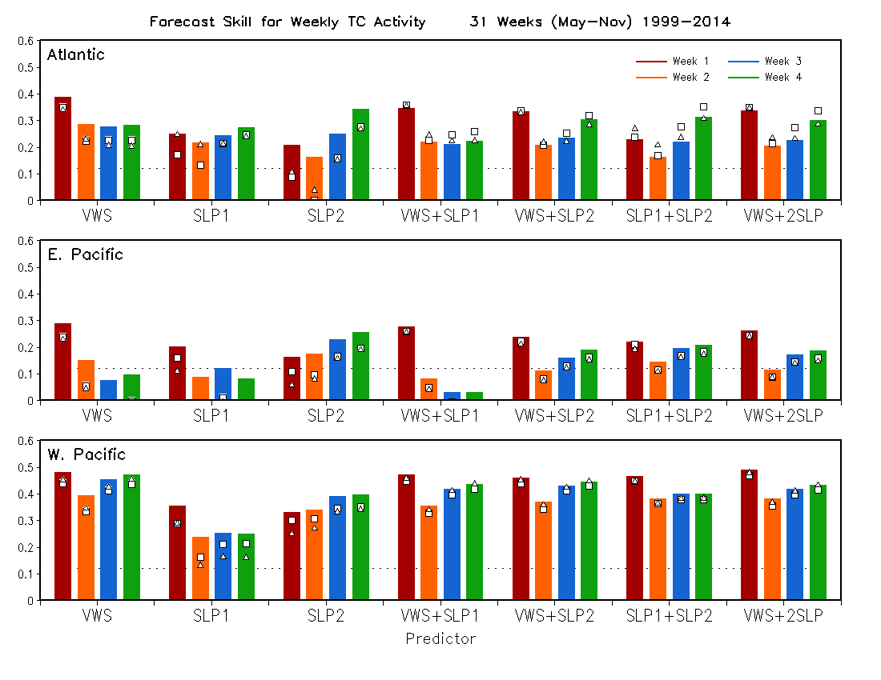
Skill with MJO PC1 as an additional predictor
Skill with MJO PC2 as an additional predictor
Color bar: Without using MJO as a predictor
Compare the skills by including MJO indices as additional predictors

