Slide 1
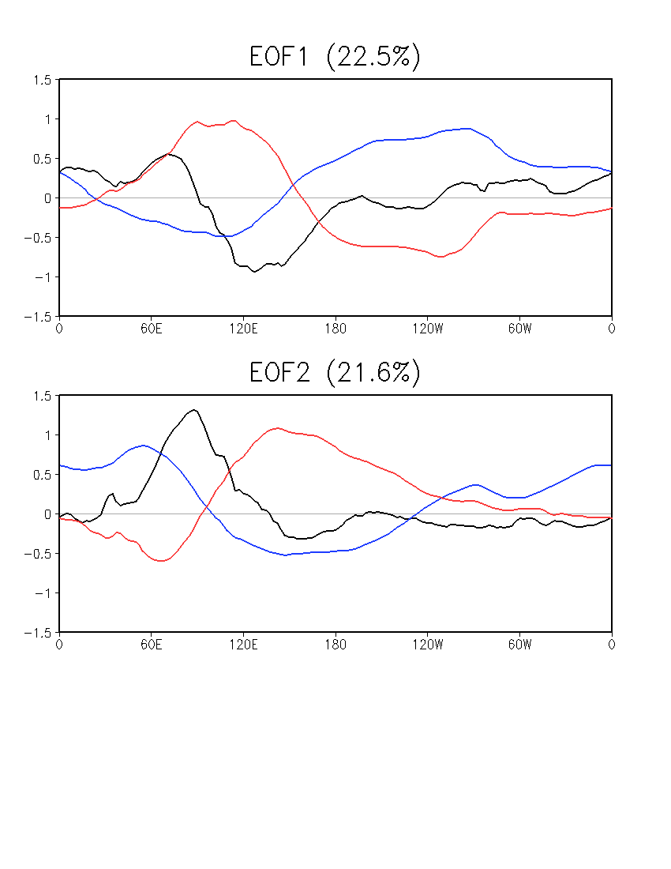
MJO
Combined EOFs of u850, u200, and OLR
Averaged over 15ºS–15ºN
01Jan1999–31Dec2014, daily data
NOAA Interpolated OLR, 1999–2013
CFSR for u850 and u200
CFSR for OLR, 2014
Anomaly w.r.t daily climatology
20–100-day band-pass filter prior to EOF
OLR
U850
U200

Slide 2
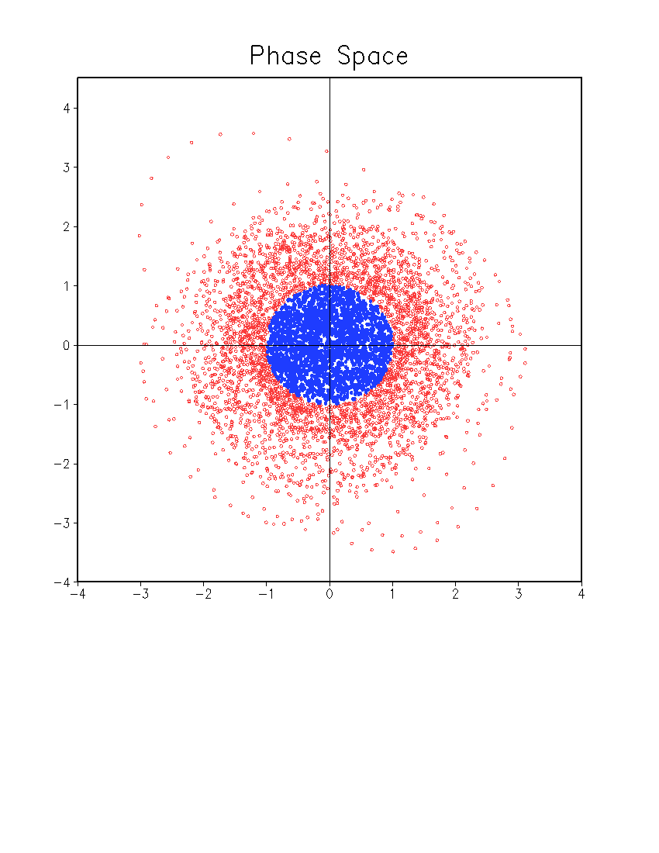
Daily MJO Index
Normalized PCs
Weak MJO: (PC1² + PC2²) ^{1/2} < 1
Weak MJO
PC2
PC1

Slide 3
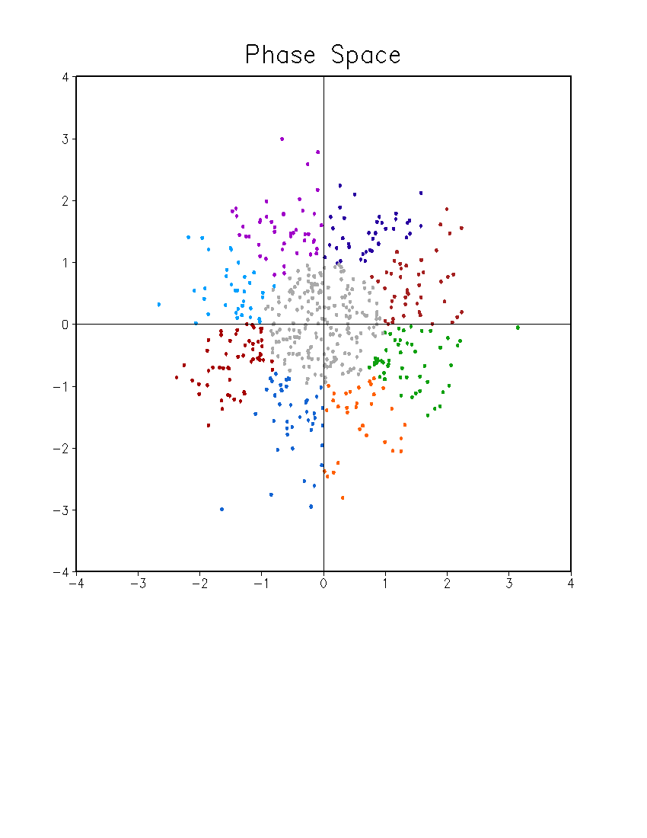
Weekly MJO Index
Normalized
8 phases
May – December
34 weeks (Sunday – Saturday)
Phase 7
Phase 6
Phase 8
Phase 5
PC2
Weak MJO
Phase 1
Phase 4
Phase 2
Phase 3
PC1

