Slide 1
Update (7/1/2025)
Updated the monthly and seasonal forecasts for CONUS precipitation using the SVD-CLSST tool, issued in June 2025.
Tested tropical Pacific SST forecasts using the SVD-CLSST tool by adding the SST trend to the forecast anomalies.
Tested tropical Pacific SST forecasts using the SVD-CLSST tool with non-detrended data, allowing the SST trend to be represented by certain SVD modes.

Slide 2
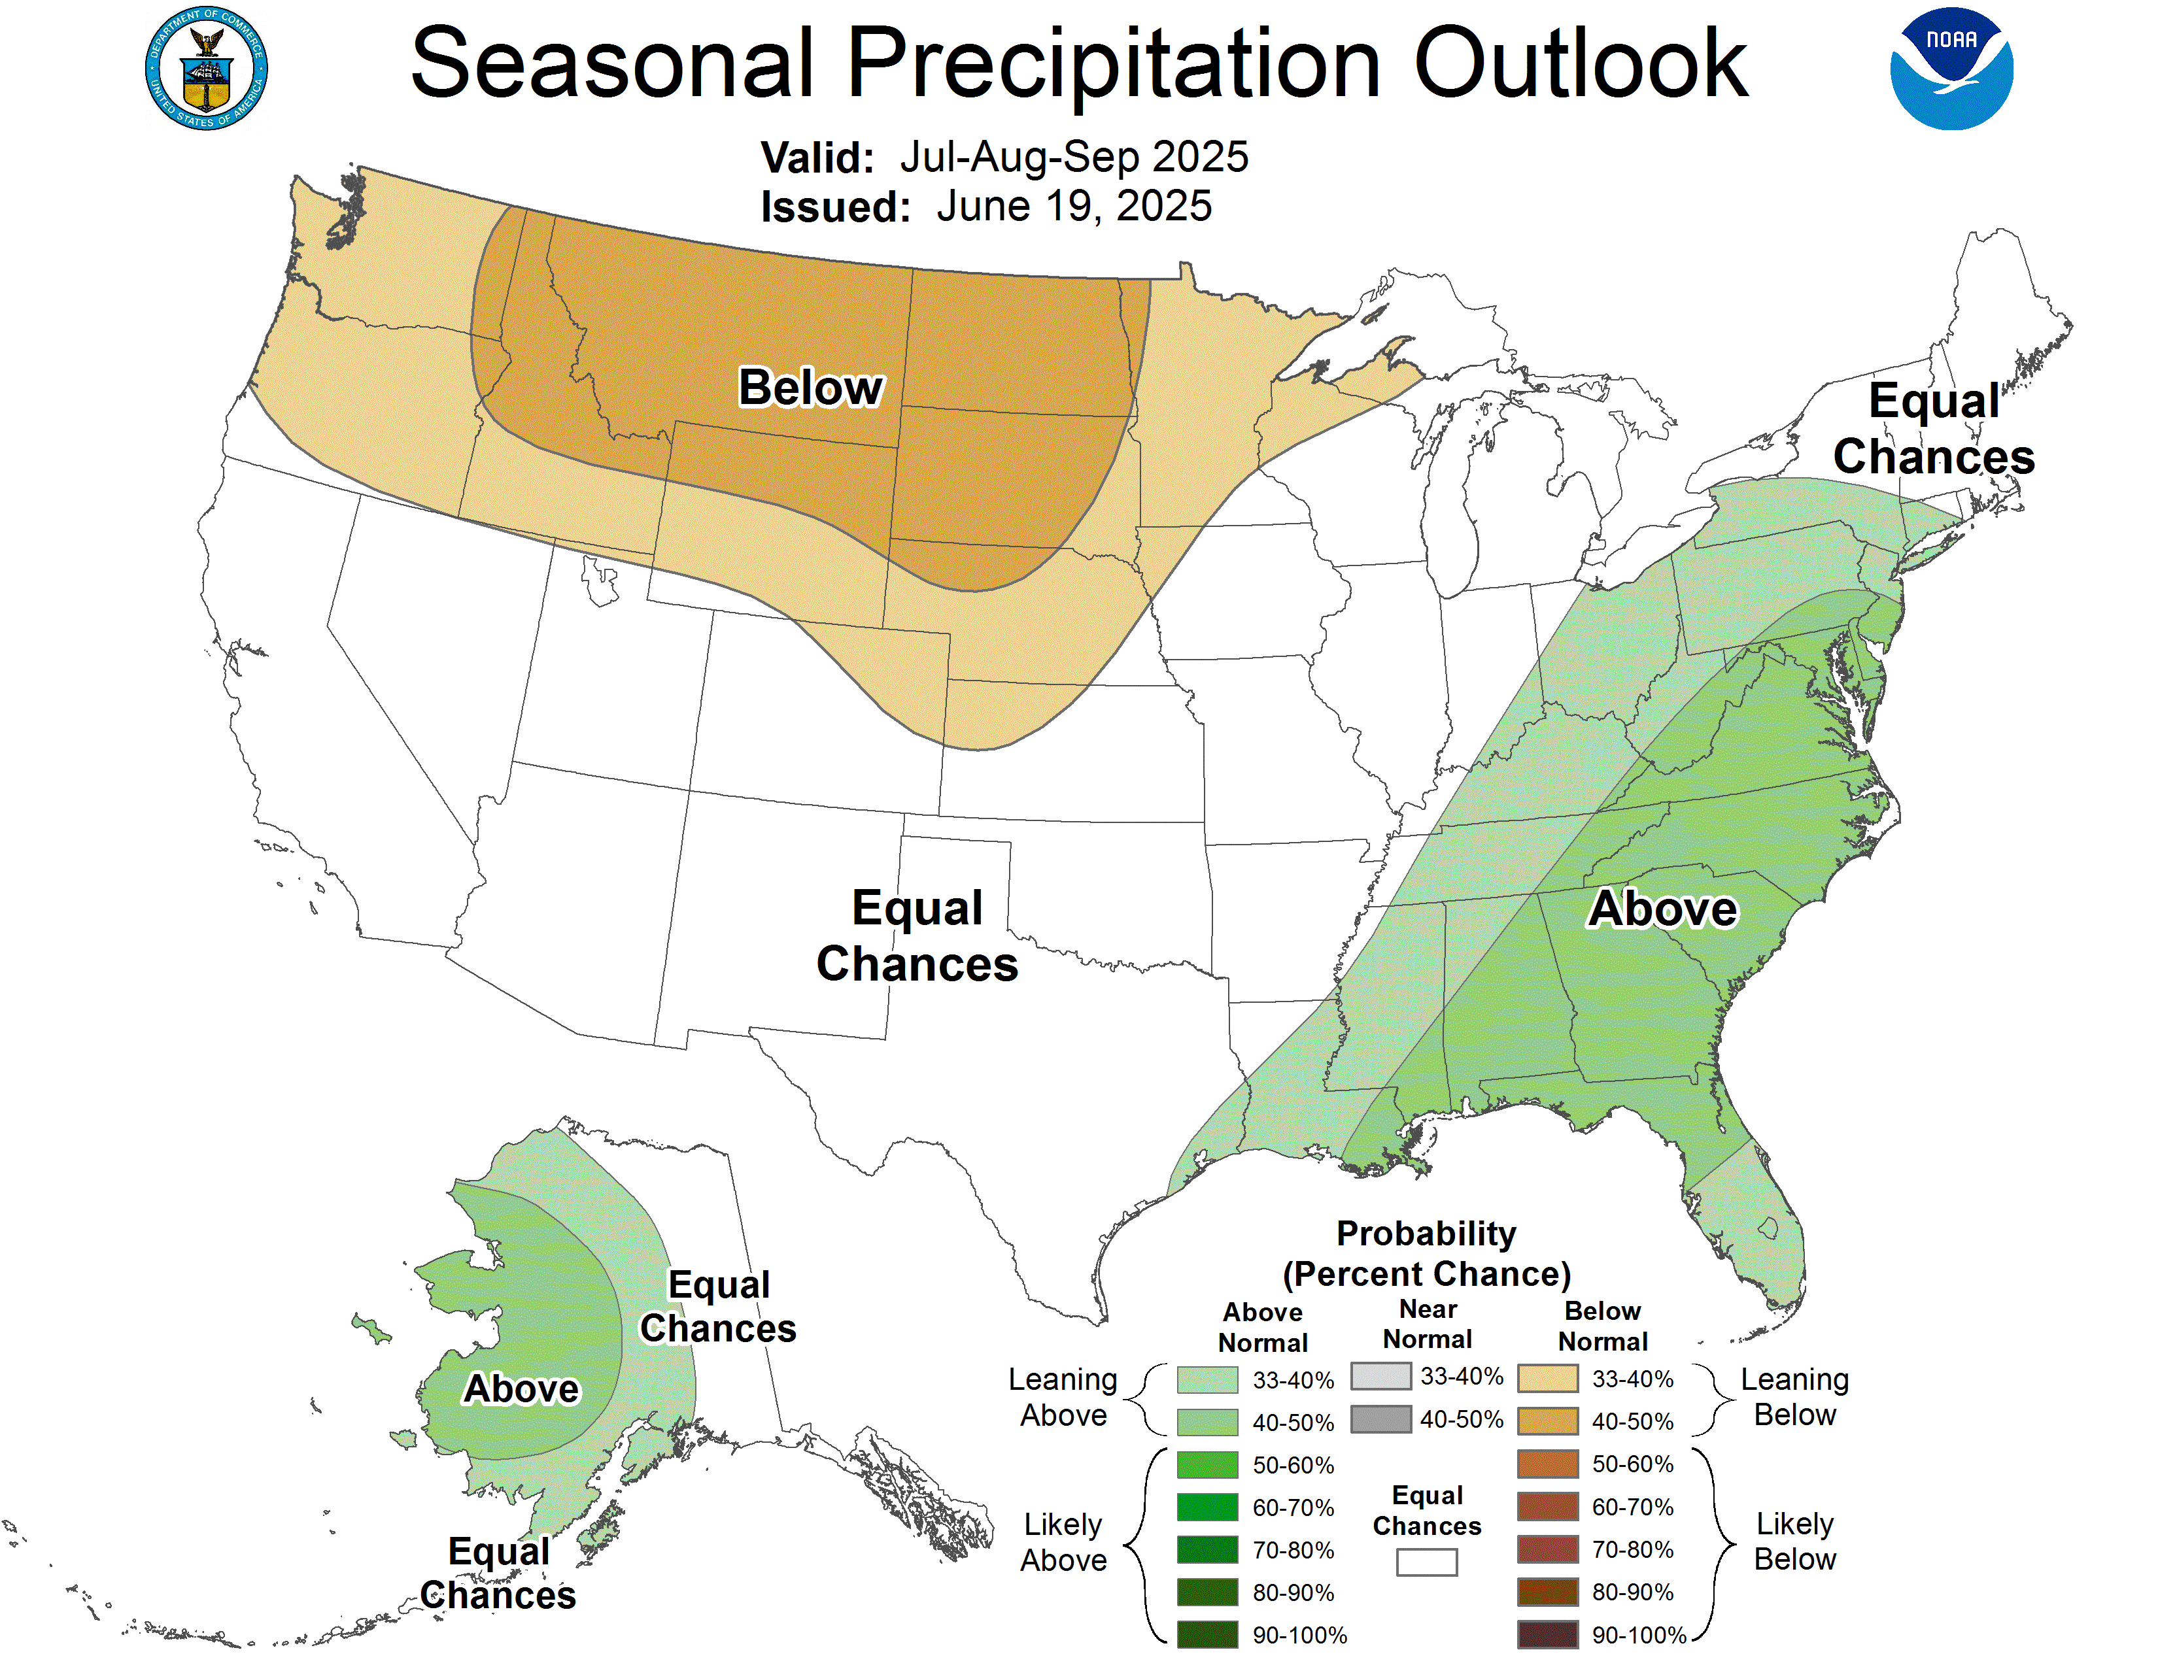
1-Month Lead Forecast for JAS Precipitation
Wet: Southeast
Dry: Northern Plains

Slide 3
Monthly SST Forecast

Slide 4
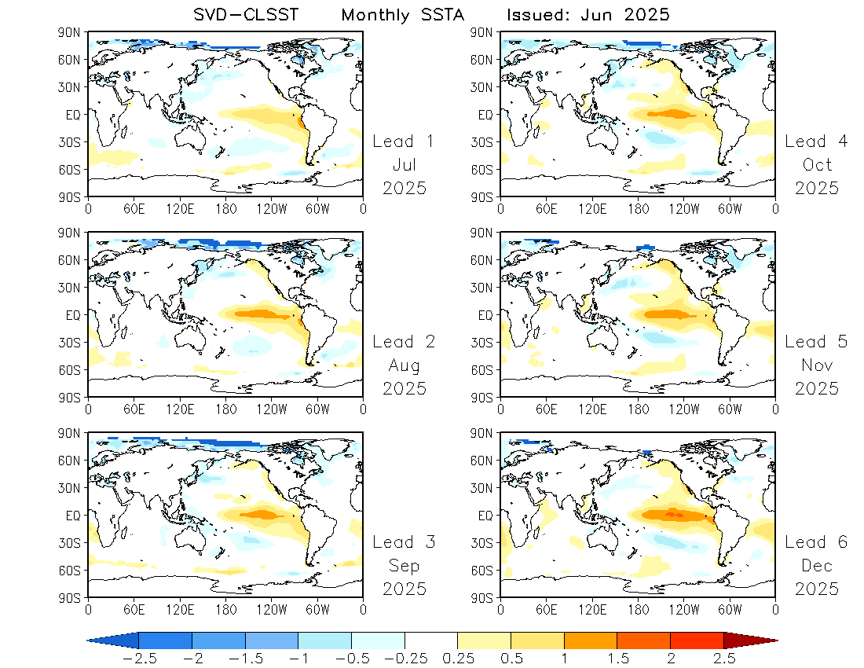
Forecast:
Detrended SST anomalies

Slide 5
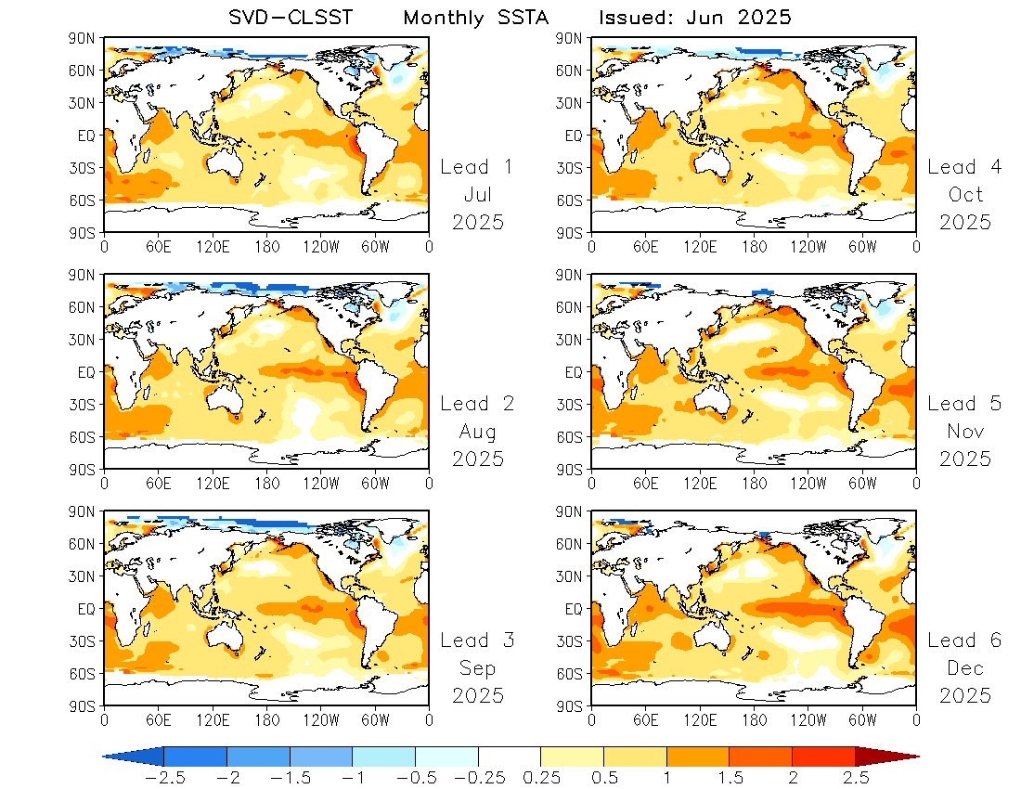
Forecast:
Detrended SST anomalies
+
SST trend
(May 2025)
Assuming the current SST trend persists over the forecast period.

Slide 6
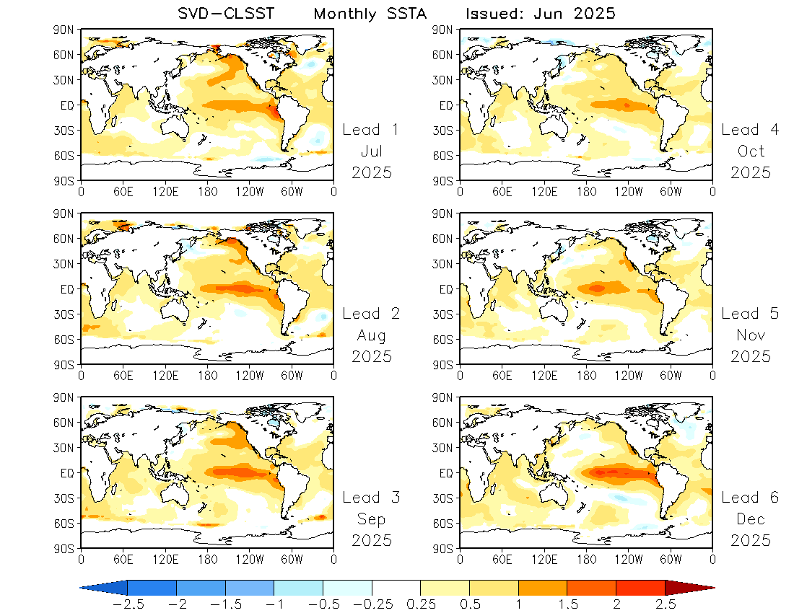
Forecast:
Using non-detrended SST data

Slide 7
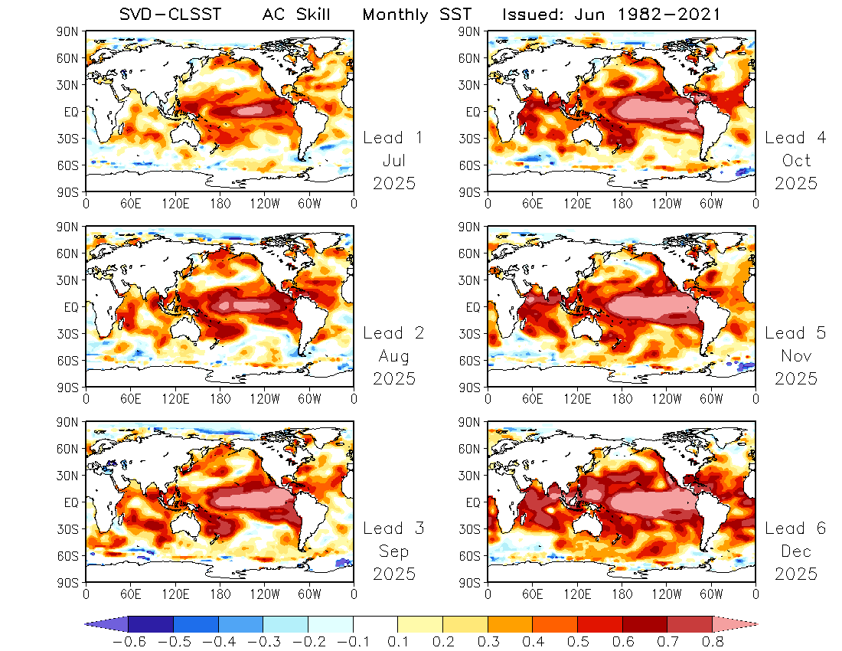
AC Skill for
Detrended SST anomalies

Slide 8
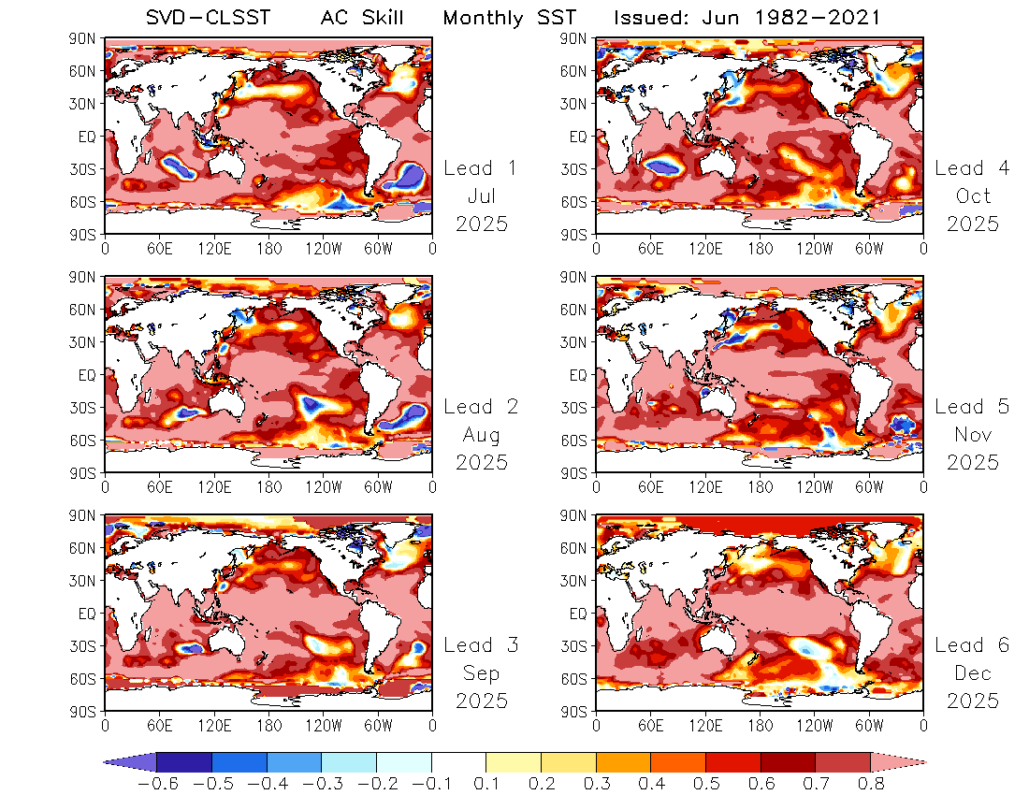
AC Skill for
Using non-detrended SST data
SST trends contribute significantly to the high AC skill.

Slide 9
Seasonal SST Forecast

Slide 10
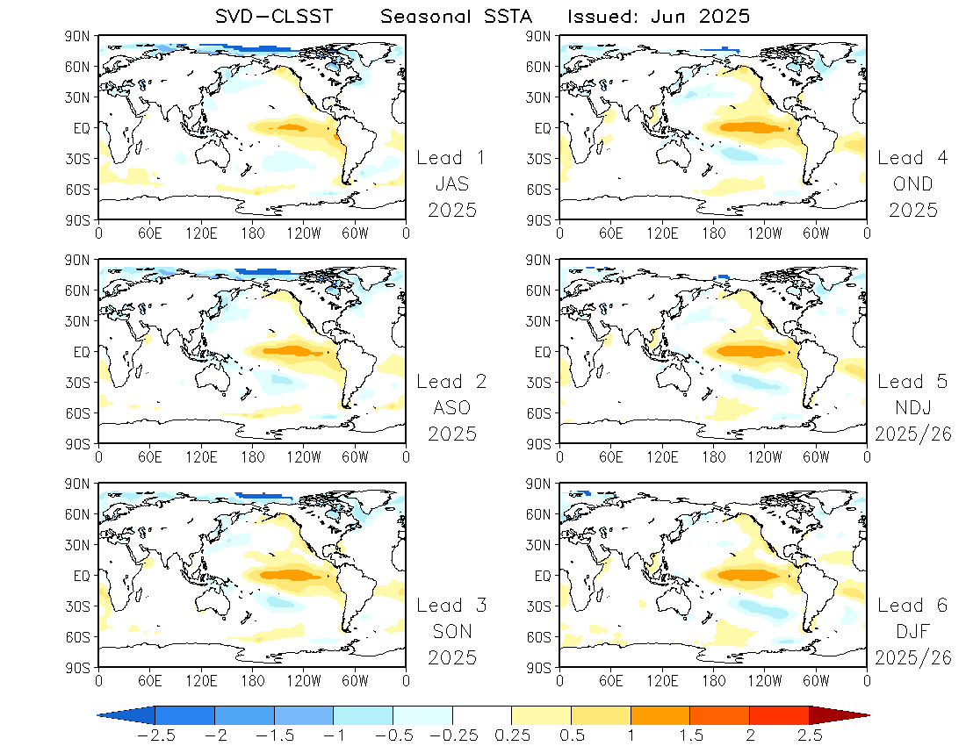
Forecast:
Detrended SST anomalies

Slide 11
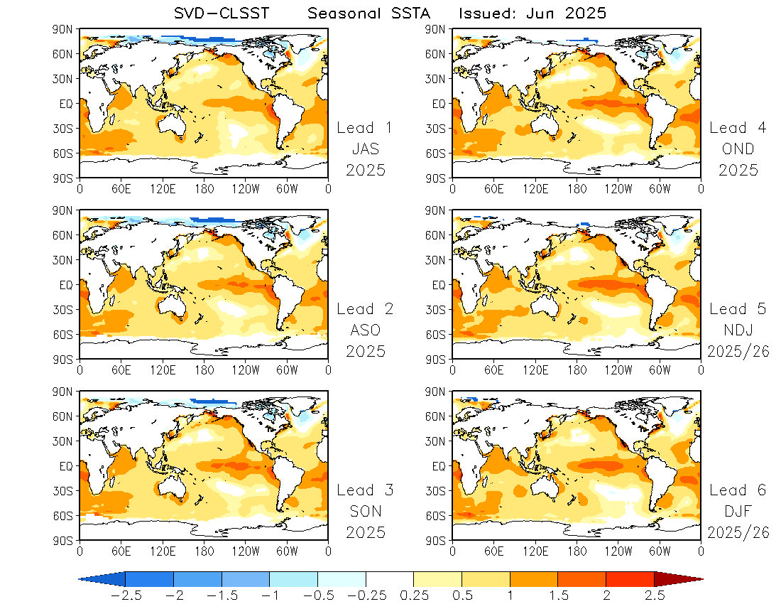
Forecast:
Detrended SST anomalies
+
SST trend
(May 2025)
Assuming the current SST trend persists over the forecast period.

Slide 12
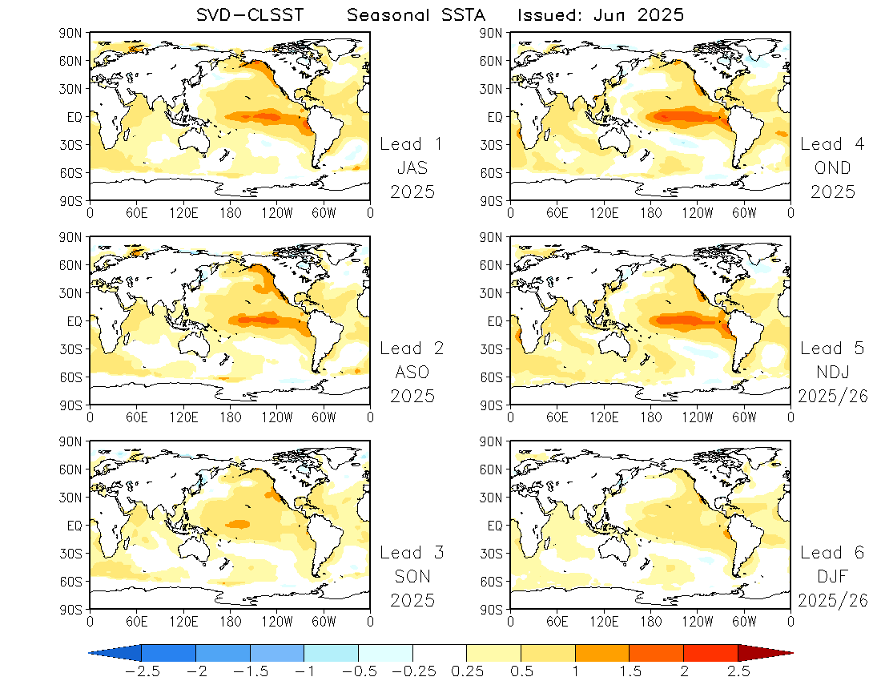
Forecast:
Using non-detrended SST data

Slide 13
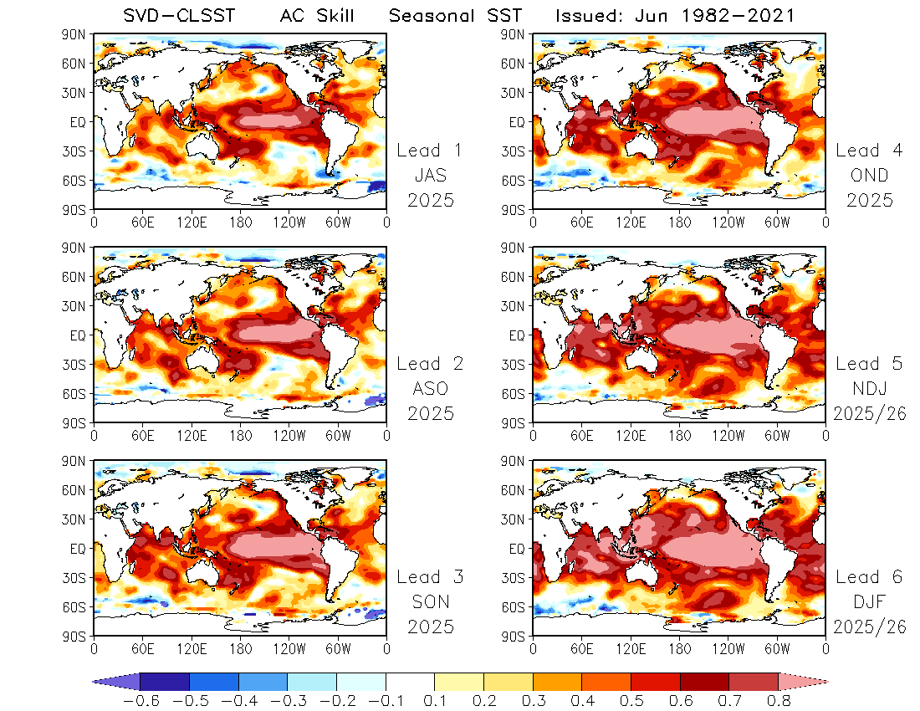
AC Skill for
Detrended SST anomalies

Slide 14
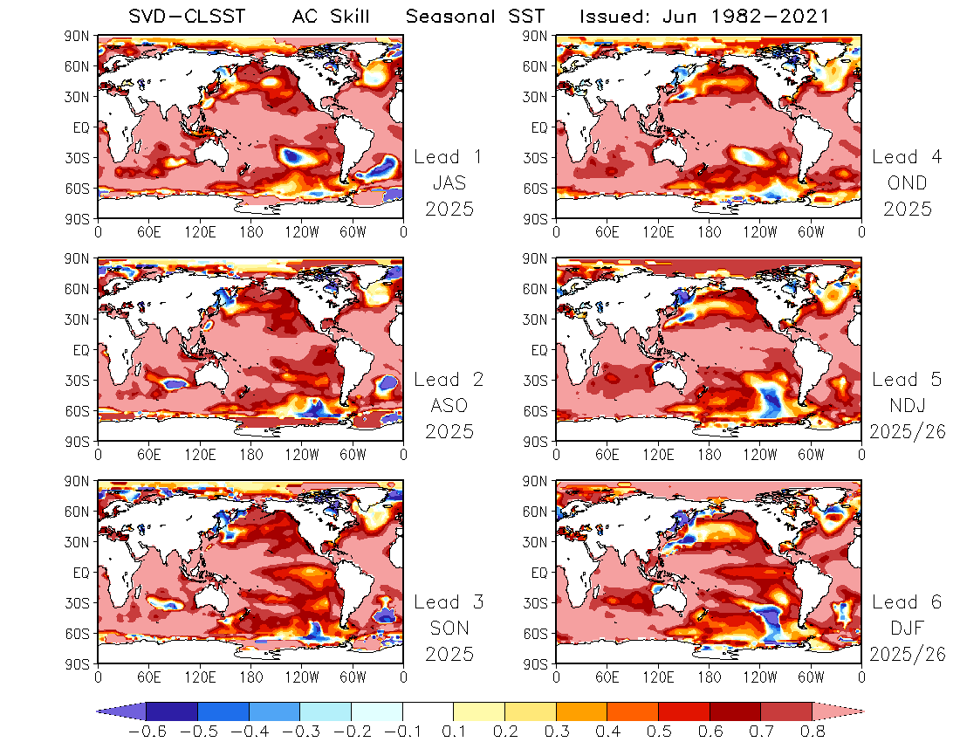
AC Skill for
Using non-detrended SST data
SST trends contribute significantly to the high AC skill.

Slide 15
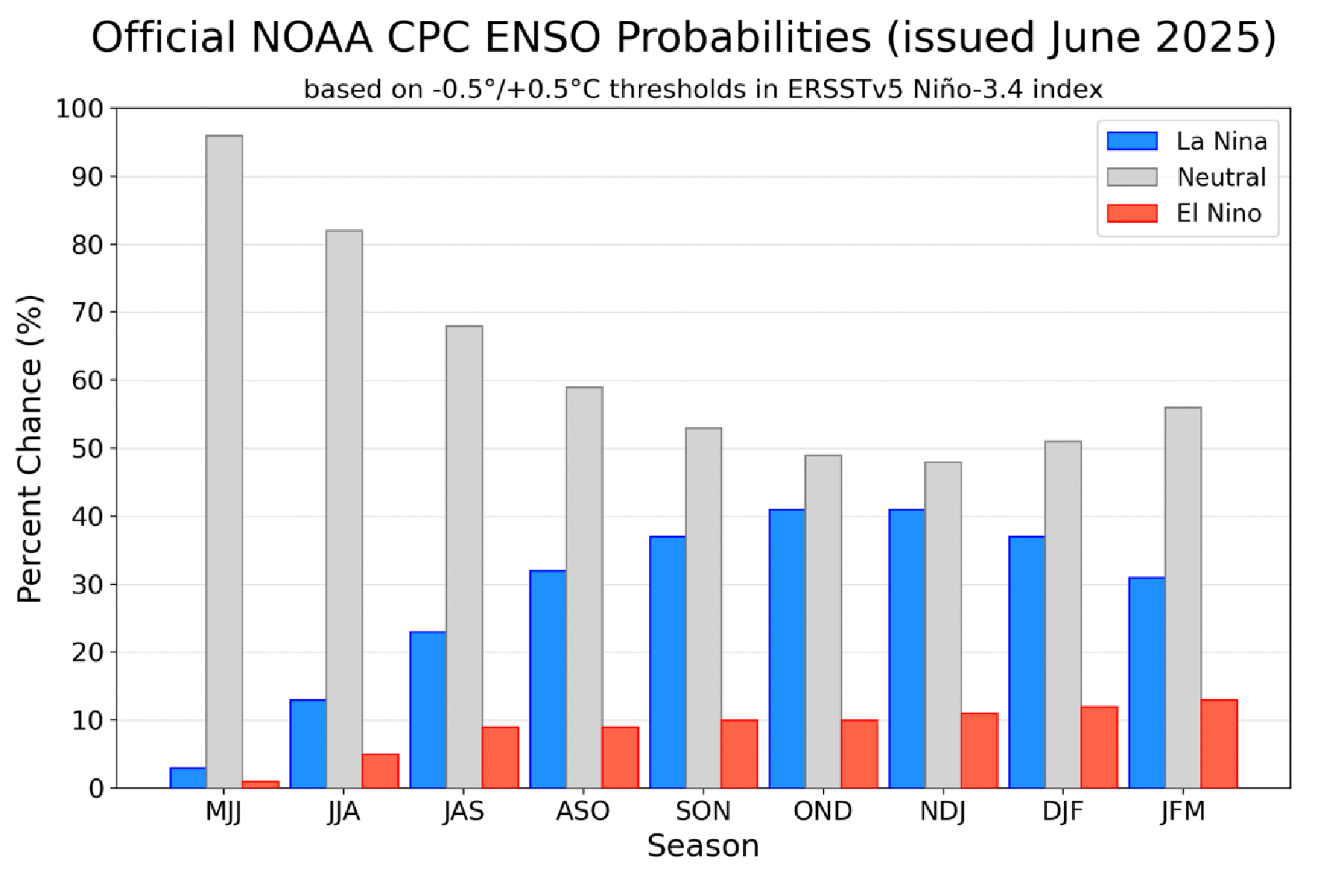
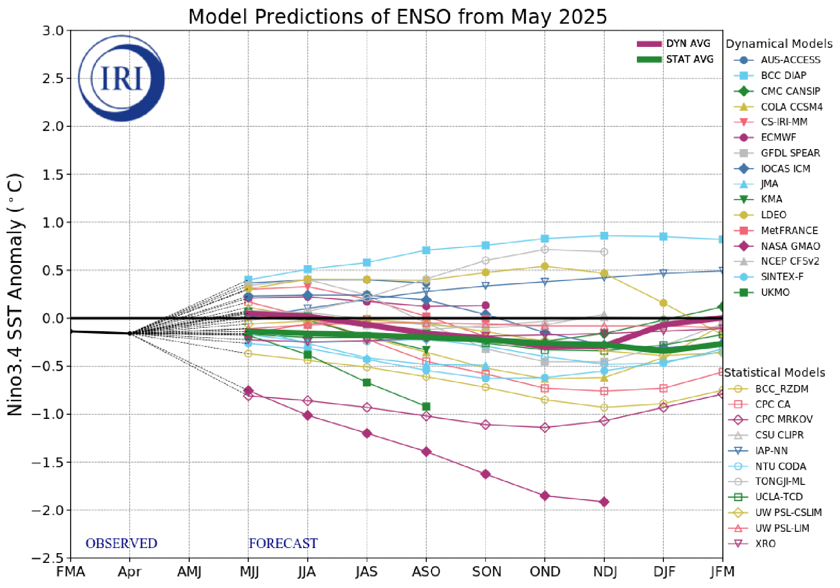
A moderate El Niño event is predicted using the SVD-CLSST model, differing from the CPC outlook.
Both SST trend approaches yield consistent results, indicating overall warm SST anomalies globally.

