Slide 1
Update (5/20/2025)
Verified the 2024/25 winter CONUS precipitation forecasts using the SVD-CLSST tool and prepared slides for Emerson’s presentation to the WSWC.
Updated the monthly and seasonal forecasts for CONUS precipitation, 2-m temperature, and tropical Pacific SSTs using the SVD-CLSST tool.
Contacted Danny Barandiaran at OPB to request access to the CCA and CA seasonal forecast archive data.

Slide 2
For each target season (ONDJFM, NDJFM, DJFM), the first slide presents the real-time forecast, generated using a model configuration (SST lags and SVD modes) selected based on anomaly correlation skill evaluated over the 1982–2021 validation period.
The second slide shows an alternative forecast using a different combination of SST lags and SVD modes that yields higher skill. However, we cannot determine whether this is truly a better forecast until the observations become available.

Slide 3
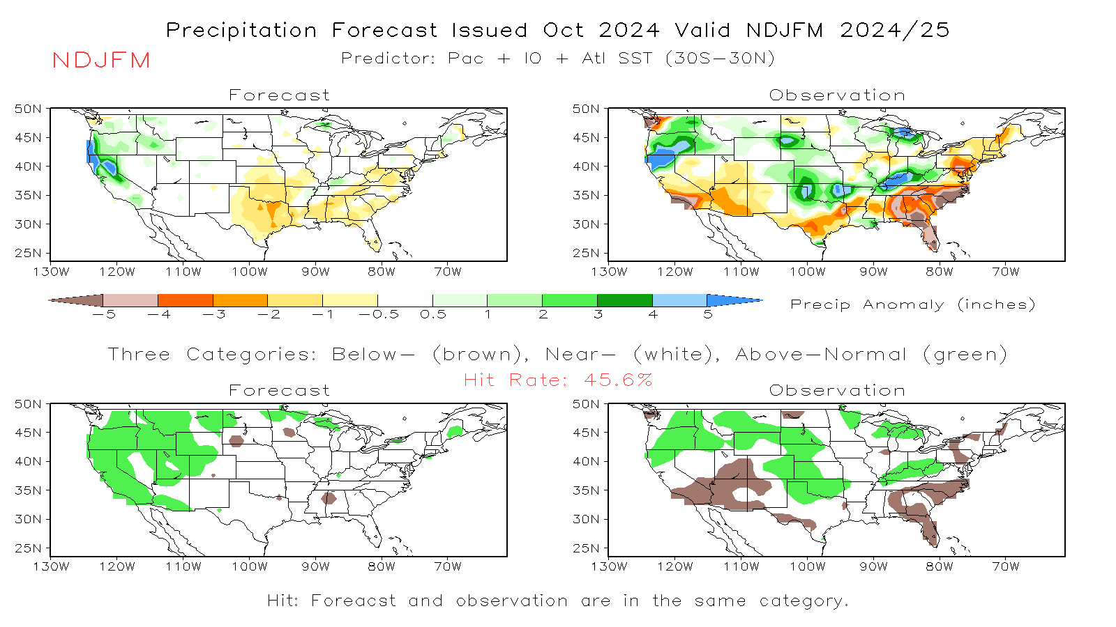
Pattern Correlation (Fcst, OBS) = 0.31
Real-Time Forecast

Slide 4
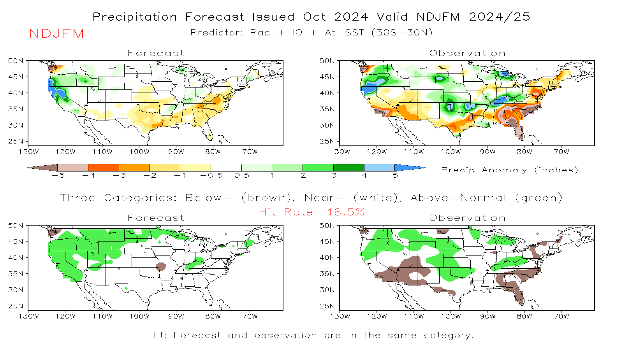
Pattern Correlation (Fcst, OBS) = 0.42

Slide 5
Real-Time Forecast
Month Forecast Issued | Forecast Target | Pattern Correlation: OBS vs. FCST | Hit Rate
September | ONDJFM | 0.33 | 37.7%
October | NDJFM | 0.31 | 45.5%
November | DJFM | 0.19 | 34.6%
Month Forecast Issued | Forecast Target | Pattern Correlation: OBS vs. FCST | Hit Rate
September | ONDJFM | 0.53 | 39.1%
October | NDJFM | 0.42 | 48.5%
November | DJFM | 0.43 | 45.0%

Slide 6
(From Emerson)

Slide 7
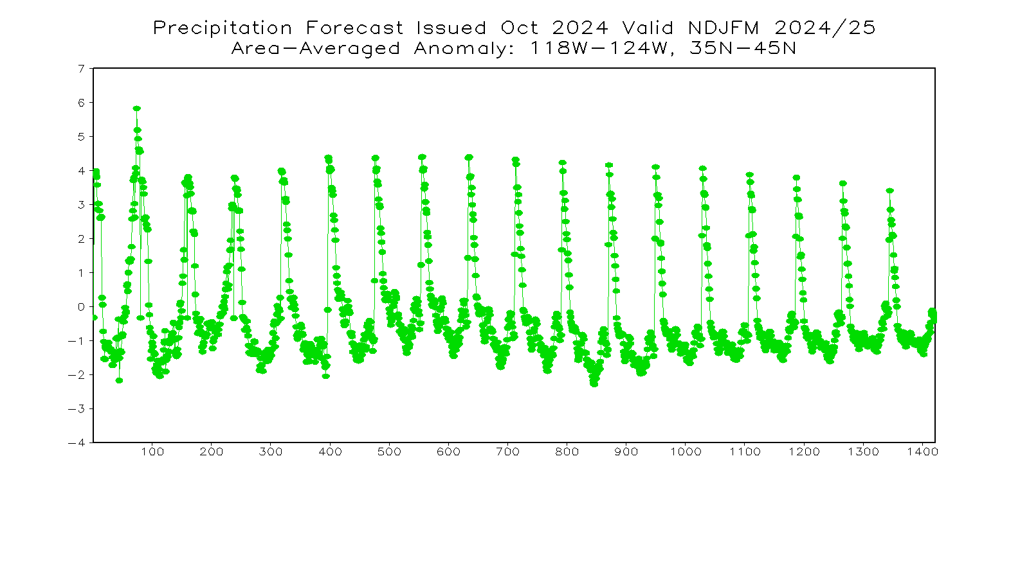
Precipitation Anomaly (Inch)
79 Modes x 18 Lags

Slide 8
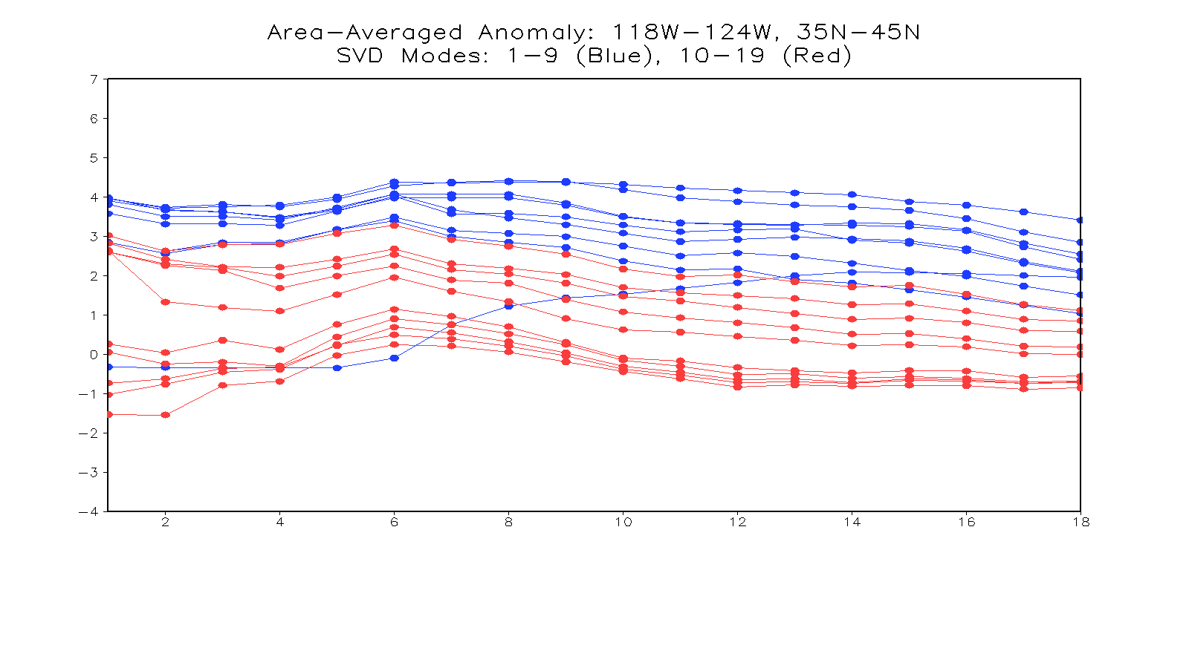
Precipitation Anomaly (Inch)
SST Lags (Month)
Forecasted rainfall anomalies are not sensitive to SST lags but are influenced by the number of SVD modes.

Slide 9
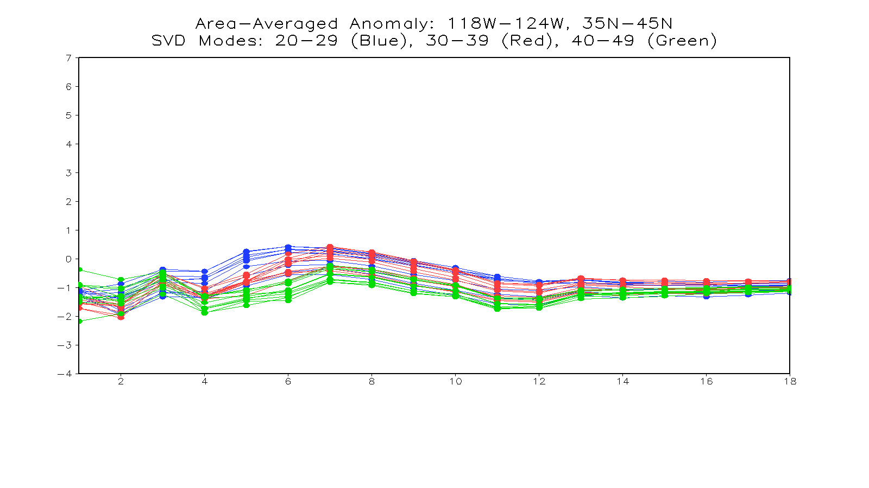
Precipitation Anomaly (Inch)
SST Lags (Month)
Increasing the number of SVD modes does not enhance the forecast.

Slide 10
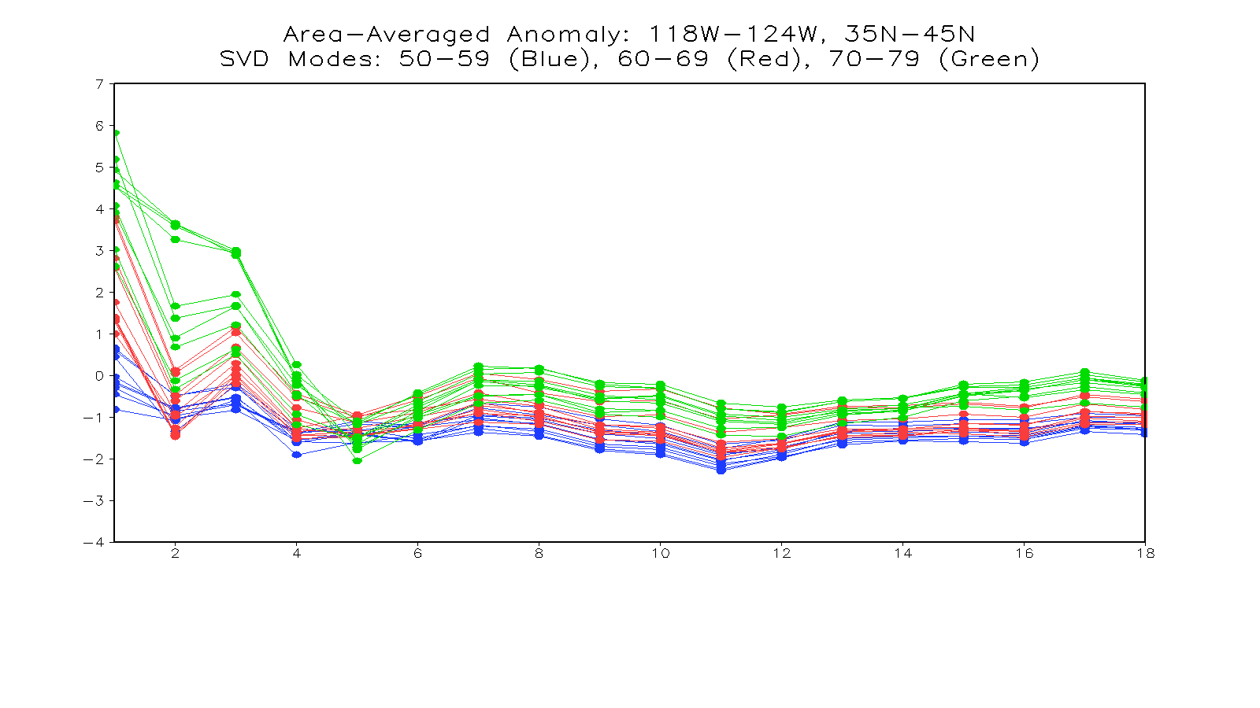
Precipitation Anomaly (Inch)
SST Lags (Month)
For short SST lags, increasing the number of SVD modes may amplify rainfall anomalies.

Slide 11
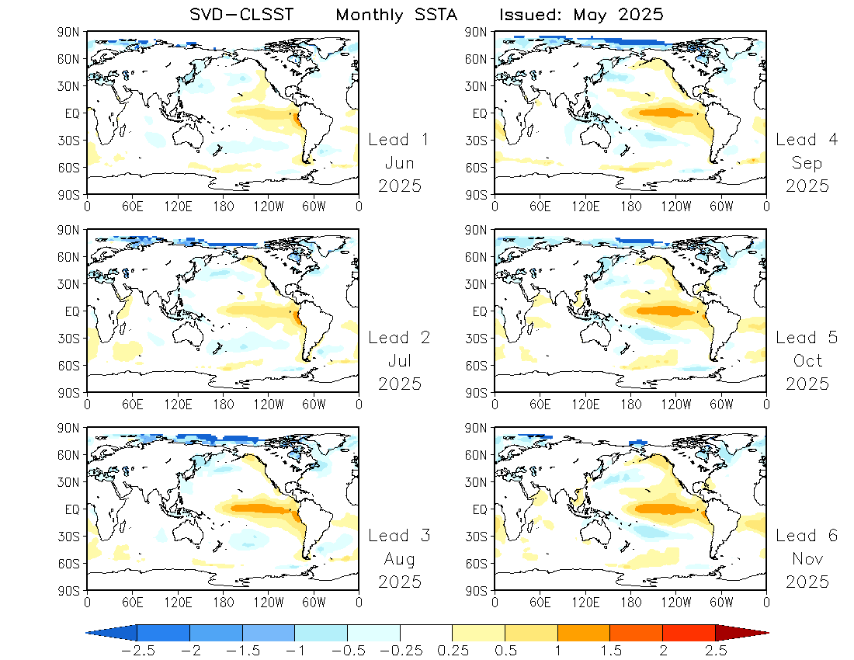
Monthly SSTA
The SVD-CLSST model predicts an El Nino developing in the upcoming summer and fall.

Slide 12
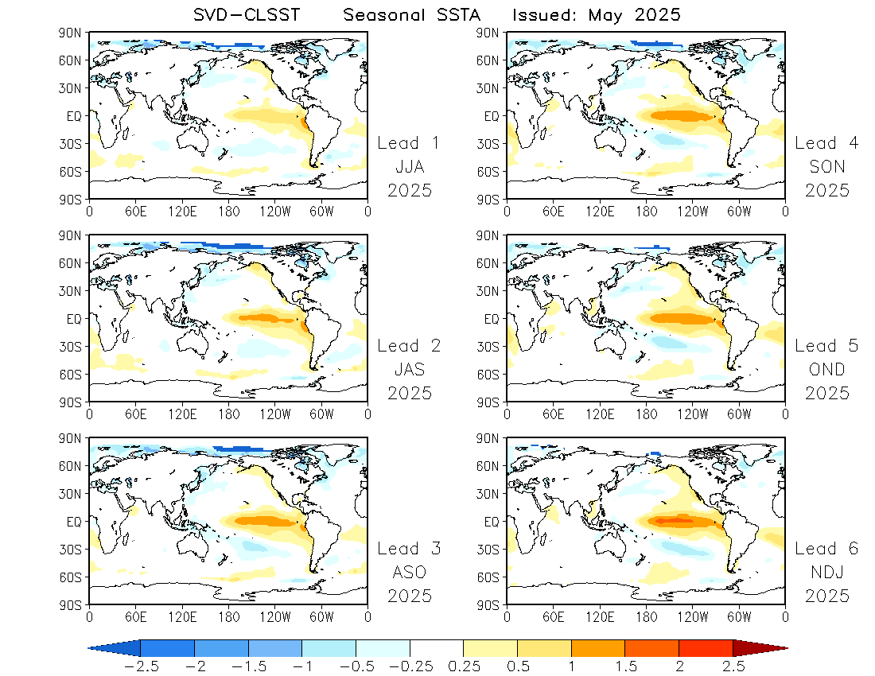
Seasonal SSTA

