Slide 1
Update (4/22/2025)
Applied the SVD-CLSST tool for real-time monthly and seasonal tropical Pacific SST forecasts.
Evaluated the forecast skill of SST prediction using the SVD-CLSST tool.
Redesigned the webpage to enhance the display of U.S. precipitation, 2-m temperature, and SST forecasts.

Slide 2
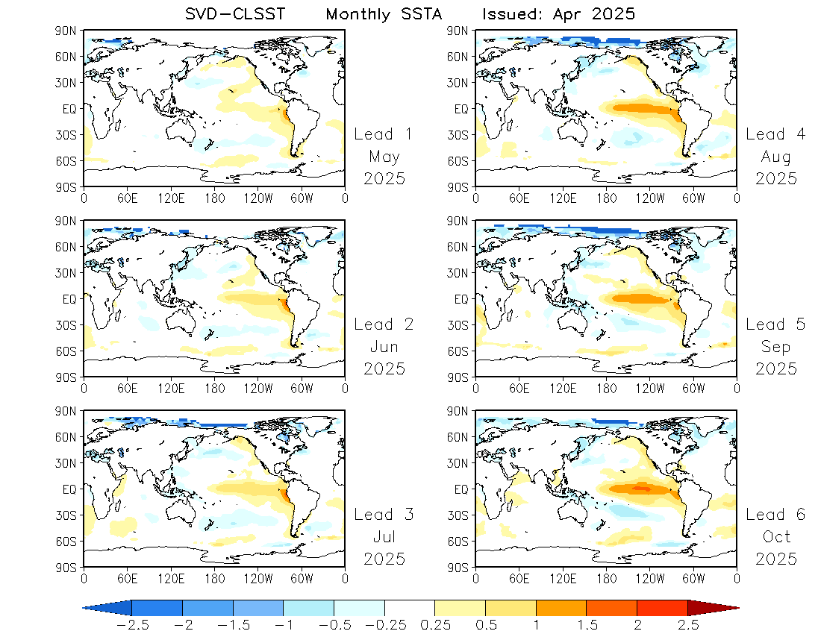
Monthly SST
Forecast
1 – 6 Leads
Predictors:
IO+Pac+Atl
30ºS–30ºN

Slide 3
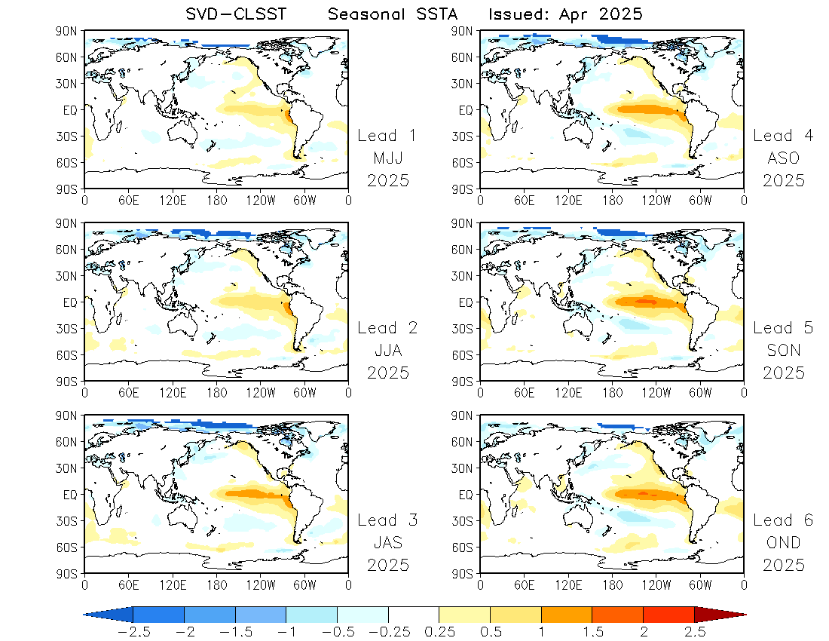
Seasonal SST
Forecast
1 – 6 Leads
Predictors:
IO+Pac+Atl
30ºS–30ºN

Slide 4
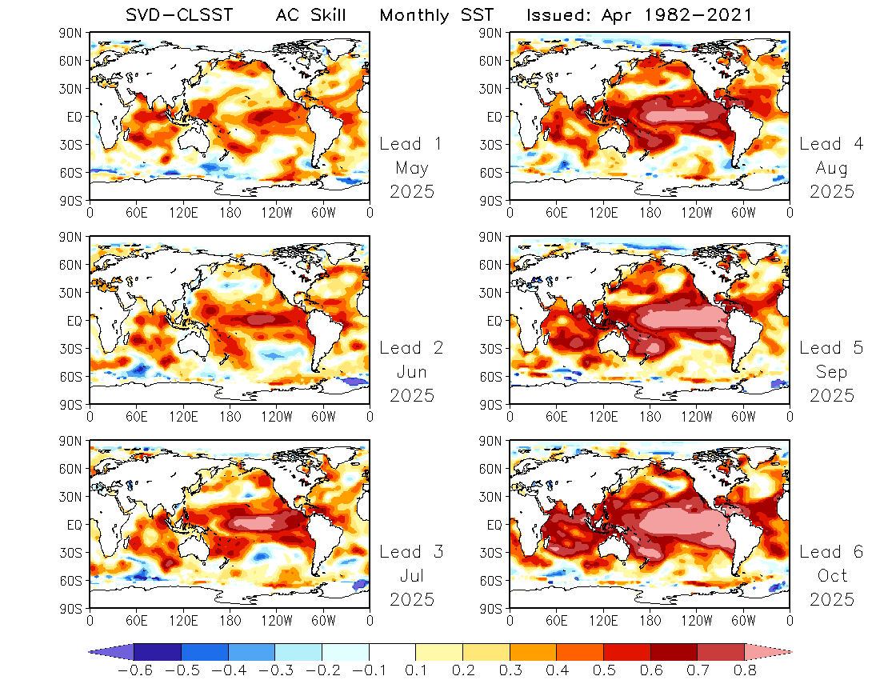
Monthly SST
AC Skill
1 – 6 Leads
Skill increases with lead time:
Due to spring predictability barrier, or SST seasonality?

Slide 5
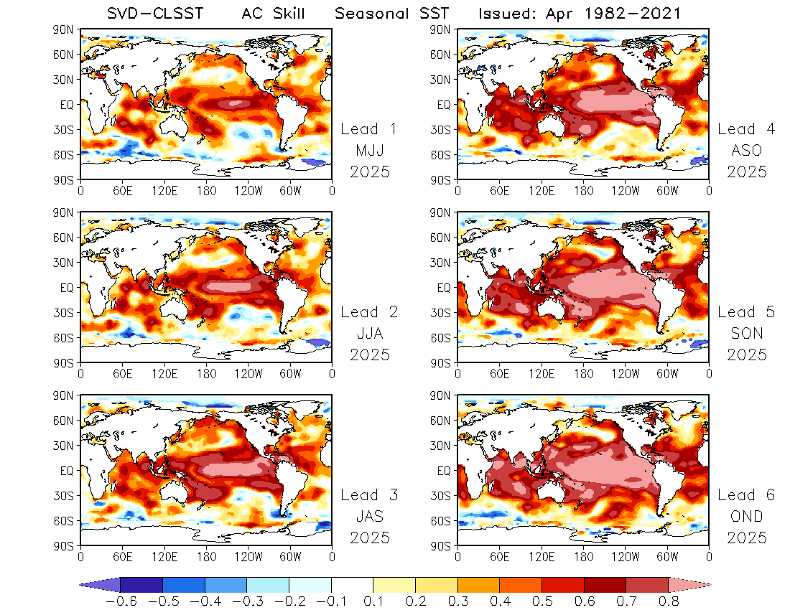
Seasonal SST
AC Skill
1 – 6 Leads

Slide 6
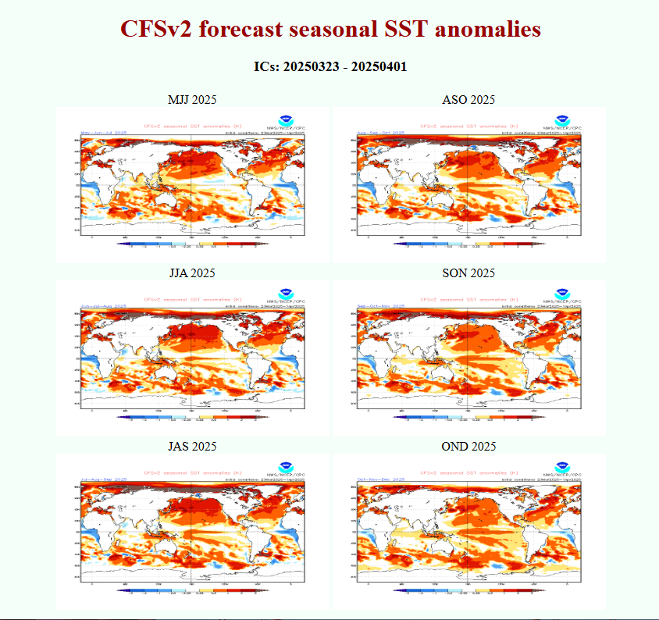
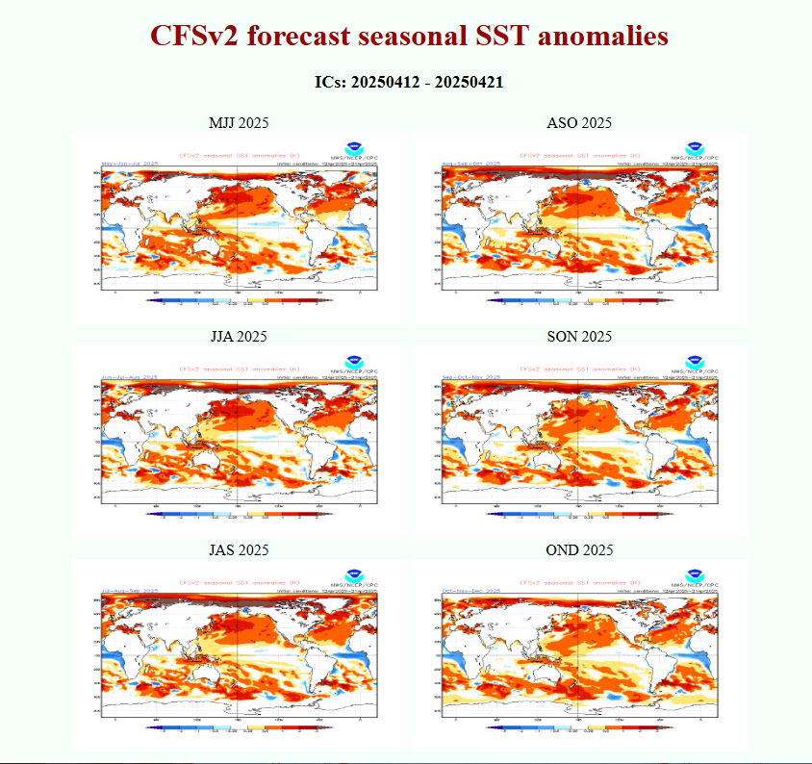

Slide 7
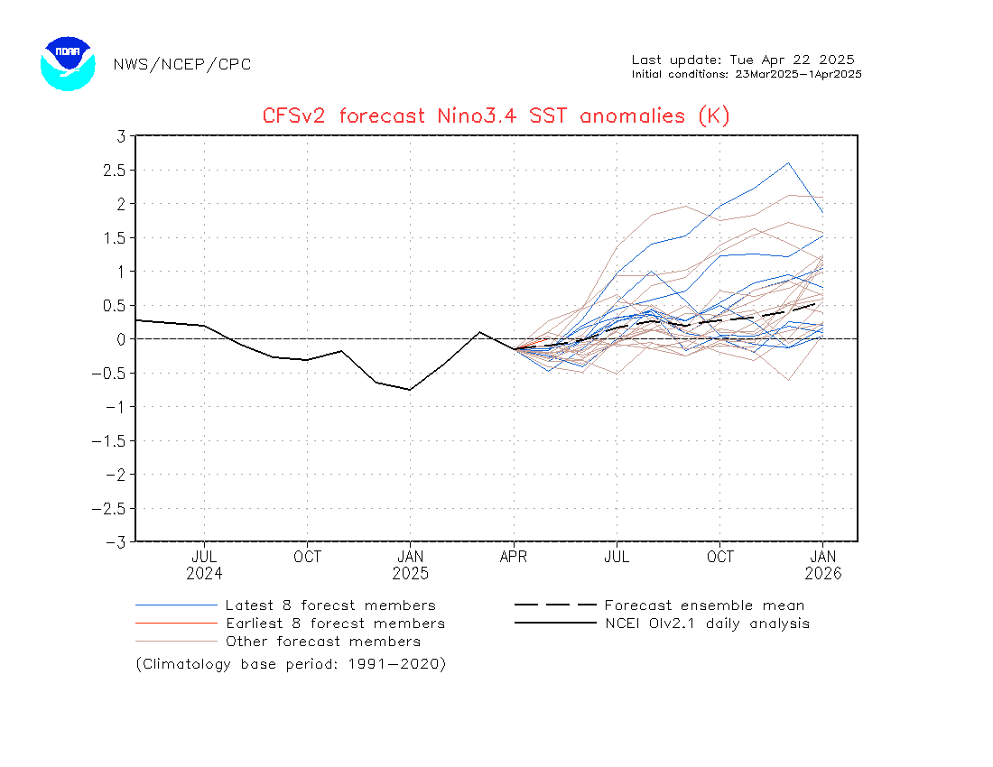
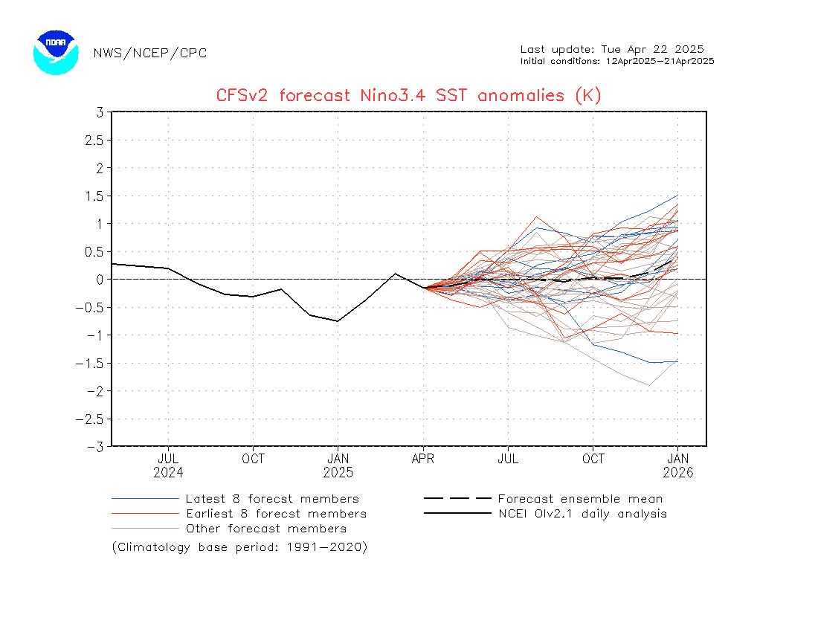
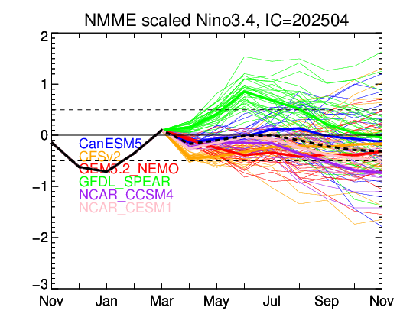
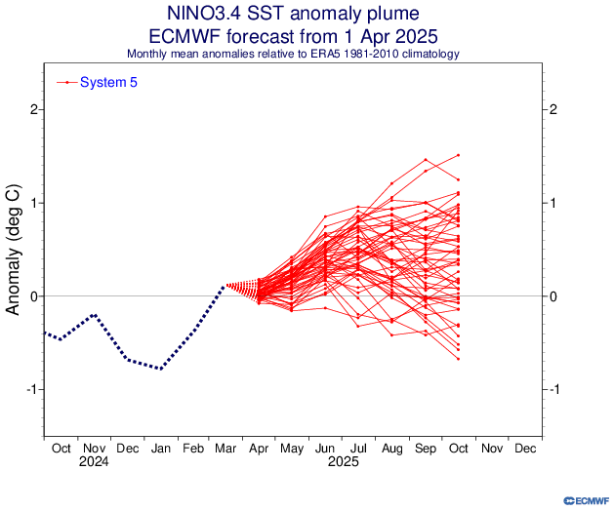
Monthly Nino 3.4 SST Forecasts
ICs: 23Mar2025 – 1Apr2025
ICs: 12Apr2025 – 21Apr2025

Slide 8
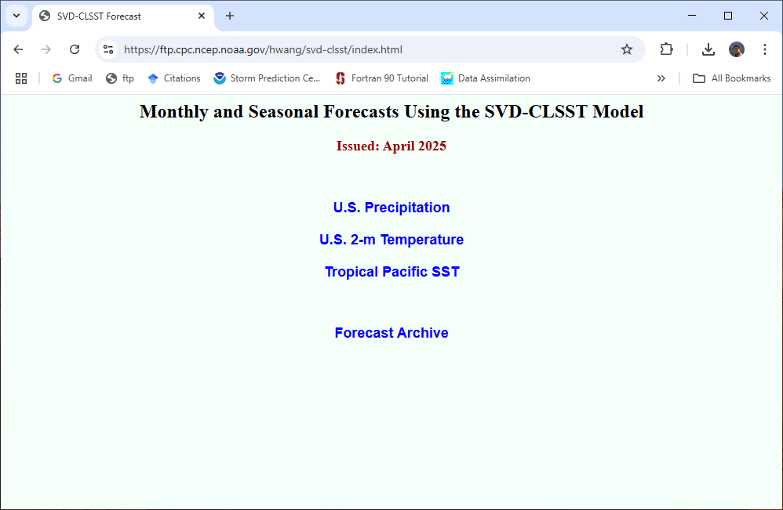
https://ftp.cpc.ncep.noaa.gov/hwang/svd-clsst/index.html

Slide 9
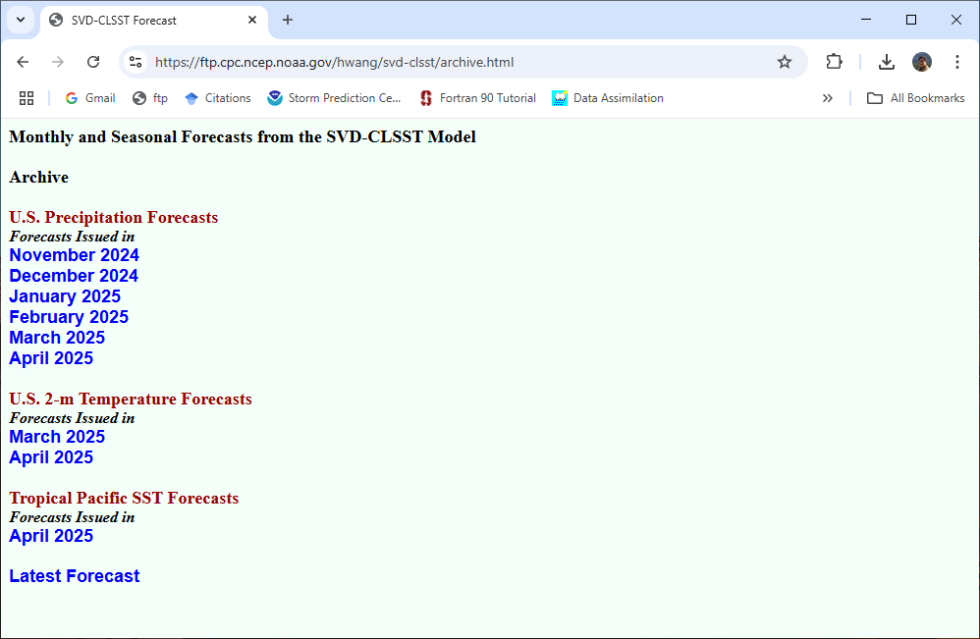

Slide 10
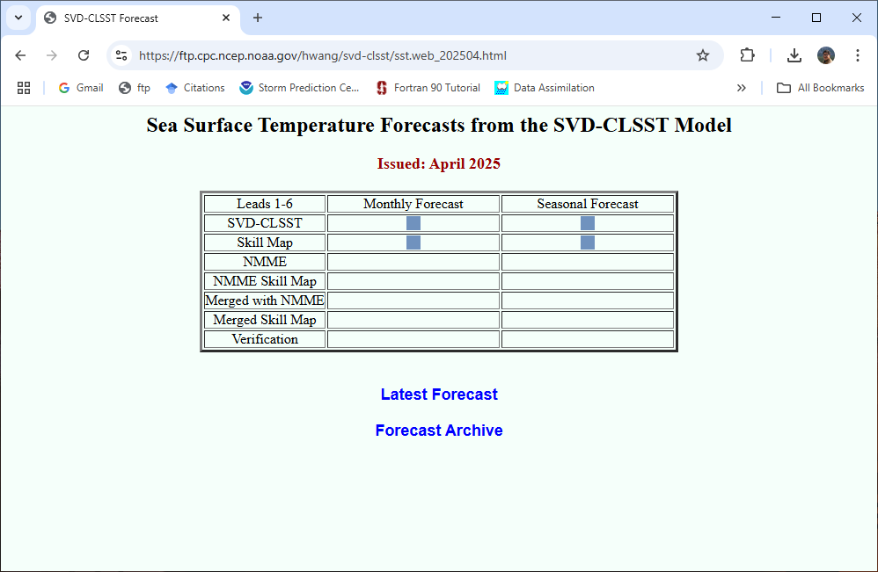

Slide 11
To-do:
Compare forecast skill between the SVD-CLSST tool and CCA/CA tools.
Generate the Nino 3.4 SST forecast plume to visualize SVD-CLSST model predictions for the tropical Pacific.

