Slide 1
Update (9/23/2025)
Produced the CONUS precipitation forecasts for ONDJFM and NDJFM 2025/26 issued in September and October 2025, using the SVD-CLSST tool for Emerson’s Experimental Extended Outlook.
Tested seasonal mean precipitation forecasts for North America using the SVD-CLSST tool, with lead times ranging from 0 to 12 months.
Merged two 2-m temperature datasets to create a single dataset with extended historical records and near-real-time updates.

Slide 2
CONUS Precipitation Forecasts for
ONDJFM and NDJFM 2025/26

Slide 3
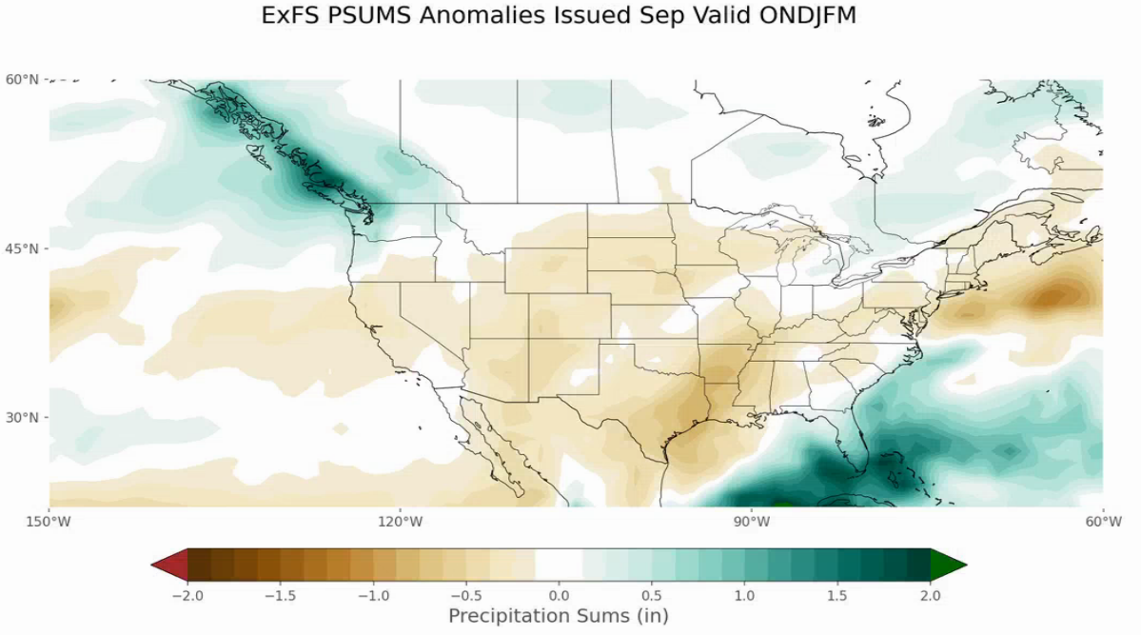
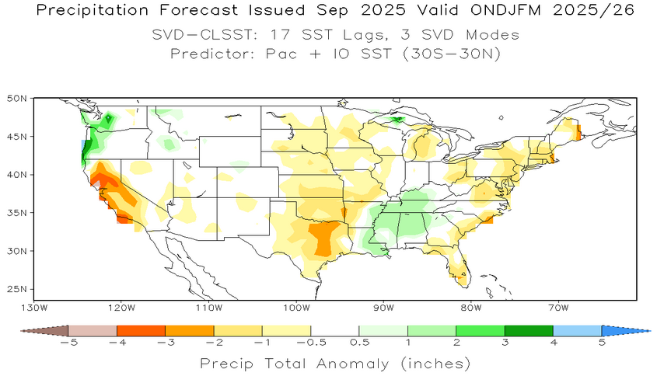
Precipitation Forecast Issued September 2025
Valid ONDJFM 2025/26
Emerson SVD-CLSST

Slide 4
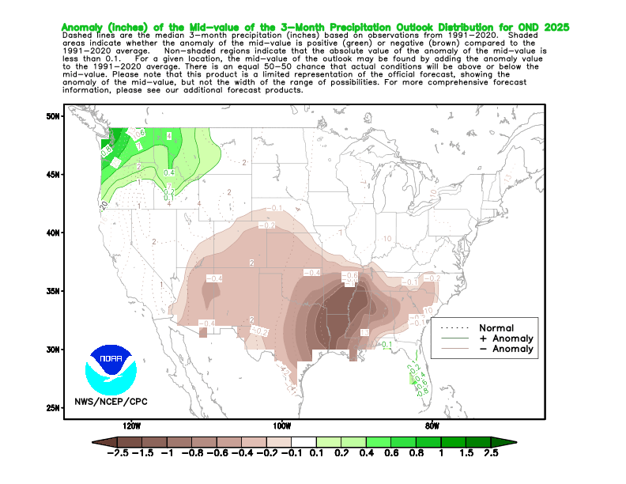
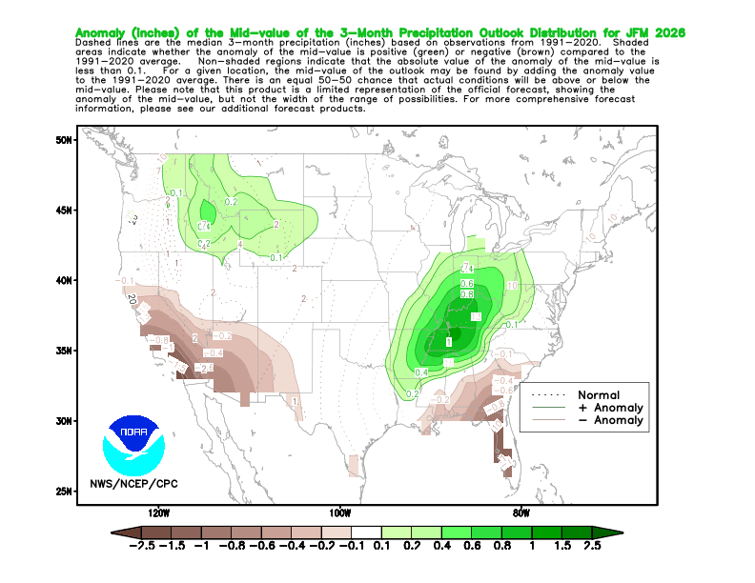
SVD-CLSST:
ONDJFM 2025/26
CPC’s Seasonal Outlook
OND 2025 JFM 2026

Slide 5
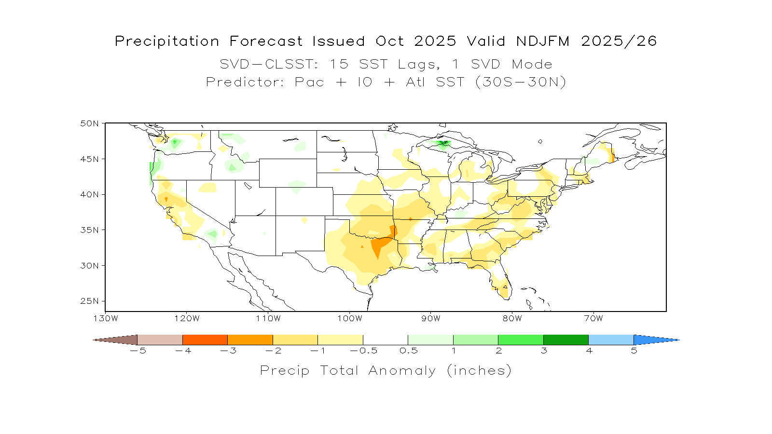
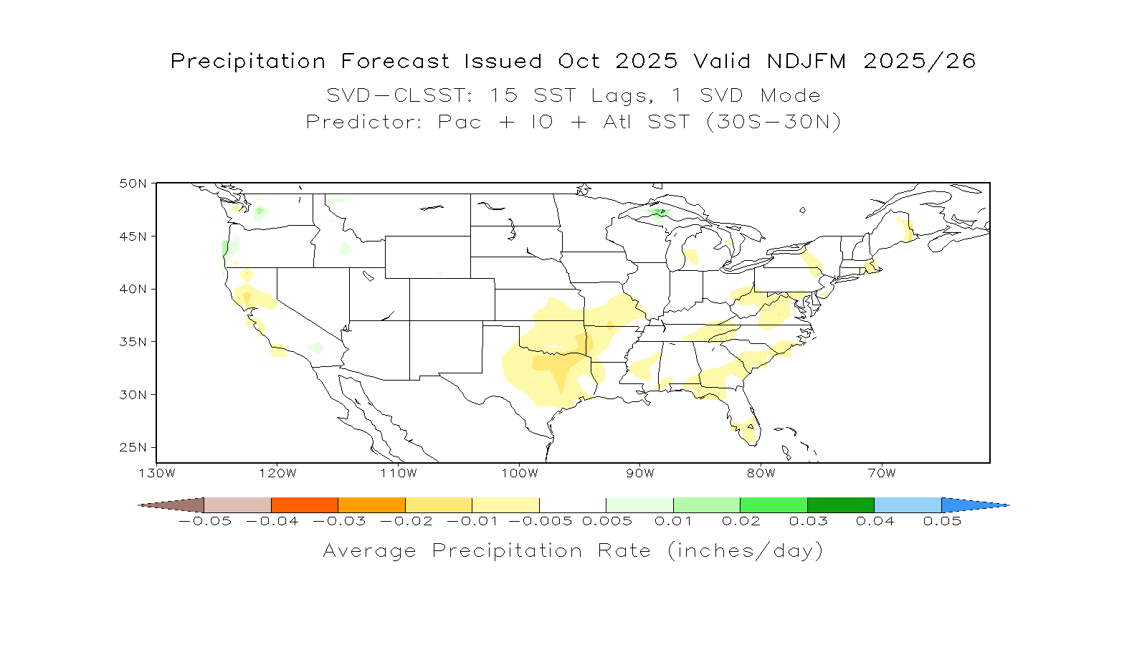
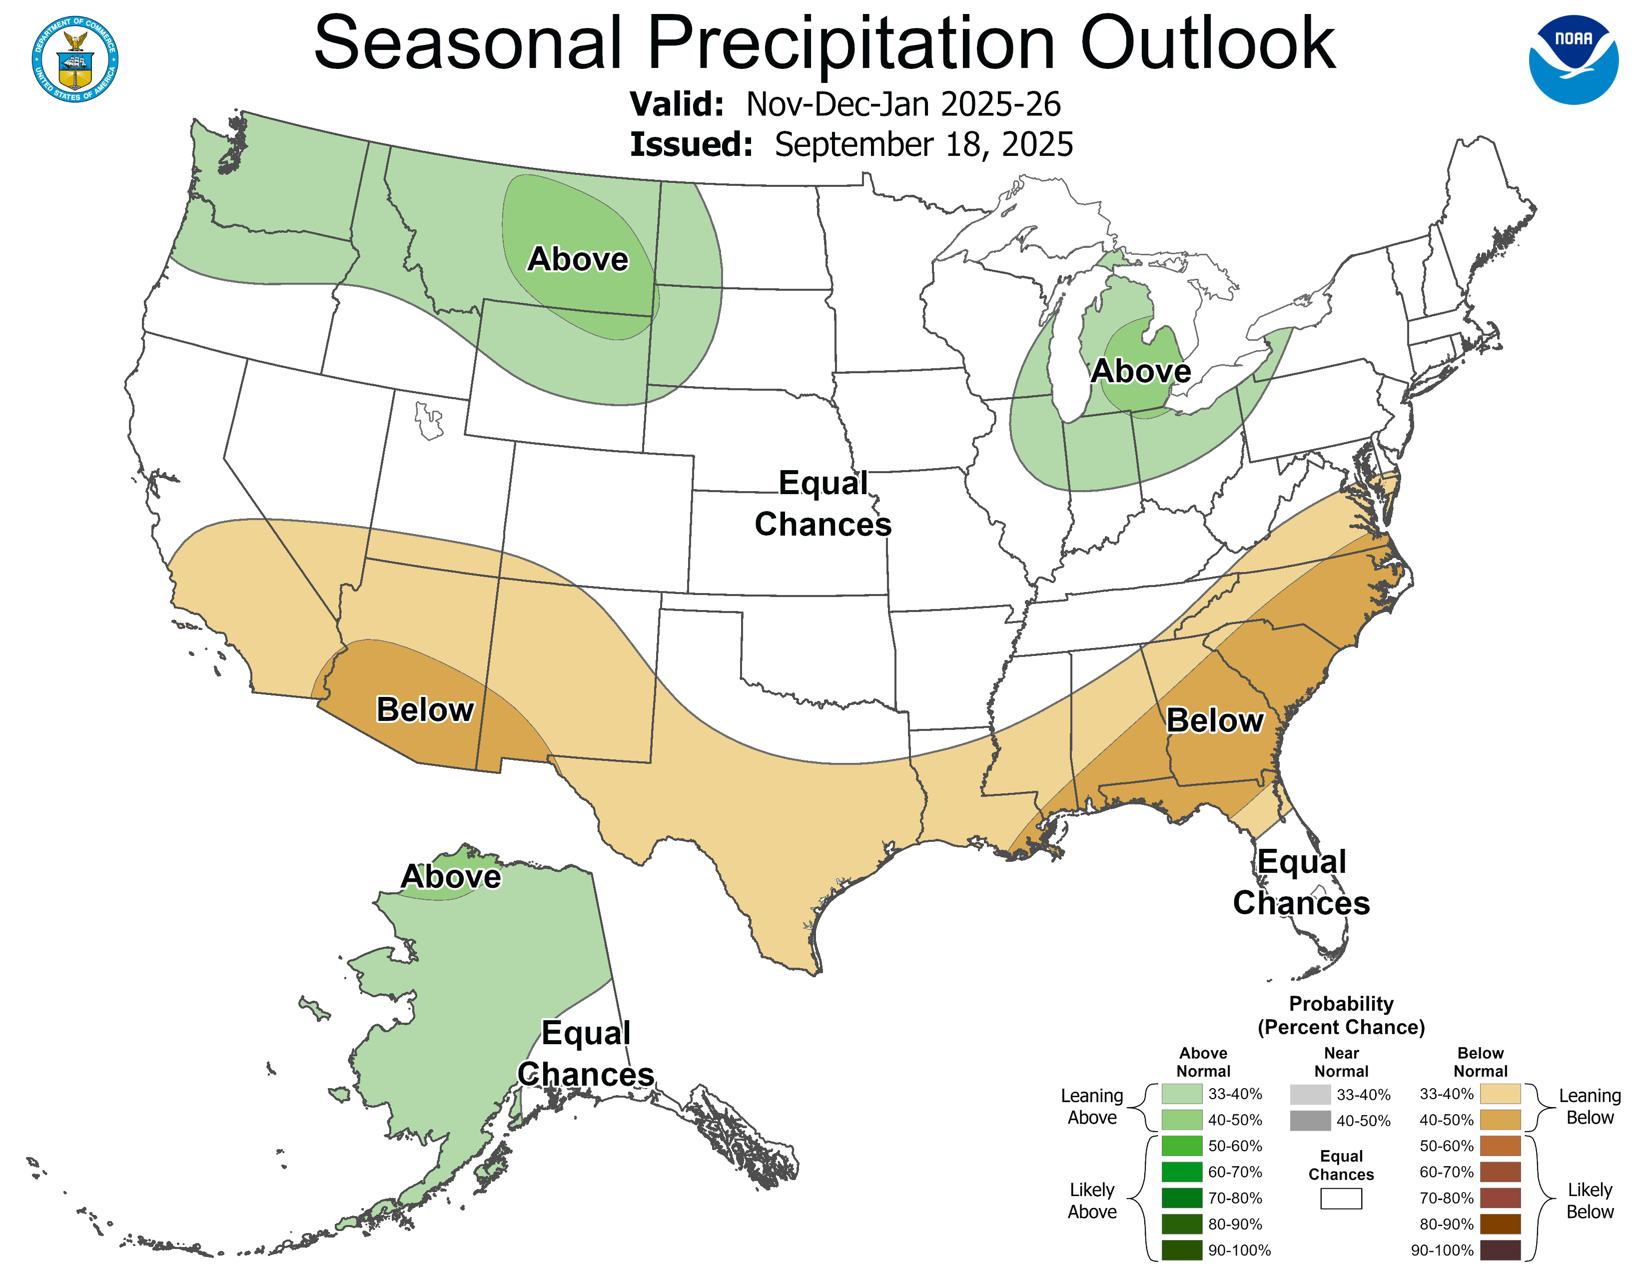
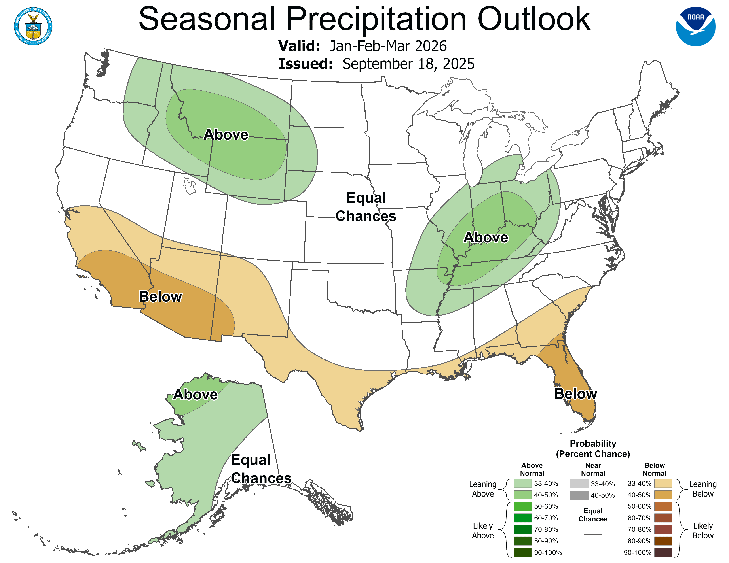
Precipitation Forecast Issued October 2025
Valid NDJFM 2025/26
CPC: La Nino Type
NDJ 25/26 JFM 26
SVD-CLSST:
ONDJFM 2025/26

Slide 6
Seasonal Mean Precipitation Forecasts
Using the SVD-CLSST tool
Larger domain: North America
Longer leads from 0 to 12 months

Slide 7
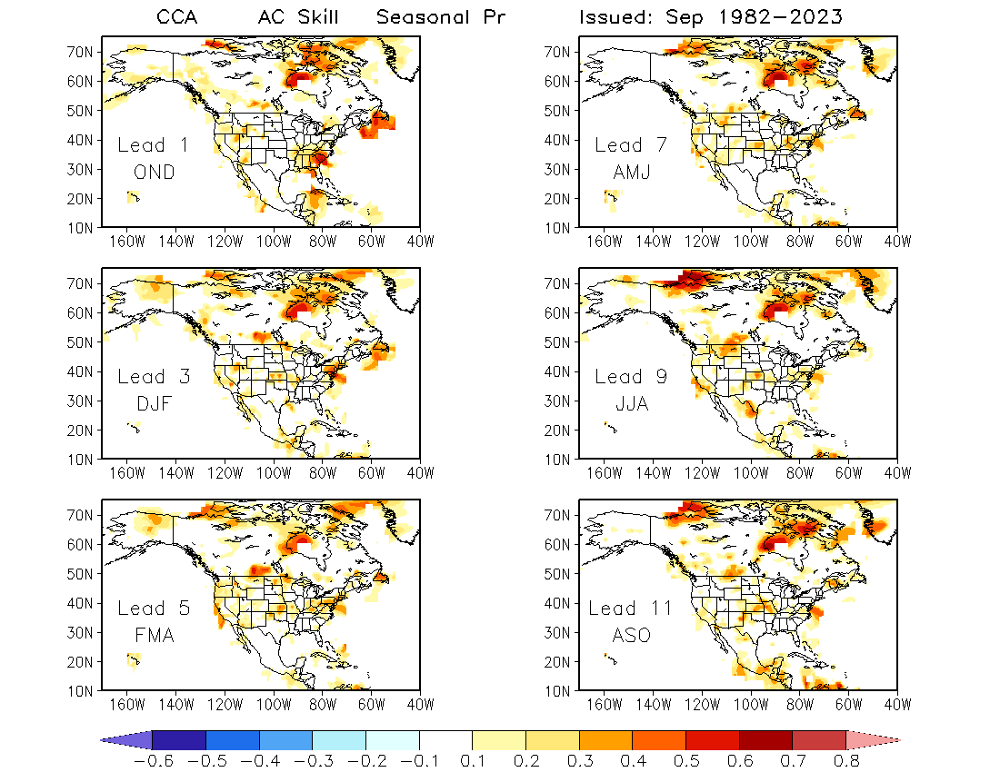
CCA

Slide 8
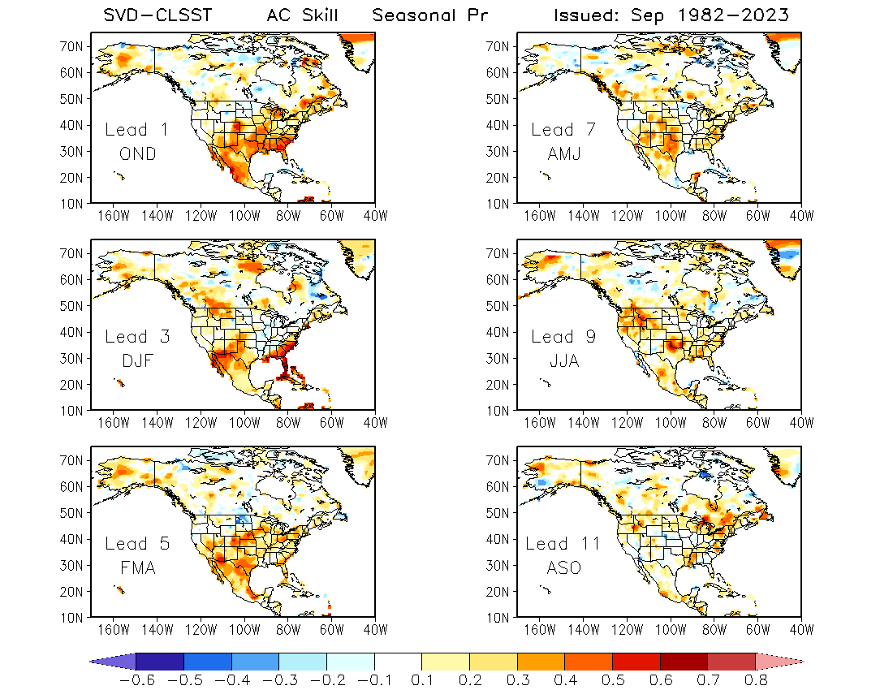
Max AC Skill:
Over N. America

Slide 9
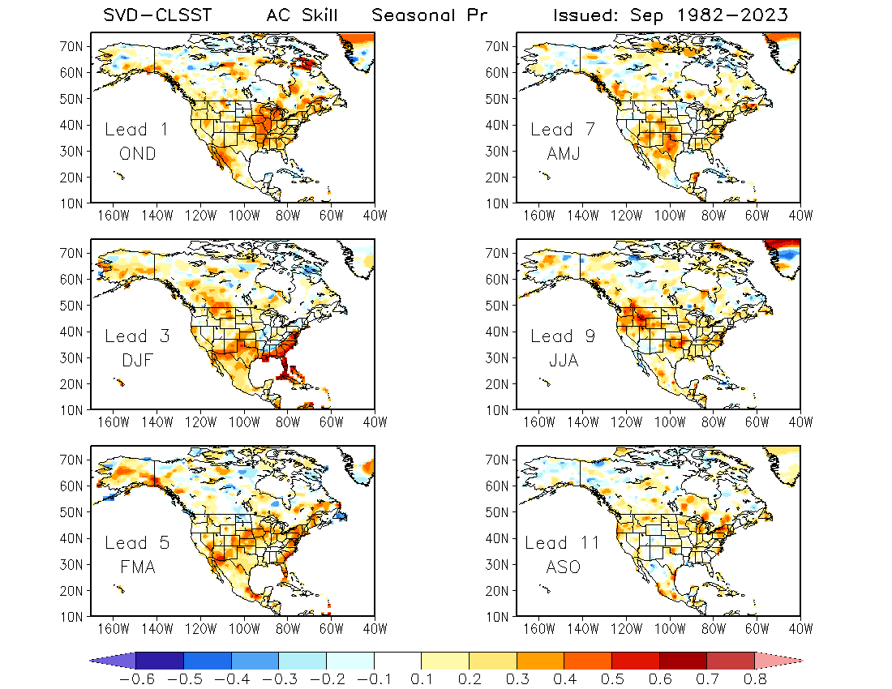
Max AC Skill:
Over US

Slide 10
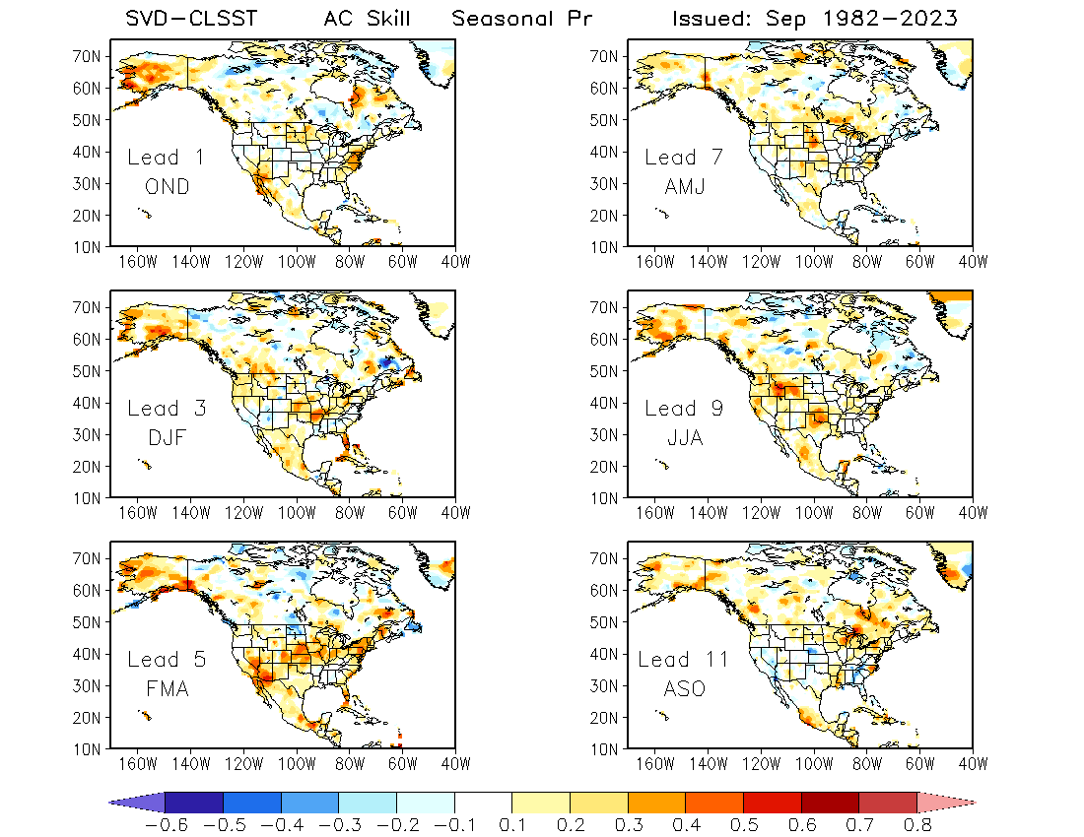
Max AC Skill:
Over Alaska

Slide 11
Two T2m Datasets
Univ. of Delaware Global Gridded Monthly Land Temperature
1900 – 2017
GHCN_CAMS Gridded 2m Temperature (Land)
1948/01 – 2025/08 (Real-time update)
Same Grid and Spatial Coverage
0.5º latitude x 0.5º longitude global grid (360x720)
89.75S - 89.75N, 0.25E - 359.75E.

Slide 12
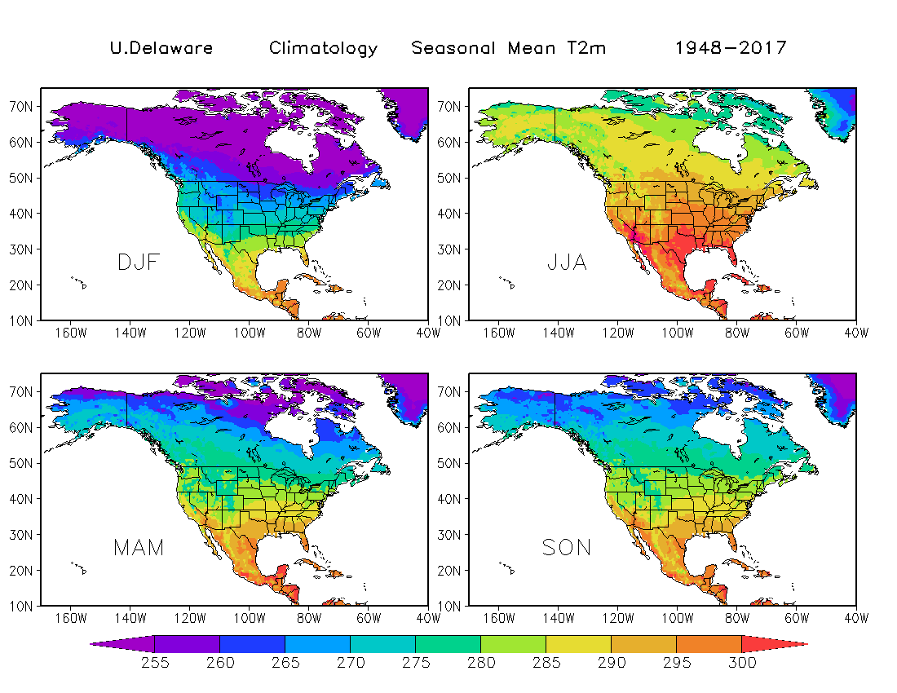

Slide 13
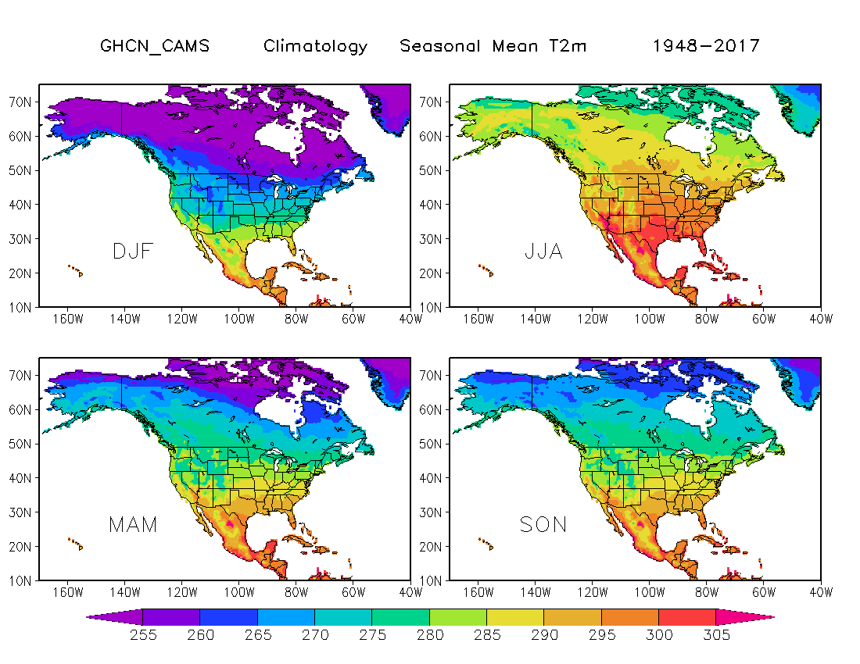

Slide 14
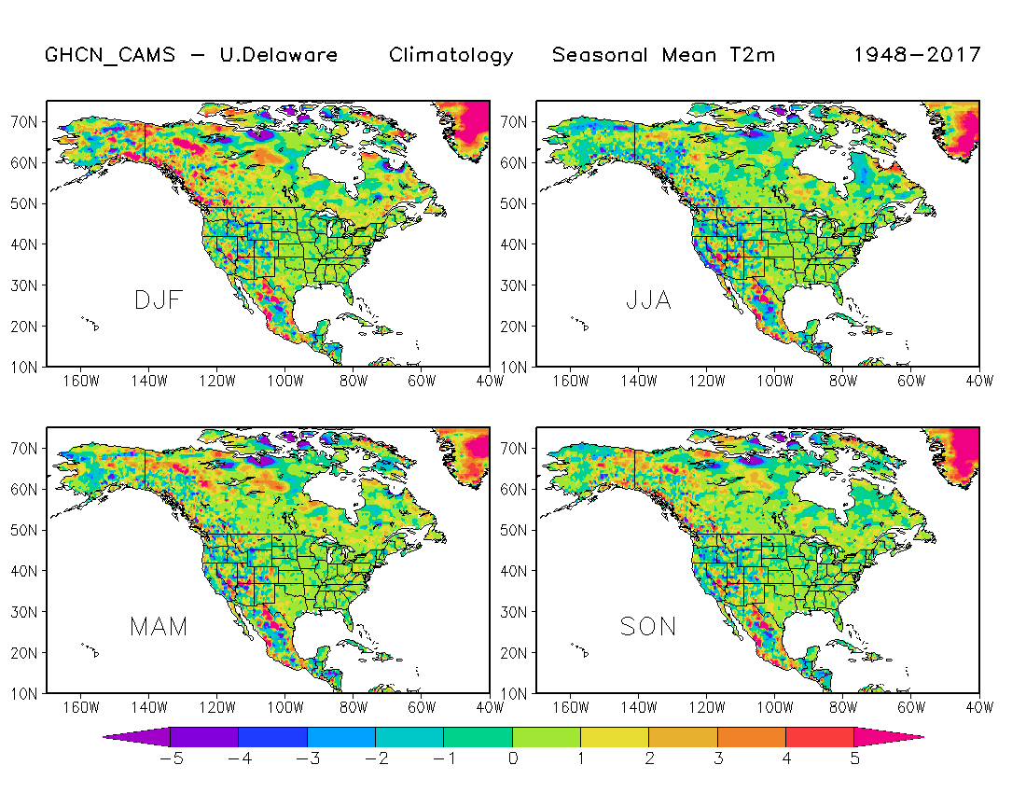

Slide 15
Question
To combine two datasets for years 2018 – 2025:
Subtracting mean differences
Using the mean differences over 70 years (overlap years: 1948 – 2017)
Or mean differences over recent period (e.g., 1988 – 2017)?

