Slide 1
SVD-based Seasonal Severe Weather Forecast for MAM 2020
Hui Wang and Arun Kumar
Climate Prediction Center
NOAA/NWS/NCEP
February 14, 2019

Slide 2
Methodology
The statistical forecast is based on lag relationships between January SST and MAM seasonal severe weather (event days with PPH values of at least 10% for tornado or 30% for hail).
The lag relationships are objectively identified by the singular value decomposition (SVD).
Forecast skill is measured by anomaly correlation with cross-validations over 1988–2018.

Slide 3
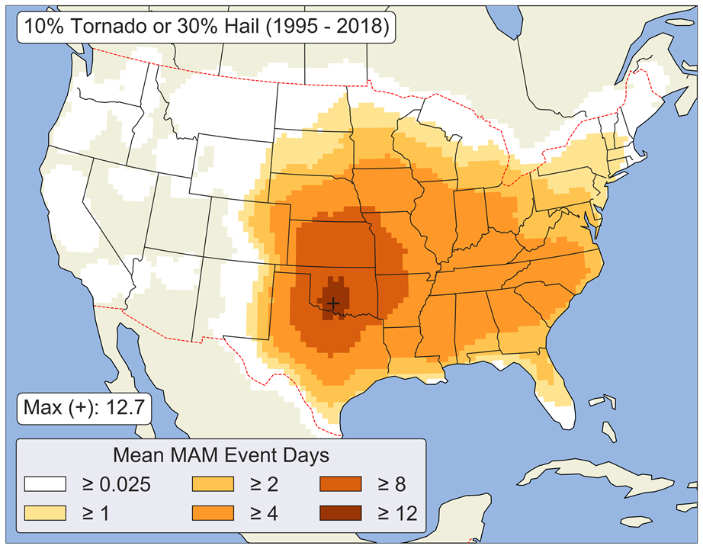
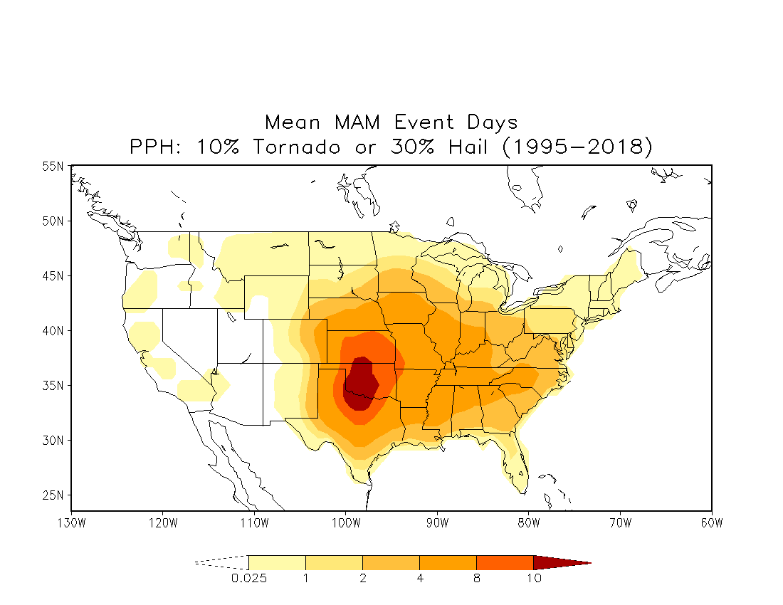
PPH = $\sum_{n=1}^{N}{\left(\frac{1}{2πσ^{2}}\right)\exp{[−\frac{1}{2} {(\frac{d_{n}}{σ})}^{2}]}}$
= 1.5
d_{n} = Distance (mile) / 50
Tornado: EF1 – EF5
Hail: Size ≥ I inch
Victor’s climatology
Climatology: MAM Event Days
PPH: 10% Tornado or 30% Hail
1995–2018
1ºx1º
The climatology is similar to Victor’s.

Slide 4
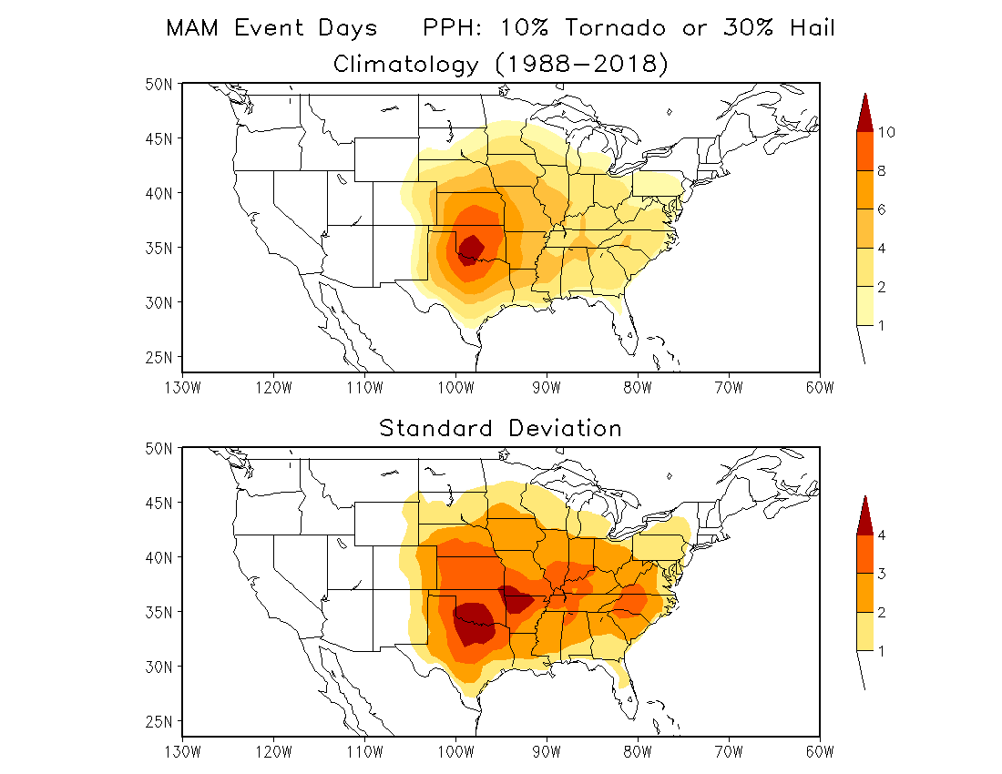
1988–2018
Days
Days

Slide 5
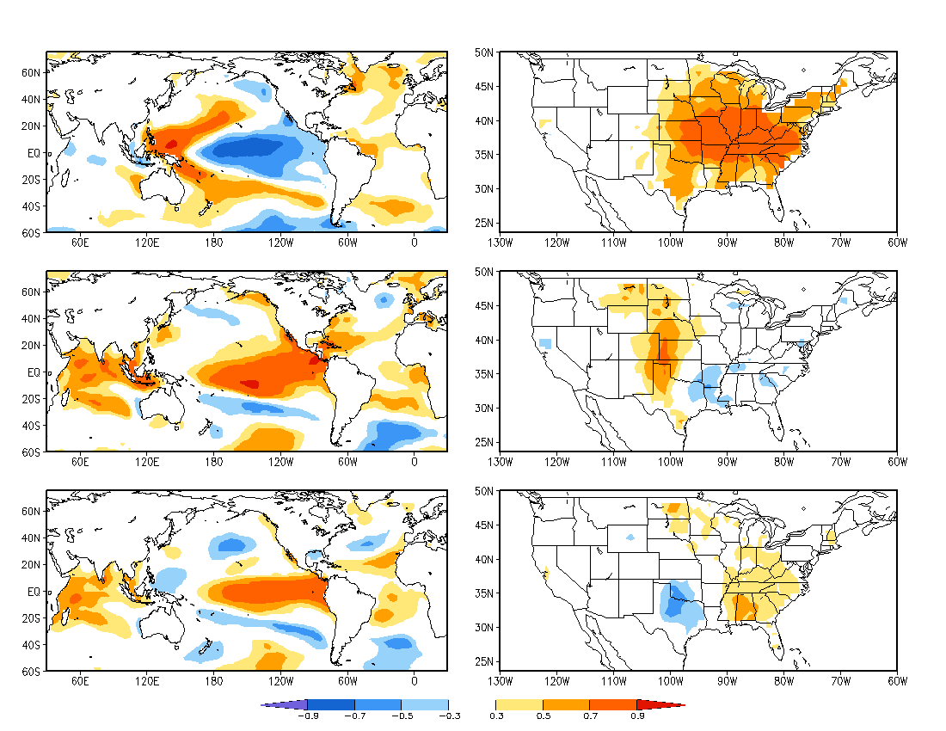
SVD
Lag Relationship: January SST and MAM Event Days
Mode 1
15%
Mode 1
40%
Mode 2
20%
Mode 2
9%
Mode 3
13%
Mode 3
8%
ERSSTv5 1988–2018
Homogeneous Correlation

Slide 6
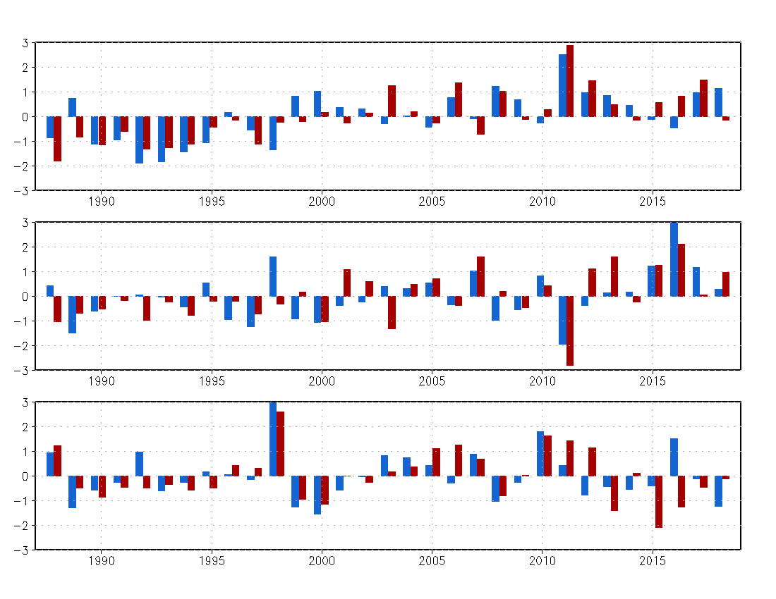
SVD Time Series: 1988–2018
Mode 1
SST
Event day
Trend
R=0.72
Mode 2
ENSO years project onto both mode 2 and mode 3
16 EN
00 LN
11LN
R=0.58
Mode 3
98 EN
10 EN
00 LN
R=0.57
Year

Slide 7
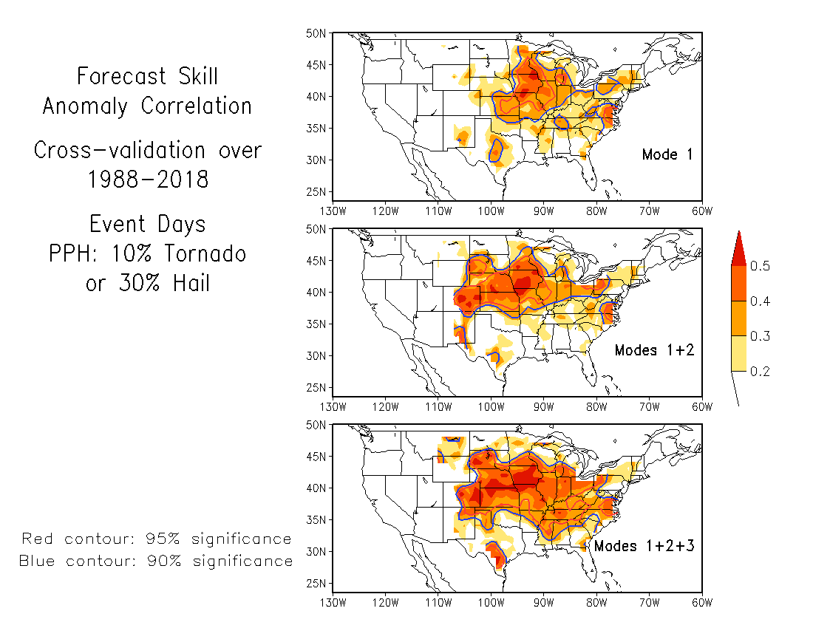

Slide 8
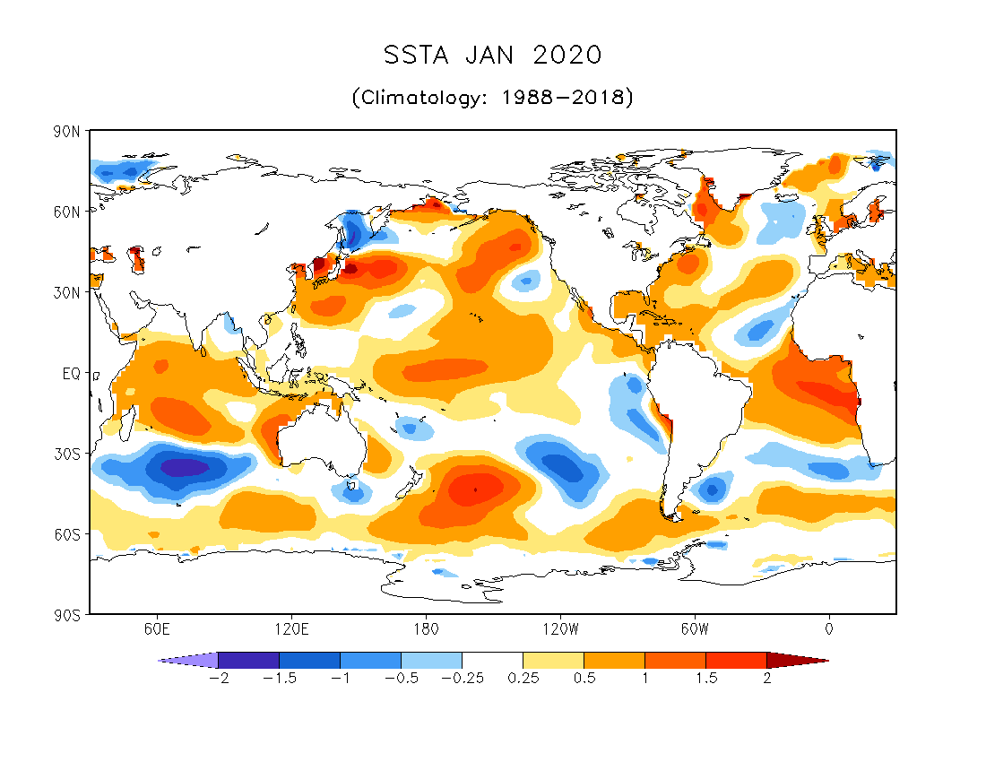
ERSSTv5
Projection coefficients:
(onto SVD SST modes)
0.41 (Mode 1) 1.52 (Mode 2) 0.17 (Mode 3)
Largest projection onto mode 2

Slide 9
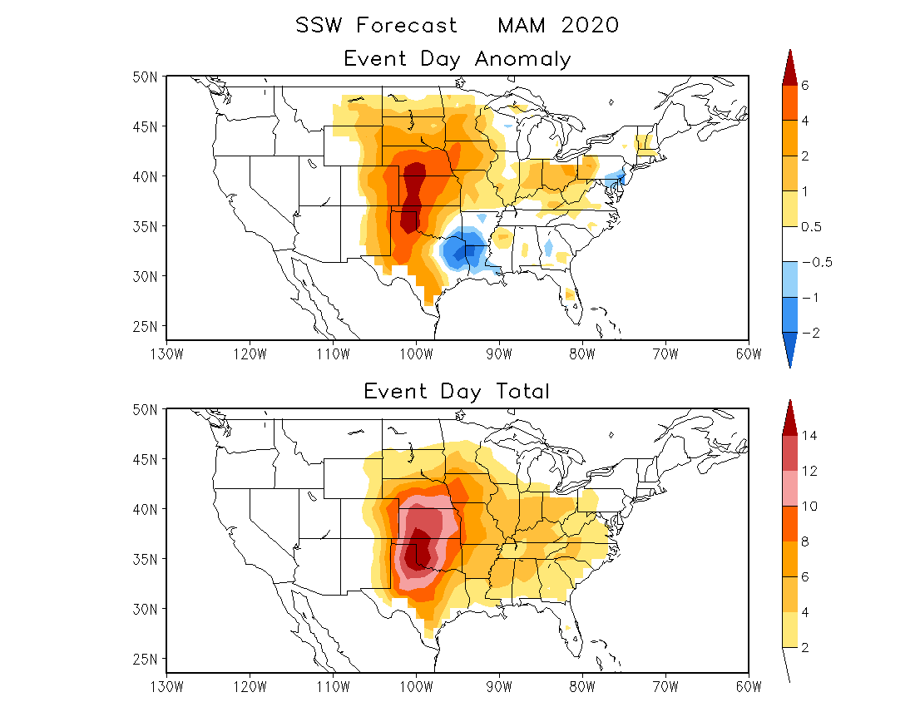
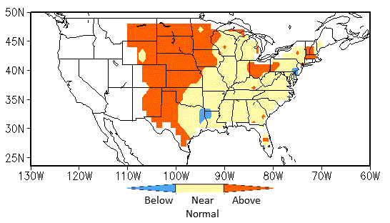
Days
3 Categories
Days
Anomaly (FCST) + Climatology (OBS)

Slide 10
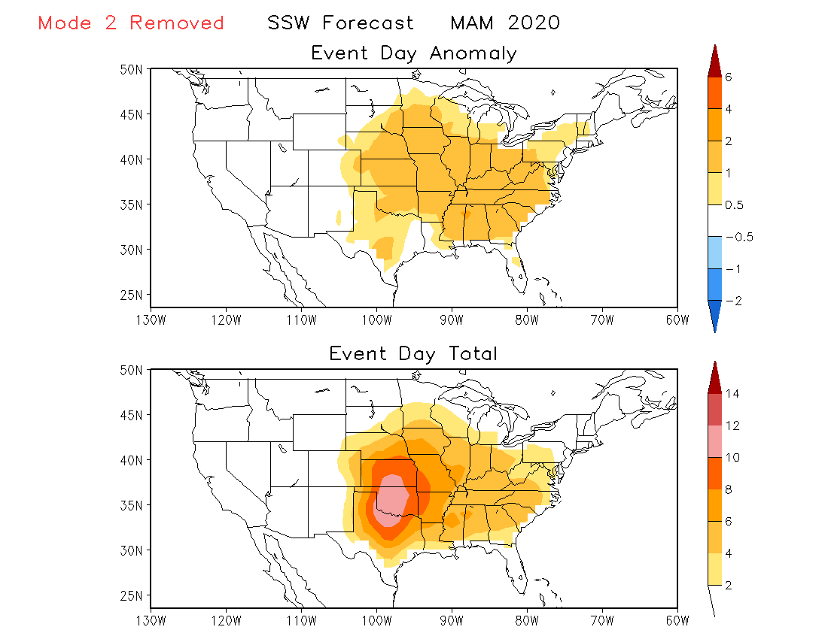
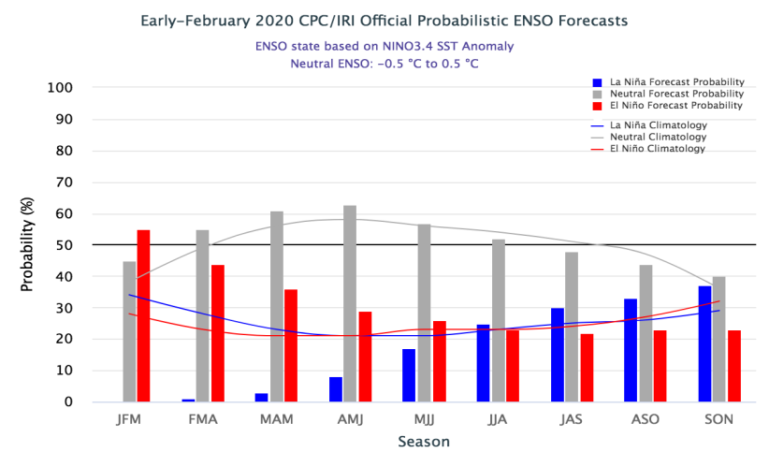

Slide 11
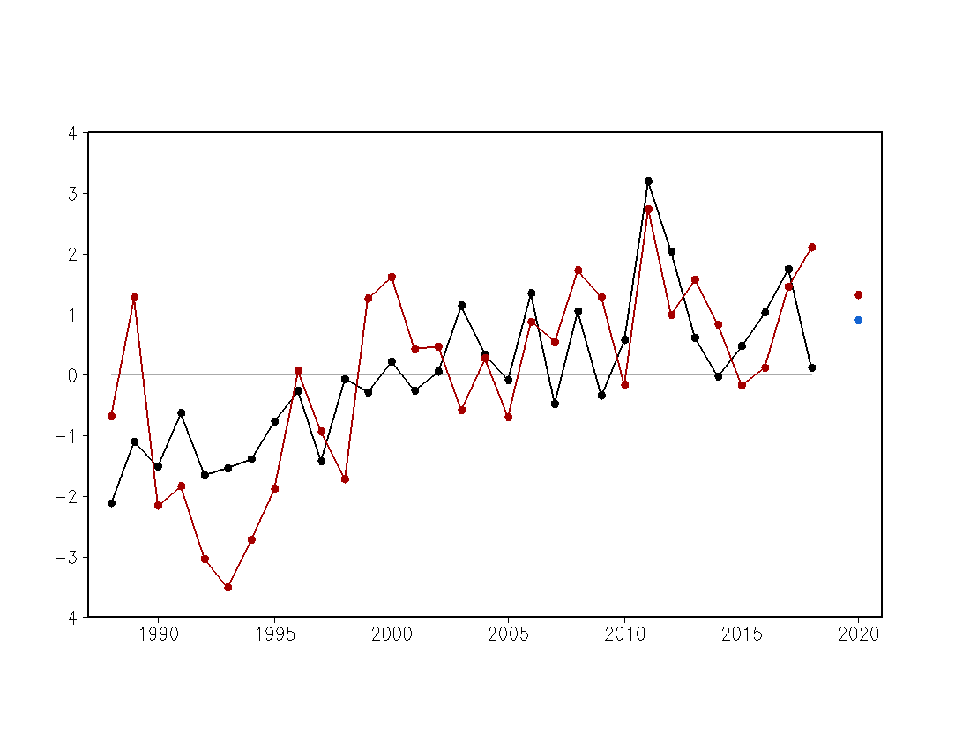
MAM SSW Forecast
Mean Event Day Anomaly CONUS
Observation
Forecast
R=0.66
Cross-validation
over 1988–2018
Rank:
78%
66%
Mean Event Day Anomaly
Mode 2 removed
Forecast for MAM 2020
Anomaly: 1.32 days
Total: 4.25 days
OBS mean: 2.93 days
(Above normal)
Year
Average of event day anomaly over CONUS

Slide 12
SSW Forecast for MAM 2020
Using Old Variables
Tornado count
Hail days

Slide 13
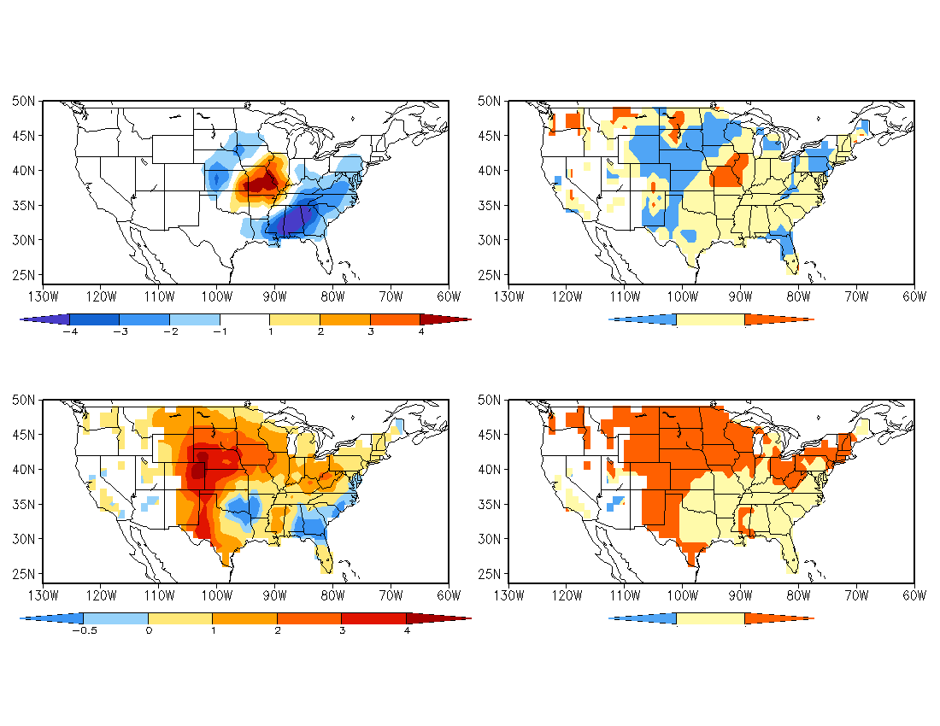
Forecast for MAM 2020
Anomaly: Tornado (EF1–EF5)
Tornado Count
Category: Tornado (EF1–EF5)
Below Near Above
Normal
Anomaly: Hail Day (≥ 1 inch)
Hail Days
Category: Hail Day (≥ 1 inch)
Below Near Above
Normal
Climatology: Tornado: 1988–2018
Hail day: 1988–2018

Slide 14
SSW Forecast for MAM 2020
Composite Analysis Based on ONI Value
Tornado reports
Tornado days
Hail reports
Hail days
Anomalies
Frequency of occurrence (%)
ONI (NDJ 2019) = 0.56 K

Slide 15
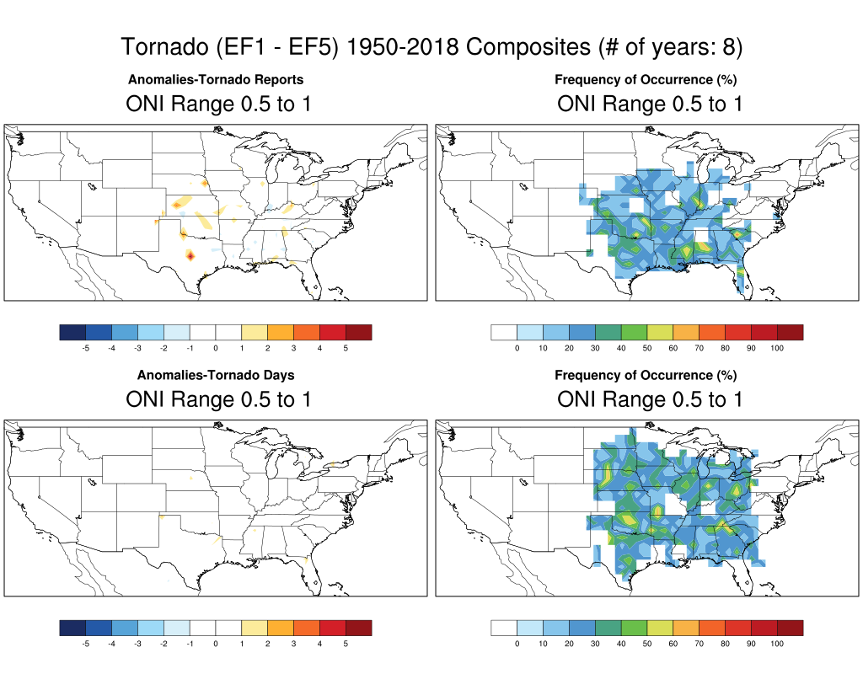

Slide 16
