Slide 1
Statistical Predictions of Seasonal Hail/Tornado Activity
12 January 2016

Slide 2
Data
Tornado and hail data are available from the SPC.
Data period: 1950–2014 for tornado; 1955–2014 for hail
Location (lat, lon) and date
Gridding of data (1x1 resolution); MAMJ seasonal total
Climatology MAMJ 1955–2014
Number of Tornadoes
Number of Hail Observations
Number in 1º x 1º box

Slide 3
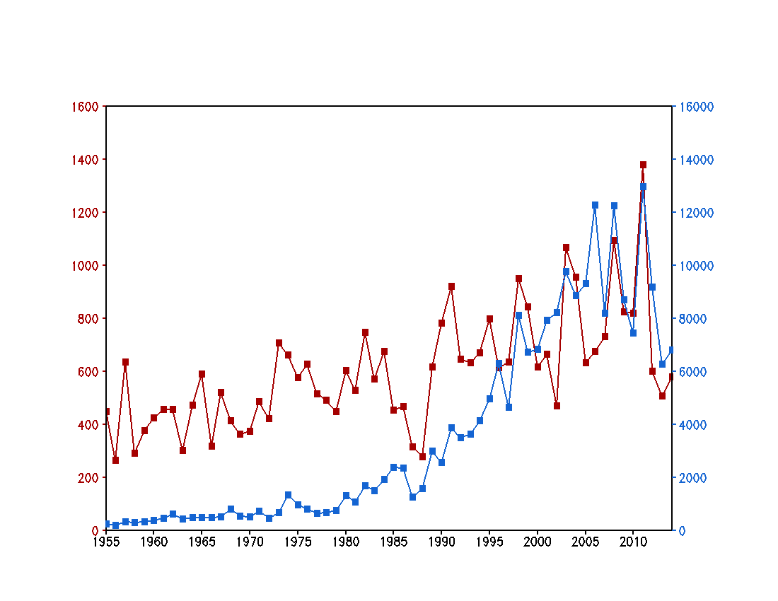
Time Series: CONUS Total MAMJ 1955–2014
Tornado
Hail
30 years
Number of Tornadoes
Number of Hail Observations
Year

Slide 4
Methodology
The statistical forecast model is based on lagged relationships between January SST and MAMJ tornado/hail activity.
The lagged relationships are objectively identified by the singular value decomposition (SVD) method.
Leave-one-out cross-validation
Forecast skill is measured by anomaly correlation and hit rate.

Slide 5
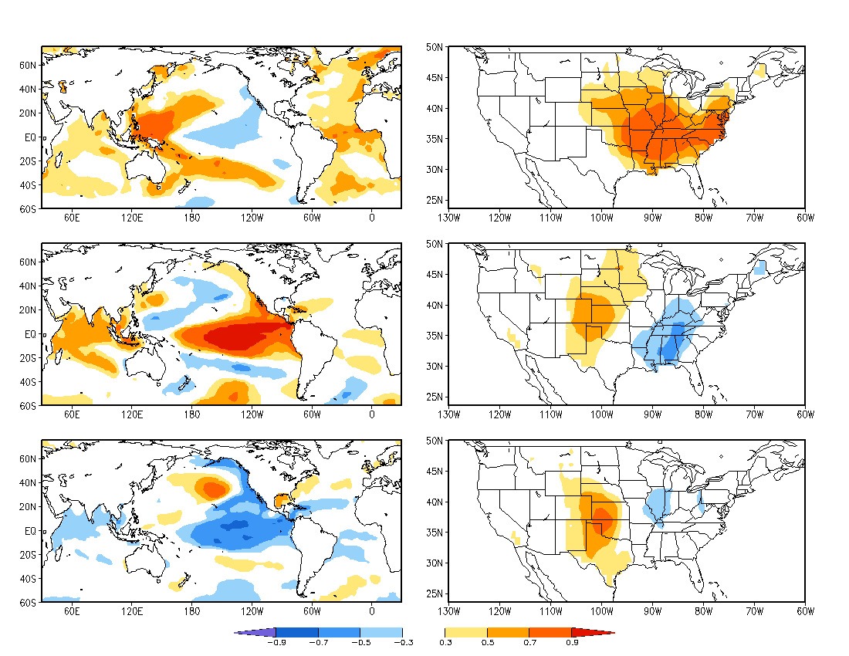
January SST
SVD: Spatial Pattern
MAMJ Tornado
Mode 1
34%
Mode 2
12%
Mode 3
10%

Slide 6
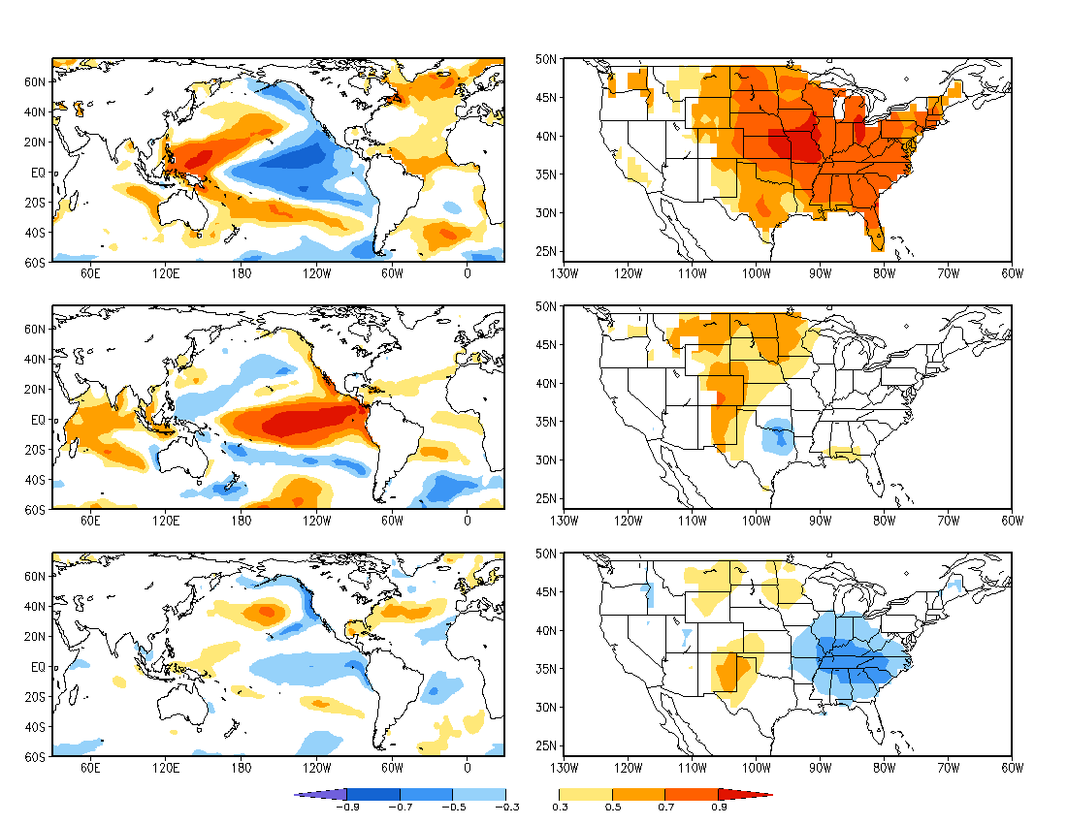
January SST
SVD: Spatial Pattern
MAMJ Hail
Mode 1
66%
Mode 2
4%
Mode 3
10%

Slide 7
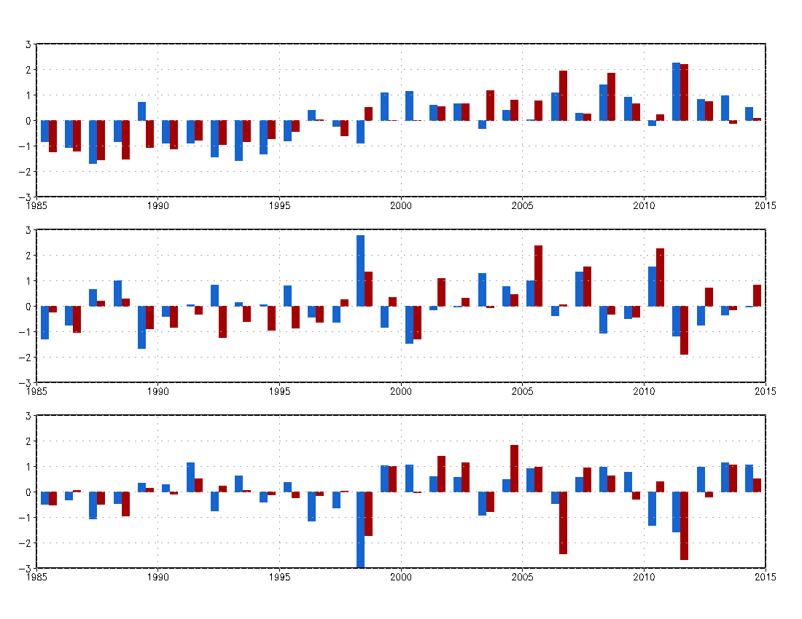
SVD: Time Series
Mode 1
R=0.74
SST
Hail
Mode 2
R=0.57
Mode 3
R=0.64

Slide 8
Statistical Forecast model
The methodology is same as Wang et al. (1999). The forecast model is cross-validated by the following steps.
To perform an SVD analysis between January SST and MAMJ tornado/hail activity to establish the lagged relationships, with a target year removed from the SVD analysis.
January SST of the target year is projected onto each SVD SST pattern. The SST projection coefficient is multiplied by the correlation coefficient between the two SVD time series to obtain tornado/hail projection coefficient.
Tornado/hail activity of the target year is predicted by the regression pattern of tornado/hail activity associated with each SVD mode multiplied by the tornado/hail projection coefficient for the target year.
Forecast skill is measured by anomaly correlation and hit rate over the 60/30 years.
Reference:
Wang, H., M. Ting, and M. Ji, 1999: Prediction of seasonal mean United States precipitation
based on El Niño sea surface temperatures. Geophys. Res. Lett., 26, 1341–1344.

Slide 9
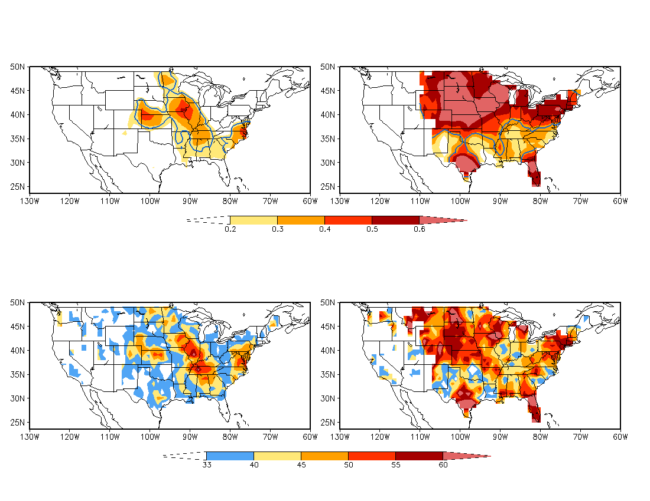
Forecast Skill
Anomaly Correlation
Tornado
Hail
95%
significance
level
Three categories
Above normal: 33%
Near normal: 33%
Below normal: 33%
Hit Rate (%)
Tornado
Hail

Slide 10
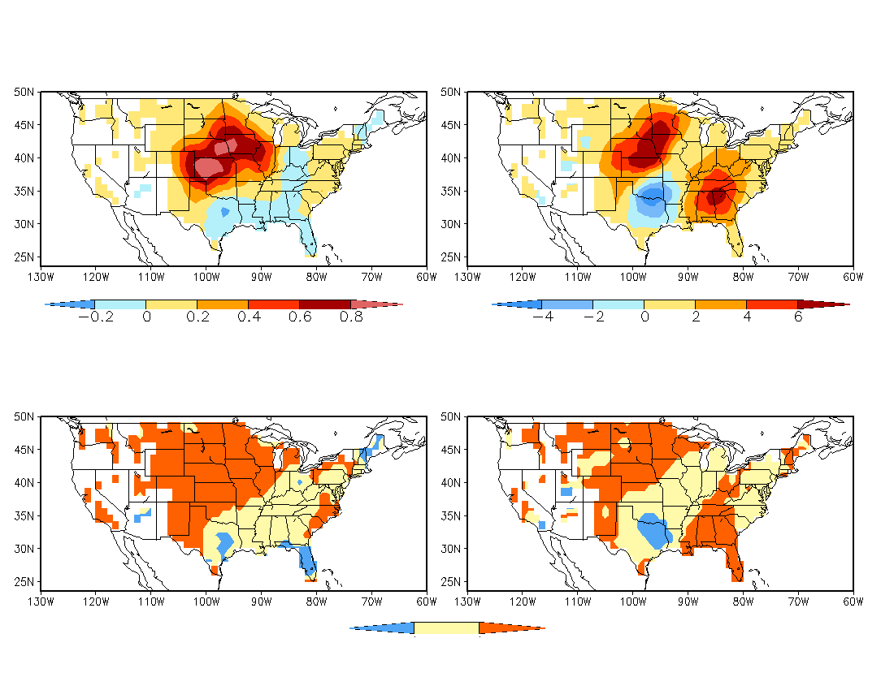
Forecast: MAMJ 2016
Assume that SSTA persists from December 2015 to January 2016
Anomaly
Tornado
Hail
Category
Tornado
Hail
Above
normal
Near
normal
Below
normal
Below Near Above
Normal

Slide 11
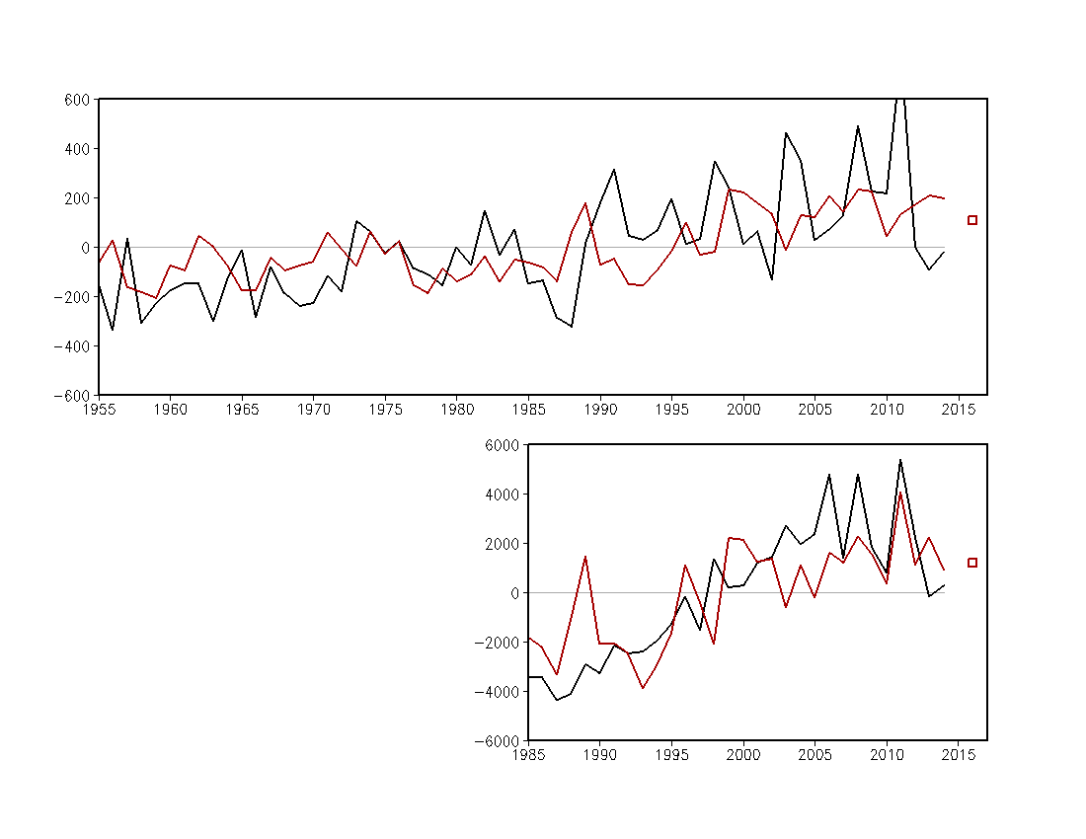
Total Anomaly over CONUS MAMJ
Tornado
R=0.40
2016
forecast
Observation
Forecast
Hail
R=0.71
2016
forecast

Slide 12
Summary
A statistical model was developed for forecasting seasonal tornado and hail activity using January SST as a predictor.
Cross-validations indicate certain skill for the central and eastern U.S.
The forecasts show a better skill for hails than for tornadoes.

