Slide 1
Hail ≥ 1”

Slide 2
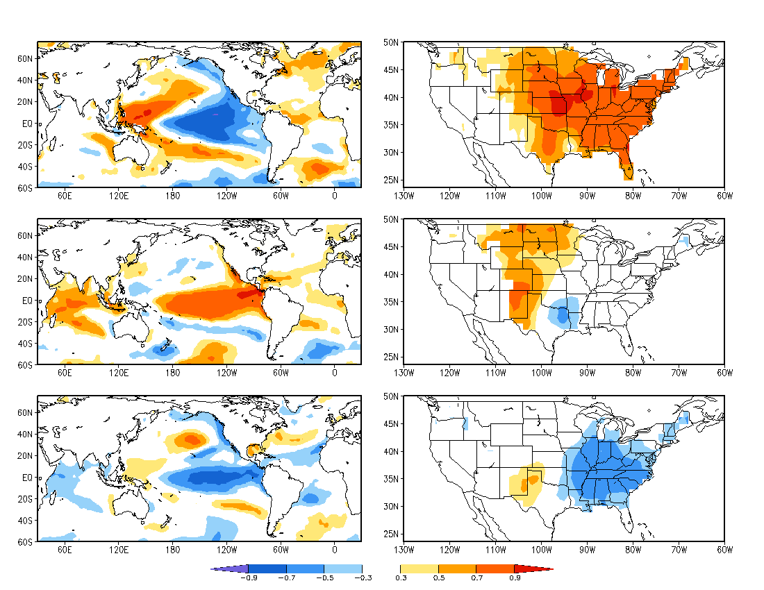

Slide 3
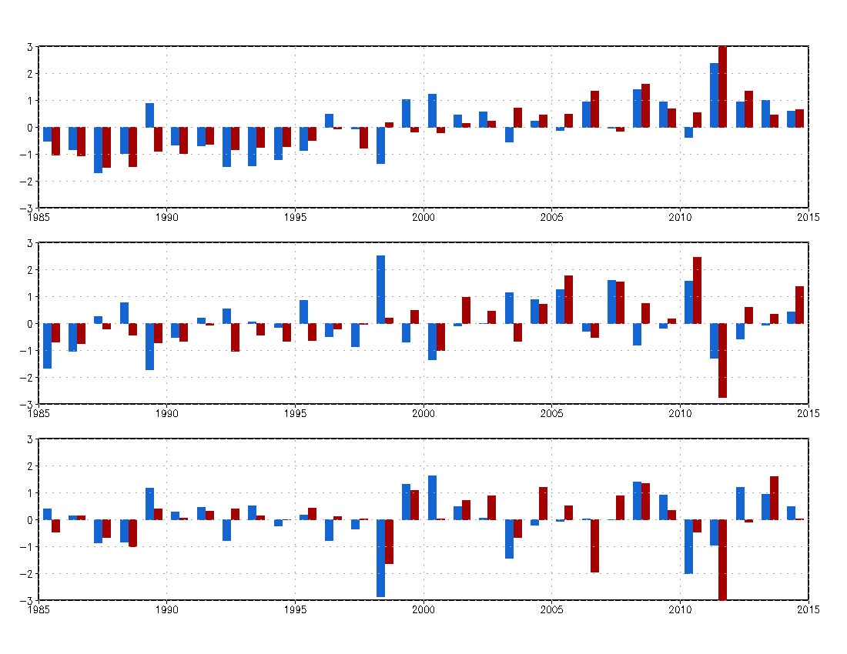

Slide 4
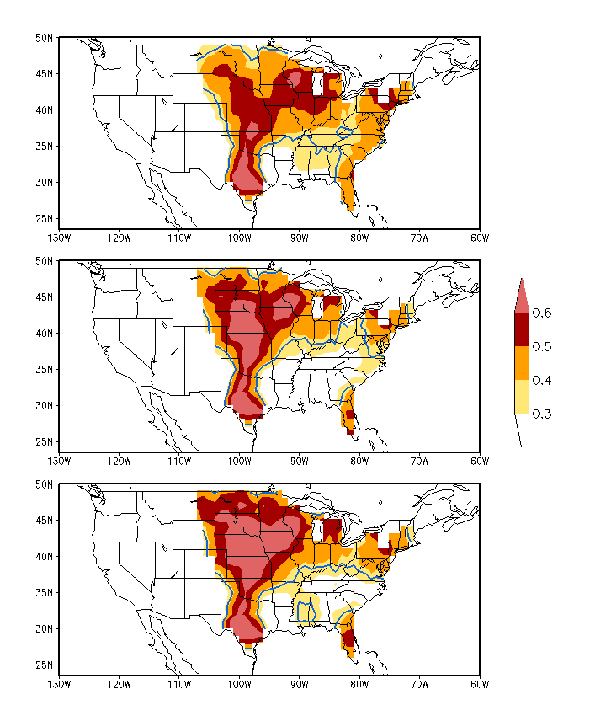

Slide 5
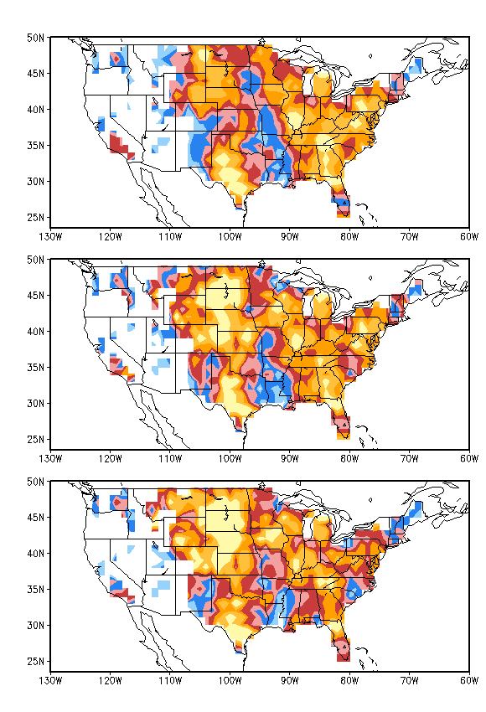
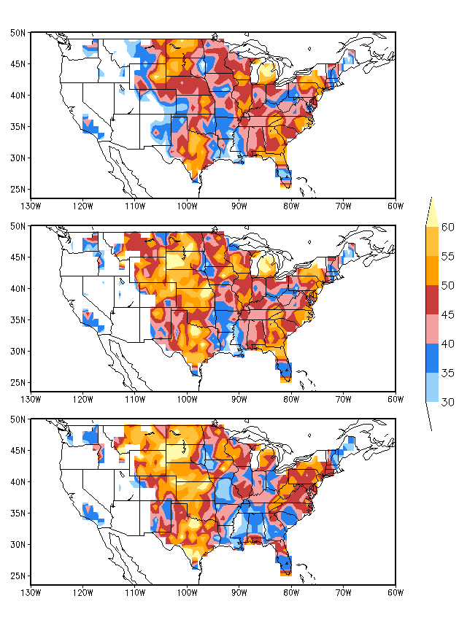
33%-33%-33%
Hit Rate
25%-50%-25%

Slide 6
Hail ≥ 1.5”

Slide 7
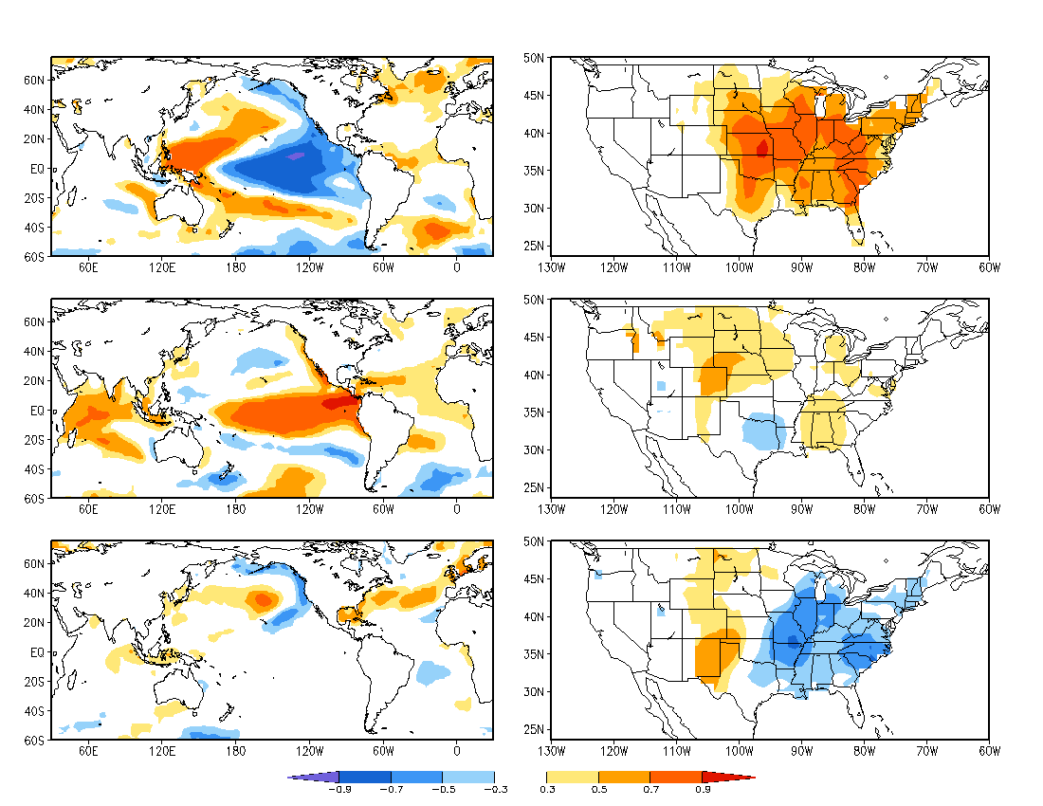

Slide 8
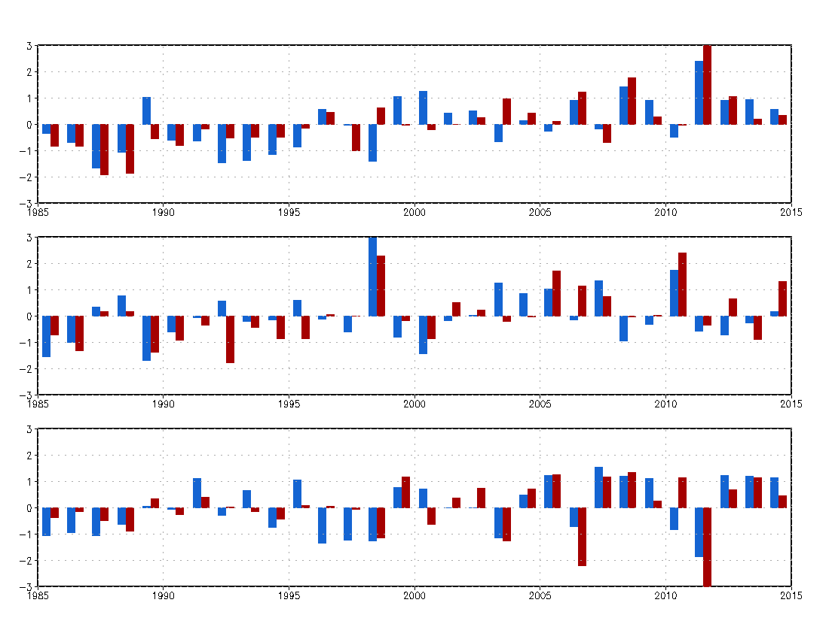

Slide 9
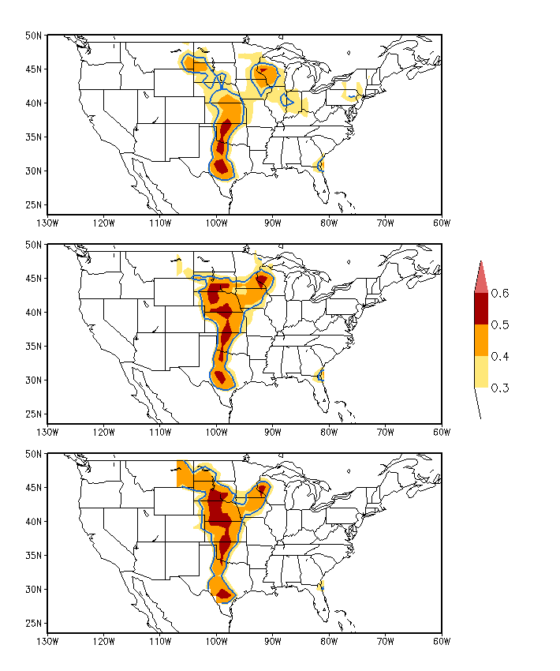

Slide 10
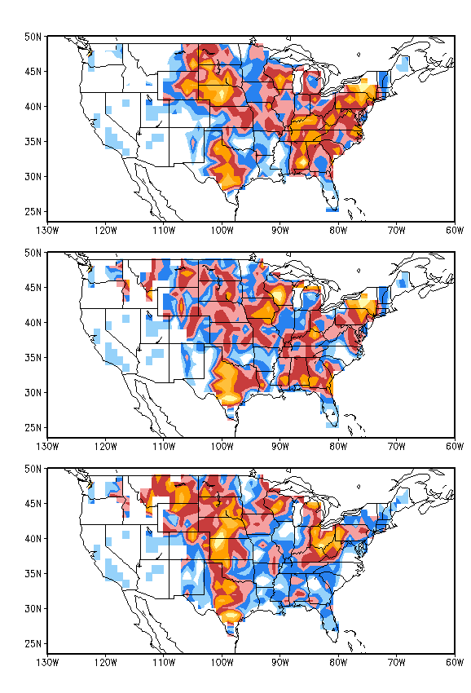
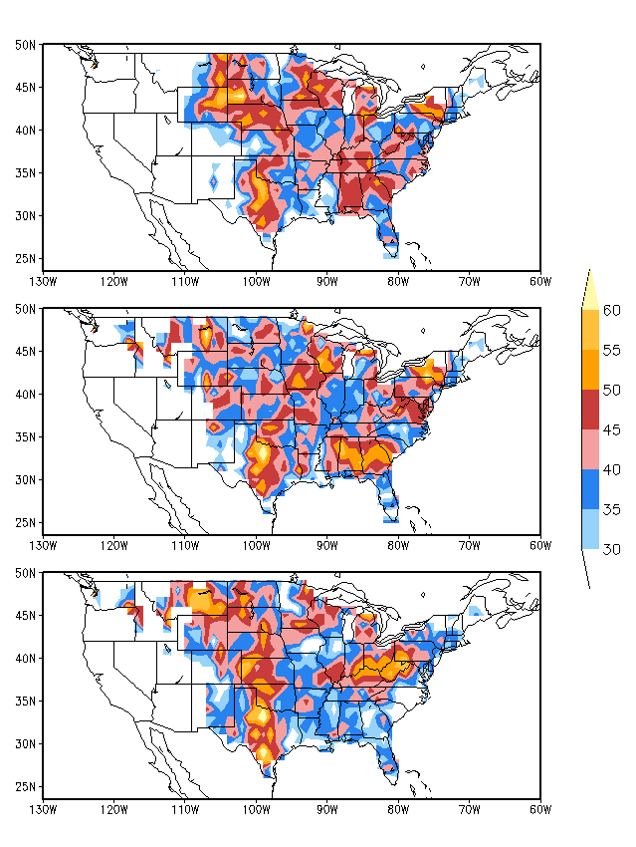
33%-33%-33%
Hit Rate
25%-50%-25%

Slide 11
Hail ≥ 2.0”

Slide 12
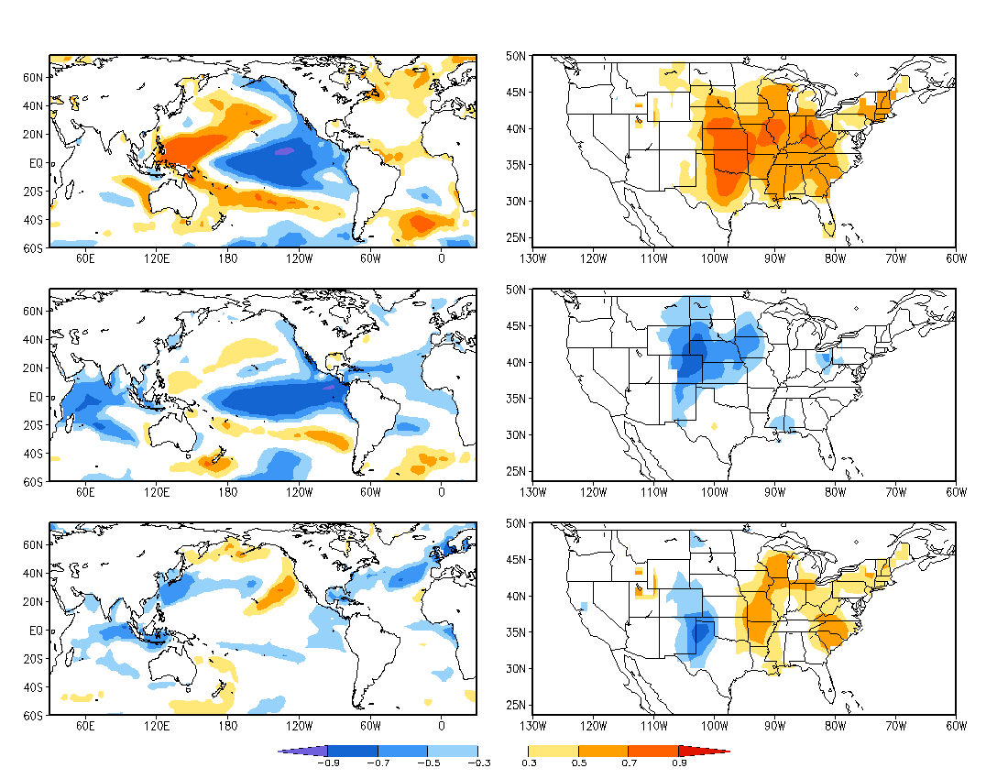

Slide 13
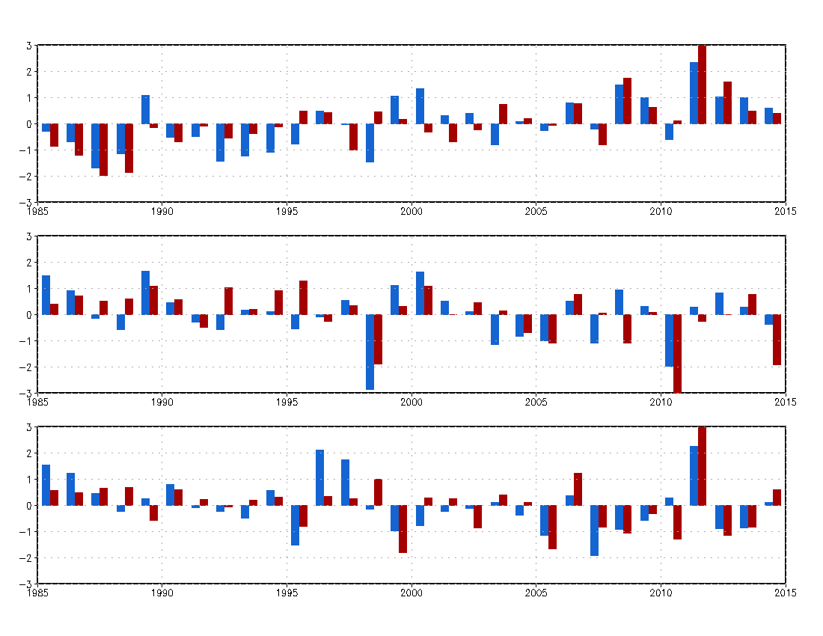

Slide 14
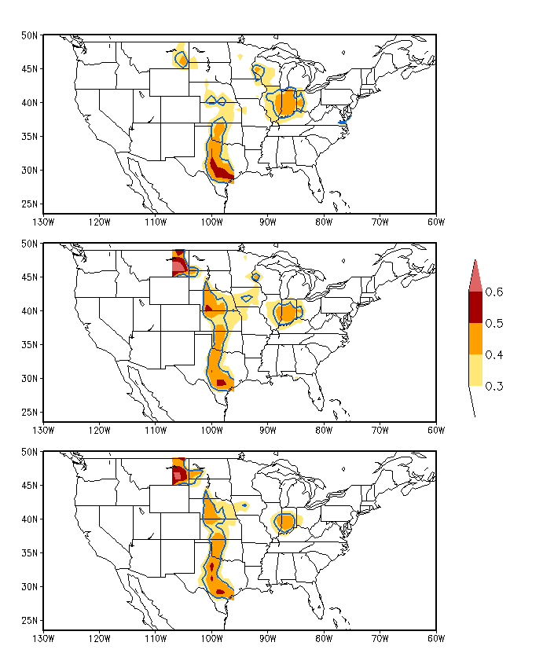
Auto Correlation

Slide 15
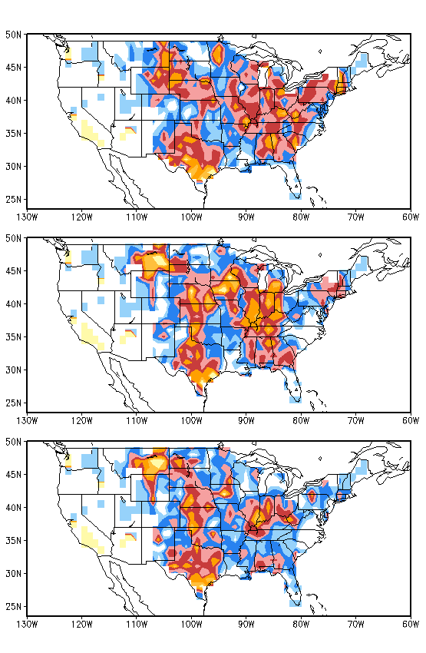
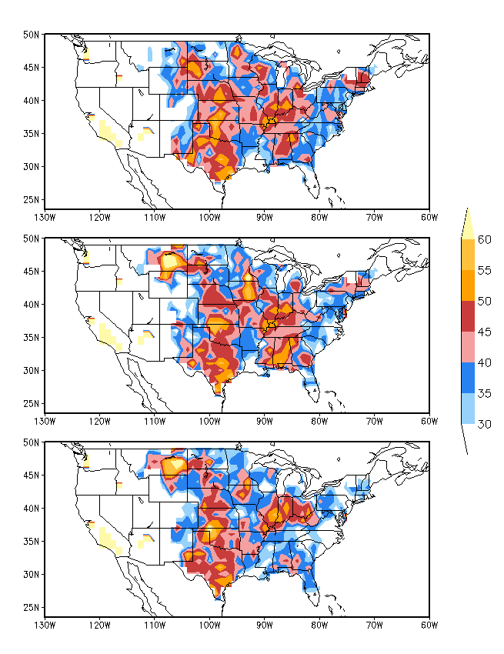
33%-33%-33%
Hit Rate
25%-50%-25%

Slide 16
Hail ≥ 2.5”

Slide 17
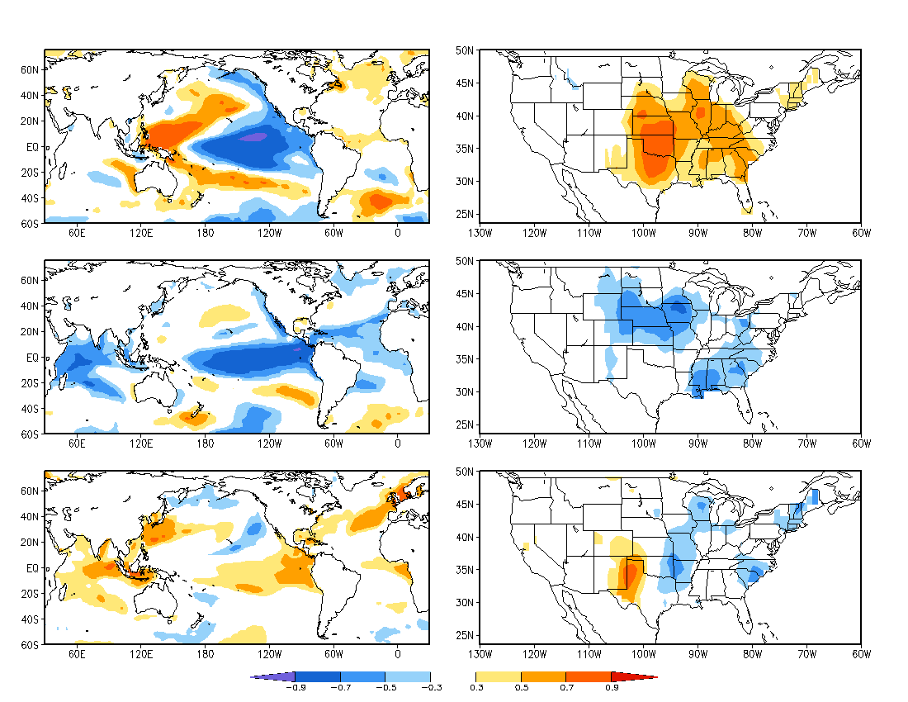

Slide 18
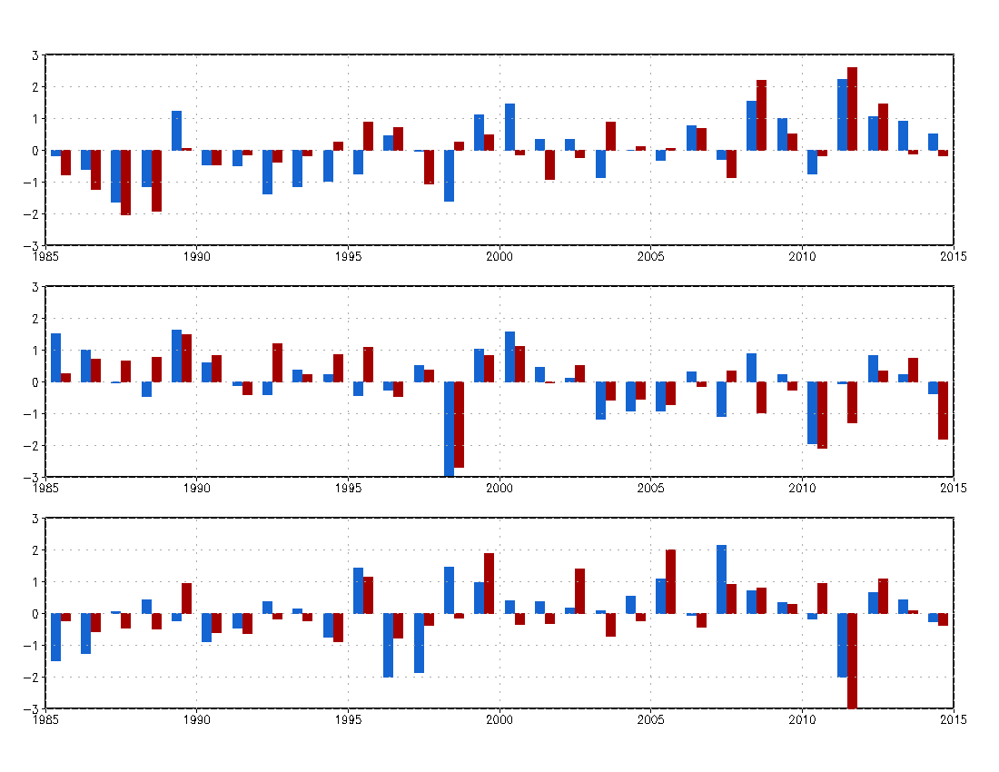

Slide 19
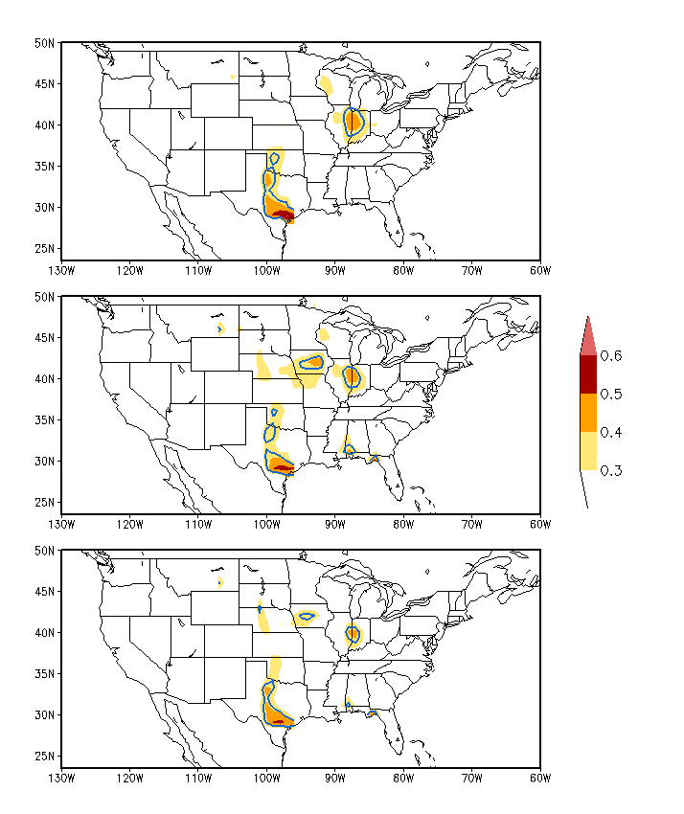
Auto Correlation

Slide 20
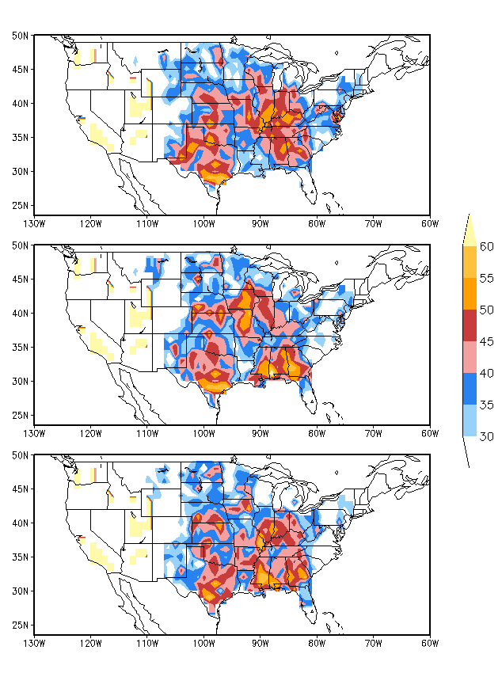
33%-33%-33%
Hit Rate
25%-50%-25%

Slide 21
Hail ≥ 3.0”

Slide 22
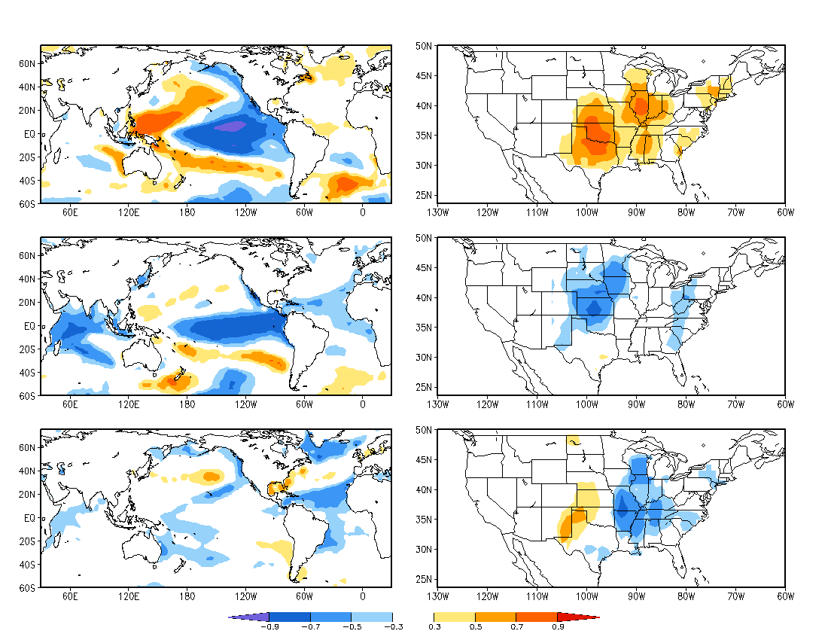

Slide 23
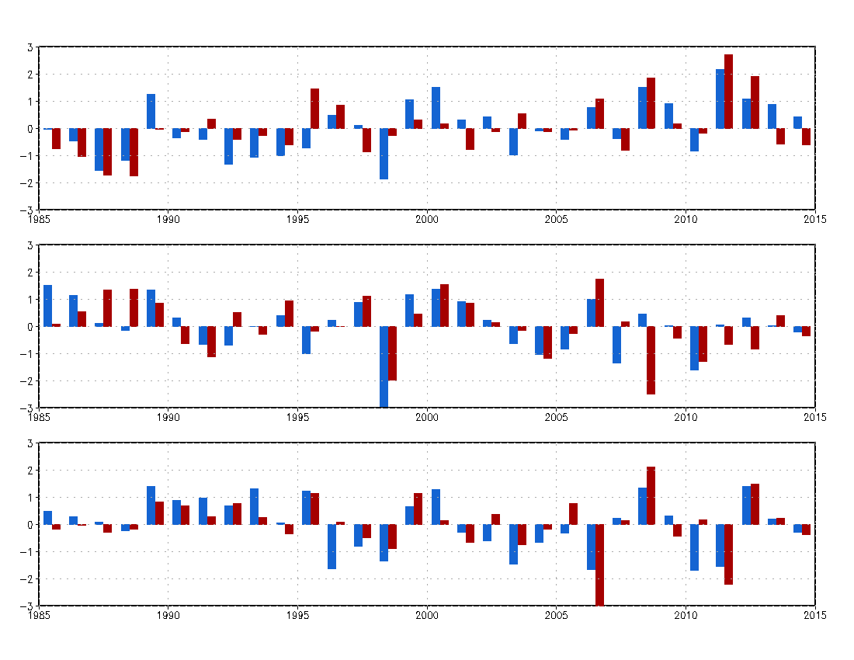

Slide 24
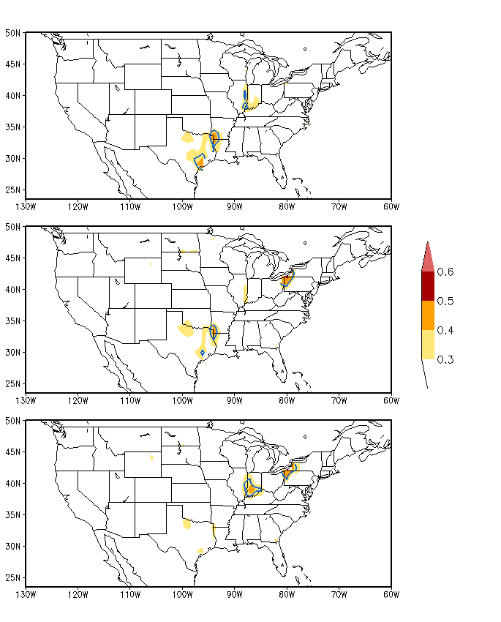
Auto Correlation

Slide 25
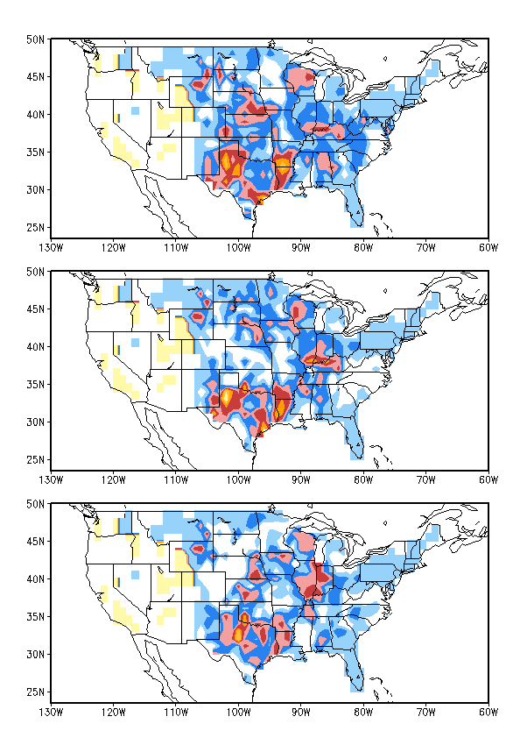
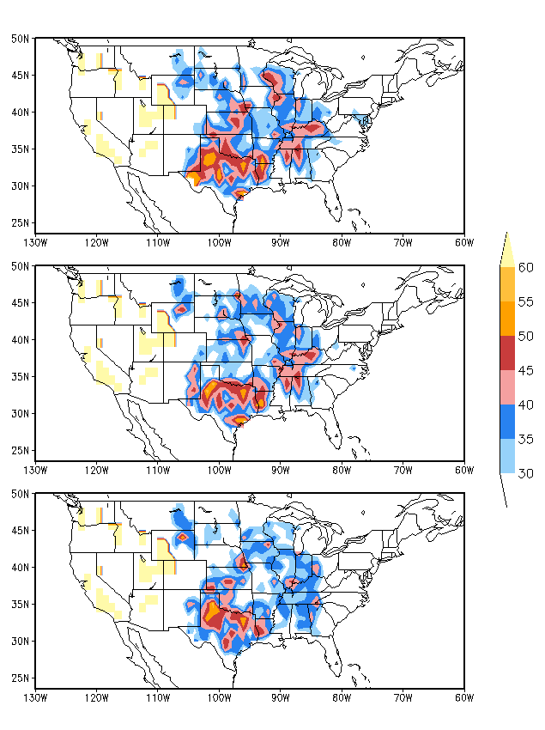
33%-33%-33%
Hit Rate
25%-50%-25%

