Slide 1
Statistical Prediction of Seasonal Hail Activity
7 January 2016

Slide 2
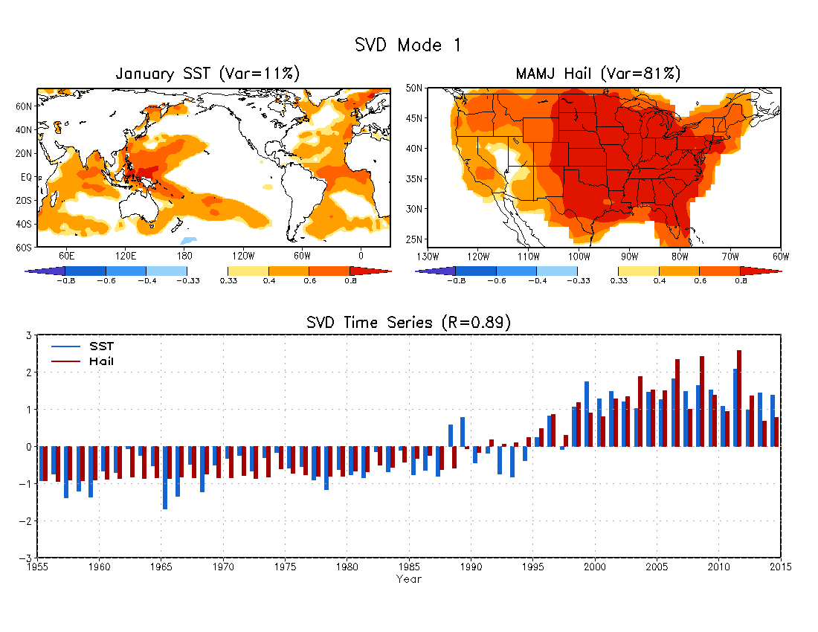
Data: 1955 – 2014
John Allen (2015)

Slide 3
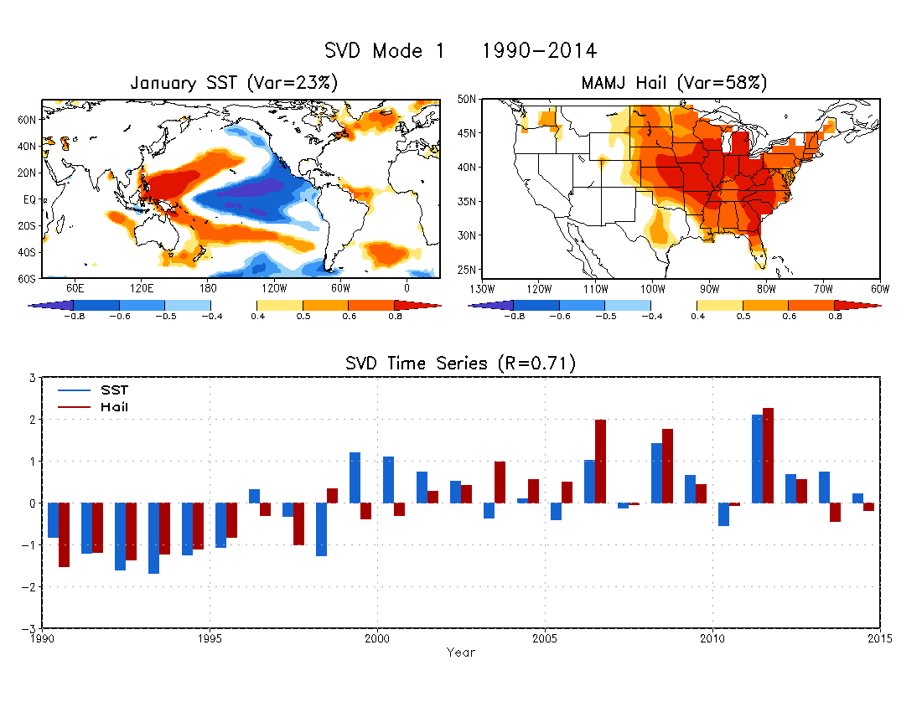
Data: 1990 – 2014

Slide 6
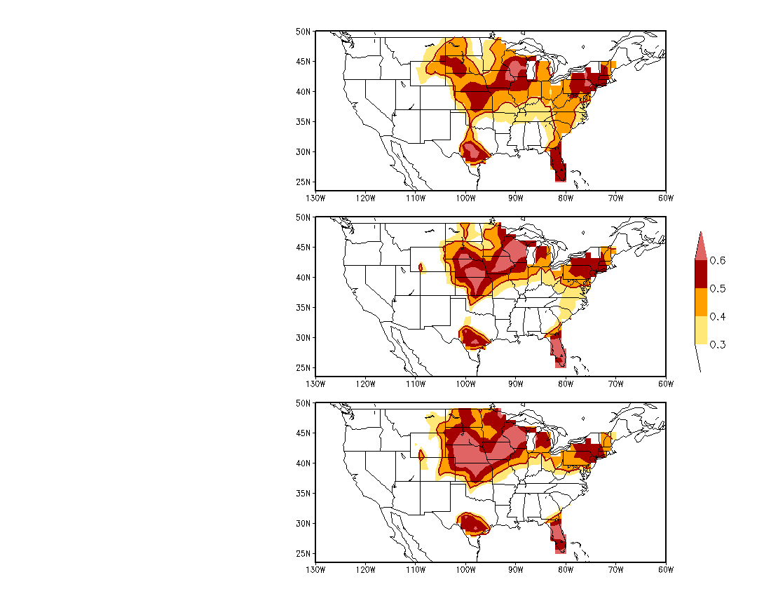
Forecast Skill
Anomaly Correlation between observed and predicted MAMJ hail activity during 1990 and 2014.
95%
significance
level
SVD1
The forecast model is based on the lagged relationship between January SST and MAMJ hail activity depicted by the SVD analysis.
SVD1+SVD2
Forecast skill is increased over the Midwest, Central and Northern Plains by including the second and third SVD modes.
SVD1+SVD2+SVD3

Slide 7
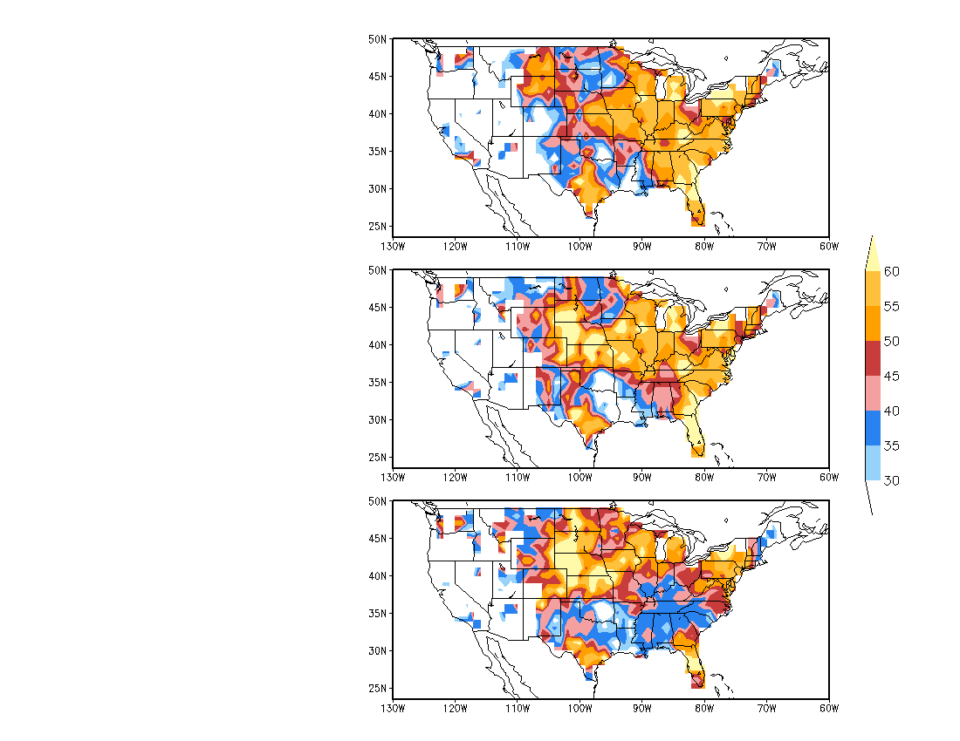
Hit Rate (%)
Three categories:
Above normal: 33%
Near normal: 33%
Below normal: 33%
SVD1
SVD1+SVD2
SVD1+SVD2+SVD3

Slide 8
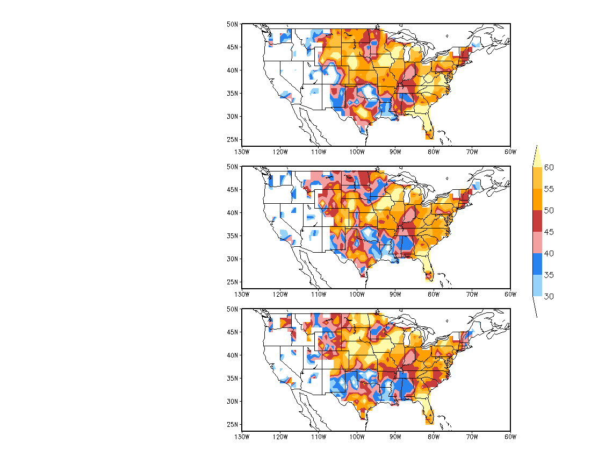
Hit Rate (%)
Three categories:
Above normal: 25%
Near normal: 50%
Below normal: 25%
SVD1
SVD1+SVD2
SVD1+SVD2+SVD3

Slide 9
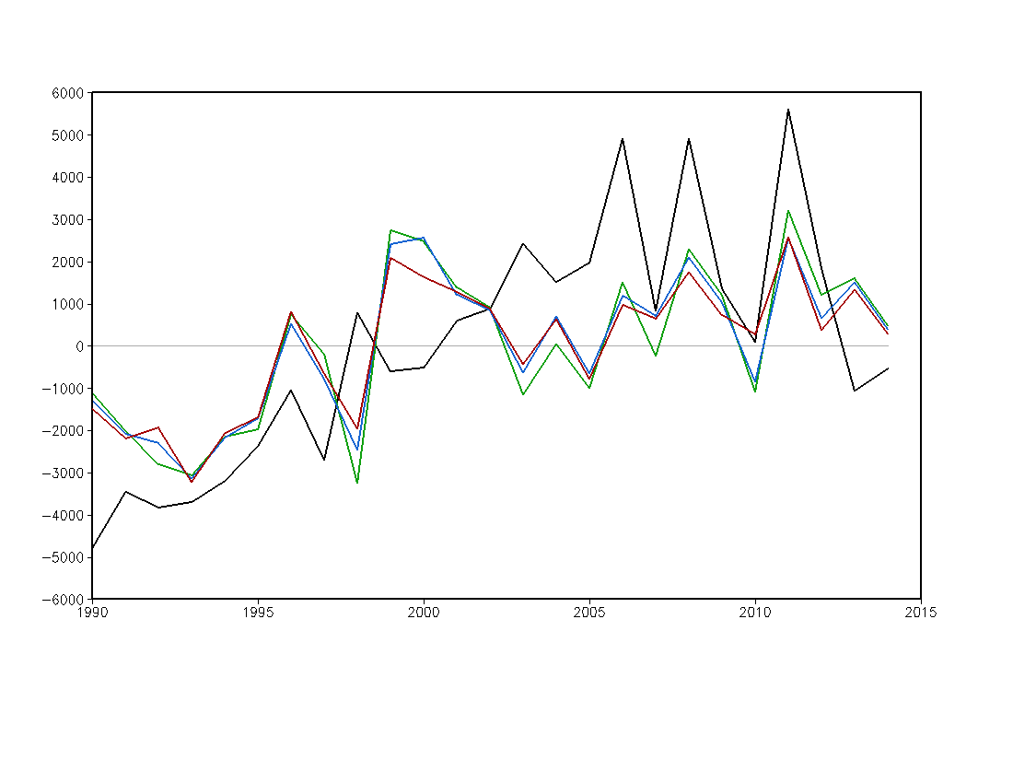
MAMJ
Anomalous Hail Activity over CONUS
OBS
SVD1 R=0.59
SVD1+SVD2 R=0.64
SVD1+SVD2+SVD3 R=0.68
Anomalous Hail Activity
Year

Slide 10
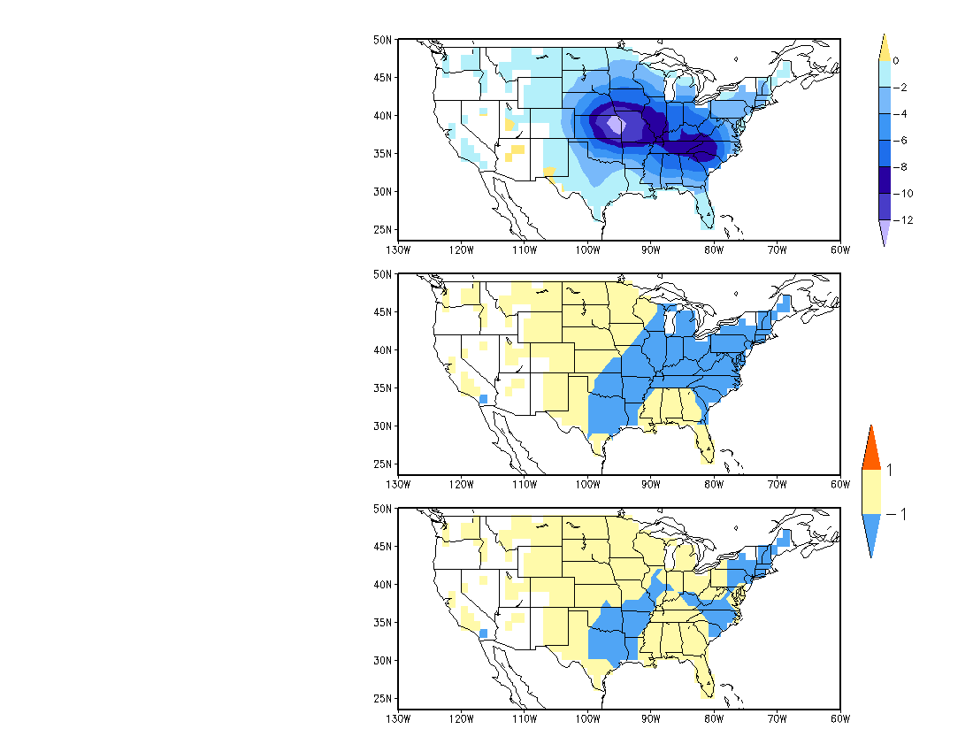
Forecast: MAMJ 2016 Hail (Anomaly)
Assume that SSTA persists from December 2015 to January 2016
Near Normal
Three categories:
Above normal: 33%
Near normal: 33%
Below normal: 33%
Below Normal
Above Normal
Near Normal
Below Normal
Near Normal
Three categories:
Above normal: 25%
Near normal: 50%
Below normal: 25%

Slide 11
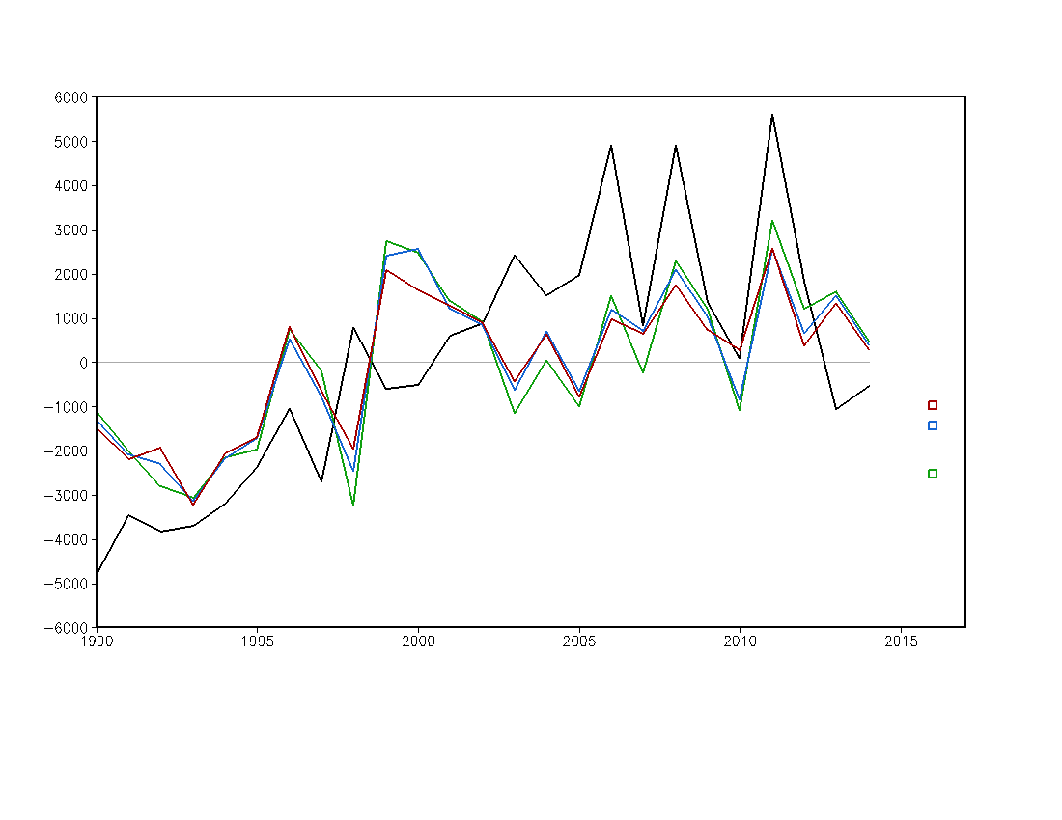
MAMJ
Anomalous Hail Activity over CONUS
OBS
SVD1 R=0.59
SVD1+SVD2 R=0.64
SVD1+SVD2+SVD3 R=0.68
Anomalous Hail Activity
Forecast for MAMJ 2016
Assuming that SSTA persists from December 2015 to January 2016
Year

