Slide 1
Covariability of Central America/Mexico Precipitation and Tropical Sea Surface Temperature under a Warming Climate and Associated Hydrological Cycle
Yutong Pan
Advisor: Dr. Ning Zeng
Examination Committee:
Dr. E. Hugo Berbery
Dr. James A. Carton
Dr. Zeng-Zhen Hu
Dr. Da-Lin Zhang
August 30, 2019

Slide 2
Outline
1. Introduction
Background
Motivation
Objectives
2. Data and Methods
Observational analysis and modeling study
AMIP: SST-forced response
CMIP: historical experiments and future climate projections
3. Preliminary Results
Covariability of CAM precipitation and tropical SST in winter
Covariability of CAM precipitation and tropical SST in summer
Regional hydrological cycle: present-day climate vs. future warmer climate
4. Future Research Plan
5. Timeline

Slide 3
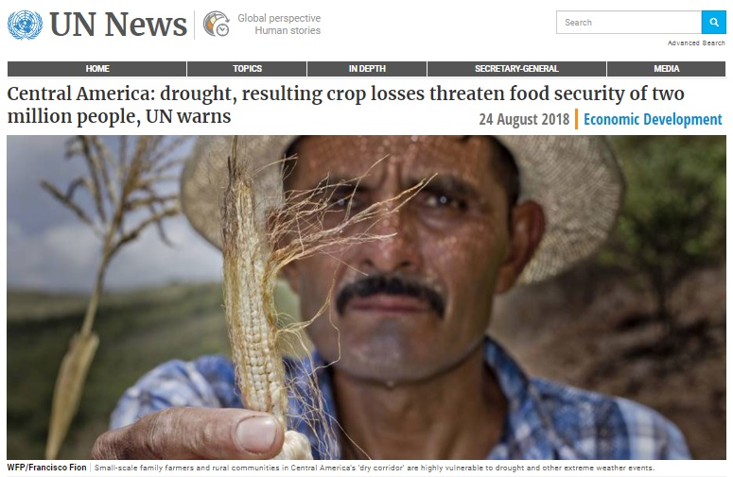
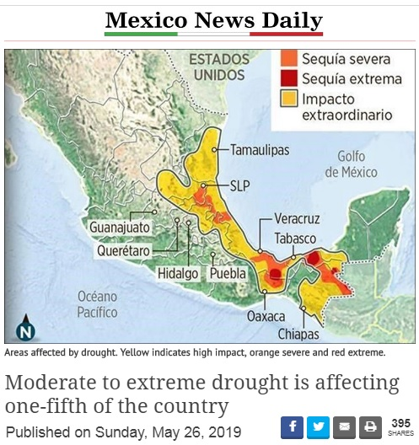
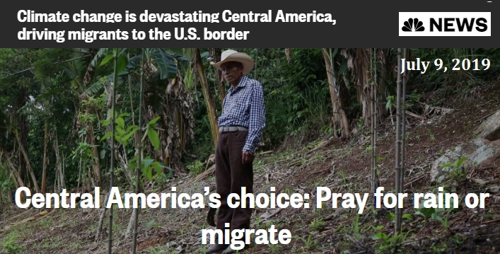
1. Introduction
Background
In the past two decades, droughts repeatedly struck Central America and Mexico (CAM).
Devastating social and economic impacts
2018
2019
2019

Slide 4
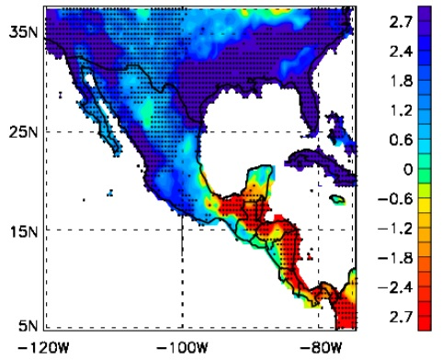
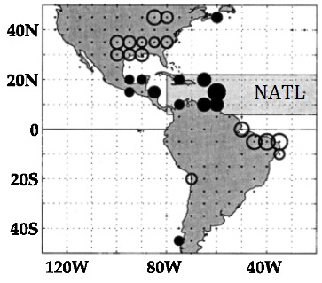
What caused the CAM droughts?
SST in the adjacent oceans have been identified as important factors modulating precipitation in CAM.
ENSO in tropical Pacific (ENSO composite)
Wetter winter in Mexico during El Niño
Opposite rainfall anomaly in Central America
Tropical Atlantic SST
High correlations between CAM precipitation and N. Atlantic SST
Influence of Atlantic SST at interannual timescale
El Niño Winter
Precip. anomaly
Melgarejo et al. (2017)
Enfield (1996)

Slide 5
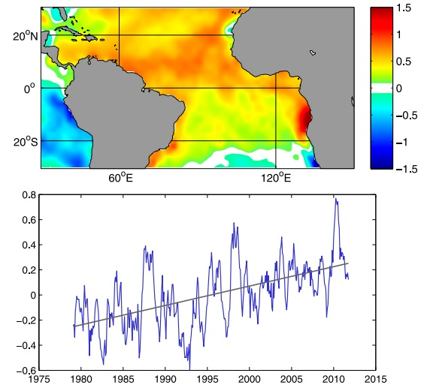
Motivation
Impact of Climate Change
Strong warming trend in tropical Atlantic SST
How the Atlantic SST warming affects CAM precipitation and contributes to the droughts has not been thoroughly examined.
Spatial pattern of SST trend
Area-average SST anomaly
Li et al. (2015)
It is also essential to quantify the relative importance of SSTs in the tropical Pacific and Atlantic in determining the CAM precipitation variability.

Slide 6
Objectives
To quantify the relationships between CAM precipitation and tropical SSTs based on observations, and characterize the seasonality (winter and summer) of the relationships .
To determine the relative importance of tropical Pacific and Atlantic SSTs to CAM precipitation, in particular, the contribution of the tropical SST warming trend associated with global warming.
To understand the relationships between CAM precipitation and tropical SSTs by examining the associated atmospheric circulation in observations and SST-forced AMIP runs.
To assess the projected changes in CAM precipitation and regional hydrological cycle through the comparison between the present-day climate and future climate simulations (CMIP5)

Slide 7
2. Data and Methods
Observational Data
Precipitation: NOAA Precipitation Reconstruction over Land (PREC/L)
SST: NOAA Extended Reconstructed SST (ERSST) v3b
Wind & Height: NCEP–NCAR Reanalysis
Other variables: T2m, evaporation, soil moisture, runoff
Monthly mean data
1948–2018
Longer records starting from 1850
Winter: DJF or JFM
Summer: JJA

Slide 8
Modeling Study: 2 types of simulations
AMIP simulations
Atmospheric model: NCEP Global Forecast System (GFS)
Driven by observed time-varying SST from 1957 to present
T126 (∼105 km) and 64 vertical layers
18 members
Maintained by Dr. Bhaskar Jha at CPC
Ensemble mean: Atmospheric response to SST forcing

Slide 9
Modeling Study: 2 types of simulations
CMIP simulations
Coupled model
CIMP5 runs
Historical experiments: 1860–2005 (present-day climate)
RCP45 scenario: 2005–2100 (future warmer climate)
Multi-model ensemble (MME): 25 models
The CMIP5 data have been used for studying climate change in the Mediterranean region (my M.S. thesis at UMD 2013; Alessandri et al. 2014; Mariotti et al. 2015)
Similar analysis will be conducted for Central America and Mexico region.

Slide 10
Methods of Statistical Analysis
Correlation, linear regression, and linear trend
Singular value decomposition (SVD) method
Objectively identify covariations between two fields (e.g., SST and precipitation)
Each SVD mode consists of a pair of spatial patterns and two time series, with an order determined by the covariance explained.
Quantify the relationship between the two fields with the percentage of covariance explained, as well as the percentage of variance for individual fields
The SVD analysis will be able to determine the relative importance of tropical Pacific and Atlantic SST to CAM precipitation.

Slide 11
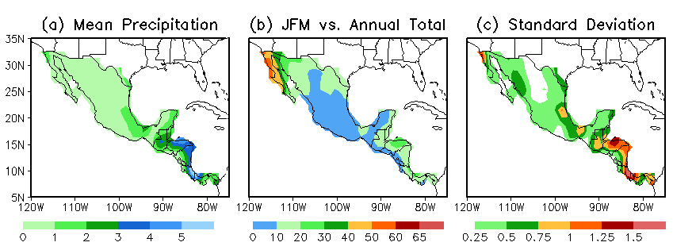
3. Preliminary Results
Covariability of CAM precipitation and tropical SST in Winter
(Pan et al. Clim Dyn, 2018)
Climatology and Variability (JFM 1948 – 2015)
Relatively wet over Central America and dry to the north
Winter precipitation ∼ 10% – 30% of annual total rainfall
Strong variability in Central America and weak variability in Mexico

Slide 12
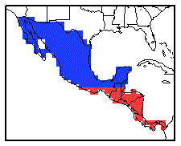
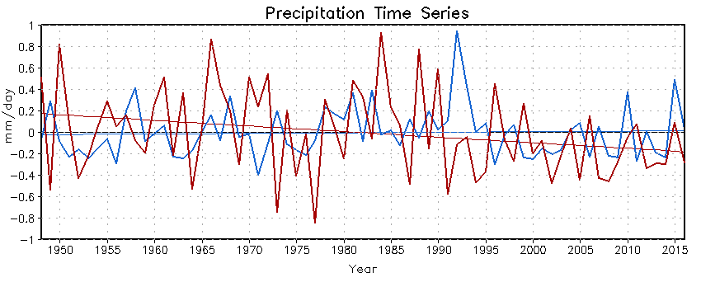
Covariability of CAM precipitation and tropical SST in winter
JFM 1948 – 2015
Central America
Mexico
High standard deviation in Central America (0.40 mm/day) and low standard deviation in Mexico (0.24 mm/day)
Correlation between two time series: –0.02
Linear trend: –0.05 mm/day per decade in Central America and 0.005 mm/day per decade in Mexico
Prolonged drought since 2000 (negative values)

Slide 13
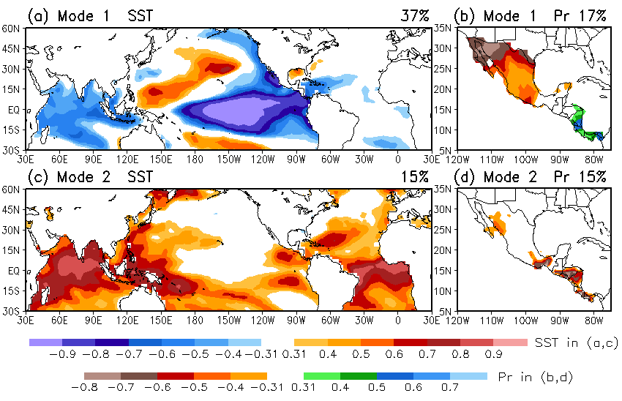
Covariability of CAM precipitation and tropical SST in winter
SVD Analysis (OBS)
67% Covariance
20% Covariance

Slide 14
Covariability of CAM precipitation and tropical SST in winter
SVD Analysis (OBS)
SST
Precip.
Pr 17%
R=0.70
Pr 15%
R=0.63
R=0.63

Slide 15
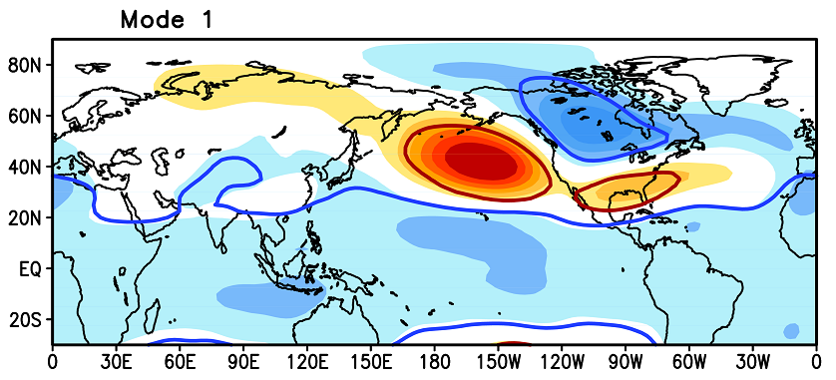
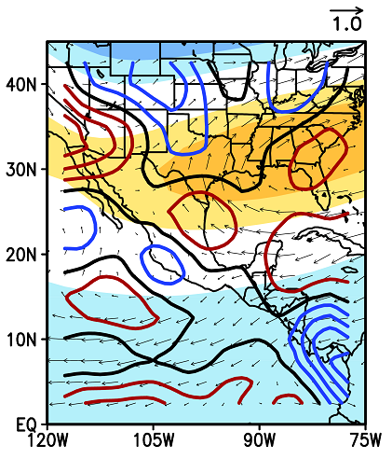
Covariability of CAM precipitation and tropical SST in winter
Circulation Anomalies Associated with Mode 1 (OBS)
850-hPa Wind and
925-hPa Divergence
500-hPa Height
A PNA pattern in response to La Niña
Local circulation
Positive height anomaly and low-level divergence in Mexico
Negative height anomaly and low-level convergence in CA
Dynamically consistent with precipitation pattern in SVD Mode 1

Slide 16
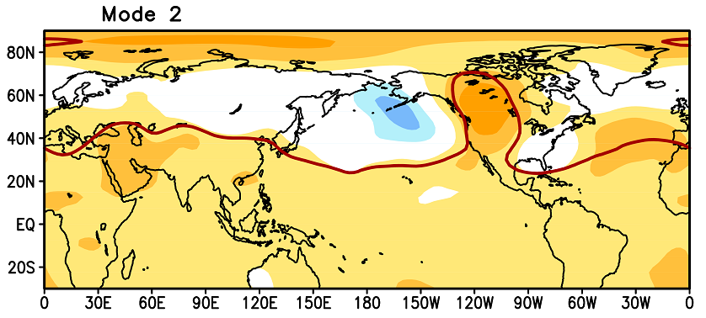
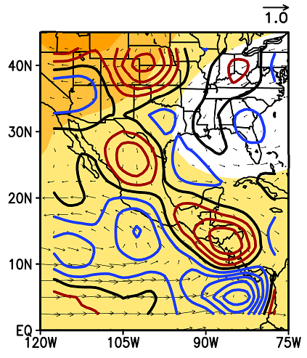
Covariability of CAM precipitation and tropical SST in winter
Circulation Anomalies Associated with Mode 2 (OBS)
850-hPa Wind and
925-hPa Divergence
500-hPa Height
Positive height anomalies in the tropics,
consistent with the warming of tropical SST in Mode 2
Local circulation
Positive height anomaly in CAM
Two centers of low-level divergence
The atmosphere bridges the tropical SST and CAM precipitation

Slide 17
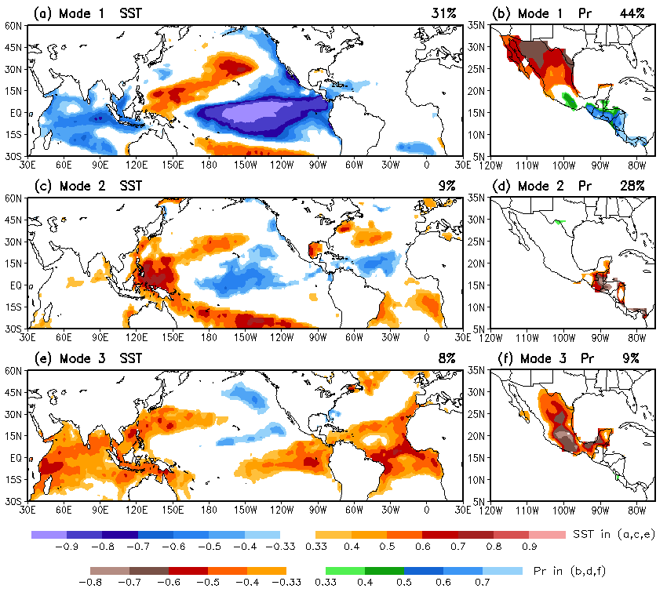
Covariability of CAM precipitation and tropical SST in winter
SVD Analysis (SST-forced AMIP)
73% Covariance
SVD applied to 18-member ensemble mean precipitation
Mode 1: La Niña SST and out-of-phase Precipitation in CAM
Mode 2: Less rainfall in CA and SST warming in western Pacific
Mode 3: Less rainfall in Mexico and warming in tropical Atlantic and Indian Ocean
17% Covariance
6% Covariance

Slide 18
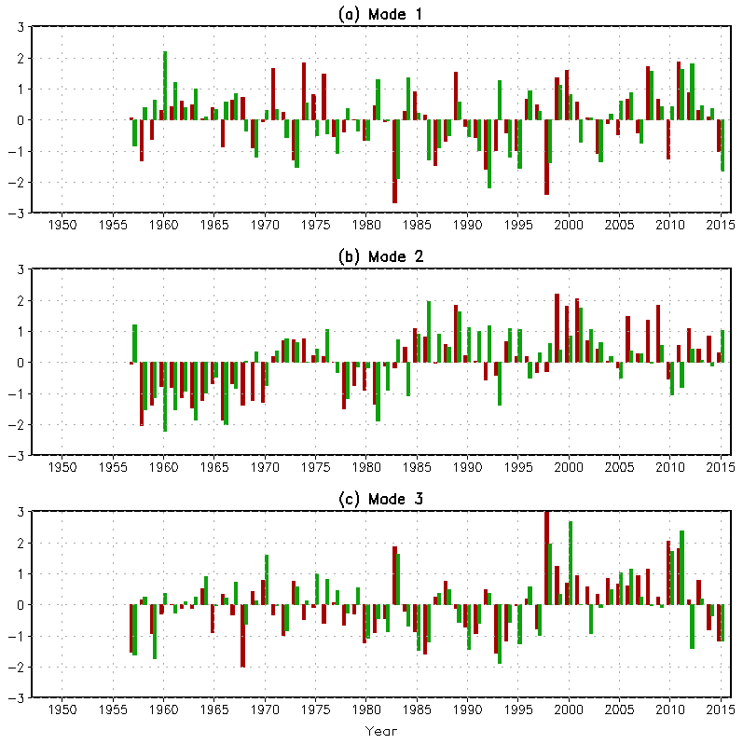
Covariability of CAM precipitation and tropical SST in winter
SST
Precip.
SVD Analysis (SST-forced AMIP)
Pr 44%
Correlations: highly significant
Strong interannual variability in Mode 1
An upward trend in both Mode 2 and Mode 3
Model results suggest that droughts over CAM in past two decades are indeed a response to the warming of tropical SST, as well as La Niña SST.
R=0.61
Pr 28%
R=0.66
Pr 9%
R=0.73

Slide 19
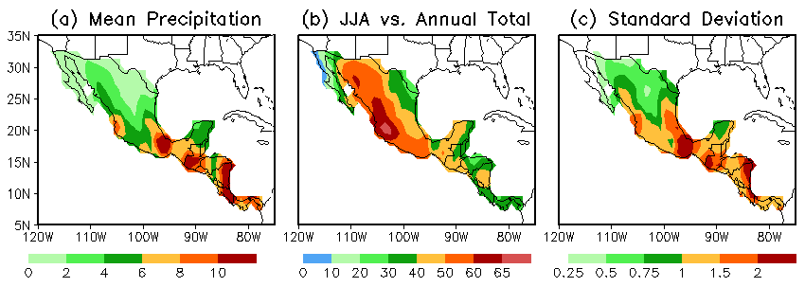
Covariability of CAM precipitation and tropical SST in Summer
Climatology and Variability (JJA 1948 – 2018)
Summer mean precipitation exceeding 10 mm/day over Central America and southern Mexico, about twice as much as winter
Mean precipitation is less in central and northern Mexico, but contributes more than 50% to the annual total, indicating the importance of summer monsoon to this region.
Large variability in Central America and southern Mexico

Slide 20
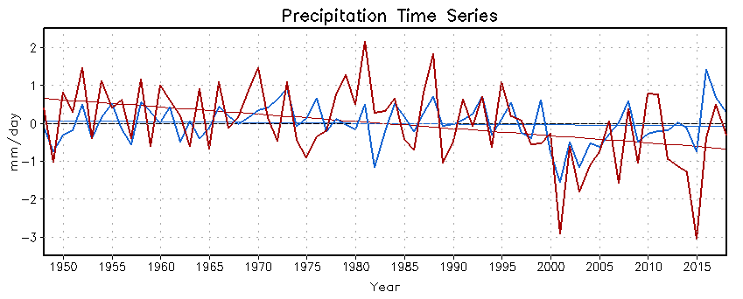
Covariability of CAM precipitation and tropical SST in summer
JJA 1948 – 2018
Central America
Mexico
High standard deviation in Central America (0.98 mm/day) and low standard deviation in Mexico (0.51 mm/day)
Correlation between two time series: 0.51
Linear trend: –0.19 mm/day per decade in Central America and –0.021 mm/day per decade in Mexico
Prolonged drought since 2000 in both regions (negative values)

Slide 21
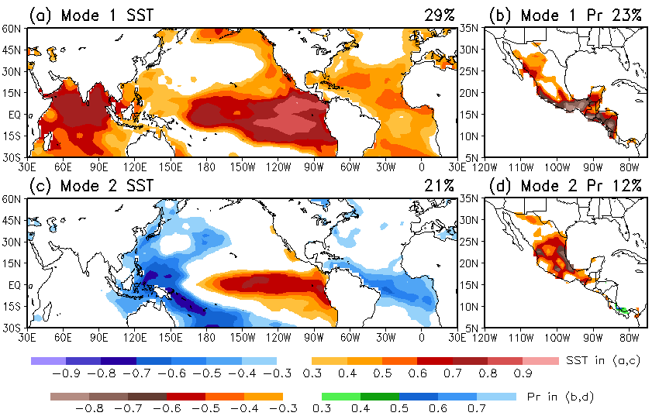
Covariability of CAM precipitation and tropical SST in summer
SVD Analysis (OBS)
58% Covariance
26% Covariance

Slide 22
Covariability of CAM precipitation and tropical SST in summer
SVD Analysis (OBS)
SST
Precip.
Pr 23%
Summer analysis is very
preliminary, but we see
some seasonality, e.g.:
R=0.55
Dominant variability in summer is associated with long-term trend
Summer precipitation in Mexico covaries with both long-term trend and interannual change in tropical SST, while rainfall in winter mainly links to the interannual change in tropical SST
Pr 12%
R=0.60

Slide 23
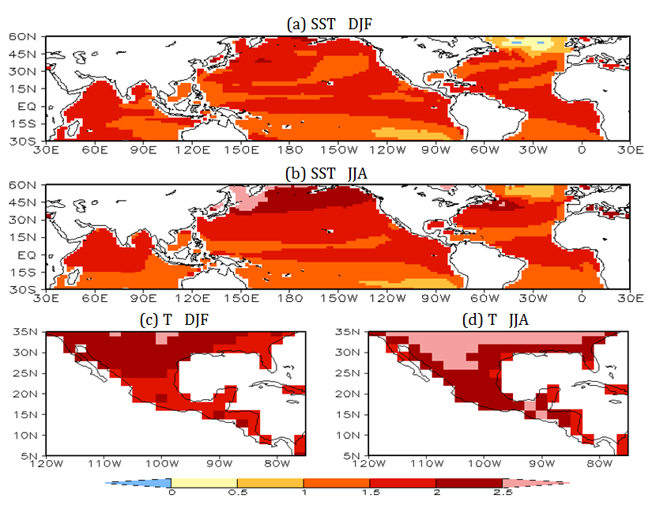
Regional hydrological cycle: Present-day climate vs. future warmer climate
CMIP5 Multi-Model Ensemble Mean: RCP45 Runs – Historical Runs
(MMEM: representative of the forced climate response) (2071-2100) (1980-2005)
CMIP5 projects
1 – 2 K warming of tropical SST
1.5 – 3 K warming of surface air temperature over CAM
in both winter and summer
by the later 21st century.
Under such a warmer climate, how would the CAM precipitation and hydro- logical cycle change?

Slide 24
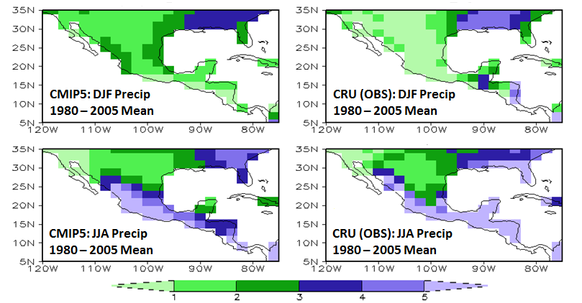
Regional hydrological cycle: Present-day climate vs. future warmer climate
Precipitation Climatology: CMIP5 Historical Runs vs. OBS
(1980 – 2005) (MMEM)
CMIP5
OBS
DJF
CMIP5: Mean Precip
1980-2005
CRU (OBS): Mean Precip
1980-2005
JJA
CMIP5: Mean Precip
1980-2005
CRU (OBS): Mean Precip
1980-2005
Overall, CMIP5 can reproduce the observed winter and summer mean precipitation reasonably well in CAM.

Slide 25
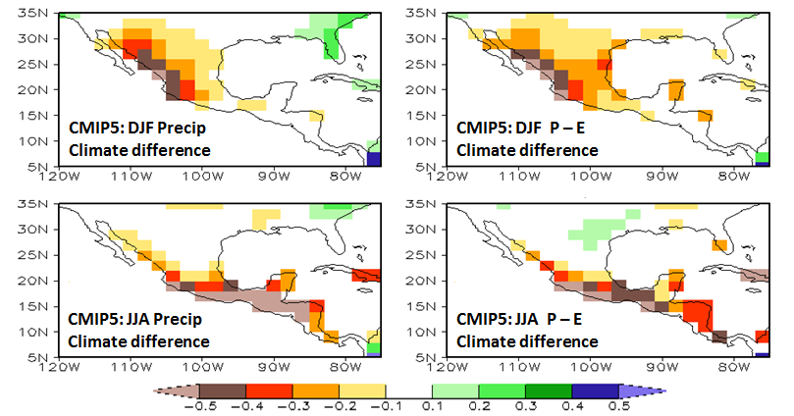
Regional hydrological cycle: Present-day climate vs. future warmer climate
CMIP5 MMEM: RCP45 Runs – Historical Runs
(2071-2100) (1980-2005)
Precip
P – E
DJF
Precip
MMEM Diff
P - E
MMEM Diff
JJA
Precip
MMEM Diff
P - E
MMEM Diff
RCP45 projects decreases in precipitation
Up to 0.5 mm/day in Mexico during winter, and
More than 0.5 mm/day in Central America and Mexico during summer
The projected P – E also decreases in both winter and summer.
CAM is expected to experience loss of water and become drier in a warmer climate.

Slide 26
Regional hydrological cycle: Present-day climate vs. future warmer climate
CMIP5 MMEM Anomalies (Subtracted by the 1980–2005 climatology)
T
P – E
DJF
JJA
Persistent warming and decrease in P–E in the 21st century.
More detailed study on the projected changes in CAM precipitation and regional hydrological cycle with focuses on
Seasonality
Difference between the northern and southern regions

Slide 27
4. Future Research Plan
Covariability of CAM precipitation and tropical SST in winter
For consistency, the analysis similar to Pan et al. (2018) will be performed using the data extended to 2018 for winter (DJF)
SVD analysis of CAM precipitation and tropical SST with observational data (DJF 1948 – 2018)
Analysis of the associated atmospheric circulation anomaly using the NCEP–NCAR Reanalysis data (DJF 1948 – 2018)
SVD analysis using the AMIP data (DJF 1957 – 2018)
Comparison between observations and AMIP simulations

Slide 28
4. Future Research Plan
Covariability of CAM precipitation and tropical SST in summer
The analysis for summer will be in parallel with that for winter.
Analysis of the SVD-related atmospheric circulation anomalies (NCEP–NCAR Reanalysis data, JJA 1948 – 2018)
SVD analysis of summer CAM precipitation and tropical SST using the AMIP data (18-member mean, JJA 1957 – 2018)
Comparison between observations and the AMIP results to verify if the observed SVD precipitation patterns are the response to tropical SST forcing
Comparison between winter and summer to characterize the seasonality of the relationship between CAM precipitation and tropical SST

Slide 29
4. Future Research Plan
Regional hydrological Cycle:
Present-day climate vs. future warmer climate
Analysis of the projected changes in soil moisture and runoff over CAM in response to global warming, in addition to precipitation and evaportranspiration (CMIP5 MMEM)
Comparison of hydrological cycle changes between winter and summer
Comparison of changes of hydrological cycle between the northern region (Mexico, monsoon region) and southern region (Central America, tropical rainforest)

Slide 30
5. Timeline
2.5 Months 3 Months 3 Months
2/16/20 – 5/15/20
9/1/19 – 11/15/19
11/16/19 – 2/15/20
Analysis for winter season
Extended period (DJF 1948 – 2018)
Related thesis chapter writing
Analysis for summer season
Related thesis chapter writing
A manuscript to be submitted to Climate Dynamics
Analysis of regional hydrological cycle in CMIP5 simulations
Complete thesis
Another manuscript to be submitted to Climate Dynamics
Thesis defense: around May 18, 2020

