Slide 1
Update (7/23/2019)
GEFS data on cpcwork1: /cpc/model_realtime/gefs/$yr/$mon/$day/$zz
Add the contour of 0.5 to the map of LSR3 forecast
Verification of the week-2 severe weather forecasts for MAM 2019

Slide 2
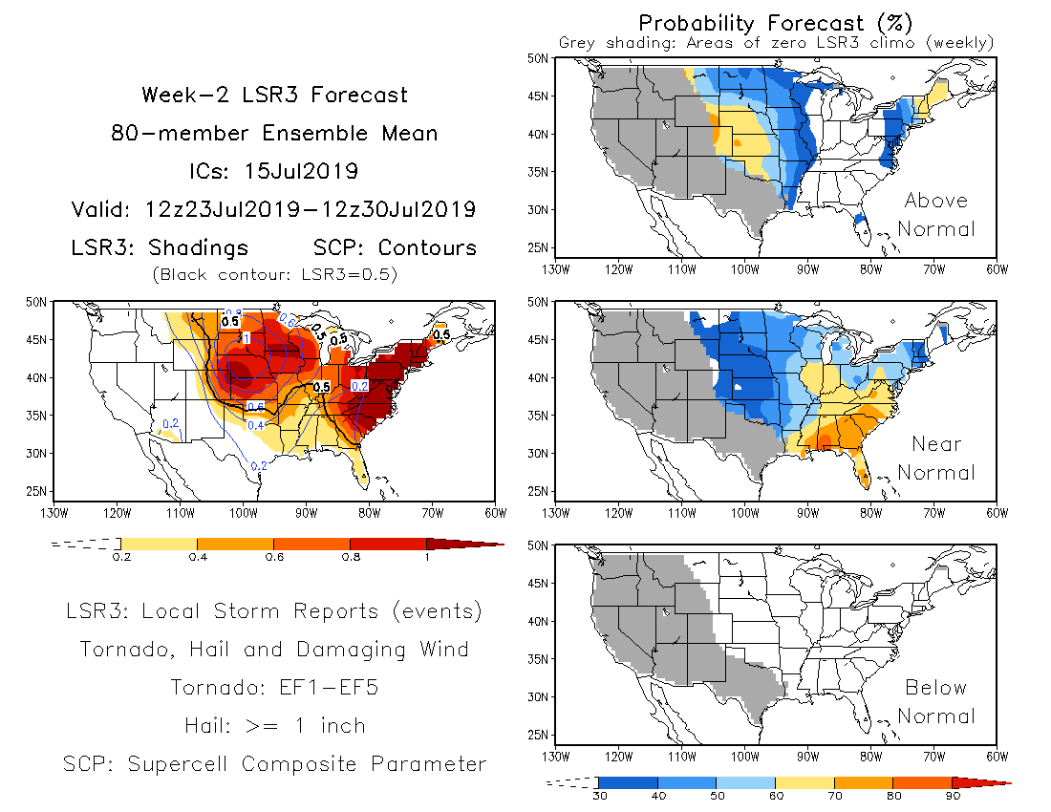

Slide 3
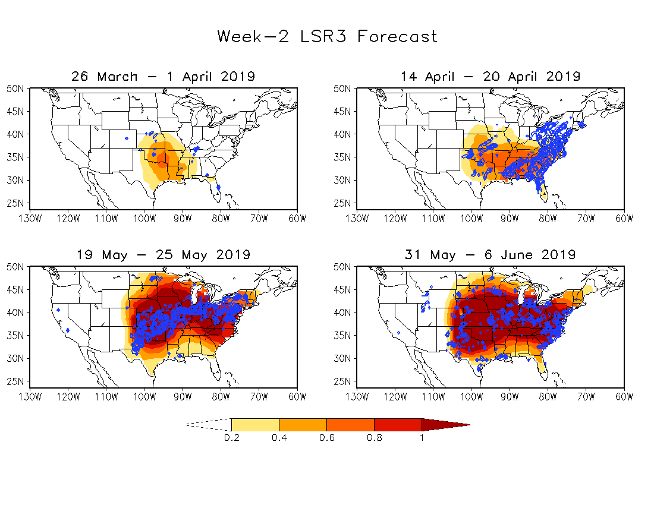
OBS:
7-day
SW

