Slide 1
Update (2/26/2019)
To test the real-time week-2 forecast of individual types of severe weather, including hail, tornado, and damaging wind
First, compare the forecast skill (Anomaly Correlation) of LSR3 with those of hail, tornado, and damaging wind.
Real-time forecast for week-2 hail, tornado, and damaging wind, separately.

Slide 2
Anomaly Correlation Skill
Week-1 Forecast
5º×5º

Slide 3
Anomaly Correlation Skill
Week-2 Forecast
5º×5º

Slide 4
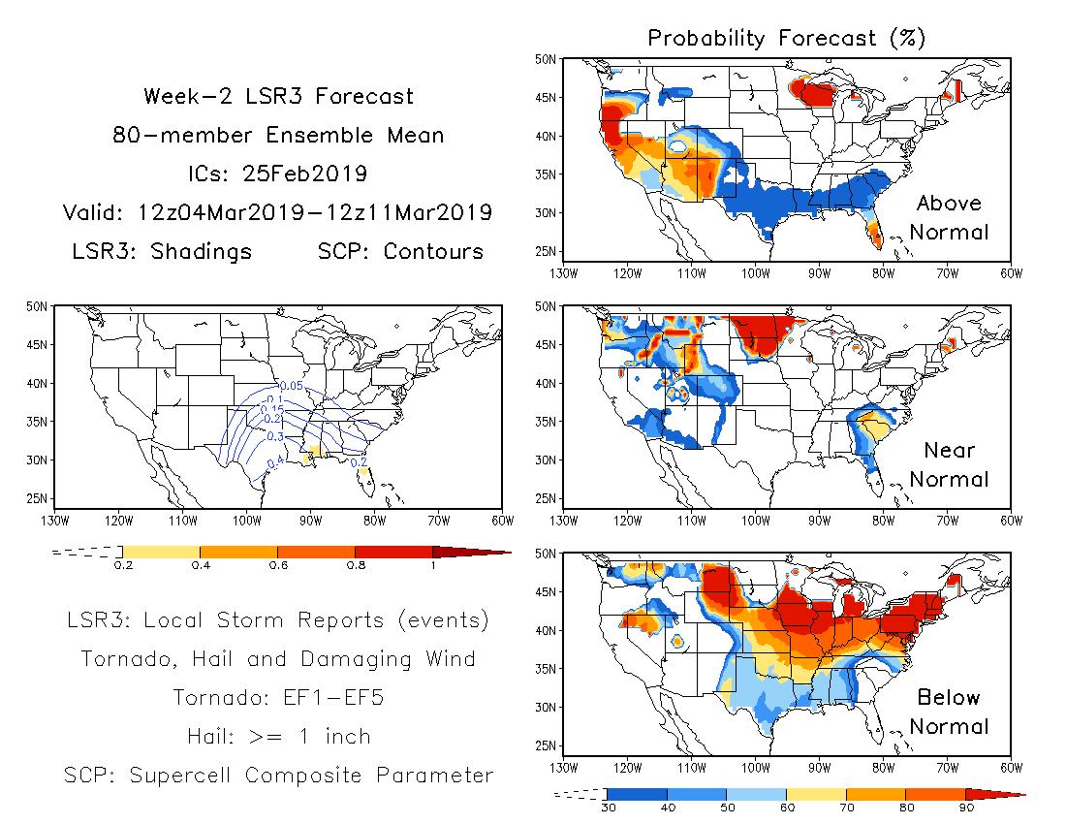

Slide 5
