Slide 1
Update
03Oct2017
Alima:
Examined hybrid model forecasts for three major severe weather events
Joplin Missouri tornado, May 22, 2011
Oklahoma/Kansas tornado outbreak, May 3, 1999
Central Alabama tornado outbreak, April 27, 2011
Compared CFSR SCP vs. CFSv2 SCP for April 1 and May 1, 1999
Re-downloading CFSv2 from 2001, stored in /cpc/cfsr/alima
To do: Calculating weekly mean

Slide 2
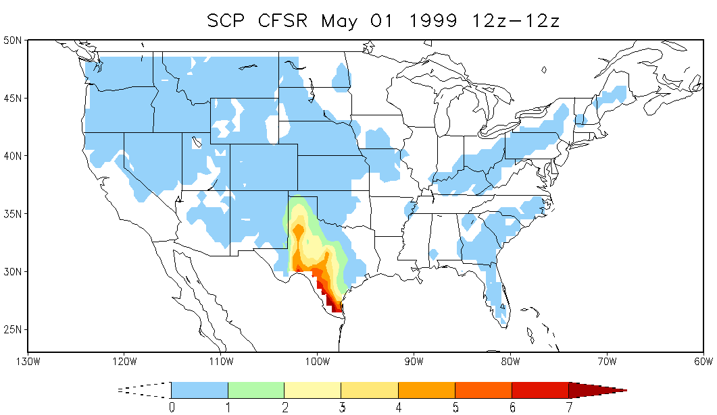
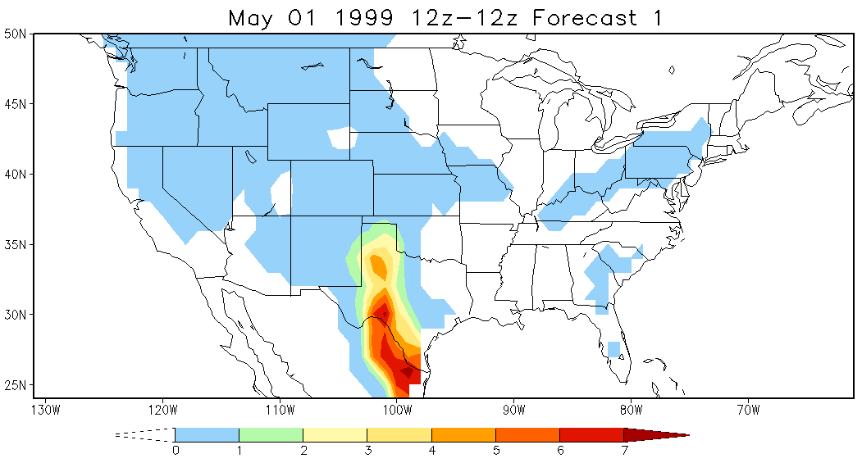
Compare CFSR SCP CFSR and CFSv2 SCP for 04/01 and 05/01/1999

Slide 4
Related GEFS 16-day hindcasts: May 9, 13, 17, 21 for 5/22/2011
Longer lead
Shorter lead
May 2011
Su Mo Tu We Th Fr Sa
1 2 3 4 5 6 7
8 9 10 11 12 13 14
15 16 17 18 19 20 21
22 23 24 25 26 27 28
29 30 31
May 2011
Su Mo Tu We Th Fr Sa
1 2 3 4 5 6 7
8 9 10 11 12 13 14
15 16 17 18 19 20 21
22 23 24 25 26 27 28
29 30 31
Week 2
Week 2
May 2011
Su Mo Tu We Th Fr Sa
1 2 3 4 5 6 7
8 9 10 11 12 13 14
15 16 17 18 19 20 21
22 23 24 25 26 27 28
29 30 31
May 2011
Su Mo Tu We Th Fr Sa
1 2 3 4 5 6 7
8 9 10 11 12 13 14
15 16 17 18 19 20 21
22 23 24 25 26 27 28
29 30 31
Week 1
Week 1

Slide 5
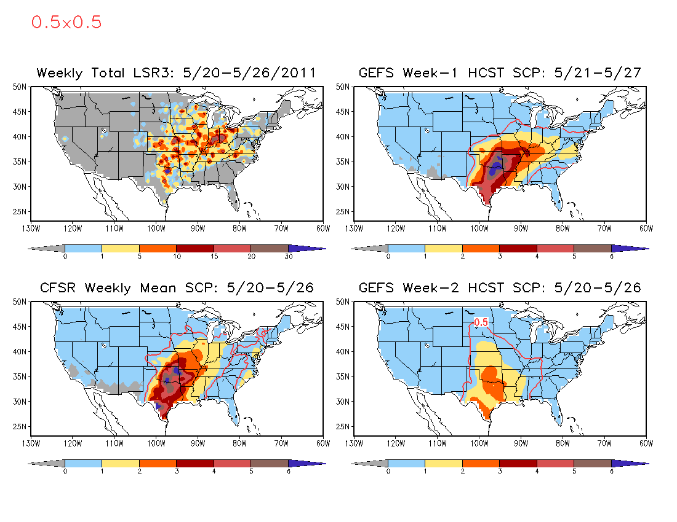

Slide 6
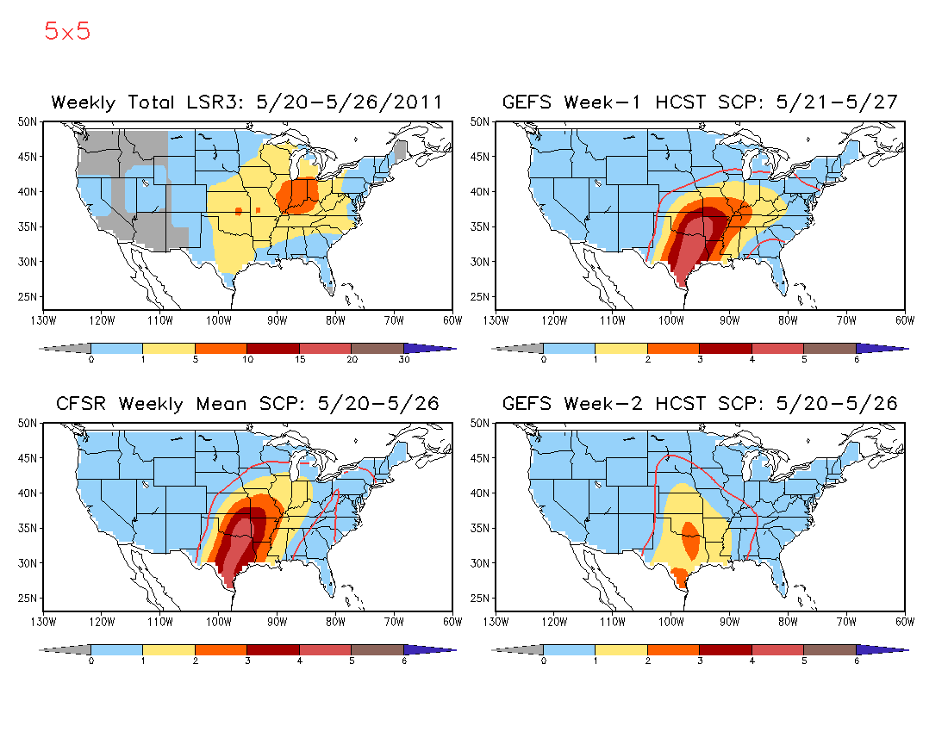

Slide 7
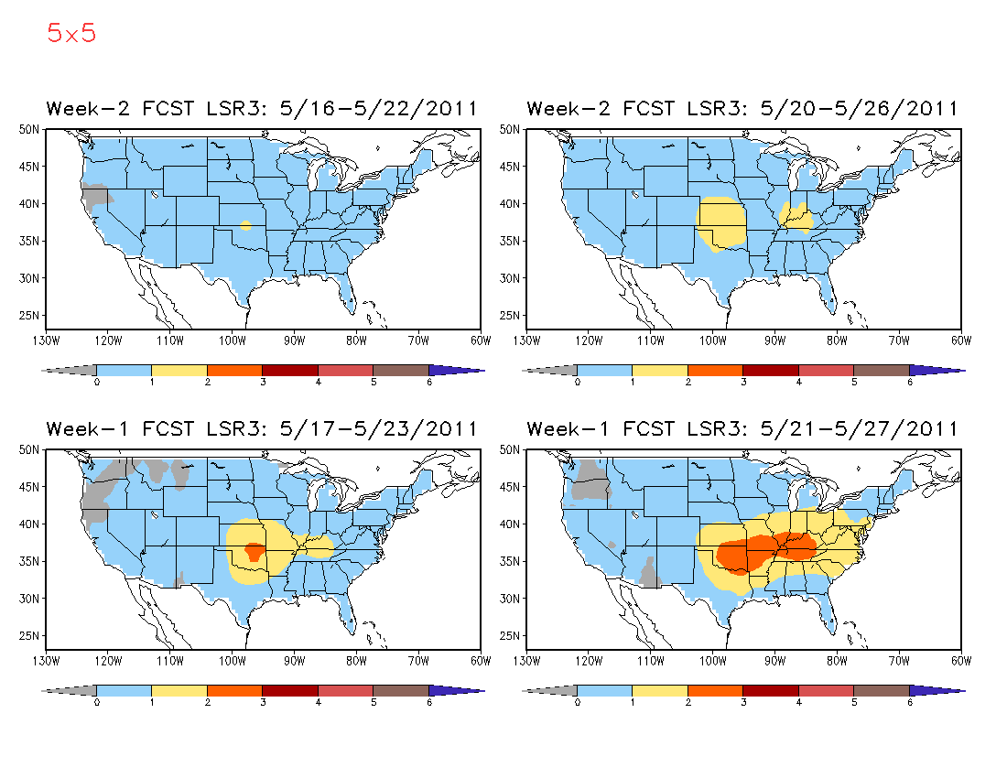
Hybrid Model Week 1 and 2 LSR3 Forecast
The forecasted intensity decreases with lead time.

Slide 8
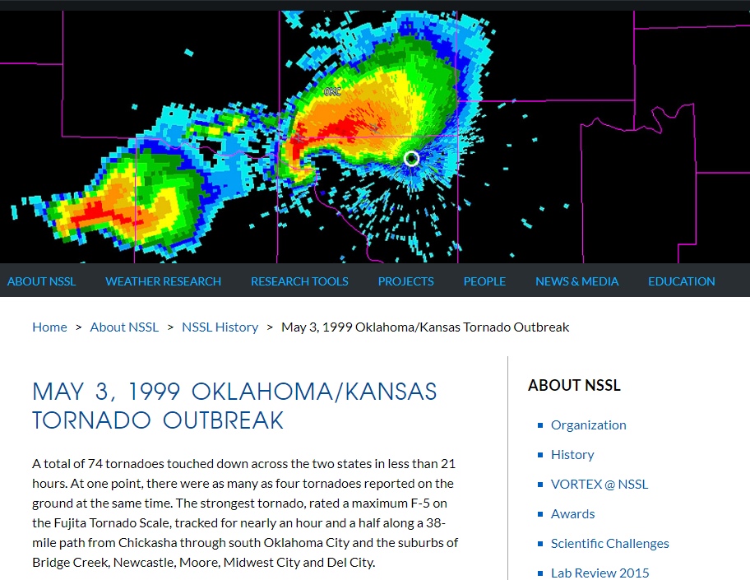

Slide 9
GEFS 16-day hindcasts: April 23, 27, May 1 for 5/3/1999
April/May 1999
Su Mo Tu We Th Fr Sa
11 12 13 14 15 16 17
18 19 20 21 22 23 24
25 26 27 28 29 30 1
2 3 4 5 6 7 8
9 10 11 12
April/May 1999
Su Mo Tu We Th Fr Sa
11 12 13 14 15 16 17
18 19 20 21 22 23 24
25 26 27 28 29 30 1
2 3 4 5 6 7 8
9 10 11 12
Beyond Week 2
Week 2
April/May 1999
Su Mo Tu We Th Fr Sa
11 12 13 14 15 16 17
18 19 20 21 22 23 24
25 26 27 28 29 30 1
2 3 4 5 6 7 8
9 10 11 12
April/May 1999
Su Mo Tu We Th Fr Sa
11 12 13 14 15 16 17
18 19 20 21 22 23 24
25 26 27 28 29 30 1
2 3 4 5 6 7 8
9 10 11 12
Week 1
Week 1

Slide 10
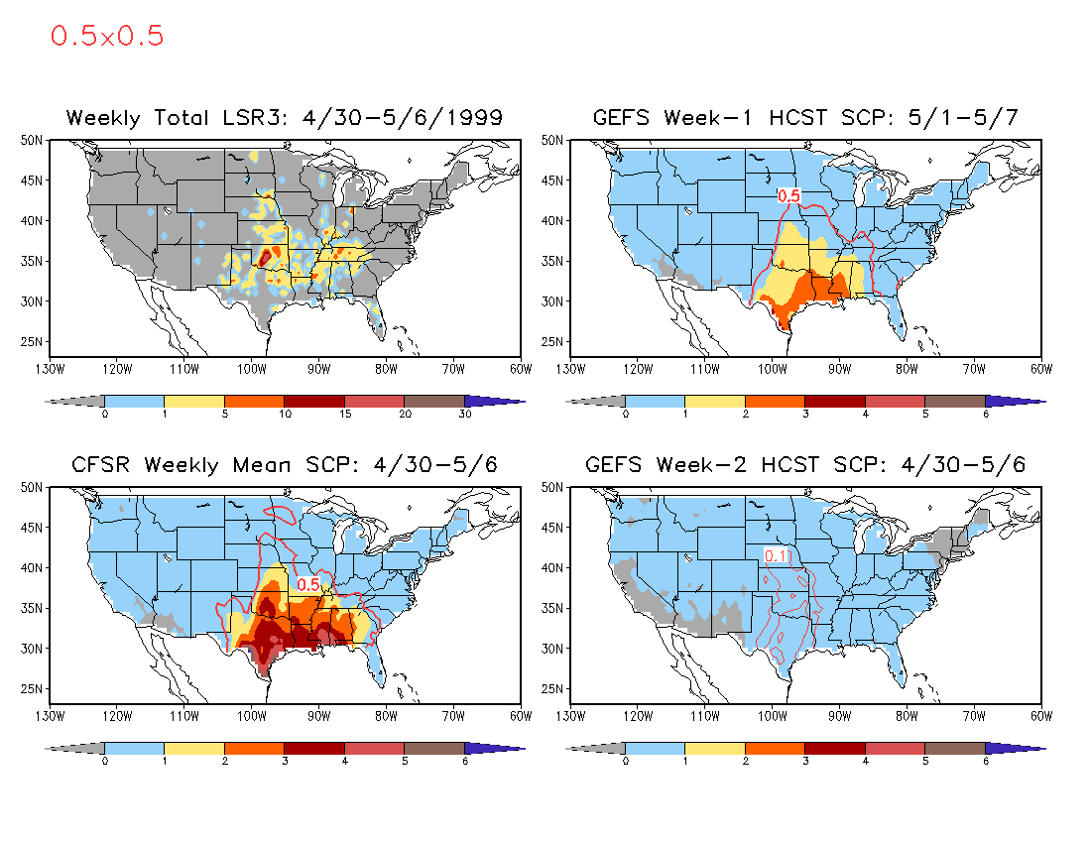

Slide 11
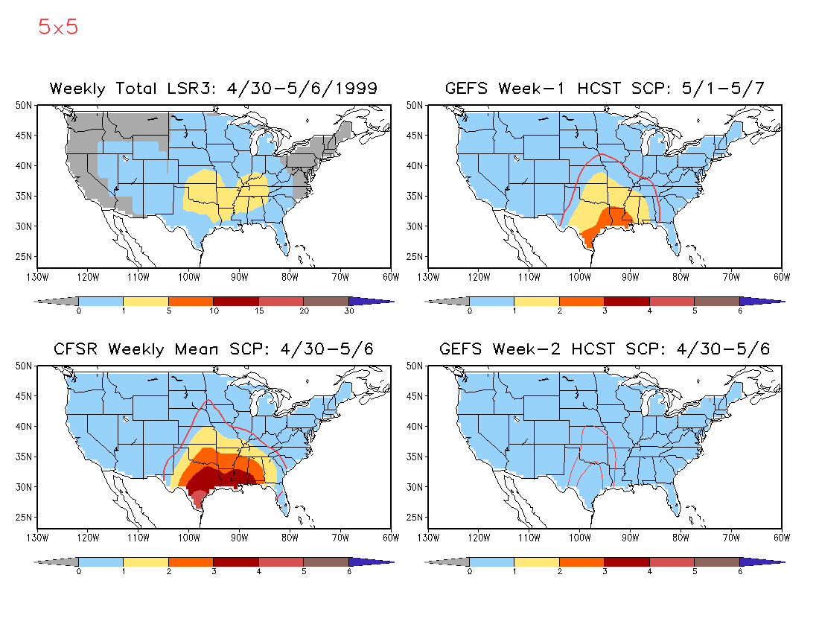

Slide 12
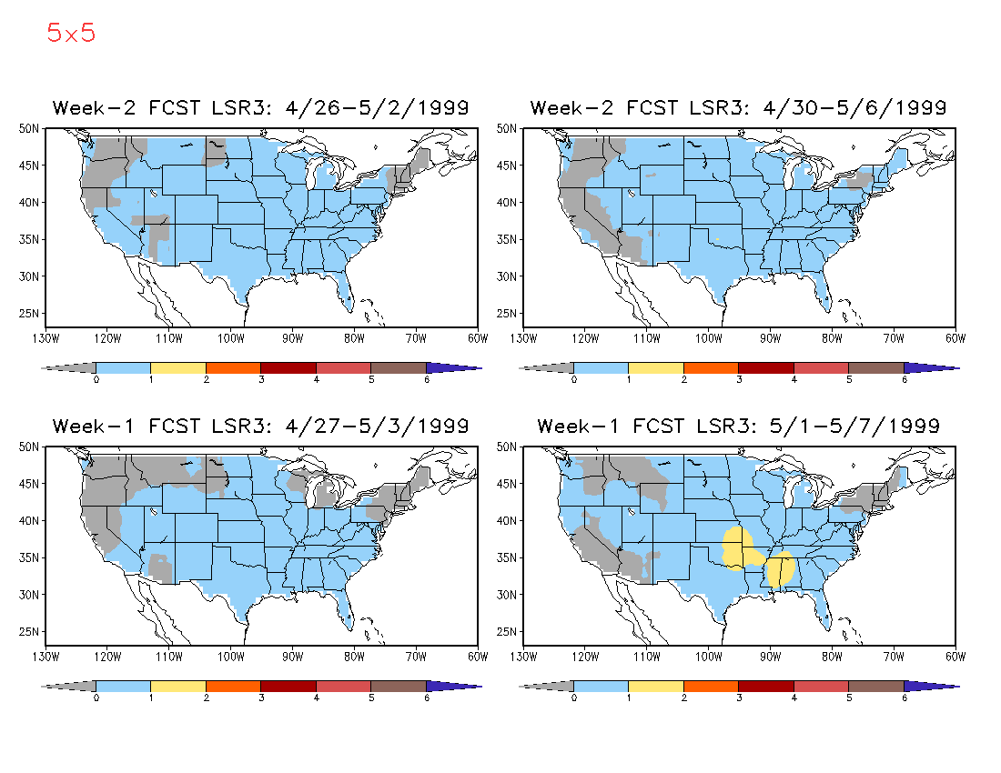
Hybrid Model Week 1 and 2 LSR3 Forecast
The forecast skill is low for Week 2.

Slide 13
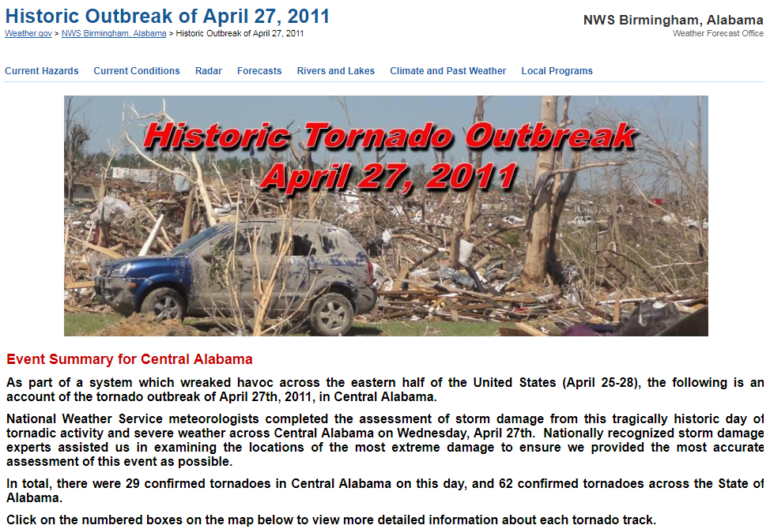

Slide 14
GEFS 16-day hindcasts: April 15, 19, 23, 27 for 4/27/2011
April/May 2011
Su Mo Tu We Th Fr Sa
3 4 5 6 7 8 9
10 11 12 13 14 15 16
17 18 19 20 21 22 23
24 25 26 27 28 29 30
1 2 3 4 5
April/May 2011
Su Mo Tu We Th Fr Sa
3 4 5 6 7 8 9
10 11 12 13 14 15 16
17 18 19 20 21 22 23
24 25 26 27 28 29 30
1 2 3 4 5
Week 2
Week 2
April/May 2011
Su Mo Tu We Th Fr Sa
3 4 5 6 7 8 9
10 11 12 13 14 15 16
17 18 19 20 21 22 23
24 25 26 27 28 29 30
1 2 3 4 5
April/May 2011
Su Mo Tu We Th Fr Sa
3 4 5 6 7 8 9
10 11 12 13 14 15 16
17 18 19 20 21 22 23
24 25 26 27 28 29 30
1 2 3 4 5
Week 1
Week 1

Slide 15
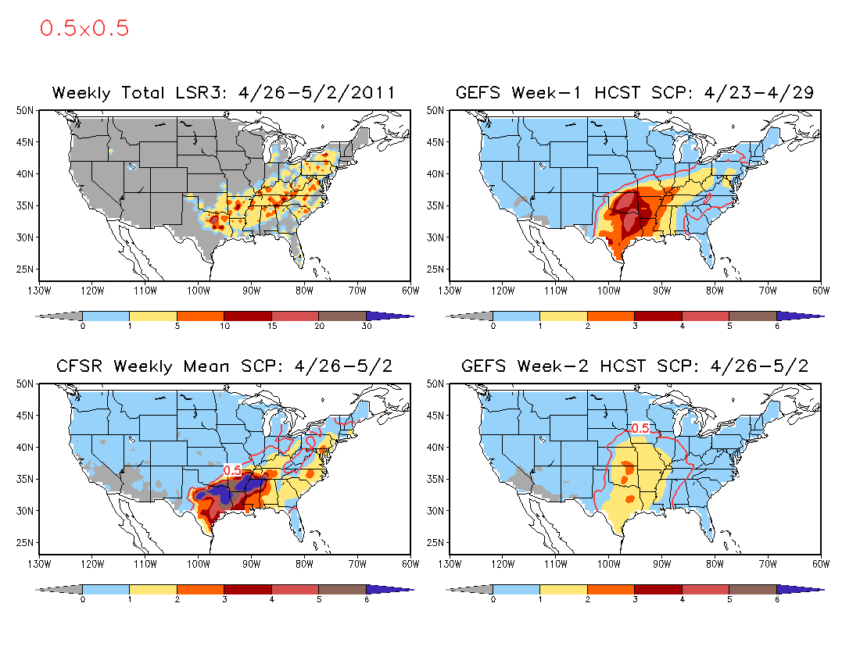

Slide 16
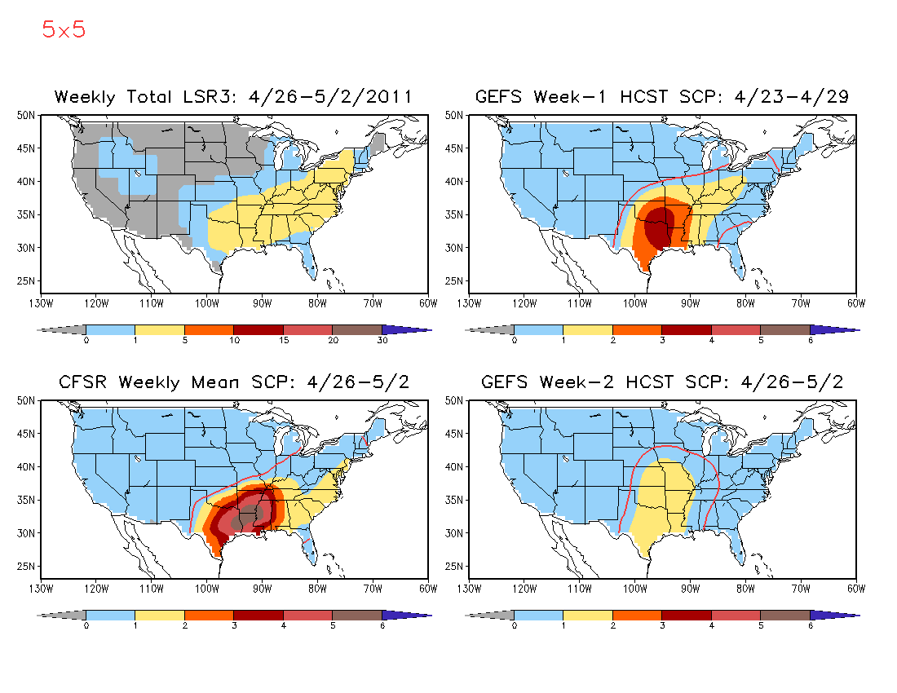

Slide 17
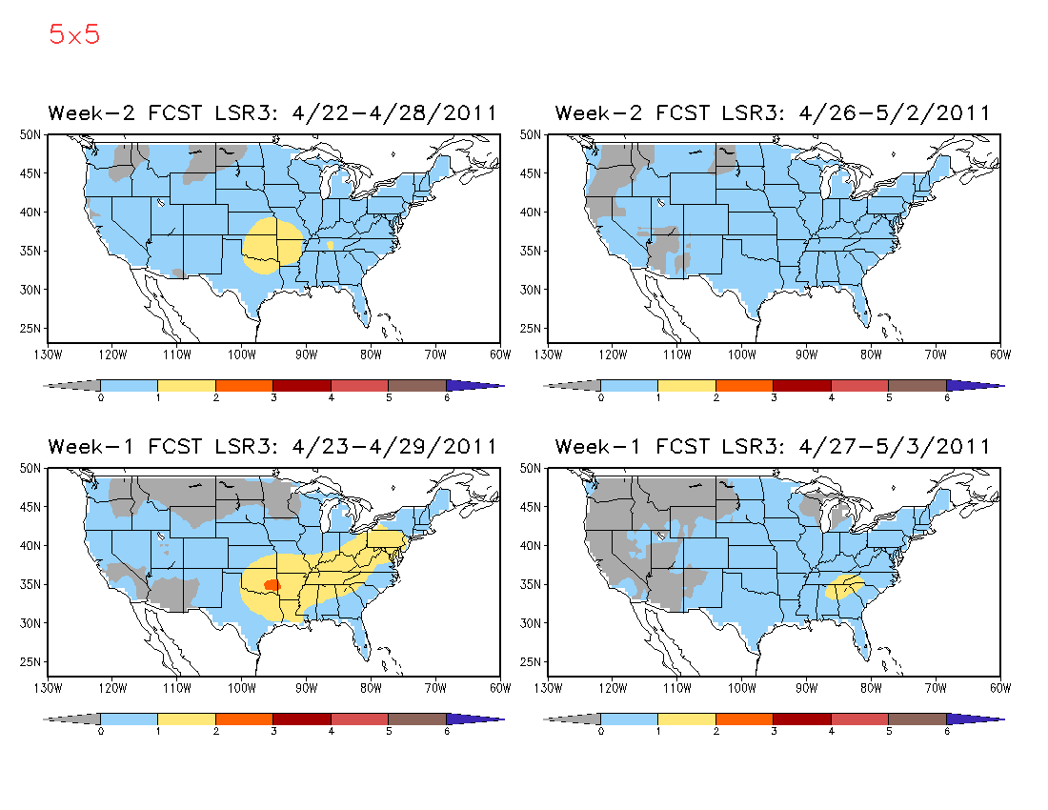
Hybrid Model Week 1 and 2 LSR3 Forecast
For both Weeks 1 and 2, longer-lead forecasts are better than the shorter-lead.

Slide 18
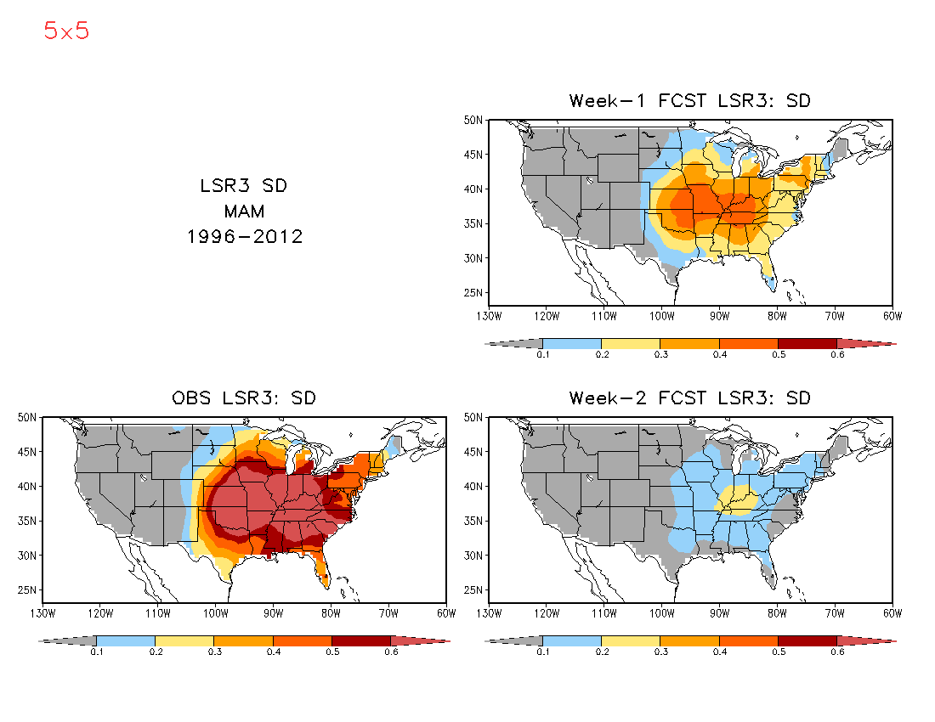
The standard deviation of the forecasted LSR3 anomalies is much smaller than the observed for both weeks 1 and 2.

Slide 19
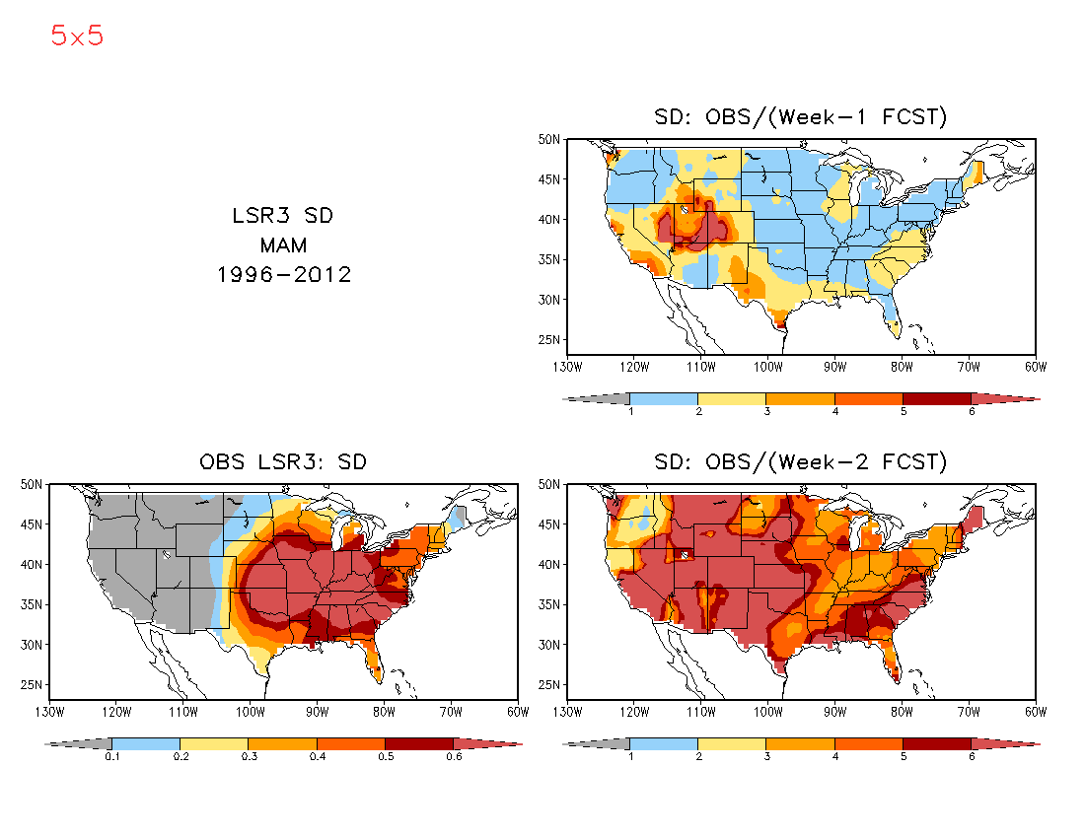
The forecasted LSR3 anomalies can be adjusted by the ratio of the observed SD of LSR3 to that of the predicted..

