Slide 1
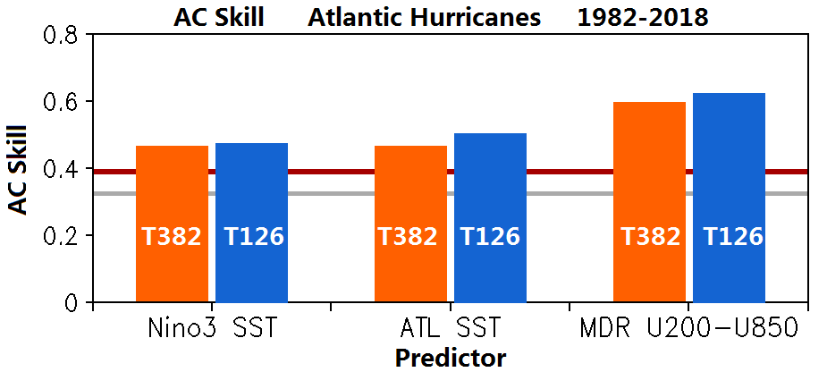
A Comparison of Seasonal Hurricane Forecasts:
Dynamical Model vs. Dynamical–Statistical Model
Hui Wang, Lindsey N. Long, Arun Kumar
NOAA Climate Prediction Center
T382 CFSv2 Dynamical Model
T126 CFSv2-based Dynamical–Statistical Model
T382 CFSv2-based Dynamical–Statistical Model
Hybrid model
95% Significance
Dynamical model

