Slide 1
Update on Week 3–4 Severe Weather Project
9 February 2018

Slide 2
Week 3–4 Severe Weather Project
Forecasts for weeks 1–2 are just a stepping stone.
Work is under progress for weeks 3–4 using the CFSv2 45-day hindcasts and real-time forecasts.

Slide 3
Methodology
Hybrid dynamical–statistical forecast model
Using the Supercell Composite Parameter (SCP) from the GEFS forecasts as a predictor
Week 1–2 SW forecast based on the statistical relationship between model SCP (GEFS hindcast) and OBS LSR (Local Storm Report), including hail, tornado, and damaging wind
Forecast improvements:
5º×5º area-average anomalies
Adjustment for the amplitude of forecasted anomalies
Forecast skill (AC) assessed with cross-validations over the 1996–2012 GEFS hindcast period

Slide 4
SCP (Supercell Composite Parameter)
SCP = (CAPE/1000 J kg⁻¹)×(SRH/50 m⁻² s⁻²)×(BWD/20 m s⁻¹)
CAPE: convective available potential energy
SRH: storm-relative helicity
BWD: bulk wind difference
GEFS Skill for SCP
AC: GEFS vs. CFSR 1996–2012
GEFS Hindcasts
16-day forecast
1996–2012 (17yrs)
4 days apart
5 members
0.5º×0.5º resolution
Week-2 skill is much lower than the Week-1.
Week 1
Week 2

Slide 5
Relationship between
GEFS SCP and OBS LSR3
Hybrid Model Forecast Skill for LSR3
Anomaly Correlation
Cross-validation over
MAM 1996–2012
5º×5º area average
LSR3: Hail + Tornado + Wind

Slide 6
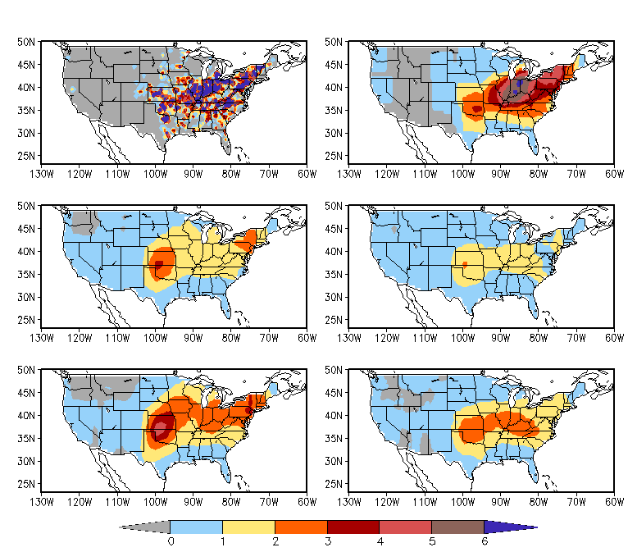
Tornado Outbreaks May 24–30, 2011
OBS Weekly LSR3
OBS Weekly LSR3
0.5º×0.5º
5º×5º
Week-1 Forecast LSR3
Week-2 Forecast LSR3
Forecast =
Anomaly_{FCST}
+ Climatology_{OBS}
Adjustment =
Anomaly_{FCST} × Ratio
+ Climatology_{OBS}
Ratio = SD_{OBS}/SD_{FCST}
Week-1 Forecast (Adjusted)
Week-2 Forecast (Adjusted)

Slide 7
GEFS Real-time Forecast for SCP
Weekly SCP is the 7-day average of daily mean SCP from 12Z to 12Z.
Day −1
12Z
18Z
Day 0
00Z
06Z
Day 0
12Z
Week 1 Week 2
20 x 4 = 80 members

Slide 8
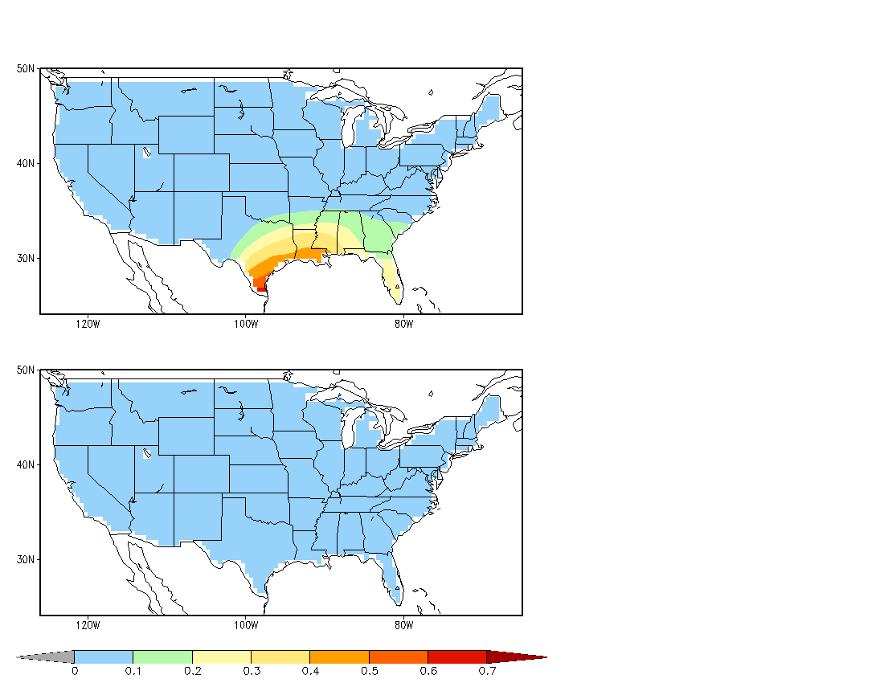
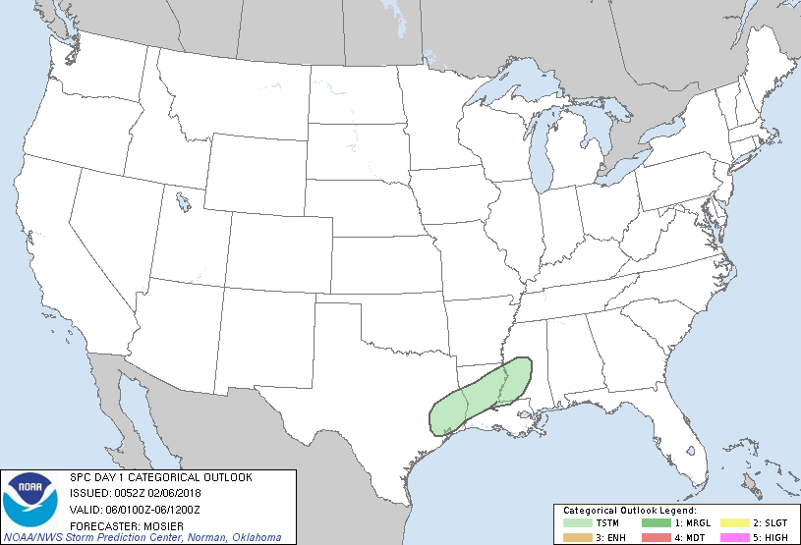
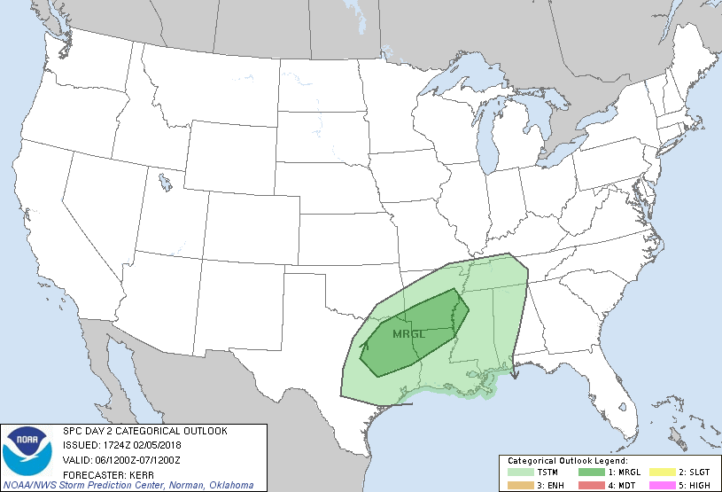
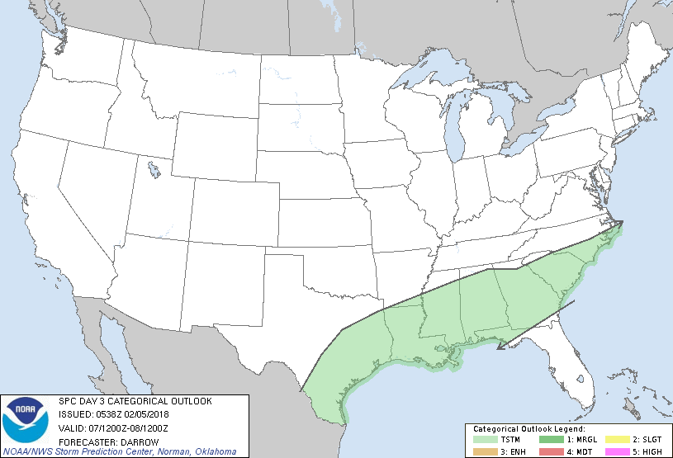
SCP
GEFS 80-member Mean Forecast
04Feb 12Z 18Z 05Feb 00Z 06Z
5º×5º
SPC Convective Outlook
Day 1
Week 1
Day 2
Day 3
Week 2

Slide 9
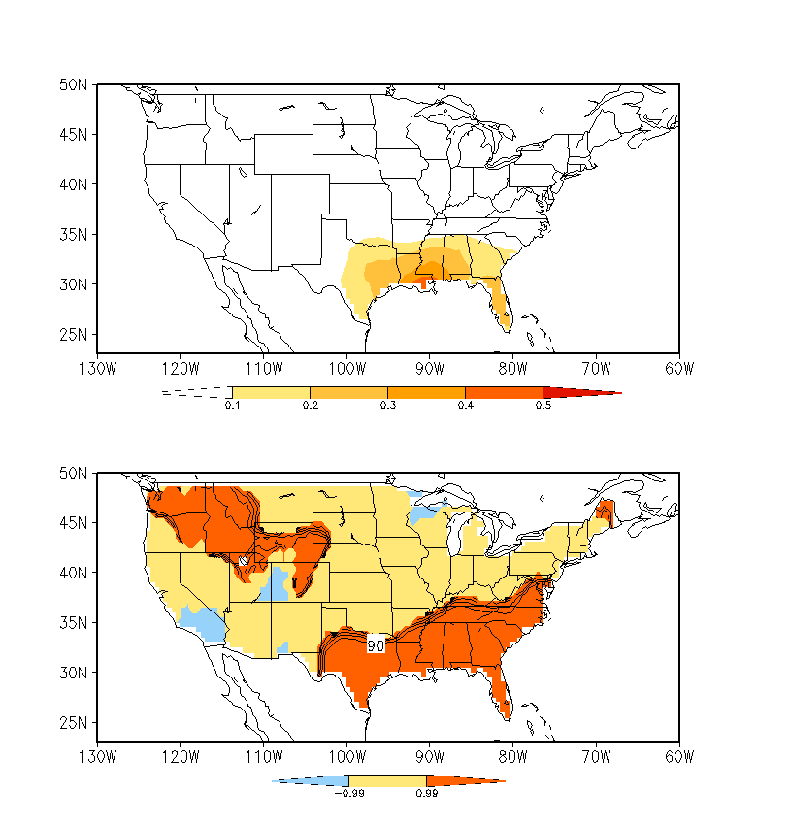
Week 1:
5–11 FEB
2018
Week-1 Forecast LSR3
80-member ensemble mean forecast
Week-1 Forecast Category and Probability
Based on the distribution of the 80-member forecasts
Below Near Above Normal
Notes:
/cpc/home/hwang/2017_wk34SWx/GEFS_0.5/LSR_fcst.5x5.JFM

Slide 10
Probabilistic Outlook
Distribution of LSR3 hindcasts (or observations) determines the thresholds for above-normal, near-normal, and below-normal categories, each 33%.
The distribution of individual 80-member forecasts in the three categories provides the probabilistic forecast for LSR3.
In few months, we can start providing real-time week 1–2 severe weather forecasts based on GEFS to OPB.

