Slide 1
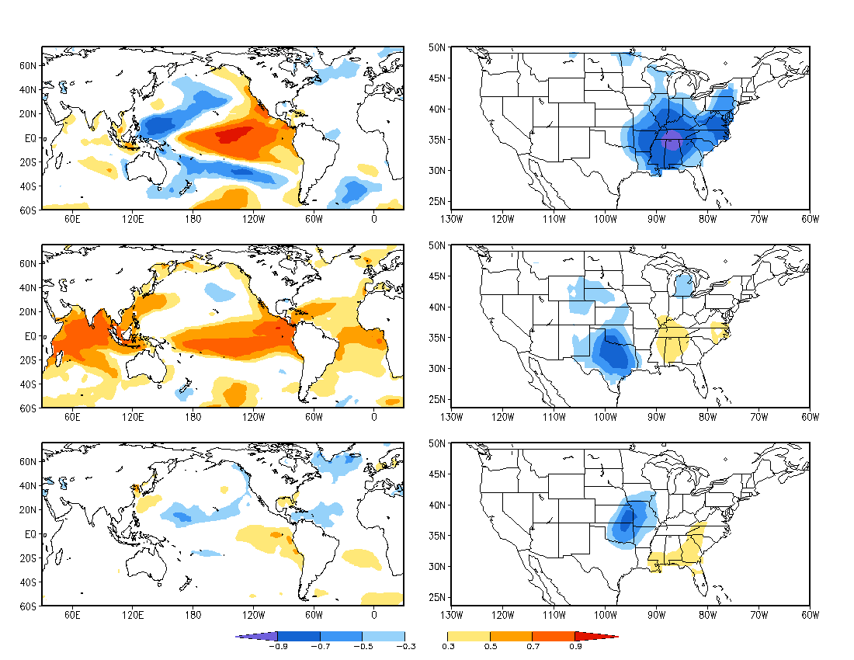
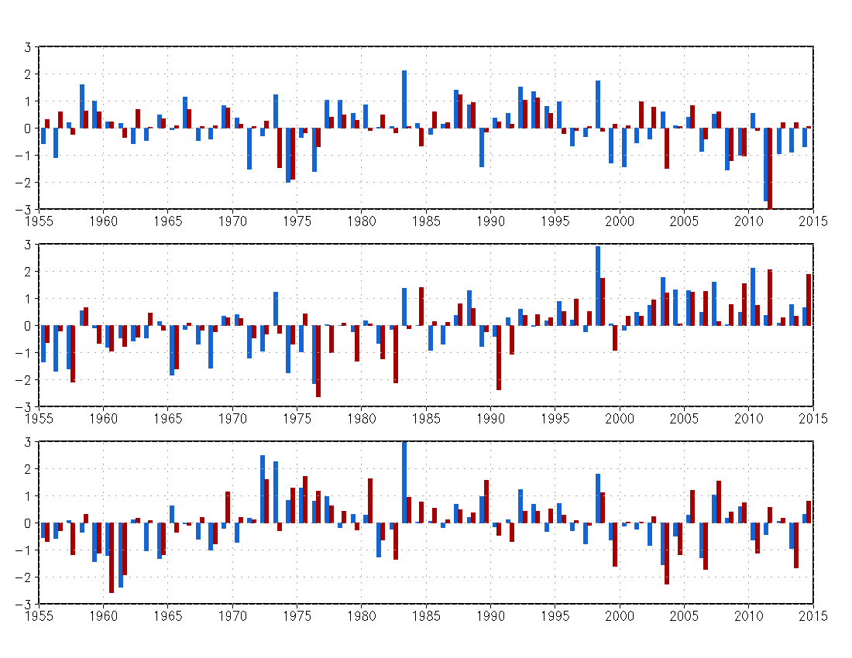
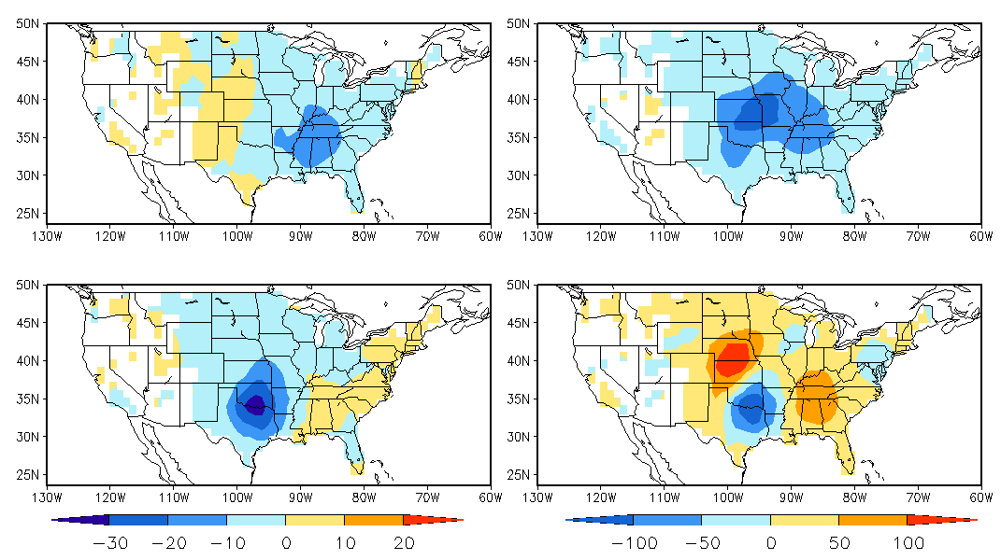
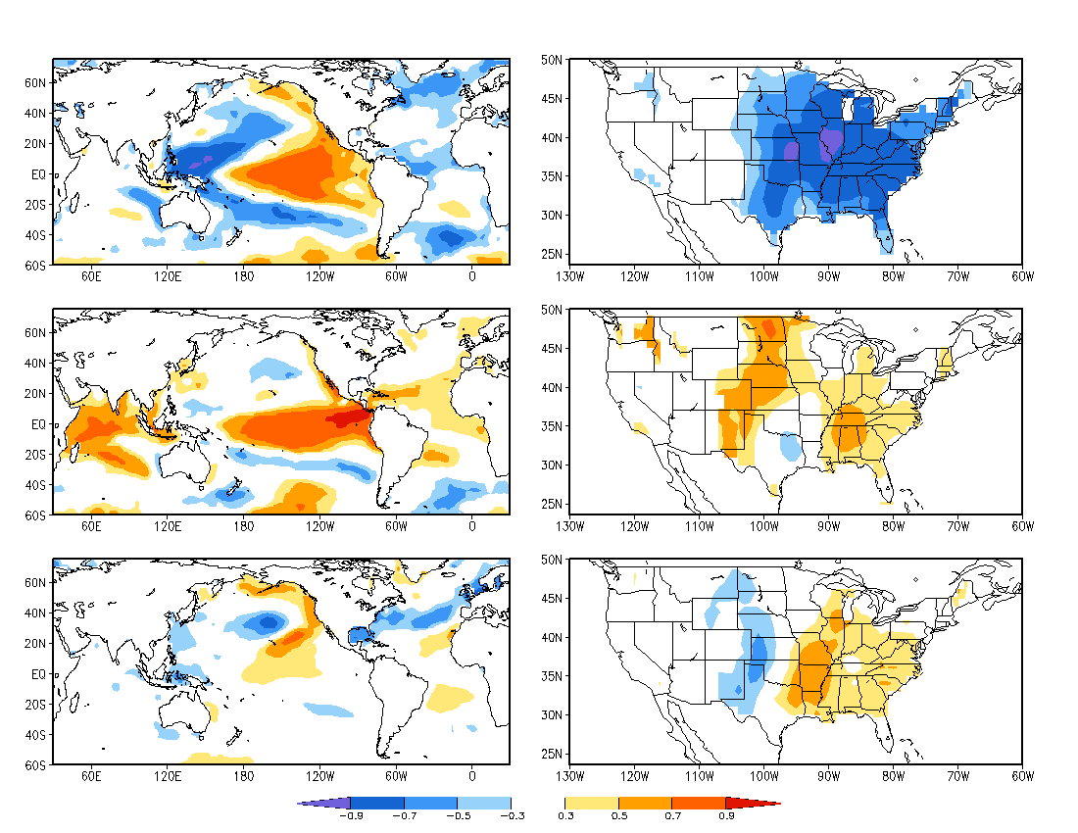
Statistical Predictions of Seasonal Tornado and Hail Activity in the United States
Hui Wang, Kirstin Harnos, and Arun Kumar
NOAA/NWS/NCEP Climate Prediction Center, College Park, MD 20740
1. Background
SST anomalies, including those associated with ENSO, are a major source of extratropical circulation variability on seasonal to interannual timescales. The seasonal mean circulation acts as an environment in which tornadoes and hails develop and thus links the SSTs to the seasonal tornado and hail activity.
Objective: To develop a statistical model for forecasting spring season U.S. tornado and hail activity based on global SST and assess forecast skill.
3.2 Relationships between tornado/hail activity and SST
3.3 Predictions of seasonal tornado and hail activity
3.4 Forecast for MAM 2016
4. Conclusions
January SST
SVD: Spatial Correlation Map
MAM Tornado
Forecast Skill: Anomaly Correlation
(a) Tornado R=0.26
Observation
Forecast
Fig. 2. Spatial patterns of homogenous correlation for the first three SVD modes between Jan global SST (30ºS–60ºN) and MAM EF1–EF5 tornadoes in the United States.
Fig. 3. Normalized time series of the first three SVD modes between Jan SST (blue bar) and MAM U.S. tornadoes (red bar).
(a) Tornado 1955–2014
Mode 1
21%
EF1–EF5
Mode 1
37%
95% significance level
(b) Hail 1985–2014
Fig. 6
(b) Hail R=0.70
Mode 2
20%
Mode 2
10%
2. Data and methodology
Data: 1955–2014 (60 years)
NOAA ERSST V3b: Jan SST
Storm Prediction Center Severe Weather Database: Mar–May (MAM) tornadoes (EF1–EF5) and hail (≥ 1”) events
Methodology:
The forecast model is based on lagged relationships between Jan SST and MAM tornado and hail activity.
The relationships are objectively identified by the singular value decomposition (SVD) technique.
The forecast skill is cross-validated over the 60 years.
Fig. 5
Mode 3
4%
Mode 3
8%
Fig. 5. Anomaly correlation skill based on cross-validations for (a) tornado and (b) hail.
Fig. 6. Time series of observed and predicted total number of (a) tornadoes and (b) hail events in the U.S.
Fig. 2
Mode 1
R=0.49
SVD: Time Series
Jan SST
MAM Tornado
Fig. 7
Mode 2
R=0.59
Fig. 7. Observed January 2016 SST anomalies, used as a predictor for MAM tornado and hail activity.
Mode 3
R=0.67
(a) Tornado (mode1)
(b) Hail (mode 1)
Fig. 8. Forecasts of MAM 2016 tornado and hail activity based on (a, b) the first SVD mode and (c, d) the three SVD modes, respectively.
3. Results
3.1 Tornado and hail climatology and variability
Fig. 3
Year
(c) Tornado (3 modes)
(b) Hail (3 modes)
Climatology MAM 1955–2014
(a) Tornado
Fig. 1. Climatology of MAM seasonal total number of (a) tornadoes and (b) hail events in 5º×5º box, and (c) time series of total number of tornadoes (red) and hail events (blue) in the U.S. from 1955 to 2014.
Observational data show weak interannual variability of hail activity in the early years. Data from 1985 to 2014 are used for hail.
Fig. 4. Spatial patterns of homogenous correlation for the first three SVD modes between Jan global SST (30ºS–60ºN) and MAM hail (≥ 1 inch) events in the United States.
January SST
SVD: Spatial Correlation Map
MAM Hail
Mode 1
22%
≥ 1 inch
Mode 1
59%
Fig. 8
(b) Hail
Mode 2
23%
Mode 2
6%
A statistical model was developed for forecasting U.S. spring seasonal tornado and hail activity based on January SST.
Lagged relationships between January SST and March–May tornado and hail activity were objectively depicted by the leading SVD modes.
Associated with El Niño, both seasonal activities of tornadoes and hails are below normal in the eastern and central U.S.
Cross-validations indicate certain forecast skills for the eastern and central U.S.
(c) Time Series: CONUS total
Mode 3
5%
Mode 3
11%
Tornado (EF1–EF 5)
Hail (≥ 1”)
Fig. 4
For both tornado and hail, the first SVD mode is associated with the ENSO variability, whereas the second SVD mode is associated with the warming trend in tropical SSTs.
Fig. 1
2nd Workshop on Severe Convection and Climate, March 9– 10, 2016, Columbia University, New York, NY

