Slide 1
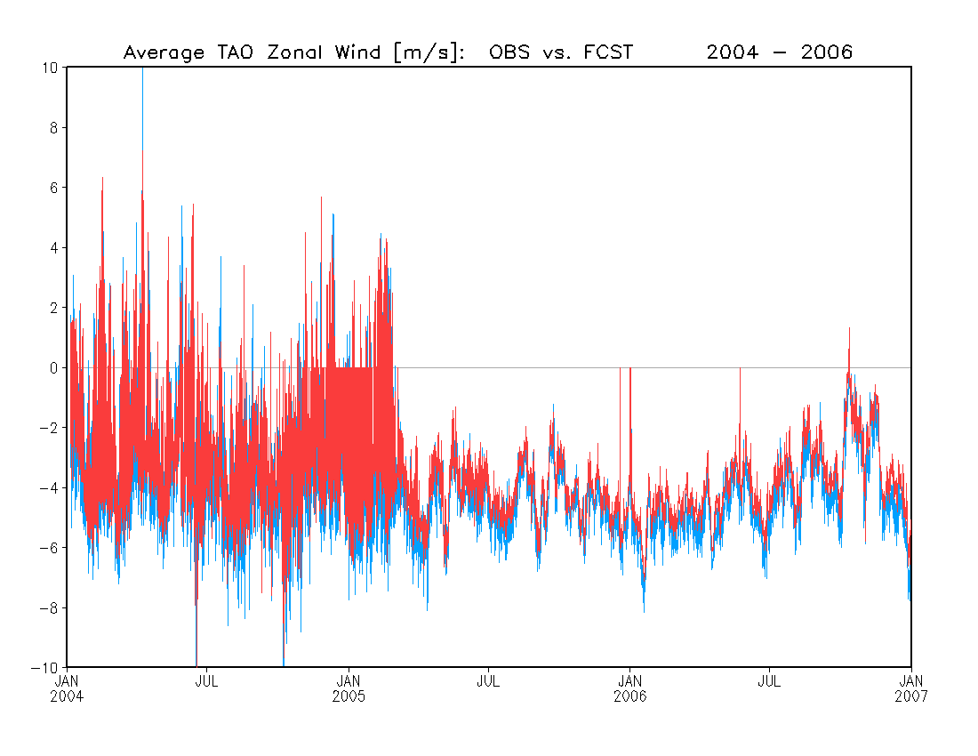
Zonal Wind
TAO OBS
FCST
Zonal wind [m/s]

Slide 2
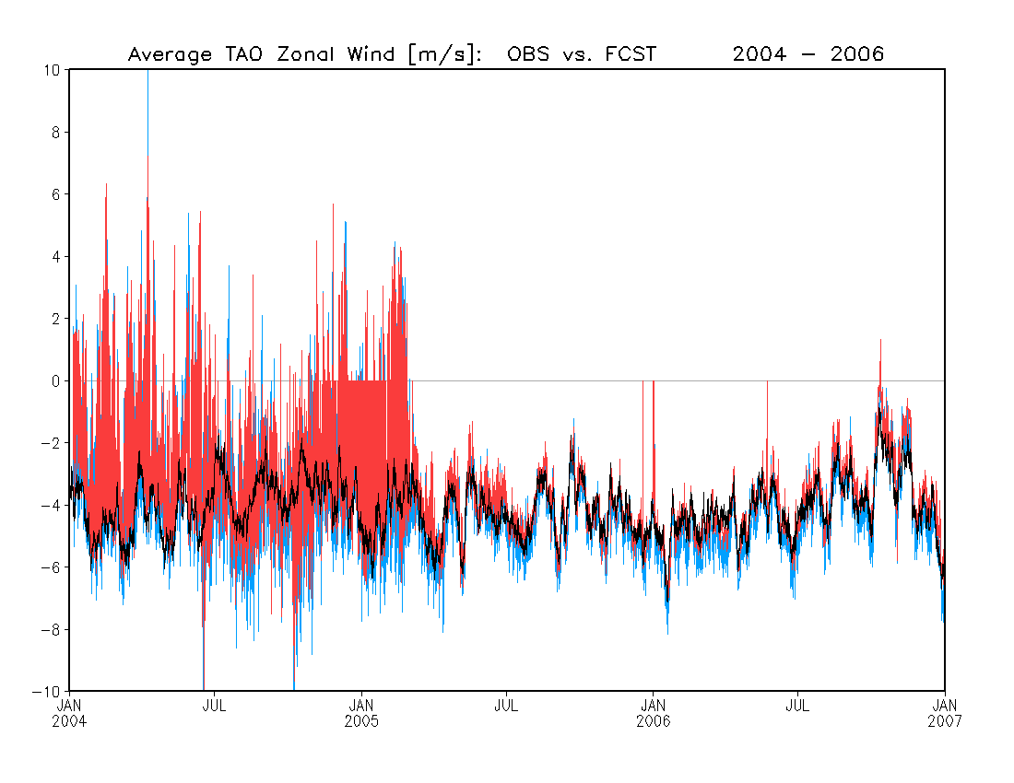
Zonal Wind
TAO OBS
FCST
R2 [150ºE-100ºE, 10ºS-10ºN]
Zonal wind [m/s]

Slide 3
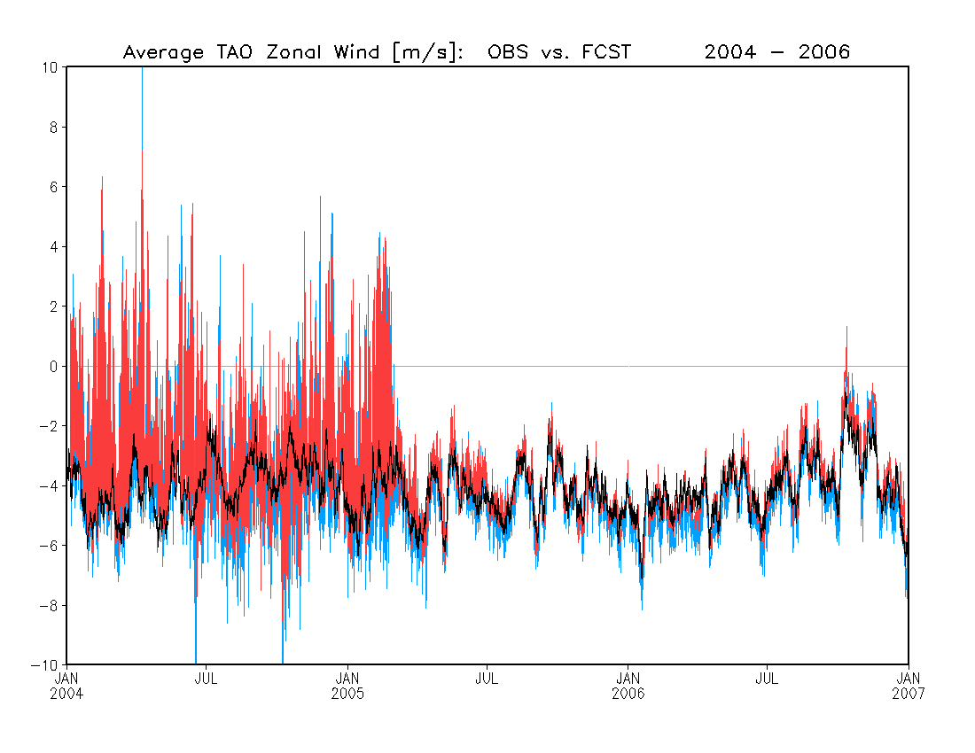
Zonal Wind
TAO OBS
FCST
R2 [150ºE-100ºE, 10ºS-10ºN]
Zero values in TAO OBS removed
Zonal wind [m/s]

Slide 4
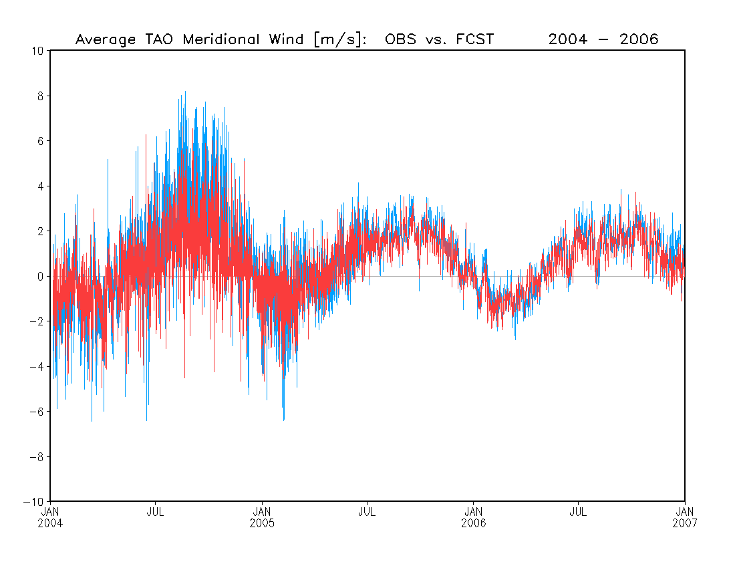
Meridional Wind
TAO OBS
FCST
Meridional wind [m/s]

Slide 5
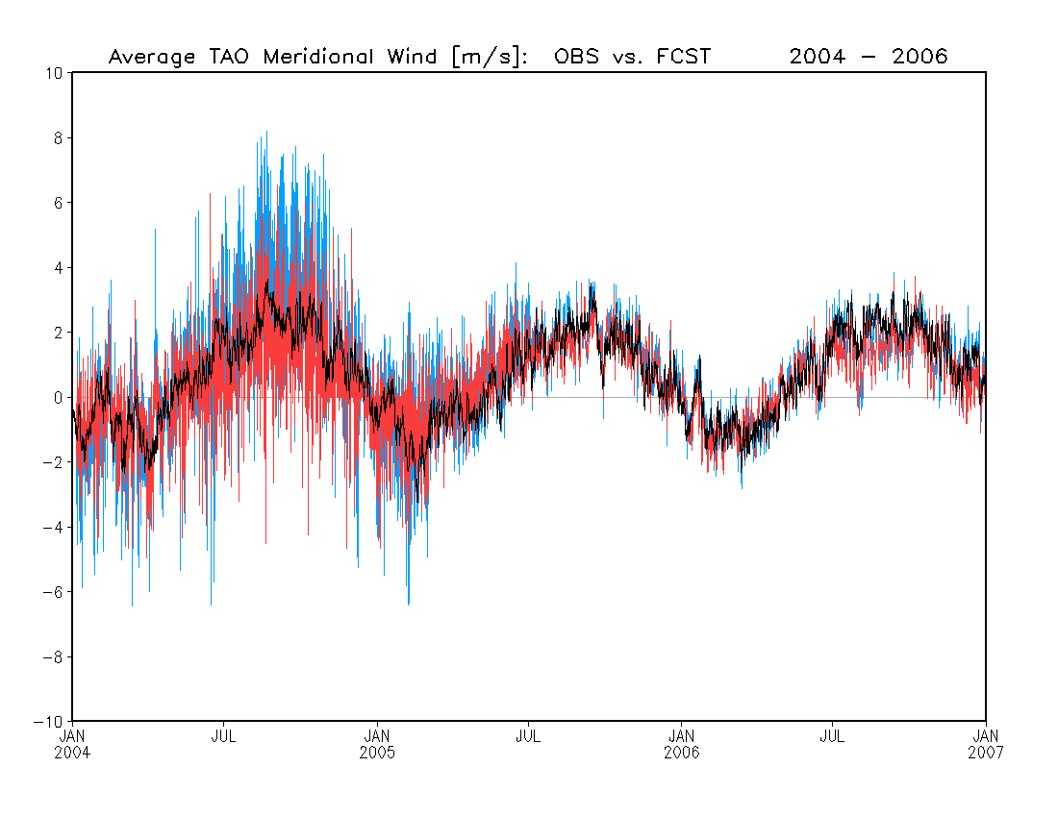
Meridional Wind
TAO OBS
FCST
R2 [150ºE-100ºE, 10ºS-10ºN]
Meridional wind [m/s]

Slide 6

Meridional Wind
TAO OBS
FCST
R2 [150ºE-100ºE, 10ºS-10ºN]
Zero values in TAO OBS removed
Meridional wind [m/s]

