Slide 1
Map Making
Miliaritiana Robjhon
Nick Novella

Slide 2
Outline
We’ve made the analysis, how do we present it?
Map Making
What is a map?
Why do we need a map?
Examples: From the good … to the bad
QGIS Map Making
Tools

Slide 3
Map Making
How do you display your spatial data?
Clearly, concisely
Can display variety of data in a variety of ways.
Take into account audience and visibility (public, private)
Up to specific standards (colorblindness etc)
Examples of GIS Maps

Slide 4
Map Making
Climate Prediction Center
CPC Africa Desk:
Week 1 Outlook
Highlights above/below-average rainfall

Slide 5
Map Making
Climate Prediction Center
CPC International Desk/FEWS-NET
Weekly Africa Weather Hazards Outlook
Combines GIS image with Microsoft word
Text is from Word.

Slide 6
Map Making
Climate Prediction Center
CPC GIS product
Global Tropics Weather Hazards
Week 1/2

Slide 7
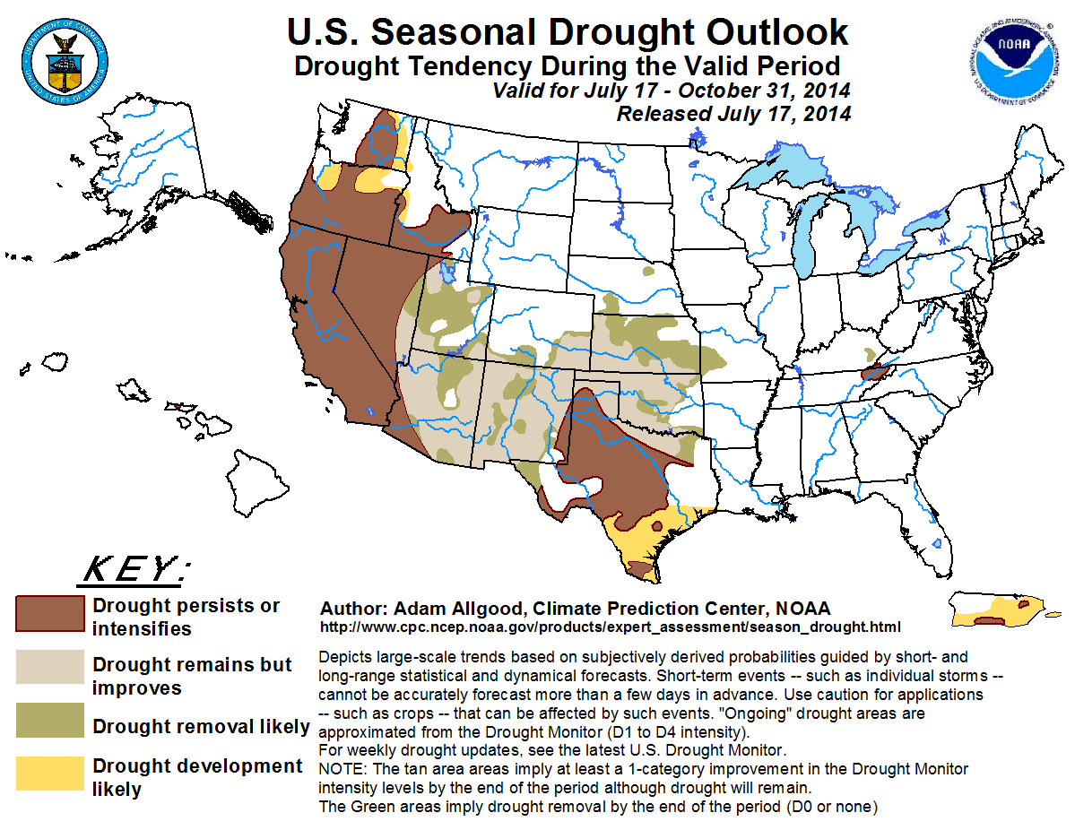
Map Making
Climate Prediction Center
US Seasonal Drought Outlook
July 17-End of season

Slide 8
Map Making
What makes a good map?
Tells a story
Not too much information
Clear data
Useful color scales
Proper Legend

Slide 9
Map Making
What does a good map have?
Geographic references
Data references
Text explanations
Title
Data source
Anything else?

Slide 10
Map Making
What makes a bad map?
You tell me

Slide 11
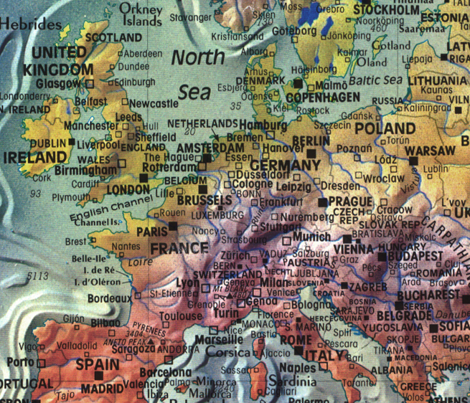
Via cartastrophe.wordpress.com by way of Portal Publications, Ltd, of Novarto, CA.

Slide 12
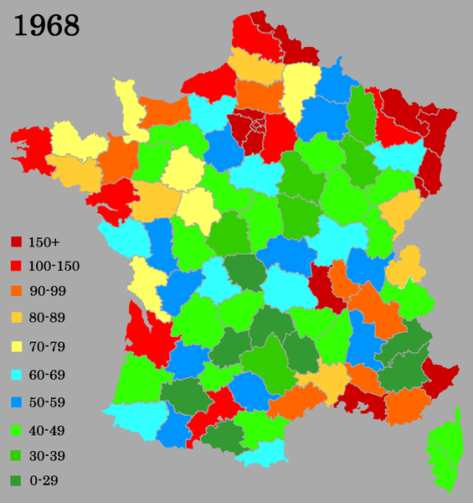
France Population Density (1968)
Via Wikifreund

Slide 13
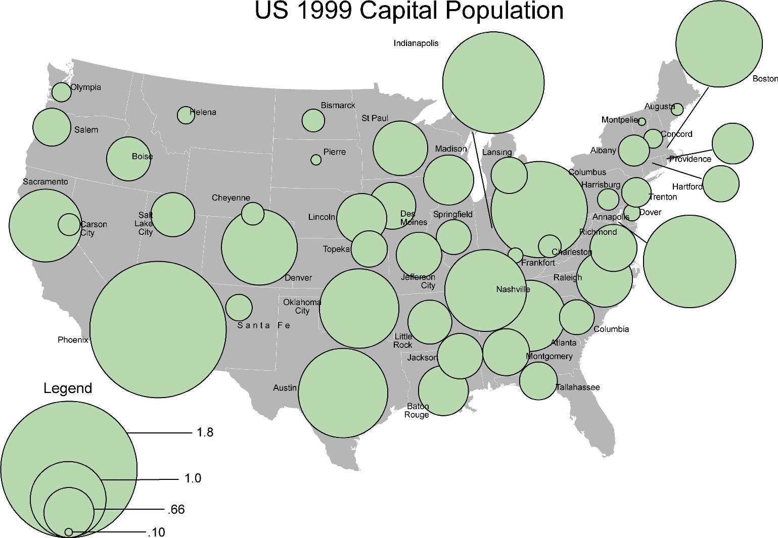
Via http://www.stratasan.com

Slide 14
Color Blindness
If using few colors as comparison then avoid: Green & Red; Green & Brown; Blue & Purple; Green & Blue; Light Green & Yellow; Blue & Grey; Green & Grey; Green & Black

Slide 15
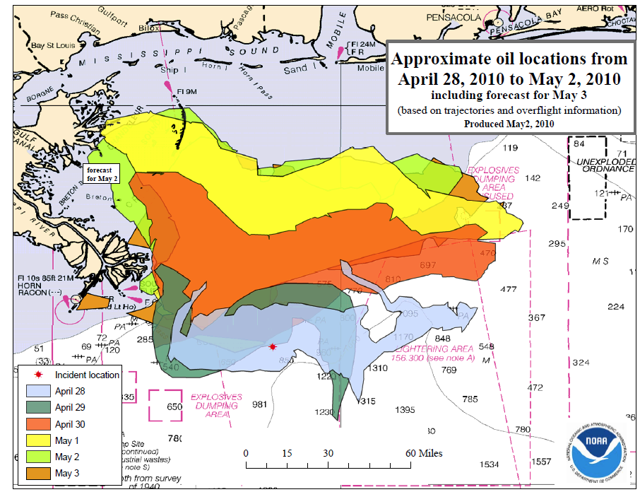
Oil Spill Trajectory
Via NOAA

Slide 16
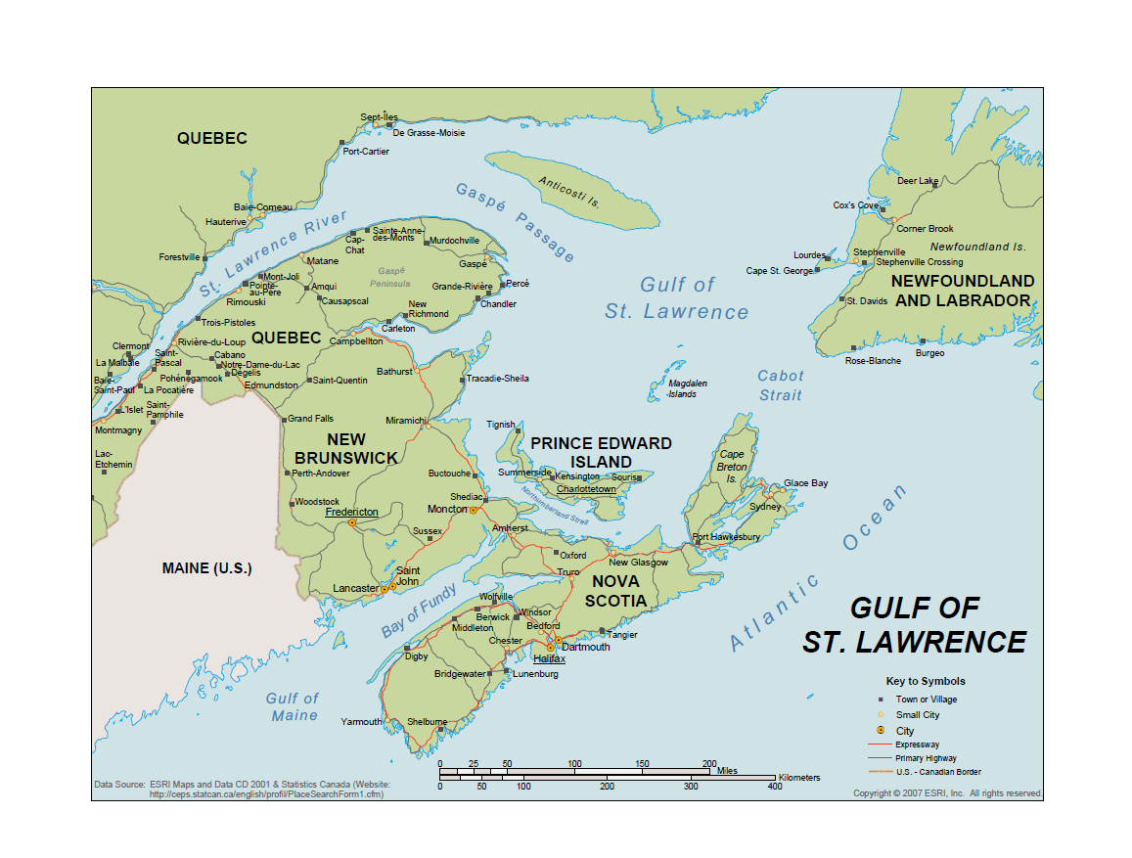
Map Making Types of Maps
Reference Maps – ex. Geographic maps
Many bits of information on one map, focusing on no one bit of information
Challenge: What group of information to include?
Courtesy of ESRI

Slide 17
Map Making Types of Maps
Thematic maps
Focused on an analysis or specific attribute.
Examples- Weather maps, Population maps, etc
Aim: Communication!
Goal: Draw readers attention to important information.
Challenge: Figuring out what information to choose

Slide 18
Map Making
Thematic map types
Qualitative
Location of data is key. Not dependent on data.
Quantitative
Shows numerical data and its variation.

Slide 19
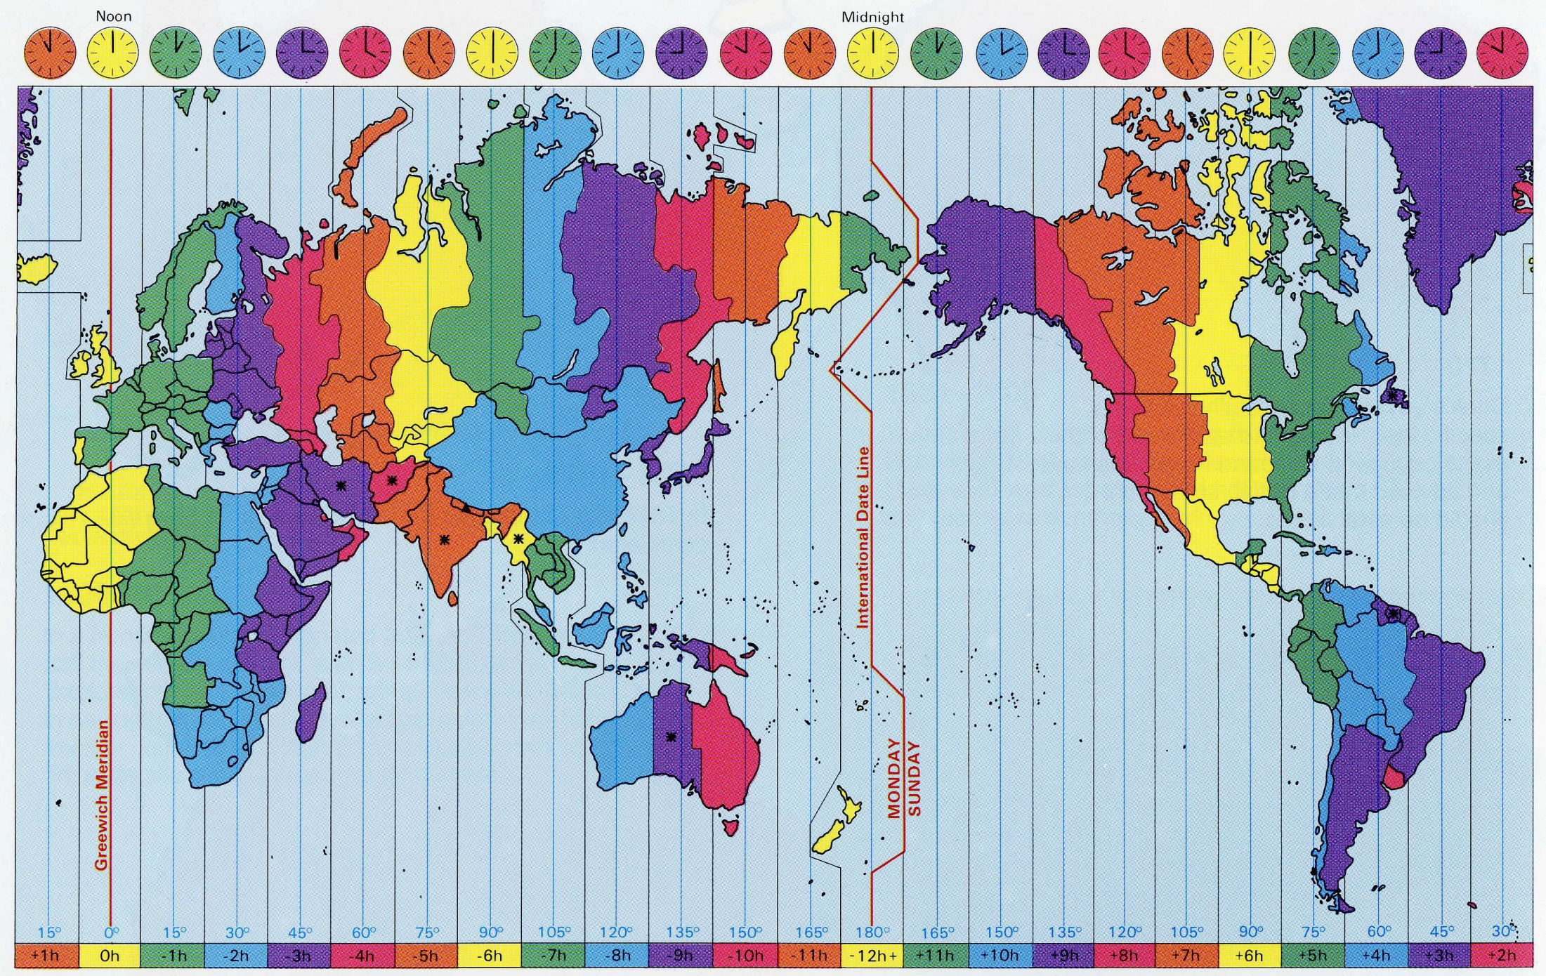
Global Time Zones
Via Intergovernmental Committee on Surveying and Mapping http://www.icsm.gov.au

Slide 20
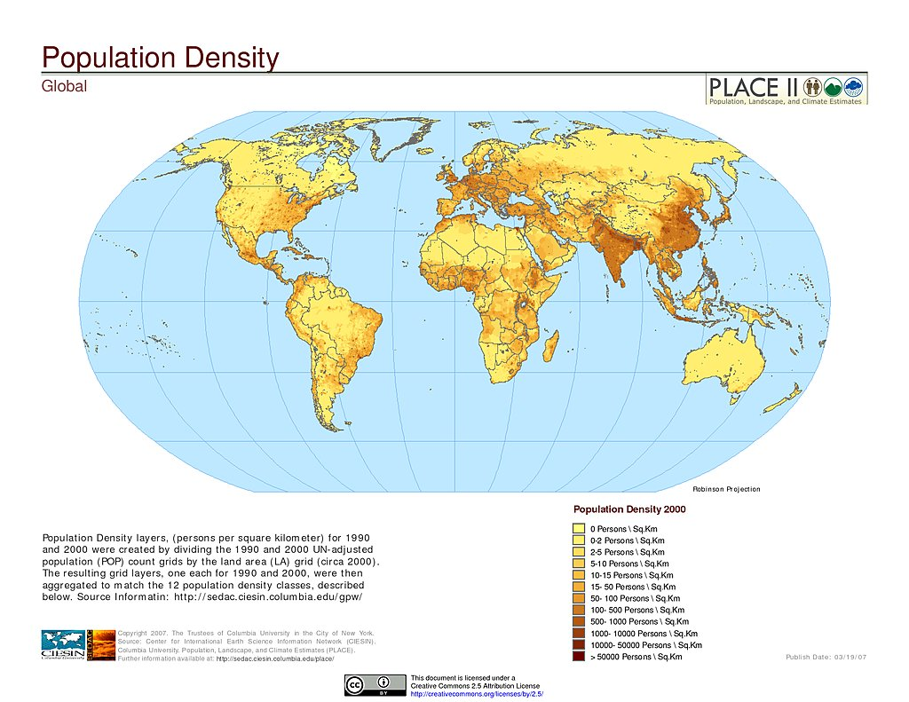
Global Population Density (2000)
Via Socioeconomic Data and Applications Center (SEDAC) http://sedac.ciesin.columbia.edu

Slide 21
Map Making - Design
Pre-work
Make an analysis.
Label fields (Give fields proper names)
Create a proper color scheme for clarity
Choose a map projection.
Choose a map location.
All of this before even composing the map!

Slide 22
Map Making - DESIGN
Title
Body
Location
Map Scale
Legend
Directional Indicator
Labels
Metadata
Guidelines
Graticule map
Other

Slide 23
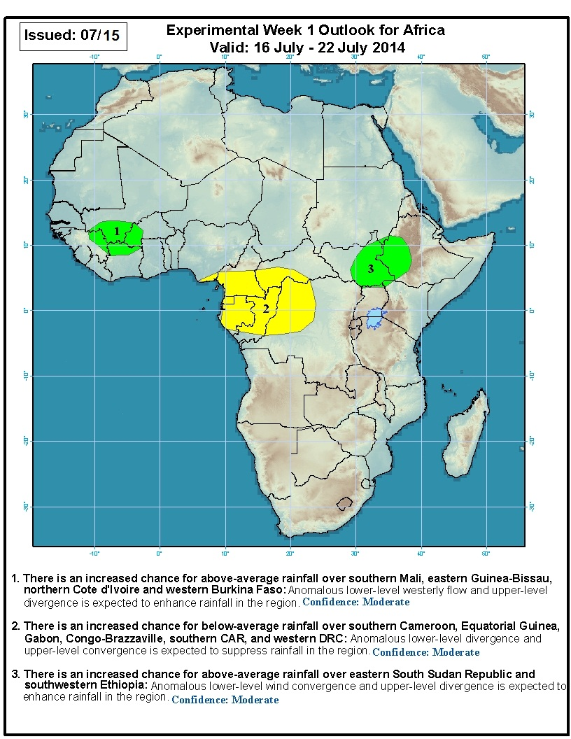
Map Making - DESIGN
Title
Body
Location - Africa
Map Scale
Legend
Directional Indicator
Labels
Metadata
Neatline
Graticule map
Other

Slide 24
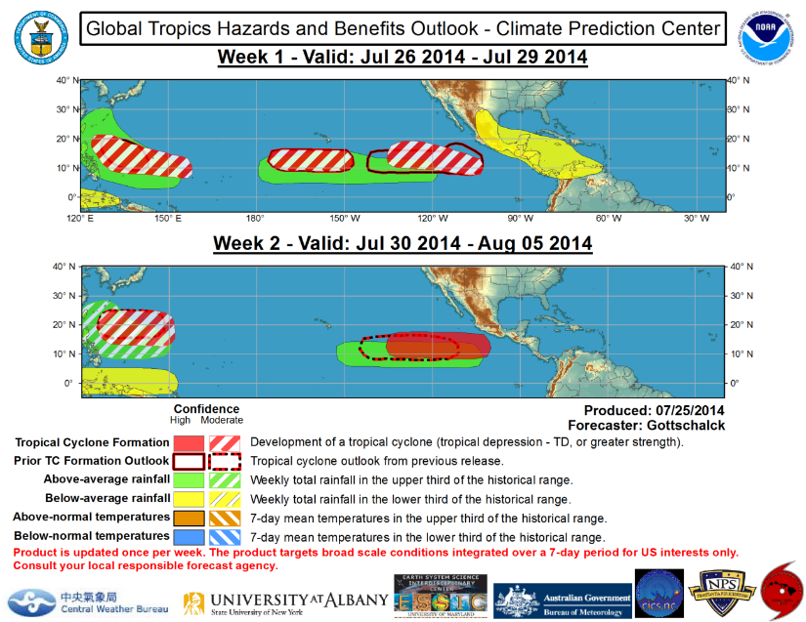
Map Making - DESIGN
Title
Body
Location
Map Scale
Legend
Directional Indicator
Labels
Metadata
Neatline
Graticule map
Other

Slide 25
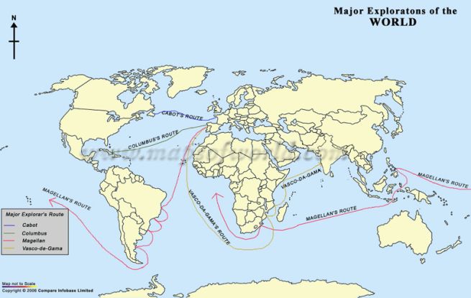
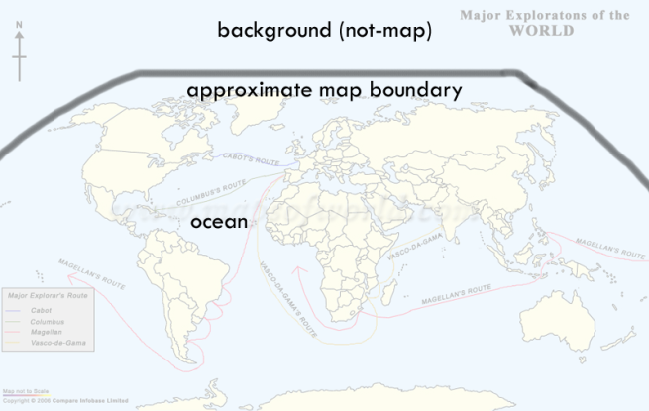
Map Making
Importance of a Neatline and color scales!
Via Cartastrophe http://cartastrophe.wordpress.com/

Slide 26
Map Making in QGIS
So you have created a forecast in QGIS …
First, use the to zoom into area you want.
Next go to Project >> New Print Composer
Print Composer = where map making occurs.

Slide 27
Map Making in QGIS
EDITOR

Slide 28
Map Making in QGIS
Print Composer

Slide 29
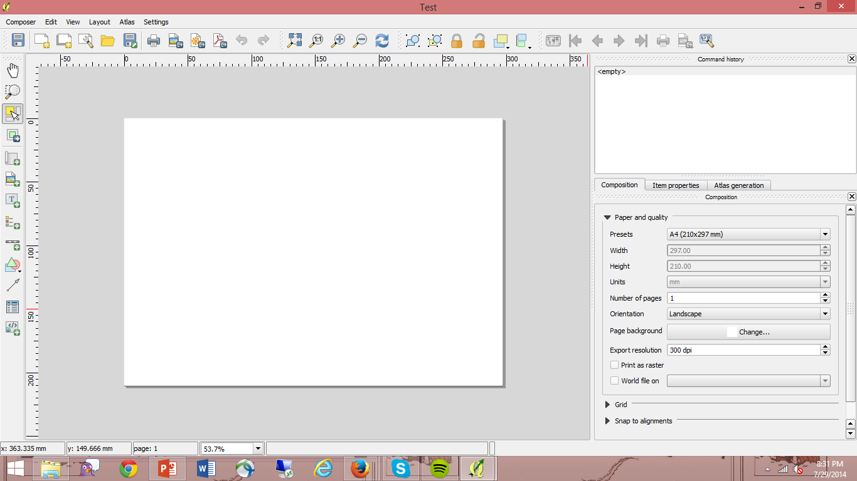
Map Making in QGIS Print Composer
Composition Tab – Output format

Slide 30
Map Making in QGIS Print Composer
To add map, hit and drag box.
Map “should” look like area on editor… but not always.
Can adjust by going to Item Properties next to Composition and changing Extents.

Slide 31
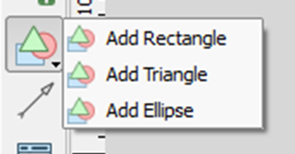
Map Making in QGIS Print Composer
To add label (title), hit
Item Properties to change text, size, font etc.
To add legend, hit
Item Properties to adjust
To add shapes, hit >>>>>>>>
To add compass rose, Layout >> Add Image
Item Properties >> Search Directories
To add scale bar, hit

Slide 32
Map Making in QGIS Print Composer
Outputting…
As an image (JPG, PNG,TIF)
As a SVG
As a PDF

