Slide 1
GEOPROCESSING BASICS AND MODELING
Miliaritiana Robjhon
Nick Novella

Slide 2
Agenda
Benefits
Tools
Buffer
Merge
Union
Contouring
Modeling
Exporting to Python
Python scripting

Slide 3
Applications
Geoprocessing can be used to solve meteorological problems.
Also used in other real world environments.
Emergency Management, urban planning, etc.
Tools commonly-used at CPC.
Intersection
Clipping
Interpolation
Contouring
Buffering

Slide 4
Buffer Tool
Accessed in newer versions by going through Geoprocessing menu
2 types of buffer
Single Ring buffer
Will have single buffer distance
Multi distance buffer
Will have multiple buffer distances
Ex. 5mi, 10mi, 15mi, 20mi
Real world applications
Flood zones(Floodplain)
Disaster areas
Others

Slide 5
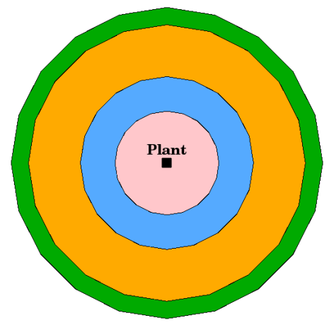
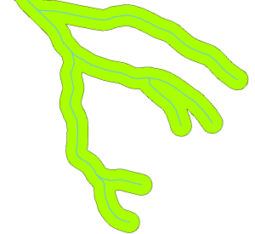
Buffers Cont.
Multi-Ring Buffer
Single Buffer

Slide 6
Buffer Applications
Real World Applications
Flood Zones
Identify areas close to rivers and streams which are likely to flood. (Floodplains)
Destruction Radius
Could be used in the case of a tornado or earthquake for damage forecasting or assessment.
Could benefit from using single or multiple distance buffers.
Other

Slide 7
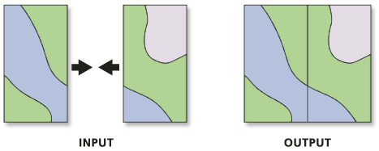
MERGE (DISSOLVE) TOOL
Tool to combine vector datasets.
Use this tool to combine datasets from multiple sources into a new, single output dataset. All input datasets must have the same geometry type.
Dissolve tool works for vector data only.
In order to merge rasters you can merge or mosaic raster tool!
Append tool sounds similar but will add attributes of one layer to another without creating a brand new dataset.

Slide 8
Union tool
Creates a single layer from multiple input layers.
Resulting layer will contain all attributes from both input layers.
In the case of polygon layers, separate features are created for overlapping and non-overlapping features. The attribute table of the union layer contains attribute values from the respective input layer for non-overlapping features, and attribute values from both input layers for overlapping features.

Slide 9
Contouring
Contour tools create a line feature class of contours (isolines) from a raster surface.
Commonly used to show separation of interpolated values.
Used at CPC for a variety of maps and levels.
Can automate contour levels or set specific values
Ex. Temperature contouring at 90, 100 degrees F. for apparent temperature maps.

Slide 10
Modeling
Accessed through the Processing menu or toolbox in QGIS.
Allows users to utilize multiple geoprocessing tools in one session.
Users can automate geoprocessing of large datasets.
Conduct more efficient analysis
Ability to export workflow to python scripts that can be expanded and used later.

Slide 11
Modeling Continued

Slide 12
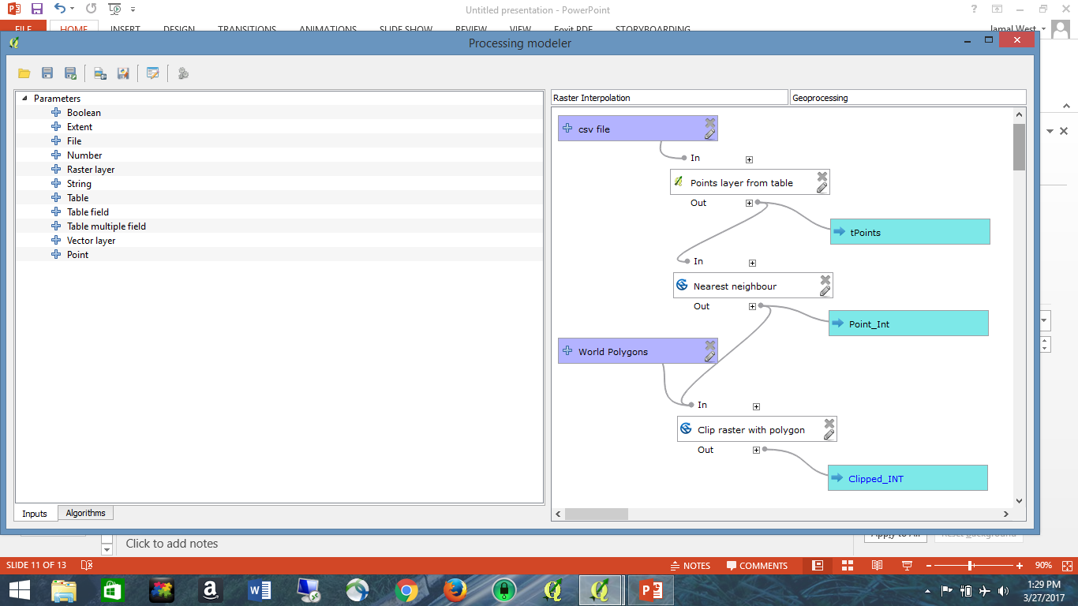
Modeling Cont.
Inputs
(Blue)
Limited to using tools in processing toolbox for modeling in QGIS.
Add tools using menu to the left when opening.
Can’t* preset some parameters, they are selected/set as you run the model*.
Can create temporary datasets that are not saved to disk.
Useful because you don’t run Algorithms on actual output files but rather the output in memory.
Algorithms
(White)
Inputs
Algorithms
Outputs
Input and Algorithm Tabs

Slide 13
Export Model to Python Script

Slide 14
Exporting Models
An exported model cannot be run right away independent of QGIS python console.
You must set the environment correctly first.
QGIS somewhat limited at this time in that you must do work on scripts before running after model output.

Slide 15
Geoprocessing - Scripting
Scripts can expand the power of the geoprocessing tools.
Using programming languages like python can allow for the automation of processing of large data sets and multiple feature classes by utilizing iterative tools and conditional statements.
With python you can take a dataset through an entire processing workflow, data retrieval, dissemination, mapping with newer modules is possible (mainly with proprietary software).

