Slide 1
Common Geoprocessing for Weather and Climate
Miliaritiana Robjhon
Nick Novella

Slide 2
Outline
What is Geoprocessing?
Table join and spatial join
Interpolating Point Measurement Data
Point Sampling Analysis
Resampling
Zonal Statistics

Slide 3
Geoprocessing
Operations that can be done on and to GIS data
Analysis methods that are possible because of the geospatial nature of the data
Vector
Joins (Spatial, non-Spatial)
Intersections
Dissolves, Clips, Buffers
Raster/Vector
Bulk Statistics
Zonal Statistics

Slide 4
Geoprocessing
Intersections
Deal with areas where spatial data overlap
Roads intersect with Counties
Forecasts intersect with counties/provinces
Can help with impacted facilities, populations
Spatial Join
Joins attributes, based on colocation

Slide 5
Table Join (Data)
A common GIS task to join the attributes from one spatial data layer to another.
Name | Number
Tom | 123
Matt | 456
Wassila | 789
Joe | 321
Dave | 654
Grade | Number
A | 123
B | 789
B | 321
C | 654
D | 456
Name | Number | Grade
Tom | 123 | A
Matt | 456 | D
Wassila | 789 | B
Joe | 321 | B
Dave | 654 | C

Slide 6
Spatial Join
Involves matching rows in the attribute table from the join layer to the target layer, based on a spatial relationship and writing to an output feature class.
Like a join based on data, but based on the location
1
2
4
3
5
Point | Value
1 | 0.9
2 | 1.5
3 | 0.5
4 | 1.5
5 | 1.1
Polygon | Hazard
1 | TSTM
Point | Value | Hazard
1 | 0.9 | NULL
2 | 1.5 | TSTM
3 | 0.5 | TSTM
4 | 1.5 | TSTM
5 | 1.1 | NULL

Slide 7
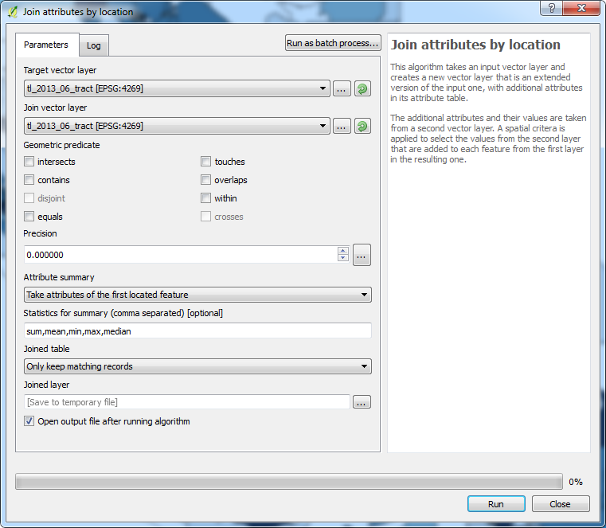
Join Attributes by Location
Menu Vector >> Data Management Tools >> Join Attributes by Location

Slide 8
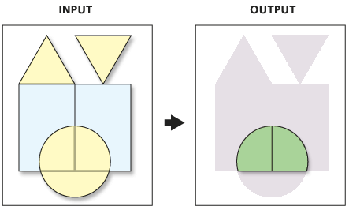
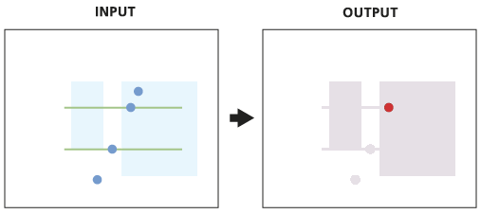
Intersections
Determines the spatial reference. Also the spatial reference of the output feature class. Input features are projected into this spatial reference.
Cracks and clusters. Cracking inserts vertices at the intersection of feature edges; clustering snaps together vertices that are within the xy tolerance.
Discovers geometric relationships (intersections) between features from all the feature classes or layers.
Writes these intersections as features (point, line, or polygon) to the output.
Attributes from both input data sources are mapped to the retained features

Slide 9
Intersections
Menu Bar
Vector
Geoprocessing Tools
Intersection

Slide 10
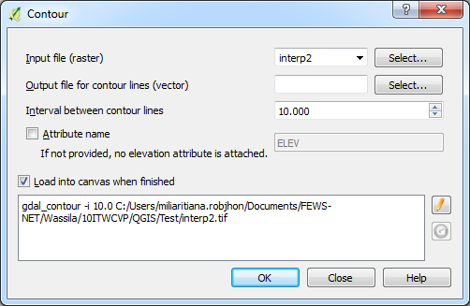
Raster to Vector Transformation
It is possible to vectorize gridded data
Ex: Create contour from a raster data
Raster >> Extraction >> Contour

Slide 11
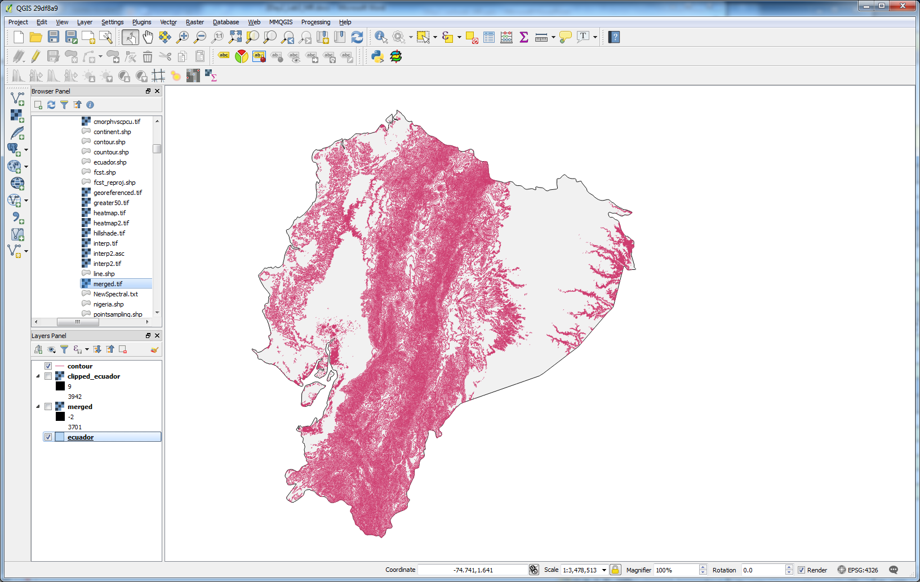
Contour from DEM raster data

Slide 12
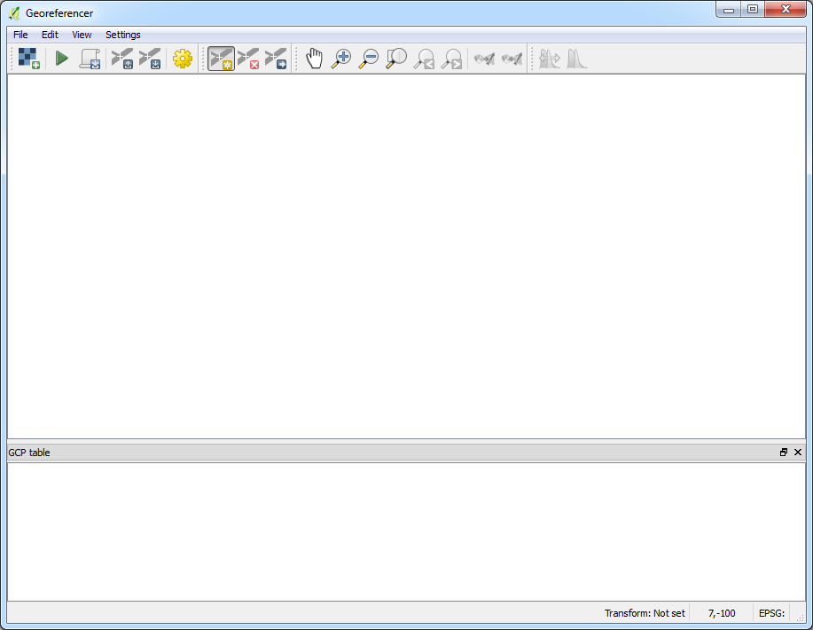
Georeferencing an imagery
Georeferencing is the process by which coordinates are assigned to pixels on the raster data.
Make sure georeference plugin is activated
Raster >> Georeferencer >> Georeferencer

Slide 13
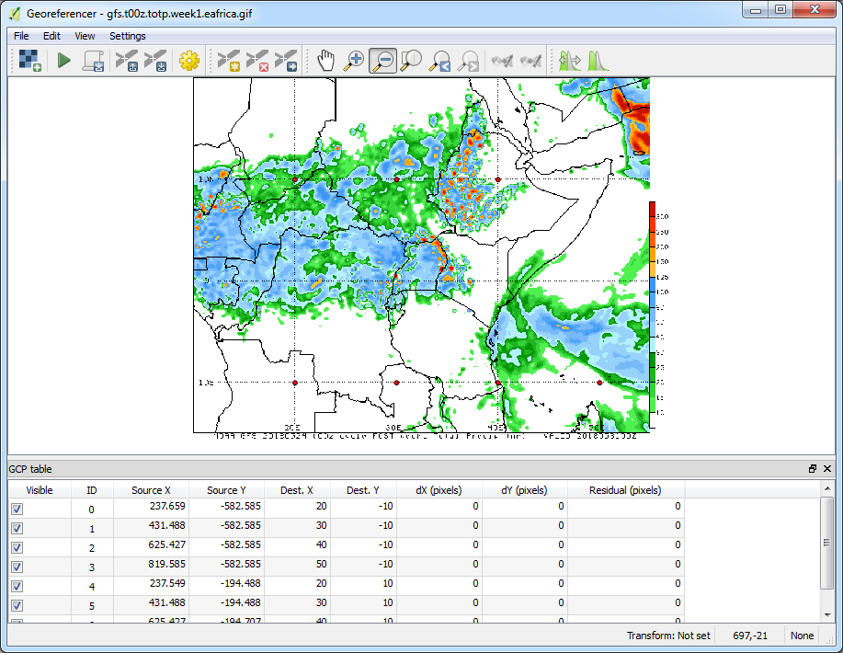
Georeferencing an imagery
Georeferencing is performed by choosing the proper CRS and adding Ground Control Points for easily identifiable locations on the map.

Slide 14
Resampling
Process of interpolating the pixel values, while transforming the raster dataset
Relates to spatial resolution
Scale up: Fine => coarse
Scale down: Coarse => fine

Slide 15
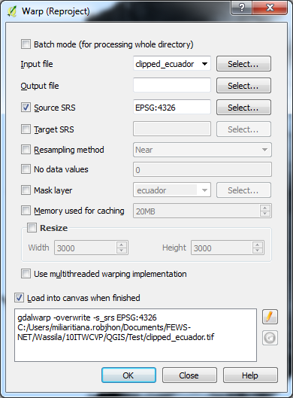
Resampling/Reprojecting
Possibility to change CRS and or cell size of raster data
Menu Raster >> Projections >> Warp (Reproject)
But other resampling tools available as well

Slide 16
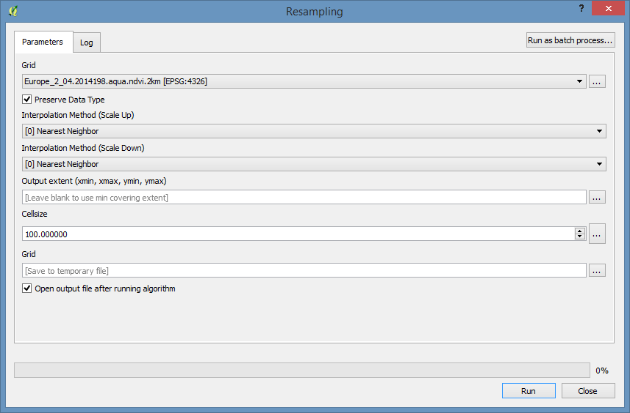
Resampling Toolbox
Menu Processing>> Toolbox >> SAGA >> Raster Tools >> Resampling
Select adequate parameters, choose Cellsize and click Run

Slide 17
Zonal Statistics
Not zonal in a meteorological sense
Statistics of a raster over each zone in a vector
Requirements
Zonal statistics Plugin
Raster data to perform statistics on and
Vector data, which defines the zones

Slide 18
Zonal Statistics
Illustration
How much rain fell in each province?
Gridded precipitation + Maps Provinces
2 | 2 | 1 | 6 | 3 | 5 | 4
2 | 1 | 6 | 0 | 6 | 4 | 4
1 | 0 | 4 | 9 | 5 | 3 | 4
3 | 0 | 2 | 3 | 5 | 5 | 2
4 | 2 | 5 | 5 | 3 | 8 | 4
3 | 3 | 2 | 6 | 8 | 9 | 7
8 | 7 | 5 | 8 | 5 | 10 | 6
3 | 6 | 8 | 9 | 9 | 9 | 8
Red | NW
Blue | SW
Yellow | Center
Green | SouthCentral
Purple | NE
Light Blue | SE

Slide 19
Zonal Statistics
Mean - get the mean of the values, appended to the attributes of the polygons.
Other functions available as well
2 | 2 | 1 | 6 | 3 | 5 | 4
2 | 1 | 6 | 0 | 6 | 4 | 4
1 | 0 | 4 | 9 | 5 | 3 | 4
3 | 0 | 2 | 3 | 5 | 5 | 2
4 | 2 | 5 | 5 | 3 | 8 | 4
3 | 3 | 2 | 6 | 8 | 9 | 7
8 | 7 | 5 | 8 | 5 | 10 | 6
3 | 6 | 8 | 9 | 9 | 9 | 8
Red | NW | 2.83
Blue | SW | 3.9
Yellow | Center | 3.93
Green | SouthCentral | 7.5
Purple | NE | 4.22
Light Blue | SE | 6.53

Slide 20
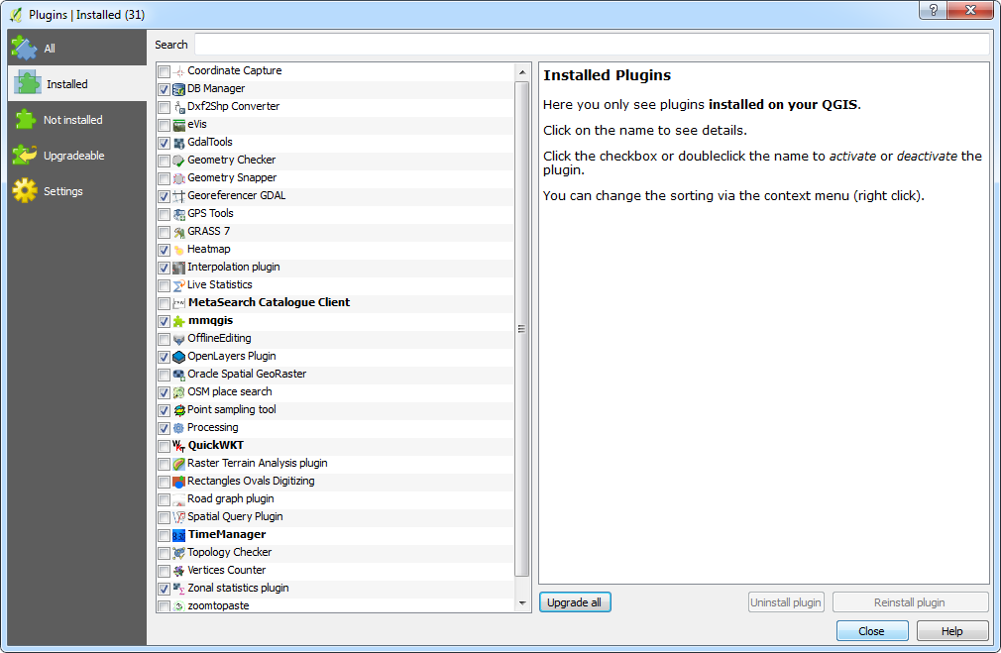
Enabling Zonal Statistics Plugin
Menu Plugins >> Manage and Install Plugins >> Installed

Slide 21
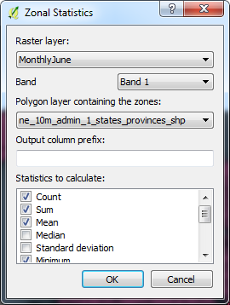
Zonal Statistics
Menu Raster >> Zonal statistics >> Zonal statistics
Choose column prefix that will help identify statistics in the output’s attribute table, e.g., ZS_

Slide 22
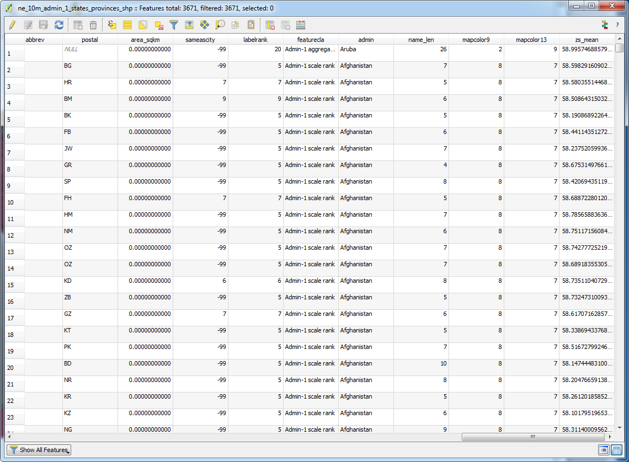
Zonal Statistics
Zonal statistics added to the attribute table of the vector layer

Slide 23
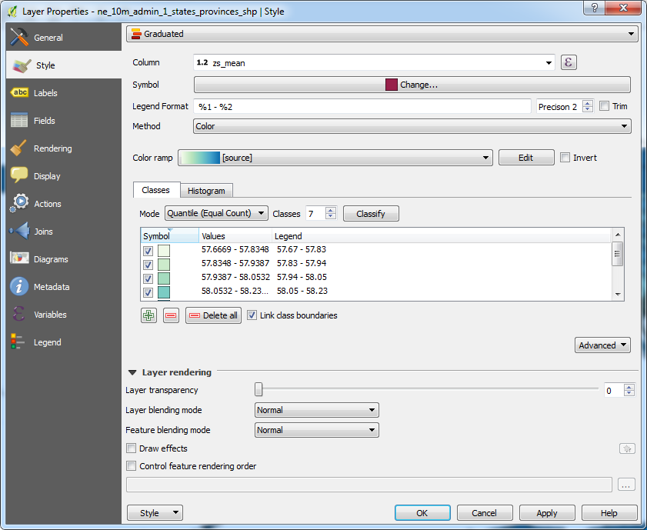
Styling for Zonal Statistics
Zonal statistics added to the attribute table of the vector layer

Slide 24
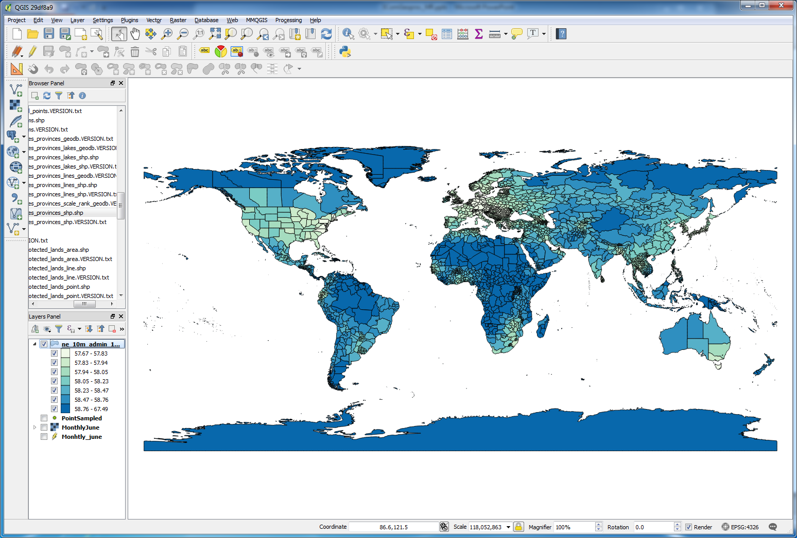
Zonal Statistics

Slide 25
Laboratory
Lab work will cover
Spatial Joins
Intersections
Loading in CSV data
Interpolations
Styling (Symbology)
Querying rasters at points (Sampling)
Resampling
Zonal statistics

