Slide 1
Raster Data in QGIS
Miliaritiana Robjhon
Nick Novella

Slide 2
Outline
What is Raster Data?
Supported Formats
What can one do with Raster Data?

Slide 3
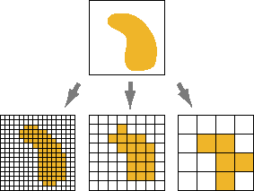
Data Types
Rasters
Gridded data
Each “cell” has a value
GIS can handle various types – binary, ASCII, netcdf, KML, CSV, Geotiff (many additional options)
Image from ESRI

Slide 4
Data Types
Rasters
Rows
Pixel /Cell
Columns

Slide 5
Data Types
Rasters
What type of data can be converted to raster format?
Satellite imagery, Land-use/agricultural data, Weather/climate data (what types?)
Different Uses for Raster data
Base map for other layers
Elevation maps, terrain, bathymetry
High level analysis of data or problems
Deforestation
Land use land cover change detection

Slide 6
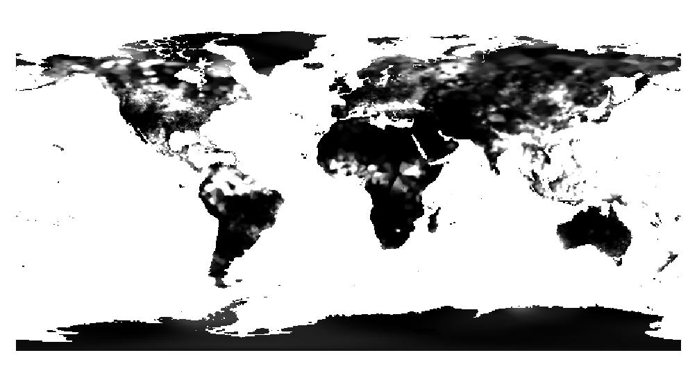
Data Types
Raster Bands (variable)
Some raster have 1 band or layer (think temperature or elevation)
Can show as grayscale or color map or two colors

Slide 7
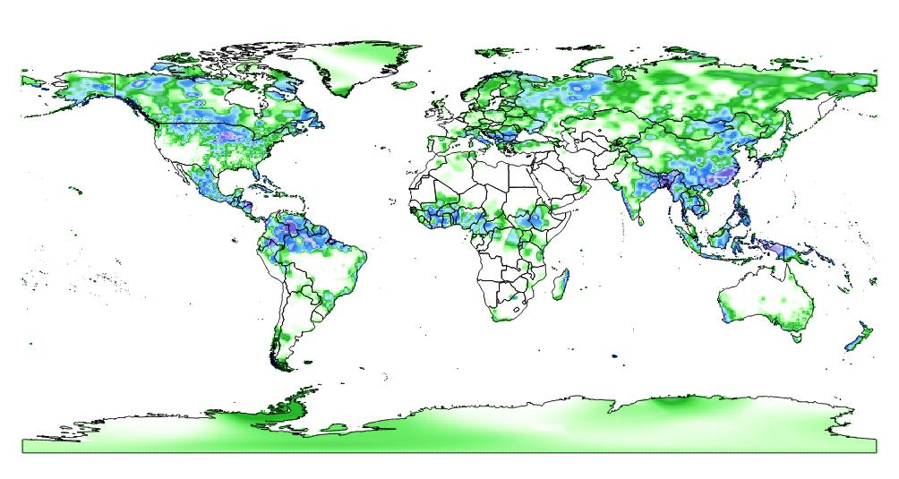
Data Types
Raster Bands
Some raster have 1 band or layer (think temperature or elevation)
Can show as grayscale or color map or two colors

Slide 8
Data Types
Raster Bands
Some rasters have multiple bands
Every cell has more than one value associated
Each band may focuses on different part of the electromagnetic spectrum.
Can display all bands together as RGB composite - make a color map.
This often is useful in analysis
Popular in satellite data.

Slide 9
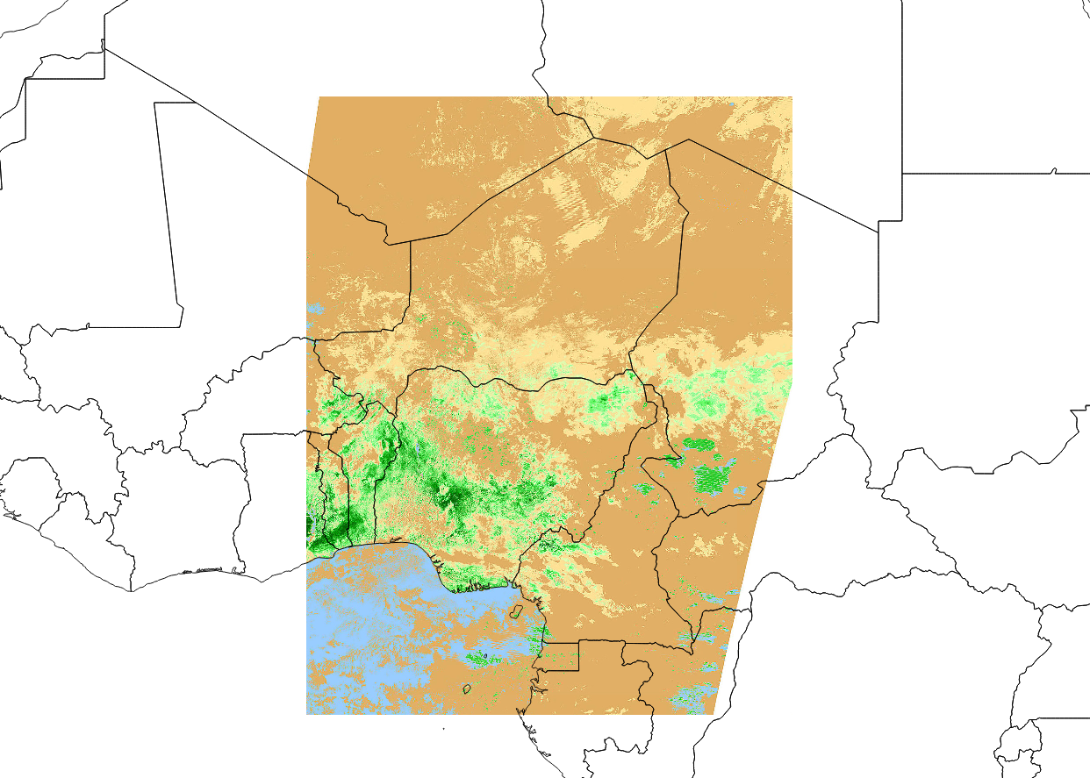
Data Types
Multibands
Normalized Difference Vegetation Index (NDVI)

Slide 10
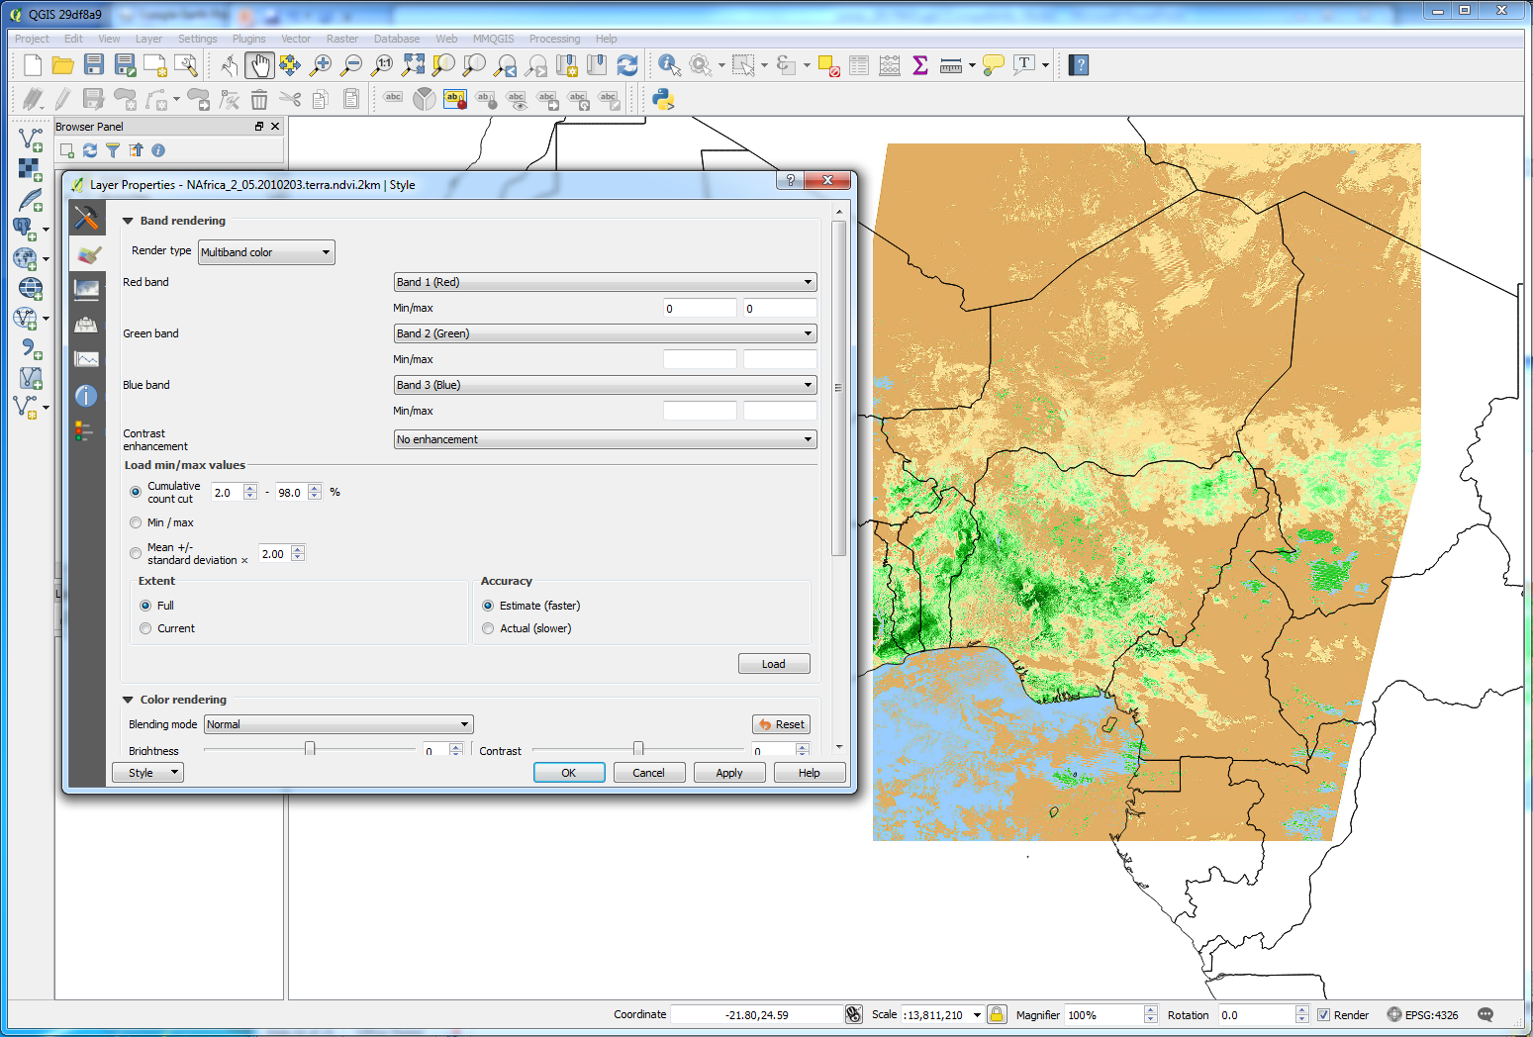
Data Types
Multibands

Slide 11
Data Types
Rasters – Pros/Cons
Pros
Good at showing spatial extent of data
Easy to perform analysis on – create new raster information
Lots of weather/climate data available in gridded format
Cons
Resolution plays a large role
More grid cells, higher resolution, larger file size, slower processing
Low resolution can be inaccurate at depicting specific features.
Mountains, rivers etc.
For analysis, all rasters have to be same resolution/same projection

Slide 12
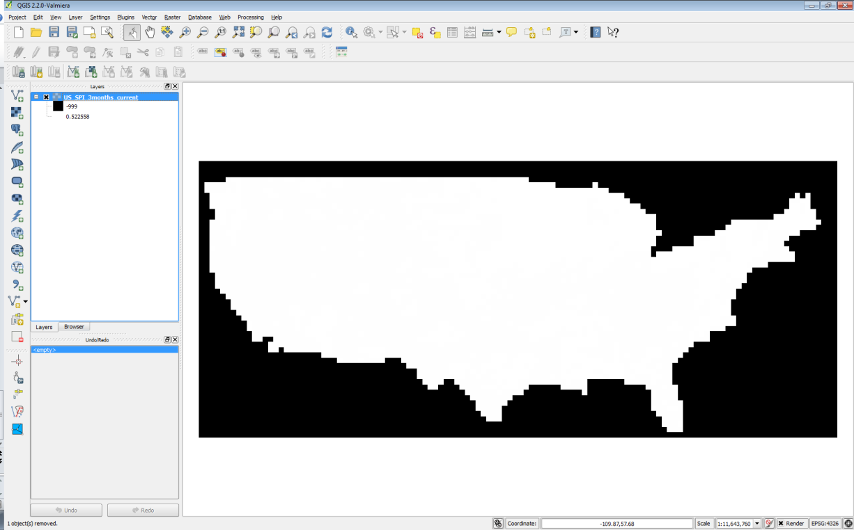
Raster Data
What good is data without interpretation?
Need to colorize/stylize/query

Slide 13
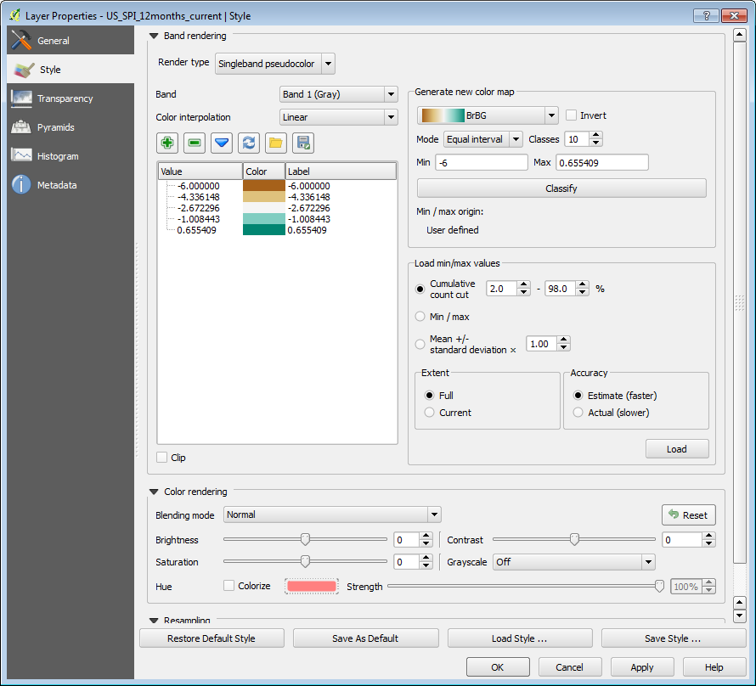
Symbologies
Singleband
Pseudocolor
Multiband

Slide 14
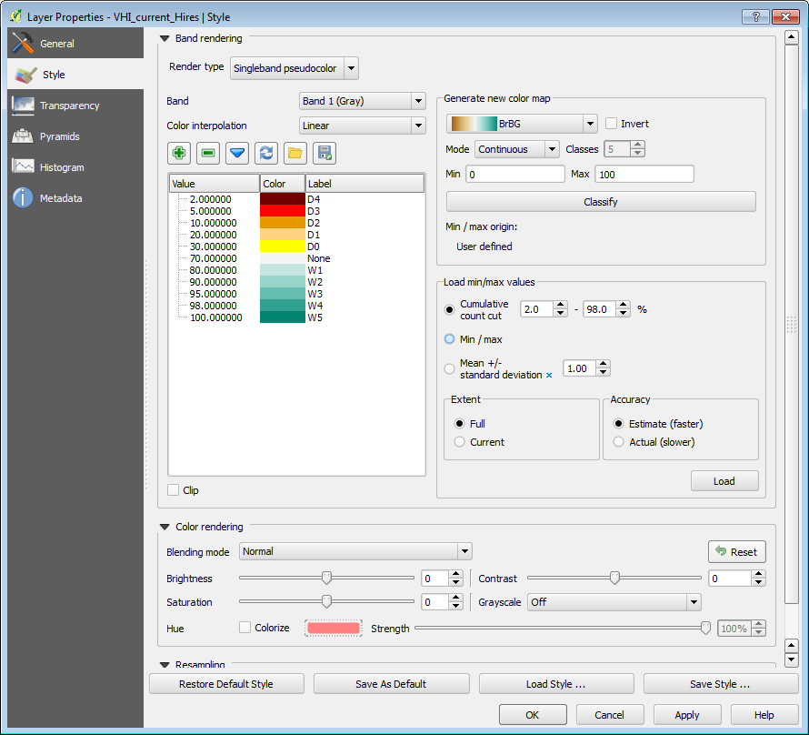
Symbologies
Pseudocolor
Scalar fields
Temperature
Precipitation
Satellite Index
Decide your thresholds
Choose colors
Apply

Slide 15
Creating Raster Data
Interpolation of point data
Multiple methods
Inverse Distance Weighted (CPC)
Natural Neighbor (used by CPC and USDA)
Kriging
SAGA GIS - open source for making gridded data

Slide 16
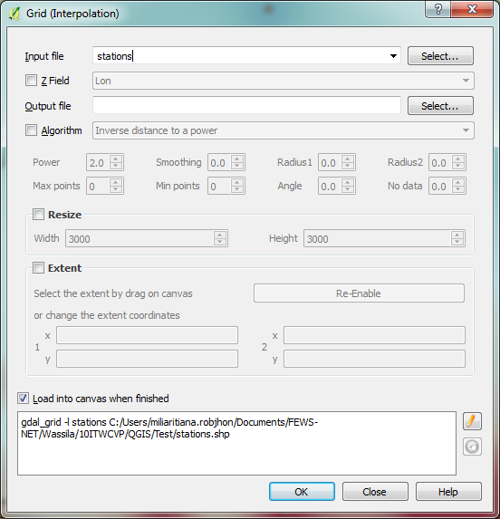
Interpolation
Transforms station point (vector) data to gridded (raster) data
Menu Raster >> Analysis >> Grid (Interpolation)

Slide 17
Interpolating Point Measurement Data
A common operation in meteorology
Interpolates unevenly-distributed data to produce a gridded, raster data
Easily-done but involves steps in QGIS
Save gauge data in MS Excel Comma-Separated Value (CSV) format
Import/add CSV data onto QGIS
Choose method and perform interpolation

Slide 18
MS Excel CSV Format
Must contain: some Identification, Coordinates, and Measurement Data and Save As Comma delimited

Slide 19
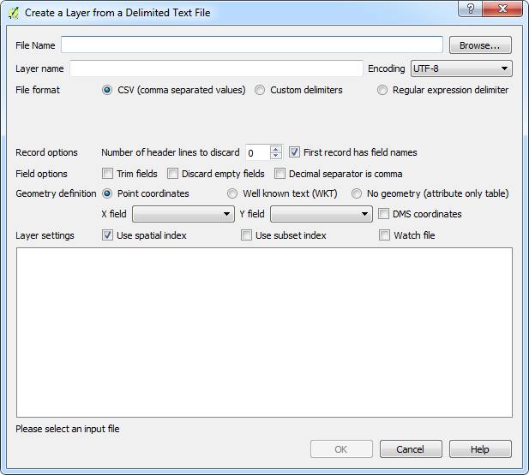
Loading in CSV Data
Menu Layer >> Add Layer >> Add Delimited Text Layer

Slide 20
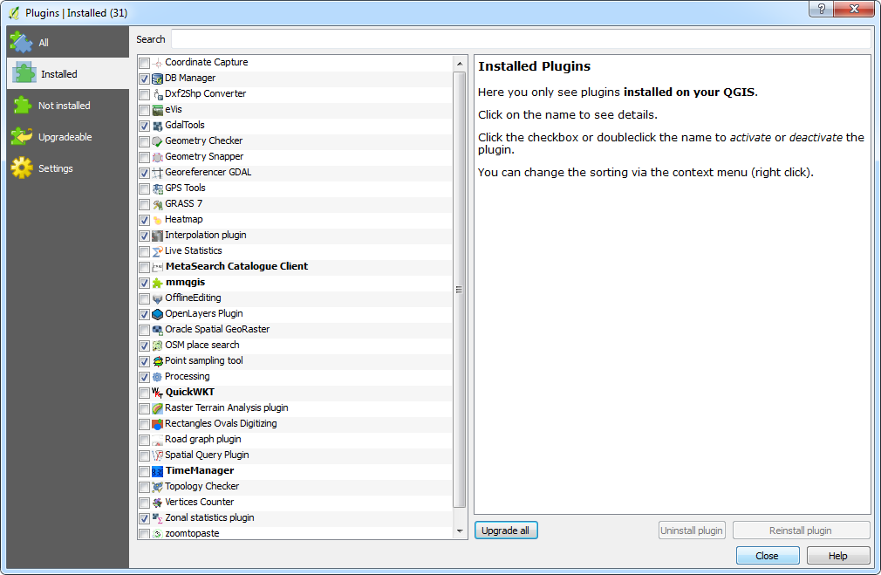
Enabling Interpolation Plugin
Menu Plugins >> Manage and Install Plugins >> Installed

Slide 21
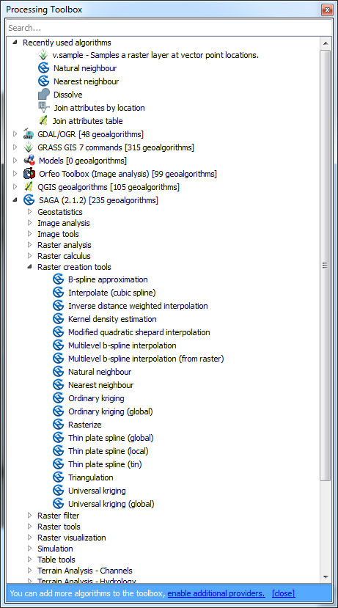
Other Methods for Interpolation
Menu Processing >> Toolbox

Slide 22
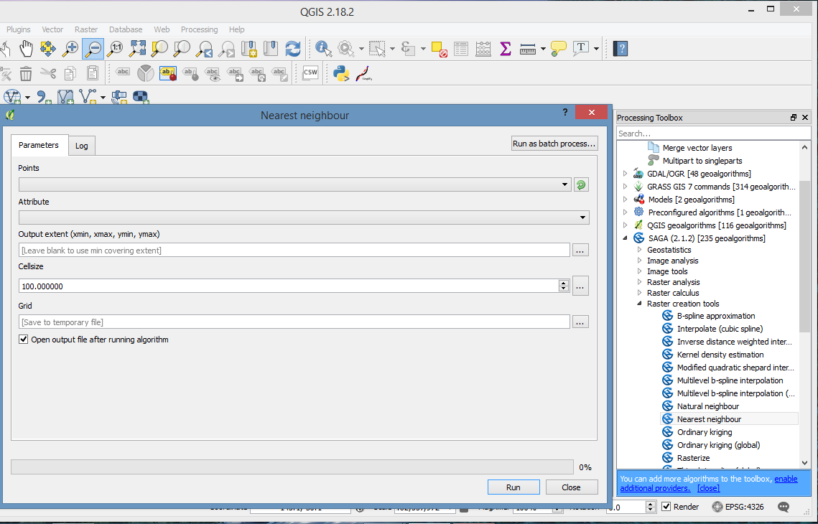
Interpolation
Menu Processing>> Toolbox >> SAGA >> Raster Creation Tools >> Nearest Neighbor
Select adequate parameters, choose Cellsize and click Run

Slide 23
Point Sampling
Extracts values over points from a raster layer
Requirements
Point Sampling Tool Plugin
Raster data to extract value from and
Vector data, which includes point locations

Slide 24
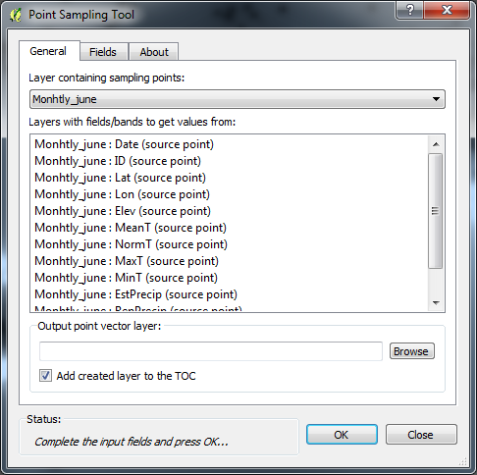
Point Sampling Tool
Click the toolbox and select layers

Slide 25
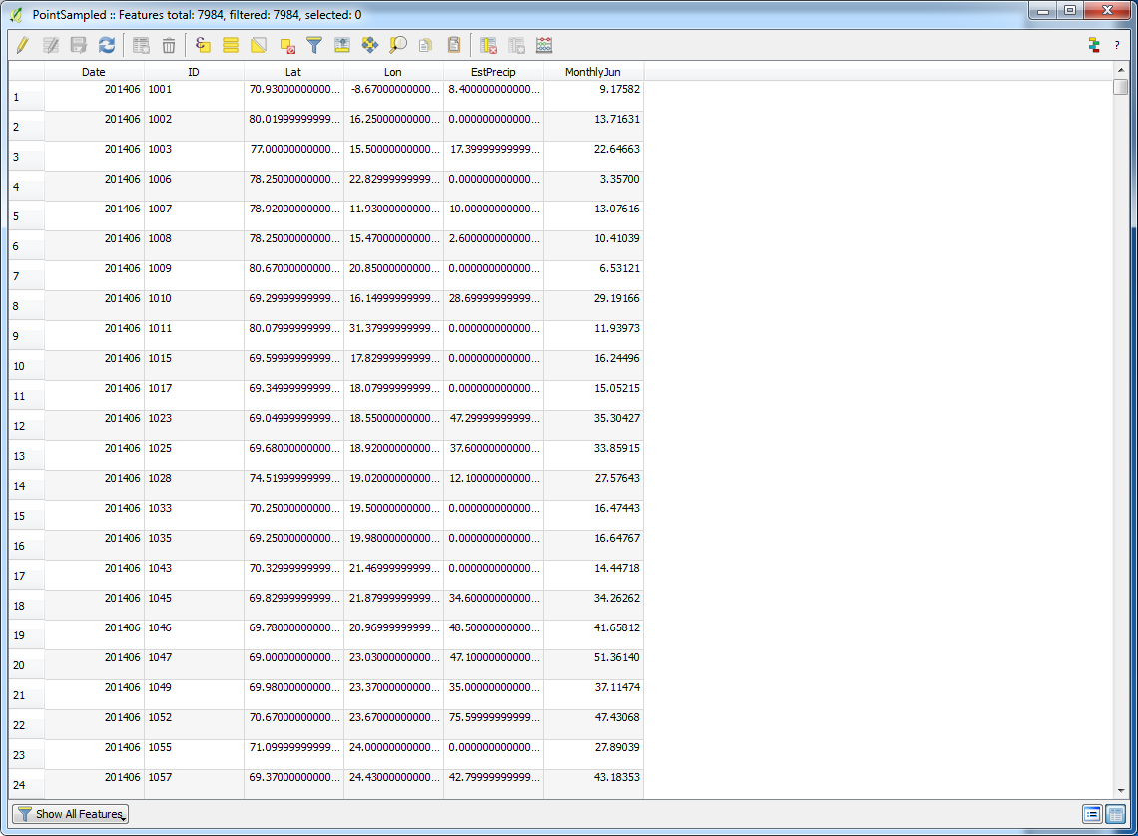
Extracted Values in Attribute Table

Slide 26
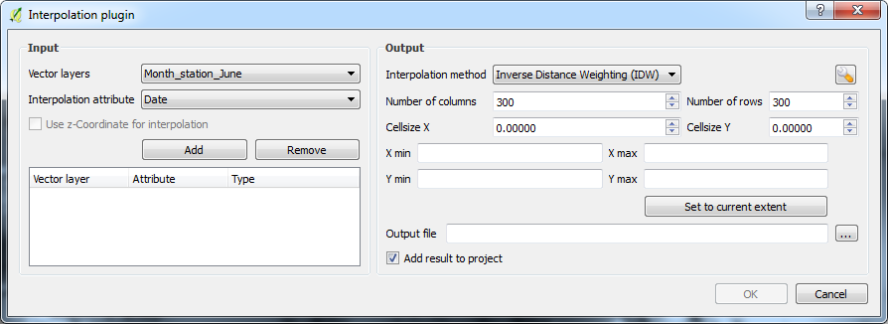
Interpolation from plugins
Menu Raster >> Interpolation >> Interpolation
Select proper Interpolation attribute and click Add
Select adequate Interpolation method and choose Cellsize X and Cellsize Y

Slide 27
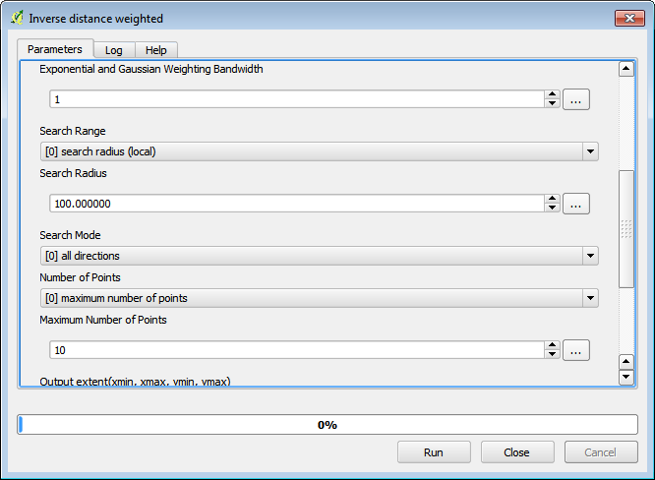
Creating Raster Data
Inverse distance weighted (CPC)
Power Value
higher = emphasis on the nearest points, less smooth
lower = emphasis on further points, smoother
Control number of points
Non physical

Slide 28
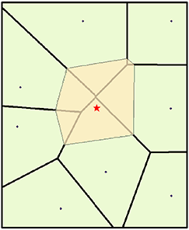
Creating Raster Data
Natural Neighbor (used by CPC and USDA)
Voronoi (Thiessen) polygons constructed
Sample point, new Thiessen polygon constructed
Weight = proportion of overlap new/initial poly

Slide 29
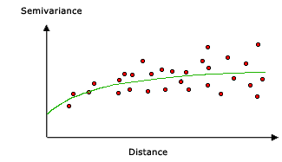
Creating Raster Data
Kriging
SAGA GIS –
Assumes distance or direction between sample points can be used to explain variation in the surface
forms weights from surrounding values to predict unmeasured locations

Slide 30
Raster Processing
Raster Processing
Clipping – GDAL Clip Raster By Extent.
Instead of masking out ocean, or able to subset for country or province
Extracting – Clip by mask(Polygon)
Point Sampling
Extracting by value
Resampling (helps to match resolution)- Covered in next section.
Mathematical operations within and across rasters
Raster Addition
Creating totals, climatology, anomalies
Local Statistics (zonal statistics) – will cover tomorrow.

Slide 31
Raster Processing
Raster Processing
Clipping – GDAL Clip Raster By Extent.

Slide 32
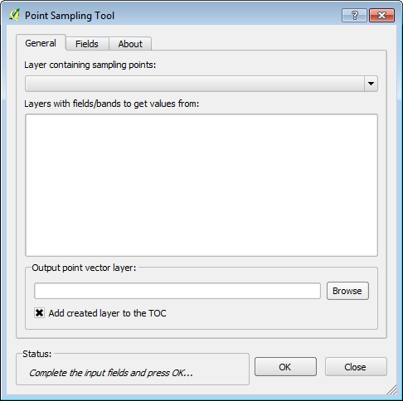
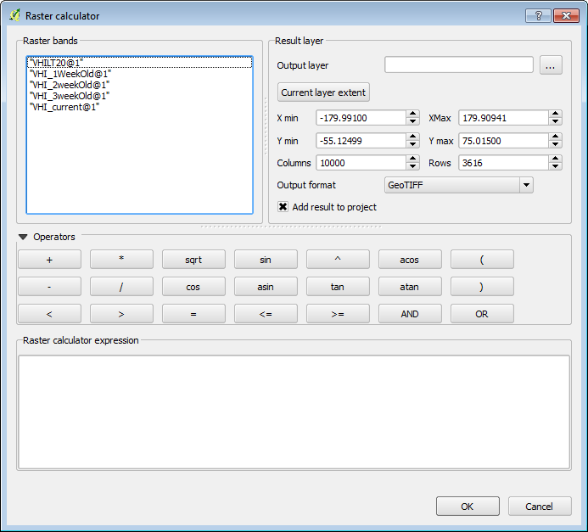
Raster Processing
Raster Processing
Extracting
Point Sampling – QGIS Plugin or SAGA tool
Extracting by value

Slide 33
Raster Processing
Lab Work will cover
Symbolizing rasters
Querying rasters
Clipping
Raster Calculator
Calculations
Interpolations
Point sampling

