Slide 1
Introduction to QGIS
Miliaritiana Robjhon
Nick Novella

Slide 2
Outline
What is QGIS?
What can we do with it?
What data can we work with?

Slide 3
QGIS
Formerly known as Quantum GIS, developed initially around 2002
Geospatial Information System
System – Collection to Analysis to Mapping
Notice … same as GIS
Free Open Source Software
Pros: FREE!, shares many similar components as ARC-GIS, user friendly, growing world-wide community of users
Cons: No traditional customer service, not all applications are available as in ARC-GIS, possibility to either build analysis techniques yourself or use other user-developed apps

Slide 4
QGIS
What does Open-Sourced mean?
Refers to how software is licensed
Everyone can use AND change the software
Source code available to the world
Users are encouraged to improve/add-to the software … voluntarily

Slide 5
What can we do with QGIS?
Mapping and analysis software
Easy mapping
In-depth spatial analysis
QGIS is a way to combine multiple types of data with human-created ideas
Useful for weather-climate communication

Slide 6
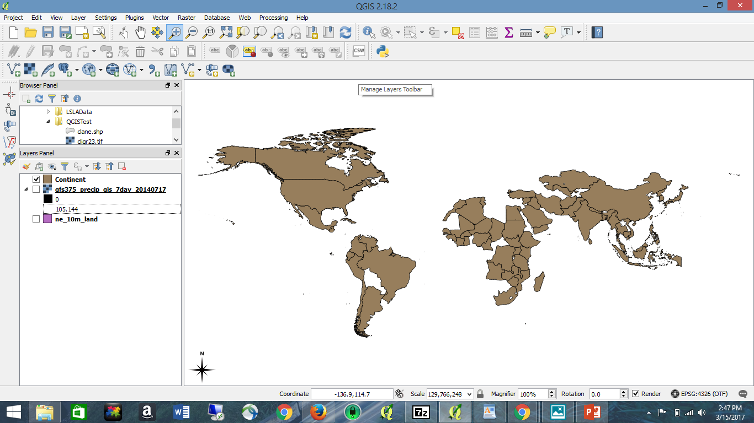
QGIS GUI
GUI = Graphical user interface
Where you do your analysis/create your products
Toolbars
Menu Bar
Map view or Canvas
Map Legend or Browser Panel
Status Bar

Slide 7
QGIS GUI
Menu Bar
Opening/creating new or old projects
Saving projects
One way to reach editing components
Create feature, add feature, edit feature
Where to change your viewpoint (Zoom)
Layer – where you add in ANY of your data
Or save layer edits – start editing shapefiles-
Settings - set projection
Plug-ins – this needs its own page

Slide 8
QGIS Plugins
Two Types: Core and External
Core – maintained by QGIS Developmental Team
Automatically part of every QGIS distribution
External – Written in Python
Stored in external repositories and maintained by individual authors
Location of new features and functions
Created by QGIS architects OR users
On Menu Bar – Can access these plug-ins
Requires downloading/installation
Some already installed (might need upgrading)
We will be using some plugins later this week
Interpolation, zonal statistics, etc.

Slide 9
QGIS GUI – Menu Bar cont.
Vector – location of all vector tools
Raster – location of raster tools
Processing – location of Toolbox
Help -

Slide 10
QGIS GUI
GUI = Graphical user interface
Where you do your analysis/create your products
Tool Bar
Menu Bar
Map Legend
Map View
Status Bar

Slide 11
QGIS GUI – Toolbar
Allows user to access most functions found in menu bar
Can personalize. Most used functions a click away.
Can switch on and off different menu toolbars
The Tool bar is found in Settings ➔ Toolbars

Slide 12
QGIS Layers Panel or Map Legend
Lists all the layers you are using.
Can check (uncheck) box to show/hide layer
Can drag layers above/below each other
Like moving a playing card on top of another
Can organize layers into groups by right clicking.

Slide 13
QGIS Map Legend cont.
Right Click Options– Raster
Similar options as from menu or tool bar
Right Click Options – Vector
Open attribute table – Toggle editing –Save
Copy Style
Layer Order – found View > Panels >Layer order
To order layers.

Slide 14
QGIS Status Bar
Shows current location in lat/lon of cursor, scale,
Shows coordinate reference system (CRS)

Slide 15
QGIS Browser
NOT the GUI Editor
Separate panel in QGIS
Helps navigate your filesystem
Can find file – add to QGIS Editor from Browser

Slide 16
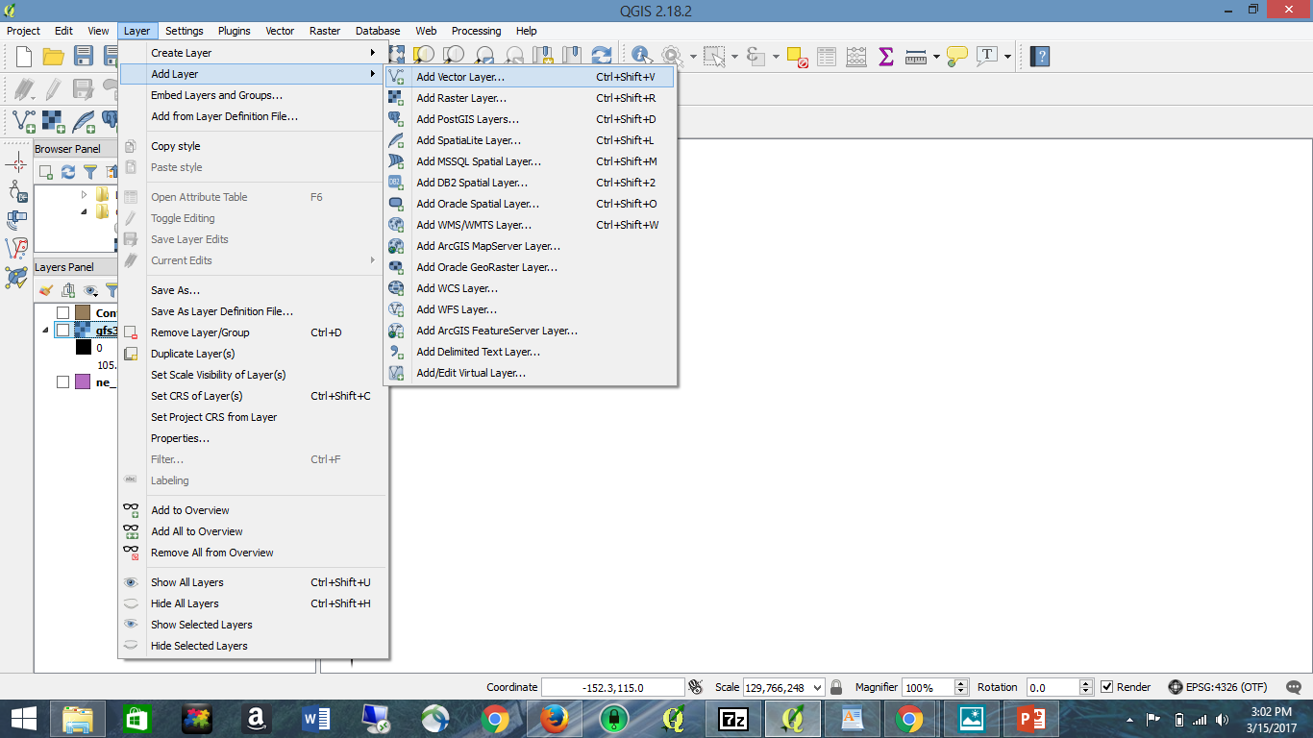
Loading Vector
Multiple ways
Menu Bar >> Layer
Drag from folder into Map View
Add Vector Button
If from Menu bar
Window pops up. Browse to dataset. Click Open
Layer is given a random color once loaded
Can change later
Add Vector
Button

Slide 17
Loading Raster
Multiple ways
Menu Bar >> Layer>>Add Layer>>Add Raster
Drag from folder into Map View
If loading multiple files – must make sure they are in same projection
Project >project Properties
CRS > enable “on the fly” reprojection”
Right Click Raster Layer in Map Legend
Style tab to create color scheme
Add Raster

Slide 18
Intro to QGIS
Lab work will cover
Importing vector data
Symbolizing or classifying vector data
Creating a new vector data
Viewing attribute table
Querying attribute table
Understanding CRS
Reprojection

Slide 19
HELP locations
Documentation
http://docs.qgis.org/2.18/en/docs/training_manual/
Gentle Intro to GIS
http://docs.qgis.org/2.18/en/docs/gentle_gis_introduction/index.html
QGIS Training Manual
http://docs.qgis.org/2.18/en/docs/training_manual/index.html

Slide 20
Additional Resources
Free QGIS Tutorials at -
http://www.qgistutorials.com/en/index.html

