Slide 1
Introduction to GIS
Miliaritiana Robjhon
Nick Novella

Slide 2
Outline
What is GIS?
What can we do with it?
What data can we work with?

Slide 3
GIS
Geographic Information System
Keyword is geographic
A system designed to store, manipulate, analyze, manage, and present geographical data
Computer-based GIS dates to the 1960s-1970s
Had advanced greatly with increased computing power.
Very popular across a spectrum of groups
Governments, scientists, NGOs, For-Profit, media

Slide 4
GIS
Geospatial Information System
System: collection of data, analysis, to mapping
3 parts
Data to digitize
Computer hardware to store data
Computer software
Pay and FREE GIS software available
ESRI ArcGIS ($$)
QGIS (Free - https://qgis.org/en/site/)
Current version: 3.0

Slide 5
GIS
Collection
Many different types of data ingestible.
Vector data (will describe later)

Slide 6
GIS
Collection
Many different types of data ingestible.
Raster data (will describe later)

Slide 7
GIS Process
Analysis:
Take different geospatial (and not) data ➔ perform analysis ➔ develop NEW geospatial information

Slide 8
GIS
Mapping
Turn new information into new geospatial products
Maps, reports, statistics

Slide 9
Questions
What type of groups would find GIS useful?
…….
Why?

Slide 10
GIS
What types of maps are there?
Literal
Generalized
Personal

Slide 11
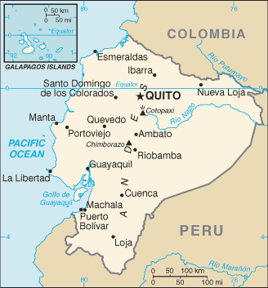
GIS
What types of maps are there?
Literal – lat/lon – specific world coordinates.

Slide 12
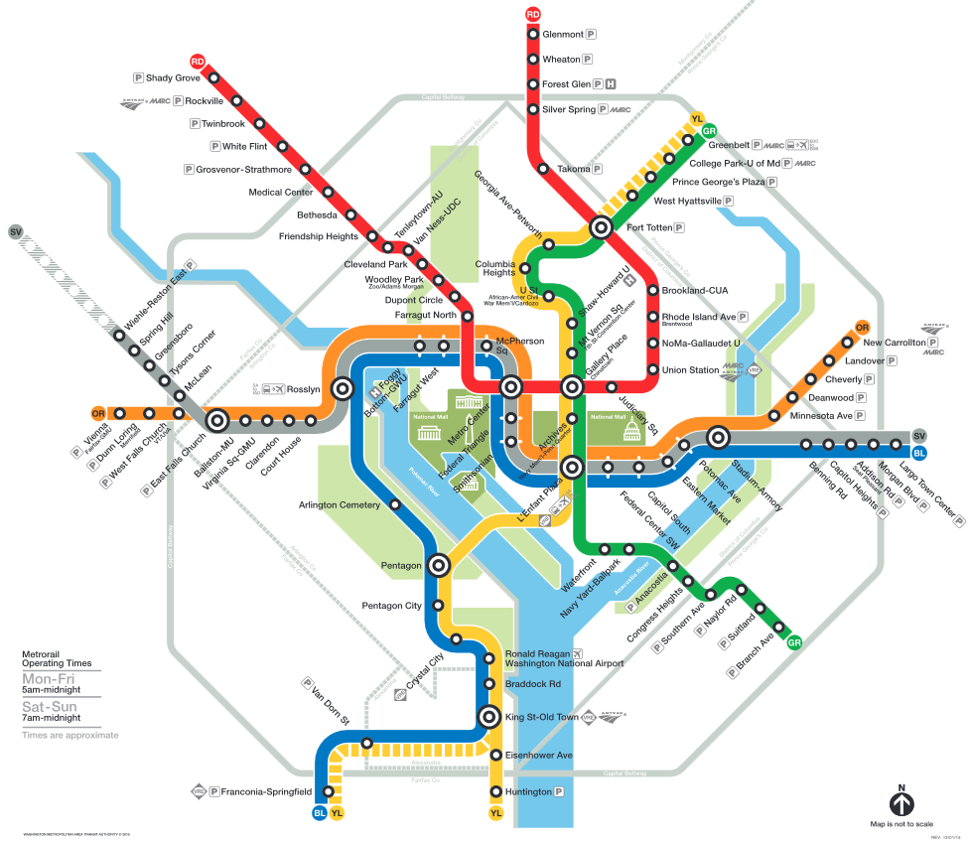
GIS
Washington DC Metro map
What types of maps are there?
Generalized – Not “exact” but informative

Slide 13
GIS
What types of maps are there?
Personal
Based on memories and experiences
Differ between users

Slide 14
What can we do with GIS?
Mapping and analysis software
Easy mapping
In-depth spatial analysis
Mix geographic and NON-geographic data
Provide insight into spatial data
But importantly, GIS is mapping
Need to know how GIS “sees the world”

Slide 15
Projection/Datum
GIS data has a spatial dimension (coordinates)
Data about a flag pole
10 ft tall, 4 inches diameter
Spatial dimension
Lat, Lon
Military Grid Reference System (MGRS)
X,Y from an origin
Now that pole is 10 feet by 4 inches, at 42N, 90W
Now we can plot it, as a point, vector.
Wait, how do we know EXACTLY where 42N, 90W is?

Slide 16
Datum
Datum are physical reference systems
Model of the earth that is used in mapping.
Series of numbers that define the shape and size of the ellipsoid and it's orientation in space.
Chosen to give the best possible fit to the true shape of the Earth.
WGS84
NAD27
NAD83

Slide 17
Datum
Cathedral in central Christchurch, New Zealand is at 172.63658E, 43.53103S in WGS-84 coordinates and 172.36344E, 43.53270S in Geodetic 1949 coordinates.
US – Hawaiian islands had their own Datum for years.

Slide 18
Datum
QGIS has transformation methods to go between datum.
Make sure of your GeoDatum.
All data transformed to the same Datum before processing or analyzing.

Slide 19
Projections
The Earth is curved, maps are flat. 3-D →2-D
The process of flattening out the Earth onto a flat piece of paper or computer screen is a mathematical process called a projection.
Can distort certain elements of the map

Slide 20
Projections
Conformality - are the shapes accurate (suited for cartography), e.g., Lambert conformal conic
Distance - are the distances accurate (suited for road atlas), e.g., azimuthal equidistant
Area - are the areas represented on the map proportional to their true area on the Earth (suited for land management), e.g., Albers equal-area conic
Direction - are directions between points on the map accurately (suited for navigation), e.g., Mercator

Slide 21
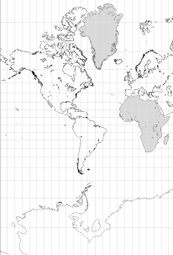
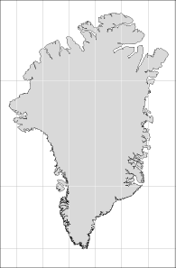
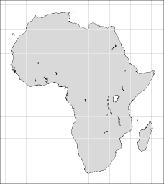
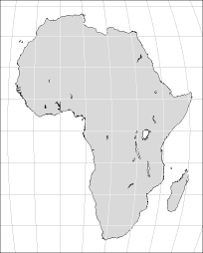
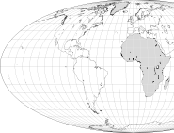
Projections
General interest Maps
Preserve area

Slide 22
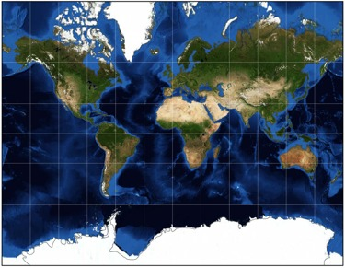
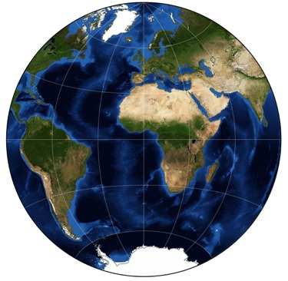
Projections
Mollweide
Mercator
azimuthal equidistant

Slide 23
Further Training
http://www.csc.noaa.gov/digitalcoast/training/datums

Slide 24
Data Types
Vector
Points, Lines, Polygons
Shapefiles, KML/KMZ
Raster
Gridded Data
netCDF, Grib2, GeoTIFF, KMZ

Slide 25
Data Types
Vector
Illustrate “features”
Roads, rivers, lakes, houses, urban areas etc.
Features have “attributes”
Additional information on the “features”
Text or numerical information
Vector shape – represented by geometry and nodes
Can even load Excel data (if in csv format).

Slide 26
Vector Types
Vector Geometry
Points, Lines, Polygons.
Points – Cities, towns, hospitals, rain gauges
Lines – roads, rivers, Cyclone track, ITCZ location
Polygons – Urban areas, Countries, Continents, Weather forecast areas, Flooding, drought, Weather Hazards, Climate Hazards
All represented by Nodes
1 node = Point
Multiple Nodes that do not touch = Line
Multiple Nodes that connect = Polygon

Slide 27
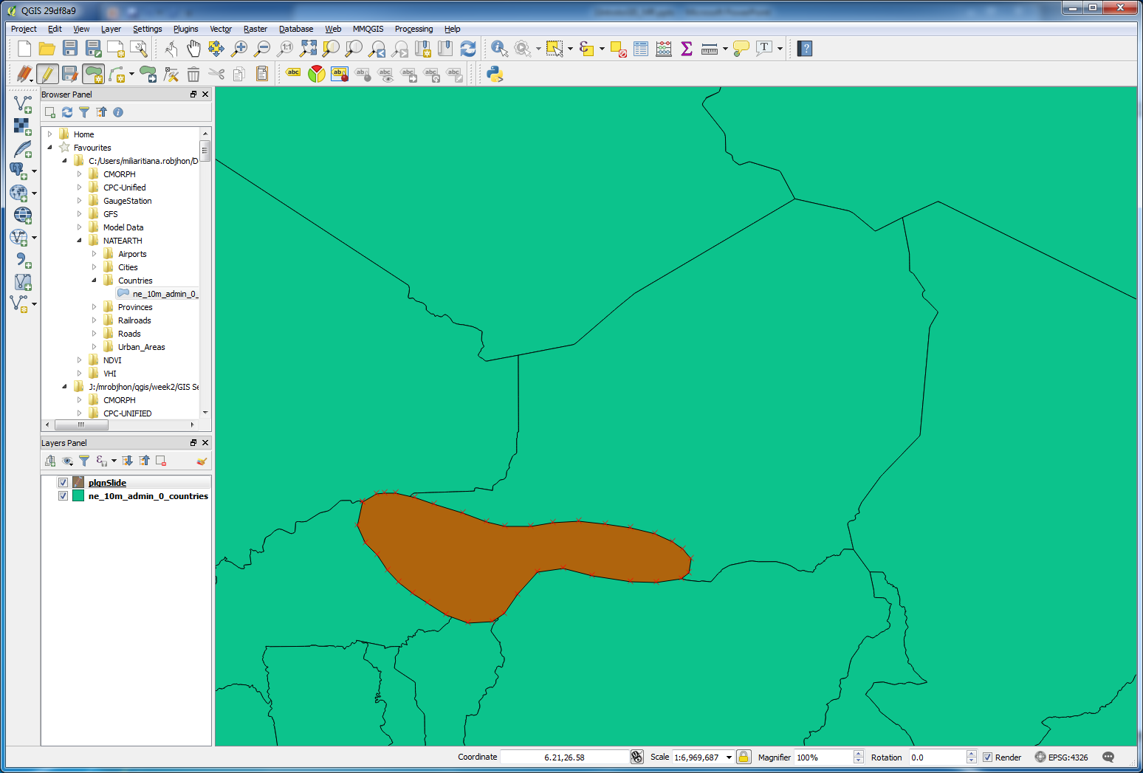
Vector Types
Polygon

Slide 28
Vector Types
Line

Slide 29
Vector Types
Point

Slide 30
Data Types
Vector – Attribute table
Table contains non-spatial information that will be connected to attribute.
Can attribute country population, continent, health stats, rainfall amounts, high/low temperature, drought category etc.
Can use this table to “search” through vector features for similar features!
Can use this table to do spatial statistics and analysis!
When creating Vector data, don’t forget to include attribute data!

