Slide 1
Tutorial on Installing Anaconda Navigator and Spyder
Miliaritiana Robjhon
Ehsan Bhuiyan

Slide 2
Download and Installation Anaconda Navigator
Go to the website: https://www.anaconda.com/download/
You can install from our shared folder (Anaconda3-2020.11-Windows-x86_64.exe) (i.e., Windows preferred)
Either 32 bits or 64 bits, depending on the architecture of your machine
Extract and install the file. Upon termination of the installation process, the Anaconda Navigator should appear among your applications

Slide 3
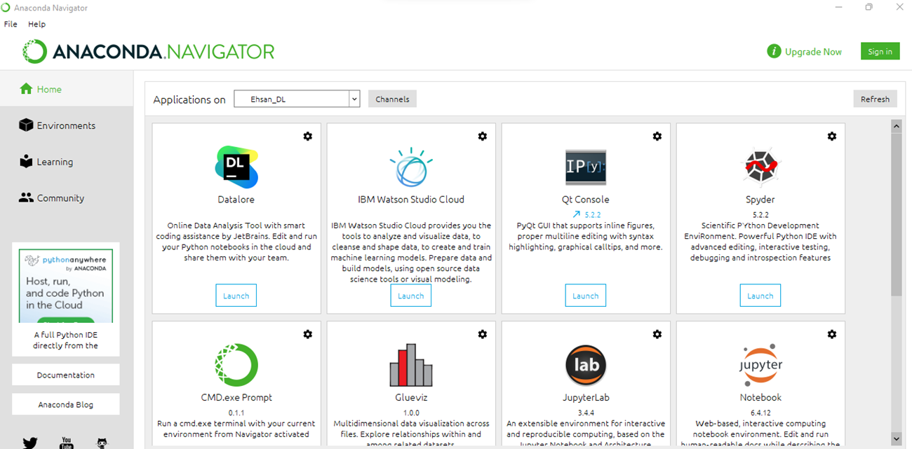
Anaconda Navigator
Open Anaconda Navigator. A screen like here should appear

Slide 4
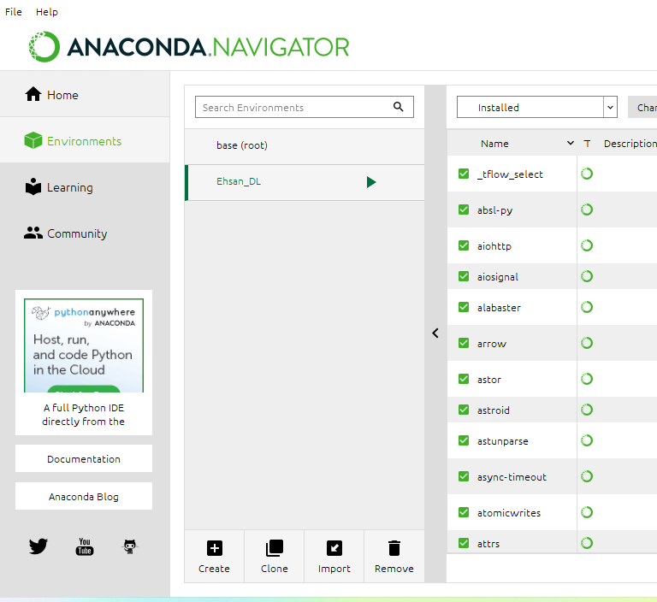
Environment Setup
Choose the Environment menu (red circle in the figure below) and create a new environment for this exercise.
An environment can be created by clicking on the tab “+Create

Slide 5
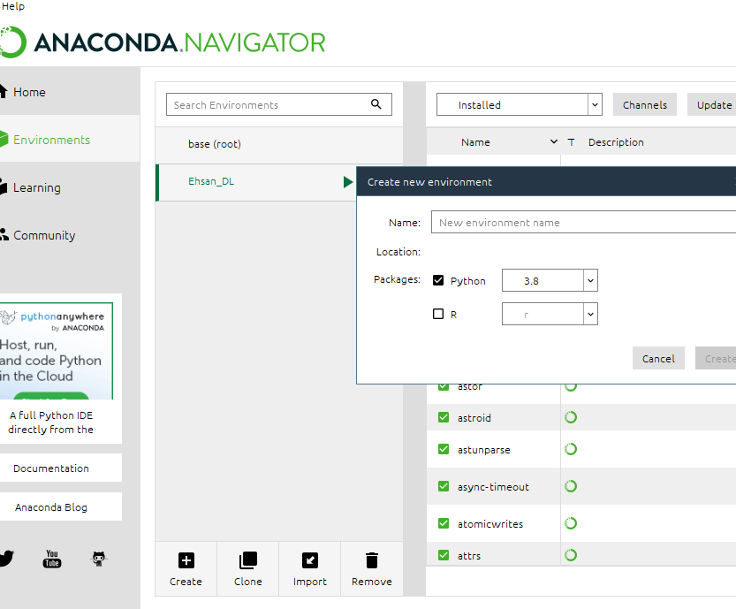
Environment Setup
A mask will pop up asking for a name and package for the new environment. Use “Python 3.8” as package of election. See image below.

Slide 6
Packages Installation
Your new environment will show all the pre-loaded software packages in the right panel of the menu. Double check that the following packages are installed.
If not, please add them:
  NumPY
  Matplotlib
  Sklearn
  Pandas
  Tensorflow
  Keras

Slide 7
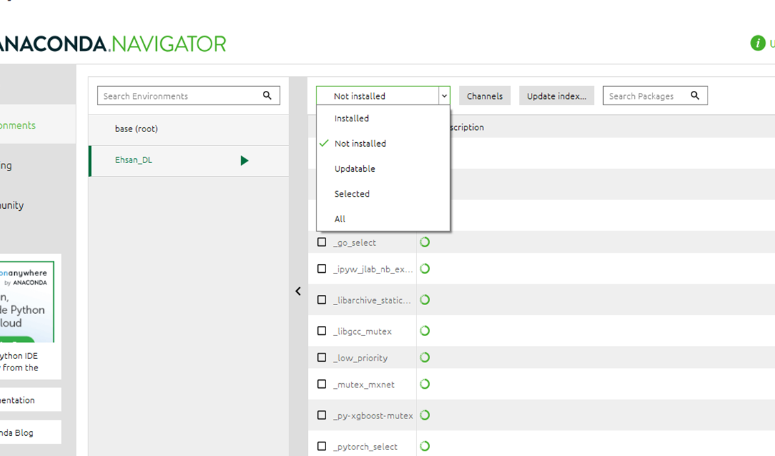

Packages Installation
You can search available packages (NumPY, Keras, Tensorflow etc )from the tab (red circle in the figure: search packages)

Slide 8
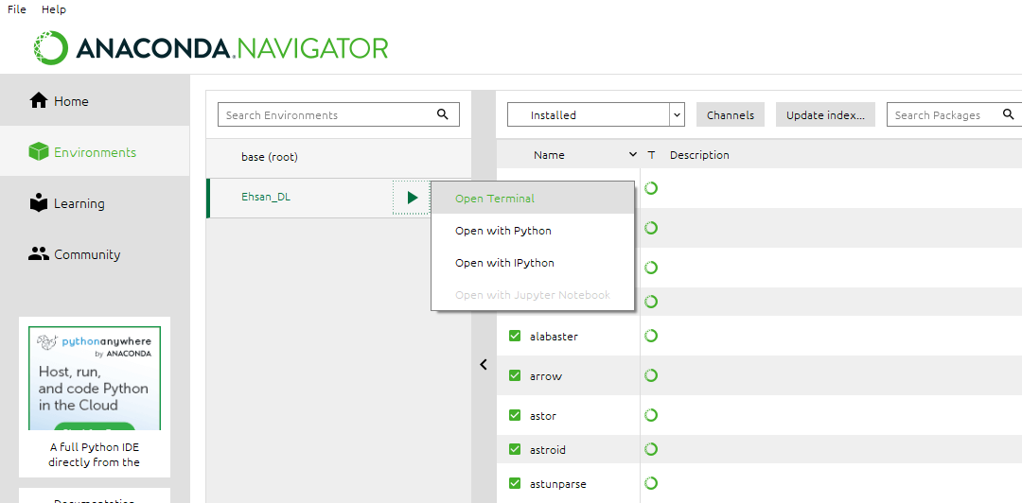
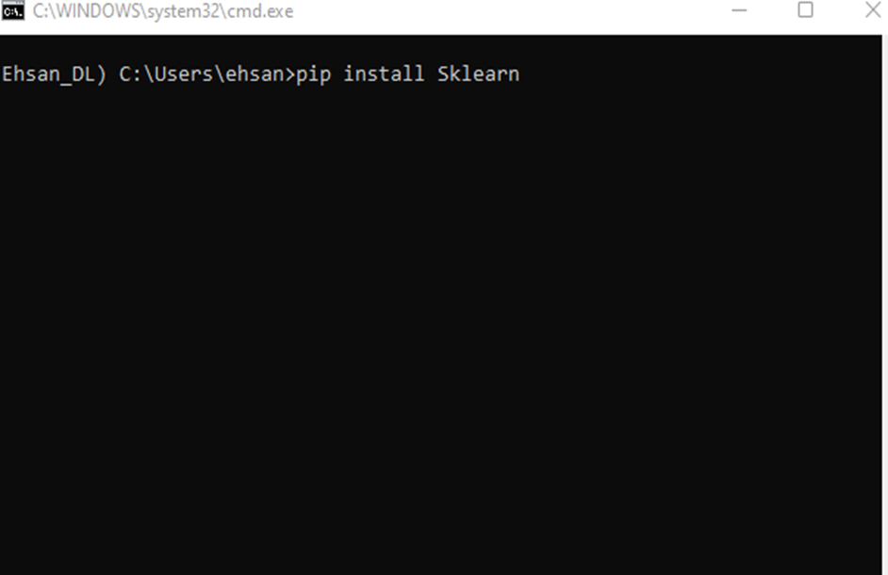
Packages Installation
If all packages are not available(eg Matplotlib, Sklearn etc.) , please open terminal by clicking on the tab
pip install matplotlib
pip install Sklearn

Slide 9
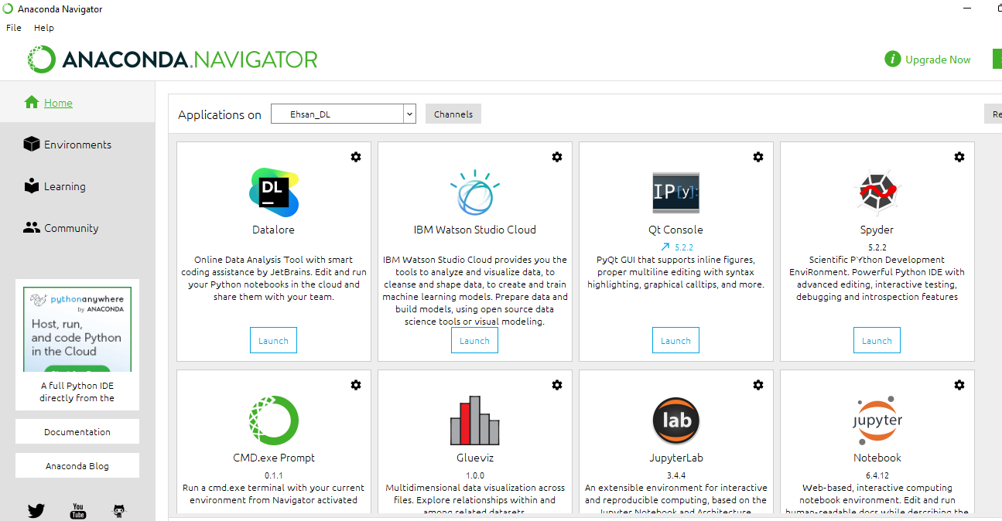
Spyder Installation
Go back to the “Home” menu and install the package “Spyder”. See image below

Slide 10
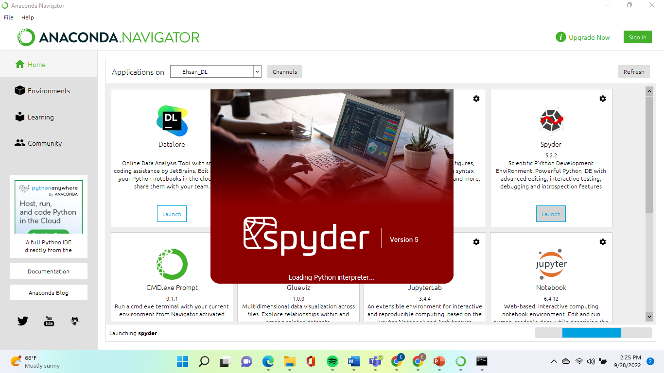
Spyder Installation
Make sure that the “Application on” tab is tuned on your new environment (check image below).
After installation, launch “Spyder” by clicking on the tab “Launch” (check image above).

Slide 11
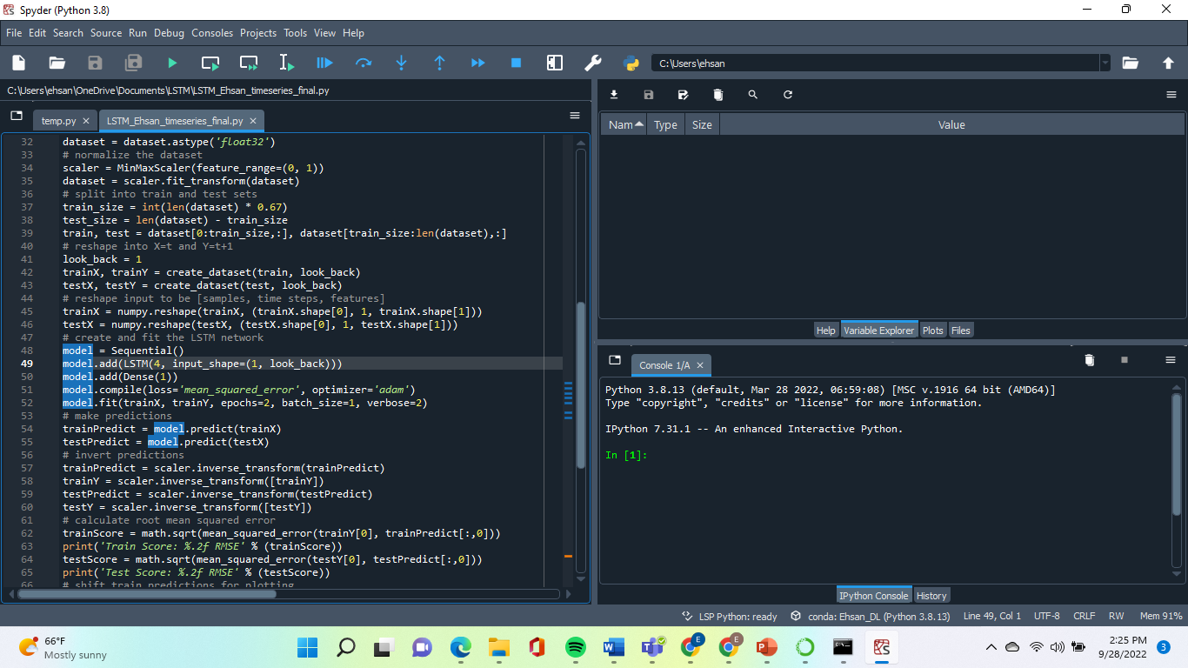
Script Run

