Slide 1
Practice GEFS Model Guidance Scripts 15ITWCVP Training Workshop Accra, Ghana, 11 – 20 September 2022
Endalkachew Bekele
NOAA/CPC International Desks

Slide 2
Install the Prerequisite Packages
Make sure that the prerequisites have been installed
Wsl/ubuntu
GNU bc maths
Image Magick
grads
Please refer to the installation instructions (Instructions are provided separately)

Slide 3
Downloading and Unzipping
Download the compressed file (subseason.tar.gz):
on your Ubuntu terminal home folder, use the command below to download the compressed file
wget https://ftp.cpc.ncep.noaa.gov/International/ghana_workshop/subseason.tar.gz
Make sure that the file has been downloaded to your current directory:
ls subseason.tar.gz
If the file is available, unzip it using:
tar -xvf subseason.tar.gz

Slide 4
Running the Script
After unzipping the compressed file, change your directory to the subseason folder, using:
cd subseason
Check if the required files are available in your directory, using:
ls
Run the one-line shell command to generate the GEFS forecasting tools:
bash plot_all.sh wlon elon slat nlat
or
bash plot_all_with_curl.sh wlon elon slat nlat
where ‘wlon’ is your west longitude, ‘elon’ your east longitude, ‘slat’ your south latitude and ‘nlat’ is your north latitude
For example if you want to run this script for Africa:
bash plot_all.sh -20 55 -40 40
If the script runs successfully, an offline web page will pop-up automatically.
If the offline page doesn’t launch automatically, type the command below to launch windows explorer in the current directory:
explorer.exe .
Then double-click index.html to launch the offline page manually

Slide 5
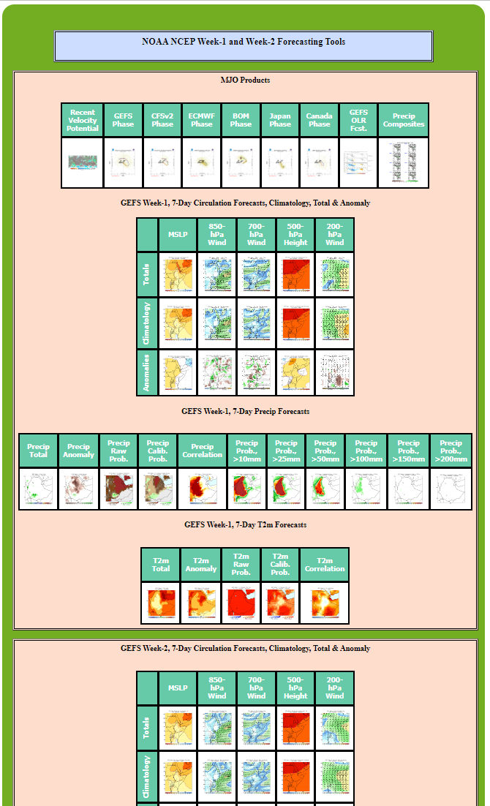
Screenshot of the offline webpage
Click each product to check if there is a broken link.
Familiarize yourself with these tools to use them in preparing your week-1 outlooks.

Slide 6
Heat Hazards Outlooks – your country
Week-1 Precip and T2m Outlooks
Date of Issue: 13 September 2023
Valid: 14 – 20 September 2023
Numerical Weather Prediction Model: NCEP GEFS

Slide 7
MJO, 200-hPa Velocity Potential Anomaly
Green shade indicates areas of upper level divergence and convection or precipitation at surface. Brown contours indicate areas of upper level convergence or subsidence and suppressed precipitation at surface.

Slide 8
MJO, Wheeler-Hendon Index - Forecasts
GEFS
CFSv2
ECMWF
BOM
Canadian

Slide 9
MJO, GEFS MJO-Related OLR Anomalies
Red shade indicate areas
of suppressed convection
Blue shade indicate areas
of enhanced convection
Initial date: 12 September 2023
1 - 5 days ave. Forecast
6-10 days ave. Forecast
11-15 days ave. Forecast

Slide 10
MJO, Rainfall Composites
Composites for ASO

Slide 11
State of the IOD, obs. and fcst.
IOD Index Forecast
7-day SST Anom
https://www.cpc.ncep.noaa.gov/products/international/oisst/oisst_7day_ind_anom.gif
https://www.cpc.ncep.noaa.gov/products/international/ocean_monitoring/ENM_iodanom.gif
7-day SST Tendency
https://www.cpc.ncep.noaa.gov/products/international/oisst/oisst_7day_ind_diff.gif

Slide 12
State of the ENSO, obs. and fcst.
7-day Pacific SST Anom
https://www.cpc.ncep.noaa.gov/products/international/oisst/oisst_7day_pac_anom.gif
ENSO composites (ASO)
https://www.cpc.ncep.noaa.gov/products/analysis_monitoring/enso_advisory/ensodisc.shtml
CPC/IRI ENSO Forecast
https://iri.columbia.edu/our-expertise/climate/forecasts/enso/current/?enso_tab=enso-cpc_plume

Slide 13
MJO Contribution?
Do the MJO predictions suggest enhanced/suppressed rainfall?

Slide 14
IOD Contribution
Is there any IOD contribution?

Slide 15
ENSO Contribution?
Is there any ENSO contribution?

Slide 16
Week-1, 7-day Circulation Anomaly Forecasts
Mean Sea Level Pressure Total
Mean Sea Level Pressure Anomaly

Slide 17
Week-1, 7-day Circulation Anomaly Forecasts
850mb Wind/Divergence Total
850mb Wind/Divergence Anomaly

Slide 18
Week-1, 7-day Circulation Anomaly Forecasts
500mb Height Total
500mb Height Anomaly

Slide 19
Week-1, 7-day Circulation Anomaly Forecasts
200mb Wind/Divergence Total
200mb Wind/Divergence Anomaly

Slide 20
Week-1, 7-day Circulation Anomaly Forecasts
MSLP
850-hPa wind/divergence
500-hPa height
200-hPa wind/divergence

Slide 21
Week-1, 7-day Precip Forecasts
Week-1 Total
Week-1 Anomaly
2-catgory Calibrated Prob. Forecast
Exceedance probability, >25mm

Slide 22
Week-1, 7-day T2m Forecasts
Week-1 Total
Week-1 Anomaly
2-catgory Raw Prob. Forecast
2-catgory Calibrated Prob. Forecast

Slide 23
Summary, Convergence of Evidence, Precip
Wet
Dry

Slide 24
Summary, Convergence of Evidence, Temperature
Cold
Hot

Slide 25
Your QGIS Precip Outlook Map
Your Text Description

Slide 26
Your QGIS T2m Outlook Map
Your Text Description

