Slide 1
Prerequisite Packages Installation
International Training Workshop
Climate Variability and Predictions (15ITWCVP)
Accra, Ghana, 11 – 20 September 2023

Slide 2
1. System Requirements
HARDWARE: Windows (64 bit, Updated version of Windows 10 or above)
MEMORY: 4GB or more (if possible)
Free DISK SPACE: 50GB or more
Internet Connection
SOFTWARE (to be installed):
WSL (ubuntu)
xming
Anaconda
xcast
GNU precision calculator (bc),
wget
curl
Image Magick
GrADS
R

Slide 3
2. PowerShell Installation
Check if you have PowerShell on your machine (by typing PowerShell on the Windows search bar)
If PowerShell is already available on your system, please proceed to the next slide.
If you don’t have Windows Powershell on your machine, follow the steps below to install it:
Install Microsoft Powershell
Search and Open Windows command prompt (type cmd on your Windows search bar and open)
Install PowerShell using:
winget install --id Microsoft.Powershell --source winget
After successful installation of the PowerShell, close the Command window

Slide 4
3. Prerequisite for Windows Subsystem for Linux (WSL) installation
Prepare environment for WSL installation
Search and Open Windows Powershell (type Windows PowerShell on your Windows search bar)
Run PowerShell as Administrator: (Start menu > PowerShell > right-click > Run as Administrator) and type the one line command below to enable the "Windows Subsystem for Linux" :
dism.exe /online /enable-feature /featurename:Microsoft-Windows-Subsystem-Linux /all /norestart
Enable Virtual Machine feature using the one line command below:
dism.exe /online /enable-feature /featurename:VirtualMachinePlatform /all /norestart

Slide 5
4. WSL Installation
Use the command below to install
wsl -- install
Wait until the WSL and Ubuntu installation is complete
Reboot your computer
Create a username and password when prompted

Slide 6
5. xming Installation (cont.)
Download the xming installation file from:
https://sourceforge.net/projects/xming/files/latest/download
Double-click the xming installation file (in your Downloads folder) to initiate the installation.
Choose the default settings
When the installation completes, search for xming and double-click to open it.

Slide 7
6. Install Additional Linux Libraries
Search and open ubuntu using your Windows search window (bottom left)
Use your ubuntu terminal to type the commands below and install the libraries
Run Updates
sudo apt-get update
(you may need to enter your password)
Install gnu precision calculator (bc)
sudo apt-get install bc
Install ImageMagick
sudo apt-get install imagemagick
Install firefox
sudo apt-get install firefox --fix-missing

Slide 8
7. OpenGrADS Installation
Using your ubuntu terminal change your directory to /usr/local/bin, by typing
cd /usr/local/bin
Download grads package using:
sudo wget https://sourceforge.net/projects/opengrads/files/grads2/2.0.2.oga.2/Linux/grads-2.0.2.oga.2-bundle-x86_64-unknown-linux-gnu.tar.gz
Unpack the package using:
sudo tar -xzvf grads-2.0.2.oga.2-bundle-x86_64-unknown-linux-gnu.tar.gz
Copy GrADS binaries and associated files to the current folder:
sudo cp -rf grads-2.0.2.oga.2/Contents/* .
You may remove the unwanted files and folders:
sudo rm -rf grads-2.0.2.oga.2
sudo rm -rf grads-2.0.2.oga.2-bundle-x86_64-unknown-linux-gnu.tar.gz
Test your GrADS installation:
Close and reopen the terminal and type grads –p
your installation is successful, if GrADS runs without an error message

Slide 9
7. OpenGrADS Installation (cont)
But, you may receive an error message that indicate missing libraries. Follow the steps below to fix the issue:
cd /usr/local/bin/Linux/Versions/2.0.2.oga.2/x86_64/gex
sudo cp ../libs/libXaw.so.7 .
sudo cp ../libs/libXpm.so.4 .
sudo cp ../libs/libXmu.so.6 .
sudo cp ../libs/libXt.so.6 .
sudo cp ../libs/libSM.so.6 .
sudo cp ../libs/libICE.so.6 .
Then, run GrADS using grads -p

Slide 10
8. Check the Installed packages
Go to your Linux terminal to check the installed packages as follows:
Type which bc to get /usr/bin/bc
Type which curl to get /usr/bin/curl
Type which wget to get /usr/bin/wget
Type which convert to get /usr/bin/convert
For GrADS
Type grads -p to see if GrADS is installed properly

Slide 11
9. Anaconda Installation
Close and reopen your Ubuntu terminal
Type the command below to download the Anaconda installation file:
wget https://repo.anaconda.com/archive/Anaconda3-2023.07-1-Linux-x86_64.sh
Type the command below to initiate the installation:
bash Anaconda3-2023.07-1-Linux-x86_64.sh
Follow the prompts on the installer screens.
When the installation is complete close and reopen the ubuntu terminal

Slide 12
10. XCast Installation
Xcast requires its own conda environment.
Type the command below on your ubuntu terminal to install XCast
conda create -n xcast_env -c conda-forge -c hallkjc01 xcast xarray netcdf4 jupyter ipykernel
Activate your XCast conda environment by typing:
conda activate xcast_env

Slide 13
11. Install, R, NCL, and eccodes (for grib handling of ECCC data)
Create an r environment
conda create -n renv
2. Activate renv environment
conda activate renv
3. Install R, ncl, and eccodes under renv
conda install -n renv -c conda-forge eccodes ncl r-ncdf4 r-rnetcdf
4. To deactivate
conda deactivate
5. To work under renv activate it using step 2 above and when done using it deactivate it using step 4

Slide 14
12. QGIS installation
The most stable version of QGIS is 3.18.3, based on users review, so we’ll use this version
Download and install QGIS from the link below
https://download.qgis.org/downloads/windows/3/3.18/QGIS-OSGeo4W-3.18.3-1-Setup-x86_64.exe
During the installation process, if asked, choose not to download the tutorial data
Have a MOUSE – you will need it for easy drawing

Slide 15
13. Artificial intelligence installation
Go to the website: https://www.anaconda.com/download/
You can install from our shared folder (Anaconda3-2020.11-Windows-x86_64.exe) (i.e., Windows preferred)
Either 32 bits or 64 bits, depending on the architecture of your machine
Extract and install the file. Upon termination of the installation process, the Anaconda Navigator should appear among your applications

Slide 16
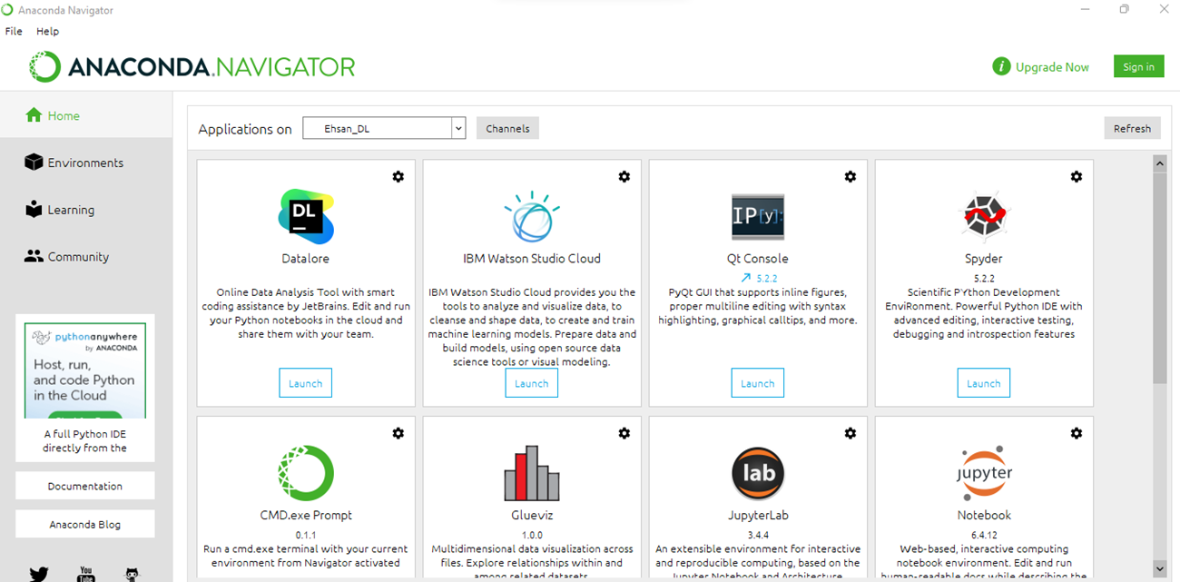
13. Anaconda Navigator
Open Anaconda Navigator. A screen like here should appear

Slide 17
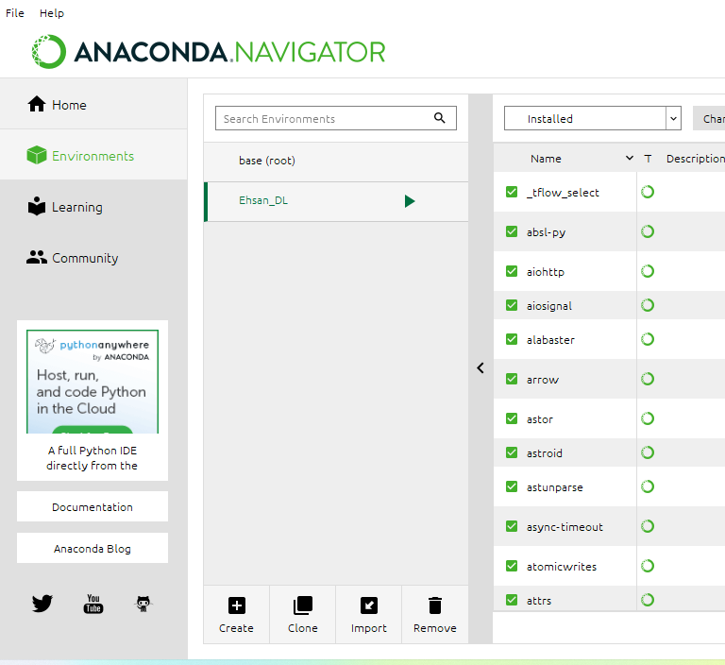
14. Environment Setup
Choose the Environment menu (red circle in the figure below) and create a new environment for this exercise.
An environment can be created by clicking on the tab “+Create

Slide 18
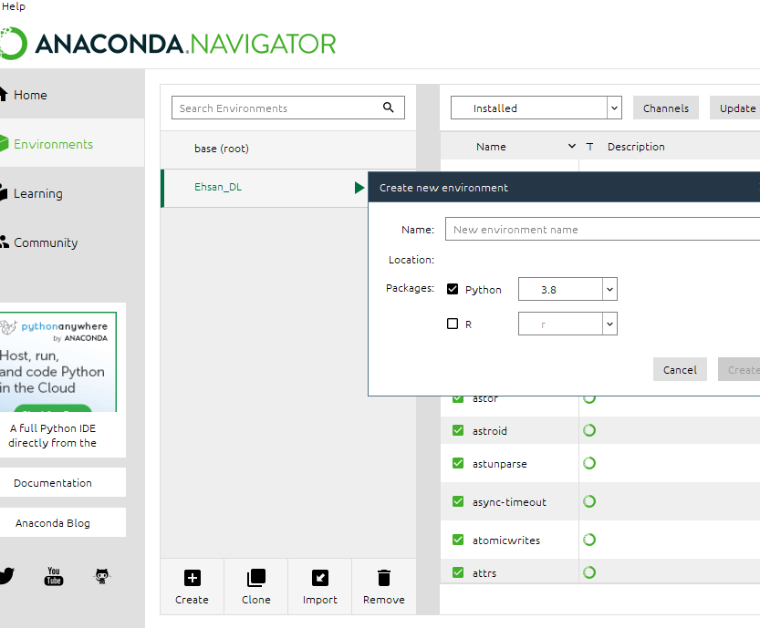
14. Environment Setup (cont.)
A mask will pop up asking for a name and package for the new environment. Use “Python 3.8” as package of election. See image below.

Slide 19
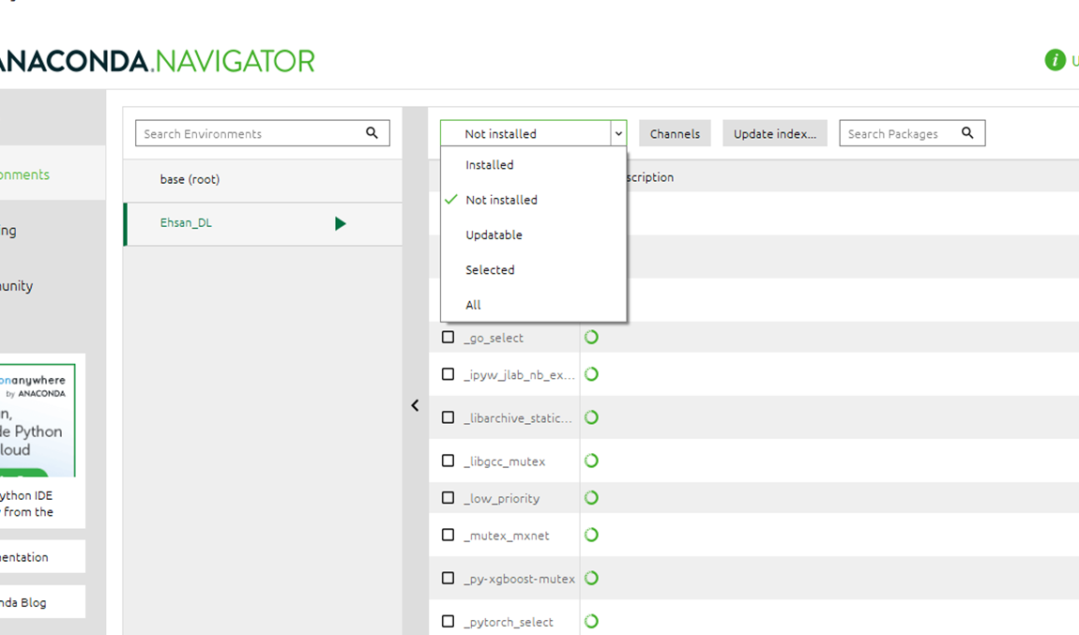
15. Packages Installation
You can search available packages (NumPY, Keras, Tensorflow etc )from the tab (red circle in the figure: search packages)

Slide 20
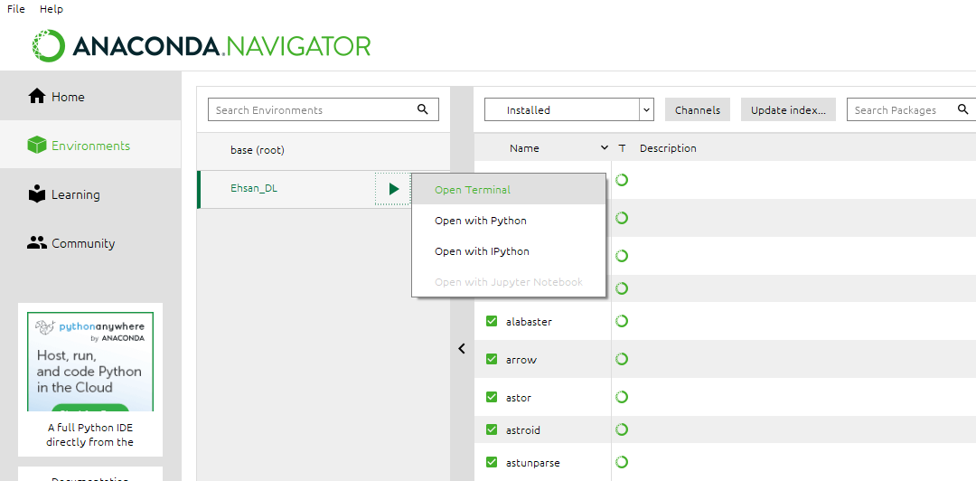
15. Packages Installation (cont.)
If all packages are not available(eg Matplotlib, Sklearn etc.) , please open terminal by clicking on the tab
pip install matplotlib
pip install -U scikit-learn

Slide 21
15. Packages Installation (cont.)
Your new environment will show all the pre-loaded software packages in the right panel of the menu. Double check that the following packages are installed.
All the required packages:
NumPY (pip install NumPY)
Matplotlib (pip install Matplotlib)
Sklearn (pip install -U scikit-learn)
Pandas (pip install Pandas)
Tensorflow (pip install Tensorflow)
Keras (pip install Keras)
netCDF4 (pip install netCDF4)
xarray (pip install xarray)
folium (pip install folium) create map object
cartopy (conda install -c conda-forge cartopy)

Slide 22
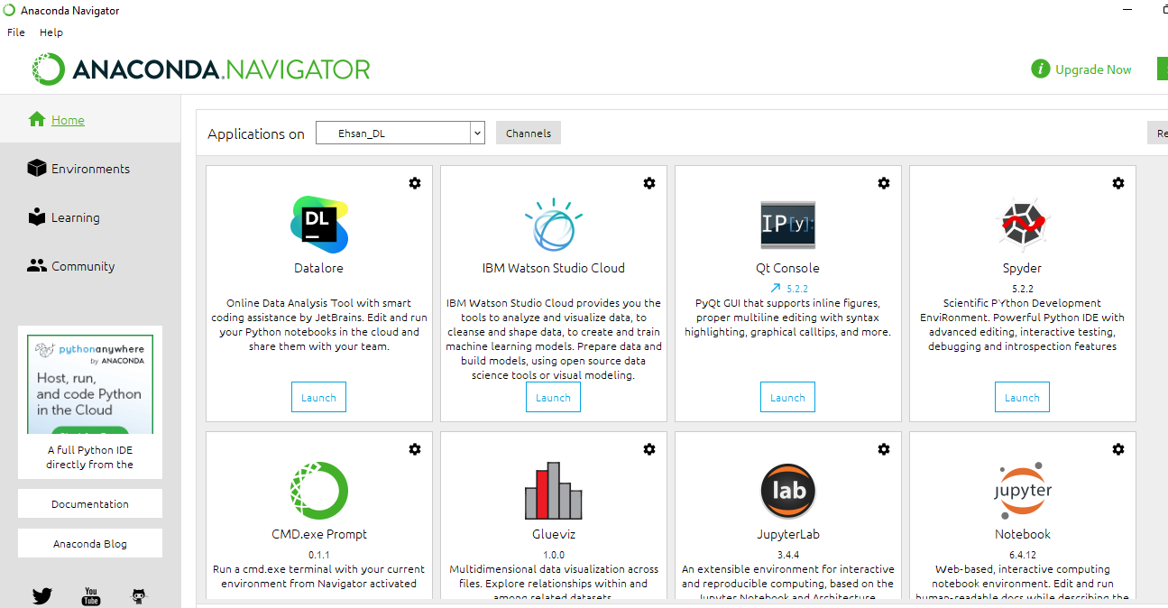
16. Spyder Installation
Go back to the “Home” menu and install the package “Spyder”. See image below

Slide 23
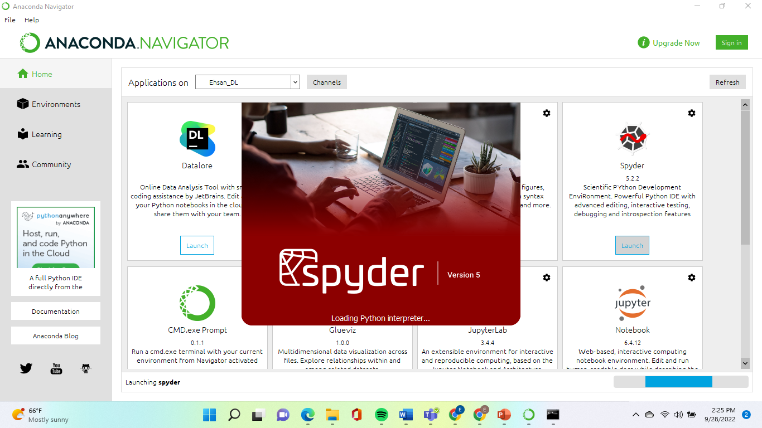
16. Spyder Installation (cont.)
Make sure that the “Application on” tab is tuned on your new environment (check image below).
After installation, launch “Spyder” by clicking on the tab “Launch” (check image above).

