Slide 1
Demonstration on Calibrated Model Forecasted Forecasting Tools 15ITWCVP Training Workshop Accra, Ghana, 11 – 20 September 2023
Endalkachew Bekele
NOAA/CPC/International Desks

Slide 2
Model Forecast Post-Processing
Forecast Calibration in simple terms:
Build a relationship between forecast and observation in the hindcast period
Then, use this historical forecast/observation relationship to correct biases in real-time forecasts
Why do we need to calibrate?
Because NWP models are not perfect >> forecast error grows with lead time
Calibration methods:
From a simple “mean bias removal” method to a very complicated Machine Learning techniques

Slide 3
Model Forecast Post-Processing Methods
We use different post-processing techniques at CPCID
Linear regression (eg. to calibrate rainfall onset/cessation forecast)
Ensemble Regression: Special form of Linear Regression applied to ensemble forecasts (eg, precip/T2m week-1/2 and week 3-4 forecasts)
Skill Weighted Ensemble Forecast Consolidation: A method used to consolidate forecasts from different Ensemble Prediction System. Higher weight is given to a model that has higher prediction skill in the past (eg week-1/2, and week 3-4 consolidated precip forecasts: (https://www.cpc.ncep.noaa.gov/products/international/drought/cons_precip.shtml ).
Our Experimental Calibration Methods
Canonical Correlation Analysis (CCA)
Extended Logistic Regression (ELR)
Extreme Learning Machine (ELM)
Extended Probability Output Extreme Learning Machine (EPOELM)
These techniques are put together in a user-friendly Python-based toolkit - XCast
For more information, Please refer to https://xcast-lib.github.io/ , K. J. C. Hall and N. Acharya, ‘XCast: A python climate forecasting toolkit’, Frontiers in Climate, vol. 4, 2022.

Slide 4
Data and Calibration Period
Hindcast Data
GEFS Reforecast (ensemble mean of 5 members), 2000 – 2019
CHIRPS Observation Data, 2000 – 2019
The sample size is increased by using 3 consecutive Wednesday IC forecasts for each year, 20 years X 3 Wednesdays = 60
Horizontal resolution of observation and forecast data is 0.5 deg.
Real-time forecast data
Ensemble mean of 30 members of GEFS forecast
Horizontal resolution is 0.5 deg.
Hindcast and Observation data sets are converted to the NetCDF format

Slide 5
Jupyter Notebook Demo
Download the demo file:
Using your Ubuntu terminal change your directory to your home folder:
cd
Download the file:
wget https://ftp.cpc.ncep.noaa.gov/International/ghana_workshop/calib_demo.tar.gz
Unzip the file:
tar -xvf calib_demo.tar.gz
Change directory to the calib_demo folder:
cd calib_demo
Using your Windows start menu, search for xming and double-click to launch xming
Launch Jupyter Notebook
Activate the XCast Conda environment:
conda activate xcast_env
Launch Jupyter Note book, using the command below
jupyter notebook
If the notebook doesn’t launch automatically, copy one of the links provided on the screen, and paste it on your internet browser to launch itmanually.

Slide 6
Jupyter Notebook Demo (cont.)
Click gen_epoelm.ipynb to open the extended probabilistic output extreme learning machine (epoelm) code

Slide 7
Jupyter Notebook Demo (cont.)
Import the required packages
Open hindcast, observation and real-time data
Handle data dimension and missing data, and climatologically dry areas

Slide 8
Jupyter Notebook Demo (cont.)
Define your domain
You can change the lat-lon values
Fit the EPOELM model and run

Slide 9
Jupyter Notebook Demo (cont.)
Classify the observation data into three tercile categories
Generate and plot the real-time forecast
Plot hindcast ROC curve (averaged over the domain)
Plot Area under the GROC curve

Slide 10
Run the Demo Code
From the top drop-down menu, select cell, and click Run All
Depending on your domain, the run takes a few minutes to complete

Slide 11
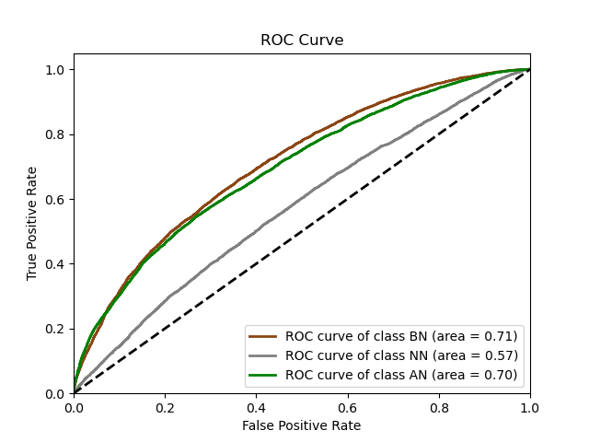
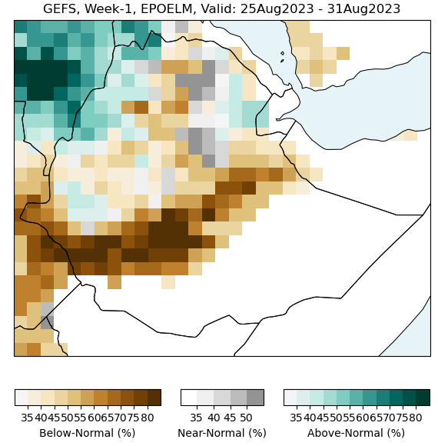
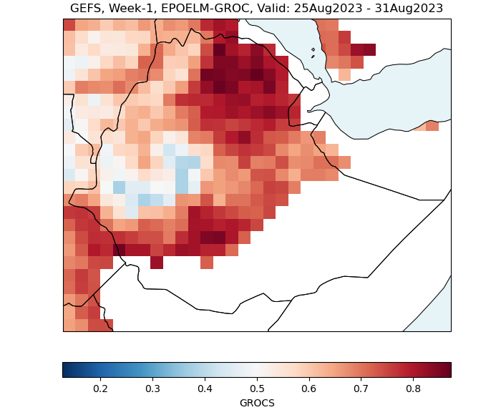
Calibrated Tercile Fcst & Hindcast Evaluation
ROC
GROC-AUC
Tercile Forecast

Slide 12
Real-Time Calibrated Forecasts
Precip Forecasts
Week-1, week-2, week-3, week 3-4 and week 1-4
Raw, and CCA, ELR, ELM and EPOELM Calibrated Forecasts
Initial Condition and Valid Dates
Previous day Initial Condition (Yesterday, day-0)
Forecast Issue Date (today, day-1)
Week-1 forecast, 1 day lead, Valid: day–2 to day-8
Week-2 forecast, 8 days lead, Valid: day–9 to day-15
Week-3 forecast, 15 days lead, Valid: day–16 to day-22
Week 3-4 forecast, 15 days lead, Valid: day–23 to day-29
Week 1-4 forecast, 1-day lead, Valid: day–2 to day-29
Domain
You can define your domain between 50S and 50N
Internet connection is required to download the input data
The model-post processing time depends on the size of your domain

Slide 13
Running Instructions
You may close Ubuntu and reopen it for the next session.
Activate the XCast Conda environment
conda activate xcast_env
Download the package:
Change your directory to your home folder:
cd
Download the package using:
wget https://ftp.cpc.ncep.noaa.gov/International/ghana_workshop/subseas_calib.tar.gz
Unzip the file:
tar -xvf subseas_calib.tar.gz
Change directory to subseas_calib folder:
cd subseas_calib
Use a 1-line shell command to run the script:
bash plot_all.sh wlon elon slat nlat
or
bash plot_all_with_curl.sh wlon elon slat nlat
where ‘wlon’ is your west longitude, ‘elon’ your east longitude, ‘slat’ your south latitude and ‘nlat’ is your north latitude
If the script runs successfully, an offline web page will pop-up automatically.

Slide 14
Offline-Page with Week-1/2/3/3-4/1-4 Calibrated Forecasts
Take your time to examine the products.
If you want to do a quick run , just for week-1 and week-2 forecasts, you can use the “short” versions:
bash plot_all_short.sh wlon elon slat nlat
or
bash plot_all_short_with_curl.sh wlon elon slat nlat

