Slide 1
Introduction to Linux Commands and Shell Scripting 15ITWCVP Training Workshop Accra, Ghana, 11 – 20 September 2023
NOAA/CPC/International Desks

Slide 2
1. Introduction
Linux is an open-source operating system that can serve as an alternative to Microsoft Windows.
There are many Linux distributions out there
The basic Linux commands are distribution independent
We will use WSL/Ubuntu, in this training

Slide 3
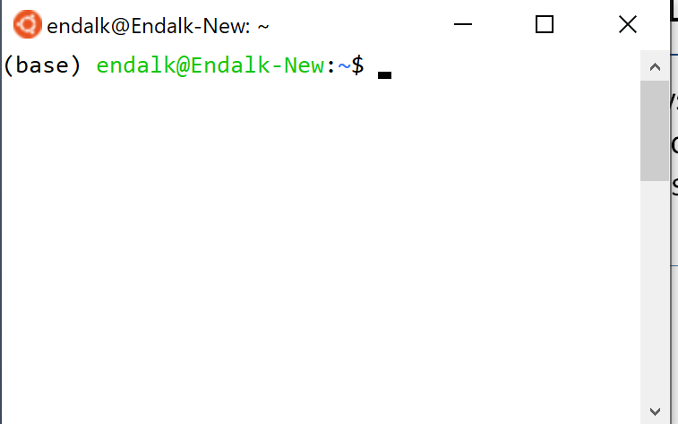
2 . WSL/Ubuntu : Linux on Windows
Search and launch xming
The Windows Subsystem for Linux (WSL) lets developers install a Linux distribution (such as Ubuntu) and use Linux applications, utilities, and Bash command-line tools directly on Windows
Search and click the Ubuntu Icon

Slide 4
3. Basic Linux Commands
There are several Linux commands, but a few them are enough to perform most basic tasks.
<< The commands >> | General Task Description
pwd | print current working directory: It prints the current location in the directory structure
ls | list: It shows the list of files in the current directory
mkdir | make directory: it create new folder
cd | change working directory: Change location to a folder of your interest
cp | copy: Make a copy of files and/or directories
mv | move: Rename file or directories
rm | remove: Delete files or directories
chmod | change mode: modify access rights (permissions or protections) of files or directories

Slide 5
4. Practice on Basic Linux Commands
1. Print the current working directory name (print working directory)
pwd
2. List files and sub-directories in your current folder (list)
ls
3. Create a new folder, linux_tutorial (make directory)
mkdir linux_tutorial
4. List files/folders in your current directory (list)
ls
5. Change your location to the newly created folder linux_tutorial (change directory)
cd linux_tutorial
→ You should see your new folder in the list linux_tutorial

Slide 6
4. Practice on Basic Linux Commands (cont.)
6. Print your current location (print working directory)
pwd
7. List the files in your new directory linux_tutorial (list)
ls
8. Use gedit as a text editor to create a text file:
gedit linux_test.txt &
9. Edit the file by typing a word or phrase
Type any word or phrase (eg. This is a test script)

Slide 7
4. Practice on Basic Linux Commands (cont.)
10. Save and exit from gedit
11. Go back to the Ubuntu terminal and hit the enter key
12. List your files (list)
ls
13. Create a copy of the old file (linux_text.txt) ,and name the new file as training.txt (copy)
cp linux_test.txt training.txt
→ You should see the newly created text file: llinux_test.txt

Slide 8
4. Practice on Basic Linux Commands (cont.)
14. List the files in your directory (list)
ls
15. Open your new file training.txt, edit it by adding a few words and phrases, save it and exit:
gedit training.txt &
16. List the files in your directory (list)
ls
17. Rename your training.txt to training_linux.txt (move)
mv training.txt training_linux.txt
18. List the files in your directory (list)
ls
→ You should see two files linux_test.txt and training.txt
→ You still see two files linux_test.txt and training.txt
→ You should see two files linux_test.txt and training_linux.txt

Slide 9
4. Practice on Basic Linux Commands (cont.)
19. Remove file (remove)
rm linux_test.txt
20. List the files in your directory (list)
ls
→ this time you will see just one file training_linux.txt

Slide 10
5. Display Date in Linux (Ubuntu users)
Display the current date
8 digits of year, month and day format → 20230911
echo `date --date "0 day ago" "+%Y%m%d”`
4 digits of year → 2023
echo `date --date "0 day ago" "+%Y “`
2 digits of month in numbers → 09
echo `date --date "0 day ago" "+%m”`
3 digits of month in string → Sep
echo `date --date "0 day ago" "+%b”`
2 digits of day → 11
echo `date --date "0 day ago" "+%d”`

Slide 11
5. Display Date in Linux (Mac users)
Display the current date
8 digits of year, month and day format → 20230911
echo `date -v+0d +%Y%m%d`
4 digits of year → 2023
echo `date -v+0d +%Y`
2 digits of month in numbers → 09
echo `date -v+0d +%m`
3 digits of month in string → Sep
echo `date -v+0d +%b`
2 digits of day → 11
echo `date -v+0d +%d`

Slide 12
5. Display Date in Linux (cont.), Ubuntu Users
20. Display past dates (eg. 2 days ago): Use positive numbers
8 digits of year, month and day → 20230909
echo `date --date “2 day ago" "+%Y%m%d”`
21. Display future dates (eg. Tomorrow): Use negative numbers
8 digits of year, month and day → 20230912
echo `date --date "-1 day ago" "+%Y%m%d”`

Slide 13
5. Display Date in Linux (cont.), Mac users
20. Display past dates (eg. 2 days ago): Use negative numbers
8 digits of year, month and day → 20230909
echo `date –v-2d +%Y%m%d`
21. Display future dates (eg. Tomorrow): Use positive numbers
8 digits of year, month and day → 20230912
echo `date -v+1d +%Y%m%d`

Slide 14
6. Help on Linux Commands
You can get additional help on Linux commands using:
In the terminal Type :
man cp
info cp
cp --help
“Yes”, you can Google it as well
→ to see a detailed description on the use of the cp command
→ gives the same or more detailed information as above

Slide 15
8. Basic Linux Commands – Exercise 2
Complete the following table to summarize things you have learned so far.
Which command is used to: | Answers :
Change to another directory?
Rename files?
List the contents of a directory?
Print your current working directory?
Make a new directory?
Open a text file?
Copy files?
Remove files?
Remove directories?
Display text or string on a terminal?
Download files from web servers?

Slide 16
9. Introduction to shell scripts
A Shell script is a file containing a series of Linux commands. The shell reads this file and carries out the commands as if they have been entered directly on the command line.
Shell scripts are used to automate a series of tasks.

Slide 17
10. Display dates in Linux using a shell script (Ubuntu)
1. Create a new text file display_dates.sh, in you linux_tutorial folder
For Linux users, type gedit display_dates.sh &
2. Type the following commands using your text editor
echo "Yesterday was:"
echo `date --date "1 day ago" "+%Y%m%d"`
echo "or:"
echo `date --date "1 day ago" "+%b %d, %Y"`
echo "Today is:"
echo `date --date "0 day ago" "+%Y%m%d"`
echo "or:"
echo `date --date "0 day ago" "+%b %d, %Y"`
echo "Tomorrow is:"
echo `date --date "-1 day ago" "+%Y%m%d"`
echo "or:"
echo `date --date "-1 day ago" "+%b %d, %Y"`

Slide 18
10. Display dates in Linux using a shell script (Mac)
1. Create a new text file display_dates.sh, in you linux_tutorial folder
vi display_dates.sh
2. Type the following commands using your text editor
echo "Yesterday was:“
echo `date –v-1d +%Y%m%d`
echo "or:"
echo `date –v-1d +%b %d, %Y`
echo "Today is:"
echo `date –v-0d +%Y%m%d`
echo "or:"
echo `date –v-0d +%b %d, %d`
echo "Tomorrow is:"
echo `date –v+1d +%Y%m%d`
echo "or:"
echo `date –v+1d +%b %d% Y`

Slide 19
10. Display dates in Linux using a shell script (cont.)
3. Save your file (shell script) display_dates.sh
4. List the files in your current directory (list)
ls
5. Change the file permissions to make the file readable, writable and executable (change mode)
chmod 755 display_dates.sh
6. List the files in your current directory (list)
ls
7. Execute the shell script display_dates.sh
bash display_dates.sh
→ You should see two files training_linux.txt and display_dates.sh
→ You should notice a change in color of display_dates.sh

