Slide 1
Introduction to GrADS Commands and GrADS Scripting
15ITWCVP Training Workshop
Accra, Ghana, 11 – 20 September 2023
NOAA/CPC/International Desks

Slide 2
1. Introduction
What is GrADS?
  GrADS – Grid Analysis and Display System
  Used for analyzing and displaying gridded data
Advantages of using GrADS
  Free
  Easy to install and use
  Very good documentation and users support (http://cola.gmu.edu/grads/gadoc/gadocindex.html)
Download Exercise data
  In your Ubuntu terminal, download the data by typing:
wget https://ftp.cpc.ncep.noaa.gov/International/ghana_workshop/grads_tutorial.tar.gz
Unzip the compressed file using: tar –xvf grads_tutorial.tar.gz

Slide 3
2. Input Data
GrADS Input data
  Gridded Binary (eg. model.dat)
  GRIB: WMO standard Gridded Binary (eg. gefs.grib2)
  Data with Self descriptive files such NetCDF (eg. gefs.nc)
  OPeNDAP and GDS based data – Remote/online access of metedata and subset of data … you can open access and analyze data without downloading it to your local computer: (eg.: http://nomads.ncep.noaa.gov:80/dods/gefs/gefs20230911/gec00_00z_pgrb2a

Slide 4
3. GrADS Control/Descriptor File
GrADS requires an intermediate file to open a gridded binary or GRIB data
This intermediate file in text format is known as control or descriptor file
It contains meta-information about the main gridded binary or GRIB data
Using your text editor, you can open and see the content of model.ctl
  cd grads_tutorial
  Use the vi editor to open the control filr:
  gedit model.ctl &

Slide 5
4. Structure of a Control File (eg. model.ctl)
DSET ^model.dat >> name of the main binary file
OPTIONS little_endian >> Data byte order (default is little_endian)
UNDEF -2.56E33 >> missing value
TITLE 5 Days of Sample Model Output >> Data title
XDEF 72 LINEAR 0.0 5.0 >> longitude dimension and grid resolution
YDEF 46 LINEAR -90.0 4.0 >> Latitude dimension and grid resolution
ZDEF 7 LEVELS 1000 850 700 500 300 200 100 >> vertical dimension and resolution
TDEF 5 LINEAR 02JAN1987 1DY >> Time dimension
VARS 8 >> Number of variables
ps 0 99 Surface Pressure
u 7 99 U Winds
v 7 99 V Winds
hgt 7 99 Geopotential Heights >> Variable short and long names
tair 7 99 Air Temperature
q 5 99 Specific Humidity
tsfc 0 99 Surface Temperature
p 0 99 Precipitation
ENDVARS

Slide 6
5. Display Variables
Exit from the text editor:
Make sure that model.ctl and model.dat are available in your current directory
ls
Run GrADS with the portrait display option
grads -p
This should launch a new display window

Slide 7
5. Display Variables (cont.)
Open your control file
open model.ctl
Query file to see the variable names
q file
  ps 0 99 Surface Pressure
  u 7 99 U Winds
  v 7 99 V Winds
  hgt 7 99 Geopotential Heights
  tair 7 99 Air Temperature
  q 5 99 Specific Humidity
  tsfc 0 99 Surface Temperature
  p 0 99 Precipitation
You should get something that looks like

Slide 8
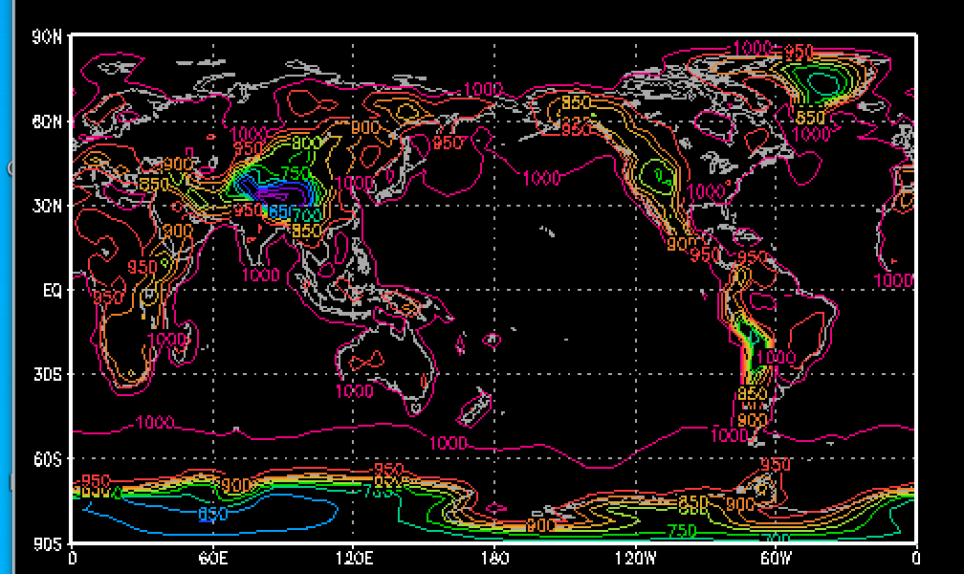
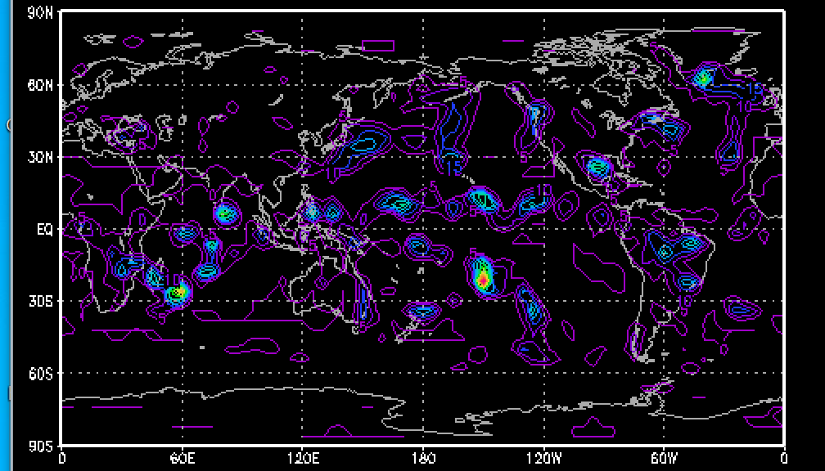
5. Display Variables (cont.)
Display Surface pressure plot
d ps
Remove the plot, and display precipitation in mm day for Jan 4, 1987. Note that precip unit in this data is mm/sec.
c
set time 4jan1987 or set t 3
d p*24*60*60

Slide 9
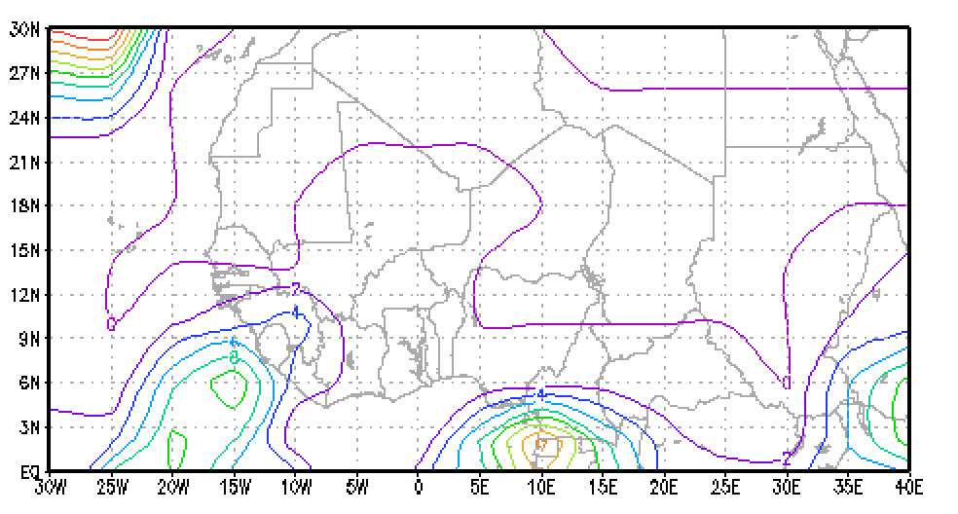
5. Display Variables (cont.)
Clear the plot, set the domain to West Africa, load a back ground map that shows country boundaries, change the background color from black to white, and redisplay precipitation.
c
set lat 0 30
set lon -30 40
set mpdset hires
set display color white
c
d p*24*60*60

Slide 10
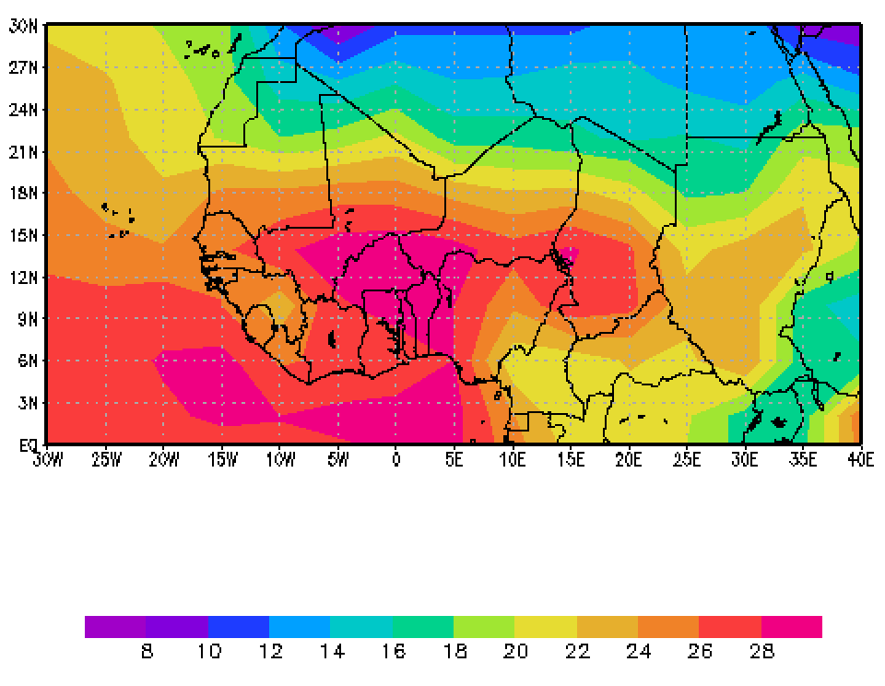
5. Display Variables (cont.)
Clear the current plot, change the graphics output from contour to shaded colors, and display surface temperature in degree Celsius. Include the color bar legend as well. Note that the temperature unit in this data is Kelvin.
c
set lat 0 30
set lon -30 40
set mpdset hires
set display color white
c
set gxout shaded
d tsfc-273.14
cbar

Slide 11
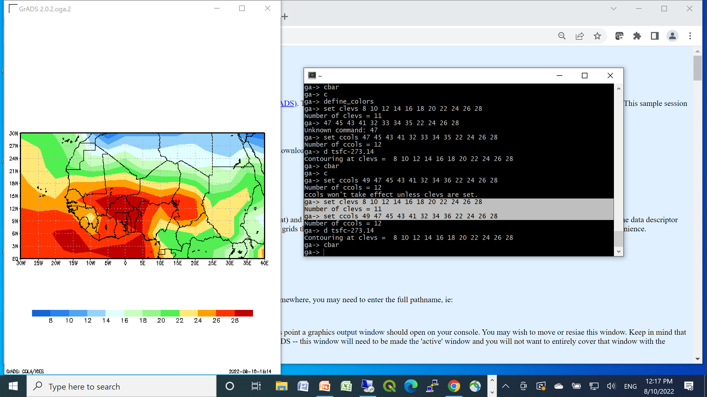
5. Display Variables (cont.)
Clear the current plot, use your own temperature interval and color definition in the temperature plot. Use blueish color for lower temperature, greenish for moderate and reddish color for higher temperature.
c
define_colors
set clevs 8 10 12 14 16 18 20 22 24 26 28
set ccols 49 47 45 43 41 32 34 36 22 24 26 28
d tsfc-273.14
cbar

Slide 12
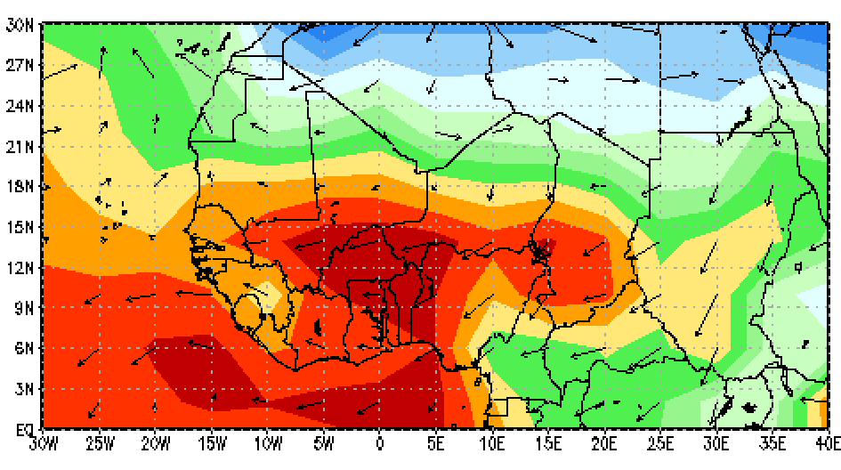
5. Display Variables (cont.)
Clear the current plot, overlay 850mb wind vector over the surface temperature. Use the u and v components of the wind to draw wind vectors;
c
Set lev 850
set clevs 8 10 12 14 16 18 20 22 24 26 28
set ccols 49 47 45 43 41 32 34 36 22 24 26 28
d tsfc-273.14
d u;v
cbar

Slide 13
6. GrADS Scripts
Let us write the surface temperature and wind vector GrADS commands in a logical order:
reinit
open model.ctl
set lat 0 30
set lon -30 40
set mpdset hires
set gxout shaded
set display color white
c
define_colors
set grads off
set clevs 8 10 12 14 16 18 20 22 24 26 28
set ccols 49 47 45 43 41 32 34 36 22 24 26 28
d tsfc-273.14
set lev 850
d u;v
cbar
printim test.png
Reinitialize GrADS
Open control file
Set latitude extent
Set longitude extent
Load background map
Set shaded color output
change background color to white
Clear the black background
Load color definition
Remove the GrADS logo
Set contour levels
Set contour color
Display temperature in Celsius
Set level to 850mb
Display wind vector
Add legend/ color bar
Save figure in png format
Copy all GrADS commands, highlighted in orange and paste them on the GrADS terminal

Slide 14
6. GrADS Scripts (cont.)
Let us enclose each GrADS command in a single quote, and generate a GrADS Script
'reinit'
'open model.ctl'
'set lat 0 30'
'set lon -30 40'
'set mpdset hires'
'set gxout shaded'
'set display color white'
'c'
'define_colors'
'Set lev 850'
'Set grads off'
'set clevs 8 10 12 14 16 18 20 22 24 26 28'
'set ccols 49 47 45 43 41 32 34 36 22 24 26 28'
'd tsfc-273.14'
'd u;v'
'cbar'
'printim test_plot.png'
'quit'
On your GrADS terminal, type quit, to stop the GrADS session
On your ubuntu terminal create a new file using:
gedit test_grads_script.gs &
Make sure that insert mode is active(click the insert key)
Copy all GrADS commands highlighted in orange (left), and paste them to the the text editor
Save and exit from the text editor.
Run your grads script in a portrait mode:
grads -pc test_grads_script.gs
Your test_grads_script.gs should generate an output figure in a png format (test_plot.png)

Slide 15
7. GrADS Script Exercise (you may refer to GRADs documentation @ http://cola.gmu.edu/grads/gadoc/gadocindex.html if needed)
Ex1. Write a GrADS script to generate GEFS Week-2 Rainfall Anomaly Plot
  Input file: gefs_week2_precip_20230810IC.ctl
  Domain : Your Country
  GrADS Commands to use: set mpdset hires
  set gxout shaded
  set display color white
  define_colors
  set clevs
  set ccols
  set grad off
  display or d
  draw title
  cbar
  printim
  Recommended contour interval: -50 -40 -30 -20 -10 -5 5 10 20 30 40 50
  Recommended color level: Dark brown to light brown for below average and light green to dark green for above-average
  Save the output figure in png format as precip_anom_week2.png

Slide 16
7. GrADS Script Exercise-1 (solution)
'reinit'
'open gefs_week2_precip_20230810IC.ctl'
'set lat 0 30'
'set lon -30 40'
'set mpdset hires'
'set gxout shaded'
'set display color white'
'c'
'define_colors'
'Set lev 850'
'Set grads off'
'set clevs -50 -40 -30 -20 -10 -5 5 10 20 30 40 50'
'set ccols 79 78 77 75 73 71 0 31 33 35 37 38 39'
'd total-clim'
'cbar‘
‘draw title GEFS week-2 Rainfall Anomaly’
'printim precip_anom_week2.png'
'quit'

Slide 17
7. GrADS Script Exercise (cont.)
  Valid Date to be used in the Title : Week-2, Valid: 18 – 24 August 2024
  Use the color code below in your ccols command: (define_colors color code)

Slide 18
7. GrADS Script Exercise
Ex2. Edit your GrADS script from Ex1, to overlay 850mb wind anomaly on the top of rainfall anomaly:
  Input file: gefs_week2_wind_20230810IC.ctl
  Domain : your country
  GrADS Commands to use: set mpdset hires
  set gxout shaded
  set display color white
  define_colors
  set clevs
  set ccols
  set grad off
  display or d
  draw title
  cbar
  printim
  Depending the size of your domain, you may need to skip some grids to plot vector winds, eg. d skip(u850mb,2,2); u850mb this will skip 2 grids in the zonal and meridional direction.
  Save the output figure in png format as precip_wind_anom_week2.png

Slide 19
7. GrADS Script Exercise-2 Solution
'reinit'
'open gefs_week2_precip_20230810IC.ctl‘
‘open gefs_week2_wind_20230810IC.ctl’
'set lat 0 30'
'set lon -30 40'
'set mpdset hires'
'set gxout shaded'
'set display color white'
'c'
'define_colors'
'Set lev 850'
'Set grads off'
'set clevs -50 -40 -30 -20 -10 -5 5 10 20 30 40 50'
'set ccols 79 78 77 75 73 71 0 31 33 35 37 38 39'
'd total.1-clim.1‘
‘d skip(u850mb.2,2,2); u850mb.2’
'cbar‘
‘draw title GEFS week-2 Rainfall & Wind Anomaly’
'printim precip_wind_anom_week2.png'
'quit'

