Slide 1
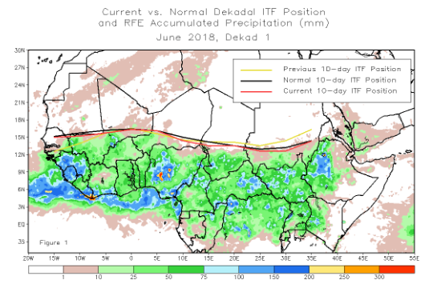
African Intertropical Front
June 20, 2018
Steven Fuhrman
Steven.fuhrman@noaa.gov

Slide 2
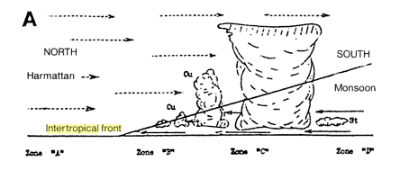
What is the ITF?
The line of convergence between moist southerly flow and dry northerly flow over western/eastern Africa.
Boundary between moist monsoonal air and very dry Saharan dessert air.
A surface feature which can manifest itself as a region of pronounced temperature and dew point gradients, as well as abrupt shift in wind direction.
dry
Moist
equator
Boundary slopes back southward forming a wedge. ITCZ considered to be south of ITF.
A: Knight and Smith (1944)

Slide 3
What is the ITF?
Propagates northward from April through July
Lags slightly behind the zenith angle of the sun
Quicker southward retreat from August through October.
Can reach as far north as about 20°N
Roughly residing across southern Mauritania, central Mali, central Niger, Central chad and Southern Sudan.

Slide 4
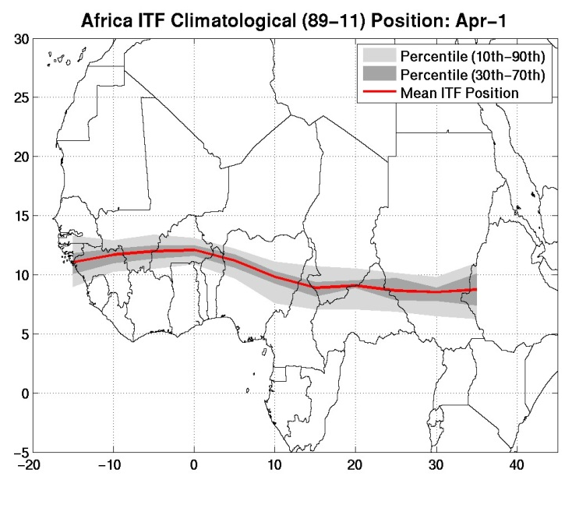
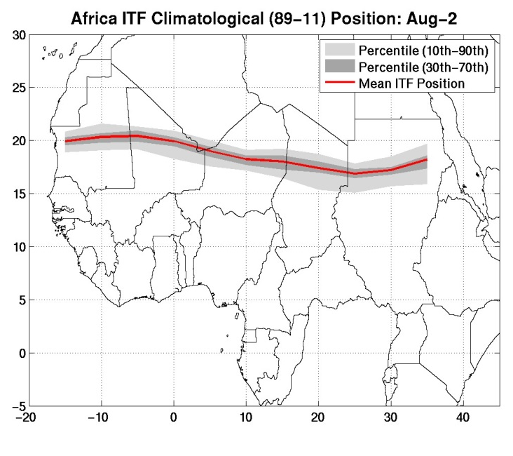
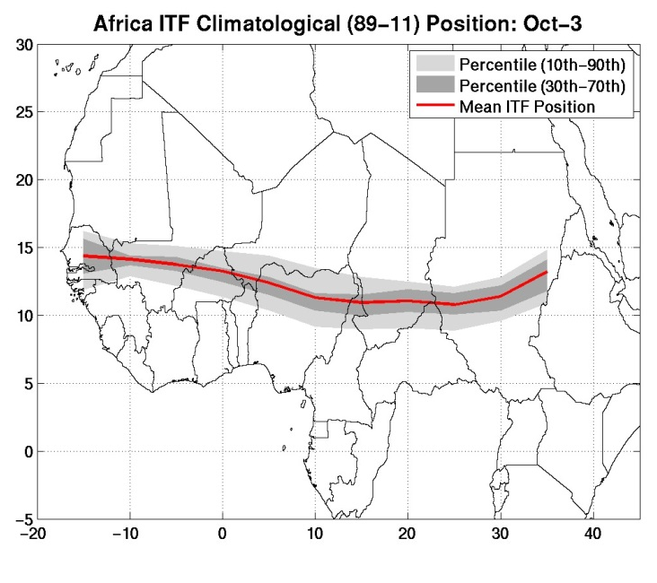
Where is it located?

Slide 5
Why Is the ITF Important?
Important for seasonal-to-interannual climate variability
Can literally mean feast or famine for the African Sahel.
Provides a boundary of the northernmost extent of Monsoonal rains.
Moisture and instability stays to its south
Zone of heaviest rain lies south of ITF
Notes:
Monitoring and prediction

Slide 6
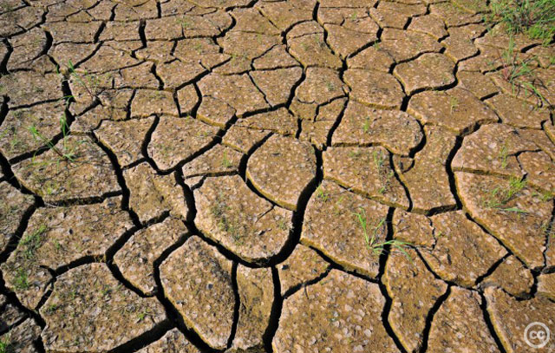
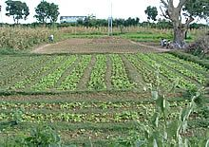
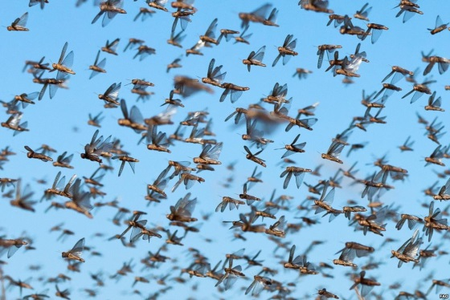
Why Is the ITF Important?
Consequently, farmers, ranchers, and other stakeholders are very interested in the ITF’s position.
Delayed or lessened northward propagation can result in drought and failed cropping seasons
Important impacts on Vector borne diseases and locust outbreaks, in addition to growing season.

Slide 7
How Do We Monitor it?
We report on ITF position once a dekad.
Average each of the 10 daily analyses over a dekadal period.
Final ITF is average of 3 meteorologist's analysis.
Values every 5° lon between 15° W and 35° E
Begin monitoring the first dekad of April and end the third dekad of October.
Notes:
Can be large day-to-day variability.
Average over a dekad because we are interested in position and movement in a climate sense

Slide 8
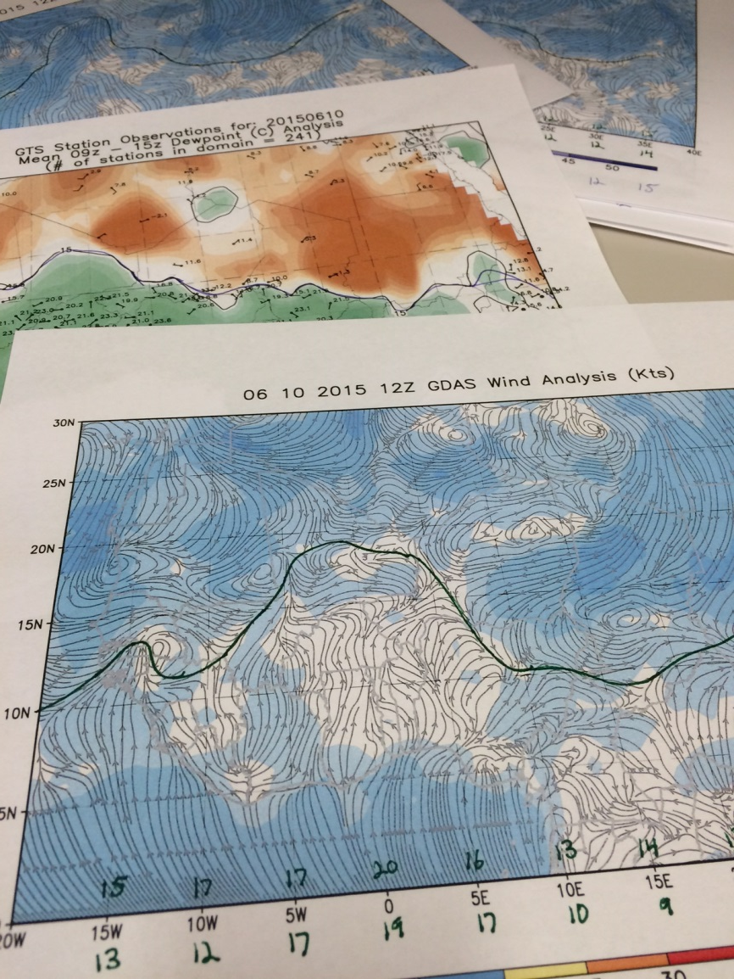
How Do We Monitor it?
Hand drawn analysis
2 variable fields
12Z GDAS Surface winds
Mean 9z-15z GTS gauge dewpoint
Line of convergence or change in direction of wind
15°C isodrosotherm

Slide 9
How Do We Monitor it?
Compare to normal and previous dekad’s ITF
Also a sanity check; make sure its realistic.
Write discussion
Notes:
As much an art as a science
Attempt a somewhat smooth analysis.
Be cautious of missing data and be cognizant that observations will be sparse.

Slide 10
Distribution
Posted to our CPC website:
http://www.cpc.ncep.noaa.gov/products/african_desk/cpc_intl/africa/africa.shtml
PDF available for download via FTP
ftp://ftp.cpc.ncep.noaa.gov/fews/itcz/
Used as part of some of FEWS NET’s other publications

Slide 11
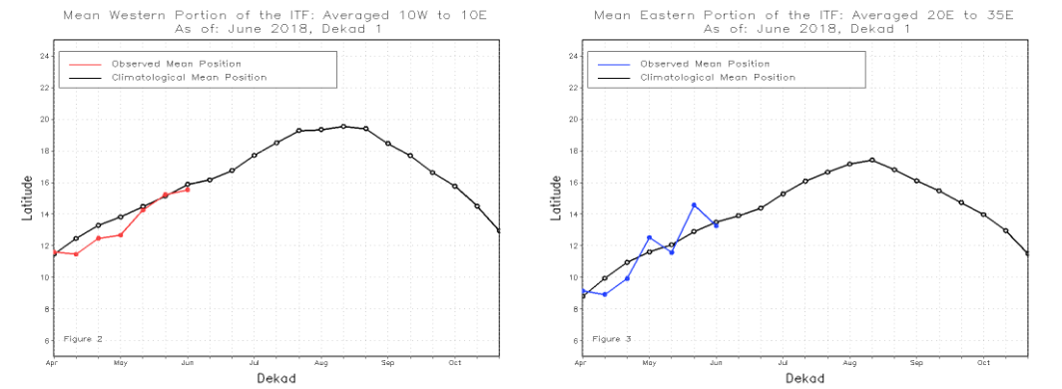
ITF Evolution In 2018

Slide 12
ITF Evolution In 2018

Slide 13
ITF Evolution In 2018

Slide 14
ITF Evolution In 2018

Slide 15
ITF Evolution In 2018

Slide 16
ITF Evolution In 2018

Slide 17
ITF Evolution In 2018

Slide 18
Thanks!
Any Questions?

