Slide 1
Introduction to Verification of Exceedance Probabilities Senegal, Dakar, September 2022
NOAA/CPC/International Desks

Slide 2
1. Introduction
Forecast verification is the process of assessing the quality of a forecast.
The forecast is compared against observation/reference data (eg. Analysis)
Very good reference by WWRP/WGNE Joint Working Group on Forecast Verification Research
https://www.cawcr.gov.au/projects/verification/verif_web_page.html
The three most important reasons to verify forecasts are:
monitor forecast quality
improve forecast quality
compare the quality of different forecast systems
There are different types of verification metrics
Heidke Skill Score (HSS): Measures the fraction of correct forecasts after eliminating those forecasts which would be correct due purely to random chance
With the standard formula, it ranges between -1 and 1, and 0 indicates no skill, while perfect score is 1.

Slide 3
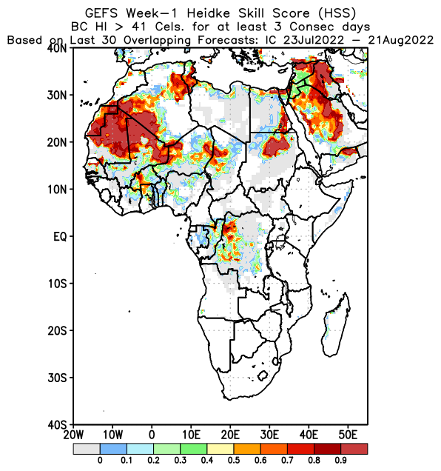
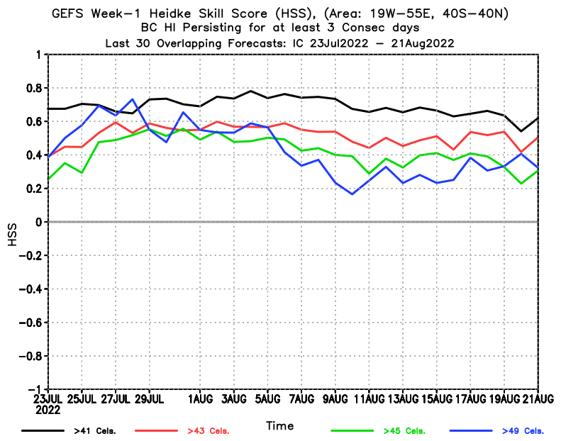
2. Verification Example, CPC/International Desks (https://www.cpc.ncep.noaa.gov/products/international/verif_realtime/heat/ )

Slide 4
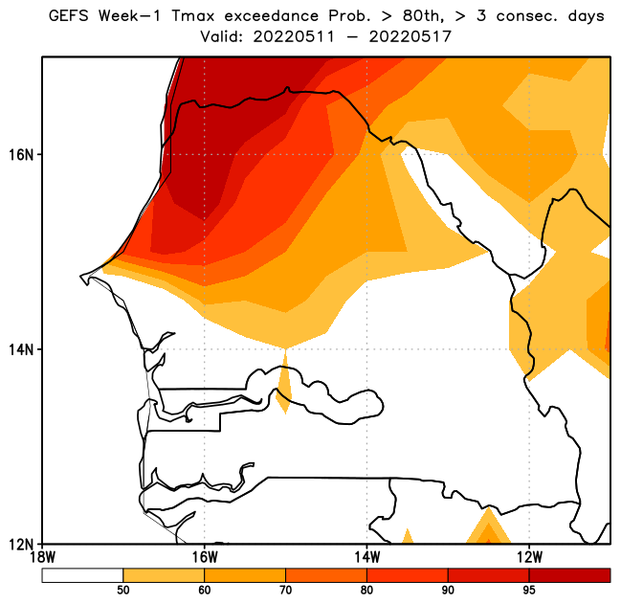
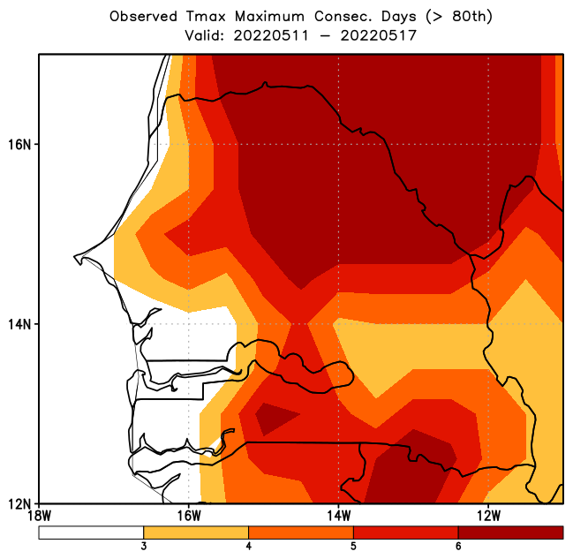
3. Verification Example, Past Event, “eye ball” (11 – 17 May 2022, >80th Pctle., >= 3 cons Days)
GEFS Week-1 Probability of Exceedance
Observed Maximum Consecutive Days

Slide 5
4. Verification Data Pre-processing
Forecast to be verified
Probability of Excceedance
Tmax > 80th pctle
Persists for at least 3 days
Forecast Probability > 0.5
Observation dataset
Extreme Tmax Observation
Tmax obs. > 80th pctle
Persists for at least 3 days
Contingency Table Elements
Hits
Misses
False Alarms
Correct Negatives

Slide 6
4. Verification Data Pre-processing (cont.)
Forecast
Observation
GEFS Week-1 Probability of Exceedance
Observed Maximum Consecutive Days
Forecast
Polygon

Slide 7
4. Verification Data Pre-processing (cont.)
GEFS Week-1 Probability of Exceedance
Observed Maximum Consecutive Days
False Alarms
hits
Correct Negatives
Misses

Slide 8
5. May 2021 Forecast Verification, Example (31 Forecasts vs 31 observations near Matam)
Forecast to be verified
Probability of Excceedance
Tmax > 80th pctle
Persists for at least 3 days
Forecast Probability > 0.5
Observation dataset
Extreme Tmax Observation
Tmax obs. > 80th pctle
Persists for at least 3 days
Contingency Table Elements
Hits
Misses
False Alarms
Correct Negatives

Slide 9
6. Pre-Processing Observation Data, Extracting Heatwave Consecutive Days
 | 1-May | 2-May | 3-May | 4-May | 5-May | 6-May | 7-May | 8-May | 9-May | 10-May | 11-May | 12-May | 13-May | 14-May | 15-May | 16-May
Percentile | 45.1 | 45.1 | 45.1 | 45.2 | 45.2 | 45.2 | 45.2 | 45.2 | 45.2 | 45.12 | 45.12 | 45.5 | 45.5 | 45.1 | 45.1 | 45.3
2022 | 45.9 | 45.0 | 44.0 | 43.6 | 45.6 | 47.6 | 47.2 | 44.1 | 39.2 | 45.3 | 47.0 | 47.5 | 45.5 | 47.0 | 46.0 | 47.0
May1 (3) | 1 |  |  |  | 1 | 2 | 3
May 2 (3) |  |  |  |  | 1 | 2 | 3
May 3 (3) |  |  |  |  | 1 | 2 | 3
May 4 (3) |  |  |  |  | 1 | 2 | 3 |  |  | 1
May 5 (3) |  |  |  |  | 1 | 2 | 3 |  |  | 1 | 2
May 6 (3) |  |  |  |  |  | 1 | 2 |  |  | 1 | 2 | 3
May 7 (4) |  |  |  |  |  |  | 1 |  |  | 1 | 2 | 3 | 4
May 8 (5) |  |  |  |  |  |  |  |  |  | 1 | 2 | 3 | 4 | 5
May 9 (6) |  |  |  |  |  |  |  |  |  | 1 | 2 | 3 | 4 | 5 | 6
May 10 (7) |  |  |  |  |  |  |  |  |  | 1 | 3 | 4 | 5 | 5 | 6 | 7

Slide 10
6. Pre-Processing Observation Data, Extracting Heatwave Consecutive Days
 | 1-May | 2-May | 3-May | 4-May | 5-May | 6-May | 7-May | 8-May | 9-May | 10-May | 11-May | 12-May | 13-May | 14-May | 15-May | 16-May
Percentile | 45.1 | 45.1 | 45.1 | 45.2 | 45.2 | 45.2 | 45.2 | 45.2 | 45.2 | 45.12 | 45.12 | 45.5 | 45.5 | 45.1 | 45.1 | 45.3
2022 | 45.9 | 45.0 | 44.0 | 43.6 | 45.6 | 47.6 | 47.2 | 44.1 | 39.2 | 45.3 | 47.0 | 47.5 | 45.5 | 47.0 | 46.0 | 47.0
May1 (3) | 0 | 0 | 0 | 0 | 0 | 0 | 1
May 2 (3) |  | 0 | 0 | 0 | 0 | 0 | 1 | 0
May 3 (3) |  |  |  |  | 0 | 0 | 1 | 0 | 0
May 4 (3) |  |  |  |  | 0 | 0 | 1 | 0 | 0 | 0
May 5 (3) |  |  |  |  | 0 | 0 | 1 | 0 | 0 | 0 | 0
May 6 (3) |  |  |  |  |  | 0 | 0 | 0 | 0 | 0 | 0 | 1
May 7 (4) |  |  |  |  |  |  | 0 | 0 | 0 | 0 | 0 | 1 | 1
May 8 (5) |  |  |  |  |  |  |  | 0 | 0 | 0 | 0 | 1 | 1 | 1
May 9 (6) |  |  |  |  |  |  |  |  | 0 | 0 | 0 | 1 | 1 | 1 | 1
May 10 (7) |  |  |  |  |  |  |  |  |  | 0 | 1 | 1 | 1 | 1 | 1 | 1

Slide 11
7. Sample: Observation / Week-1 Forecast Data
Date | Maximum Obs. Consc. Days | Obs. Bins >=3 | Fcst. Prob. | Fcst. Bins >0.5
1-May | 3 | 1 | 0 | 0
2-May | 3 | 1 | 0.2 | 0
3-May | 3 | 1 | 0.4 | 0
4-May | 3 | 1 | 0.2 | 0
5-May | 3 | 1 | 0.6 | 1
6-May | 3 | 1 | 0.6 | 1
7-May | 4 | 1 | 0.6 | 1
8-May | 5 | 1 | 0.7 | 1
9-May | 6 | 1 | 0.5 | 0
10-May | 7 | 1 | 0.7 | 1
11-May | 7 | 1 | 0.8 | 1
12-May | 7 | 1 | 0.7 | 1
13-May | 7 | 1 | 0.8 | 1
14-May | 7 | 1 | 0.7 | 1
15-May | 6 | 1 | 0.8 | 1
16-May | 5 | 1 | 0.7 | 1
17-May | 4 | 1 | 0.5 | 0
18-May | 3 | 1 | 0.5 | 0
19-May | 2 | 0 | 0.2 | 0
20-May | 1 | 0 | 0 | 0
21-May | 0 | 0 | 0 | 0
22-May | 0 | 0 | 0 | 0
23-May | 0 | 0 | 0 | 0
24-May | 0 | 0 | 0.1 | 0
25-May | 0 | 0 | 0.3 | 0
26-May | 0 | 0 | 0.3 | 0
27-May | 0 | 0 | 0.5 | 0
28-May | 0 | 0 | 0.2 | 0
29-May | 0 | 0 | 0.1 | 0
30-May | 0 | 0 | 0 | 0
31-May | 0 | 0 | 0 | 0
The table on the left contains observation/week-1 forecast data for a location close to Matan
Colum-1: Observation/Week-2 Forecast Period (01 – 31 May 2022)
Column-2: Number maximum observed consecutive days per week with Tmax > 80th percentile
Colum-3: Observation bins, with >=3 to 1 and the rest to 0
Column-4: GEFS Forecast Probability (>80th for at least 3 consecutive days per week)
Column-5: Forecast bins, with >=1 to 1 and the rest to 0

Slide 12
7. Sample: Observation / Week-1 Forecast Data
Date | Maximum Obs. Consc. Days | Obs. Bins >=3 | Fcst. Prob. | Fcst. Bins >0.5 | Obs. Bin plus Fcst. Bin | Obs. Bin minus Fcst. Bin | Fcst. Bin minus Obs. Bin | 2 minus (Obs. Bins plus Fcst. Bins)
1-May | 3 | 1 | 0 | 0 | 1 | 1 | -1 | 1
2-May | 3 | 1 | 0.2 | 0 | 1 | 1 | -1 | 1
3-May | 3 | 1 | 0.4 | 0 | 1 | 1 | -1 | 1
4-May | 3 | 1 | 0.2 | 0 | 1 | 1 | -1 | 1
5-May | 3 | 1 | 0.6 | 1 | 2 | 0 | 0 | 0
6-May | 3 | 1 | 0.6 | 1 | 2 | 0 | 0 | 0
7-May | 4 | 1 | 0.6 | 1 | 2 | 0 | 0 | 0
8-May | 5 | 1 | 0.7 | 1 | 2 | 0 | 0 | 0
9-May | 6 | 1 | 0.5 | 0 | 1 | 1 | -1 | 1
10-May | 7 | 1 | 0.7 | 1 | 2 | 0 | 0 | 0
11-May | 7 | 1 | 0.8 | 1 | 2 | 0 | 0 | 0
12-May | 7 | 1 | 0.7 | 1 | 2 | 0 | 0 | 0
13-May | 7 | 1 | 0.8 | 1 | 2 | 0 | 0 | 0
14-May | 7 | 1 | 0.7 | 1 | 2 | 0 | 0 | 0
15-May | 6 | 1 | 0.8 | 1 | 2 | 0 | 0 | 0
16-May | 5 | 1 | 0.7 | 1 | 2 | 0 | 0 | 0
17-May | 4 | 1 | 0.5 | 0 | 1 | 1 | -1 | 1
18-May | 3 | 1 | 0.5 | 0 | 1 | 1 | -1 | 1
19-May | 2 | 0 | 0.2 | 0 | 0 | 0 | 0 | 2
20-May | 1 | 0 | 0 | 0 | 0 | 0 | 0 | 2
21-May | 0 | 0 | 0 | 0 | 0 | 0 | 0 | 2
22-May | 0 | 0 | 0 | 0 | 0 | 0 | 0 | 2
23-May | 0 | 0 | 0 | 0 | 0 | 0 | 0 | 2
24-May | 0 | 0 | 0.1 | 0 | 0 | 0 | 0 | 2
25-May | 0 | 0 | 0.3 | 0 | 0 | 0 | 0 | 2
26-May | 0 | 0 | 0.3 | 0 | 0 | 0 | 0 | 2
27-May | 0 | 0 | 0.5 | 0 | 0 | 0 | 0 | 2
28-May | 0 | 0 | 0.2 | 0 | 0 | 0 | 0 | 2
29-May | 0 | 0 | 0.1 | 0 | 0 | 0 | 0 | 2
30-May | 0 | 0 | 0 | 0 | 0 | 0 | 0 | 2
31-May | 0 | 0 | 0 | 0 | 0 | 0 | 0 | 2
 |  |  |  |  | Hits (count if 2) | Misses (count if 2) | Fal. Ala. (count if 2) | Corr. Neg. (count if 2) | N. Tot
 |  |  |  | Sum | 11 | 7 | 0 | 13 | 31
The table on the left contains observation/week-1 forecast data for a location close to Matan
Colum-1: Observation/Week-2 Forecast Period (01 – 31 May 2022)
Column-2: Number maximum observed consecutive days per week with Tmax > 80th percentile
Colum-3: Observation bins, with >=3 to 1 and the rest to 0
Column-4: GEFS Forecast Probability (>80th for at least 3 consecutive days per week)
Column-5: Forecast bins, with >=1 to 1 and the rest to 0
Column-6: Pre-process hits (Column-3 Plus Column-5)
Column-7: Pre-process Misses (Column-3 minus Column-5)
Column-8: Pre-process False alarms (Column-5 minus Column-3)
Column-9: Pre-process Correct Negatives (2 minus Column-6)
The bottom row calculates (counts) the total number of “Hits”, “Misses”, “False Alarms”, “correct Negatives” and “Number of total Observation/Forecast)

Slide 13
VI. Extracting Contingency Table Values
 | Observed
Forecast |  | Yes | No | Total
 | Yes | Hits | False Alarms | Forecast Yes
 | No | Misses | Correct Negatives | Forecast No
 |  | Observed Yes | Observed No | Total (N)
Contingency table
 | Observed
Forecast |  | Yes | No | Total
 | Yes | 11 | 0 | 11
 | No | 7 | 13 | 20
 |  | 18 | 13 | 31
Contingency table Example

Slide 14
VII. Heidke Skill Score Computation
The Heidke Skill Score is computed using:
It measures the accuracy of the forecast relative to that of a random forecast.
Range of HSS: -1 to 1, 0 indicates no skill, and Perfect skill score is 1
where

Slide 15
VII. Heidke Skill Score Computation (cont.)
The “expected Correct” value is computed using the “hits”, “misses”, “False Alarms”, “Correct Negatives”, and “N” from the previous slides:
(expected Correct)_{random} = (1/31) * [((11 + 7 )* (11+0)) + ((13 + 7) * (13+0))] = 14.77
Finally:
HSS = ((11 + 13) – (14.77)) / (31 – 14.77) = 0.57

Slide 16
Exercise on Heidke Skill Score Verification

Slide 17
Exercise on Heidke Skill Score Verification

Slide 18
Exercise: Observation / Week-2 Forecast Data
Date | Maximum Obs. Consc. Days | Obs. Bins >=3 | Fcst. Prob. | Fcst. Bins >0.5 | Obs. Bin plus Fcst. Bin | Obs. Bin minus Fcst. Bin | Fcst. Bin minus Obs. Bin | 2 minus (Obs. Bins plus Fcst. Bins)
1-May | 3 | 1 | 0.5 | 0 | 1 | 1 | -1 | 1
2-May | 3 | 1 | 0.3 | 0 | 1 | 1 | -1 | 1
3-May | 3 | 1 | 0.4 | 0 | 1 | 1 | -1 | 1
4-May | 3 | 1 | 0.4 | 0 | 1 | 1 | -1 | 1
5-May | 3 | 1 | 0.5 | 0 | 1 | 1 | -1 | 1
6-May | 3 | 1 | 0.4 | 0 | 1 | 1 | -1 | 1
7-May | 4 | 1 | 0.2 | 0 | 1 | 1 | -1 | 1
8-May | 5 | 1 | 0.6 | 1 | 2 | 0 | 0 | 0
9-May | 6 | 1 | 0.7 | 1 | 2 | 0 | 0 | 0
10-May | 7 | 1 | 0.8 | 1 | 2 | 0 | 0 | 0
11-May | 7 | 1 | 0.9 | 1 | 2 | 0 | 0 | 0
12-May | 7 | 1 | 0.8 | 1 | 2 | 0 | 0 | 0
13-May | 7 | 1 | 0.7 | 1 | 2 | 0 | 0 | 0
14-May | 7 | 1 | 0.5 | 0 | 1 | 1 | -1 | 1
15-May | 6 | 1 | 0.3 | 0 | 1 | 1 | -1 | 1
16-May | 5 | 1 | 0.4 | 0 | 1 | 1 | -1 | 1
17-May | 4 | 1 | 0.2 | 0 | 1 | 1 | -1 | 1
18-May | 3 | 1 | 0.1 | 0 | 1 | 1 | -1 | 1
19-May | 2 | 0 | 0.1 | 0 | 0 | 0 | 0 | 2
20-May | 1 | 0 | 0.2 | 0 | 0 | 0 | 0 | 2
21-May | 0 | 0 | 0.2 | 0 | 0 | 0 | 0 | 2
22-May | 0 | 0 | 0.1 | 0 | 0 | 0 | 0 | 2
23-May | 0 | 0 | 0.1 | 0 | 0 | 0 | 0 | 2
24-May | 0 | 0 | 0.1 | 0 | 0 | 0 | 0 | 2
25-May | 0 | 0 | 0.2 | 0 | 0 | 0 | 0 | 2
26-May | 0 | 0 | 0.1 | 0 | 0 | 0 | 0 | 2
27-May | 0 | 0 | 0.3 | 0 | 0 | 0 | 0 | 2
28-May | 0 | 0 | 0.3 | 0 | 0 | 0 | 0 | 2
29-May | 0 | 0 | 0.3 | 0 | 0 | 0 | 0 | 2
30-May | 0 | 0 | 0.4 | 0 | 0 | 0 | 0 | 2
31-May | 0 | 0 | 0.3 | 0 | 0 | 0 | 0 | 2
 |  |  |  |  | Hits (count if 2) | Misses (count if 2) | Fal. Ala. (count if 2) | Corr. Neg. (count if 2) | N. Tot
 |  |  |  | Sum | 6 | 12 | 0 | 13 | 31
The table on the left contains observation/week-2 forecast data for a location close to Matan
Colum-1: Observation/Forecast Period (01 – 31 May 2022)
Column-2: Number maximum observed consecutive days per week with Tmax > 80th percentile
Colum-3: Observation bins, with >=3 to 1 and the rest to 0
Column-4: GEFS Forecast Probability (>80th for at least 3 consecutive days per week)
Column-5: Forecast bins, with >=1 to 1 and the rest to 0
Please fill up columns 6 -9 with appropriate values.

Slide 19
Exercise, Contingency Table Values
Please fill up the contingency table below with appropriate values:
 | Observed
Forecast |  | Yes | No | Total
 | Yes | 6 | 0 | 6
 | No | 12 | 13 | 25
 |  | 18 | 13 | 31
Contingency table Exercise
Calculate the (expected correct)_{random} and Heidke skill score (HSS):
(expected correct)_{random} = (1/31) * [((6 + 12 )* (6 + 0)) + ((13 + 12) * (13+0))] = 13.97
Heidke skill score (HSS) = ((6 + 13) – (13.97)) / (31 – 13.97) = 0.30

