Slide 1
Demonstration on Realtime Subseasonal Forecasting 16ITWCVP Training Workshop Dakar, Senegal, 11 – 23 September 2024
Endalkachew Bekele
NOAA/CPC/International Desks

Slide 2
Tools for Operational Sub-Seasonal Forecasting
Tropical Cyclone A.
Week 1/2
Week 3-4
Madden Julian Oscillation (MJO)
Numerical Weather and climate models (NWP)
El Nino Southern Oscillation (ENSO)
IOD
NAO

Slide 3
State of the MJO
The Madden-Julian Oscillation (MJO) is a tropical disturbance that propagates eastward around the global tropics with a cycle on the order of 30-60 days.
The MJO has wide ranging impacts on the patterns of tropical and extratropical precipitation, atmospheric circulation, and surface temperature around the global tropics and subtropics.
Much emphasis is given to the state of the MJO and its projected phases on the Wheeler-Hendon diagram at the moment of the forecasts.
Refer to the MJO monitoring and prediction tools to determine if an active MJO is present
https://www.cpc.ncep.noaa.gov/products/precip/CWlink/MJO/mjo.shtml#discussion

Slide 4
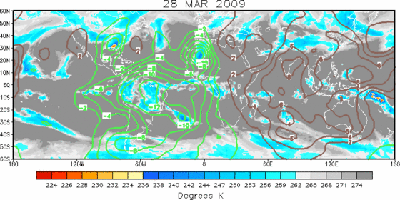
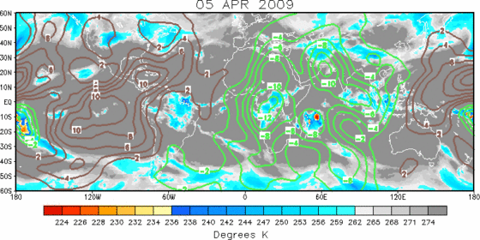
MJO, 200-hPa Velocity Potential Anomalies
Green shades: Anomalous divergence (favorable for precipitation).
Brown shades: Anomalous convergence (unfavorable for precipitation).
Eastward propagation of
Area of an enhanced convection (precipitation)
Area of Upper-level divergence (green contour)

Slide 5
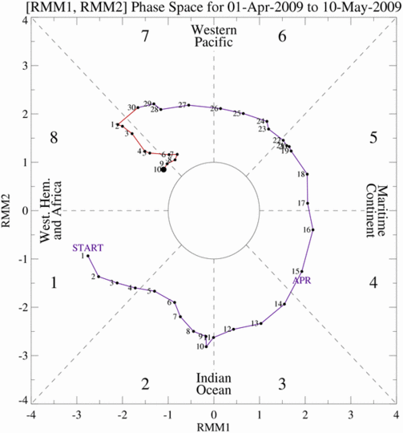
MJO, The Wheeler-Hendon Diagram
Each dot/number represents a single day and location of the MJO enhanced rainfall.
MJO exists when there is counterclockwise movement on diagram
Weak
MJO
Strong
MJO

Slide 6
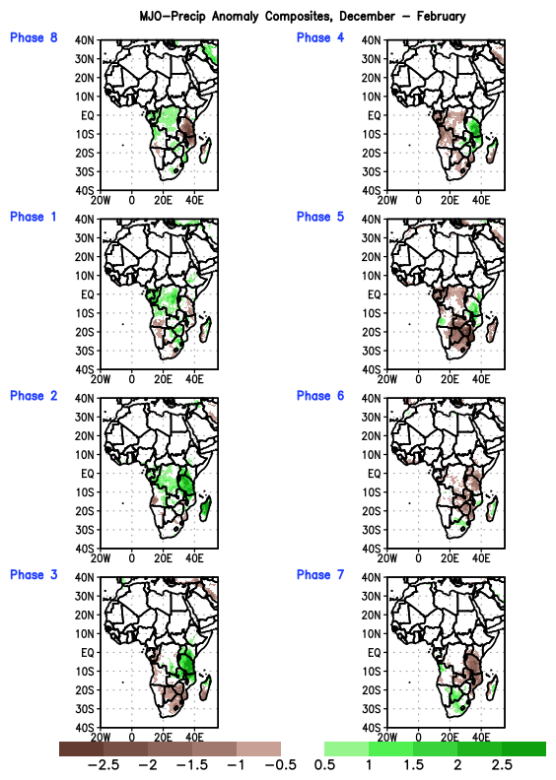
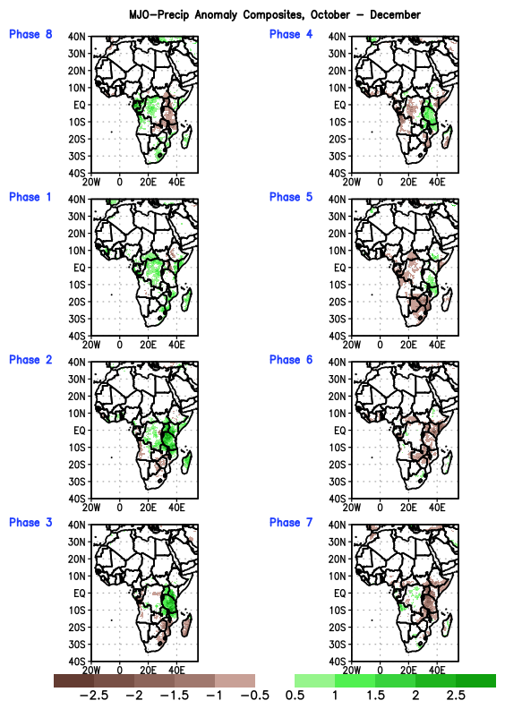
MJO Precip Composites source: https://ftp.cpc.ncep.noaa.gov/International/mjo_composites
Dec-Jan-Feb
Oct-Nov-Dec

Slide 7
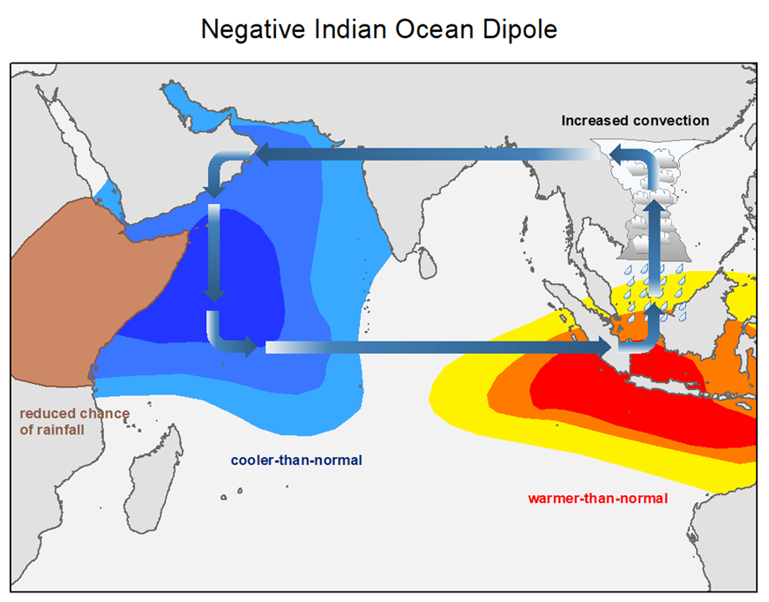
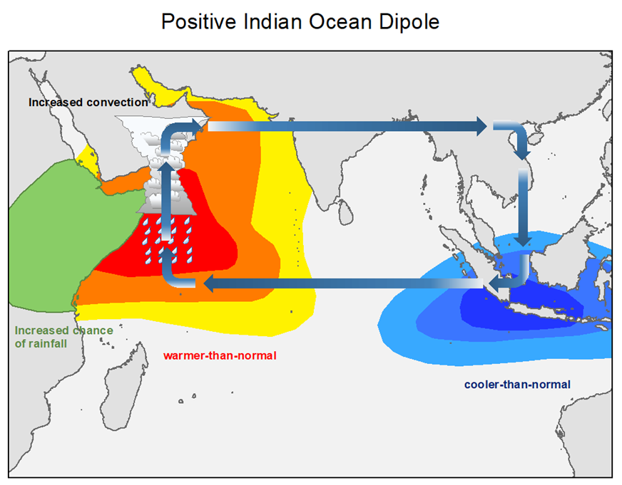
IOD Influences source: https://www.cpc.ncep.noaa.gov/products/international/ocean_monitoring/IO_monitoring_fcsts/io_index.shtml
Negative IOD
Positive IOD
An east-west Gradient in the Indian Ocean SST Anomaly
Negative IOD brings drought to equatorial East Africa and Excessive rainfall to eastern Asia and Australia
Positive IOD brings floods to equatorial East Africa and droughts and bushfires to eastern Asia and Australia

Slide 8
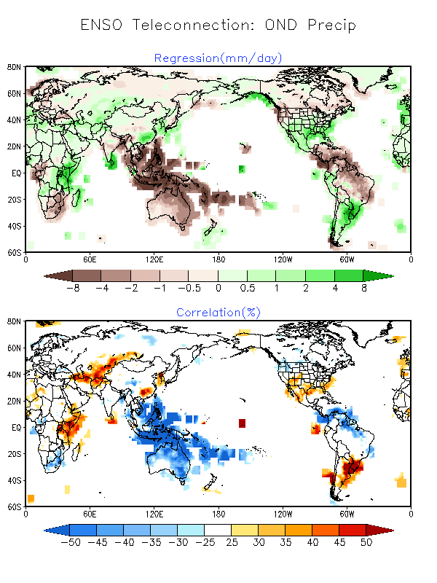
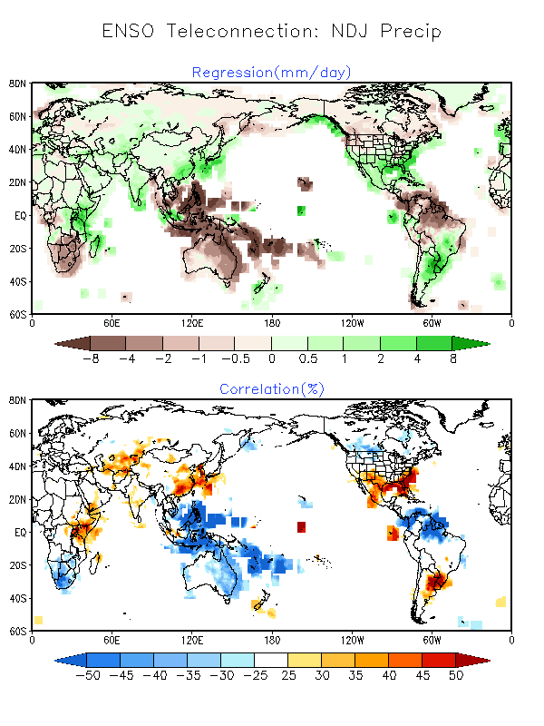
ENSO Influences (OND/DJF), source: https://www.cpc.ncep.noaa.gov/products/precip/CWlink/ENSO/regressions/geplr.shtml
OND
NDJ

Slide 9
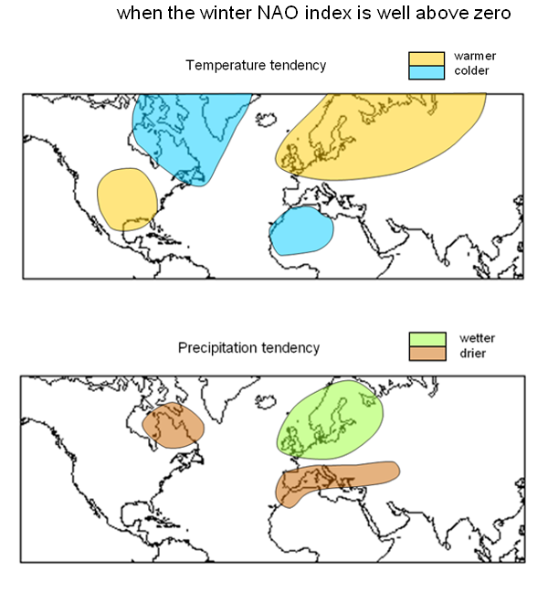
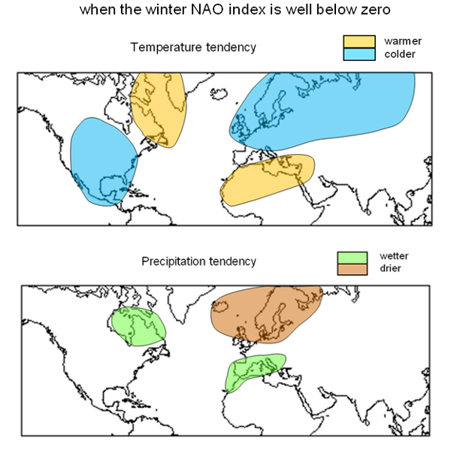
NAO Influences (DJF), source: https://www.metoffice.gov.uk/research/climate/seasonal-to-decadal/gpc-outlooks/ens-mean/nao-description
NAO Positive
NAO Negative

Slide 10
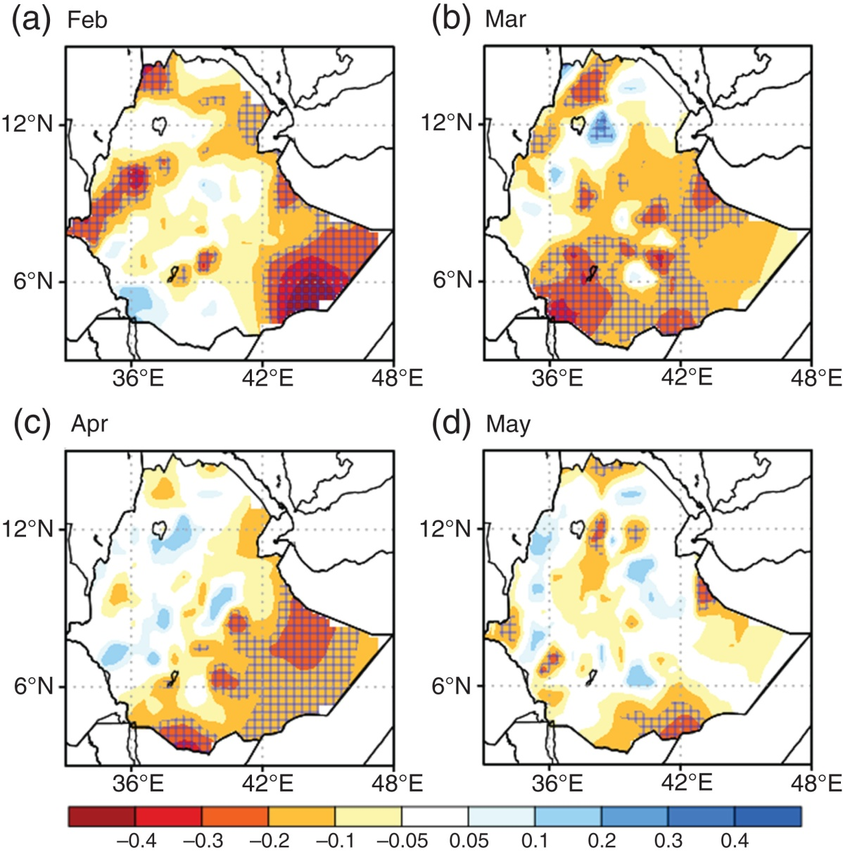
NAO Influences (Belg Season of Ethiopia), source: (Bekele et al, 2018): https://rmets.onlinelibrary.wiley.com/doi/10.1002/joc.5474
Wetter than normal Belg rains during the negative phase of NAO, and drier than normal during positive NAO phase.
Pronounced NAO influence over central, southern and southeastern Ethiopia in March

Slide 11
NWP Tools
Lower mid, and Upper-level Circulation Anomalies
850-hPa, 700-hPa, 200-hPa wind and Divergence
MSLP and 500-hPa height
Raw Rainfall Forecasts
Rainfall & T2m Anomaly
Precip exceedance probabilities with respect to fixed thresholds
>10mm, >20mm, > 30mm, >40m, >50mm, > 75mm
Post-processed forecasts
Statistically calibrated tercile forecasts
Calibrated Exceedance Probabilities with respect to percentile thresholds
<10th , <20th & >80th, >90th

Slide 12
NWP Tools, GEFS Precip Forecasts
GEFS - Global Ensemble Forecast System
A weather forecast model made up of 31 separate forecasts, or ensemble members.
Ensemble Mean – Average of the 31 ensemble member forecasts
Raw Forecasts - no bias correction/calibration
Model Climatology – Average of model reforecasts over the reference hindcast period (2000 – 2019)
Raw forecast anomalies are computed by removing model climatology from the ensemble mean forecast.

Slide 13
NWP Tools, Post-Processing
The skill of NWP models decreases with forecast lead time.
Larger model errors for forecasts beyond week-2
A need for forecast error correction methods:
Simple to advanced statistical methods
mean bias removal (eg.
Ensemble Regression calibration
(eg. Unger et al, 2009: https://www.cpc.ncep.noaa.gov/products/people/wd51hd/vddoolpubs/AMS_MWR_2009_2365-2379_ensembleregression.pdf )
Machine learning approaches (eg. Kyle and Acharya, 2022: https://www.frontiersin.org/journals/climate/articles/10.3389/fclim.2022.953262/full )

Slide 14
Week-1/2 Forecast Process
Incorporate MJO influences incase of active MJO is present
Incorporate IOD/ENSO/NAO influences incase of active IOD/ENSO/NAO event
If the IOD/ENSO/NAO influence is not significant as well as the MJO is not active, or projected to weaken considerably during the week-1/2 outlook period.
NWP outputs are the primary tools for guiding week-1/2 forecasts.
NWP output tools include quantitative precipitation forecasts (raw), and post-processed precipitation forecasts.
Examine the predicted circulation features associated with the predicted rainfall anomalies.
More weight will be given to the NWP precipitation outlook tools that are more consistent with the predicted circulation anomalies.

Slide 15
Week-1/2 Forecast Process
Active MJO
Phase diagrams and composites
Yes
Consensus Forecast, Polygons and Text Description
No
Circulation Anomalies
Forecast Discussion
ENSO/NAO/IOD forecasts and composites
Raw Rainfall Forecasts
No
Active ENSO/NAO/IOD
Yes
Bias Corrected / Reg Calibrated

Slide 16
Demonstration: Week-1 Outlook for Africa
Week-1 Forecast, valid 15 – 21 March 2023
Tools
MJO
IOD
ENSO
NWP Guidance

Slide 17
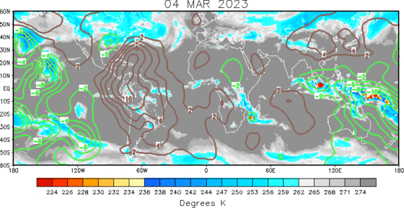
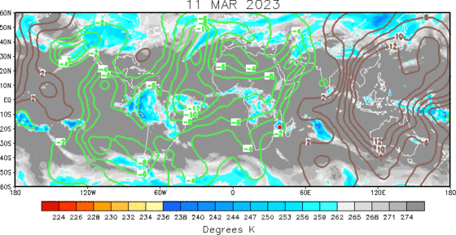
200 hPa Velocity Potential Anomaly
Previous
Recent
Eastward propagation is observed
Green shade indicates areas of upper-level divergence and convection or precipitation at surface.
Brown contours indicate areas of upper-level convergence or subsidence and suppressed precipitation at surface.
Notes:
200 hPa Velocity Potential Anomalies Animation: https://www.cpc.ncep.noaa.gov/products/precip/CWlink/ir_anim_monthly.shtml

Slide 18
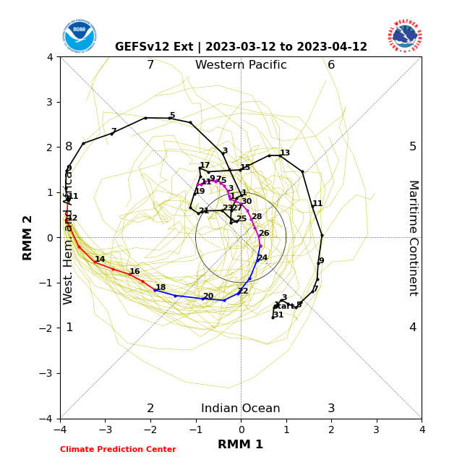
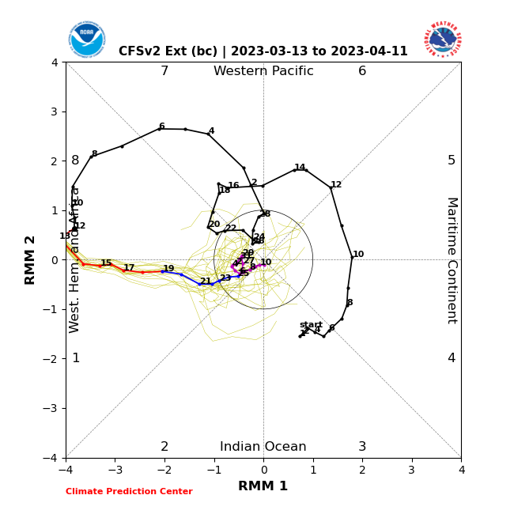
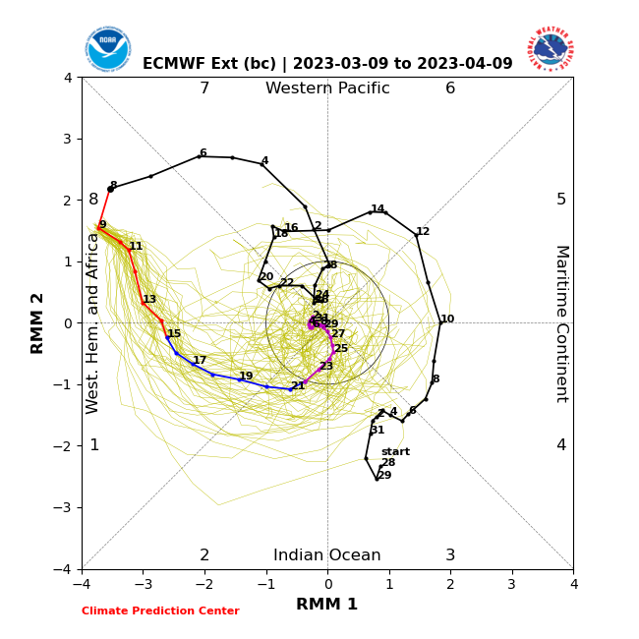
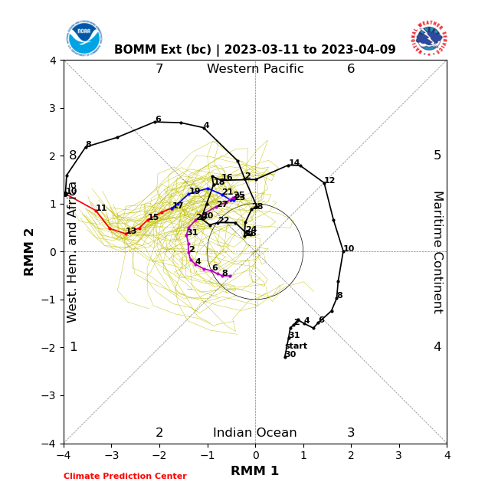
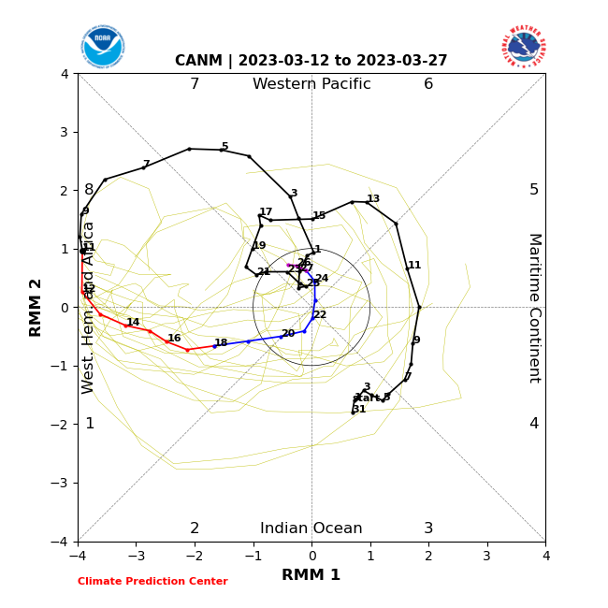
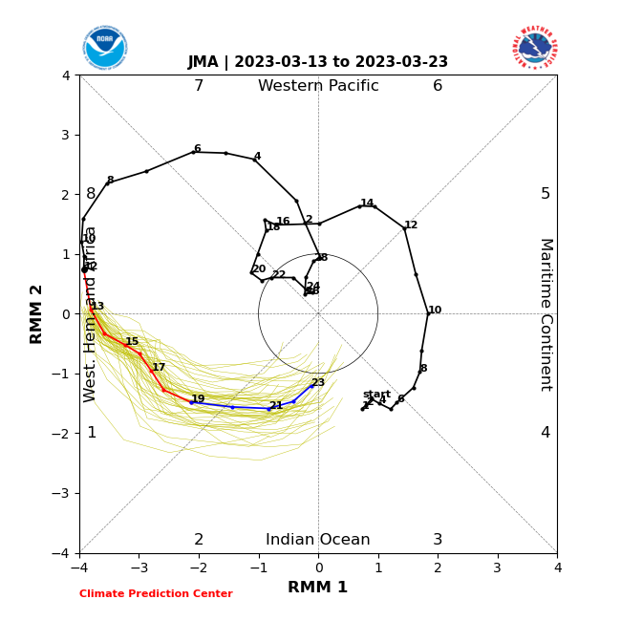
Wheeler-Hendon Index - Forecasts
GEFSv12
CFSv2-ext
ECMWF-ext
Observation
Forecast
BOM-ext
CANM
JMA

Slide 19
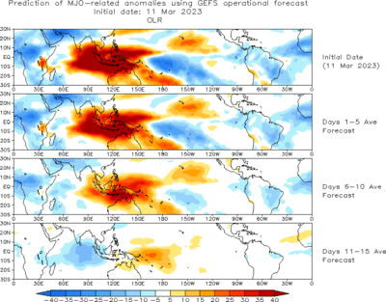
Evolution of MJO-related Anomalies
Initial date: 11 Mar 2023
Red shade indicate areas
of suppressed convection
Blue shade indicate areas
of enhanced convection
1 - 5 days ave. Forecast
6-10 days ave. Forecast
11-15 days ave. Forecast

Slide 20
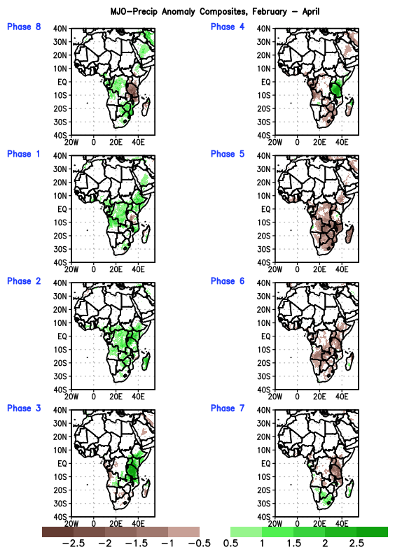
MJO, Rainfall Composites
MJO Rainfall Composites, Africa, FMA
Wetter than normal rainfall during MJO phases of 8 to 2 in central Africa, and phases 1 to 4 in equatorial East Africa.
Drier than normal rainfall during 4 6 in Southern Africa, and phases 5 to 8 in equatorial East Africa.
Mjo prediction suggest propagation from phase 8 to phase 1 through week-2

Slide 21
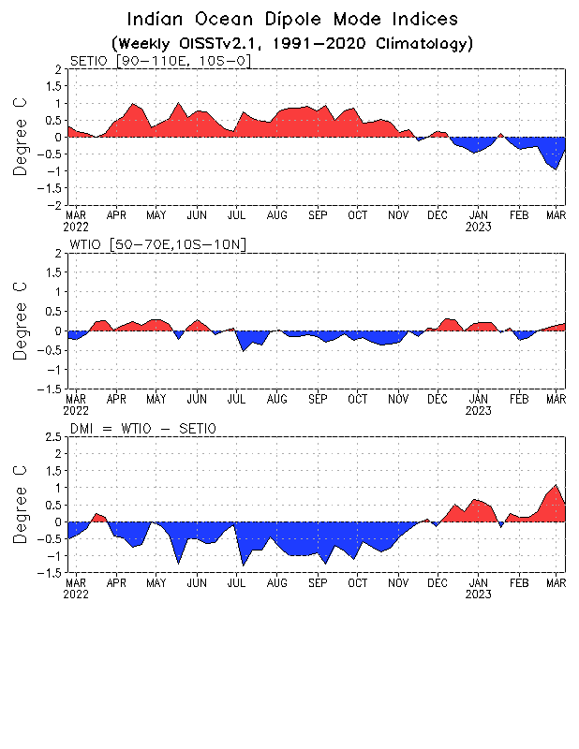
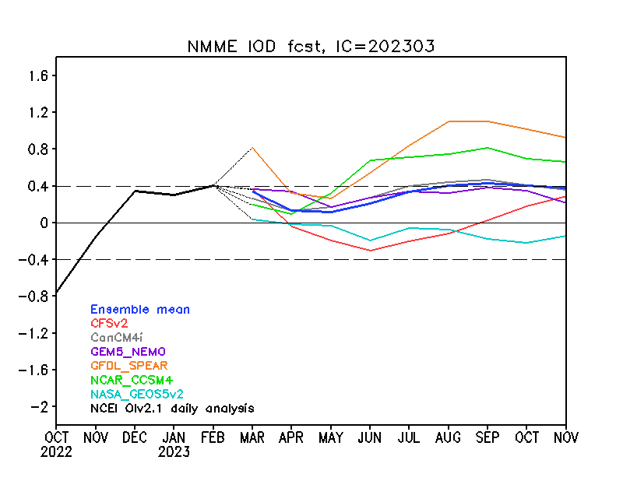
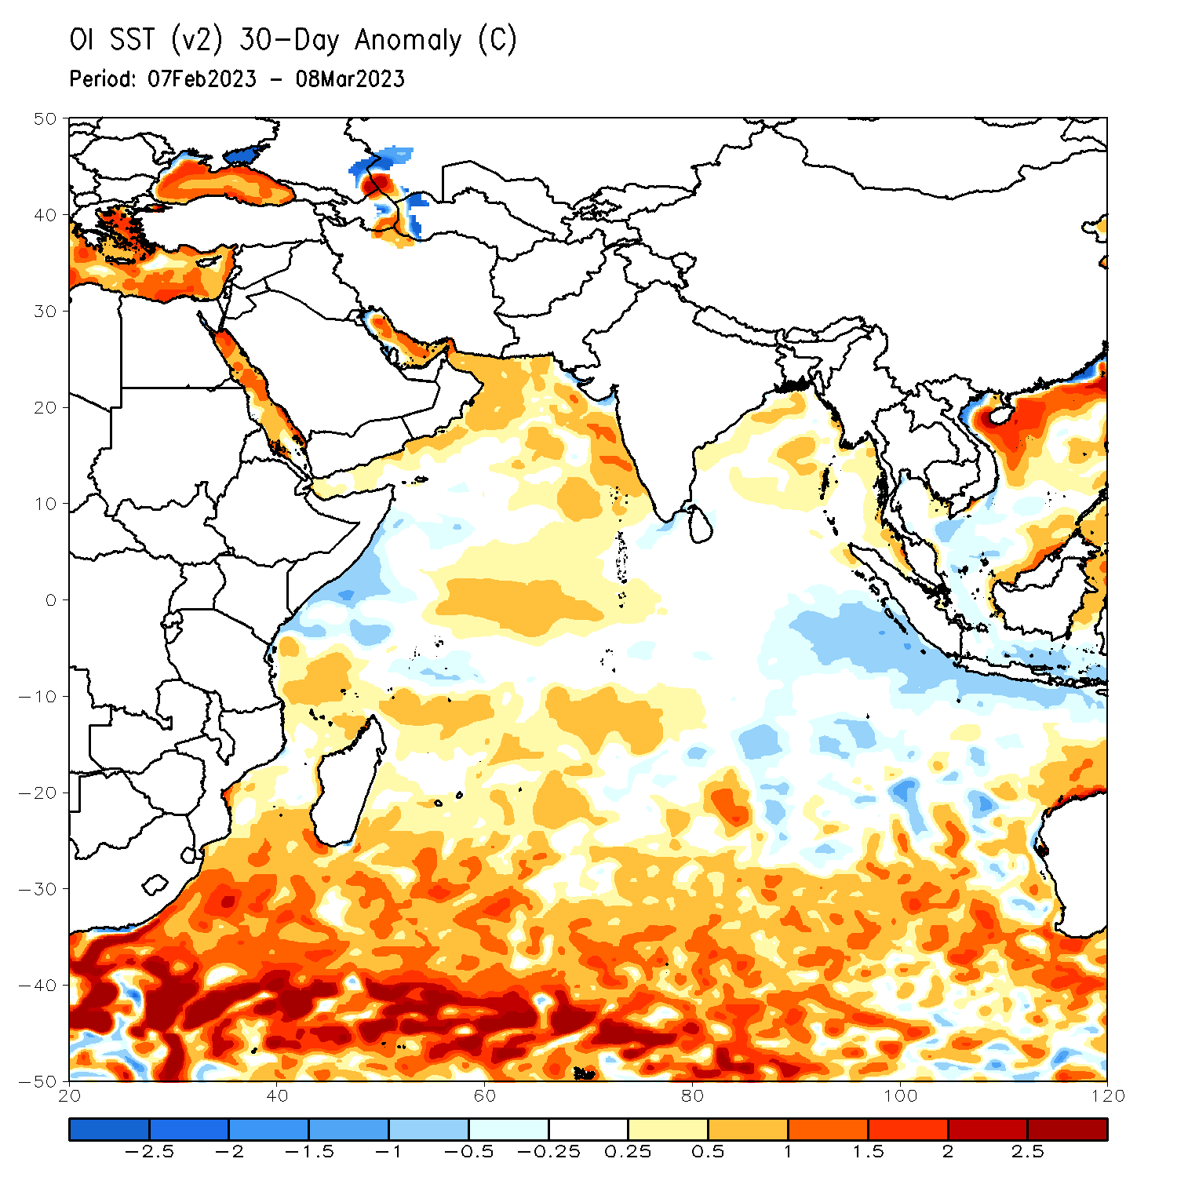
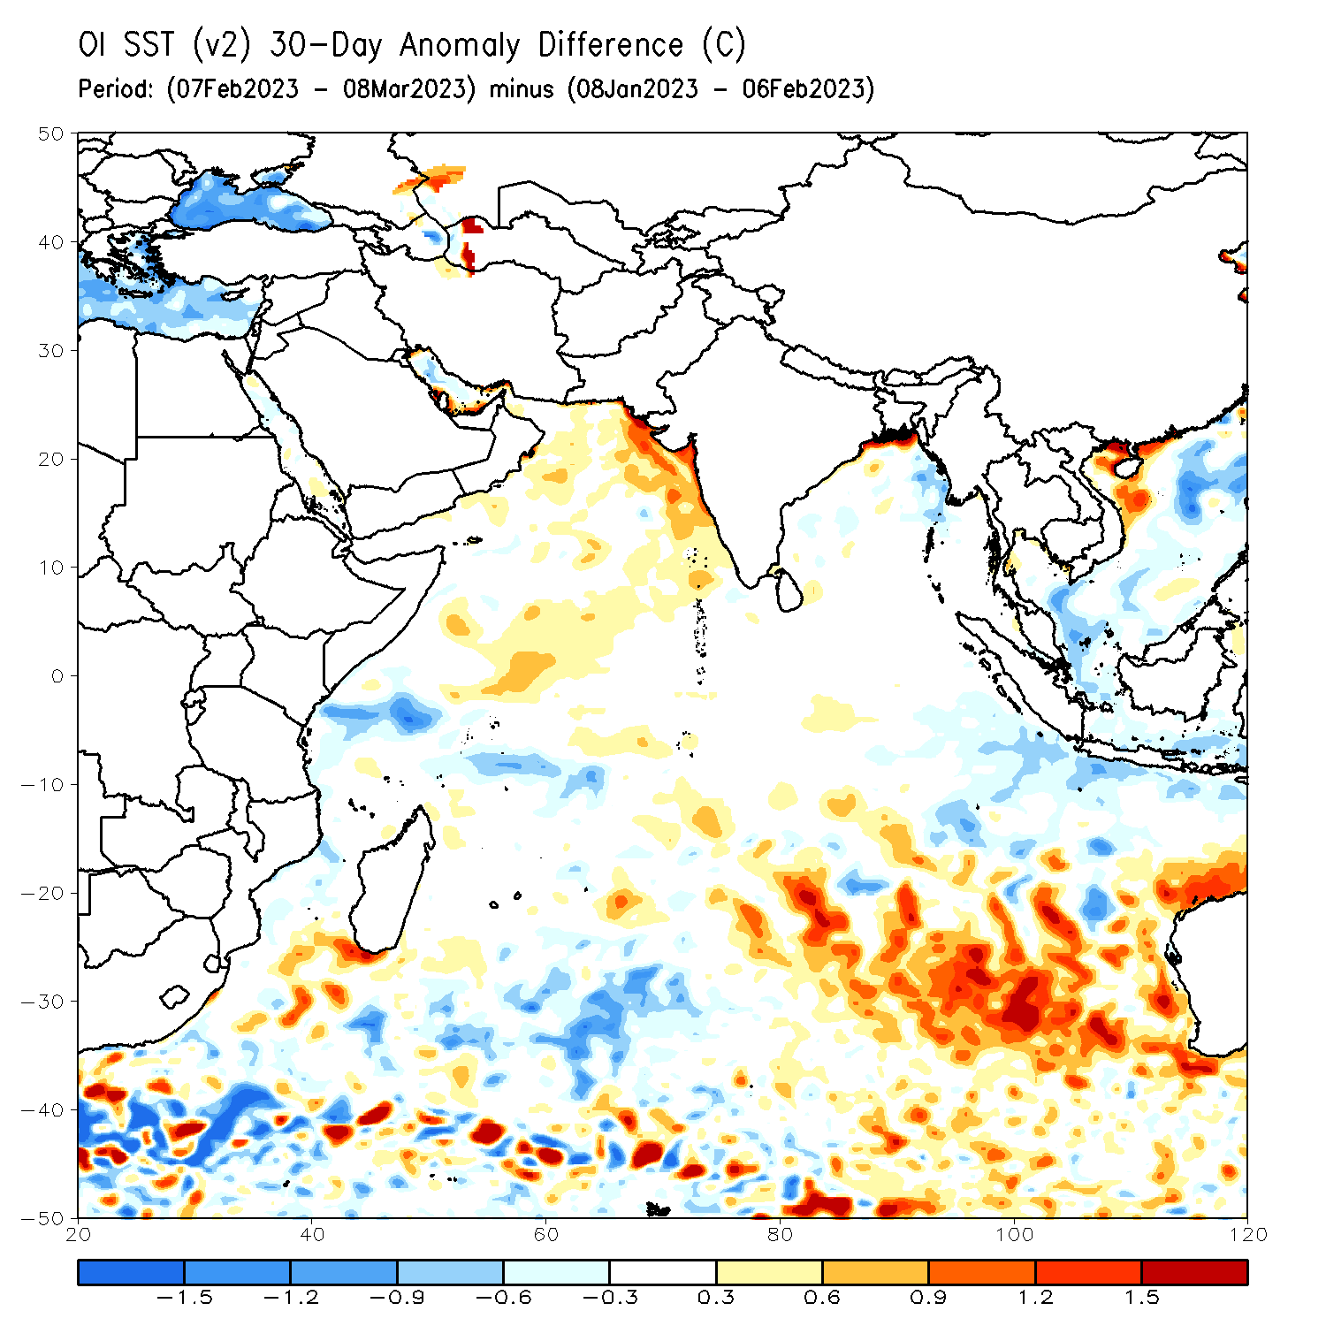
State of the IOD
NMME IOD Forecast
NMME calls for the IOD to remain in the neutral phase through the northern hemisphere summer 2023.
The Indian Ocean Dipole (IOD) has increased over the past few weeks.

Slide 22
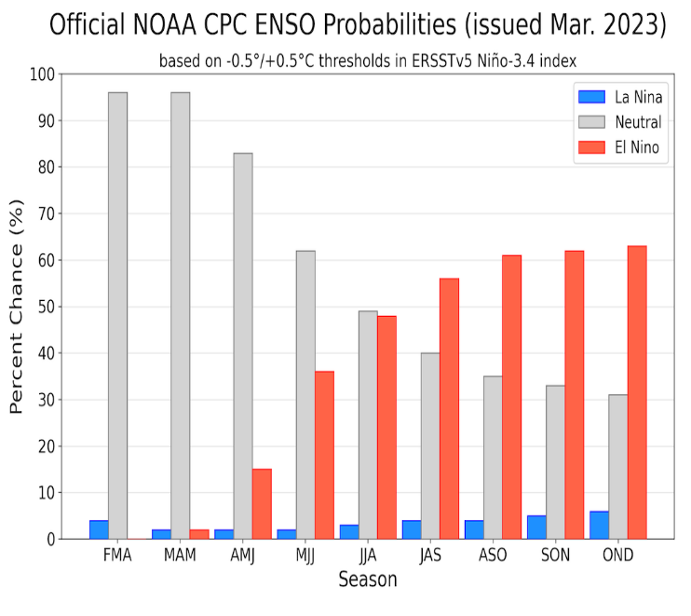
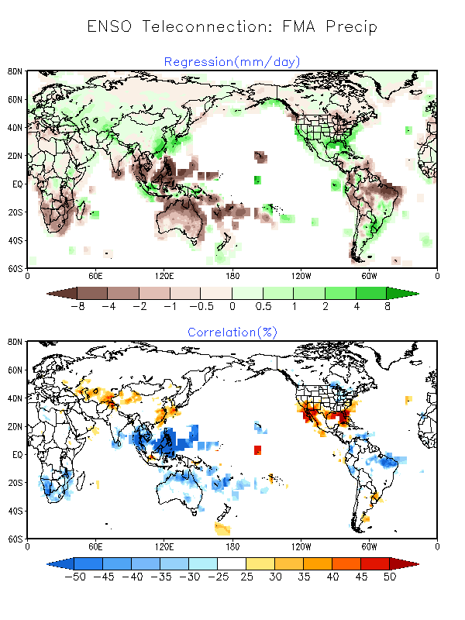
State of the ENSO
CPC ENSO Alert System Status: Final La Niña Advisory
La Niña has ended and ENSO-neutral conditions are expected to continue through the Northern Hemisphere spring and early summer 2023.
Season | La Niña | Neutral | El Niño
FMA | 4 | 96 | 0
MAM | 2 | 96 | 2
AMJ | 2 | 83 | 15
MJJ | 2 | 62 | 36
JJA | 3 | 49 | 48
JAS | 4 | 40 | 56
ASO | 4 | 35 | 61
SON | 5 | 33 | 62
OND | 6 | 31 | 63

Slide 23
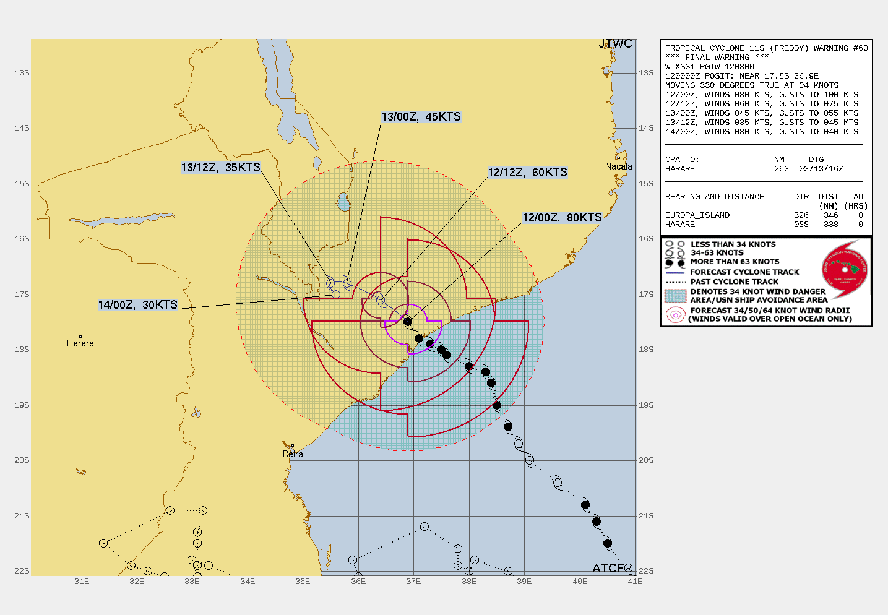
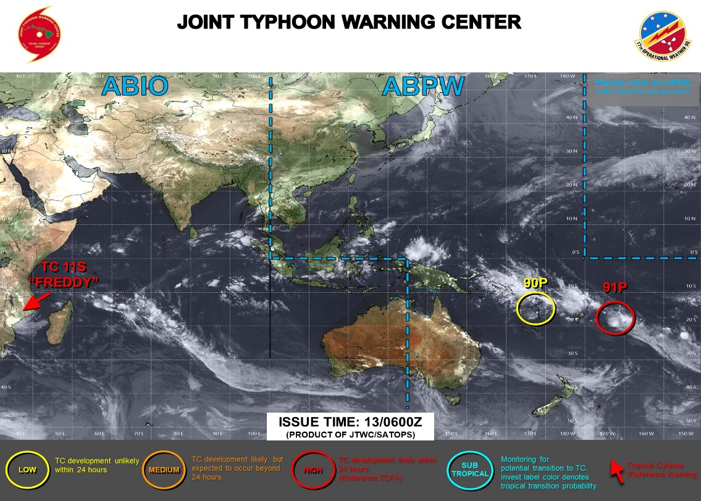
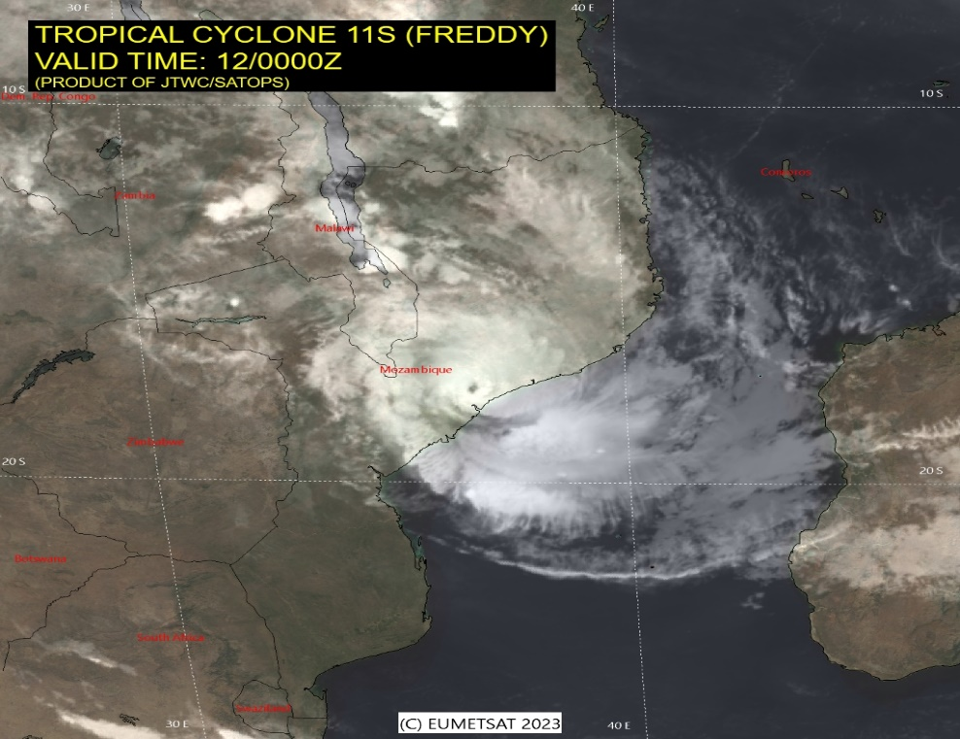
Tropical Cyclone Freddy
TC FREDDY MADE LANDFALL ON MARCH 11, 18Z
TC 11S IS FORECAST TO WEAKEN RAPIDLY THROUGH THE FORECAST PERIOD AND SHOULD DISSIPATE BY TAU 48.

Slide 24
MJO Contribution?
Do the MJO predictions suggest enhanced/suppressed rainfall?
Eastward propagation across Africa, phase-8 to phase-2
Wetter than normal rainfall during MJO phases of 8 to 2 in central Africa, and phases 1 to 4 in equatorial East Africa.

Slide 25
IOD Contribution?
Is there any IOD contributions?
Neutral during the forecast period
No contribution.

Slide 26
ENSO Contribution?
Is there any ENSO contributions?
With end of the La Nina condition, there will be little or no contribution.

Slide 27
TC Contribution?
Is there any TC contributions?
Remnants of TC Freddy may enhance rainfall over parts of Southeast Africa

Slide 28
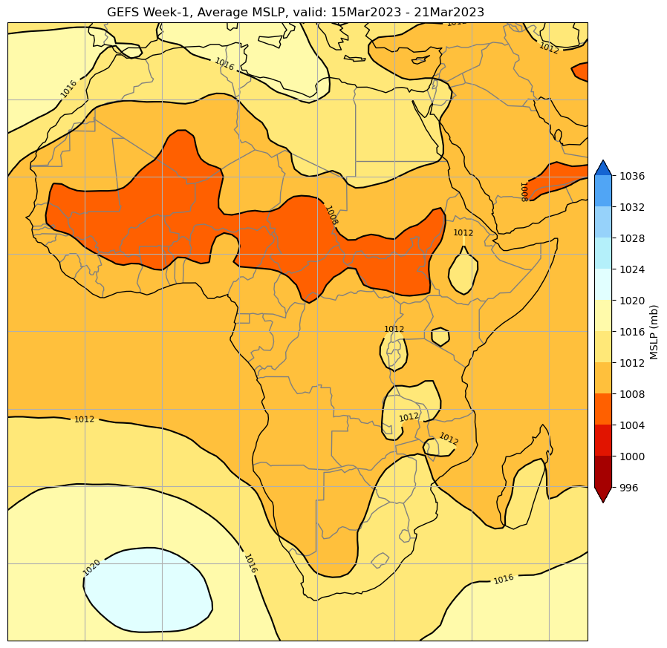
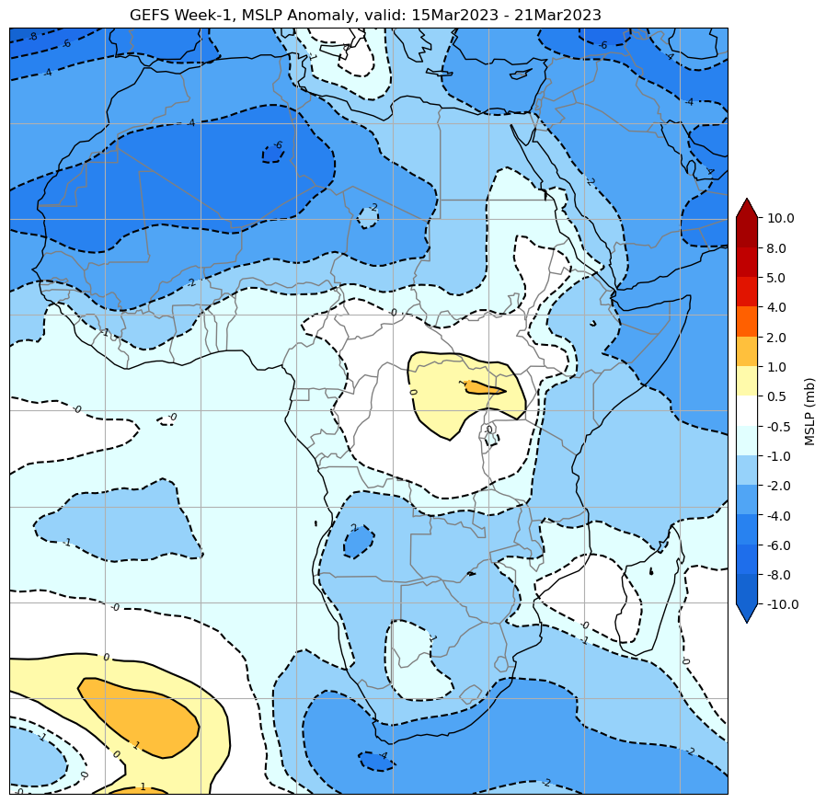
Week-1, 7-day Circulation Total & Anomaly Forecasts
Mean Sea Level Pressure Total
Mean Sea Level Pressure Anomaly

Slide 29
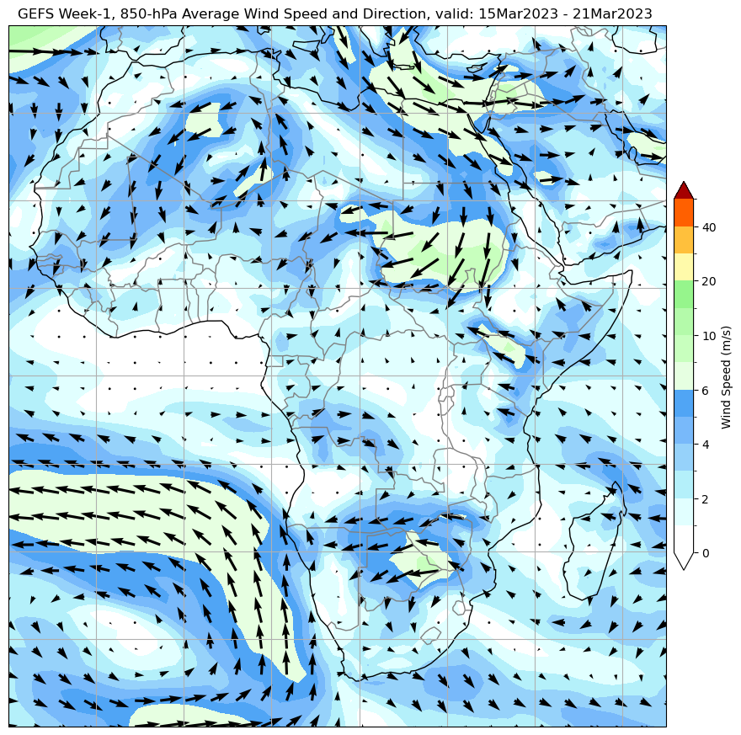
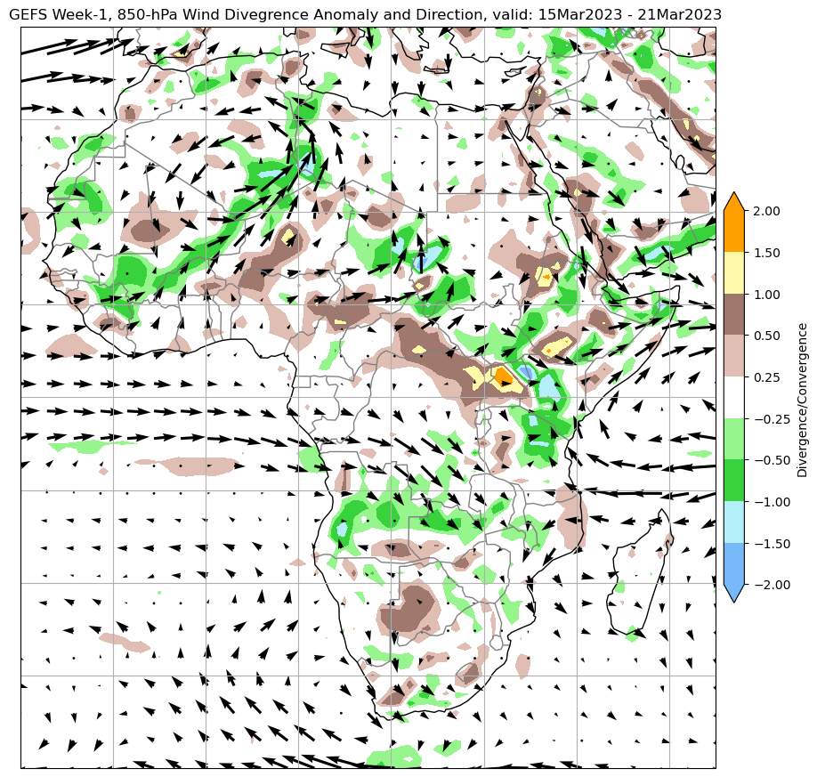
Week-1, 7-day Circulation Total & Anomaly Forecasts
850mb Wind/Divergence Total
850mb Wind/Divergence Anomaly

Slide 30
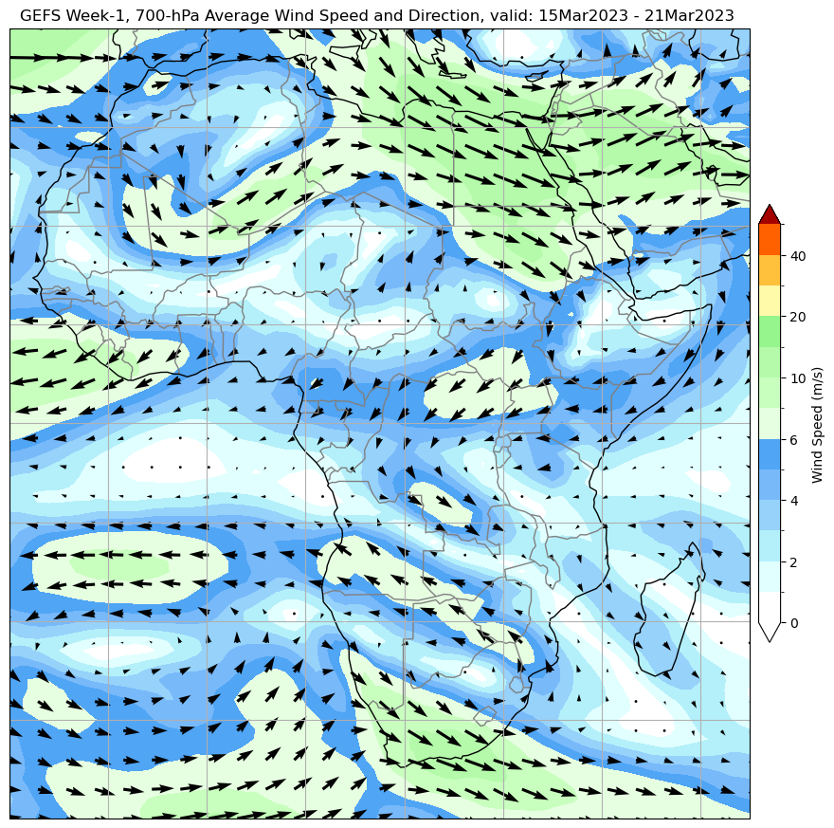
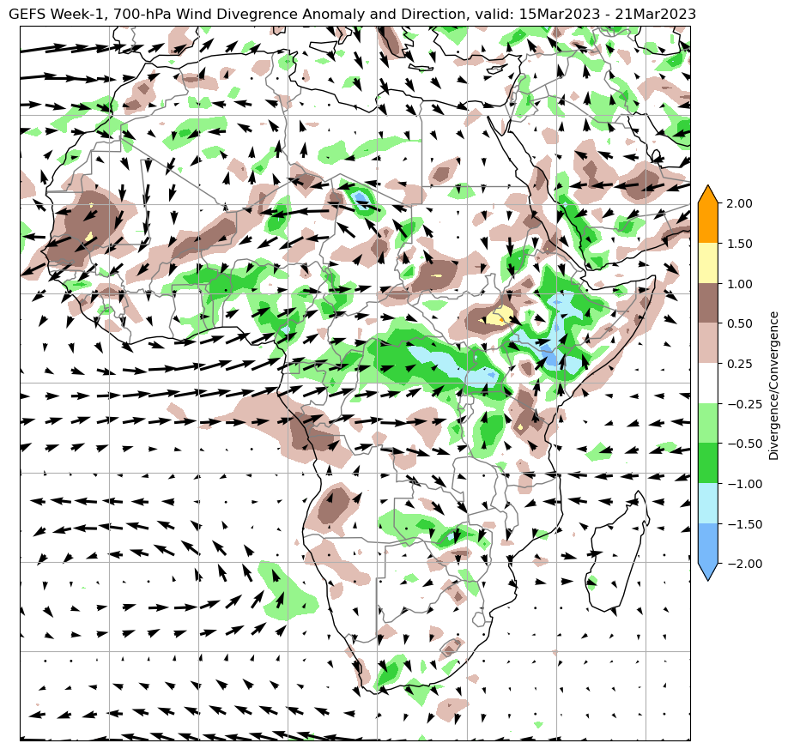
Week-1, 7-day Circulation Total & Anomaly Forecasts
700mb Wind/Divergence Total
700mb Wind/Divergence Anomaly

Slide 31
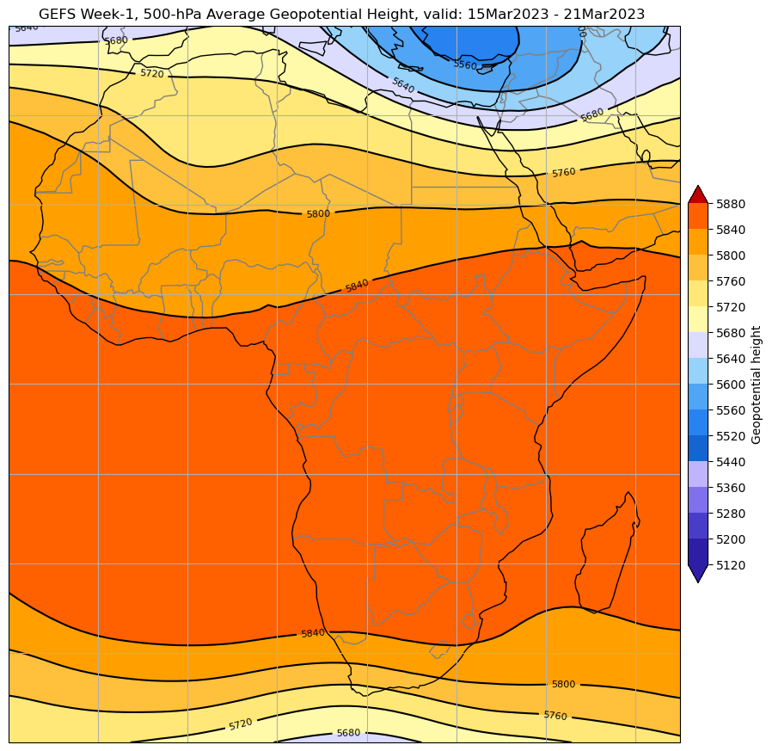
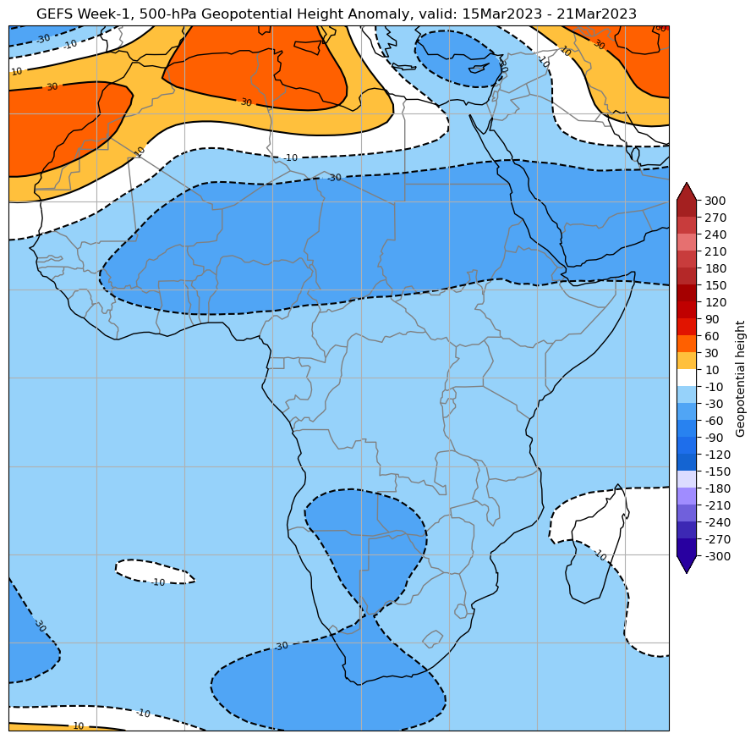
Week-1, 7-day Circulation Total & Anomaly Forecasts
500mb Height Total
500mb Height Anomaly

Slide 32
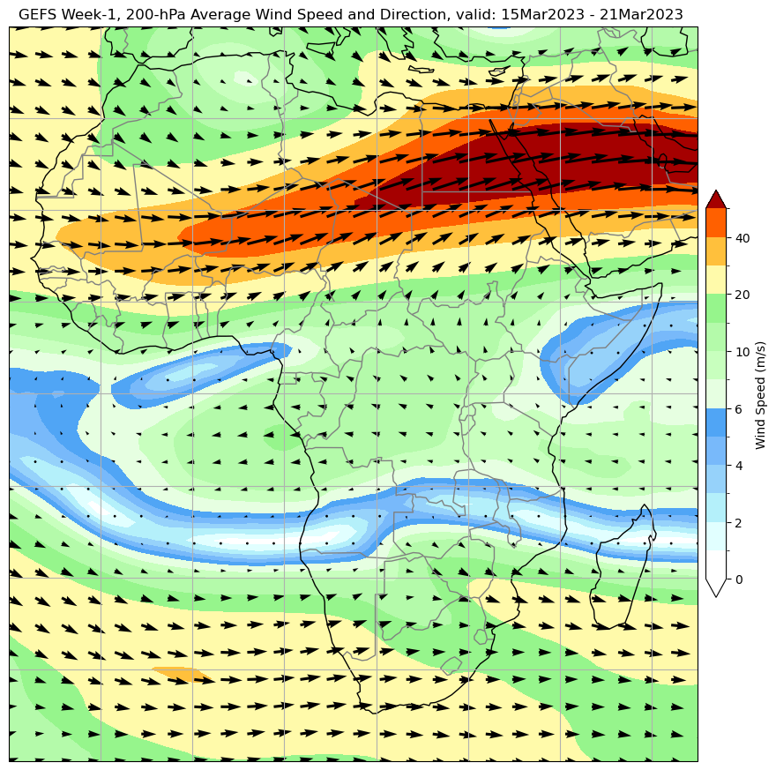
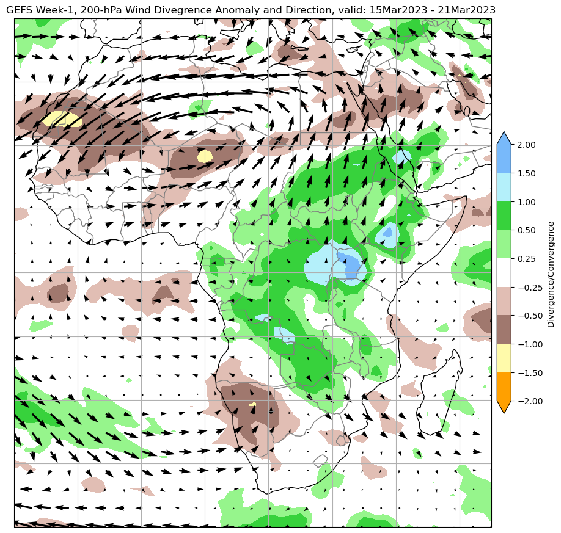
Week-1, 7-day Circulation Total & Anomaly Forecasts
200mb Wind/Divergence Total
200mb Wind/Divergence Anomaly

Slide 33
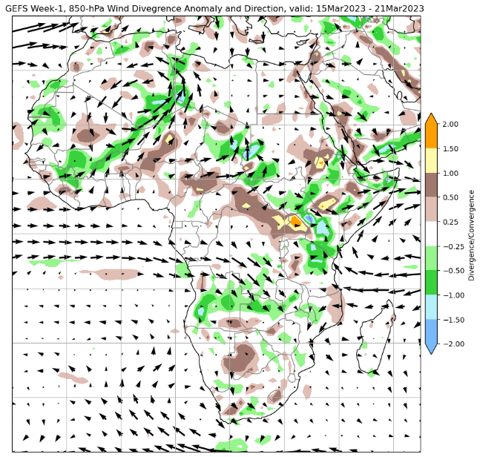
Week-1, 7-day Circulation Anomaly Forecasts
MSLP
850-hPa wind/divergence
700-hPa wind/divergence
200-hPa wind/divergence

Slide 34
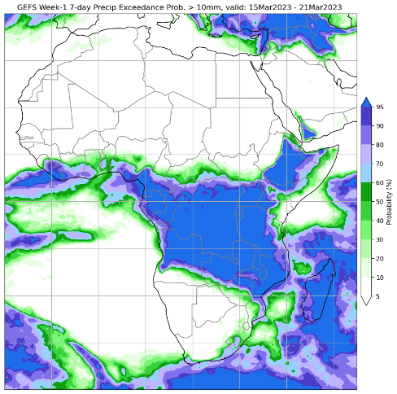
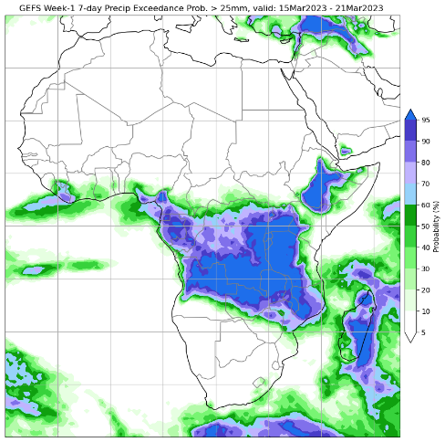
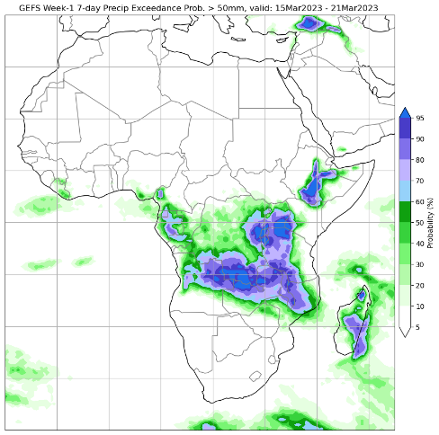
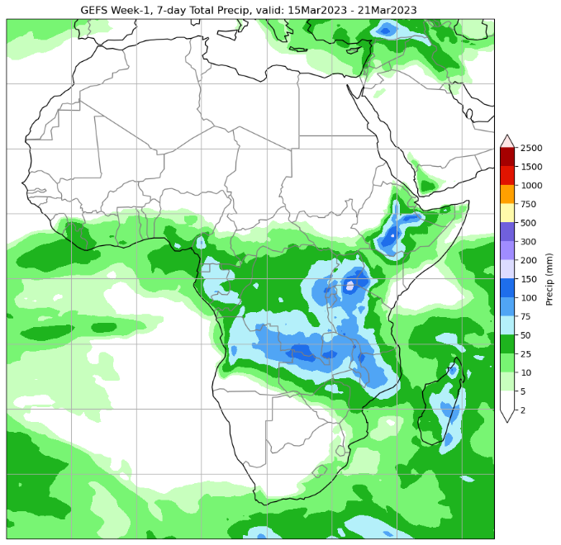
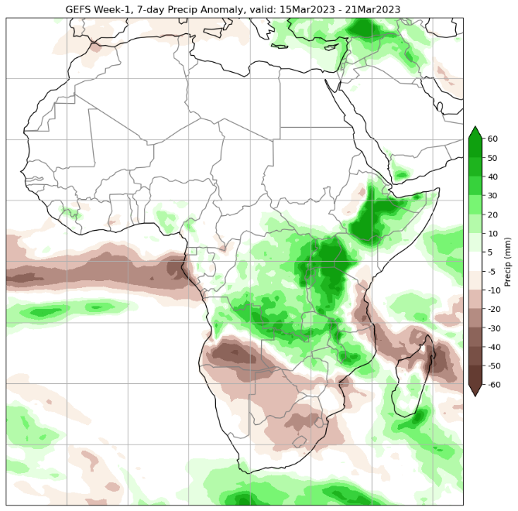
Week-1, 7-day Precip Forecasts (raw)
>10mm
>25mm
>50mm
Exceedance probability, with respect to fixed thresholds
Week-1 Total
Week-1 Anomaly
Wetter-than average over much of Central and equatorial East Africa.
Drier than average across Southern Africa and coast East Africa.

Slide 35
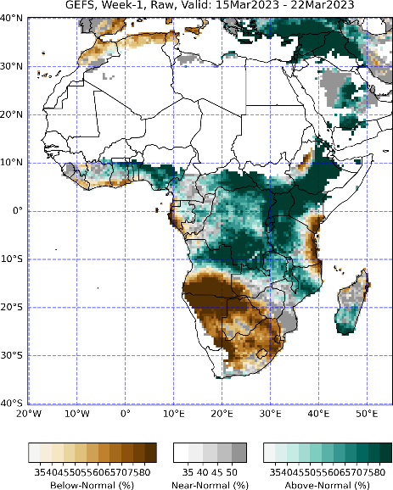
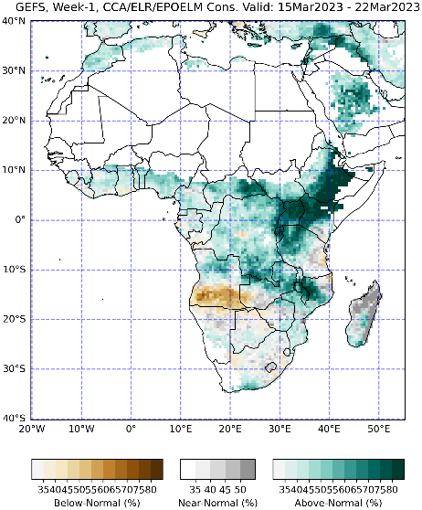
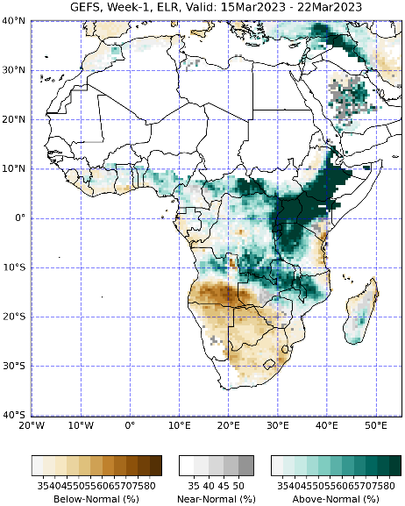
Week-1, 7-day Precip Forecasts (Calibrated)
GEFS Raw Fcst
CCA Calibrated Fcst
ELR Calibrated Fcst
EPOELM Calibrated Fcst
CCA/ELR/EPOELM Cons. Fcst
CCA GROC Skill
ELR GROC Skill
EPOELM GROC Skill
GROCS plots: Darker Red good skill, darker blue bad skill

Slide 36
Week-1, 7-day Precip Forecasts (Calibrated)
GEFS Raw Fcst
CCA Calibrated Fcst
ELR Calibrated Fcst
EPOELM Calibrated Fcst
CCA/ELR/EPOELM Cons. Fcst
CCA GROC Skill
ELR GROC Skill
EPOELM GROC Skill
The closer the ROC curve is to the upper left corner of the graph, the higher the accuracy of the forecast.

Slide 37
Week-1, 7-day Extreme Precip Forecasts (Calibrated)
Dry, <10th
Dry, <20th
Wet, >80th
Wet, >90th
CCA Calib, Fcst
ELR Calib. Fcst
EPOELM Calib. Fcst

Slide 38
Summary, Convergence of Evidence, Precip
Wet
Lower/mid/upper-level Circulation -> suggest above-average rainfall over parts of central and Eastern Africa
Rainfall Model Guidance -> Suggest above-average precip over Central and Eastern Africa, and parts of Southeast Africa.
MJO predictions are also in favor of enhancing rainfall over parts of Central and Eastern Africa
Remnants of TC Freddy may enhance rainfall over parts of Southeast Africa
Dry
Lower/mid/upper-level Circulation -> suggest below-average rainfall over parts of Southern Africa
Rainfall Model Guidance -> Suggest below-average in the Eastern portion of Gulf of Guinea, Southern Africa, and along the East Africa coast.

Slide 39
Consensus Week-1 Precip Outlook, Valid: 15 – 21 March 2023
Below-Average due to:
Lower and upper lever circulation anomalies.
Above-average due to:
MJO, Lower and upper level circulation anomalies, and remnants of TC Freddy (parts of Southeast Africa).
.

Slide 40
Demonstration: Week-1 Outlook for Africa
Week-1 Forecast, valid 13 – 19 March 2024
Tools
MJO
IOD
ENSO
NWP Guidance

Slide 41
200 hPa Velocity Potential Anomaly
Previous
Recent
A slight eastward propagation is observed
Green shade indicates areas of upper-level divergence and convection or precipitation at surface.
Brown contours indicate areas of upper-level convergence or subsidence and suppressed precipitation at surface.
Notes:
200 hPa Velocity Potential Anomalies Animation: https://www.cpc.ncep.noaa.gov/products/precip/CWlink/ir_anim_monthly.shtml

Slide 42
Wheeler-Hendon Index - Forecasts
GEFSv12
CFSv2-ext
ECMWF-ext
Forecast
Observation
BOM-ext
CANM
JMA
The enhanced phase of the MJO is expected to propagate eastwards from the Maritime continent ((phase-4) to the Western Pacific (phase-6) during week-1 and week-2.

Slide 43
Evolution of MJO-related Anomalies
Red shade indicate areas
of suppressed convection
Blue shade indicate areas
of enhanced convection
Initial date: 10 Mar 2024
Initial Date
1 - 5 days ave. Forecast
6-10 days ave. Forecast
11-15 days ave. Forecast
The filtered OLR Anomaly forecasts also indicate eastward propagation during the forecast period

Slide 44
MJO, Rainfall Composites
MJO Rainfall Composites, Africa, FMA
Wetter than normal rainfall during MJO phases of 4 equatorial East Africa changes to drier than average precipitation as the MJO signal propagates into phases 5 and 6.
Drier than normal rainfall during 4 6 in Southern Africa, and phases 5 to 8 in equatorial East Africa.

Slide 45
State of the IOD
IOD observation
NMME IOD Forecast
NMME forecasts indicate the positive IOD to remain in the neutral range during the Northern Hemisphere spring 2024, with a slightly increased chance for negative IOD in late summer and fall 2024.
The IOD index has weakened recently.

Slide 46
State of the ENSO
CPC ENSO Alert System Status: El Niño Advisory / La Niña Watch
A transition from El Niño to ENSO-neutral is likely by April-June 2024 (83% chance), with the odds of La Niña developing in June-August 2024 (62% chance).
El Nino is likely to suppress rainfall in parts of southern Africa.

Slide 47
Tropical Cyclone Filipo
Active tC Filipo, affecting Mozambique Channel and the neighboring areas.

Slide 48
MJO Contribution?
Do the MJO predictions suggest enhanced/suppressed rainfall?
Your notes

Slide 49
IOD Contribution?
Is there any IOD contributions?
Your notes

Slide 50
ENSO Contribution?
Is there any ENSO contributions?
Your notes

Slide 51
TC Contribution?
Is there any TC contributions?
Your notes

Slide 52
Week-1, 7-day Circulation Total & Anomaly Forecasts
Mean Sea Level Pressure Total
Mean Sea Level Pressure Anomaly

Slide 53
Week-1, 7-day Circulation Total & Anomaly Forecasts
850mb Wind/Divergence Total
850mb Wind/Divergence Anomaly

Slide 54
Week-1, 7-day Circulation Total & Anomaly Forecasts
700mb Wind/Divergence Total
700mb Wind/Divergence Anomaly

Slide 55
Week-1, 7-day Circulation Total & Anomaly Forecasts
500mb Height Total
500mb Height Anomaly

Slide 56
Week-1, 7-day Circulation Total & Anomaly Forecasts
200mb Wind/Divergence Total
200mb Wind/Divergence Anomaly

Slide 57
Week-1, 7-day Circulation Anomaly Forecasts
MSLP
850-hPa wind/divergence
700-hPa wind/divergence
200-hPa wind/divergence

Slide 58
Week-1, 7-day Precip Forecasts (raw)
>10mm
>25mm
>50mm
Exceedance probability, with respect to fixed thresholds
Week-1 Total
Week-1 Anomaly
Wetter-than over many places, except over the southern portion of the Solomon Islands.

Slide 59
Week-1, 7-day Precip Forecasts (Calibrated)
GEFS Raw Fcst
CCA Calibrated Fcst
ELR Calibrated Fcst
EPOELM Calibrated Fcst
CCA/ELR/EPOELM Cons. Fcst
CCA GROC Skill
ELR GROC Skill
EPOELM GROC Skill
GROCS plots: Darker Red good skill, darker blue bad skill

Slide 60
Week-1, 7-day Precip Forecasts (Calibrated)
GEFS Raw Fcst
CCA Calibrated Fcst
ELR Calibrated Fcst
EPOELM Calibrated Fcst
CCA/ELR/EPOELM Cons. Fcst
CCA GROC Skill
ELR GROC Skill
EPOELM GROC Skill
The closer the ROC curve is to the upper left corner of the graph, the higher the accuracy of the forecast.

Slide 61
Week-1, 7-day Extreme Precip Forecasts (Calibrated)
Dry, <10th
Dry, <20th
Wet, >80th
Wet, >90th
CCA Calib, Fcst
ELR Calib. Fcst
EPOELM Calib. Fcst

Slide 62
Summary, Convergence of Evidence, Precip
Wet
Your notes
Dry
Your notes

Slide 63
Consensus Week-1 Precip Outlook, Valid: 13 – 19 March 2024
Above-average due to:
Your notes
Below-Average due to:
Your notes
Your QGIS generated forecast map

