Slide 1
Heat Hazards Outlooks for the Caribbean
Practice for Trinidad and Tobago Hazardous Heat Forecast Training Workshop
Date of Issue: 2024-09-24 Week-1, Valid for: 25 Sep - 01 Oct 2024 Week-2, Valid for: 02 - 08 October 2024

Slide 2
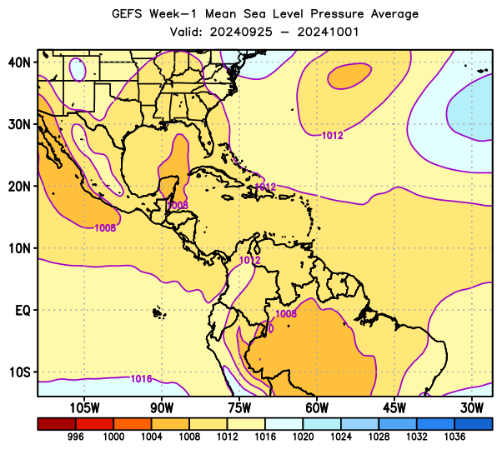
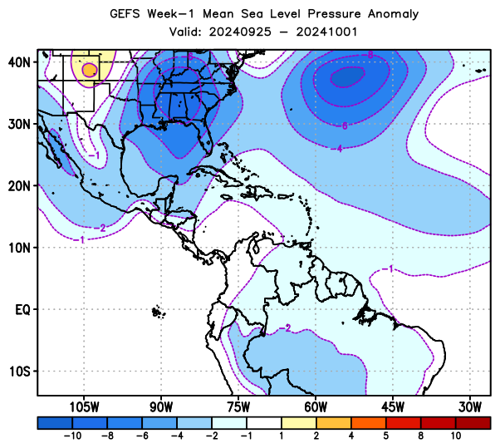
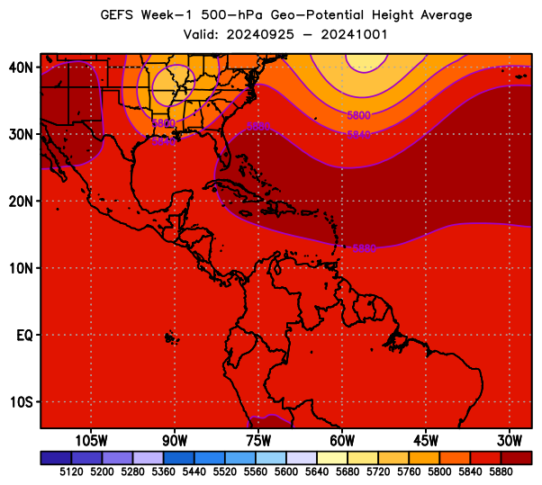
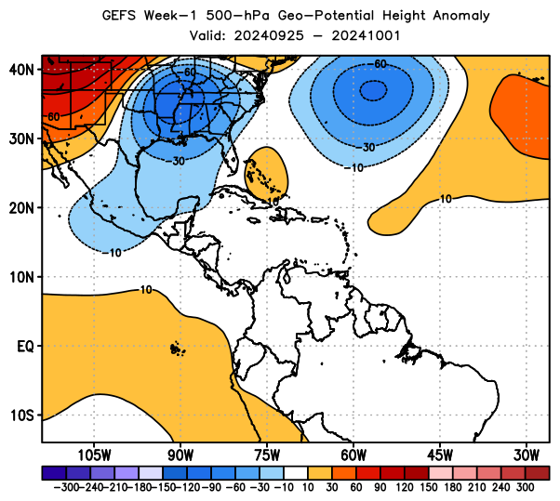
Week-1, Mean Sea Level Pressure & 500-hPa Height
7-day Total
7-day Anomaly
Text Here
MSLP
Text Here
Geop. Height (500-hPa)

Slide 3
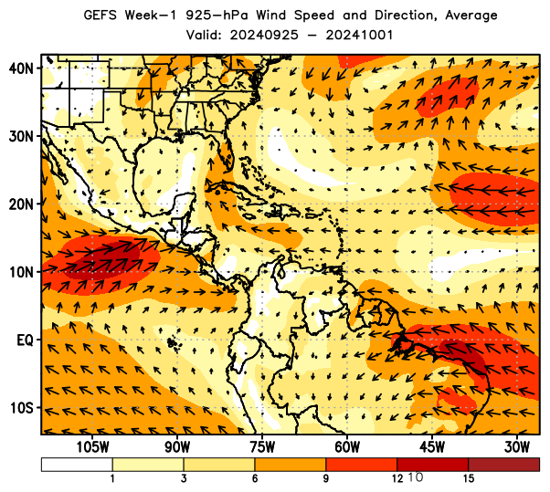
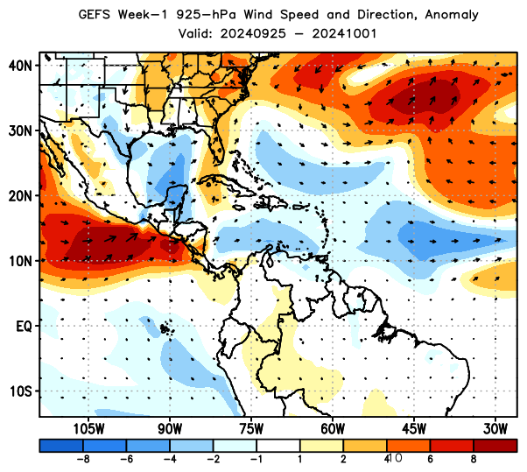
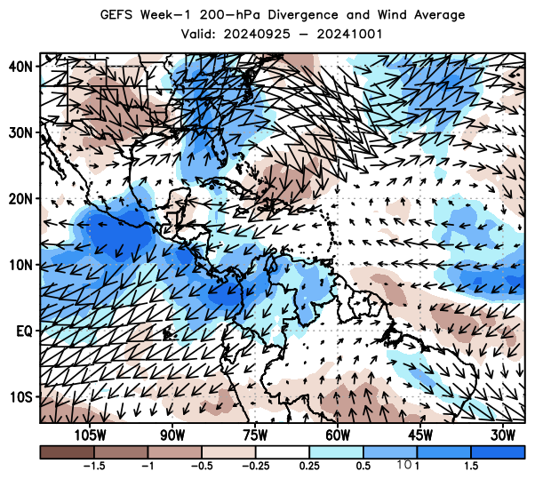
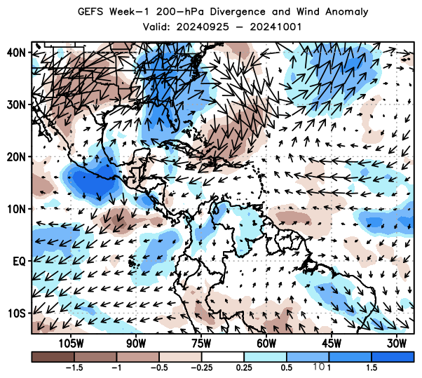
Week-1, 925-hPa and 200-hPa Wind
7-day Total
7-day Anomaly
Text Here
Wind (925-hPa)
Text Here
Wind & Diverg. (200-hPa)

Slide 4
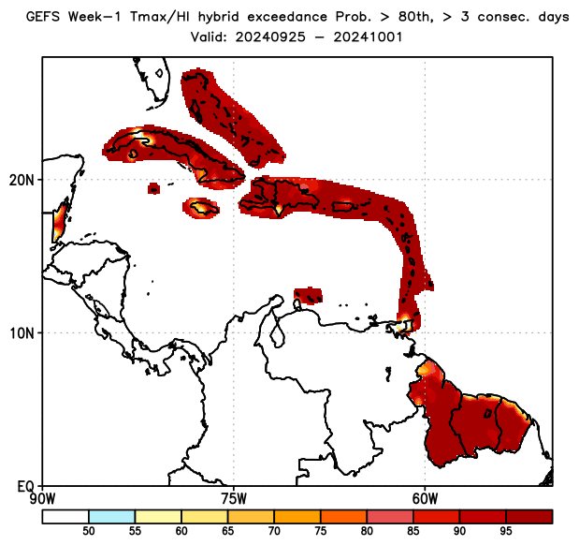
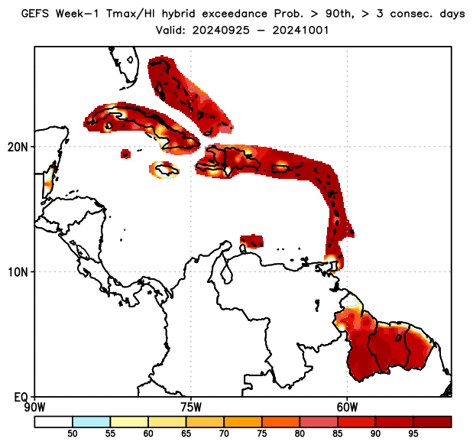
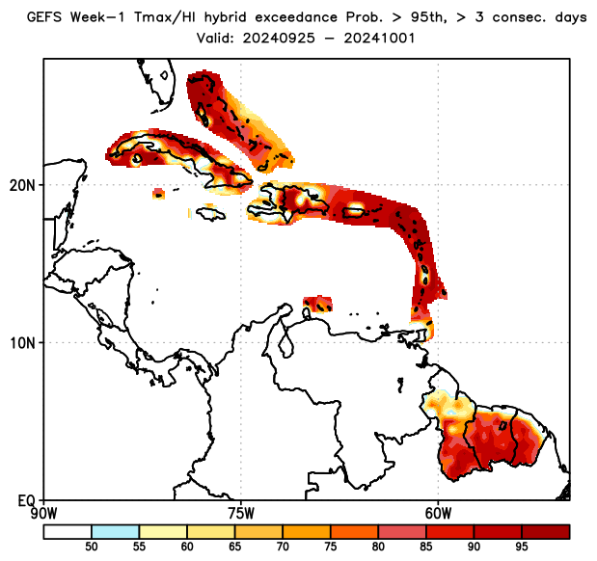
Week-1, Daily Tmax/HI Hybrid Index Exceedance Probability, with Respect to Percentile Thresholds
hybrid > 80th percentile, ≥3 consecutive days
hybrid > 90th percentile, ≥3 consecutive days
hybrid ≥ 95th percentile, ≥3 consecutive days
Text Here

Slide 5
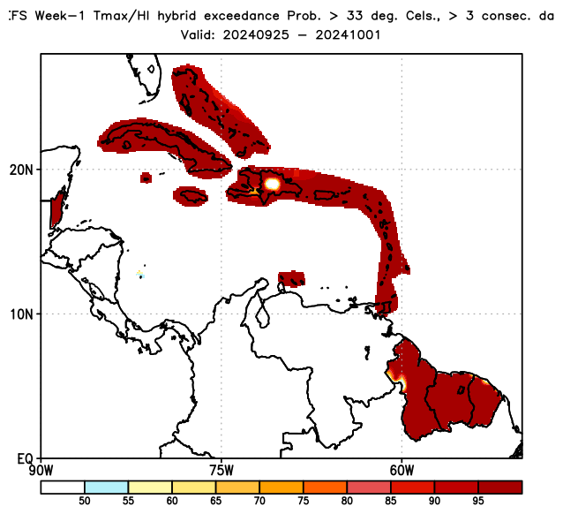
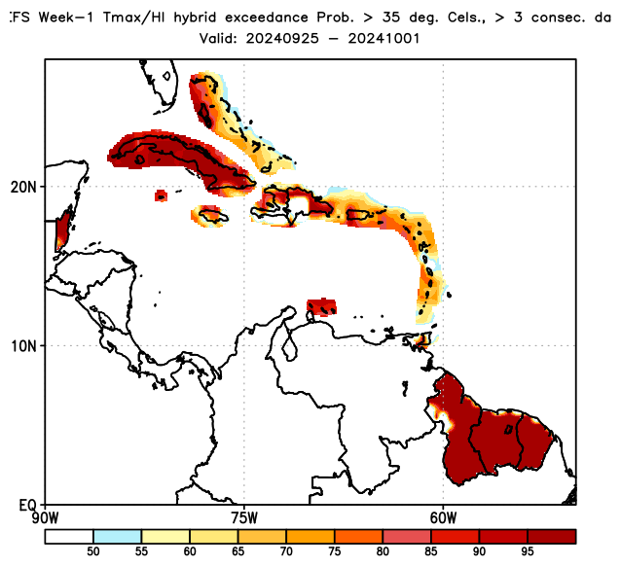
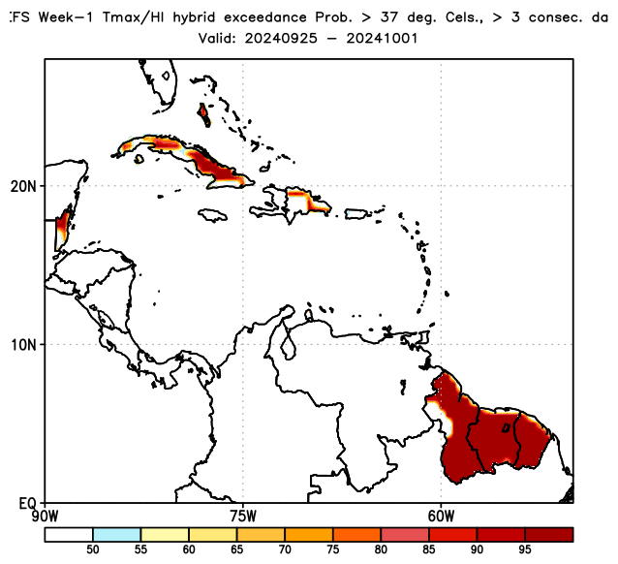
Week-1, Daily Tmax/HI Hybrid Index Exceedance Probability, with Respect to Fixed Thresholds
hybrid > 33°C, ≥3 consecutive days
hybrid > 35°C, ≥3 consecutive days
hybrid > 37°C, ≥3 consecutive days
Text Here

Slide 6
Week-1, Convergence of Evidences
hybrid:80th
hybrid:33°C
hybrid:90th
hybrid:35°C
Where do you see high percentile and hybrid tool thresholds overlapping?
Text Here:
hybrid:95th
hybrid:37°C

Slide 7
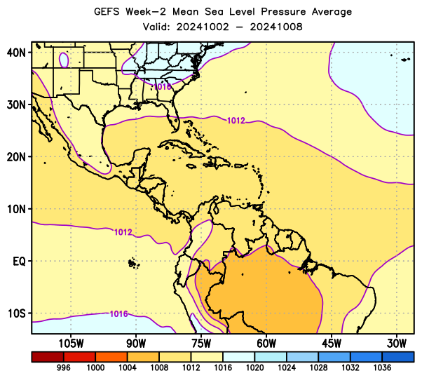
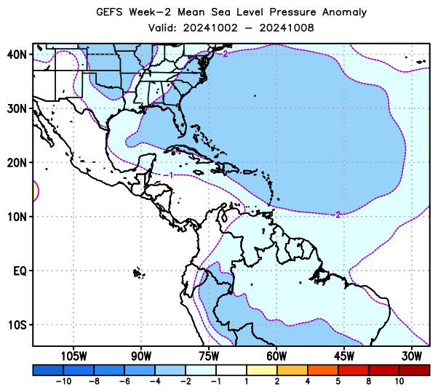
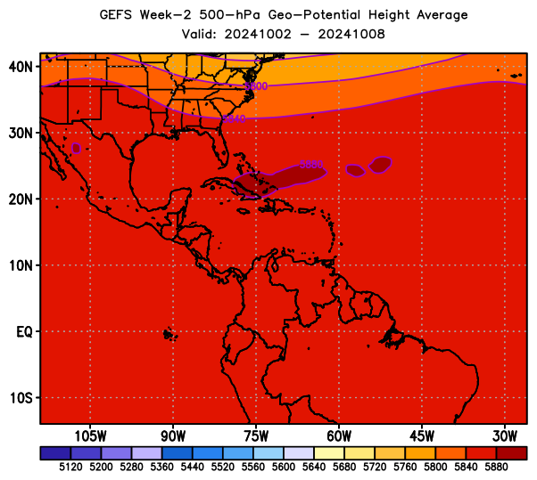
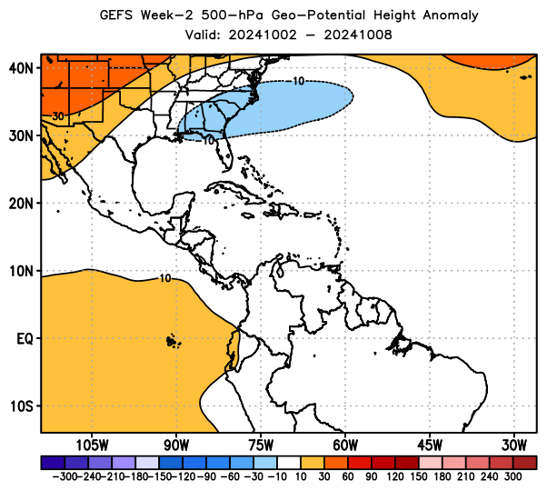
Week-2, Mean Sea Level Pressure & 500-hPa Height
7-day Total
7-day Anomaly
Text Here
MSLP
Text Here
Geop. Height (500-hPa)

Slide 8
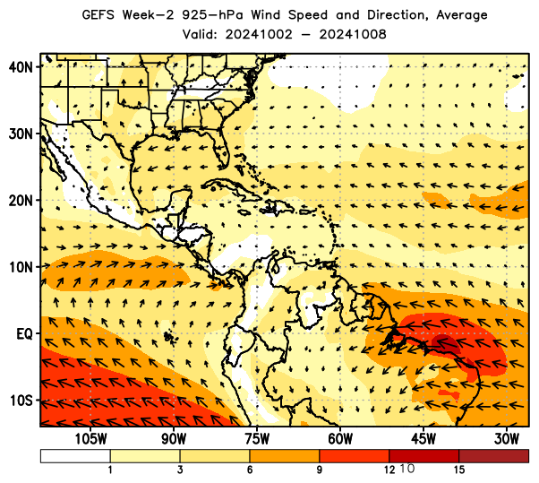
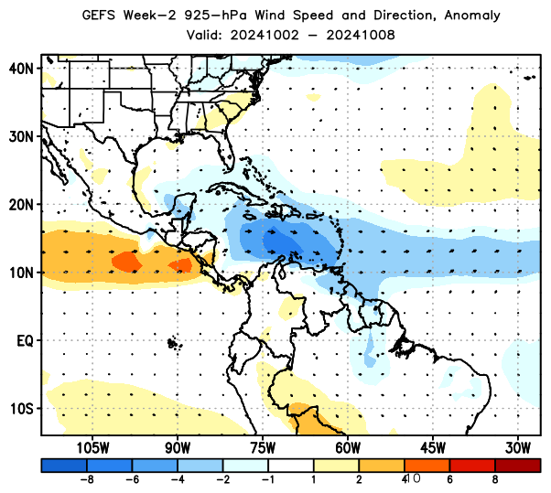
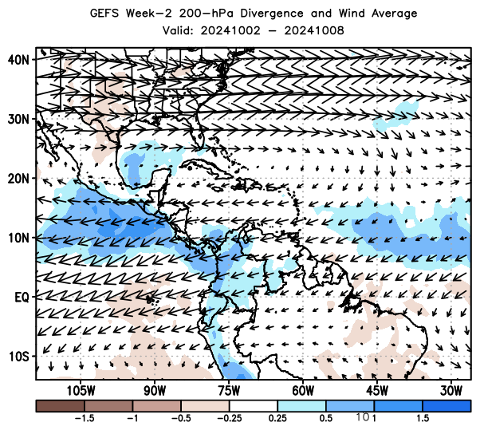
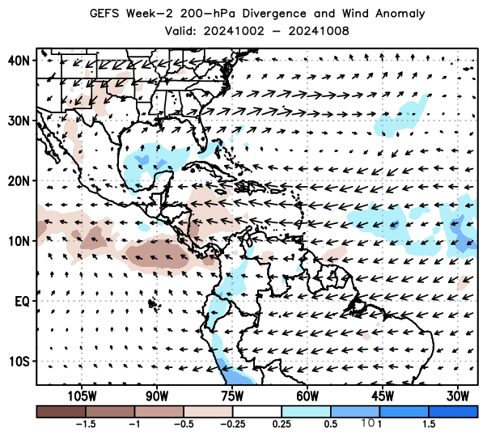
Week-2, 925-hPa and 200-hPa Wind
7-day Total
7-day Anomaly
Text Here
Wind (925-hPa)
Text Here
Wind & Diverg. (200-hPa)

Slide 9
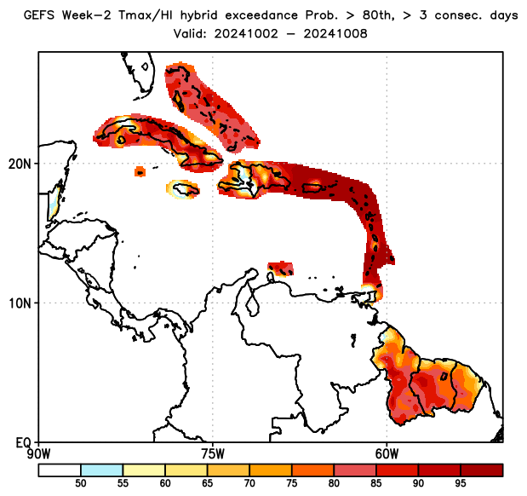
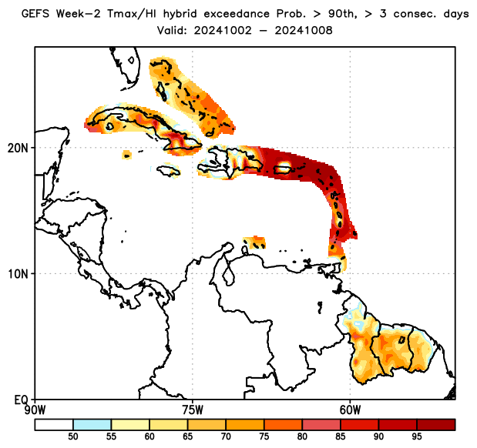
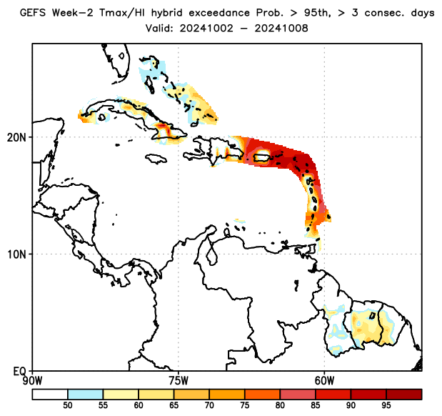
Week-2, Daily Tmax/HI Hybrid Index Exceedance Probability, with Respect to Percentile Thresholds
hybrid > 80th percentile, ≥3 consecutive days
hybrid > 90th percentile, ≥3 consecutive days
hybrid ≥ 95th percentile, ≥3 consecutive days
Text Here

Slide 10
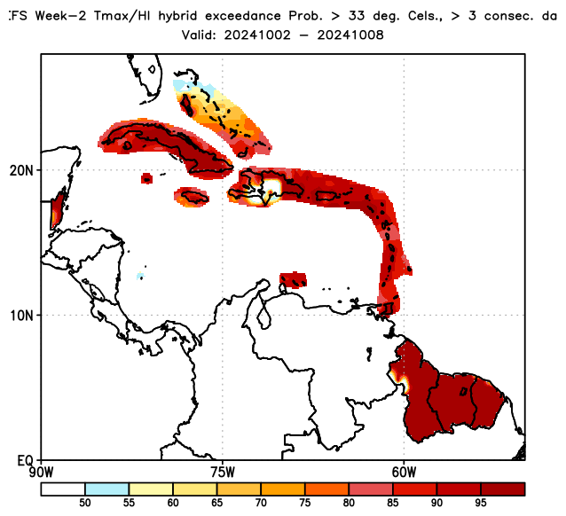
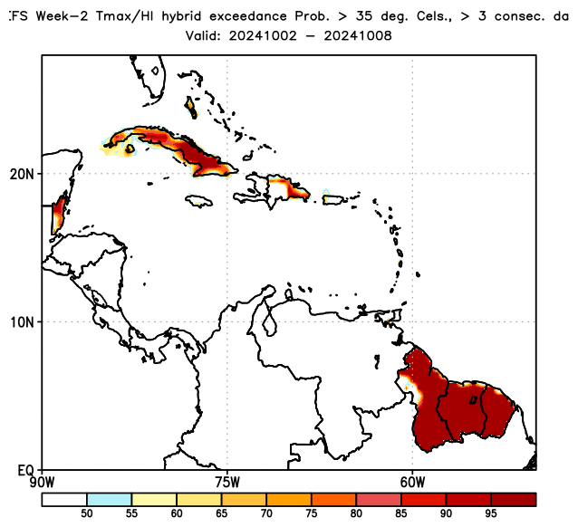
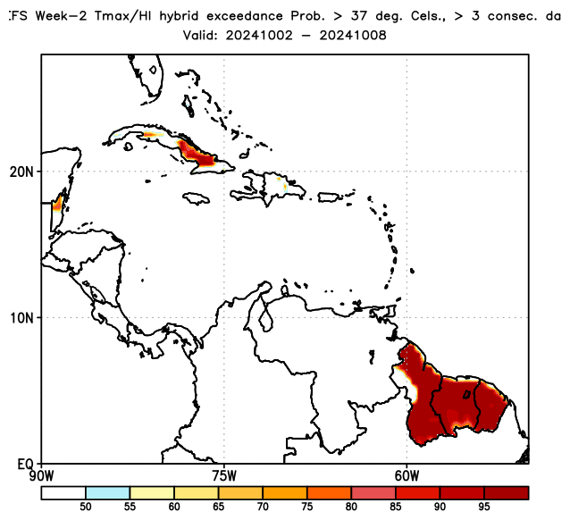
Week-2, Daily Tmax/HI Hybrid Index Exceedance Probability, with Respect to Fixed Thresholds
hybrid > 33°C, ≥3 consecutive days
hybrid > 35°C, ≥3 consecutive days
hybrid > 37°C, ≥3 consecutive days
Text Here

Slide 11
Week-2, Convergence of Evidences
hybrid:80th
hybrid:33°C
hybrid:90th
hybrid:35°C
Where do you see high percentile and hybrid tool thresholds overlapping?
Text Here:
hybrid:95th
hybrid:37°C

Slide 12
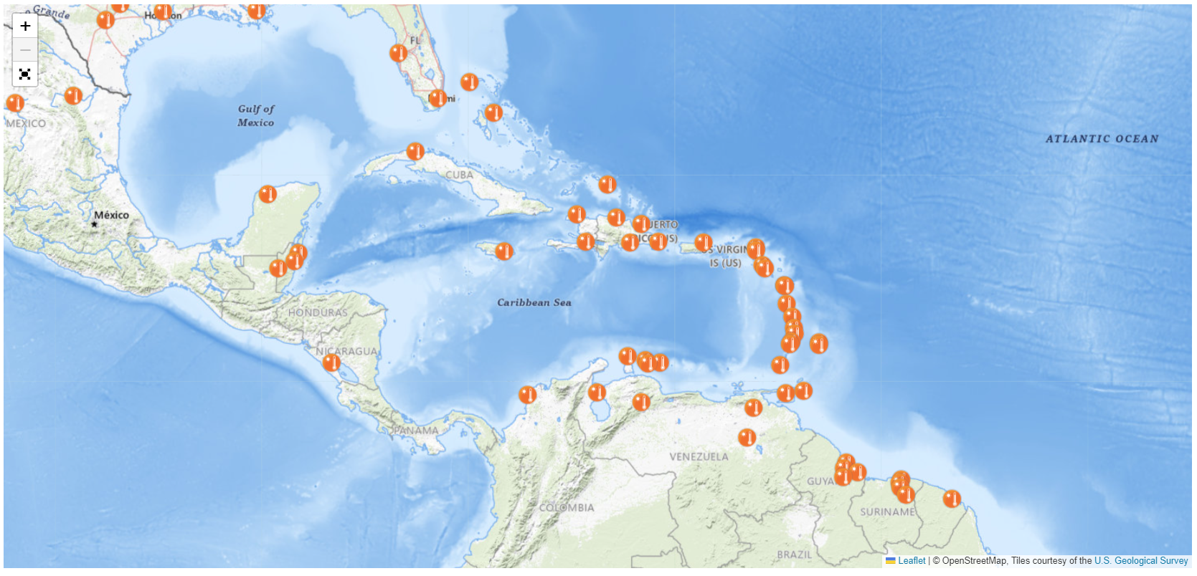
Urban Heat Island Alerts for Caribbean

Slide 13
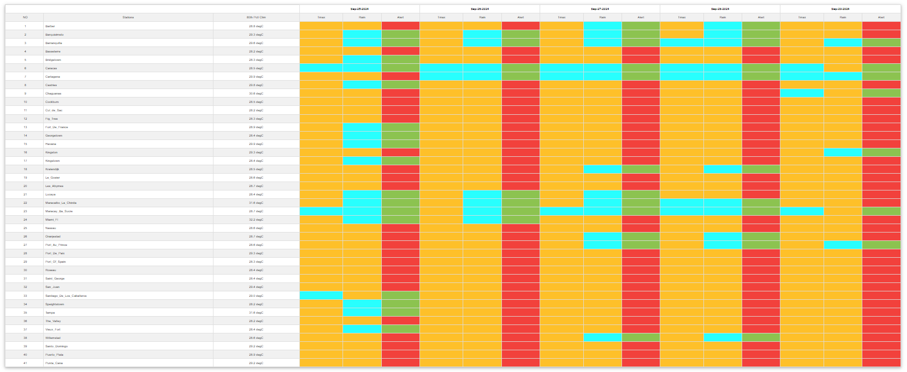
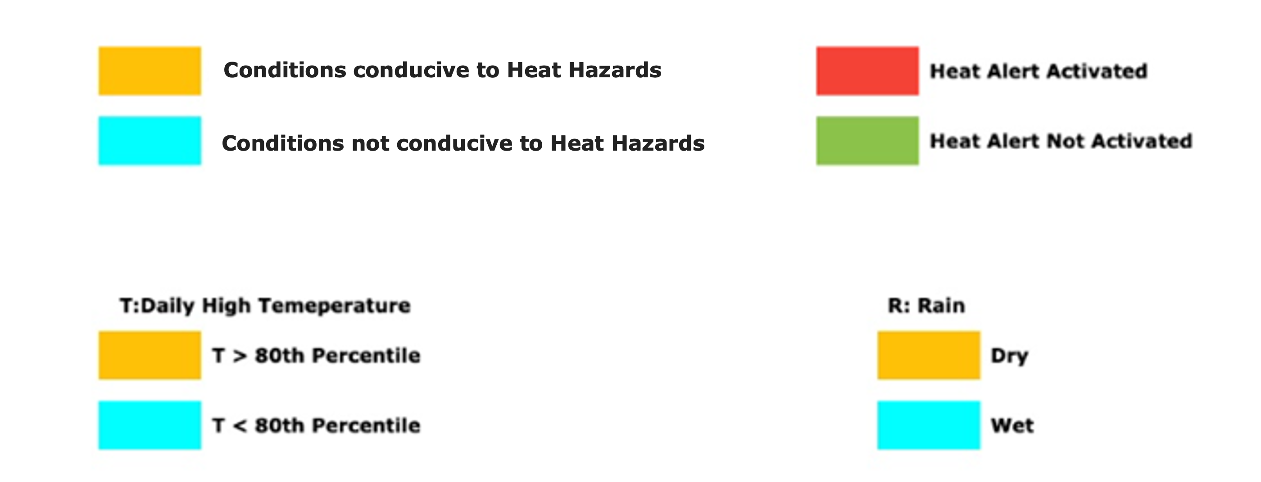
Urban Heat Island Forecasts Week-1

Slide 14
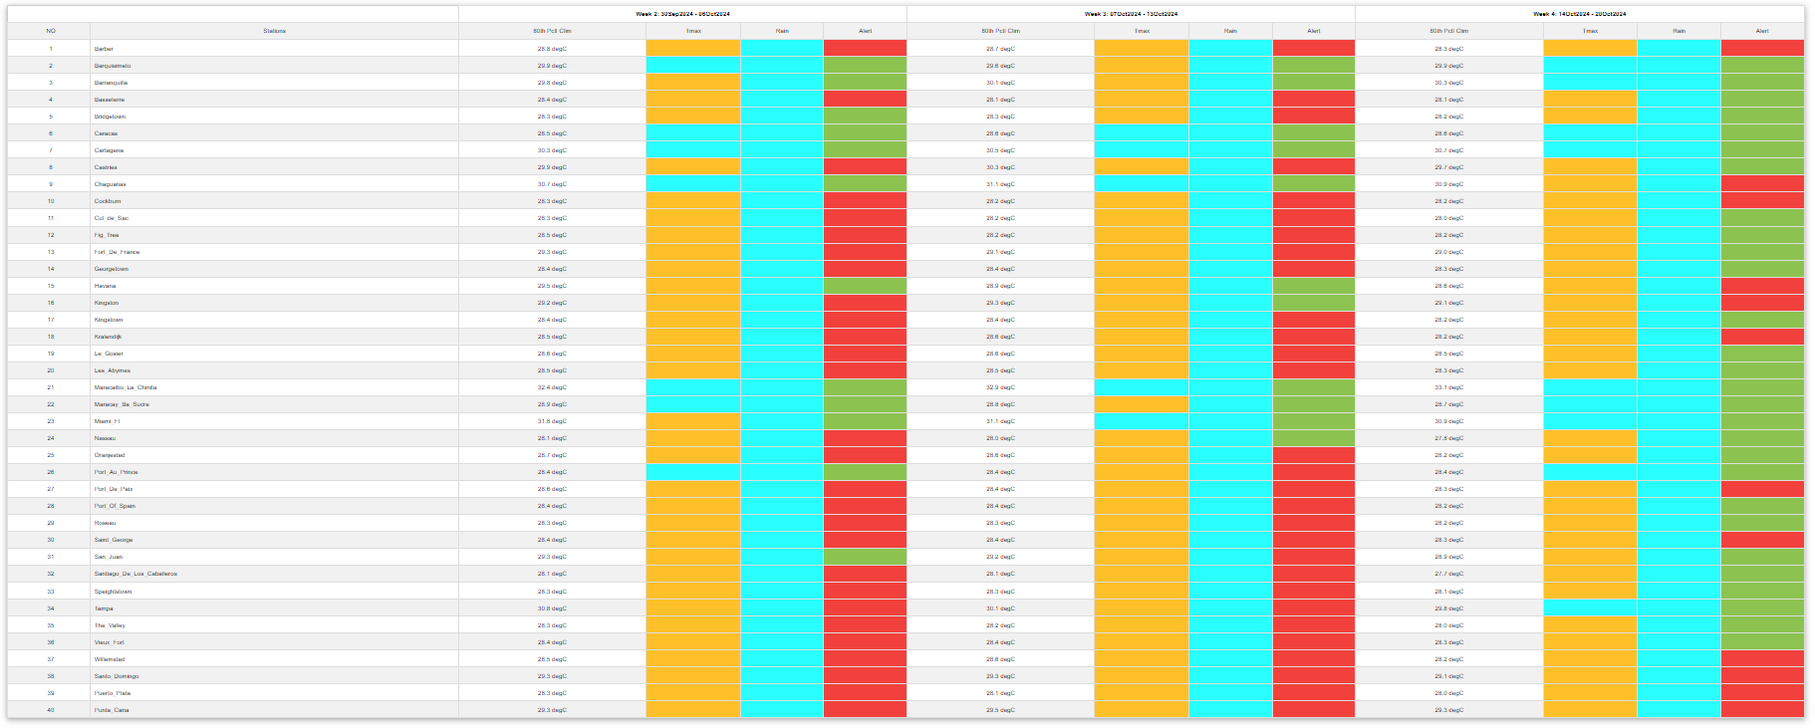
Urban Heat Island Forecasts Weeks-2, 3, & 4

Slide 15
Week-1 Heat Hazards Outlook
Place finished Heat Hazard Outlook for week-1 here

Slide 16
Week-2 Heat Hazards Outlook
Place finished Heat Hazard Outlook for week-2 here

