Slide 1
Breakout Group Instructions
President Emergency Plan for Adaptation and Resilience (PREPARE)
Forecasters’ Training Workshop Hazardous Heat Forecasts
NOAA/CPC/International Desks
Port of Spain, Trinidad and Tobago
4 – 10 December 2024

Slide 2
1. Three Breakout Groups
Group-1: Greater Antilles, including the Bahamas (Bahamas, Dominican and Jamaica:
Target area1: ['west’: -80, 'east’: -68, ‘south’: 17, ‘north’: 28]
Group-2: Lesser Antilles and NE S. America excluding Trinidad and Tobago (Antigua and Barbuda, Barbados, Dominica, CIMH, St. Lucia and Suriname ):
Target area1: ['west’: -66, 'east’: -51, ‘south’: 1, ‘north’: 20]
Group-3: Trinidad and Tobago
Target area: ['west’: -63, 'east’: -60, ‘south’: 9, ‘north’: 12]

Slide 3
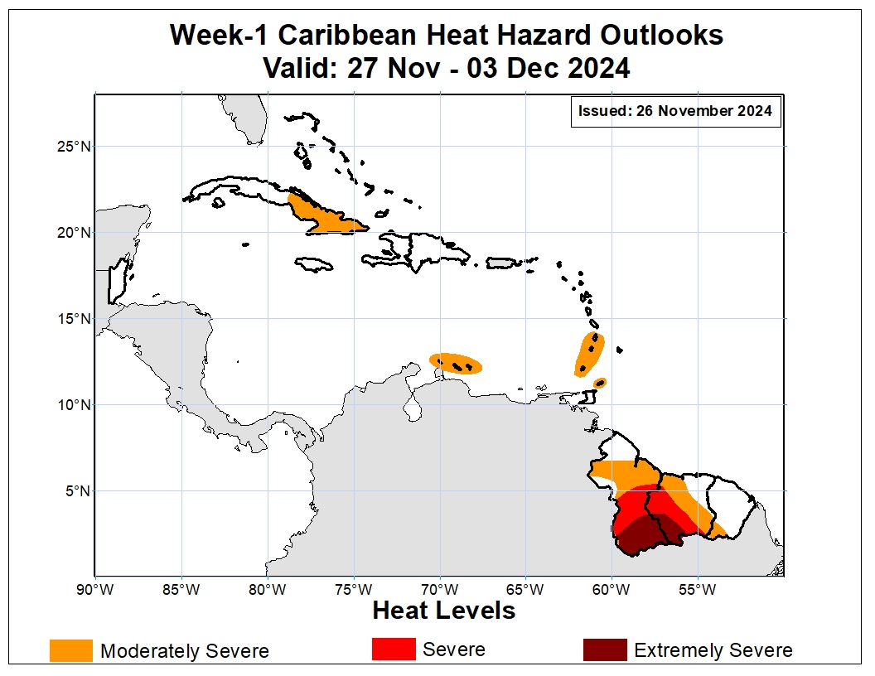
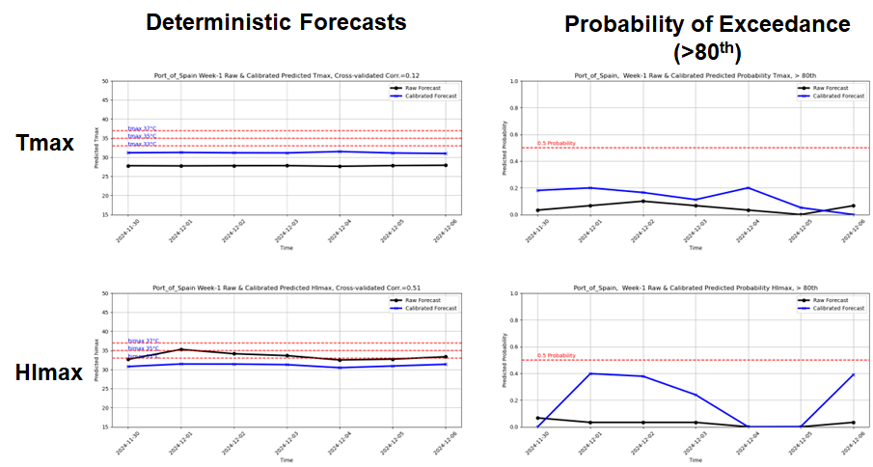
2. Topics of discussions & expected outcome
Realtime heat hazard Outlooks
Week-1 QGIS generated outlook maps along with summary of your justifications.
Raw and calibrated forecasts for selected cities.
Raw and calibrated city forecasts

Slide 4
3. Forecasting tools instructions
Launch your Ubuntu terminal.
Change directory to the heat_notebooks folder:
cd heat_notebooks
Change directory to the heat_spatial_notebooks
cd heat_spatial_notebooks
Activate the XCast Conda Environment
conda activate xcast_env
Launch Jupyter Notebook
jupyter notebook

Slide 5
4. Generate forecasting tools
Large-scale atmospheric anomalies
DoubleClick
gen_gefs_week1_circulation_plots.ipynb
Set your domain extent (please refer to slide 2 for the domain extent of your domain)
Under the 'Cell' menu, select 'Run All' to execute the entire code.
Follow similar steps to run the scripts below:
gen_gefs_week1_tmax_himax_hybrid_fixed_threshold.ipynb
gen_gefs_week1_tmax_himax_hybrid_percentile_thresholds.ipynb
gen_gefs_week1_tmin_himin_hybrid_fixed_threshold.ipynb
gen_gefs_week1_tmin_himin_hybrid_percentile_thresholds.ipynb

Slide 6
4. Prepare PPT slide
The graphics output files are available under fig_dir
Use these tools to prepare your PowerPoint Presentation.
Use QGIS to draw polygons for your consensus heat hazard outlooks.
Please see examples in the next slides:

Slide 7
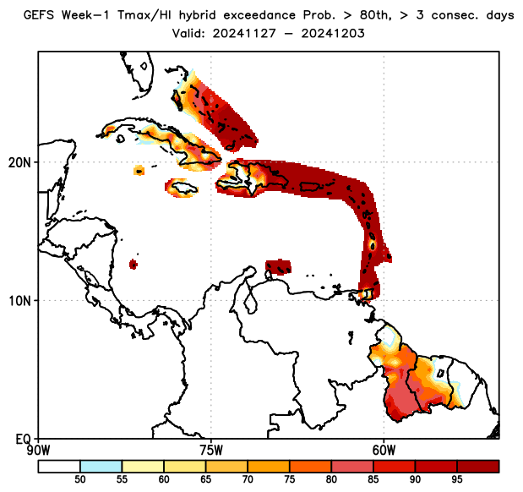
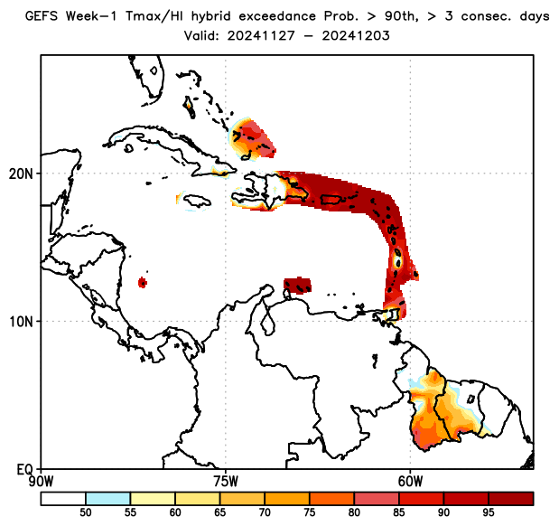
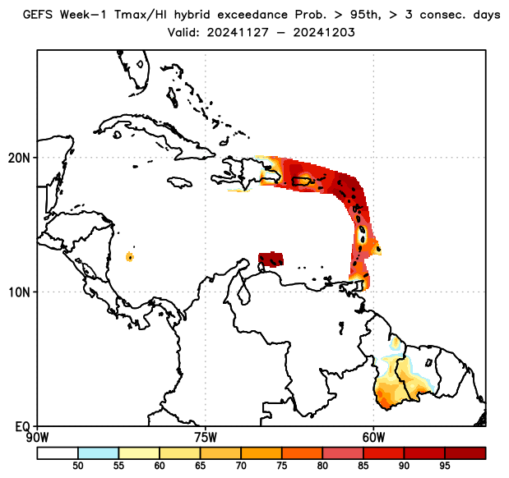
Week-1, Daily Tmax/HI Hybrid Index Exceedance Probability, with Respect to Percentile Thresholds
hybrid > 80th percentile, ≥3 consecutive days
hybrid > 90th percentile, ≥3 consecutive days
hybrid ≥ 95th percentile, ≥3 consecutive days
There is a high chance for daily Tmax/HImax hybrid index to exceed the 80th percentile for at least 3 consecutive days over most of the Bahamas, portions of Cuba, Dominican Republic, Lesser Antilles, Tobago, ABC islands, Guyana, and central-western Suriname. There is also a moderate to high chance for daily Tmax/HImax hybrid index to exceed the 95th percentile for at least 3 consecutive days over most Lesser Antilles islands, Tobago, ABC islands, southern Guyana and southwest Suriname.

Slide 8
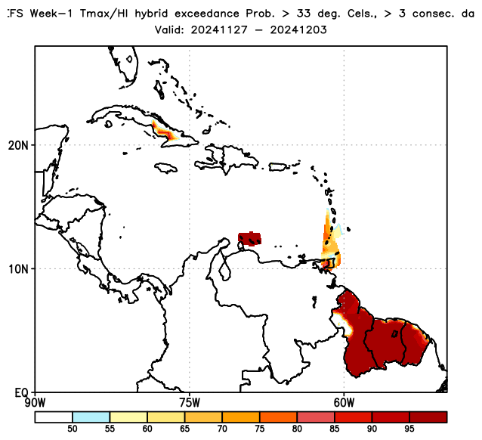
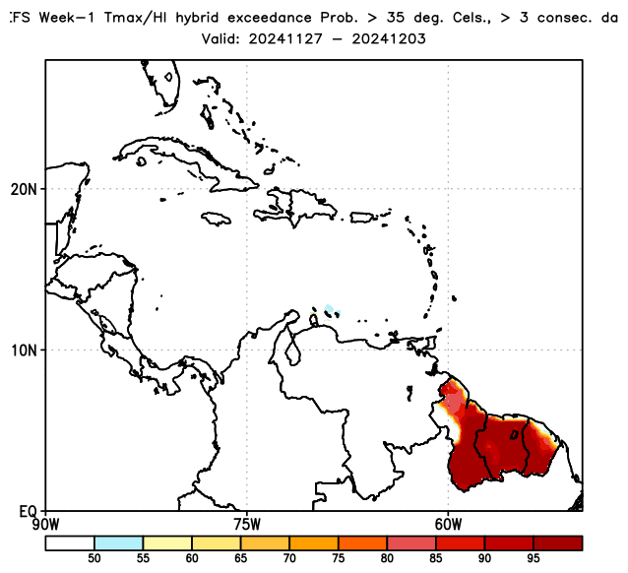
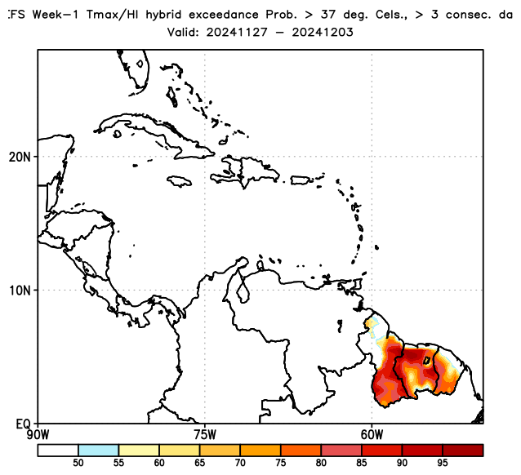
Week-1, Daily Tmax/HI Hybrid Index Exceedance Probability, with Respect to Fixed Thresholds
hybrid > 33°C, ≥3 consecutive days
hybrid > 35°C, ≥3 consecutive days
hybrid > 37°C, ≥3 consecutive days
There is a high probability for daily Tmax/HImax hybrid index to exceed 33°C for at least 3 consecutive days over central-eastern Cuba, Trinidad and Tobago, some southern Lesser Antilles islands, ABC islands, and most of Guyana, Suriname, and French Guiana. There is also a moderate to high chance for daily Tmax/HImax hybrid index to exceed 37°C over central-eastern Guyana, most of Suriname, and central-southern French Guiana.

Slide 9
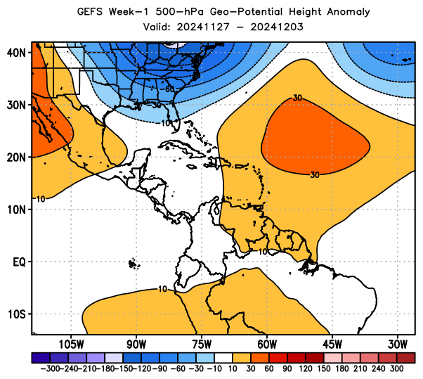
Week-1, Convergence of Evidences
hybrid:80th
hybrid:33°C
hybrid:90th
hybrid:35°C
At 500-hPa, model forecasts indicate geopotential height anomalies in the region expected to be near-normal over central-western islands and slightly-above-average over central-eastern regions of the Caribbean and northern South America.
Hybrid index exceedance probability forecasts indicate:
High chances for the hybrid index to exceed the 95th percentile most Lesser Antilles islands, Tobago, ABC islands, southern Guyana and southwest Suriname.
High chances for the hybrid index to exceed 37°C over central-eastern Guyana, most of Suriname, and central-southern French Guiana.
hybrid:95th
hybrid:37°C

Slide 10
5. City Forecast instructions
Close and re-launch your Ubuntu terminal.
Change directory to the heat_notebooks folder:
cd heat_notebooks
Change directory to the heat_cities_notebooks
cd heat_cities_notebooks
Activate the XCast Conda Environment
conda activate xcast_env
Launch Jupyter Notebook
jupyter notebook

Slide 11
6. Generate city forecasts
Raw and calibrated city forecasts for selected cities
DoubleClick
gefs_week1_rawNcalibrated_tmax.ipynb
Select a city name in your domain.
Under the 'Cell' menu, select 'Run All' to execute the entire code.
repeat the process if there are additional cities in the list
Follow similar steps to run
gefs_week1_rawNcalibrated_tmax.ipynb

Slide 12
7. Group Outcome
Use QGIS to draw your consensus heat hazard outlook.
Provide summary of your justification for your outlook.
Include raw and calibrated city forecasts for selected cities in your domain.
Please see sample plots in the next slides:

Slide 13
8. Sample: Week-1 Heat Hazards Outlook
There is an increased chance for moderately severe heat over central-eastern Cuba, St. Lucia, St. Vincent and the Grenadines, Grenada, Tobago, Aruba, Bonaire, and Curacao, and portions of northern Guyana, Suriname, and southwest French Guiana
An increased chance for severe heat exists over central Guyana and central-western Suriname
An increased chance for extremely severe heat exists over southern Guyana and southwest Suriname.
Hybrid index probability of exceedance forecasts also suggest high chances for persistent heat in the orange and red shaded areas.

Slide 14
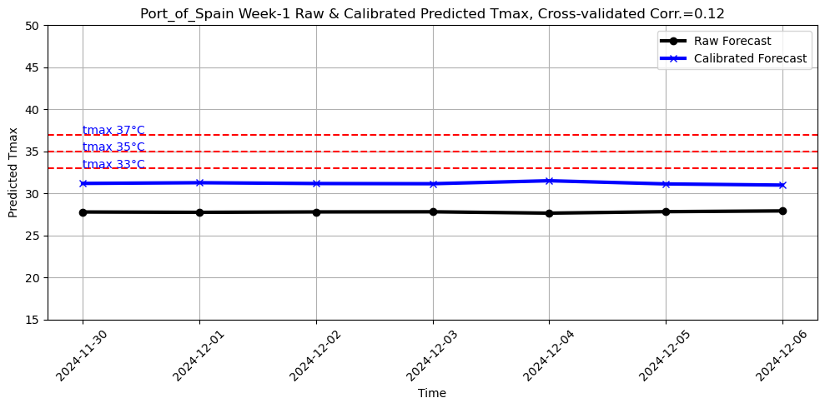
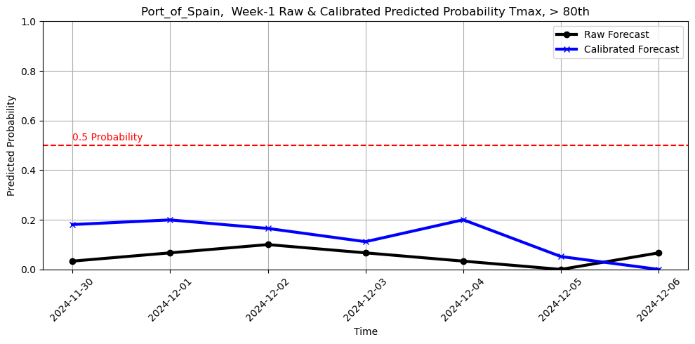
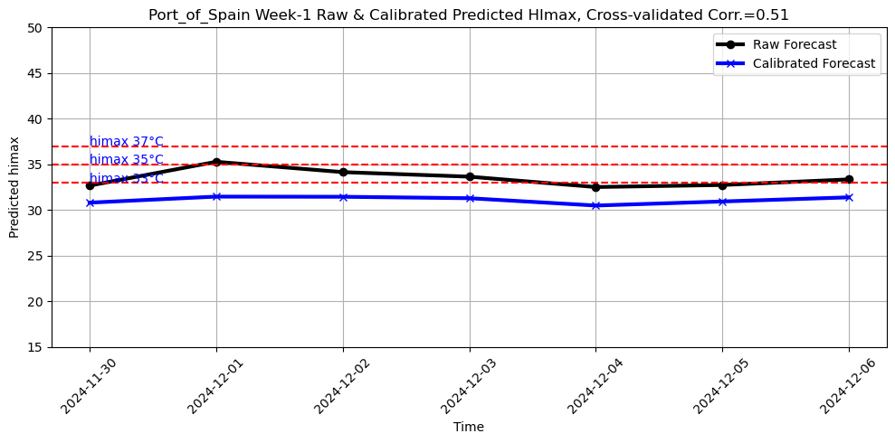
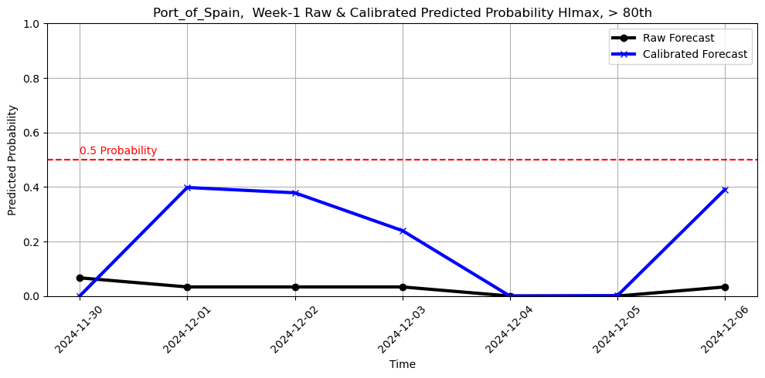
9. Sample: Raw and Calibrated City Forecasts
Deterministic Forecasts
Probability of Exceedance (>80th)
Tmax
HImax

